Slide 1
Bonding Geometries in the Current Stave/Tooling Design
Adam Huddart
ePIC F2F - 03/10/2024

Slide 2
Introduction
3 Bonding Locations
ASIC to EIC-LAS LEC
ASIC to bridge FPC (or carrier if integrated)
Bridge FPC (or carrier) to Primary FPC

Slide 3
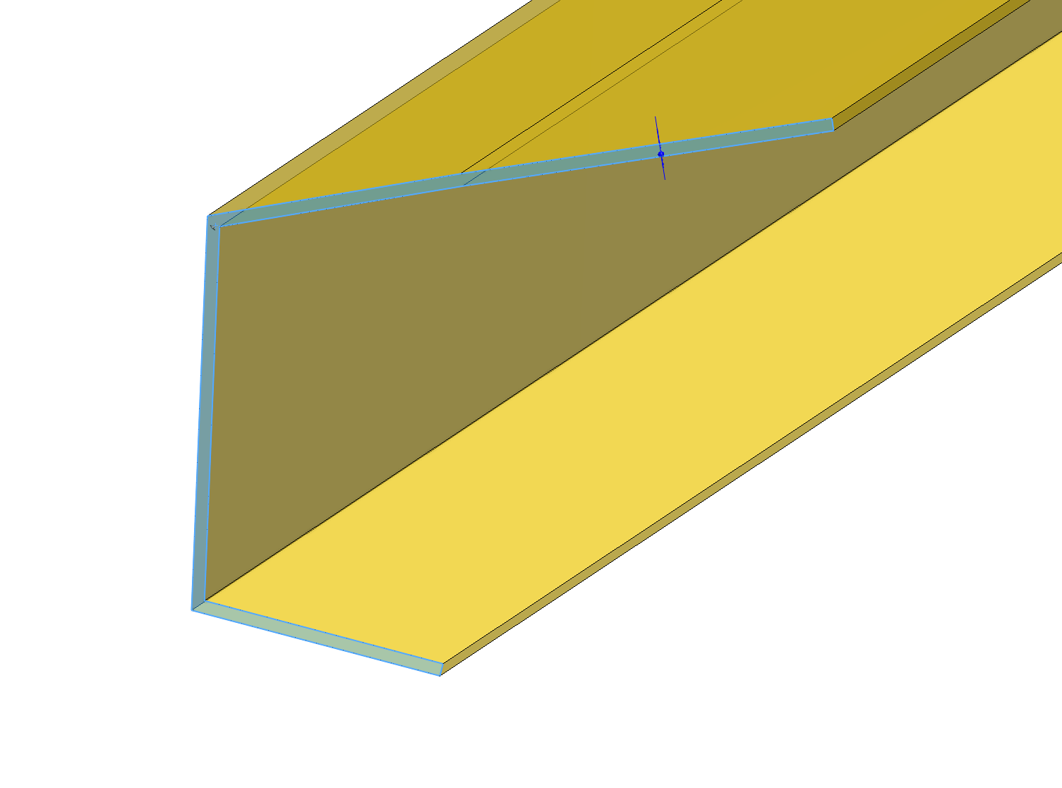
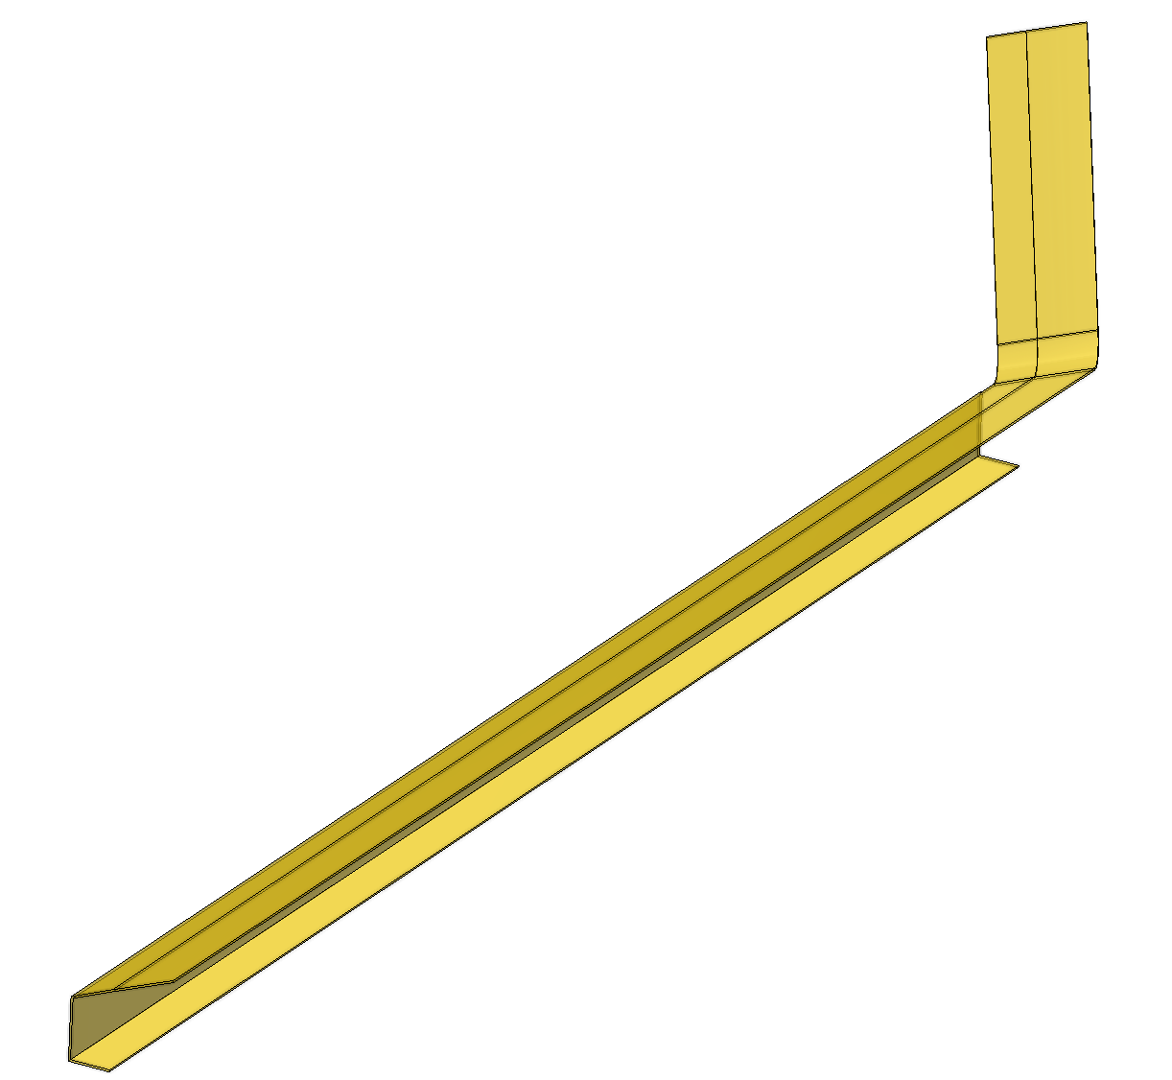
Conceptual FPC Layout
FPC
Traces on the top wing of the FPC (approx. 7mm wide)
Majority covered by carbon fibre skin
Cutouts in carbon fibre skin for access to bonding locations

Slide 4
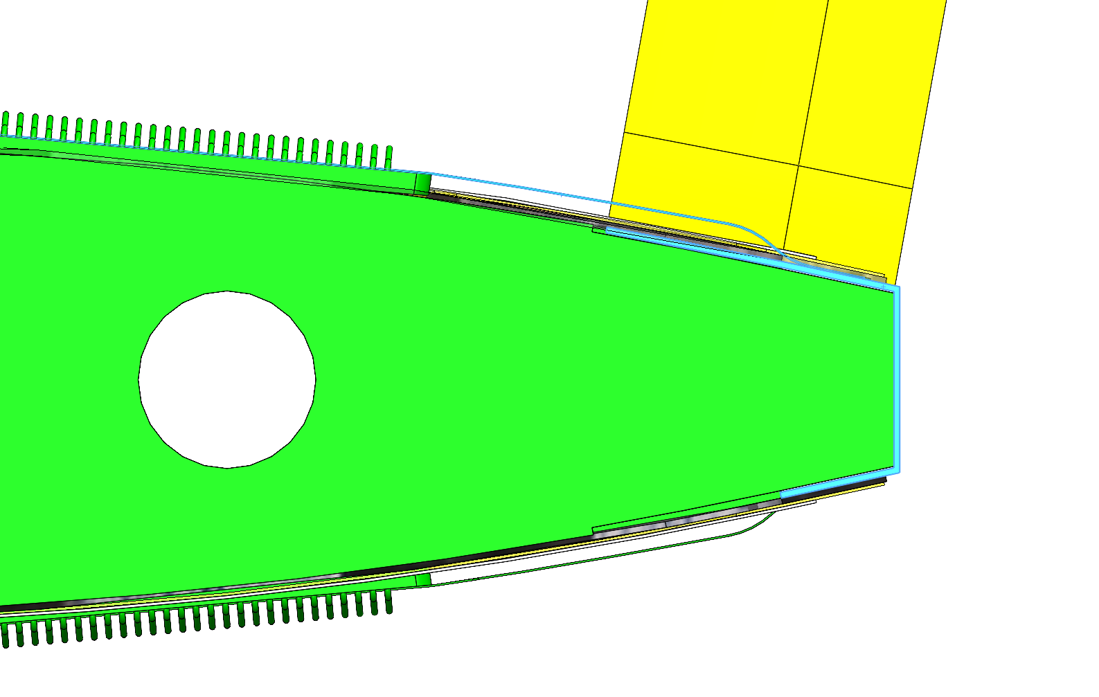
Bridge FPC to Primary FPC
Tab Bond
Curvature of stave ends before bond location
Flat surface (at angle)
Bonding surface fully backed by K9 foam
Bridge FPC
Primary FPC
K9 Foam Block
Bond Location

Slide 5
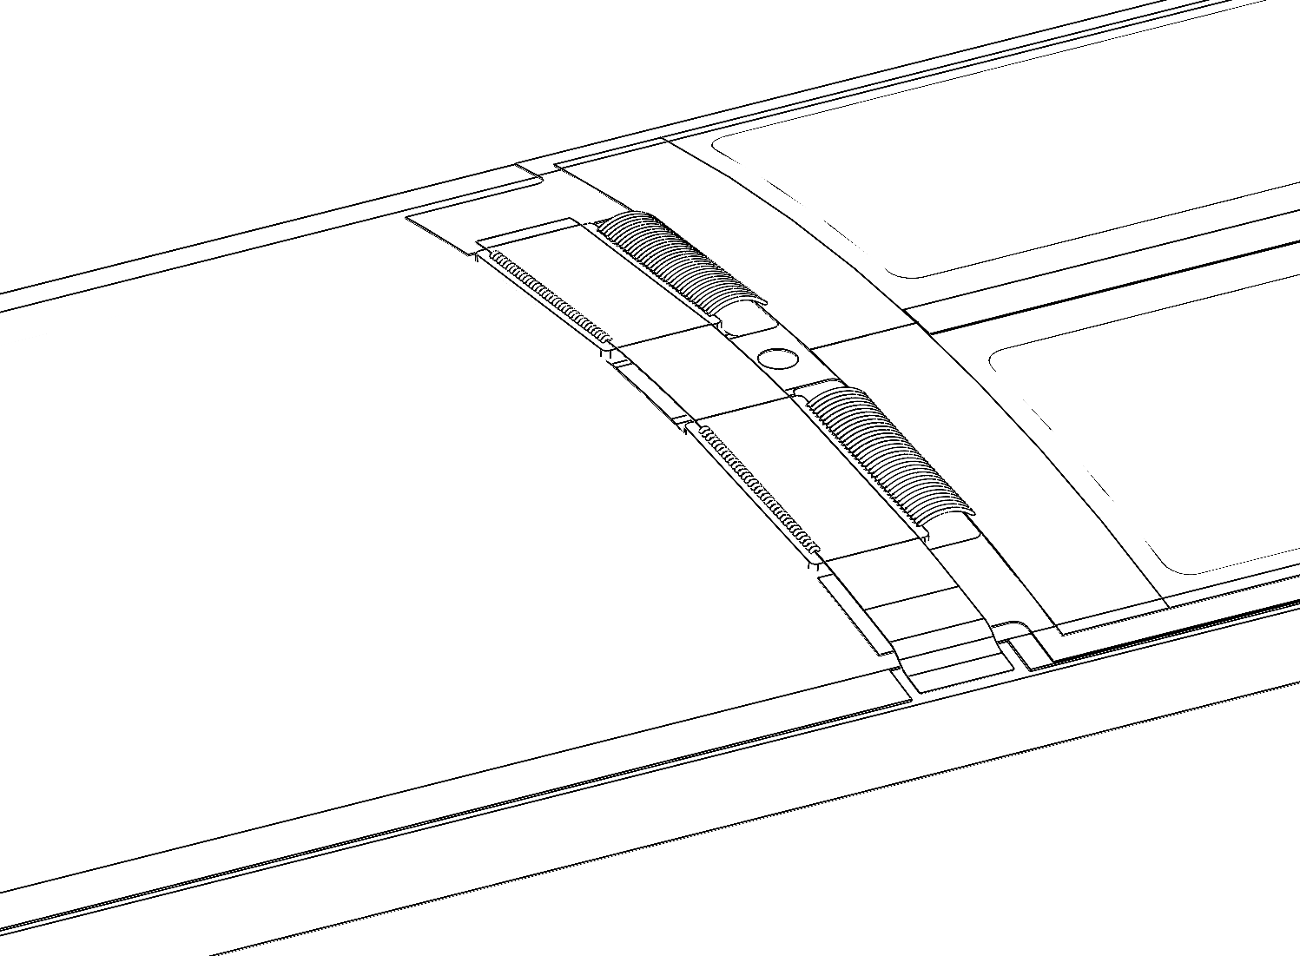
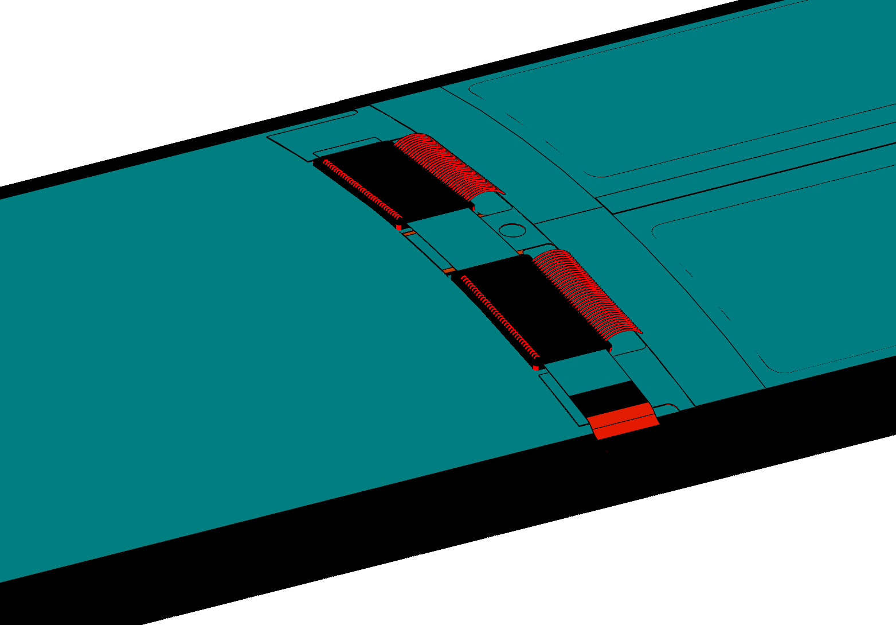
Bridge FPC to Primary FPC
Tab Bond
Curvature of stave ends before bond location
Flat surface (at angle)
Bonding surface fully backed by K9 foam
Bond Region
Curvature Display (Black is flat)

Slide 6
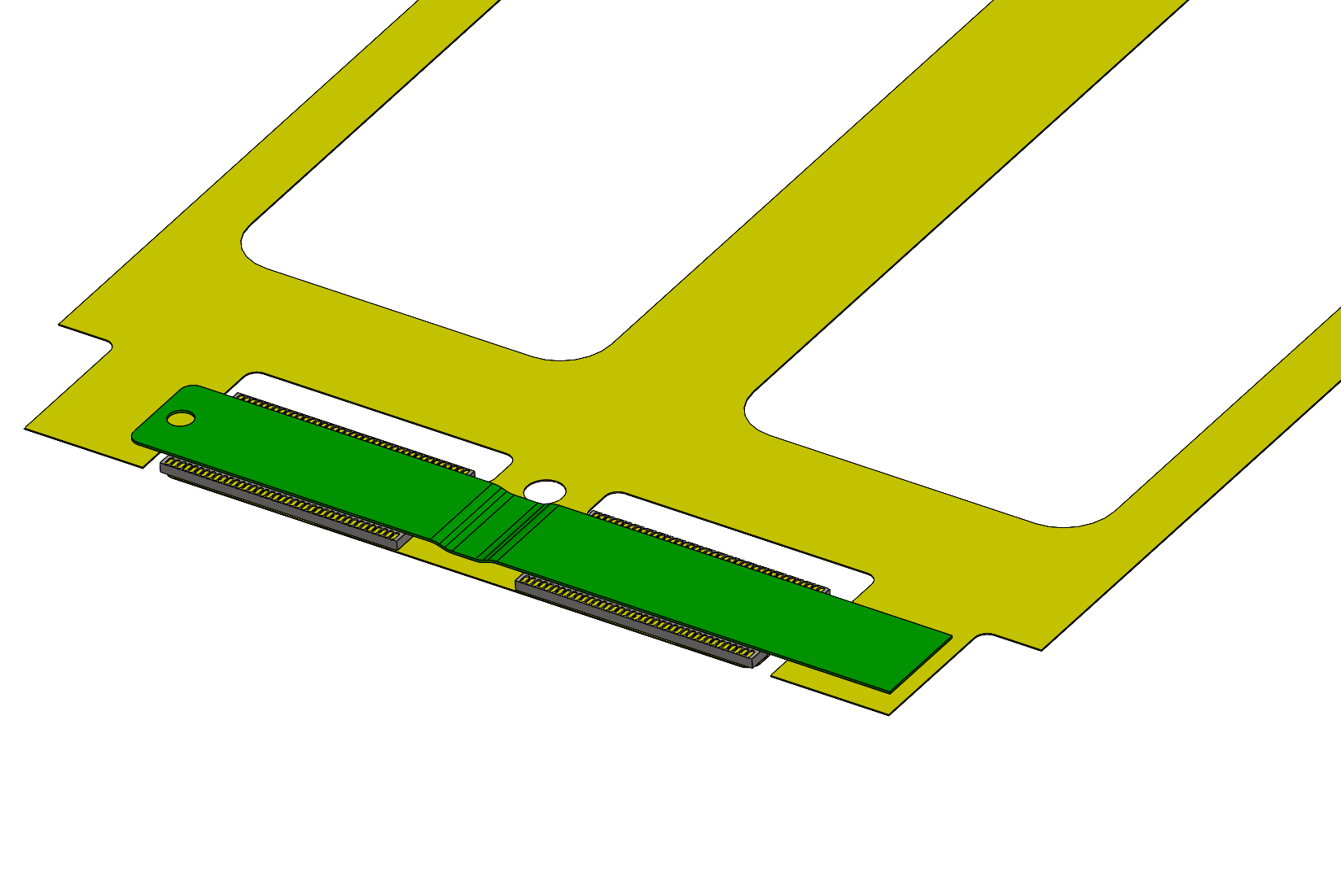
ASIC to Bridge FPC
Wire Bond
Bond connection made on module assembly tooling
ASIC is adhesively mounted to Kapton carrier
Assembled Flat

Slide 7
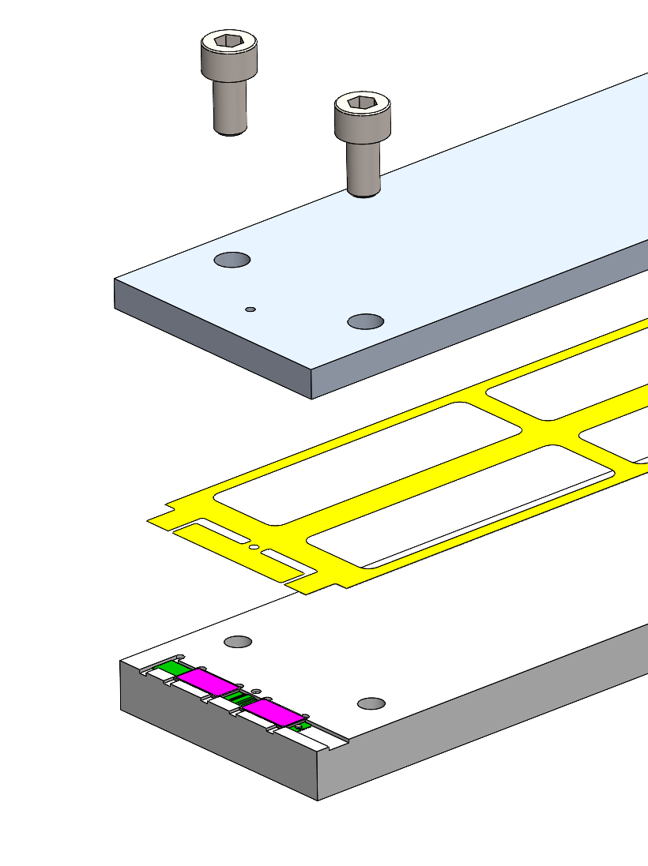
ASIC to Bridge FPC
Wire Bond
Bond connection made on module assembly tooling
ASIC is adhesively mounted to Kapton carrier
Assembled Flat

Slide 8
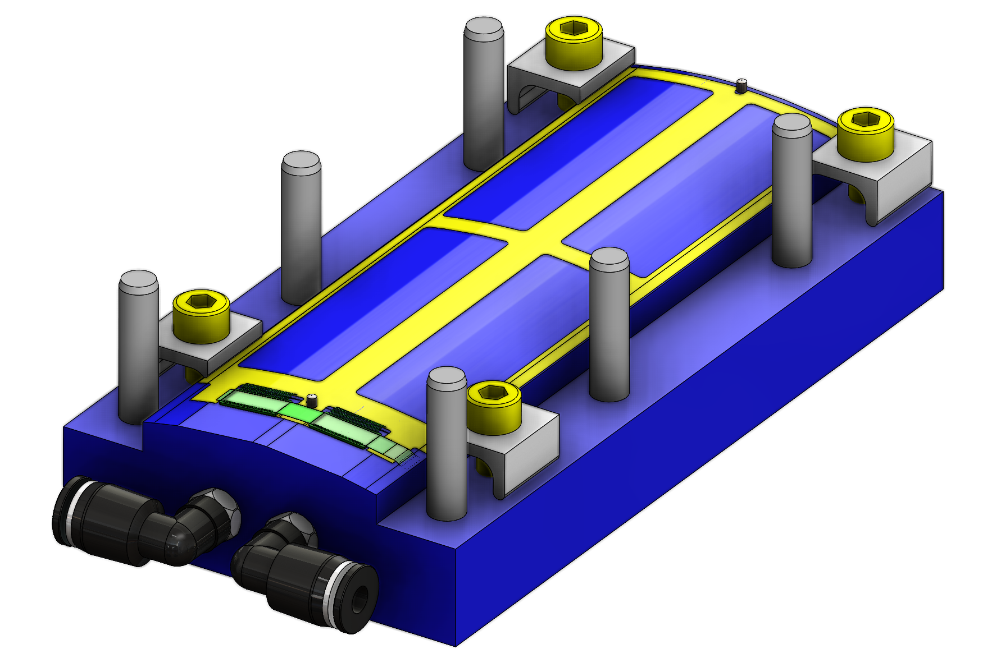
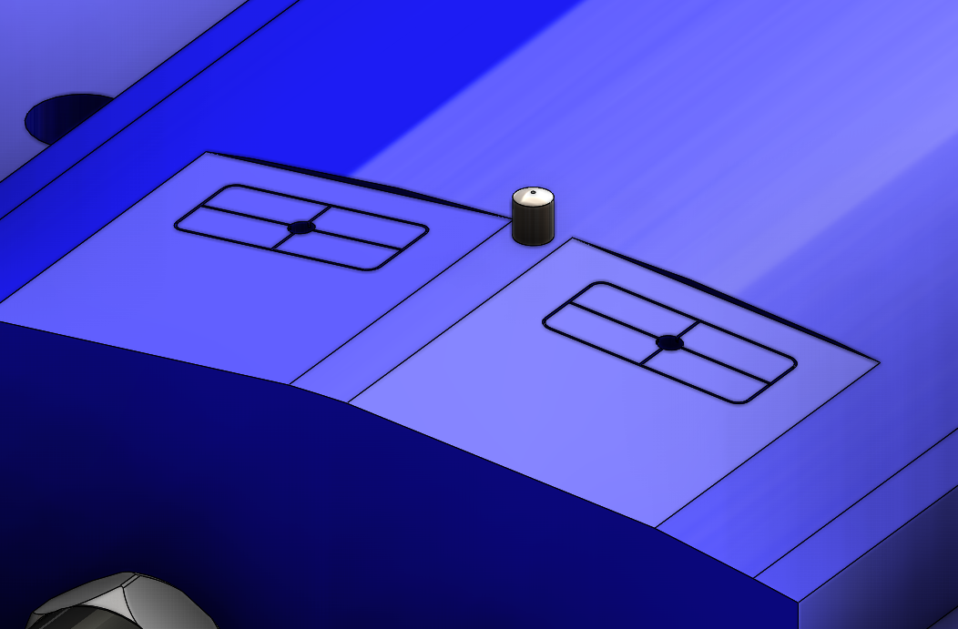
ASIC to Bridge FPC
Wire Bond
Bond connection made on module assembly tooling
ASIC is adhesively mounted to Kapton carrier
Assembled Flat
Kapton carrier held against module tooling with vacuum pad

Slide 9
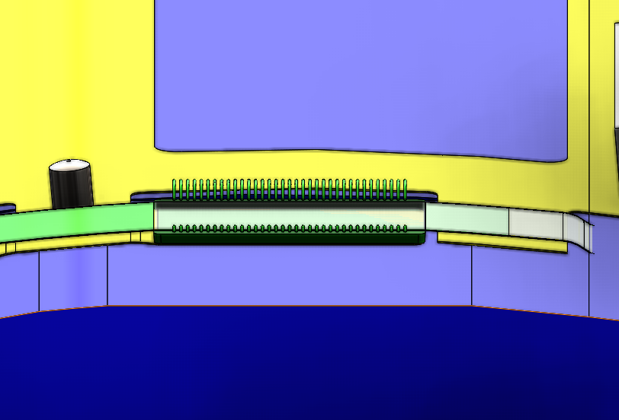
ASIC to Bridge FPC
Wire Bond
Bond connection made on module assembly tooling
ASIC is adhesively mounted to Kapton carrier
Assembled Flat
Kapton carrier held against module tooling with vacuum pad
Bonding surfaces are flat but at an angle
Supported on Aluminium
(2 glue layers, ASIC and Kapton carrier)

Slide 10
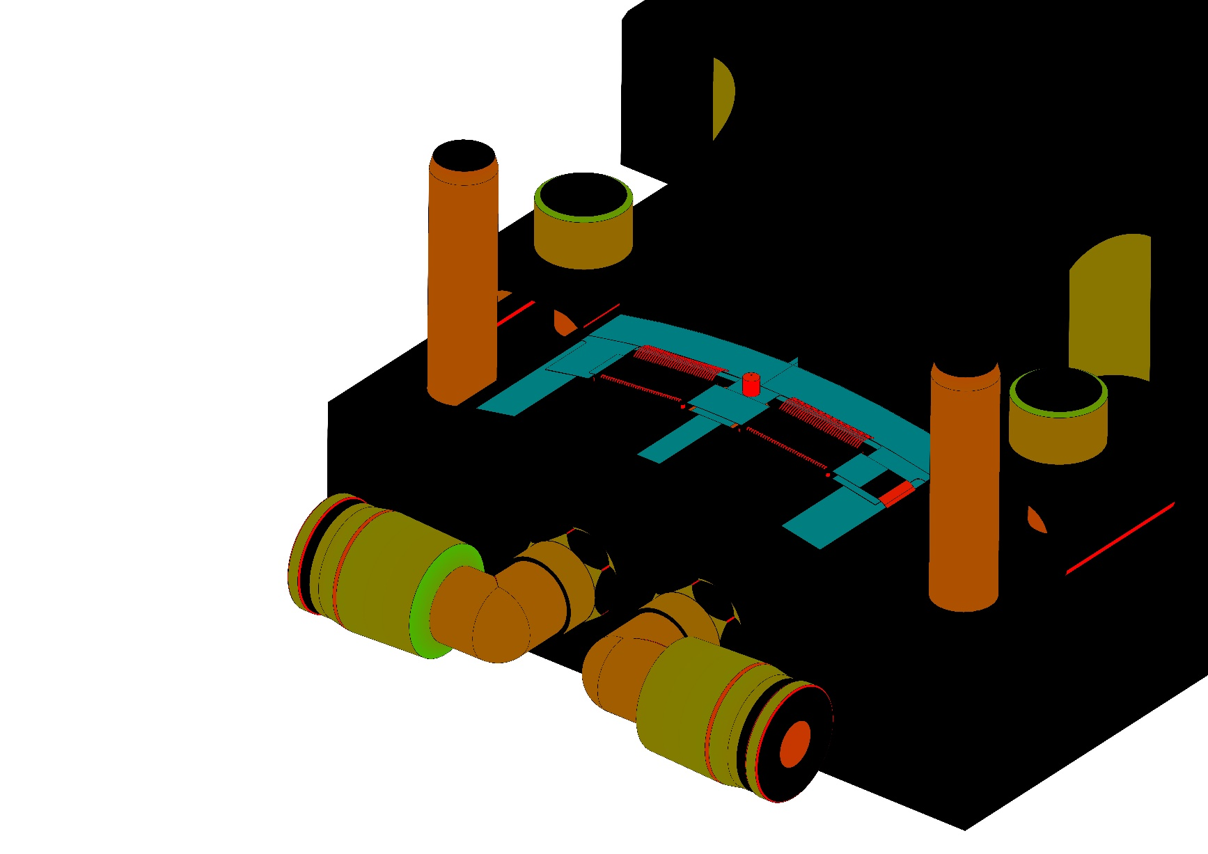
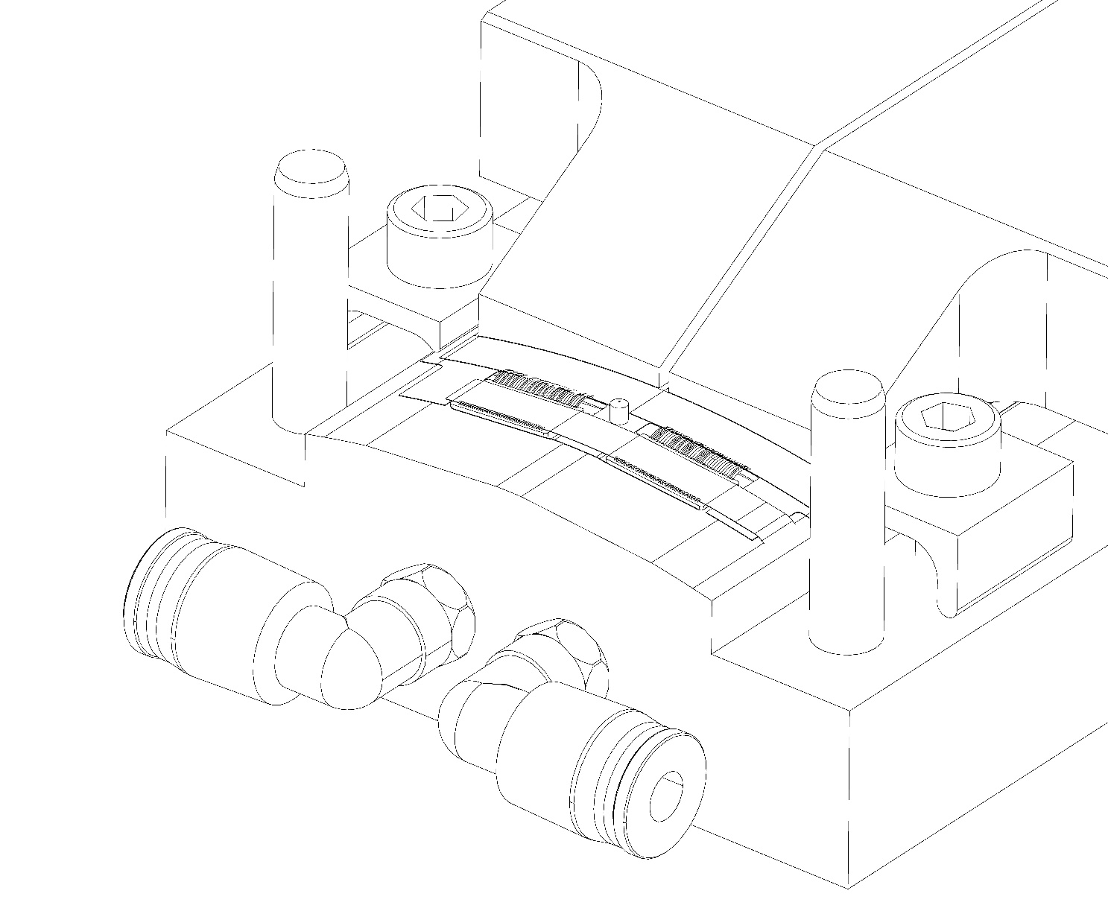
ASIC to EIC-LAS LEC
Wire bond on module assembly tool
LEC well constrained by EIC-LAS vacuum chuck
Wire Bond
Surface of the ASIC flat
LEC curved with 180mm diameter
Only shown wire bond parallel to the ASIC, width of pads on LEC unknown
Curvature Display (Black is flat)

Slide 11
ASIC to EIC-LAS LEC
Alternatively, we could wire bond once adhesively mounted to the stave
Pros
ASIC will be in its final resting position, less likely to damage bond during module installation
Cons
Access more limited
Less rigid mounting surface
Module can’t be tested on assembly tooling

Slide 12
Conclusions
2 out of 3 bonding operation are flat even with curved stave
Flat stave would remove the odd angle (current setup requires tooling to provide a horizontal bonding surface)
ASIC to EIC-LAS LEC wire bond would be a flat interface

