Slide 1


Using CAD in Detector Simulations
Dr. Sam Henry, University of Oxford
Tuna Tasali, University of Oxford
UK

Slide 2
Importing CAD Designs

Slide 3
Conversion Everything Is Automated!
Except…
UK
Conversion Script
FreeCAD API
.STL (mesh)
.gdml (mesh)
sensitive=«true»
Set automatically by the .gdml file name.
.STL (mesh)
.gdml (mesh)
.STEP
.FCStd
silicon_barrel.xml
.STL (mesh)
.gdml (mesh)
Sensitive volume handled differently by
Open and save in FreeCAD
(Will be fully automatd in the future.)
.STL (mesh)
.gdml (mesh)
Define dictionary/YAML to map each stl file to a physical material
BarrelTrackerOuter_geo_standardized.cpp
.xml File generated from GDML files automatically

Slide 4
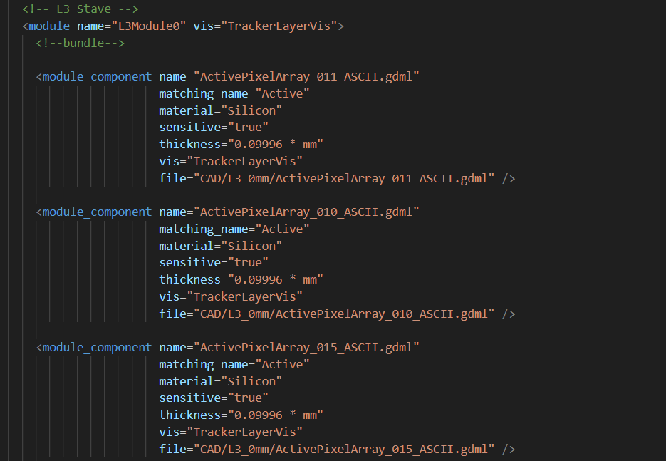
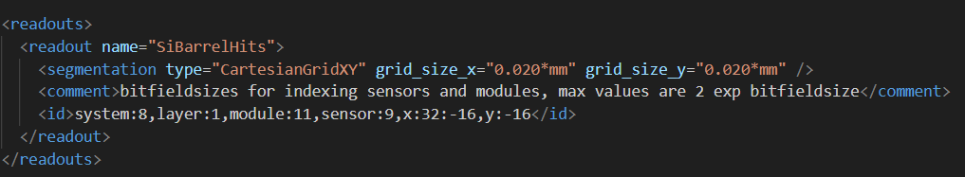
Compact: silicon_barrel.xml
UK
<detector/>
  <module #n/>
    <module_component file=PATH_TO_GDML_File/>
  <layer #n/>
    Where binning and placement paremeters belong
Max number of <module_component/> per <module/> determined in the python script generating the .xml file.

Slide 5
Compact: silicon_barrel.xml
UK
Max. 2^9 senstive components (= total number of extruded facets in sensitive <module_component>s) per <module>
2^11 <module> allowed on the entire barrel

Slide 6
Sensitive Components
UK
Instead of importing a mesh as dd4hep::TessellatedSolid
  Extrude appropiate faces of the mesh to construct a curved sensitive surface
  Allows us to attach ACTS surfaces to each mesh for reconstruction?
There is an algorithm to decide which facets to extrude in what direction. See backup slides.

Slide 7
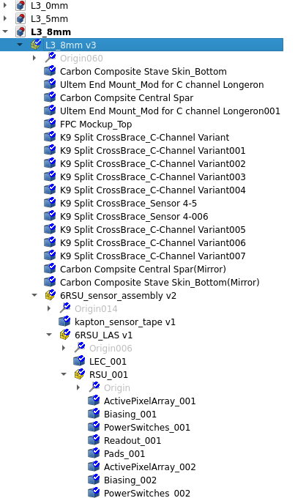
New Method: Everything Is Automated!
Except… Dictionary/YAML?
UK
Suppose we have a design like this

Slide 8
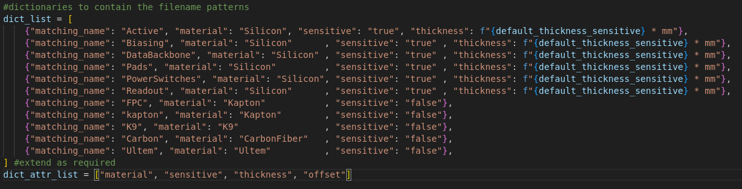
New Method: Everything Is Automated!
Except… Dictionary/JSON?
UK
Suppose we have a design like this

Slide 9
New Method: Everything Is Automated!
Except… Dictionary/JSON?
UK
Not the best way to keep the dictionary in the Python script, will move this to a YAML file later…

Slide 10
Applications

Slide 11
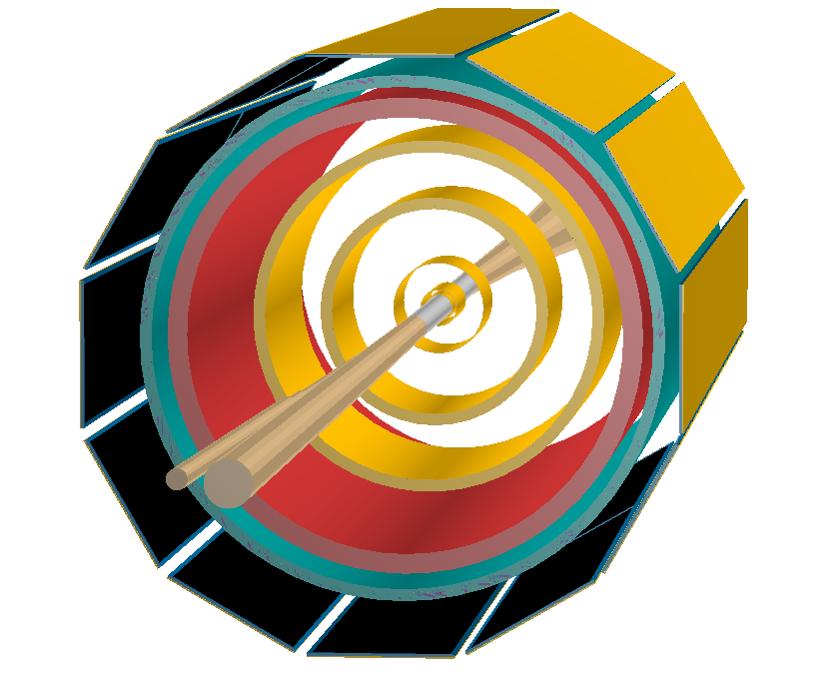
Setup
SVT L0 & L1
UK
SVT L2
SVT L3
Note that only barrel envelopes are shown (except for MPGD Outer Barrel)
SVT L4
MPGD Inner Barrel
ToF Barrel
MPGD Outer Barrel
Note: The viewer is only able to render ENVELOPES and not the volumes themselves.
Note: Setup includes the same detectors as in Long Li’s (Uni of Birmingham) design (that is, no endcaps)
Beam Pipe

Slide 12
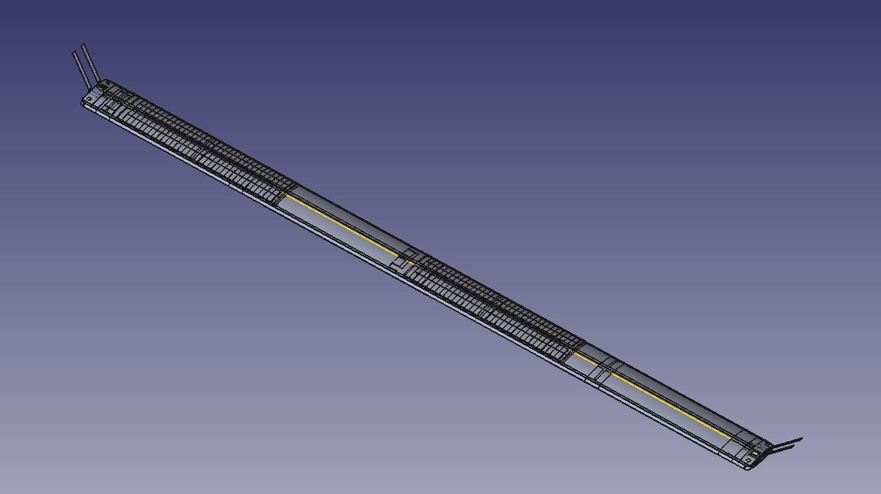
Stave Design: L3
UK

Slide 13
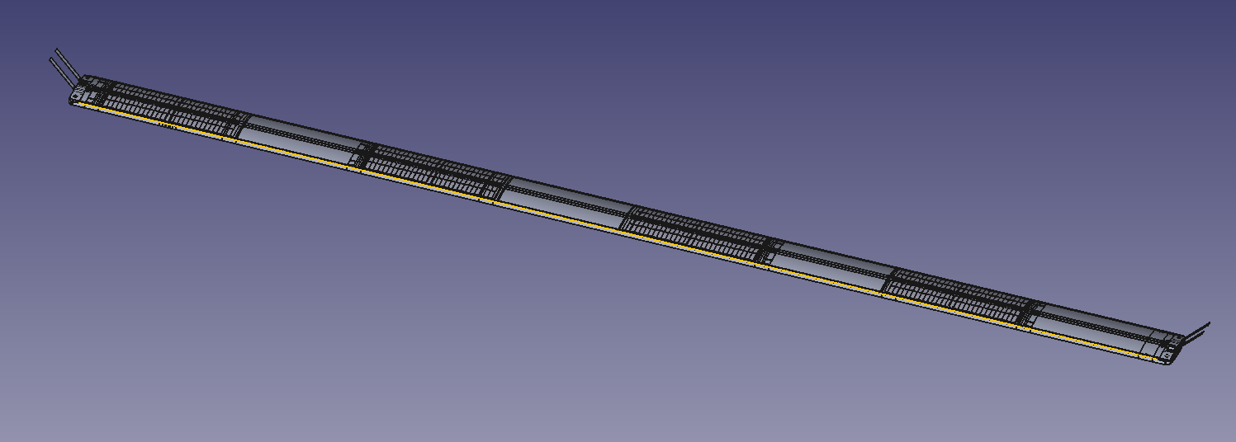
Stave Design: L4
UK

Slide 14
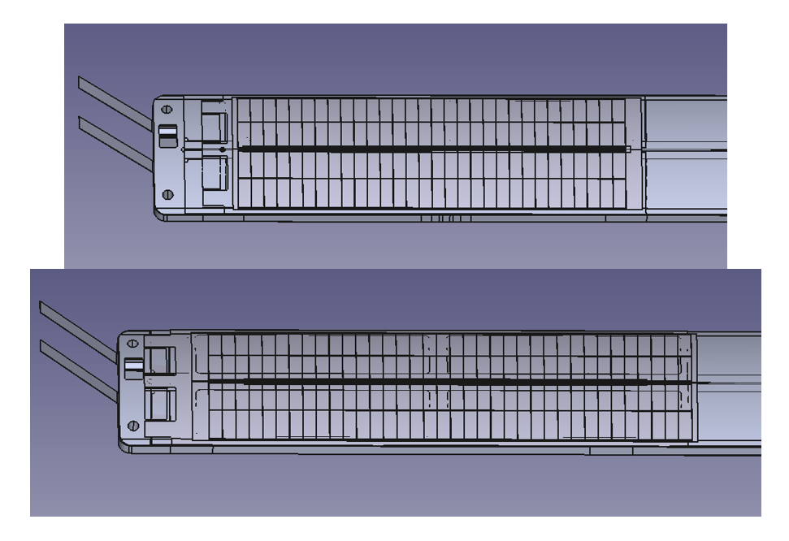
6RSUvs5RSU LAS
UK
LAS on L4 Stave
LAS on L3 Stave: Longer due to size constraints that is the length of the L3 stave. (optimal overlap)

Slide 15
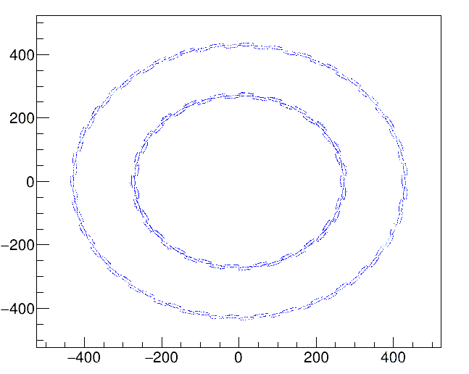
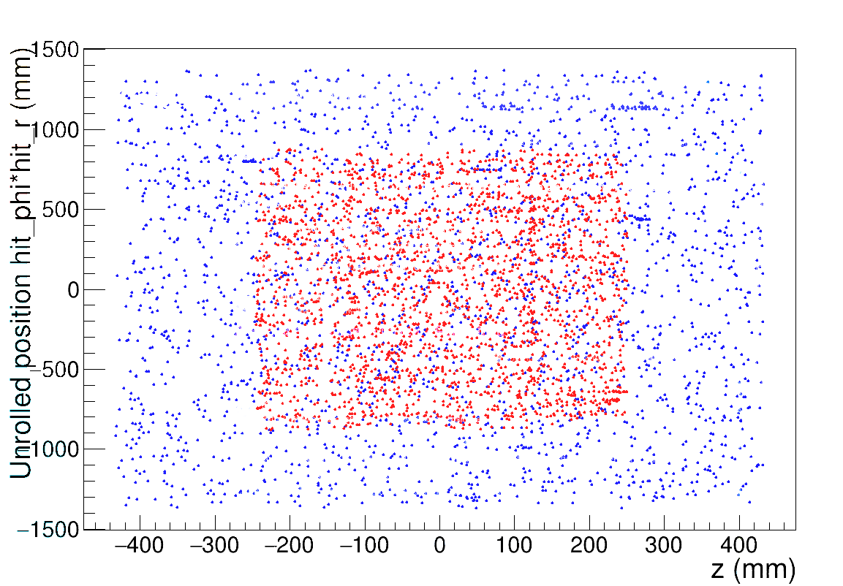
To veryify correctly imported geometry: Hit Plots
(from L3 8mm overlap, p=10GeV/c)
UK
y (mm)
Red: L3 Hits
Blue: L4 Hits
x (mm)

Slide 16

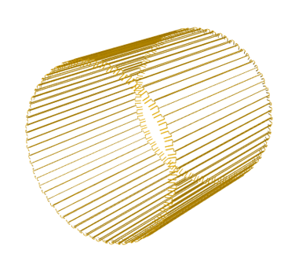
To verify correctly imported geometry: Visualisation
UK
Note: The viewer crashes when trying to render all staves, this rendered only 20 of them with the carbon fiber supports only
The best the viewer could do to model a barrel (Only FPC cables rendered, at least shows that we have the correct barrel structure)

Slide 17
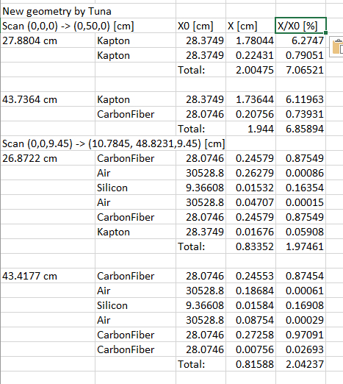
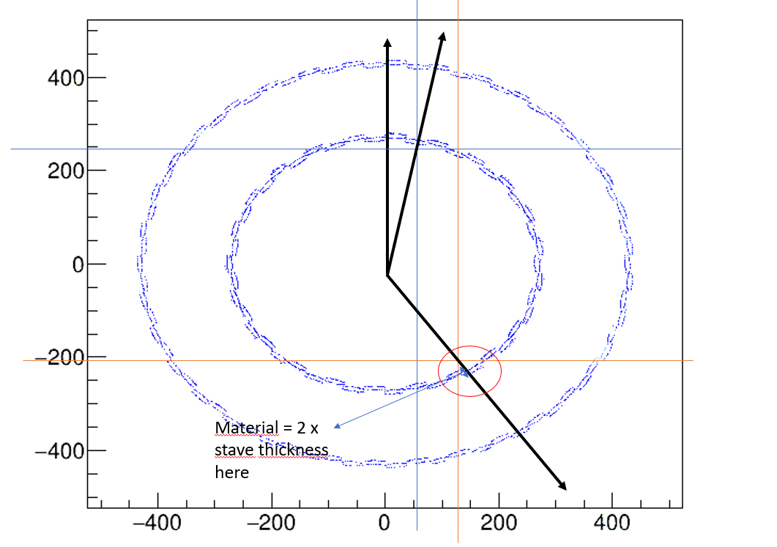
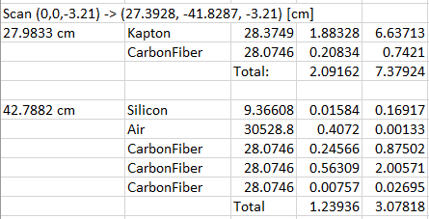
To verify correctly imported geometry: materialScan
UK
Something might be wrong here, too high of a material budget…

Slide 18
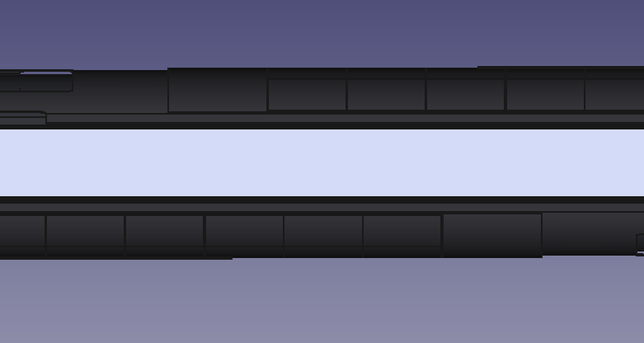
Overlap Study (in L3 only):
UK
Overlap (in this case 8mm)
Inactive Silicon
Side view of the L3 Stave.
Inactive Silicon

Slide 19
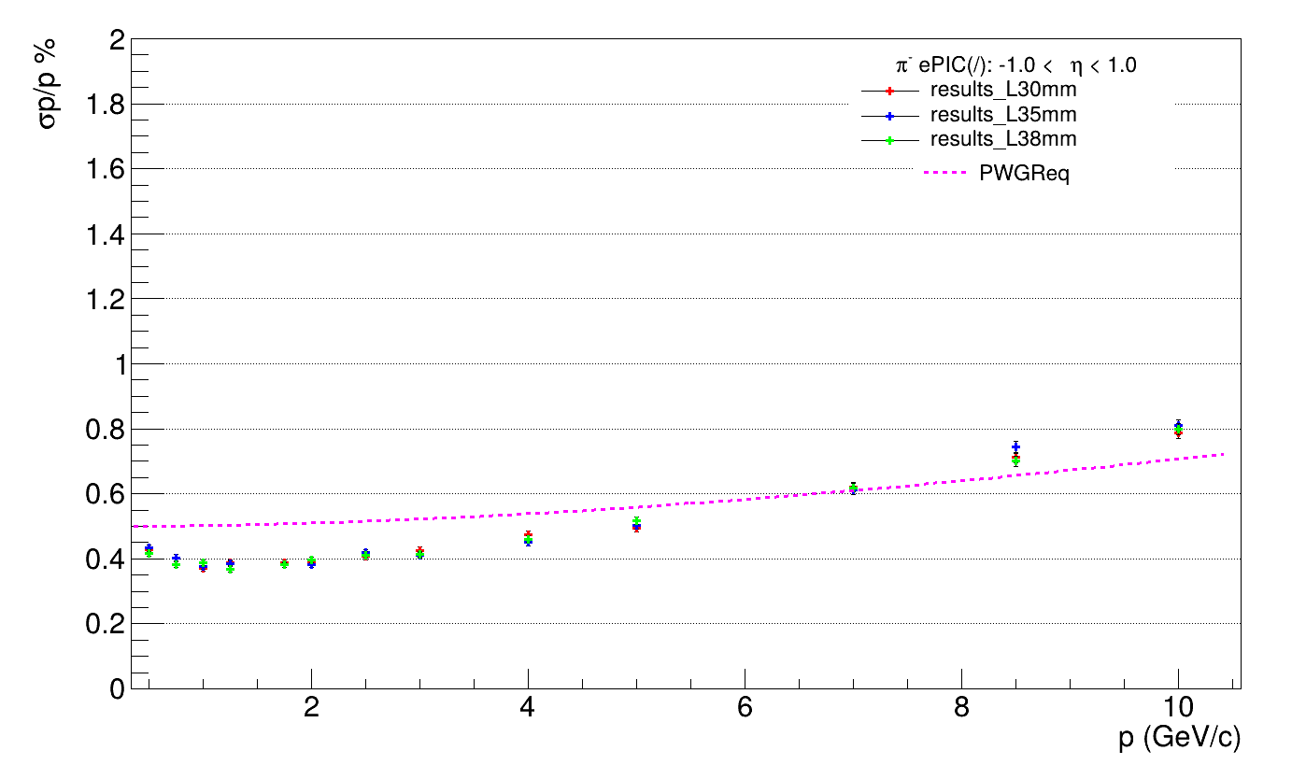
Overlap Study (in L3 only): deltap/p
UK
L3_0mm Overlap
L3_5mm Overlap
L3_8mm Overlap
Pion momentum:
0.5-10GeV/c

Slide 20
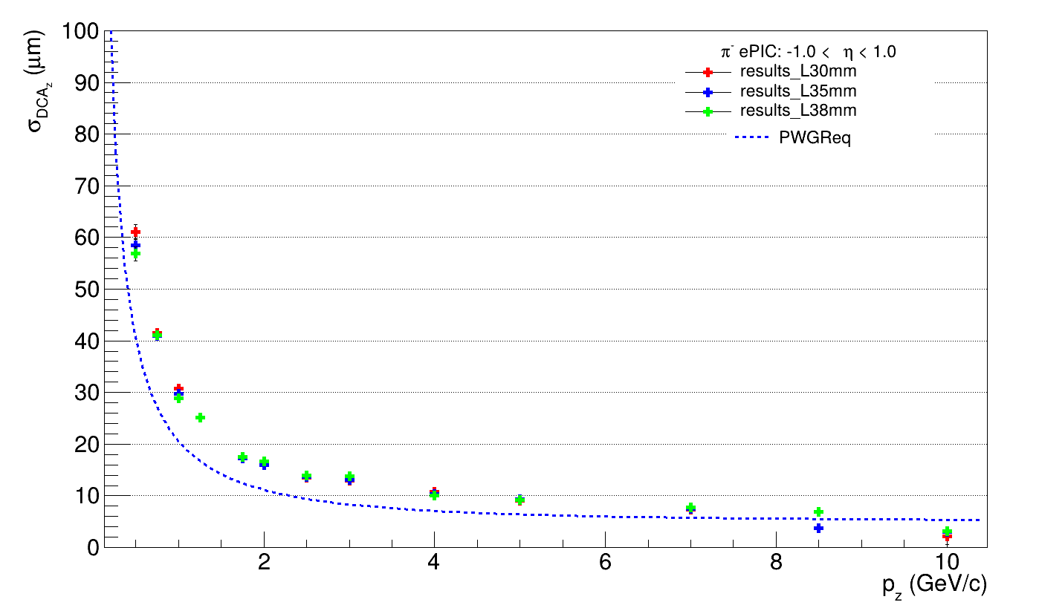
Overlap Study (in L3 only): dca_z
UK
Some missing datapoints here and there due to empty recon data, perhaps a fault/error/bug?

Slide 21
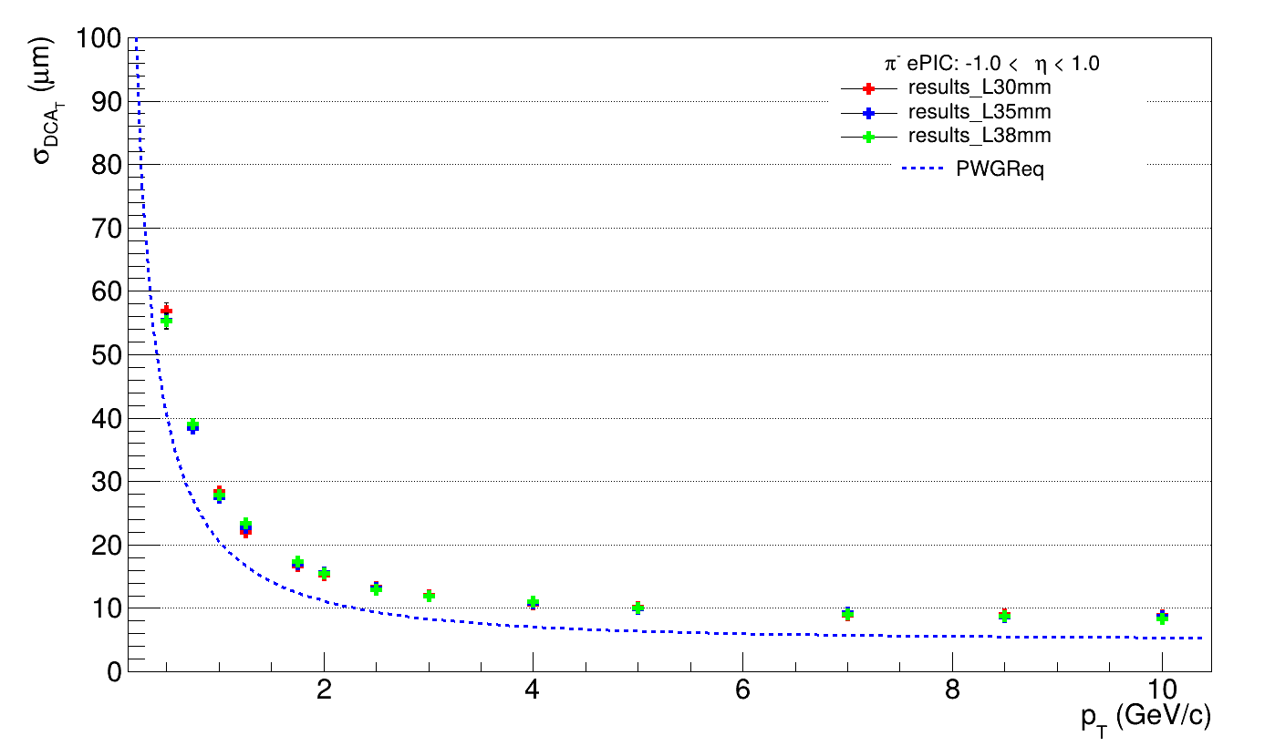
Overlap Study (in L3 only): dca_T
UK

Slide 22
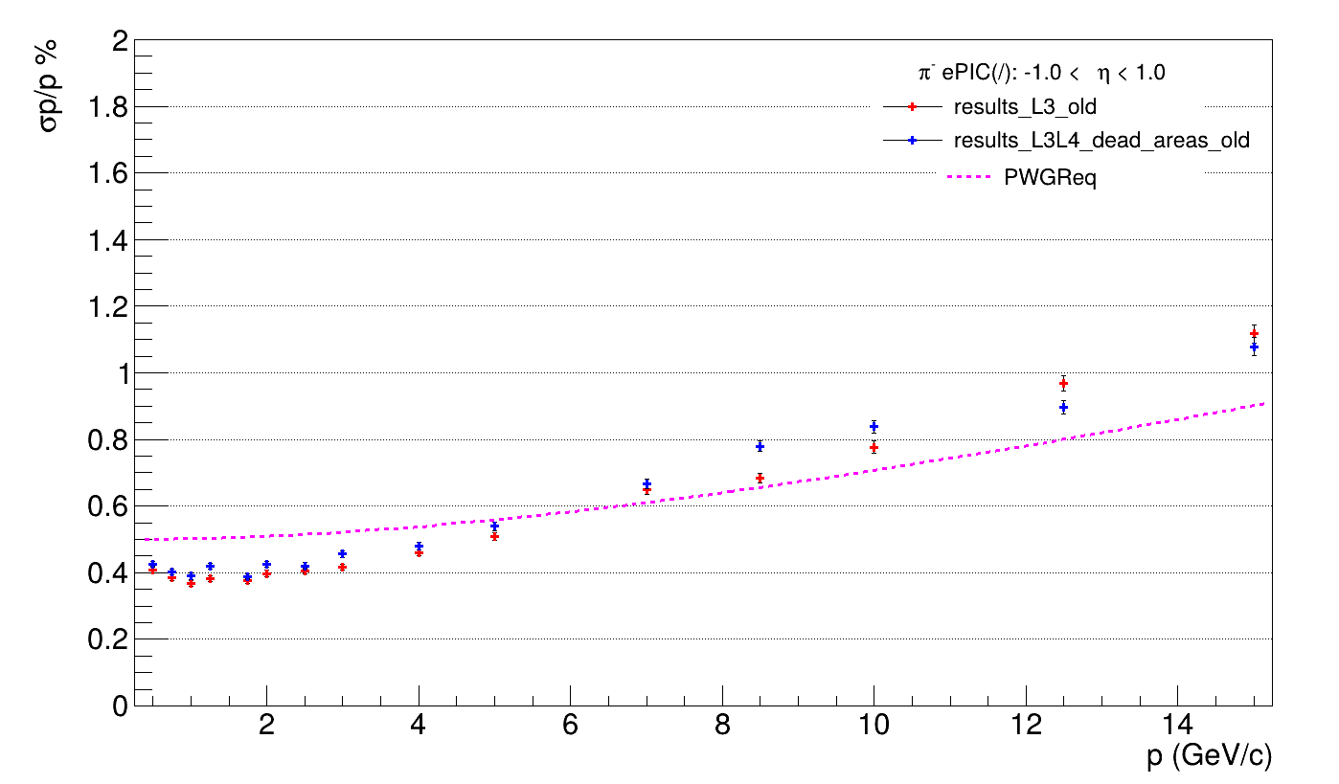
Sensitive Area Study (both layers)
UK

Slide 23
Sensitive Area Study (both layers)
UK
A flipped trend?
(I double checked that I didn’t enter the data wrong.)

Slide 24
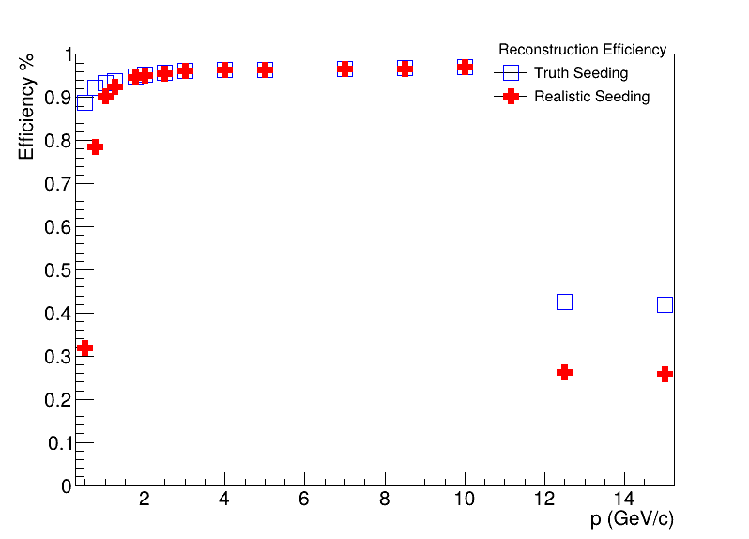
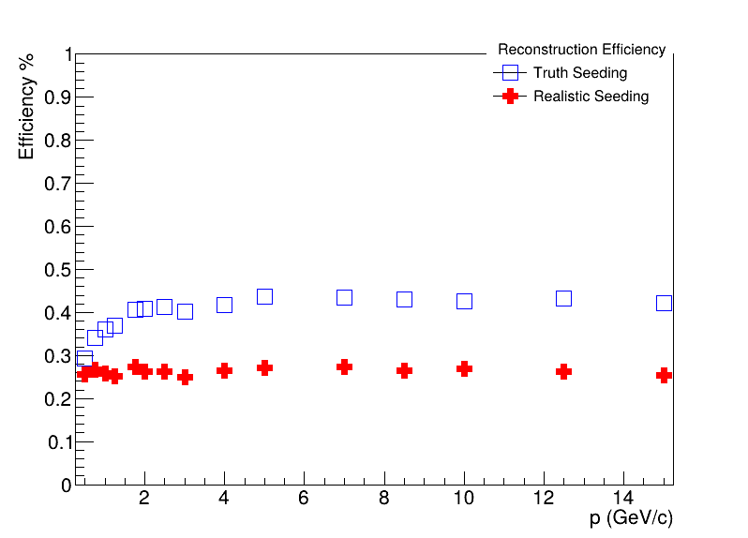
Sensitive Area Study: Bad News
UK
There seems to be an unexplained drop in recon efficiency especially with the old design??
Diagnosis: Draw Hit plots for these faulty runs as well (had no time for this)
New Design with Dead Areas
Old Design with No Dead Areas
I remember generating these data points on a separate run, hence it might it be something to do with the run and not the old design.

Slide 25
Backup Slides

Slide 26
Compact: silicon_barrel.xml
UK
Max. 2^9 senstive components (= total number of extruded facets in sensitive <module_component>s) per <module>
2^11 <module> allowed on the entire barrel

Slide 27
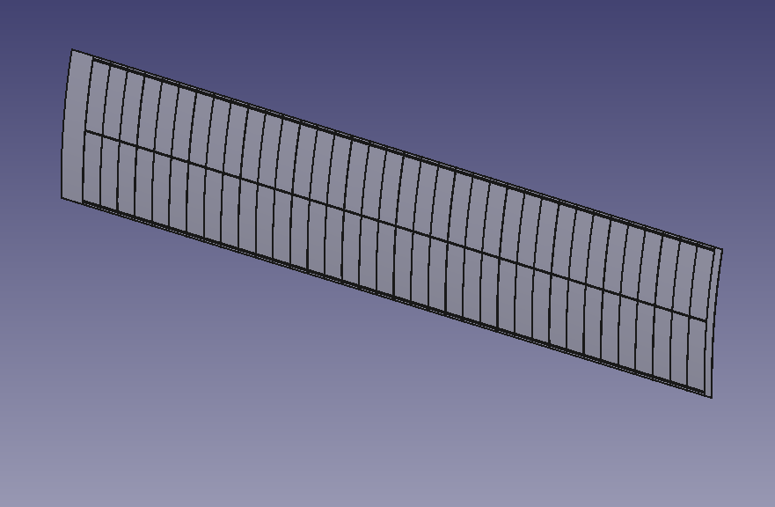
Sensitive Components
UK
Assumptions:
Curvature restricted to xy plane
Stave placed with the long axis along the z axis, and the thickness along the y axis
Looking from this side

Slide 28




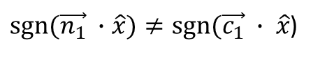

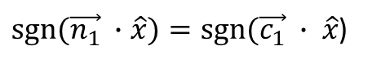


Sensitive Components
UK
Facet 1
$$\vec{n_{1}}$$
$sgn⁡(\vec{n_{1}} ∙$ $\hat{x})=sgn⁡(\vec{c_{1}} ∙ \hat{x}$)
$$\vec{c_{1}}$$
Don’t Extrude this Facet
$$\hat{x}$$
$$\hat{y}$$
$$O$$
$sgn⁡(\vec{n_{1}} ∙$ $\hat{x})≠sgn⁡(\vec{c_{1}} ∙ \hat{x}$)
Extrude this Facet in the direction opposite to the normal
$$\vec{c_{2}}$$
It should also work if the silicon was curved the other way, equivalent to a y-> -y transformation which keeps x invariant!
(Please correct me if I am wrong.)
$$\vec{n_{2}}$$
Facet 2

