Slide 1
Ancillary ASIC Thermal FEA
Stephanie Yang
WP1 face to face meeting at Oxford, 3rd October 2024

Slide 2
Introduction
Sensitivity studies to understand the temperature distribution on the Ancillary chip:
  Estimated Ancillary chip size and total power at max 45ºC case
  (Reference: SLDO considerations v10, page10, by Iain Sedgwick)
    Bigger than 7mm x 1.5mm
    Total power of 604mW
  Various boundary conditions are studied
    Constant cooling: fixed temperature
    Convective cooling: heat transfer coefficient
  Various width of the chip
  Various thickness of Silicon
Realistic Ancillary chip thermal model and next steps

Slide 3
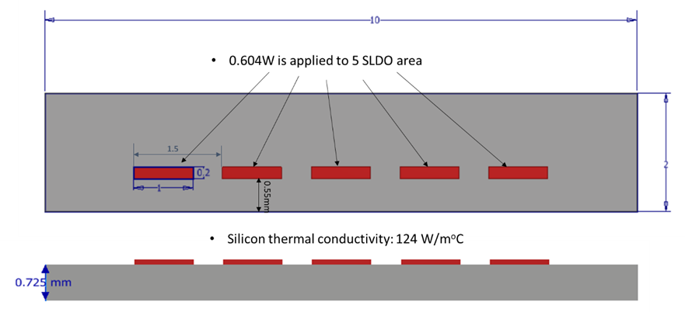
Ancillary chip FEA model and material data
Material thermal properties:
Initial temperature: 22ºC

Slide 4
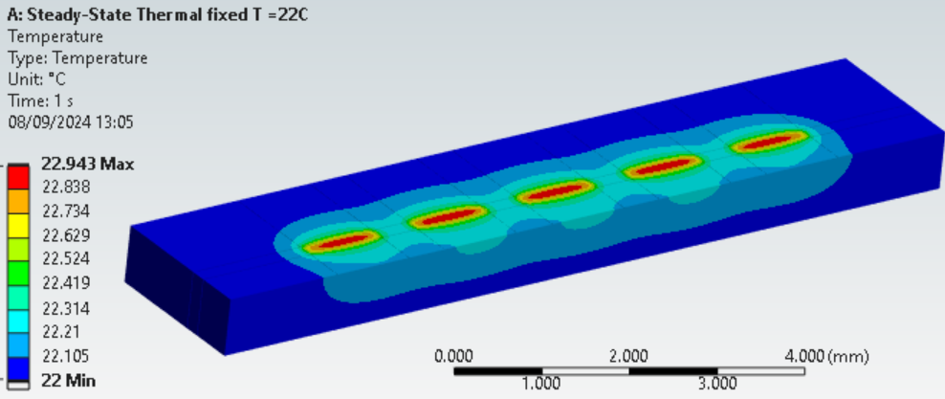
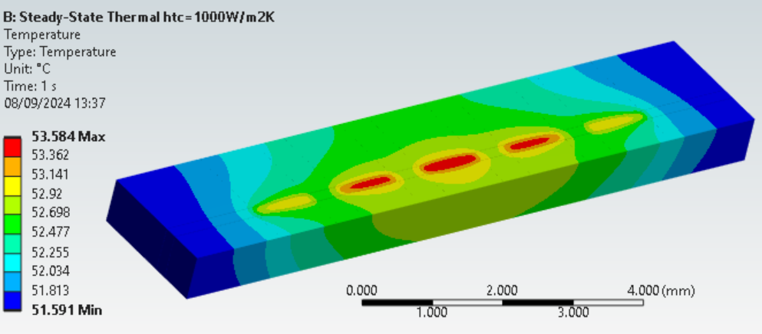
Temperature profile at difference BCs
Initial temperature is 22 ºC
Bottom face fixed at 22ºC
Bottom face HTC = 1000 W/m²C
This is to see how heat is conducted through from top to bottom faces when a constant cooling is assumed (i.e. bottom face fixed at 22ºC).
Heat transfer by conduction through the bottom face causes local heat build-up around the SLDO areas.
The temperature difference of 0.94C is seen throughout the whole model.
This is the best scenario but may not be realistic in practice.
When heat transfer coefficient of 1000W/m2K (typical value for Air) is applied to the bottom face of the model, the max temperature reaches to 53.6C.
The average temperature to the rest of the model is 51.6C.

Slide 5
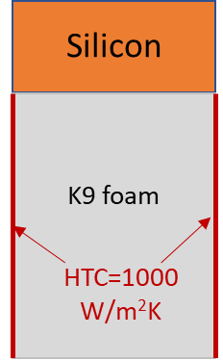
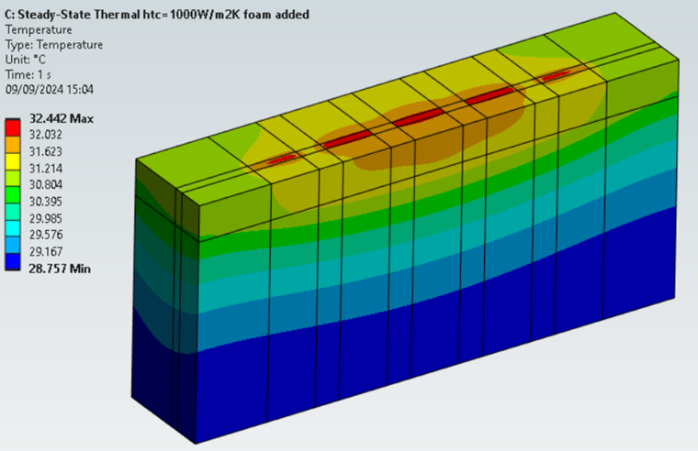
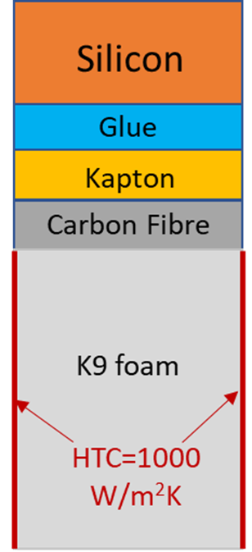
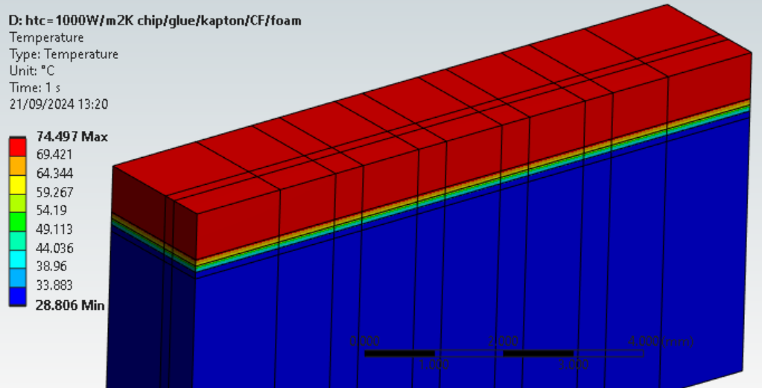
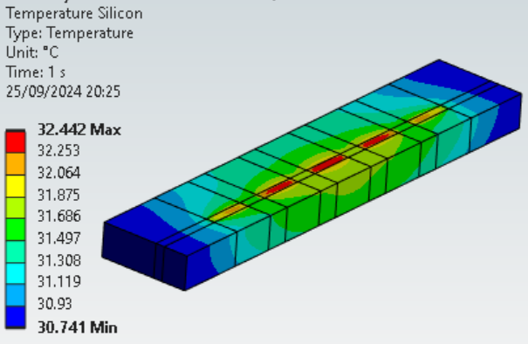
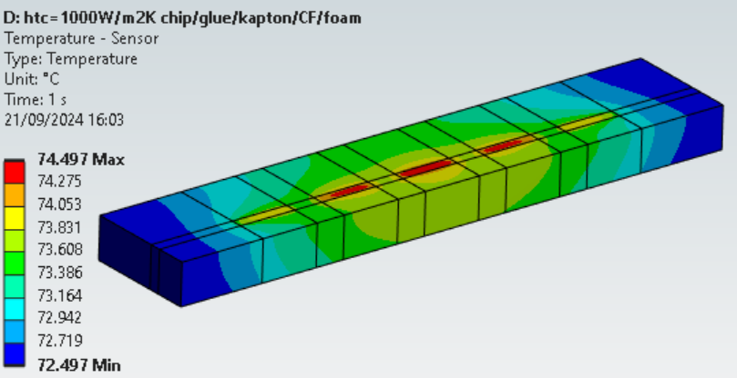
Temperature profile w/o added interface layers
2mm
2mm
4mm
This case shows the heat is directly conducted through from Silicon to K9 foam.
The max temperature is 32.4C.
This indicates the K9 foam is effective in conducting heat
Heat is conducted from Silicon to the K9 foam via glue/Kapton/Carbon fibre layers.
Temperature profile on the sensor
Temperature profile on the sensor
The max temperature reaches to 74.5C.
Although the K9 foam is cooled by air, the interface layer restricts heat conduction between it and the silicon.

Slide 6
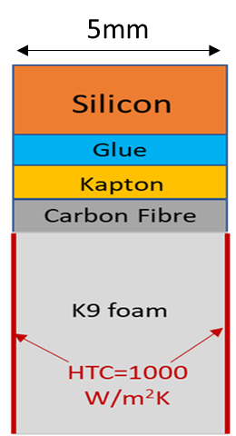
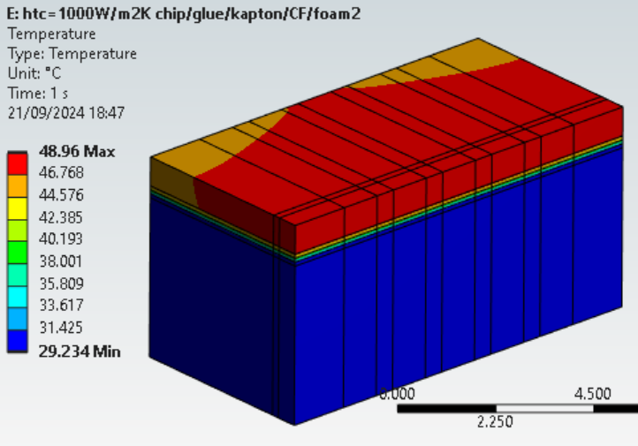
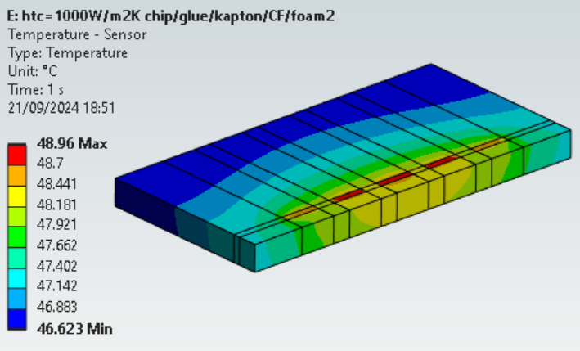
Temperature profile with wider chip
Chip width increased from 2mm to 5mm, the max temperature reduced from 74.5ºC to 49ºC.
This indicates that the thermal conductivities of glue/Kapton/carbon fibre layers though poor, the increased surface area still plays a role in conducting heat.

Slide 7
Max temperature vs Silicon width
The result shows that further increase of the chip width from ~6mm slows down significantly.

Slide 8
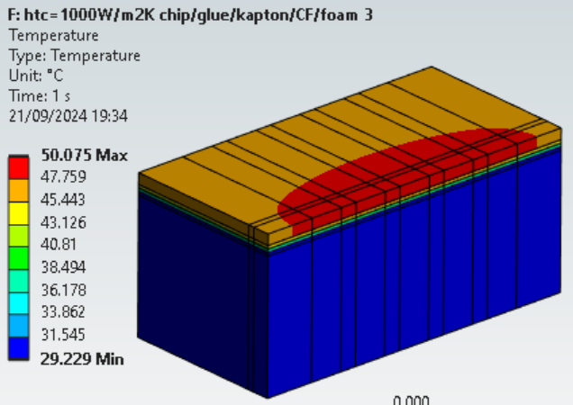
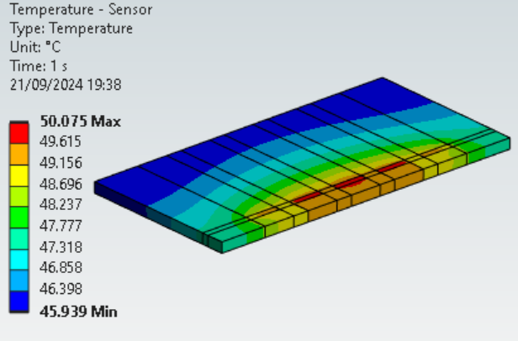
Temperature profile with thinner chip
5mm
Chip thickness reduced from 0.725mm to 0.325mm, the max temperature is 50ºC, only 1ºC increase.
This case shows the cooling is not sensitive to the Silicon thickness.

Slide 9
Temperature profile at various Silicon thicknesses
At 0.04mm thick silicon, the max temperature is high.
However, at 0.15mm thick, the temperature reduction is most significant.
But at 0.3mm thick, it begins to be ineffective, i.e. not much improvement in temperature reduction.
The result shows that the threshold for the silicon thickness is 0.15mm for effective cooling.

Slide 10
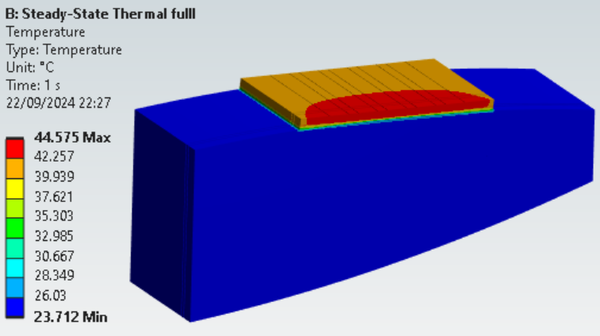
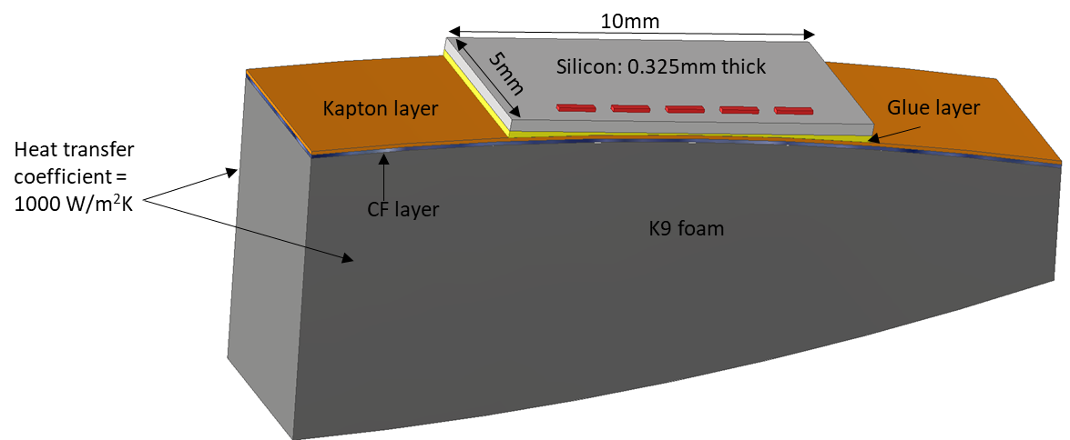
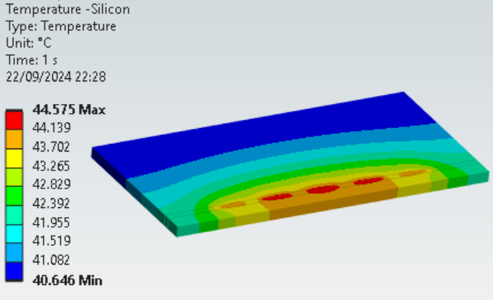
Realistic model
Total HTC area = 131.7 x 2 = 263.4mm²
The max temperature is 44.6ºC.
The temperature difference on the silicon is 4ºC
the temperature difference between maximum and initial temperature is 22.6ºC.

Slide 11
Next steps
Heat transfer coefficient of 1000W/m²K was used for the analysis but this is as good a value we could assume. Further testing are needed to validate this value.
We plan to build a test model and to measure the HTC vs flow rate.
The measured value will be used to feed back to the analysis model.

Slide 12
Backup slides

Slide 13
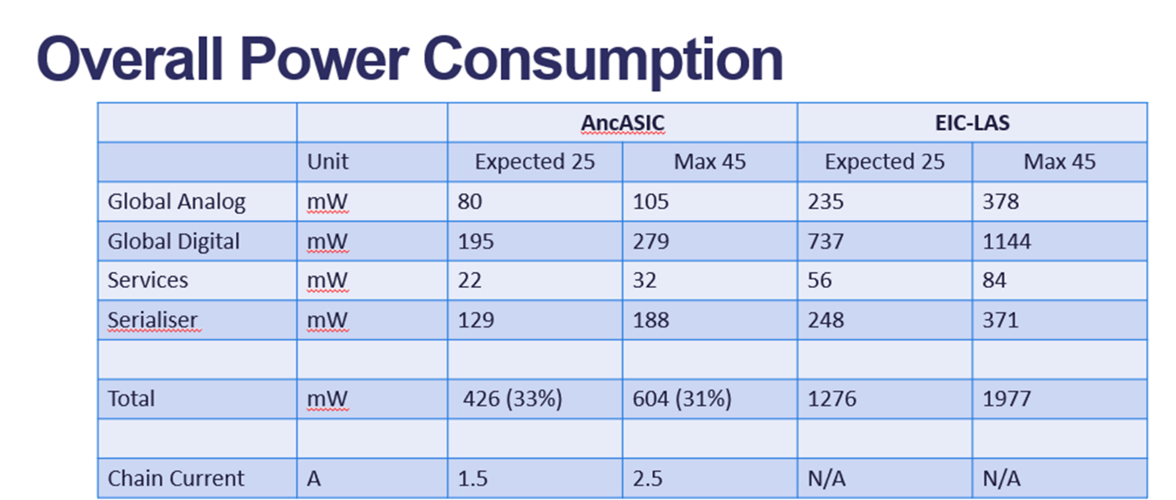
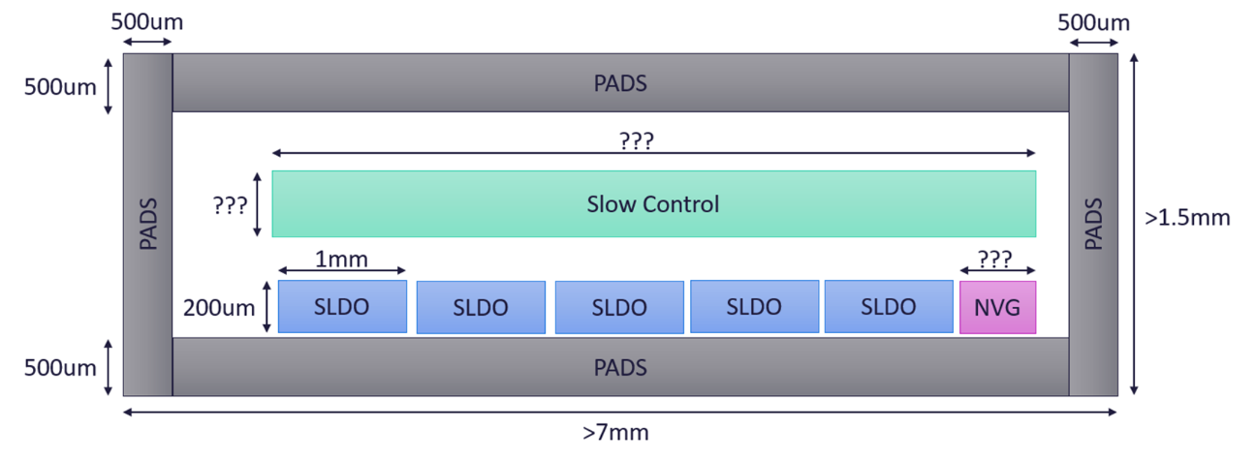
Ancillary chip size and power
Reference: SLDO considerations v10, page10, by Iain Sedgwick
Reference: SLDO considerations v10, page 8, by Iain Sedgwick

