Slide 1
Flex Printed Cable (FPC) test plans
Todd Huffman – Oxford

Slide 2
Current status
Cable and Bridges expected soon
Interface boards done – @ RAL/Oxford & Daresbury

Slide 3
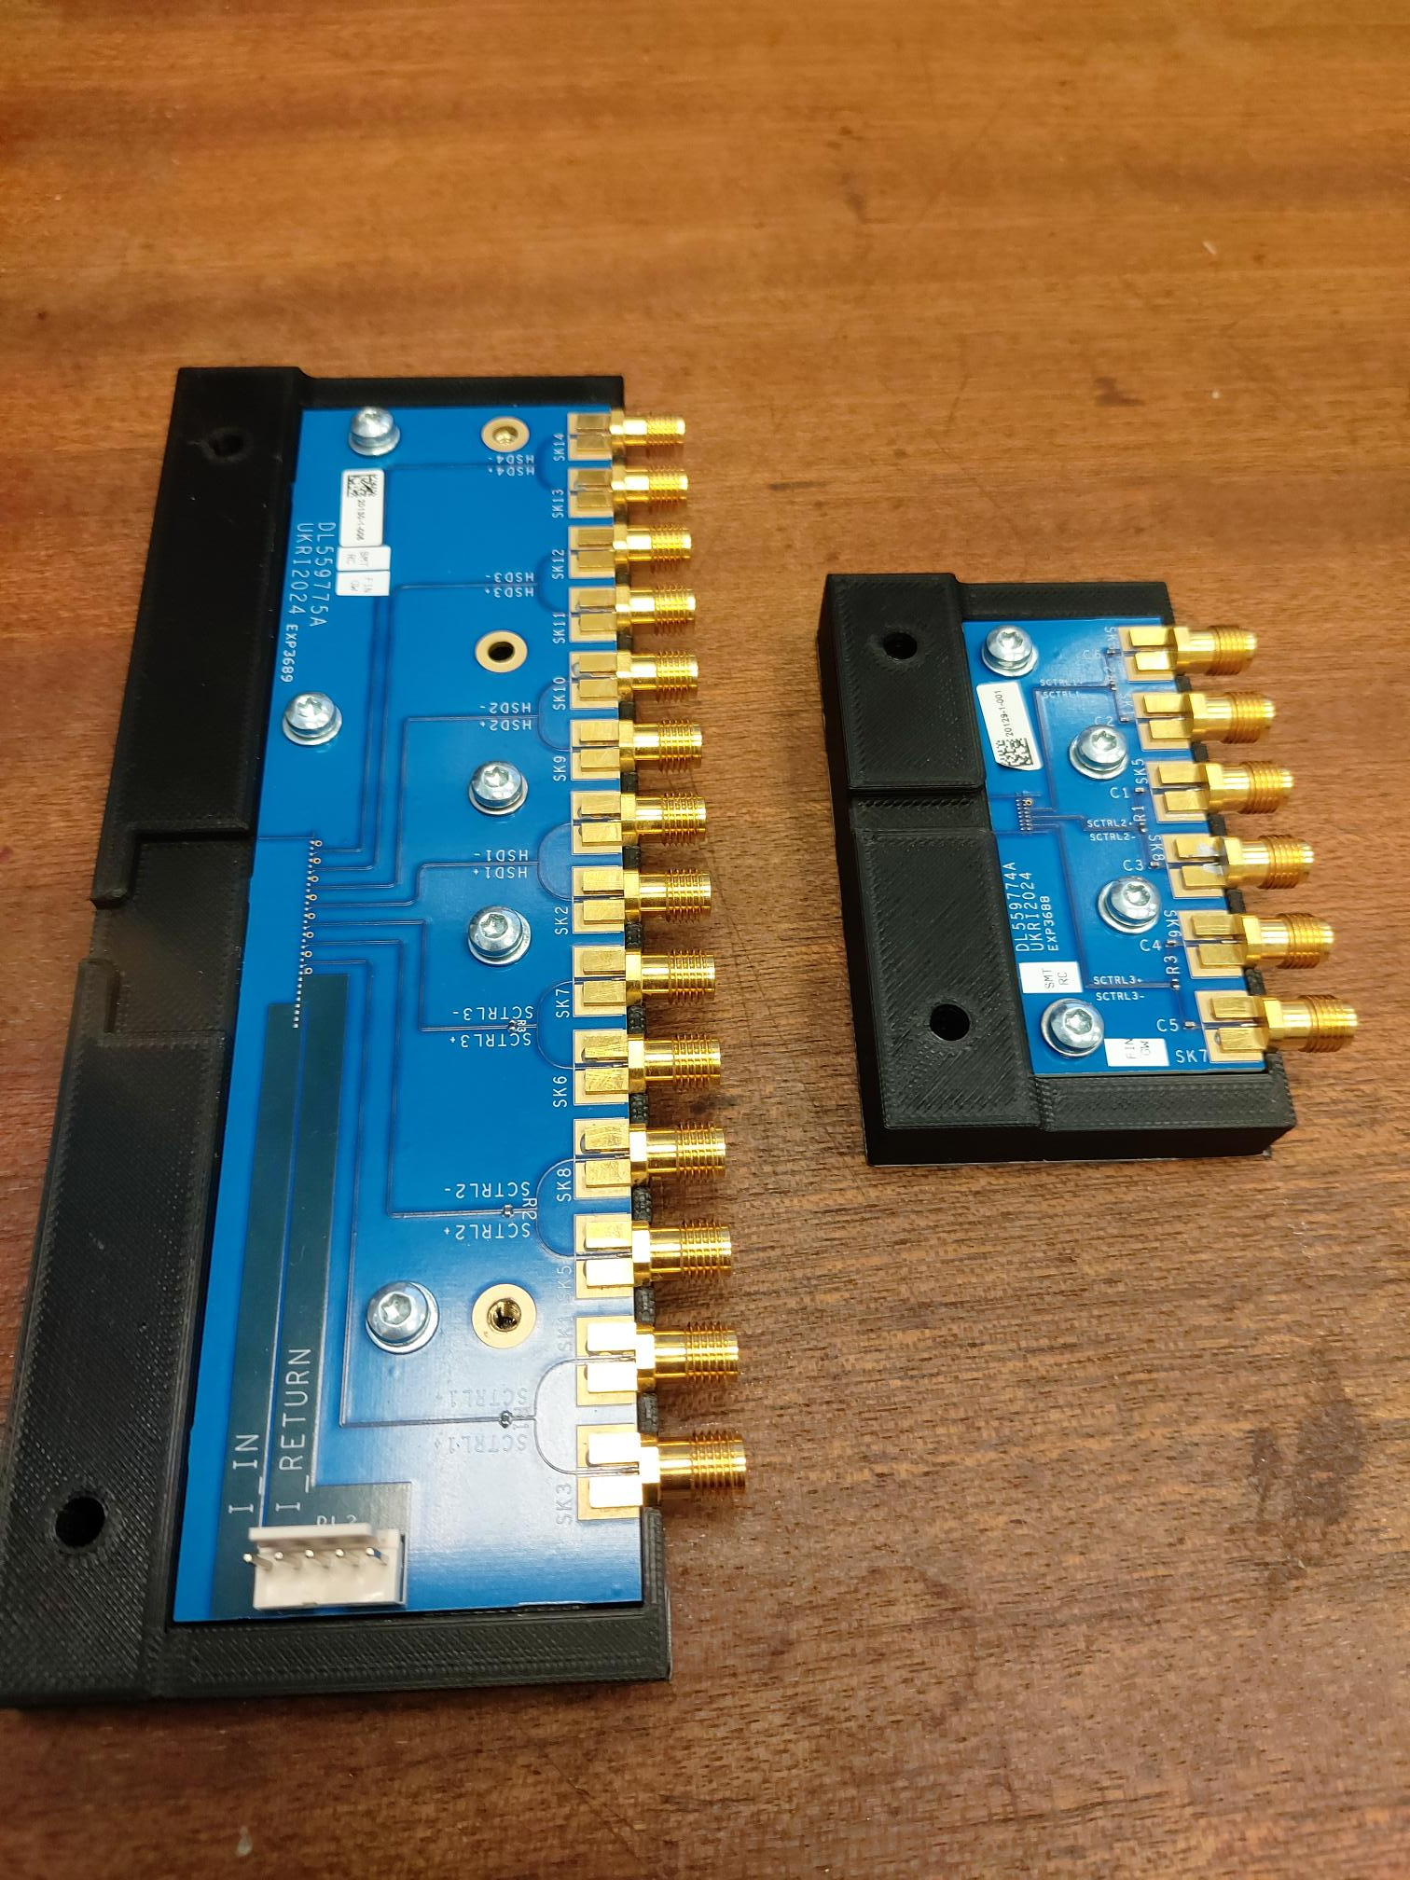
FPC + interface board carrier
Terminations need to be removed. Blocking capacitors replaced with shorts Then - Take to RAL and have TDR look at these boards.
Status of the test FPC – Marcello

Slide 4
Best eye we get now
KCU105 at RAL
conditions
Differential signal into a balun
Running at 10 Gbps

Slide 5
The land of many eyes
Virex7 board and No Balun
Virex7 board and using a balun

Slide 6
Eye’s Wide Open - Using a “balun”
Makes a single ended output from Diff. input
Here is a picture of it.

Slide 7
Better clock cable input to sampling scope
Better clock cable Helps remove clock-related jitter of system

Slide 8
Data Transmission prototyping project
Main Goal – Test Data transmission train in parallel to ITS3 development
A plan for signal transmission from the LAS to the lpGBT and the optical conversion.
Medium Term goal:
Have ancillary chip → FPC →lpGBT→VTRX+ as a working unit
independent of the ITS3 development stream.
Ancillary chip and lpGBT-VTRX+ on high speed PCB’s
Tab bond FPC to them
Shorter term
Plan for ancillary chip test board (PCB with SMA connector interfaces)
LDO tests – chip response to load changes, shunt testing
Multiplexer tests
lpGBT-VTRX+ boards
Already exist? If so can we get them for tests at RAL and Daresbury?

Slide 9
Ancillary chip concept
PCB to test functions of ancillary chip
Shunt LDO testing
Muliplexing functions for slow controls?
Needs thought – then design
SMA outputs for high speed TX-RX
DeMux slow controls
10 GPS data link from FPGA data test board
Abiliity to connect to Flex Cable (FPC) interface boards
SMA to SMA on interface boards
Make flexible enough to re-form boards with tab-bonding area instead of SMA connectors.
Connector - FPGA data test board
Ancillary Chip
SMA
SMA
SMA
SMA

Slide 10
VTRX+ lpGBT
Use on any drop point Or better – design to fit Next Gen FPC

Slide 11
conclusions
Purposes
To be able to work out data and slow-control transmission problems
Parallel to ITS3 development instead of serially
Test structures for Ancillary chip tests
Shunt LDO functions and capabilities
Demultiplexing of slow-controls.
Feed back to Ancillary chip design iteration (also in parallel to ITS3)
Ultimate Goal - more realistic tests of the full electrical signal and powering pathway.
Gain UK expertise for production quality control
Multiple institutions

Slide 12
Backups

Slide 13
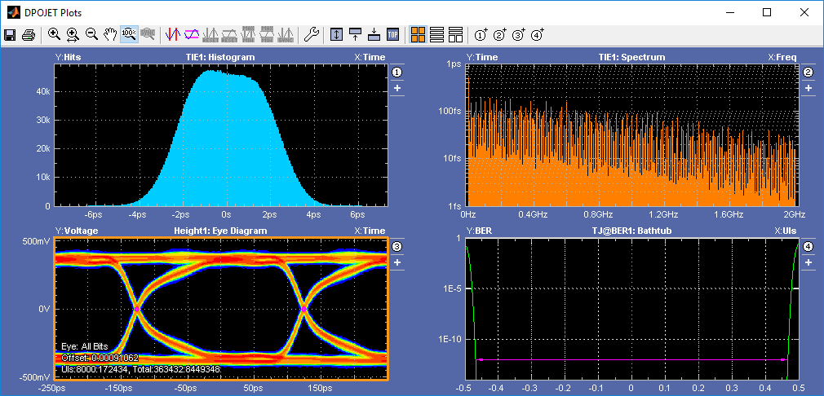
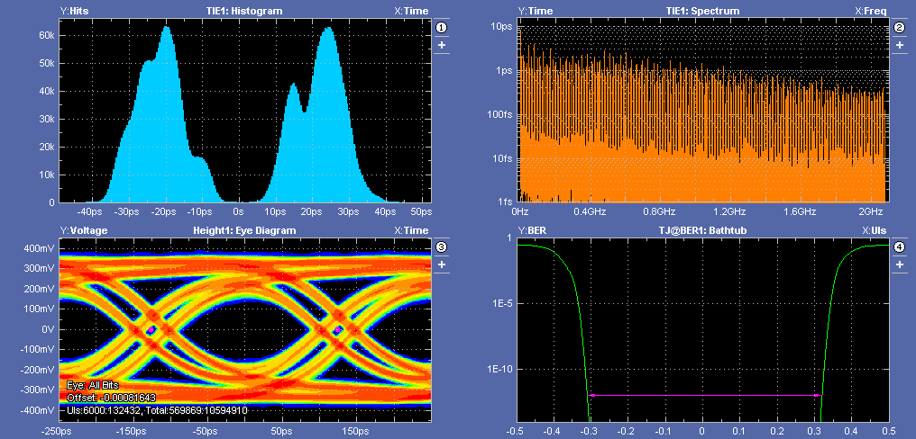
Hoping to do something similar with FPC
KCU105 direct to ’scope (72 inch cables)
KCU105 to DUT to ’scope (72 inch cables)
Pictures From William Helsby – Daresbury lab.
Eye diagrams, bathtub plots – other suggestions?

Slide 14
Updated preliminary design: unfolded assembled FPC
Composition of the assembled FPC:
a) Main FPC (M-FPC in short) – 1pc
b) Bridge FPC (B-FPC in short) – 4 pcs (same FPCs)
Schematic cross-section
April 24, 2024
viatcheslav.borshchov@cern.ch, ihor.tymchuk@cern.ch

Slide 15
Updated main FPC
Composition of the main FPC:
Cover Layer (insulation) – polyimide 25um or 12,5um
Signal Layer (signals, I_IN&I_OUT) – FDI-A-24
Spacer Layer (for impedance) – polyimide 25um or 12,5um
GND layer (GND, I_RETURN) – FDI-A-24
All layers
Cover Layer
Signal Layer
Spacer Layer
GND Layer
Note: M-FPC is rotated on 180 degree, view from Cover Layer side
April 24, 2024
viatcheslav.borshchov@cern.ch, ihor.tymchuk@cern.ch

Slide 16
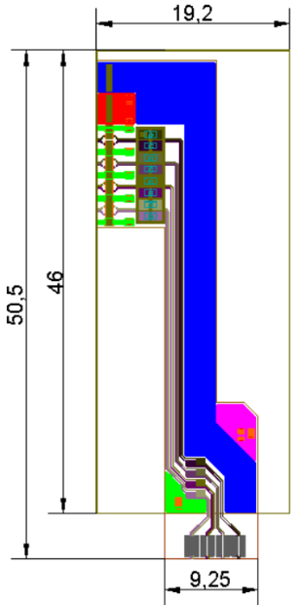
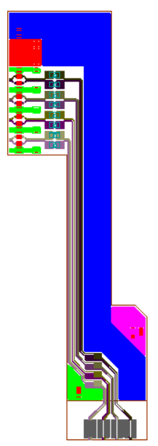
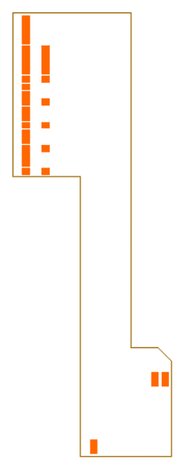
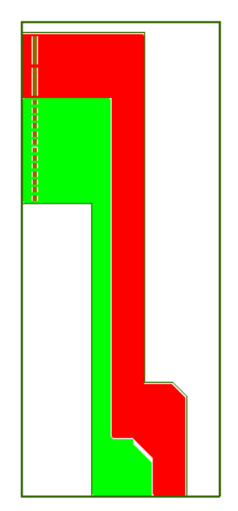
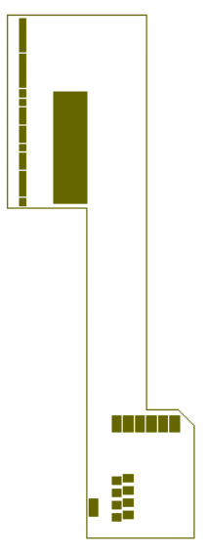
Updated Bridge FPC
Composition of the Bridge FPC:
Cover Layer (insulation) – polyimide 25um or 12,5um
Signal Layer (signals, I_IN) – FDI-A-24
Spacer Layer (for impedance) – polyimide 25um or 12,5um
GND layer (GND, &I_OUT) – FDI-A-24
All layers
Cover Layer
Signal Layer
Spacer Layer
GND Layer
April 24, 2024
viatcheslav.borshchov@cern.ch, ihor.tymchuk@cern.ch

Slide 17
UNIQ+ summer student @Oxford Equipment @RAL
54754A TDR
86112A 20 GHz (12.4 GHz)
Test board: Use to set up tests
Also have a Kintex 7 board to generate Psuedorandom bit streams

