Slide 1
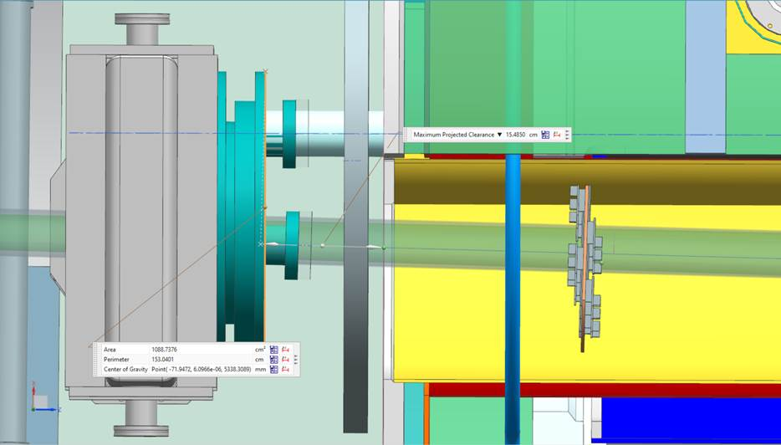
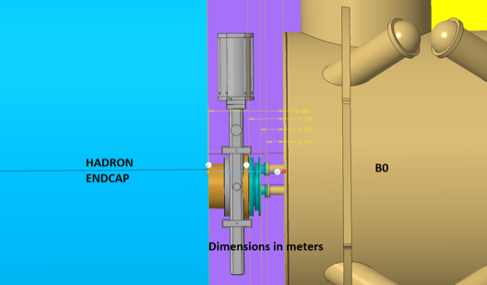
B0 tasks overview: vacuum
Vacuum
Free space in front is currently < 5cm
Gate-valve: bellows servicing the B0 will be on the IP side of the beampipe, between the valve and endcap. Vertical placement is preferred.
Z-thickness of AC-LGAD layers ( needs to be <5cm). Readout boards/VTRX+
Stay-clear area near the beam-pipe:
2mm spacing needed between calorimeter/tracking layers and the beampipe. Depending on the bake-out procedure this distance could be ca 5mm ( temperature tolerance of AC-LGADs needs to be checked)
Fernando/Christophe: The operating temperature for the ASICs is limited to 70 degree C (not guaranteed above this). Un-powered, the ASICs survive to about 120 degree C. However, the limitation is then determined by other components, such as PCB, solder, etc.
Bake-out temperature?
Caption

Slide 2
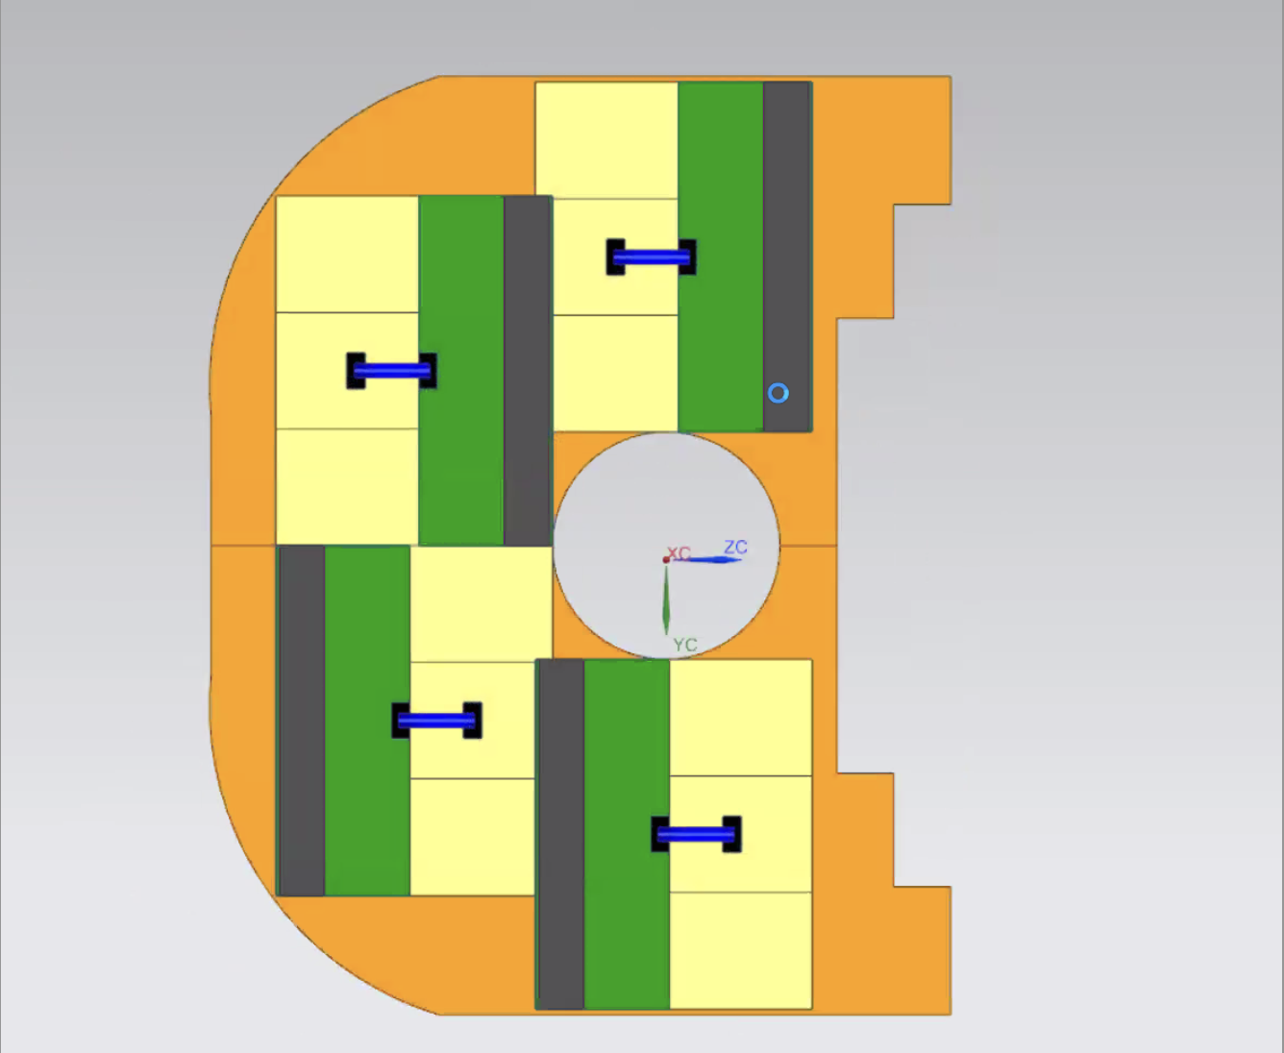
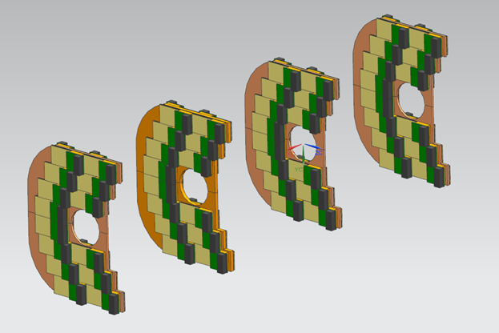
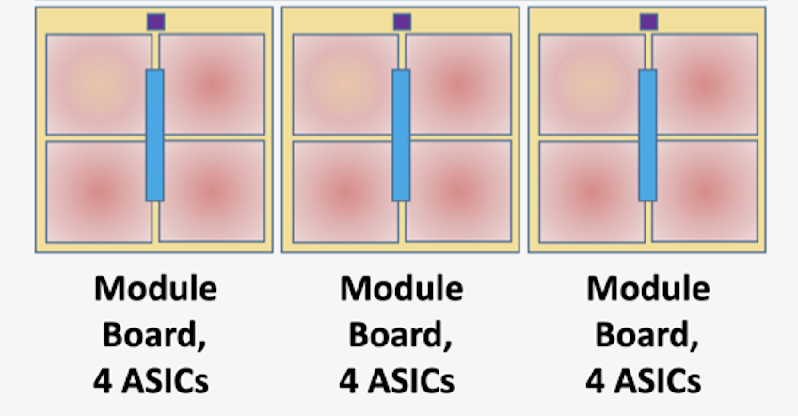
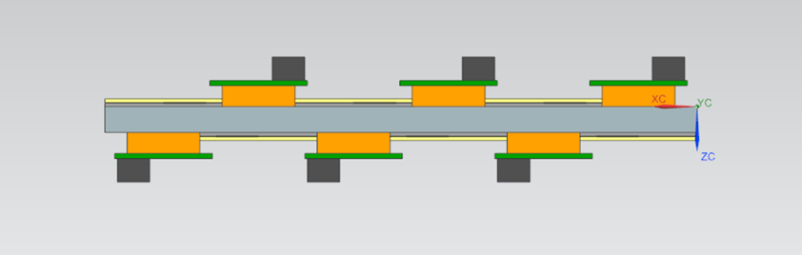
B0 tasks overview: tracker
AC-LGAD tracker
Z-thickness of AC-LGAD layers ( needs to be <5cm).
Location for Readout boards
FTOF layout - min RD3 ( 3x4 =12 EICROCS per board)
Decouple Modules ( AC-LGAD+ EICROC and Readout Boards) => cable length < 2m ( Fernando/Christophe: The HGCROC and ALTIROC ASICs -similar to the EICROC - were tested with 2 m long cables on the outputs and they worked well at 1.28 Gbps. )
PCB board for HV/LV, etc distribution ?
Cooling
Geant4 simulation with actual sensor layout
Installation
Yellow Module== 4EICROCs

Slide 3
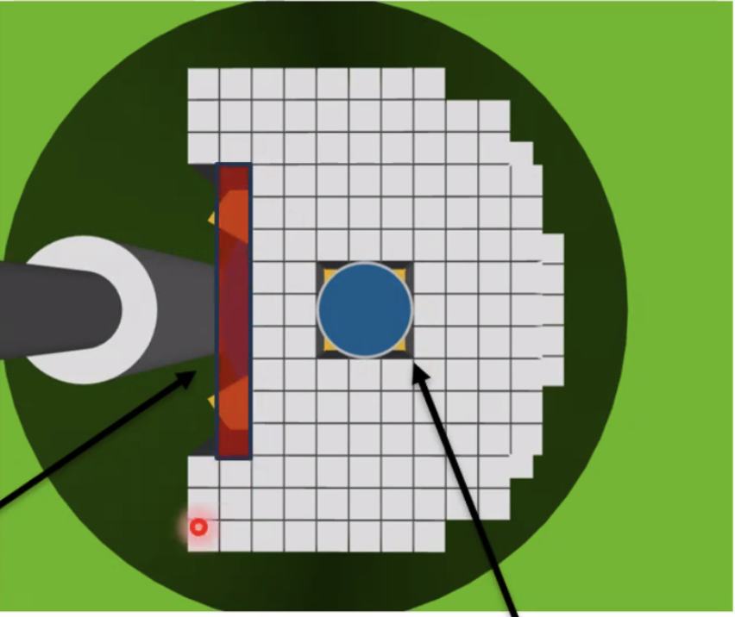
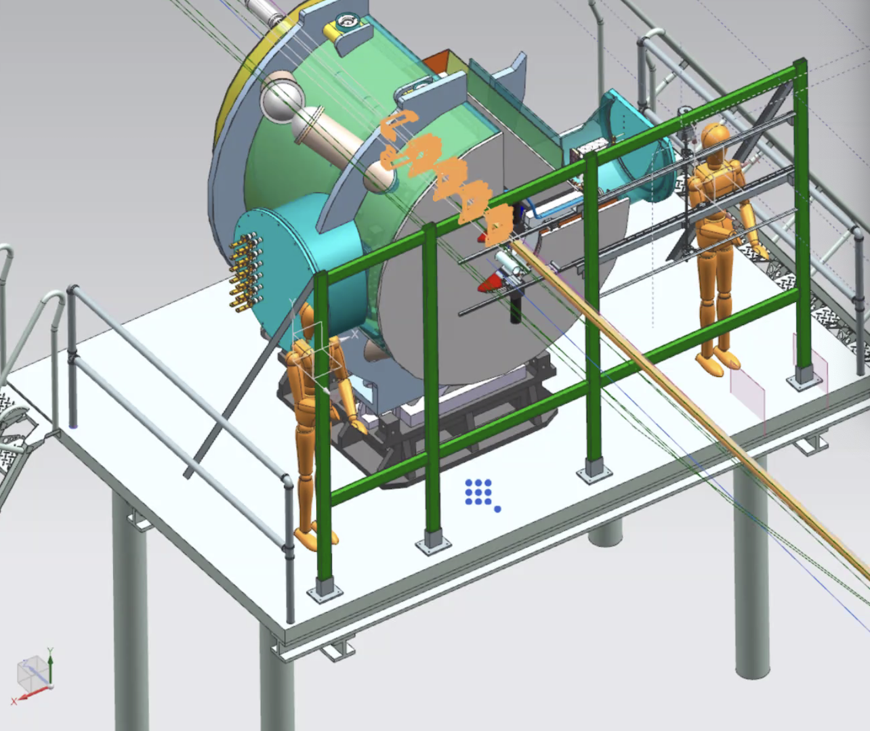
B0 tasks overview: EMCAL
EMCAL and integration with B0-magnet:
Mechanical support from the back-side of B0 ( heavy weight)
Assembly/installation sequence:
B0-EMCAL assembly: glue or a frame for individual crystals?
B0-EMCAL how to attach SiPM boards
The mechanical structure and calorimeter modules without electronics will be installed in the assembly hall ( need to know B0-magnet availability, lab space for assembly) :
Installation of crystals inside B0. B0 magnet with crystals will be transported to the hall (crane?)
Beam commissioning
Installation of SiPMs/readout on calorimeters
Installation of AC-LGAD tracking layers
Balcony: space for readout/DAQ, shielding?
Mockup

Slide 4
Mockup
India Krehbiel

