Slide 1
Hadron Injector Complex Staffing Requirements
Charge Q7
C-AD Staffing - History and Present Actuals
Staffing Plan - Assumptions and Requirements
Staffing Requirements in Detail
Workforce Demographics
Summary
Michiko Minty
Associate Department Chair for Accelerators and Applications
Accelerator Division Head
Hadron Injector Complex Operations Review
25–26 September 2024

Slide 2
CAD Staffing – History and Present Actuals
M. Minty Sept 2024 Hadron Injector Complex Operations Review

Slide 3
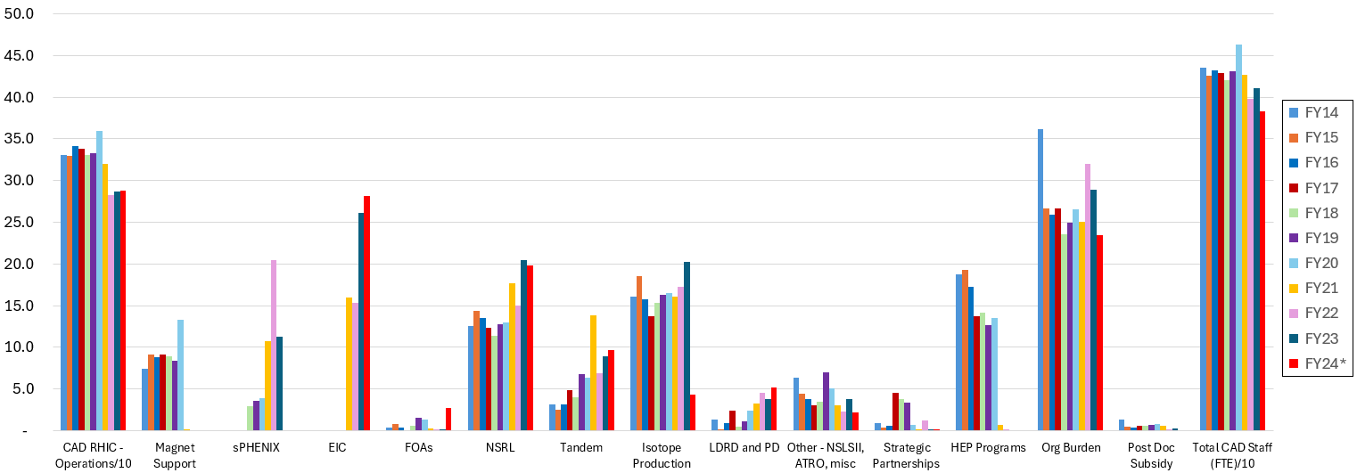
(add animation to guide viewers)
C-AD Staffing History
FY24 (red bars) show present status – more details on next slide
Restructuring: magnet support and ATF (FY20), Isotope Production (FY24), and business office (FY14)
strong C-AD support for new sPHENIX detector
MOUs to EIC (FY21+)
(ATF, G-2 and waste management)
C-AD staff provided strong support for sPHENIX and for the EIC (via MOUs)
C-AD staff totals are declining due to transfers to the EIC, MOUs with the EIC, and retirements (with difficulty in recruiting qualified staff)
M. Minty Sept 2024 Hadron Injector Complex Operations Review

Slide 4
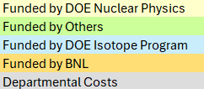
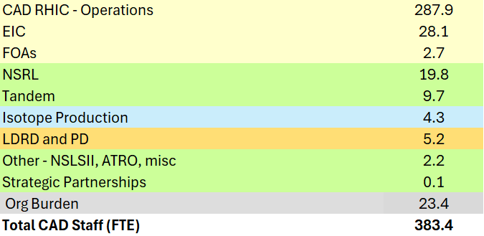
CAD Staffing – Present Actuals,
annualized (Aug 2024)
This talk will concentrate on these
… with a short summary of these
presently
management (8.5) – department
chair, admin and division heads
ES&H/QA (14.9)
Definitions:
“CAD RHIC – Operations” : includes all staff needed to support the Hadron Injector Complex and RHIC
“EIC” : indicates CAD staff working on the EIC through MOUs
M. Minty Sept 2024 Hadron Injector Complex Operations Review

Slide 5
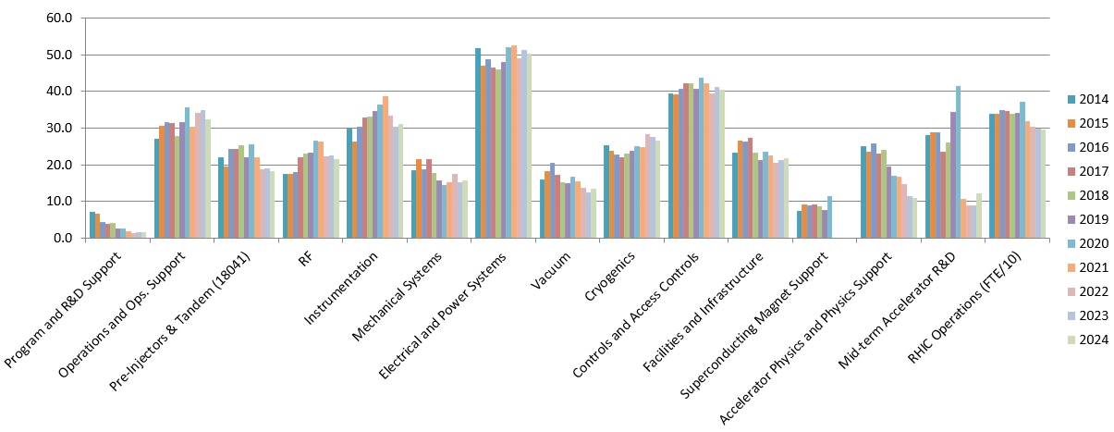
CAD – RHIC Operations Staffing History
From BNL Nuclear Physics FY2026 Budget Briefing
(23 Feb 2024)
Increased effort for EIC conceptual design
Staff Level [FTE]
Redirects to EIC
C-AD based RHIC ops staff: 297 FTEs (FY24), including
23 FTEs for experimental support
12 FTEs for mid-term accelerator R&D (including CeC)
10-15 FTEs for RHIC accelerator improvement (including in the injectors) and FOA support
M. Minty Sept 2024 Hadron Injector Complex Operations Review

Slide 6
Staffing Plan: Assumptions and Requirements
M. Minty Sept 2024 Hadron Injector Complex Operations Review

Slide 7
Staffing Plan - Assumptions
FY24-FY25: completion of RHIC physics science mission; operation through the end of FY25 (possibly CY25).
FY25: staffing reduced (with some programmatic risk) during final year of RHIC operations for physics.
FY26 and beyond
maintain accelerator complex (ion sources, LINAC, AGS Booster, AGS) in a ready state for EIC operations,
continued operation of applications programs (NSRL, Isotope Production),
continued accelerator R&D in support of future NP facilities including the EIC,
continued upgrades and end-of-life replacements,
ARRs for LINAC/Booster (Apr 2026), the AGS (Oct 2027) + RF Test Facilities (per DOE O420.2D),
execute removal and repurpose (R&R) for the EIC.
Staff transitions from RHIC (i.e. CAD) to the EIC continue throughout - Position Review Board recently created.
M. Minty Sept 2024 Hadron Injector Complex Operations Review

Slide 8
Aside on RHIC (CAD) to EIC Transition
From BNL Nuclear Physics FY2026 Budget Briefing
(23 Feb 2024)
The EIC project is organizationally outside of the NPP Directorate.
A large fraction of the expertise and staff required by the EIC project resides at C-AD within NPP.
Three main approaches to provide the EIC project with this expertise:
Staff transfers: in total 35 FTEs, including WBS level 2 and 3 leaders and accelerator physicists, have transferred from C-AD to the EIC project.
Staff matrixing: C-AD staff working with MOUs to the EIC.
FY24 projection 38 FTEs (144 heads)
FY23 actuals 27 FTEs (142 heads)
FY22 actual 16 FTEs (102 heads)
have reverse-MOUs (EIC-to-CAD) to support RHIC Ops if needed.
update: FY24 annualized actuals
33 FTEs (163 heads)
M. Minty Sept 2024 Hadron Injector Complex Operations Review
Notes:
Update Heather Turbush, 2/16/23.
Update Cris Manalo, 9/20/24.
Per Lynanne DiFillipo: staff transfers unchanged since 2024 LMBB.

Slide 9
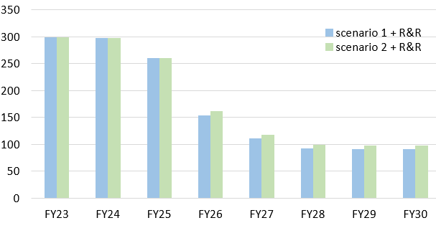
Staffing Requirements (“RHIC Ops”, NPP-funded)
From BNL Nuclear Physics FY2026 Budget Briefing
(23 Feb 2024)
end of RHIC operations
Δ ~ 37
Δ ~ 105
Staff Level [FTE]
Δ ~ 45
Δ ~ 20
staff required to maintain hadron complex in a ready state for the EIC
(staff for R&R)
Note: experienced accelerator workforce could be lost if EIC project funding does not accommodate workforce released from RHIC operations.
M. Minty Sept 2024 Hadron Injector Complex Operations Review

Slide 10
Staffing Requirements in Detail NPP funded staff Non-NPP funded staff
M. Minty Sept 2024 Hadron Injector Complex Operations Review

Slide 11
Staffing Requirements in Detail – NPP Funded Staff
2017 senior level management estimate for maintaining the accelerator complex: 89 FTEs (T. Roser, W. Fischer)
independent estimate based on group functions: 97.5 FTEs (M. Minty)
2023+ bottoms-up estimate in progress (D. Hatton)
Off-project (R&R) scope was added with staffing estimates communicated to the DOE (Feb 2024 LMBB);
J. Tuozzolo (EIC Technical Systems Division Director and C-AD Chief Mechanical Engineer) leading
these estimates, which have evolved and been refined since the Feb 2023 LMBB.
An EIC Accelerator Dependencies Review was held 19-20 August 2024 to review the requirements (not
covered in this review).
the estimates from 2021 were updated (M. Minty), slide 17
M. Minty Sept 2024 Hadron Injector Complex Operations Review

Slide 12
Staffing Requirements – Methodology of 2021 Estimate
Until FY21 most groups - with the exception of Booster/AGS Ring PS systems and Collider Electrical PS systems - charged time to their groups, not to geographic regions.
Objective: estimate efforts of each group according to geographic region
Methodology: using group staffing data (slide 5, through 2019), estimated the allocation of each group’s effort to support source/LINAC, Booster, AGS, RHIC, LEReC, CeC, sPHENIX and 56 MHz cavity, electron gun develop-ment at Stony Brook University, experimental support, eRHIC/EIC R&D, polarimetry, BLIP, NSRL, CBETA, LDRD & FOAs, management & general maintenance
a) using BNL job classifications (scientist, professional, technical, IT, administrative, management)
b) expanded labor estimates further into individual Work Group IDs (for incorporation into the Resource
Comparison Tool (RCT) used by the EIC after recategorization of staff according to their work
functions (as opposed to previous classification in PeopleSoft Work Groups, where personnel were
assigned according to their reporting chain)
c) further subclassification of Work Groups into > 20 RCT Site Resource Groups (not completed)
M. Minty Sept 2024 Hadron Injector Complex Operations Review

Slide 13
Staffing Requirements – Methodology, continued
Estimates took into account organizational changes:
- elimination of the eRHIC R&D group
- elimination of Superconducting Magnet staff support
- addition of groups: beam cooling, electron source development, laser group
Estimates took into account future efforts only if funded.
M. Minty Sept 2024 Hadron Injector Complex Operations Review

Slide 14
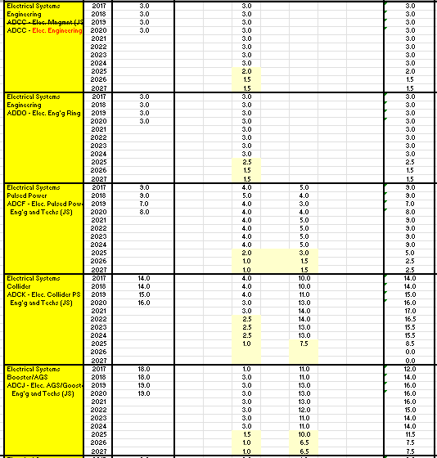
Example: Electrical Systems Group – breakdown by job classification
Output: staffing projections
input:
historical staffing actuals
Output: staffing release to the EIC
Note: had assumed that RHIC operations would end 30 Jun 2024
M. Minty Sept 2024 Hadron Injector Complex Operations Review

Slide 15
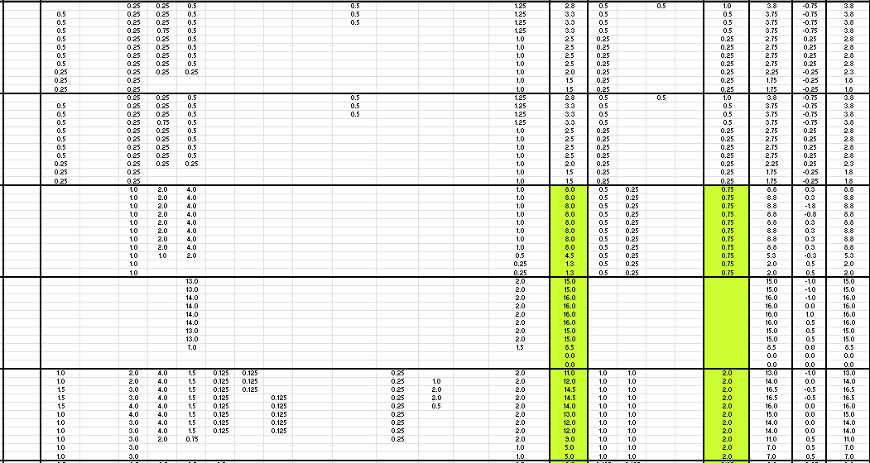
Example: Electrical Systems Group – breakdown detail
Effort levels by region assigned (best judgement) to match actuals in 2017, 2018, 2019, and 2020 and used to project requirements for after end of RHIC physics programs
M. Minty Sept 2024 Hadron Injector Complex Operations Review

Slide 16
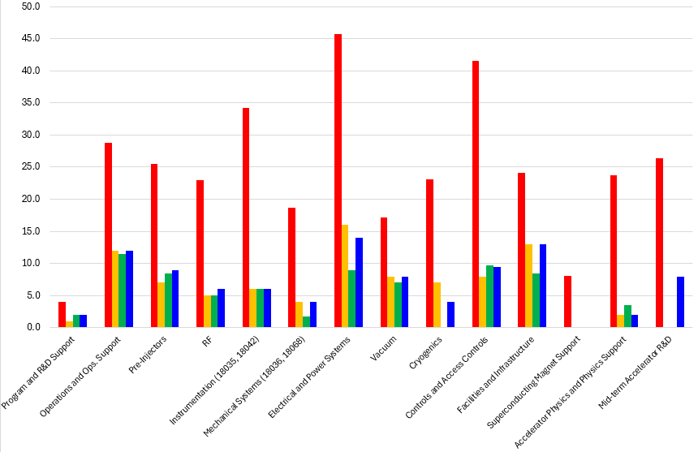
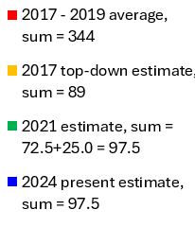
Result: staffing, by groups
Examples: significant reduction without RHIC operations
RHIC Ops
hadron injector complex only
(2017 – 2019 includes the AGS)
2021 estimate of 72.5 FTEs to maintain operation of the injectors with additional (historical) 25 FTEs for accelerator R&D and to-be-funded accelerator upgrades.
M. Minty Sept 2024 Hadron Injector Complex Operations Review

Slide 17
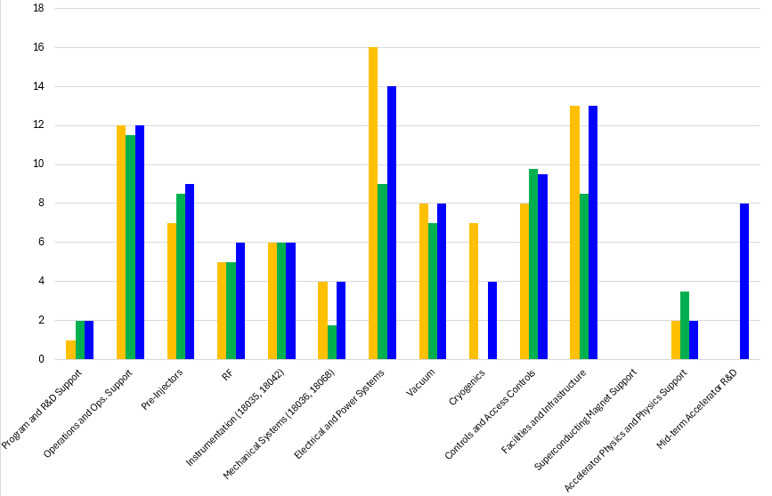
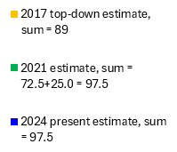
Result: staffing by groups, hadron injector complex only
includes new scope including ARRs
includes new scope: ARRs
includes new scope: He3 and ARR, and deferred maintenance*
restores historical level of accelerator R&D in support of future NP facilities including the EIC
includes new scope: increased cryo support
includes new scope: ARR and LINAC deferred maintenance*
Top-down estimate: why such high cryo support? why no mid-term R&D?
*deferred maintenance - backlog due to extended operating hours in support of Isotope Production [check of in agreement with business model] (if not, remove ‘deferred maintenance’)
M. Minty Sept 2024 Hadron Injector Complex Operations Review

Slide 18
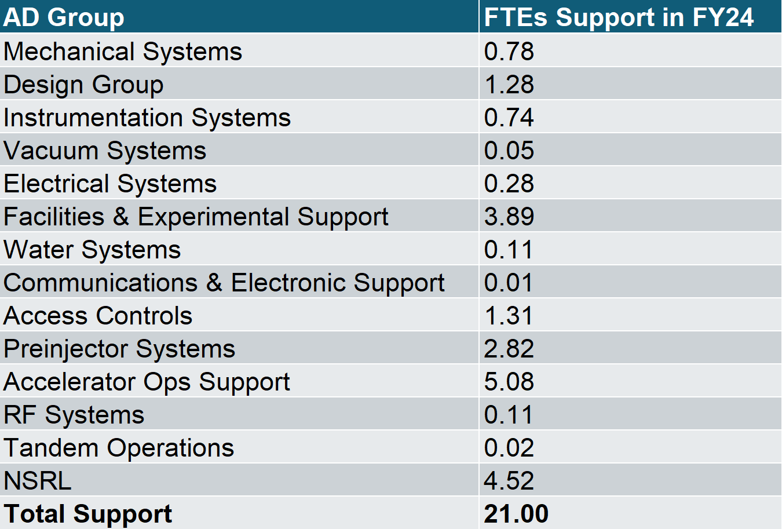
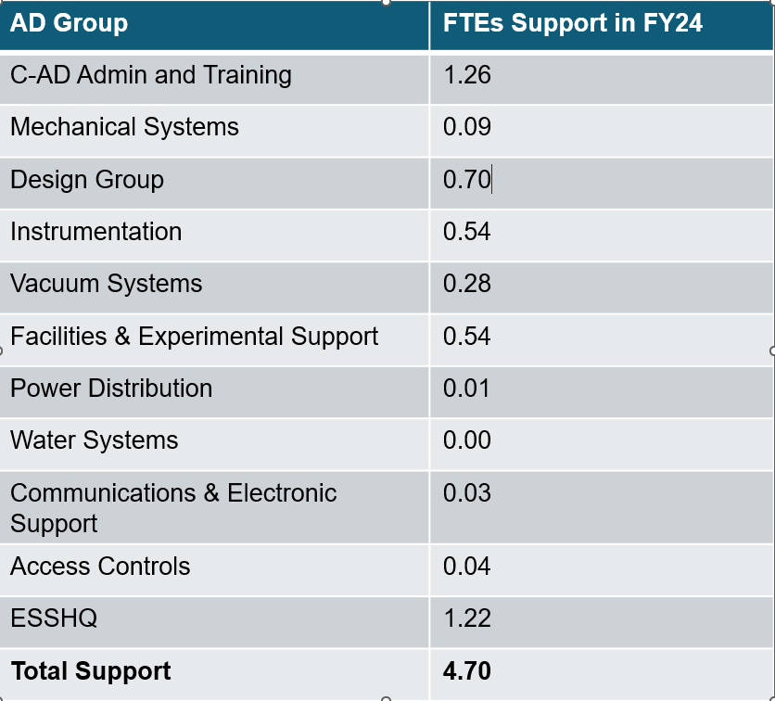
CAD staff for Applications Programs, top 3 (with external funding)
NSRL and Isotope Program: assume constant level of effort at present funding levels
NASA Space Radiation Lab (NSRL)
Isotope Program
Tandem van De Graaff: stand-alone non-designated User Facility (10 FTEs)
actively seeking to increase user base (including LDRD-funded experiments)
M. Minty Sept 2024 Hadron Injector Complex Operations Review

Slide 19
Workforce Demographics
M. Minty Sept 2024 Hadron Injector Complex Operations Review

Slide 20
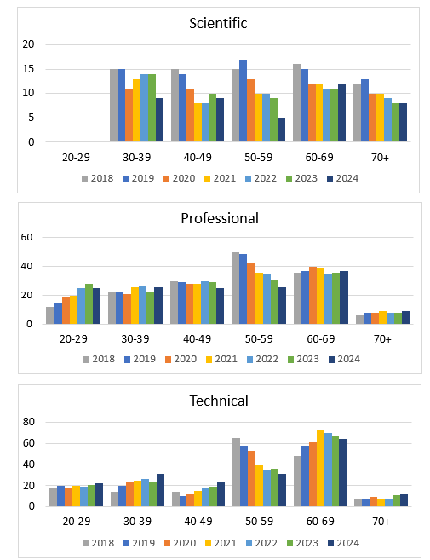
Age Demographics of C-AD Staff
From BNL Nuclear Physics FY2026 Budget Briefing
(23 Feb 2024)
The age distribution of C-AD staff is of concern
Uptick in retirements: in FY20 – FY22 (40 FTEs) and FY23 (10 FTEs, shown in blue):
Technical 13 + 3
Professional 13 + 2
Administrative 4
Scientific 3 +3 phased retirement
3 +2 emeritus
Management 2
Information tech 2
Planning for higher than (lab) average retirement rates after completion of RHIC physics program
Update with FY24 actuals if time allows
M. Minty Sept 2024 Hadron Injector Complex Operations Review

Slide 21
On ensuring a trained and knowledgeable technical and professional workforce for EIC operation
This is challenging (reference DOE “Mini-Workshop on Accelerator Science and Technology Workforce in National Labs”, Jan 2024).
The largest risk (personal view) is further transfers of the best and brightest of CAD staff to the EIC:
the EIC Technical Systems Division (TD) director is also CAD Chief Mechanical Engineer
in the EIC Technical Division (TD)
8 of 11 EIC TD group leaders were recruited from CAD
3 of 5 EIC TD deputy group leaders were recruited from CAD
the deputy Technical Director was also recruited from CAD
CAD has invested and will continue (when possible) to invest much effort in recruiting to backfill positions and ensure transfer of knowledge to new staff.
M. Minty Sept 2024 Hadron Injector Complex Operations Review

Slide 22
Summary
M. Minty Sept 2024 Hadron Injector Complex Operations Review

Slide 23
Summary
Charge Question #7
C-AD staffing models were developed to estimate workforce needed to ensure proper maintenance of the hadron accelerator complex (proton- and ion sources, LINAC, AGS Booster synchrotron and the AGS) for later use as the Electron-Ion Collider (EIC) hadron injector complex and continued successful operation of the Applications Facilities (NSRL, Isotope Production and Tandem).
AIP/CE funding for hadron complex funding has been redirected since FY23.
The staffing model from 2021 was recently updated with estimates reflecting new additions:
Accelerator Readiness Reviews required by the DOE for the LINAC, AGS Booster, and the AGS
off-project scope for the EIC performed by CAD:
polarized He3 beam generation and delivery
cryogenic system upgrades
reinstatement of personnel for accelerator R&D in support of future NP facilities including the EIC
Uncertainty exists in the effort levels due to
lack of estimate basis for performing ARRs for legacy accelerators
funding profiles, especially for the cryogenic systems
A bottoms-up estimate is in development (D. Hatton/EIC) however challenged by the above-mentioned uncertainties.
More detailed analyses would seem to require additional resources.
M. Minty Sept 2024 Hadron Injector Complex Operations Review

Slide 24
Reference Material
M. Minty Sept 2024 Hadron Injector Complex Operations Review

Slide 25
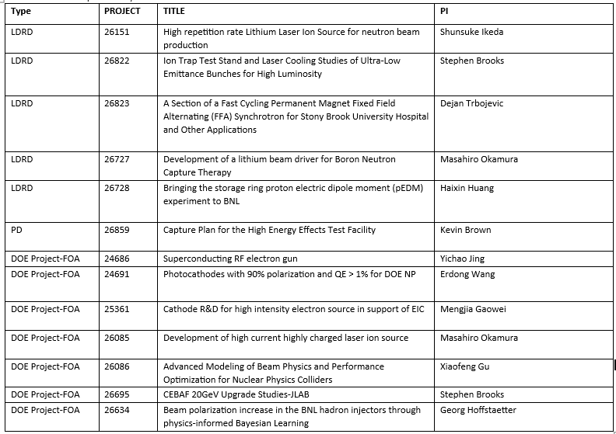
NPP / Collider-Accelerator Department (C-AD) R&D

Slide 26
To remove: charge and staff for ES&H ARRs
Subtitle
M. Minty Sept 2024 Hadron Injector Complex Operations Review

Slide 27
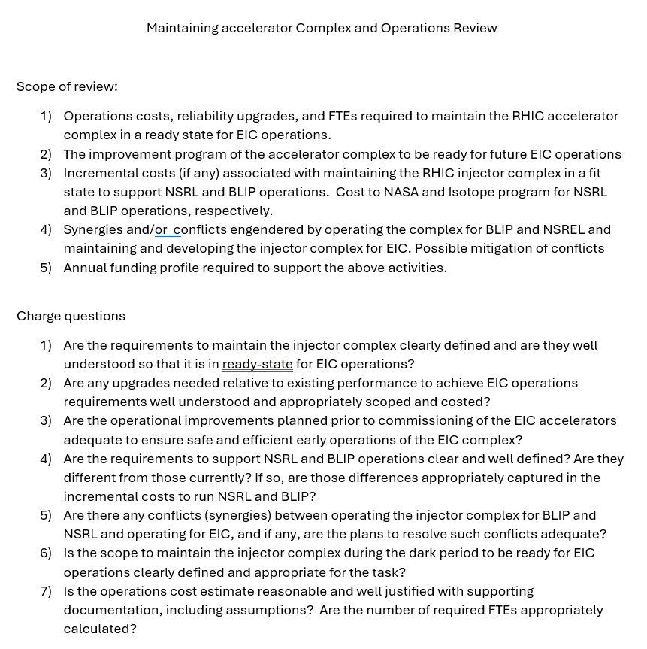
Charge Question #7

Slide 28
Staff for ARRs
Assumptions: scope here is in development of documents and procedures
effort levels for facility upgrades not included
1 engineer – SAD and ASE development
0.75 engineer – ARR preparation
0.25 engineer – QA
0.2 manager - ESSHQ Head
0.25 admin – procedure revisions/updates
0.5 physicist – Linac and EBIS LP
0.5 engineer – Linac and EBIS LE
0.5 physicist – Booster and NSRL LP
0.5 engineer – Booster and NSRL LE
0.5 physicist – AGS LP
0.5 engineer – AGS LE
0.5 physicist – Radiation Calc Updates ~ 6FTEs total for all Linac/Booster and AGS ARRs.
If we are going to include the 2 RF test facilities, I would add another 0.5 LP and 0.5LE for each, some time for rad calcs and ODH calcs.
M. Minty Sept 2024 Hadron Injector Complex Operations Review

Slide 29
M. Minty Sept 2024 Hadron Injector Complex Operations Review

