Slide 1
Electronics and DAQ WG Meeting 9/12/24
Agenda
lpGBT and VTRX+ counts (MPGD & AC-LGAD detectors)
  elinks / EICROC?
TDR status / guidance
(Very) preliminary GTU discussion (William)

Slide 2
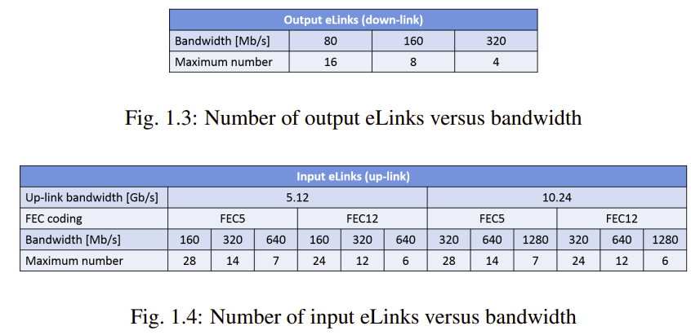
RDO: lpGBT and VTRX+ counts per ASIC (Assume low speed elinks)
Output e-links / ASIC | lpGBT/ASIC | VTRX+/ASIC | Fibers (up+down)
1 | 1 / 16 | 1 / 16 | 2 | 16 up-elink in 1 lpGBT , 1 VTRX+
2 | 2 / 16 | 1 / 16 | 3 | 32 up-elink in 2 lpGBT, 2 uplink fiber in 1 VTRX+
3 | 2 / 16 | 1 / 16 | 3 | 45 up-elink in 2 lpGBT, 2 uplink fiber in 1 VTRX+
4 | 3 / 16 | 1 / 16 | 4 | 64 up-elink in 3 lpGBT, 3 uplink fiber in 1 VTRX+
8 | 4 / 14 | 1 / 14 | 5 | 112 up-elink in 4 lpGBT, 4 uplink fiber in 1 VTRX+
16 | 4 / 7 | 1 / 7 | 5 | 112 up-elink in 4 lpGBT, 4 uplink fiber in 1 VTRX+
22 | 4 / 5 | 1 / 5 | 5 | 110 up-elink in 4 lpGBT, 4 uplink fiber in 1 VTRX+
28 | 4 / 4 | 1 /4 | 5 | 112 up-elink in 4 lpGBT, 4 uplink fiber in 1 VTRX+
FPGA Version:
RDO ~$500 Artix AU15P
12 transceivers (Fiber)
156 Single-Ended HP IO/pins (4 per “elink”)
  But need others for other features
  32 ASIC supported

Slide 3
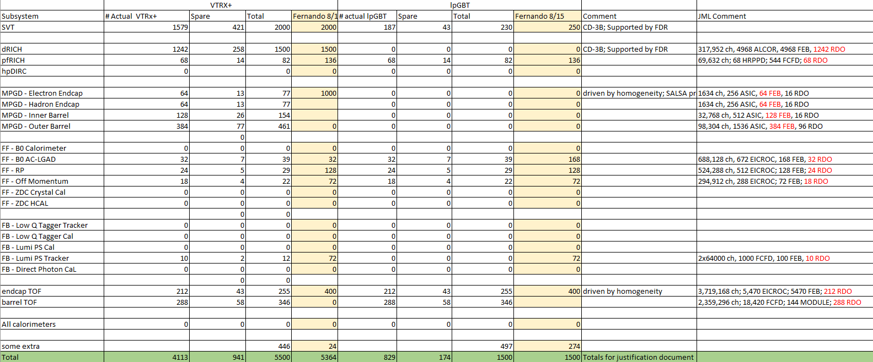
Showed VTRX+ / lpGBT counts, needs minor changes
Biggest Change: barrel TOF would need 288 x 4 VTRX+, and thus should not use lpGBT!

Slide 4
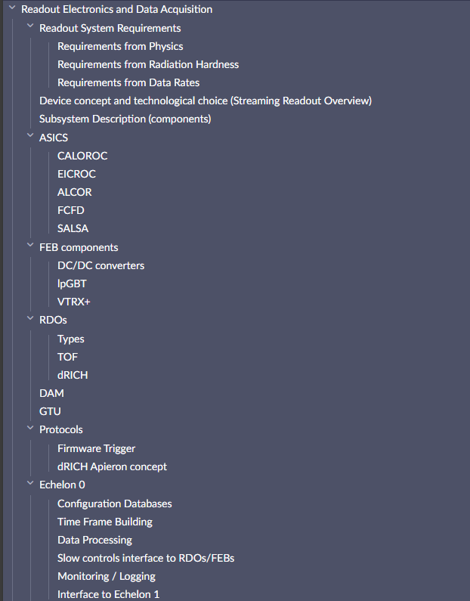
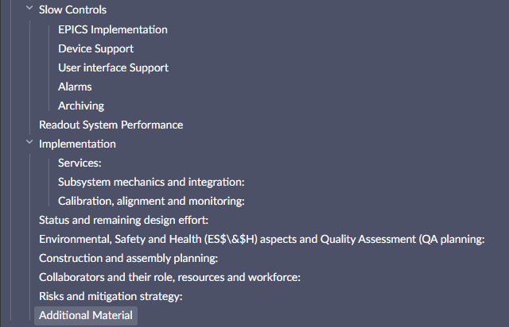
TDR Guidance:
10-15 page / DSC
“Executive summary format”
As much space as needed in “Additional Material”
Additional Material (as much as needed) for appendices
  sPHENIX DAQ -> 33 pages
  LHCB upgrade -> 66 pages
  ALICE upgrade -> >100 pages
    ~ 10 pages / component
I’ve invited many of you to the a “Electronics and DAQ” development overleaf… ask if you need access or want to help double check/edit
Follows the projects request roughly, but not enough levels
Do not worry about length, Jeff/Jin/Fernando can move to additional material and summarize…

