Slide 1
ePIC
1. Overall Hardware Design
System Clock: 98.5 MHz (100MHz nominal)
GTU: Global Timing Unit
control encoding, status decoding.
The interface for machine clock source,
Data acquisition control and monitor etc.
DAM: Data Aggregation Module:
The clock/control fanout, and status/busy accumulation.
local control over the RDO boards connected, though the main function of the DAM is for Data Acquisition.
RDO: optical interface of detector ReaDOut
control decoding, status encoding.
The clock/control interface to the front end electronics.
Data collection from Frontend boards, and data transmission to the DAM
FEB:
Detector dependent Front End / ASIC carrier boards.
Online computer
Status
GTU
GTU (O)1
Control
EIC
Common
Platform
Clock
Data Acquisition
DAM
(O)100
DAM
DAM
RDO
(O)1000
RDO
RDO
RDO
RDO
FEB
FEB
FEB
4

Slide 2
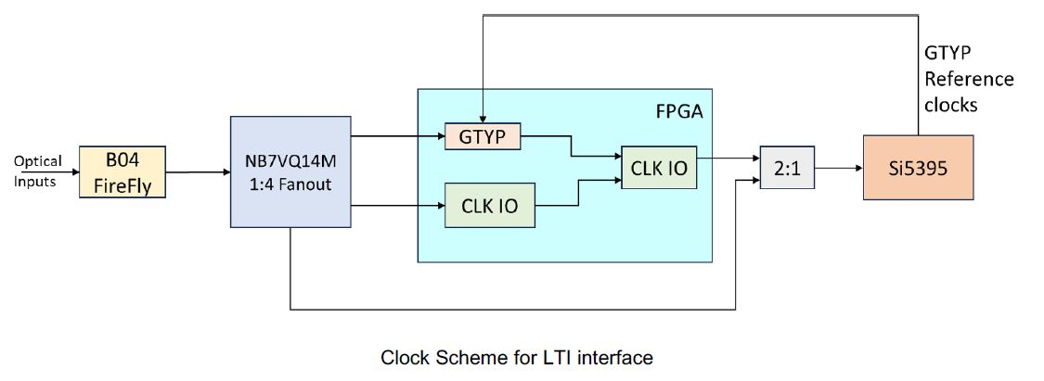
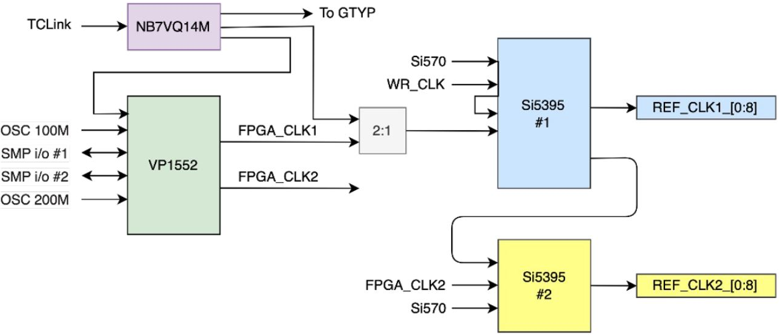
2. DAM FLX155 interface
Dedicated Clock input,
up to three MGT lanes (Tx/Rx)
MTP multimode 850um optical

Slide 3
3. GTU design: Inputs and Outputs
MTP: 4 Tx/4 Rx
MTP fibers, ~10 meters
Clock @ 98.5 MHz
Online computer
Run Control
GTU
Clock, Control, status
DAM
GTU_CONTROL
GBE
MTP
DAM/RDO Status
MTP
Clock, Control, status
DAM
Optional/extra
EIC common platform
Beam synced Clock, orbit
~150
CLOCK distribution
MTP
Clock, Control, status
DAM
LC fibers, ~100 meters
Beam monitor
RDO clock phase
LC
Clock
TOF_RDO
LC
Clock
TOF_RDO
~200
LC
Clock
TOF_RDO
Risk mitigation for extremely stringent requirement by TOF
7

Slide 4
3. GTU design: DAM connection
Clock @ 98.5 MHz
Transmitters
Receivers
Downlink
GTU_CONTROL, min. 8-bits (+ 1 k_bit) @ 98.5 MHz
GTU
DAM
Receivers
Uplink
DAM/RDO Status, min. 8-bits (+ 1 k_bit) @ 98.5 MHz
Transmitters
Transceivers
To fully use the DAM connection
Transceivers
Available on DAM:
4 MGT (MultiGigabit Transceivers) (One Rx for Clock)
Design on GTU:
Clock,
1 Tx and 1 Rx using MGT;
1 Tx and 1 Rx using FPGA’s regular IO
7

Slide 5
3. GTU design: FPGA selection
Enough GigabitTransceivers (~150)
Enough General IOs, (~600)
FPGA lifetime
 | Versal Primium |  |  | AI Edge | Versal Prime |  | Versal HBM |  | UltraScale (plus)
FPGA | VP1552 | VP1502 VP2502 | VP1802 VP2802 | VE2802 | VM1802 | VM2302 VM2902 | VH1522, 42, 82 | VH1742 VH1782 | VU9P | VU190
GTY/XH | 68 | 28 | 28 | 32 | 44 | 8 | 68 | 68 | 120 | 60+60
GTM | 20 | 60 | 140 | 0 | 0 | 36 | 20 | 60 | 0
Gen_IO | 570 | 570 | 570 | 300 | 506 | 192 | 570 | 570 | 832 | 702
Eval kits | FLX155 |  | VPK180 $18K | VEK280 $7K | VMK180 $9,345 |  | VHK158 $15K |  | VCU118 $9K | VCU110 $21K
The GTM can be used similarly as GTY, but the RxFIFO, and TxFIFO can NOT be bypassed ➔ Delay uncertainly;
GTM internal data width 64/80, minimum 9.5 Gbps ➔ better for faster data throughput (trick: doulble counting, “01011…” @5Gbps is the same as “0011001111……” @10Gbps, or “000111000111111………” @15 Gbps) ;
7

Slide 6
3. GTU design: FPGA selection: PROs and CONs of three preferred FPGA candidate
FPGA | PRO | CON
Versal VP1802 VSVA5601, 570 XPIO, 28 GTY, 140 GTM | Dual core Arm® Cortex-A72; 1:1 GT with DAM | 1:2 Tx to DAM, 1:1 Rx from DAM on XPIO; GTM, harder to control
Versal VH1582 VSVA3697, 570XPIO, 68 GTY, 20 GTM | Dual core Arm® Cortex-A72; Large on-die memory | 1:2 Tx to DAM, 1:1 Rx from DAM on XPIO; 1:3 with DAM on MGT
UltraScale+ VU9P B2104, 702 HPIO, 76 GTY | 1:1 HPIO with DAM Compatible with VU5P, VU7P | No Arm® CPU; 1:2 GTY Older FPGA,
Prefer: AMD Versal Primium VP1802 ACAP
Two (or three) smaller FPGAs are easier for the PCB design (less risk).
7

Slide 7
3. GTU design: functional diagram
EIC
COMMON PLATFORM
Optic transmitter
EIC/ePIC clock & beam orbit info
TOF_RDO_1
jitter cleaner & phase adjustment
1:400
fanout
TOF_RDO_1
~200
TOF_RDO_200
Beam vs clock phase monitoring
Clock phase adjustment
XPIO_1
MGT_1
DAM_1
Optic transceivers
XPIO_2
MGT_2
DAM_2
Run Control
Synchronous
~150
User interface
Run Control computer
XPIO_150
MGT_150
DAM_150
DAM/RDO status configure
FPGA
GTU

Slide 8
3. GTU design: If the optical transceivers are on the GTU PCB
12* 12-port transmitter for Clock
12* 12-port transmitter for XPIO
12* 12-port receiver for XPIO
144* MTP to DAM
12* 12-port transmitter for MGT
12* 12-port receiver for MGT
MTP to DAM
MTP to DAM
12-port transmitter for Clock
MTP to DAM
12*
12-port transmitter for XPIO
MTP to DAM
12-port receiver for XPIO
MTP to DAM
MTP to DAM
MTP to DAM
12-port transmitter for MGT
MTP to DAM
12-port receiver for MGT
MTP to DAM
MTP to DAM
MTP to DAM
MTP to DAM

Slide 9
3. GTU design: modular design
GTU base board
Optic transceiver plugin modules (to DAM)
Fits in a 19U wide rack
Takes 4U high space
MTP fiber ports to DAM
Clock
Receiver, control, distribution
Run Control
Memory
‘services’
Quad optic TRX
Optic Transceiver plugin module
19 U wide
Quad optic TRX
FPGA
Quad optic TRX
Power
regulators
Quad optic TRX
4 U high
Quad optic TRX
Quad optic TRX
Quad optic TRX
Quad optic TRX
Quad optic TRX
Clock fanout
Possible TX fanout
Power
supplies
Quad optic TRX
Quad optic TRX
GTU base board
All the electrical signals are differential signals (PCB and connector)
The FPGA can be a single piece, or two pieces with fast interconnect.

Slide 10
3. GTU design: risk mitigation
Optic Transmitter plugin modules
Clock only, to TOF_RDO (optional)
Clock phase monitoring:
Beam pickup, and digital feedback to GTU
GTU: Phase Correction
Optic transmiter
Optic Transceiver plugin module
Optic transmiter
Power
regulators
4 U high
Optic transmiter
RF-SoC (?)
Optic transmiter
PhaseOrbit (average)
Optic transmiter
Clock fanout
Optic transmiter
Phase#1
Phase#2
Phase#1160
Phase#1
RDO(area) Clock
Beam pickup

