Slide 1
Report from the SP Office
J. Lajoie, S. Dalla Torre
November 8, 2024

Slide 2
Welcome new Institutions and Conveners!
New institutions joining ePIC:
-Tohoku University, Japan
Institutional Representative: Prof. Masashi Kaneta
- University of Petroleum and Energy Studies (UPES), India
Institutional Representative: Prof. Vipin Gaur
New conveners endorsed by CC vote:
Stephen Kay (University of York) - User Learning WG Convener
Jeff Landgraf (BNL) - Third Streaming Computing WG Convener
Rongrong Ma (BNL) - Jets+HF WG Convener
Juliette Mammei (University of Manitoba) - BSM + Precision EW WG Convener
Stephen Maple (University of Birmingham) - Inclusive Physics WG Convener
Ralf Seidl (RIKEN) - SIDIS WG Convener
Zhoudunming (Kong) Tu (BNL) - Exclusive+Diffractive+Tagging WG Convener

Slide 3
News from the SP Office
ePIC draft pre-TDR Version 1 December 1, 2024
EIC Strategy Mtg August 21st
ePIC Early Physics Workshop Sept. 13, 2024
FDR: Magnet Flux Return Steel
(CD-3B scope) October 16, 2024
Detector Advisory Committee R&D Meeting
August 28-28th
ePIC Software and Computing Review Sept. 26-27th
EIC Project CD-3B/Status Review January 7-9th, 2025
Lehigh Collab. Mtg. July 2024
Frascati, Jan 20-24,2025
PDR2: Barrel EMCal
September 19th
ePIC draft pre-TDR Version 0.1 Sept. 30, 2024
Directors Review for CD-3B/Status Review
October 22-24
EIC “Host” Lab User Experience Workshop
August 26th

Slide 4
TDR and Publication Strategy
Execting the plan from the ANL Collab. Meeting:
A draft of the ePIC contributions to the EIC TDR
Chapters on Physics Goals and Requirements and Experimental Systems
Not just the document, but the simulations and detector R&D that form the basis
Requires close cooperation between the collaboration and the project!
In 2025 the collaboration will produce:
An ePIC Detector Design paper:
Derived and expanded from the Experimental Systems TDR chapter
An ePIC Physics Performance paper:
Derived and expanded from the Physics Goals and Requirements TDR chapter
An ePIC Streaming Computing Model paper
A coordinated activity pushing all parts of ePIC forward!
process design phase
structuring the
effort
draft ePIC pre-TDR
ePIC pre-TDR (CD-2)
writing
(TDR/notes)
Preparing papers for
publication
Mid Jan.24
Mid Mar.24
Version 0.1
Sept. 30, 2024
Version 1
Dec. 1, 2024
Early 2025

Slide 5
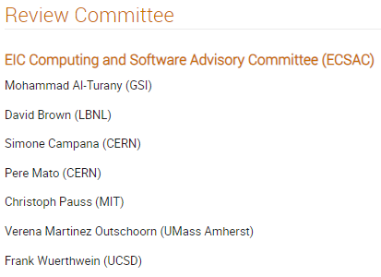
Software and Computing Review
Sep 26 – 27, 2024
Catholic University of America
A very successful and productive review!

Slide 6
Jan 2025 Collaboration Meeting
University of Rome Tor Vergata & INFN
January 20-24th, 2025
Via Frascati (Roman Hills)
https://agenda.infn.it/event/43344/
Registration is available now!
US National Lab folks – register early!

Slide 7
Proposed Workfests @ Jan 2025 Collaboration Meeting
SVT
Organized by Laura Gonella, Ernst Sichtermann, Georg Viehhauser
ePIC Data: From Readout to Analysis
Organized by Marco Battaglieri, Fernando Barbosa, Markus Diefenthaler, Jin Huang, Jeff Landgraf, Torre Wenaus
Integration
Organized by Prakhar Garg
AI/ML Workflows Tutorial
Organized by S&C
Tracking Projections/Resolution @ hpDIRC
Organized by Matt Posik
AI-Assisted Detector Design Optimization
Organized by Cristiano Fanelli, Karthik Suresh, Wen Guan
MPGD’s
Organized by Kondo Gnanvo, Annalisa D’Angelo, Matt Posik, Francesco Bossu
Exclusive, Diffraction and Tagging WG
Organized by Raphael Dupre, Kong Tu
TOF
Organized by Zhangbu Xu and Satoshi Yano
TBD - PID CC WG
Look for the final schedule on the collaboration meeting Indico early next week.

Slide 8
Looking Forward…
The Jan 2024 meeting at ANL established the goals and priorities for the collaboration for the coming year.
At the Summer 2024 meeting at Lehigh we took stock of where we were on the roadmap, made adjustments, and began the early science discussions.
The meeting in Frascati in Jan 2025 will come immediately after the EIC Project CD-3B review. We will again discuss the goals and priorities for the collaboration in the coming year.

Slide 9
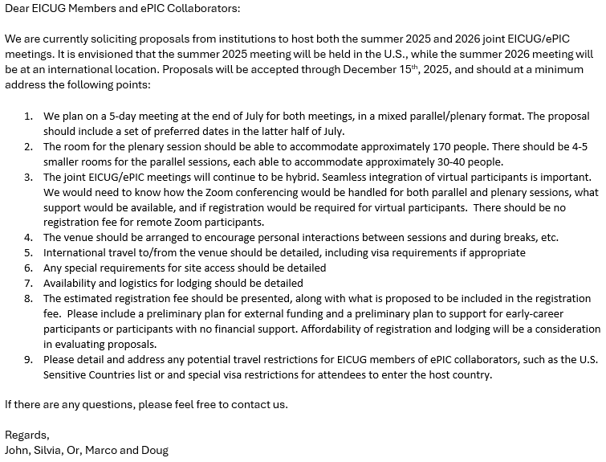
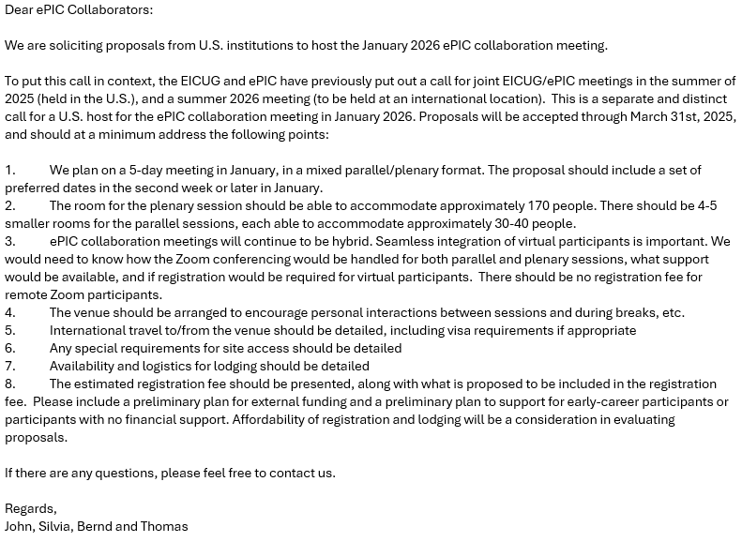
Future Collaboration Meetings
Sent to ePIC Collaboration and EICUG Users Sept 27, 2024
After consultation with the coordinators and EICUG SC, we agreed on:
Jan 2025 (ePIC) – Frascati
Summer 2025 (EICUG/ePIC) – U.S.
Jan 2026 (ePIC) – U.S.
Summer 2026 (EICUG/ePIC) – Intl.
A joint call has been issued for the Summer 2025/26 joint meetings
A call for the Jan 2026 ePIC meeting has also been sent out.
Sent to ePIC Collaboration Oct 10, 2024
Note the “double”

Slide 10
EIC RRB Meeting
Fourth meeting of the EIC RRB:
RRB made up of international funding agency representatives
Coordinating body for contributions to the experimental program
Agenda includes:
Reports from the EIC Project and Collaboration, report from DOE
Presentations and discussions on Common Funds, International Computing Model, Global Engagement Strategy
As always, will report back to the Collaboration in upcoming General Meeting

Slide 11
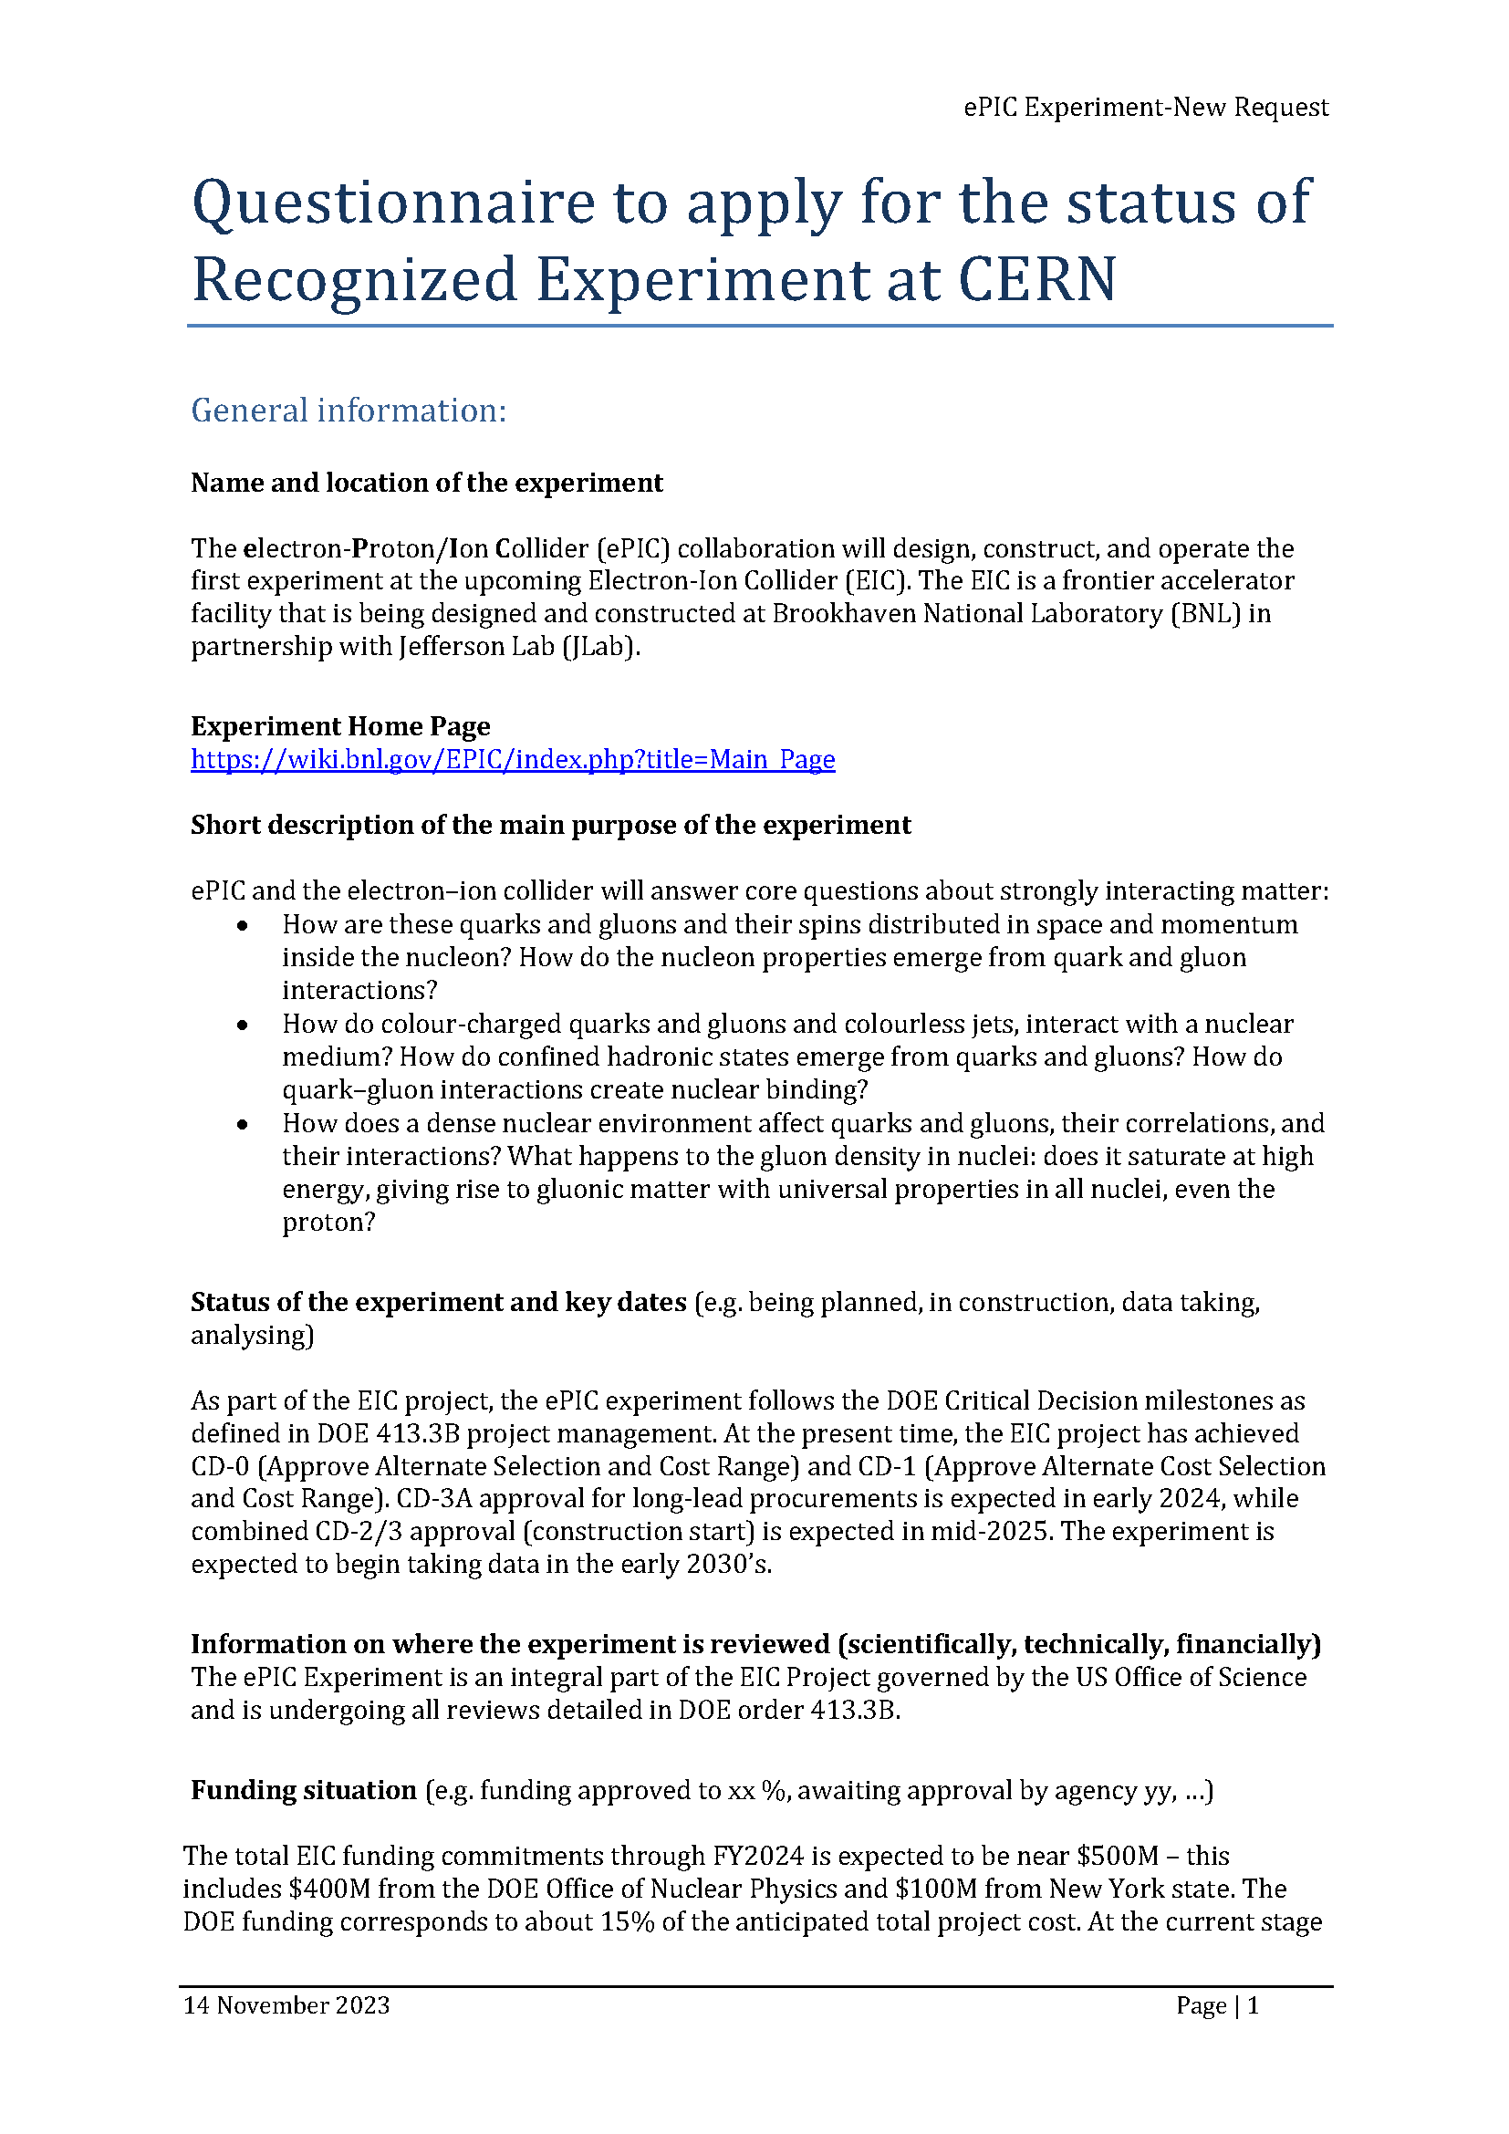
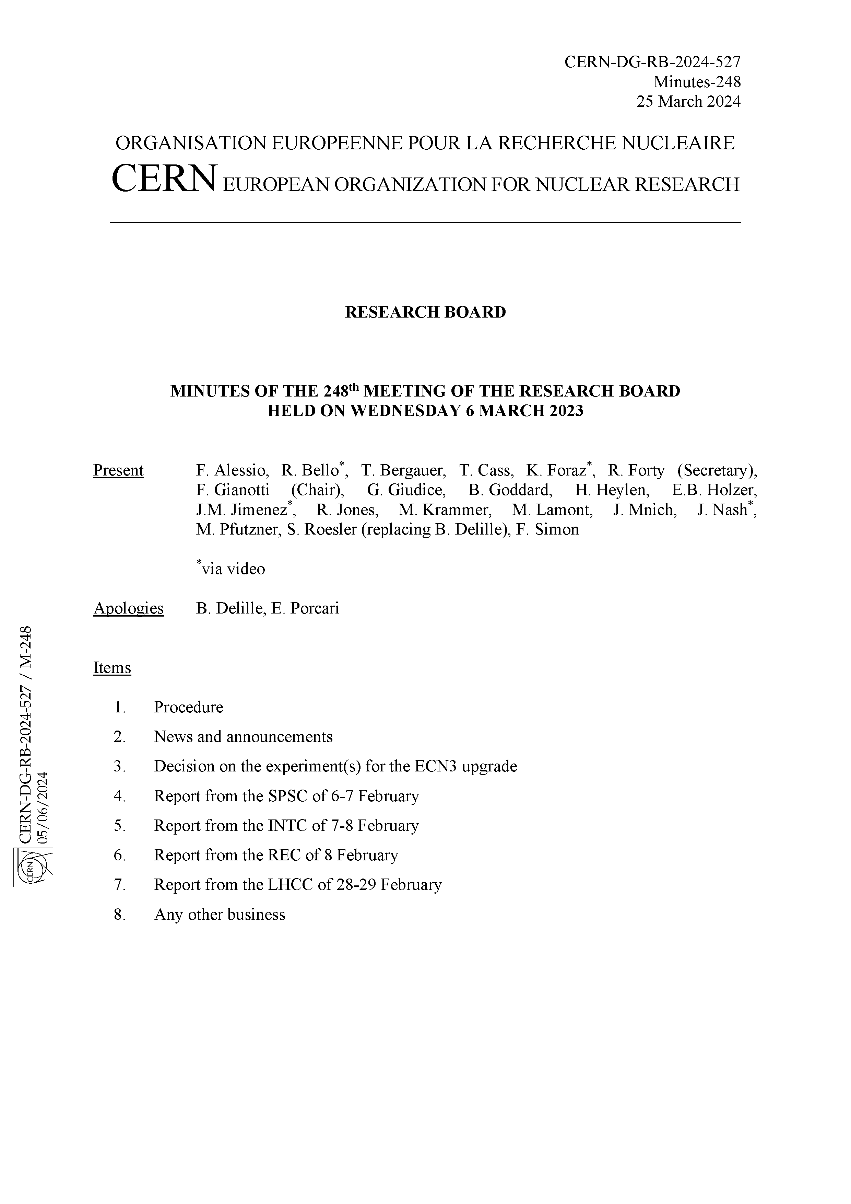
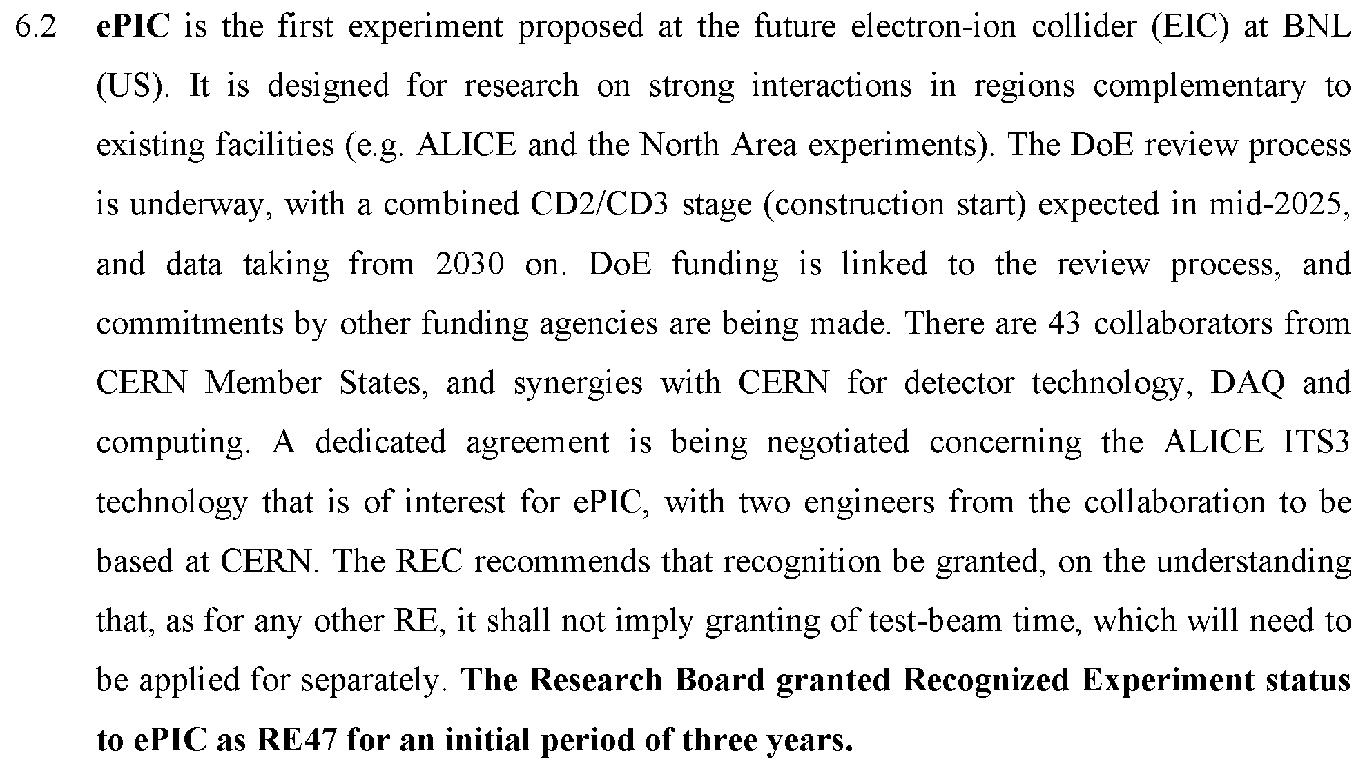
CERN Recognized Experiment
The CERN Recognized Experiment MOU is in the signature process.
Once this agreement is in place, ePIC collaborators will be able to:
Establish team accounts
Register as CERN users
Apply for test beam time as ePIC
SIGNED

Slide 12
Summary
The collaboration has been very successful since the Lehigh collaboration meeting!
EIC RRB Meeting Nov. 12-13th @ BNL
Next General Meeting – Thursday, Nov. 14th, 7:30PM ET
Collaboration Meeting in Frascati – January 20-24th, 2025
Workfests and Parallel Session agenda to be finalized soon

Slide 14
ePIC Resources
Public Website - https://www.bnl.gov/eic/epic.php
Mailing Lists – https://lists.bnl.gov/mailman/listinfo
Indico Agenda - https://indico.bnl.gov/category/402/
ePIC Software and Computing: https://indico.bnl.gov/category/435/
Wiki - https://wiki.bnl.gov/EPIC
ePIC Software Training:
Landing Page: https://eic.github.io/documentation/landingpage.html
Tutorials: https://eic.github.io/documentation/tutorials.html
Mattermost: https://chat.epic-eic.org
ePIC Zenodo Community: https://zenodo.org/communities/epic

Slide 15
EICUG Membership
The EICUG is a vital organization to promote the interests of the EIC community!
Without the EICUG we would never have gotten far enough to form ePIC!
Please register your institution!
Check with your EICUG IB representative to get registered as a member
https://www.eicug.org/content/join.html

Slide 16
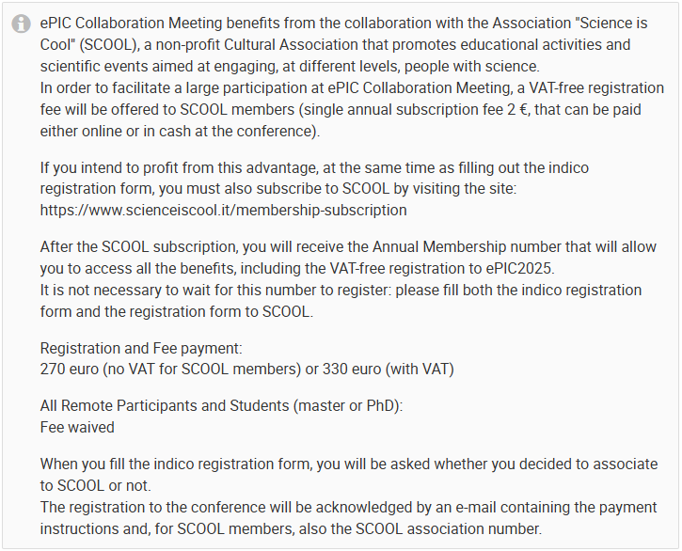
Death and Taxes
Associating your registration with SCOOL membership (2€) waives VAT taxes. (SCOOL is a non-profit entity.)
INFN and the University can’t accept money from individuals, so they need a partner. If they use a private company, they can avoid VAT but then pay 22% in fees…

Slide 17
Draft Workfest Schedule
Tuesday Morning:
SVT - Session 1
ePIC Data: From Readout to Analysis – Session 1
Tuesday Afternoon:
Integration - Session I (With Engineers)
SVT – Session II
ePIC Data: From Readout to Analysis – Session II
AI/ML Workflows Tutorial
Thursday Morning:
Integration - Session II (Subsystem Grounding)
Tracking projections/resolution @ hpDIRC
Friday Morning:
AI-Assisted Detector Design Optimization
MPGD’s

Slide 18
preTDR Version 0.1! – On to Version 1.0!
Executing the plan from the Jan. 2024 Collaboration Meeting:
process design phase
structuring the
effort
draft ePIC pre-TDR
ePIC pre-TDR (CD-2)
writing
(TDR/notes)
Preparing papers for
publication
Mid Jan.24
Mid Mar.24
Early 2025
Version 0.1
Sept. 30, 2024
Version 1
Dec. 1, 2024

