Slide 1
Operations Perspective
Eric Herbert
2024 November 15th

Slide 2
Context
RHIC 4 O'clock DX magnet
Congratulations to RHIC Power Supply group on a successful repair
Valve Box Repair
New lead flow rates

Slide 3
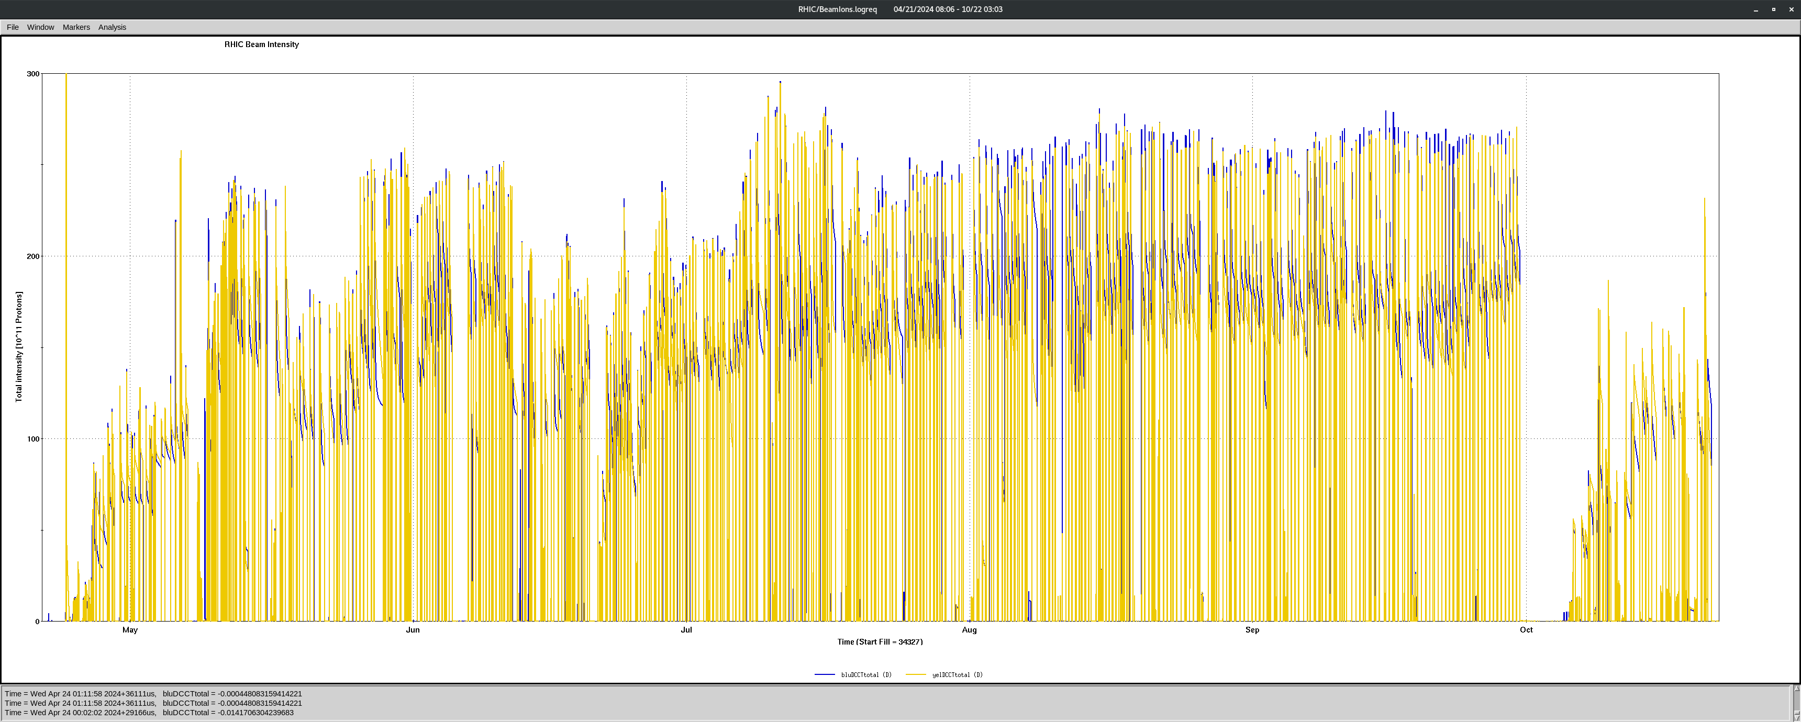
RHIC Operations: April 21st – October 21st
Increasing intensity Consistent running Au

Slide 4
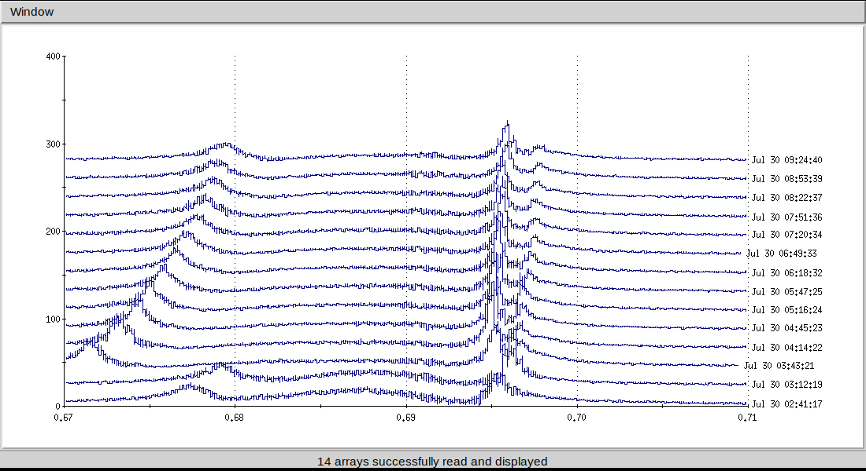
Increasing Intensity April 21st – August 21st (~16 Weeks)
New configuration every week
Commendable dedication by specialist staff
VODH suspended from May 30th – July 12th
Personal oxygen monitor and escape pack required for every access
New lattices and ramps
Emittance growth at year start
Lattice
56 MHz fundamental damper
Adjusting crossing angles and flipping DX leads
Collapsing interaction points independently during zero crossing angle
Watching coherent beam-beam tune shift

Slide 5
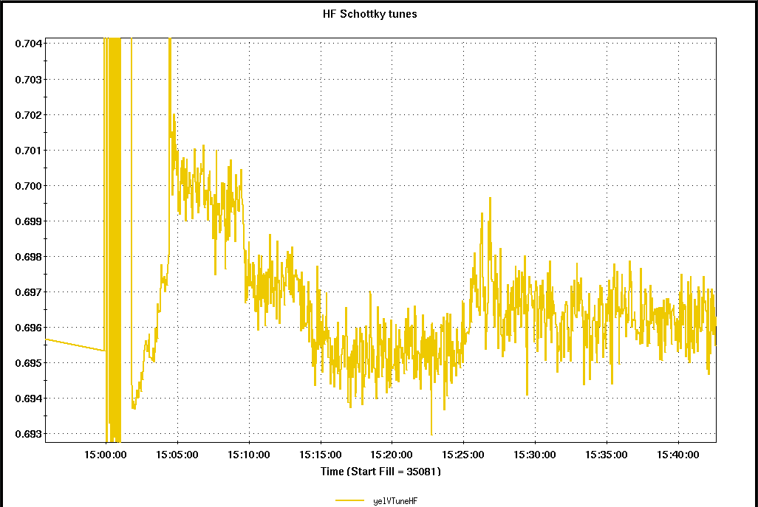
Consistent Running August 21st – September 30th (~6 weeks)
Limited by Forward power limit of Blue 9 MHz at max Bdot
Limited by Losses at rebucketing
Manual tune change every ramp
Disabled loss monitor at STAR
sPHENIX access between many stores

Slide 6
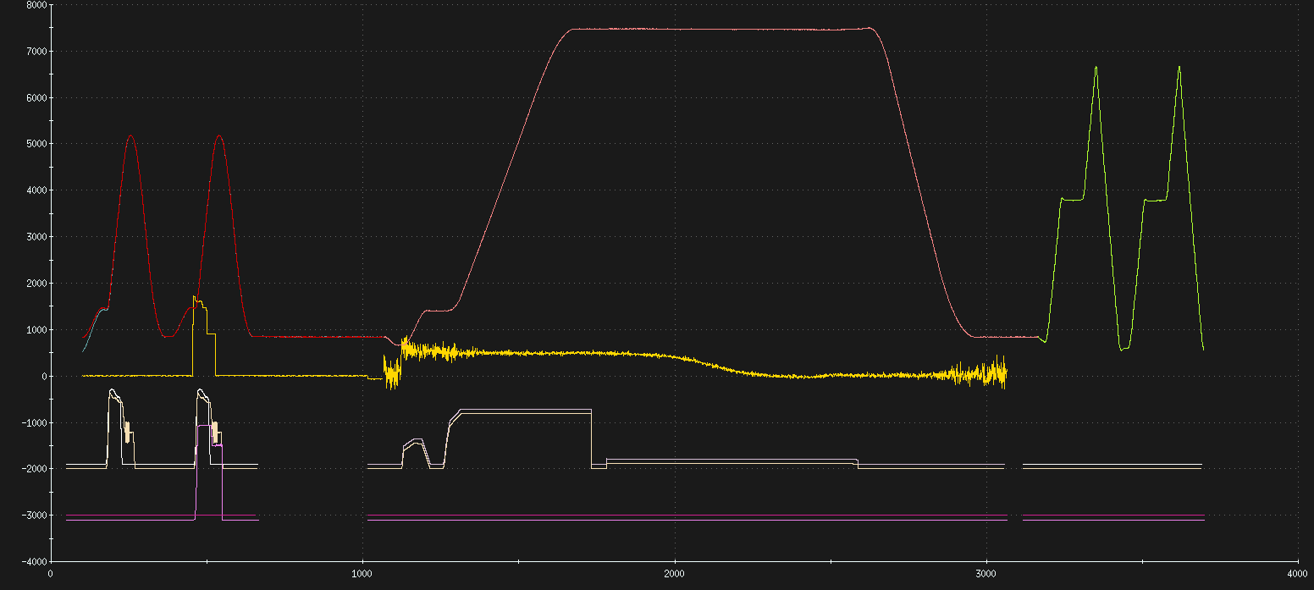
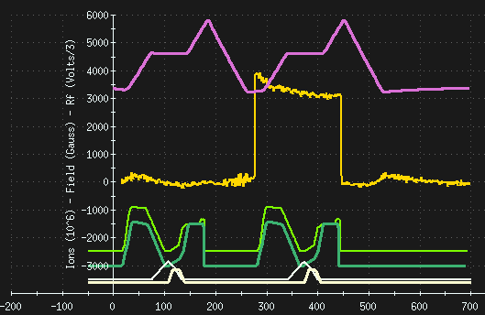
Injector Operation
Nominal
Mismatched
New injector configurations
Commendable dedication by specialist staff
Fast injection loss
Turbulent Bunch Lengthening in RHIC
BtA longitudinal mismatch to lengthen bunches
Injector Development
Vincent Schoefer Skew quadrupoles success
Keith Zeno Simultaneous development of tandem Au while PP and NSRL were running

Slide 7
APEX
New Configurations for many APEX
No rest for specialists
Some APEX prevented due RHIC mains
Some operators still left out of the plan

Slide 8
Gold Running September 30th – October 21st (3 Weeks)
EBIS unable to deliver
Pulsed power trouble to start
Yellow abort kicker ps
AGS G09-blw-ps
H11-blw-ps used for both G09-blw and H11-blw
Impressive AGS extraction by Vincent in this setup
Late nights for operations specialists
Kevin and Feddy prepare 56 MHz operations
MVTX studies

Slide 9
Summer Operations
Improved air conditioning (A/C)
Less building temperature alarms
Less reliant on simple fans
Improved response by A/C technicians
A/C technicians were well supplied
Prior years they were lacking parts

Slide 10
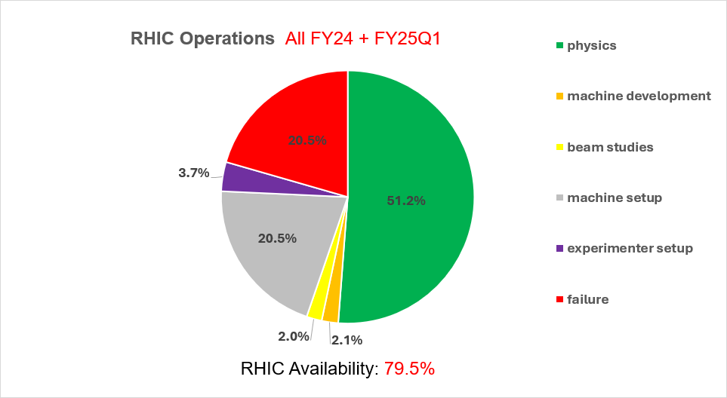

Slide 12
Memorable Failures
Subtitle

Slide 13
Cryogenic systems
Regular lead flow controller faults
Correlated to new lead flow rates?
AGS cold snake needed regular He refills
Stopped polarization tuning

Slide 14
BtA Vacuum and Instrumentation
Lost many BtA gauges
Vacuum permit needed many configuration changes
Lost BtA pneumatic air
Poorly documented BtA flag left in beamline after pneumatic repair

Slide 15
Work Planning
Highly reliant on core work control coordinators
Disconnect switches required work plans
Two work control coordinators and ECP required for work >50V
Reliant on Paul Sampson for Lockout of booster/AGS
Linac RF was extremely limited on core work control coordinators

Slide 16
Additional Gripes
Struggling operating system
Web browser may not open
“numlock” command needed to have full functional applications
Terminal crashes
Hard drives running low on space
Computer slows beyond two workspaces
Schottky not setup at start

Slide 17
The End
Special Thank You - Controls group for their availability and overall help!

Slide 18
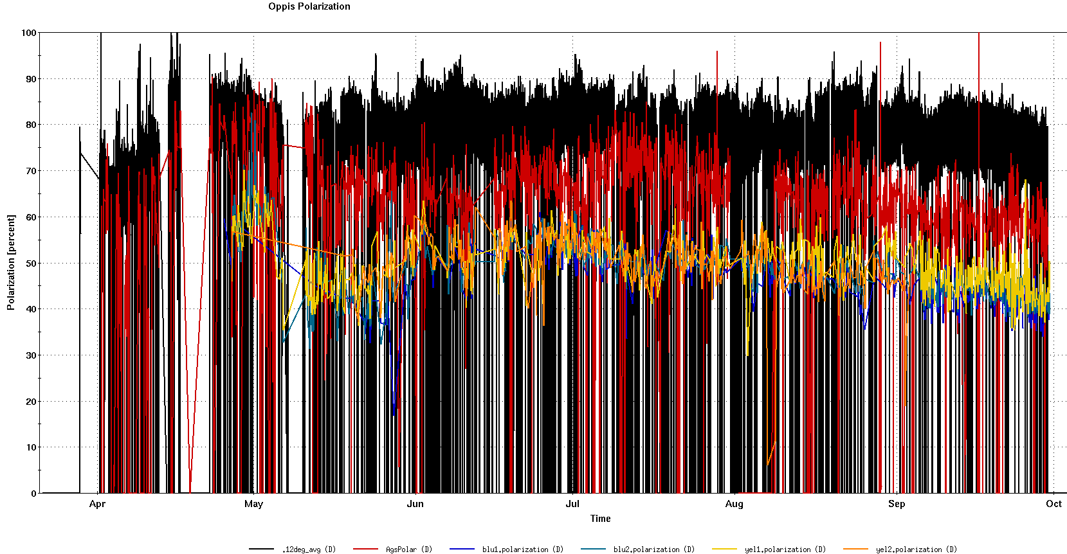
Template
Template
Bullet1
Bullet2

Slide 19
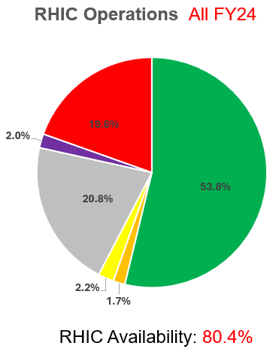
Comparison to Run22 Polarized Protons

Slide 20
Comparison to Run22 Polarized Protons

Slide 21
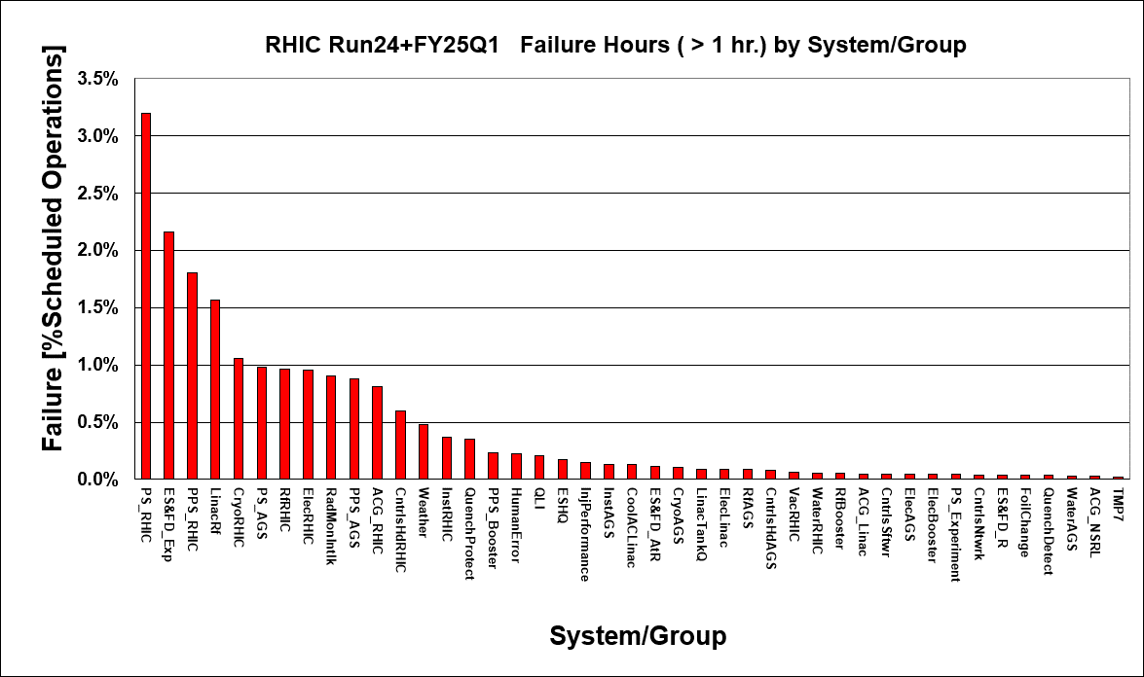

Slide 22
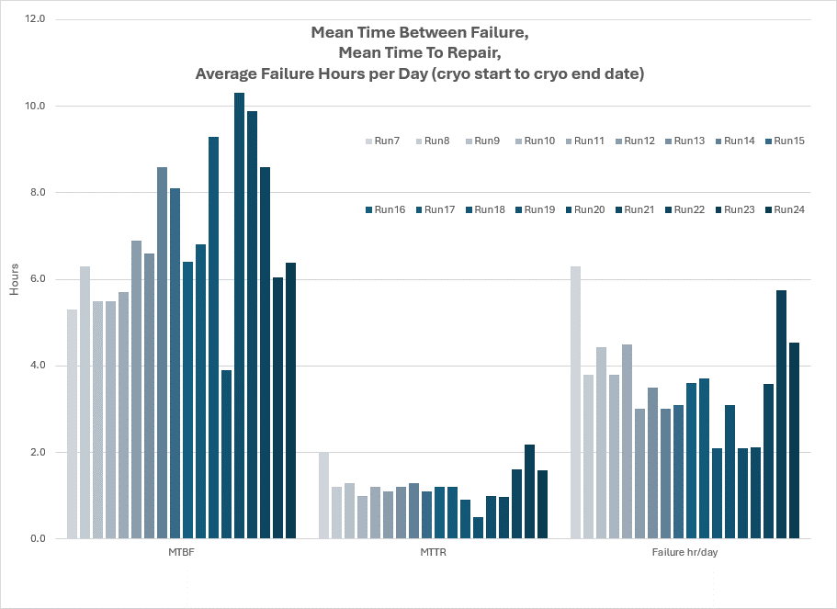
Historical Mean Failure Timing

Slide 23
RHIC Development
New configuration every week
Commendable dedication by specialist staff
New lattices and ramps
Guillaume and Brendan
Emittance blowup from lattice at year start
Rotator ramp implemented
Collapsing interaction points independently
Watching coherent beam-beam tune shift
Adjusting crossing angles and flipping DX leads
Losses at rebucketing
Worked around with manual tune change for every ramp during consistent running
sPHENIX access between most stores

Slide 24
Under Served Systems
OPPIS
RHIC mains
Uncertainty for 100GeV Au ramp
BtA vacuum
Most vacuum gauges lost
Failed components suspended by air

Slide 25
Positives of Run24
VHS skew quadrupoless successfully applied

Slide 26
Pulsed Power
Many supplies failed at once
Bullet Tier 2 mosfet?
Vincent achieved AGS extraction with G09 very well below nominal

Slide 27
Focus for Shutdown
Pulsed Power
Reliability, Repairability, Replaceability
Procedure Based Work not work planned work
BtA Vacuum

Slide 28
Template
Template
Bullet1
Bullet2

Slide 29
Template
Template
Bullet 1

Slide 30
Section Break
Subtitle

