Slide 1
APEX Summary and Plans
Yun Luo
2024 RHIC Retreat
Snyder Seminar Auditorium (Bldg. 911)
Nov 15, 2024

Slide 2
Content
View from APEX Coordinator
Statistics and Highlights
Outlook for Run’25
Summary

Slide 3
View from APEX Coordinator
Run’24 is one of the best years for APEX coordination:
- Early APEX proposal collection
- Successful 2024 March APEX workshop
- Clear priorities of APEX proposals
- Draft APEX schedules planned ahead
- Closer communications between all parts
- Experiment plans and results posted promptly
…

Slide 4
APEX Planning Before Run 24
Collection of APEX proposal started right after run 23, until the start of 2024 APEX workshop in March. Several rounds of email reminders sent out.
2024 APEX workshop is a great success: a large participation, a lot of discussions about APEX planning, execution, coordination, priorities, etc.
Grading of new APEX from the APEX Steering Committee came out before APEX workshop and priority coincided with Ferdinand’s recommendation.
We (thanks to Haixin) planned draft schedules for each APEX sessions and the necessary ramp file requirements.

Slide 5
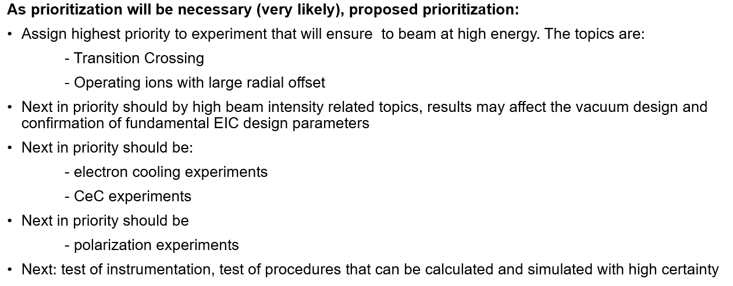
Priority of APEX Proposals
@Ferdinand
These priority guidance should also apply to Run 25.
5

Slide 6
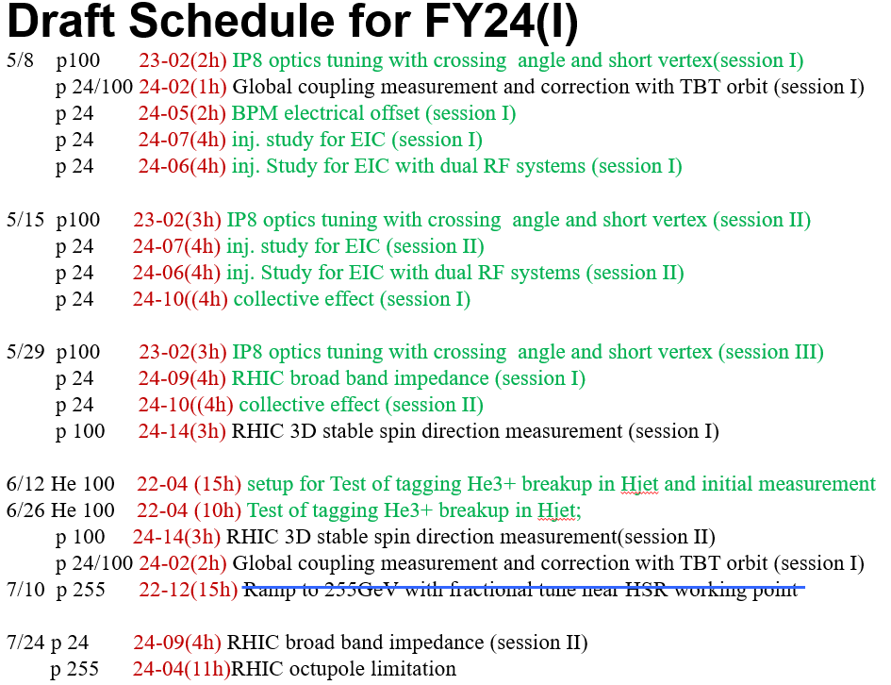
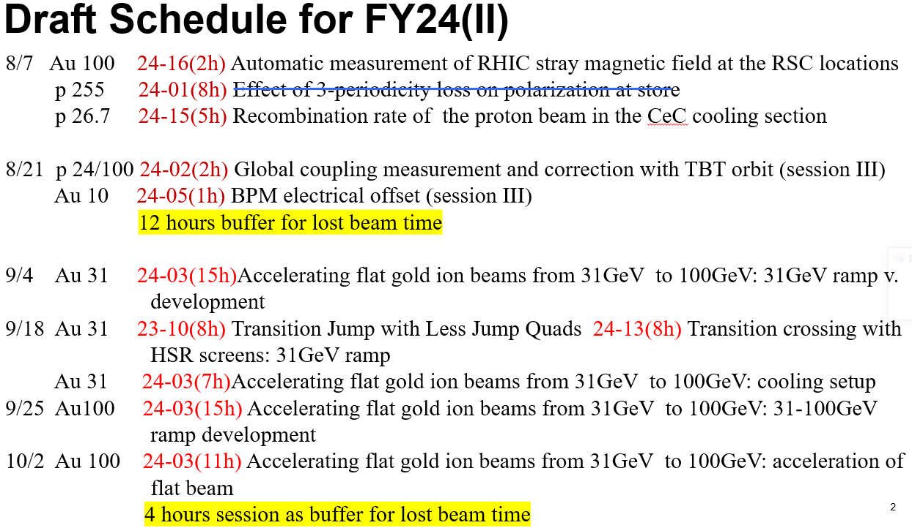
Draft Schedules for Run 24
@Haixin Huang
We will plan ahead draft schedules for Run 25 APEX too.

Slide 7
Efficient Communications
We encouraged people to attend bi-weekly APEX meetings for each APEX session planning and result review.
We also have group emails among the APEX spokespersons, the run coordinator, run scheduling physicist, and operation group, machine specialists for each APEX session planning.
Great communications between scheduling physicist and APEX coordinator. Caitlin, thanks!
Better connections between MCR coordinators and APEX coordinator. Thanks to Travis’ hard pushing for these changes.
Experiment plans and presentations posted online promptly. Caitlin, thank you again!

Slide 8
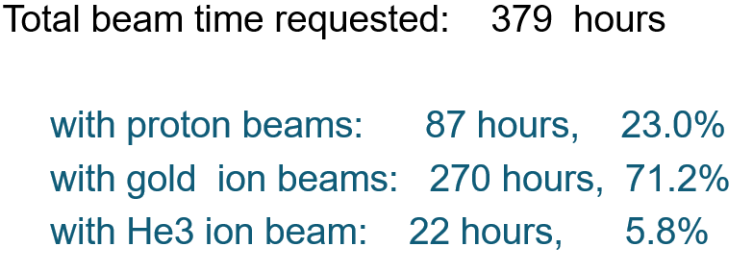
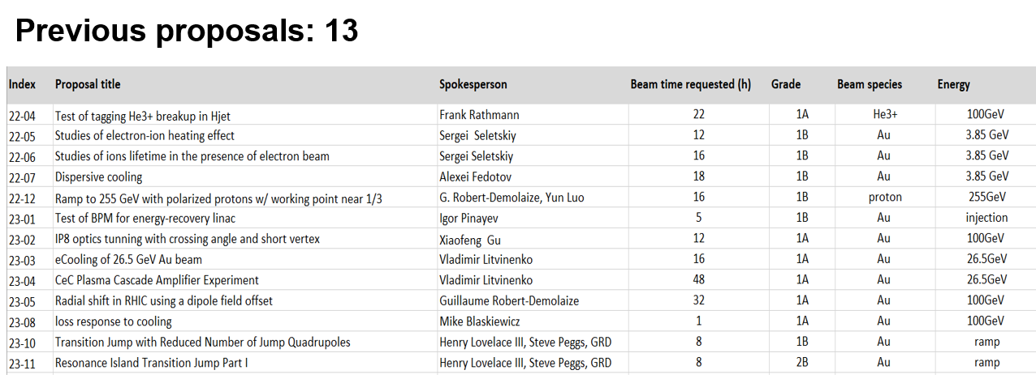
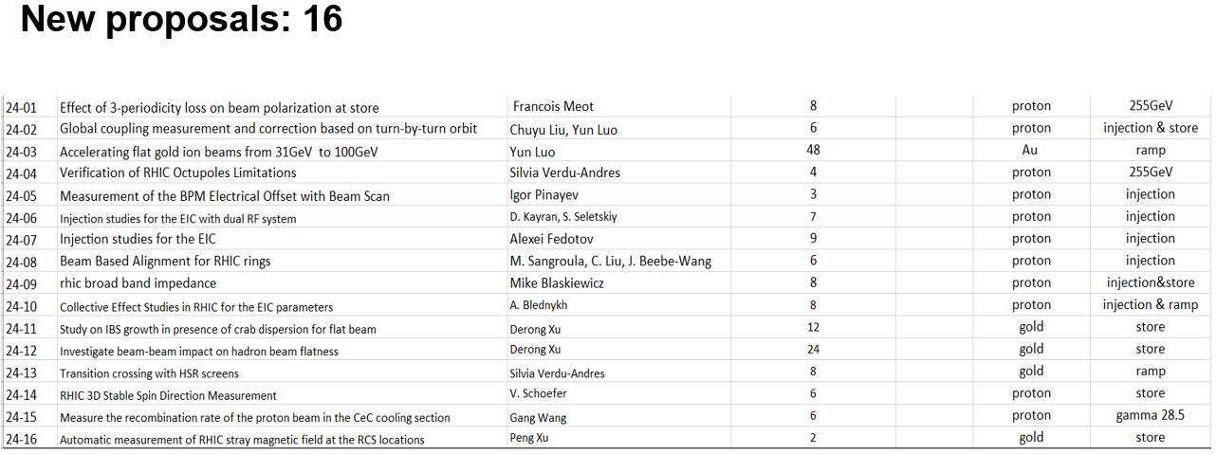
Statistics: Active Proposals

Slide 9
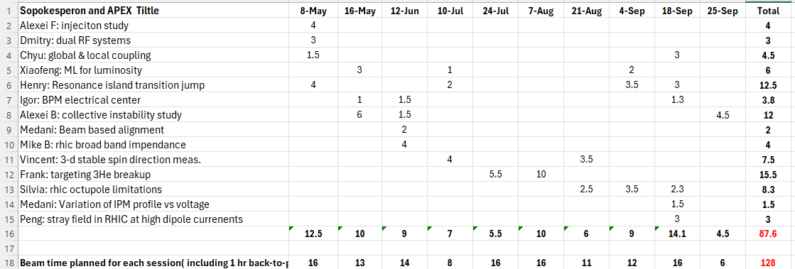
APEX Experiments Done In Run’24
Totally 10 sessions executed, total actual AEPX beam time is 87.6 hours
( total planned beam time is 128 hours).

Slide 10
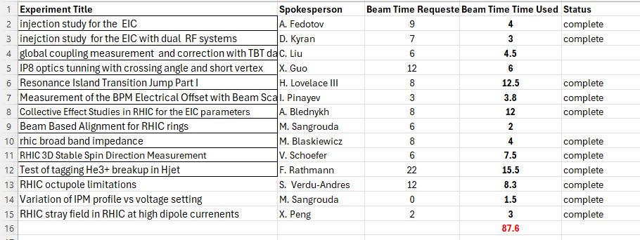
Beam Time Requested vs Actual Beam Time Used
Note: I marked some experiments as ‘complete’, please let me know if it is not true.

Slide 11
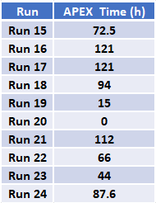
APEX Beam Time By Year Since Run 15

Slide 12
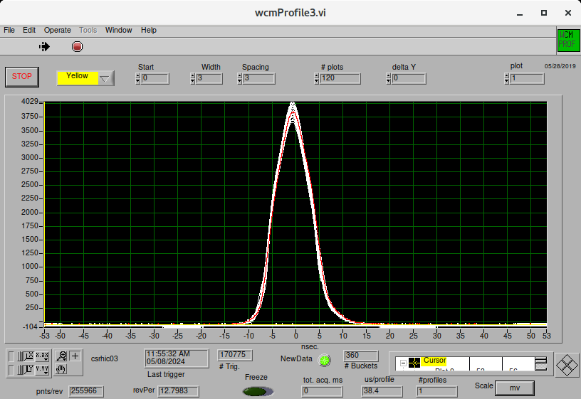
Highlights: Injection Studies for the EIC
@Alexei Fedotov
The goal of this experiment is to:
1. Explore and establish proper beam parameters of high intensity protons at injection with 28MHz RF system
Experiment:
Explored injection into 28MHz RF with Quad Pumping in AGS, measured beam parameters:
Case 1: S₉₅=1.1eVs, Erms,s=0.06, sigma_s=0.7m, sigma_p=1.1e-3
Case 2: S₉₅=1.1eVs, Erms,s=0.06, sigma_s=1.0m, sigma_p=7.4e-4
Case 2 is better for cooling of protons at EIC injection energy - will use it as a baseline. It is also better than Case 1 since it corresponds to smaller peak current of 5.4A for the EIC bunch intensity. Double RF with flattened bunch profile should help to reduce peak current further to 2.7A for the EIC intensity bunches (2.8e11).
( quad pumped to 20nsec full base )

Slide 13
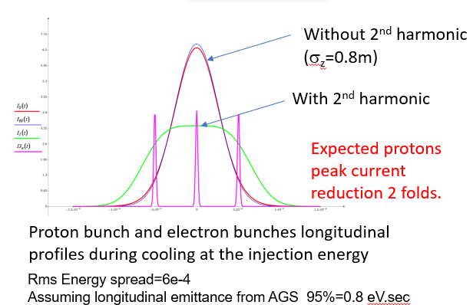
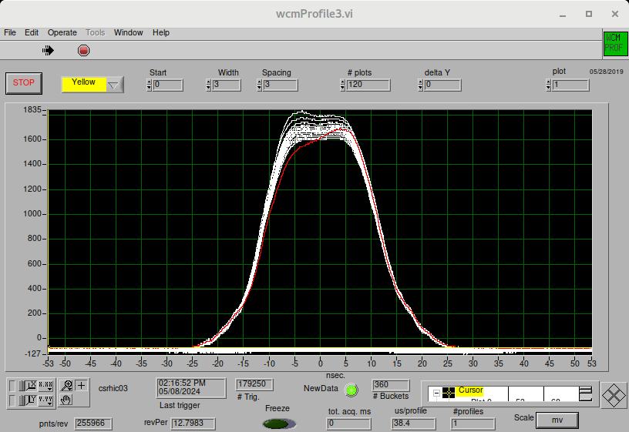
Injection studies for EIC with dual RF systems
@Dmitry Kayran
The closest to EIC configuration: main RF 28MHz and 2nd harmonic 56 SRF cavity for flattening profile.
For experiment, we propose to use 9 MHz system with 28MHz as a 3rd harmonic (similar configuration as it was used during Low Energy Run in 2021)
They demonstrated that highest required intensity proton bunch (2.8x10¹¹) can be injected and can be kept stable in the dual RF system flat longitudinal profile

Slide 14
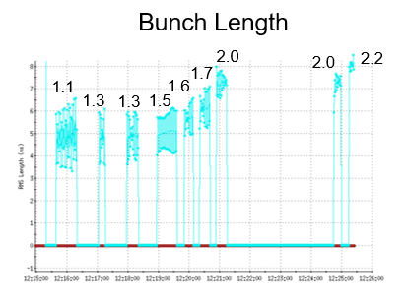
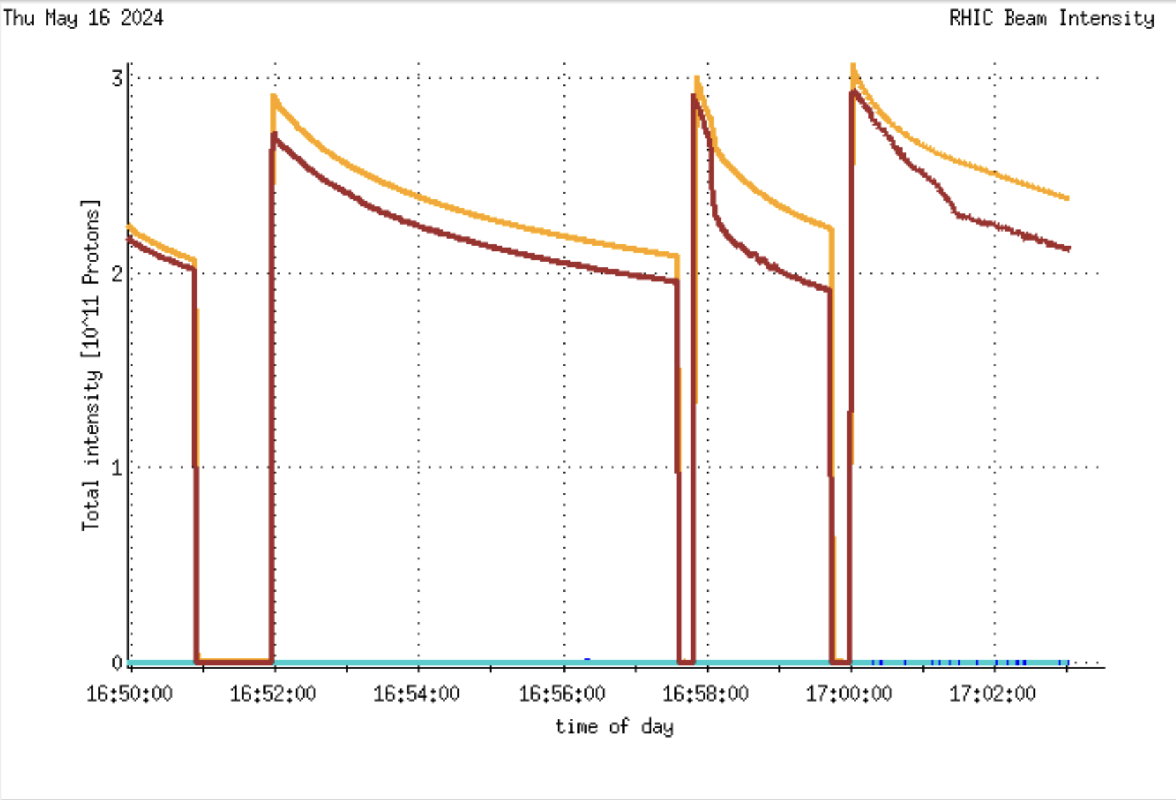
Collective Effect Studies in RHIC for the EIC parameters
@Alexei Blednykh
Experiment goal:
Understanding beam intensity limitation and benchmarking the numerically simulated results for the beam parameters related to the EIC project.
9MHz with gamma-t=23.7
28MHz with gamma-t=23.7
Beam is unstable at ~1.6 mA
The MWI threshold is approximately the same in both the Yellow and Blue Rings, while the geometric + RW impedance differs: Z/n = 1.5 Ω (Blue Ring) vs. Z/n = 5.4 Ω (Yellow Ring).
No instabilities observed by varying RF voltage. RF voltage needs to be plotted.
Beam intensity was limited. Significant losses occurred on collimators. Slightly opening collimators could help to inject ~3e11.

Slide 15
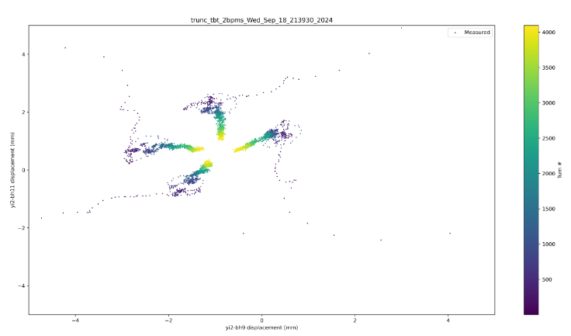
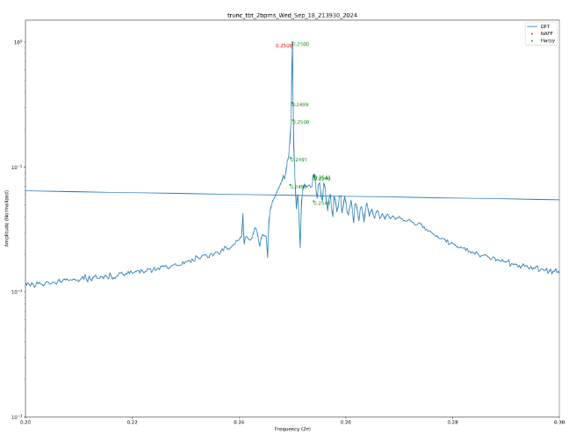
Resonance Island Transition Jump Part I
@Henry Lovelace III
Goal: Establish stable resonance islands at injection and measure island tune, and Twiss parameters.
Experiment Plan: The resonance islands will be generated using octupoles. Different methods to be tested to generate the resonance islands.
TBT BPM readings
FFT

Slide 16
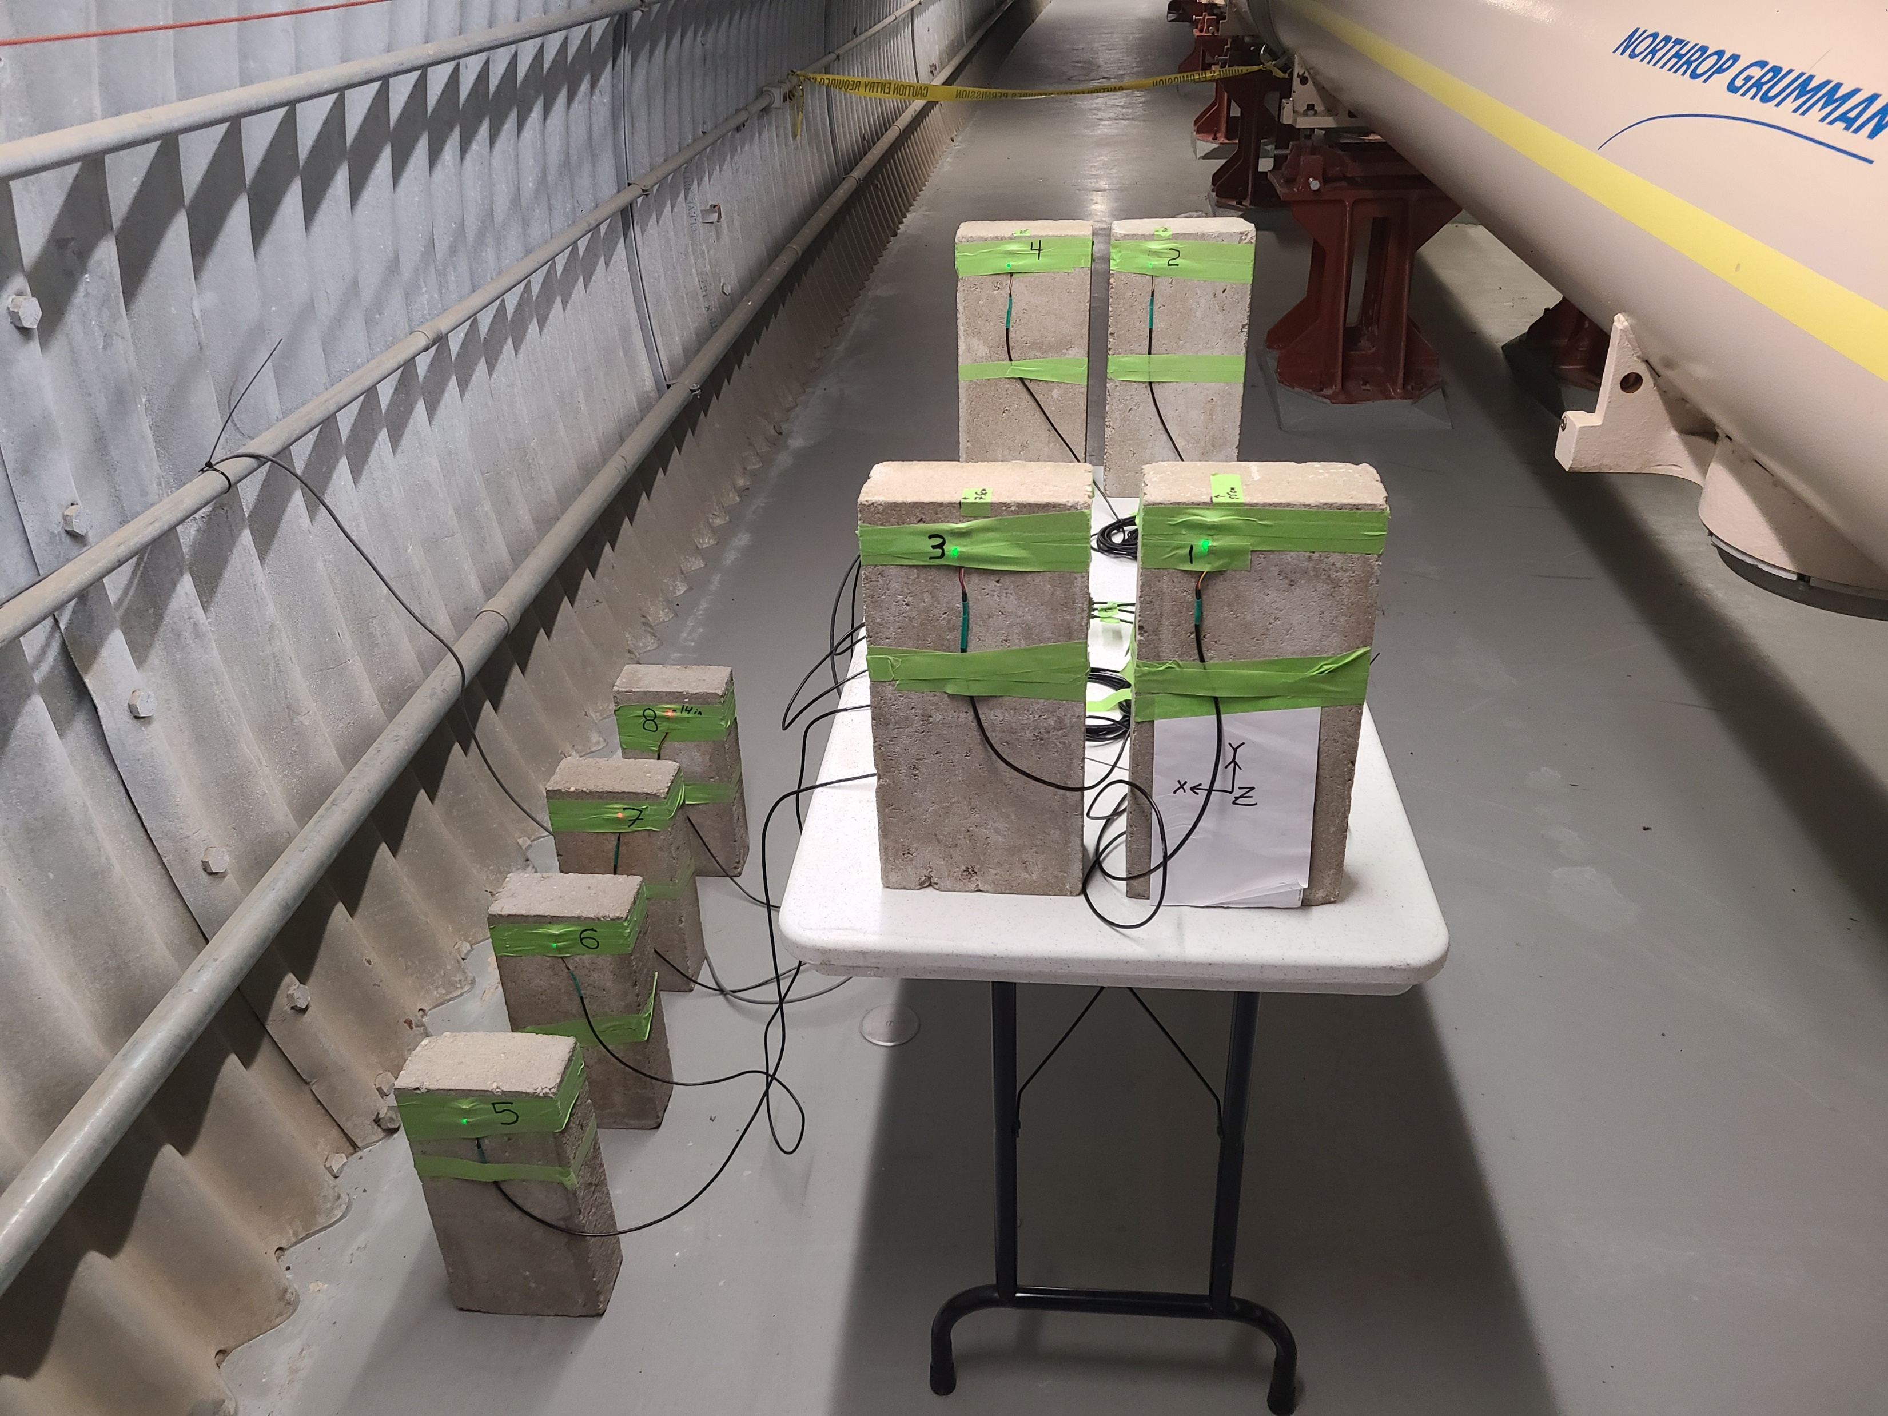
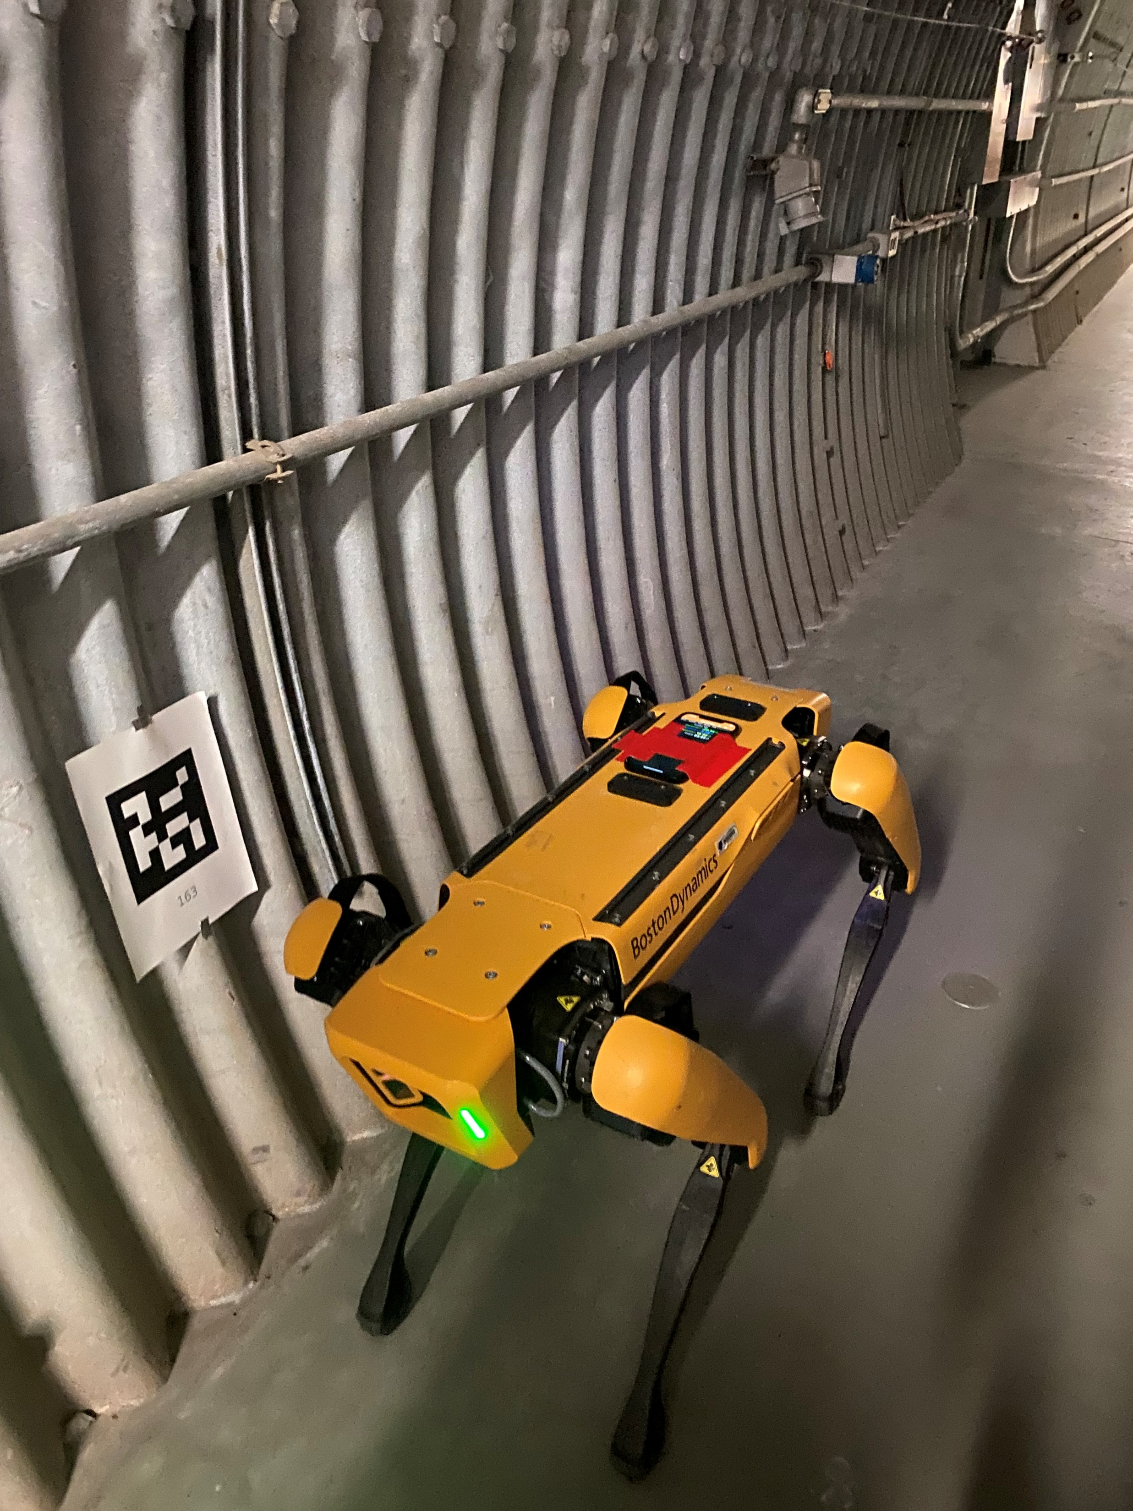
Ambient Field Measurement in RHIC
@Peng Xu
The Rapid Cycling Synchrotron (RCS) “was” designed to accelerate the electrons from 400 MeV to 18 GeV. At the injection low energy (400 MeV), the dipole field is low (57 Gauss), the electron beams are very sensitive to the ambient magnetic field (1-2.5 Gauss could kick beam out of the pipe).
Summary with SPOT in straight section:
The ambient field at the RCS locations during RHIC operation (Magnets on) has been measured at IR10 from DU4Q5 to Q9 using the SPOT. The maximum measured field at full current was 3.5 G (may be due to the sensor close to the cryostat), at the RCS locations, the max field was 1.5 G.
Summary with stationary sensors in arc:
At the RCS locations, the measured field are very low,
even lower than the earth magnetic field (0.5 G).
When it is close to the cryostat, the fields at sensor 1& 2 are a little bit over 1 G.

Slide 17
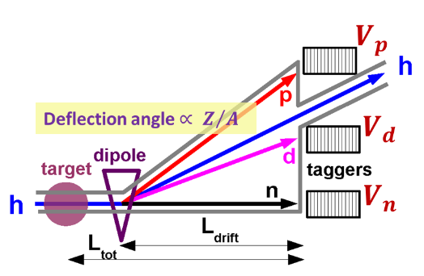
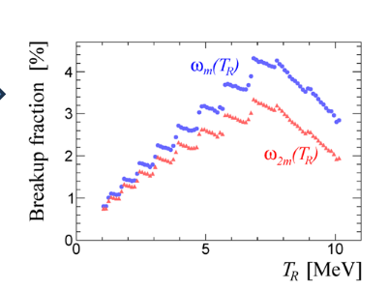
He3 Breakup Tagging
@Andrea Poblaguev
Goal: validate model of recoil beam breakup - using existing proton polarimeter (together with new “tagger” detectors to measure the beam breakup fraction.
Summary:
Preliminary experimental results confirm that the breakup corrections to the elastic rate in He3-proton scattering are small, less than 3%.
• Consequently, these breakup corrections largely cancel out in the He3 beam polarization measurements with HJET.
However, using taggers to veto breakup events at the EIC could be
important for ensuring redundancy and monitoring corresponding
systematic errors

Slide 18
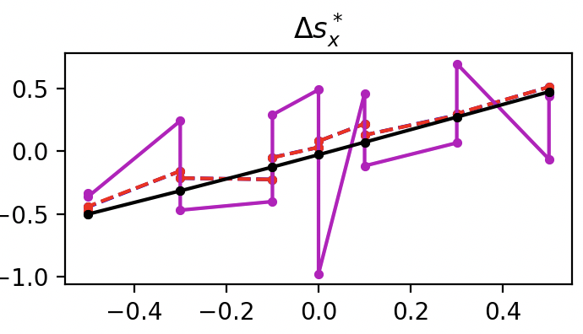
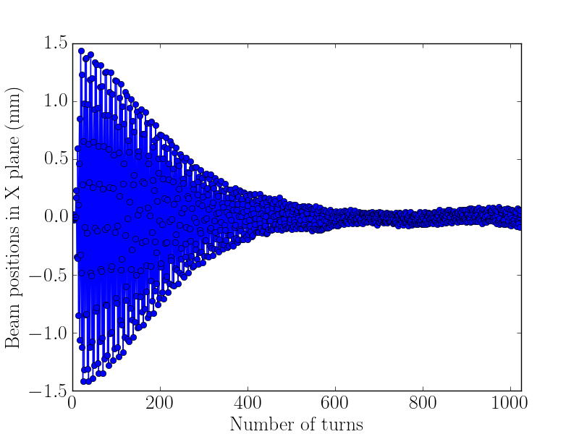
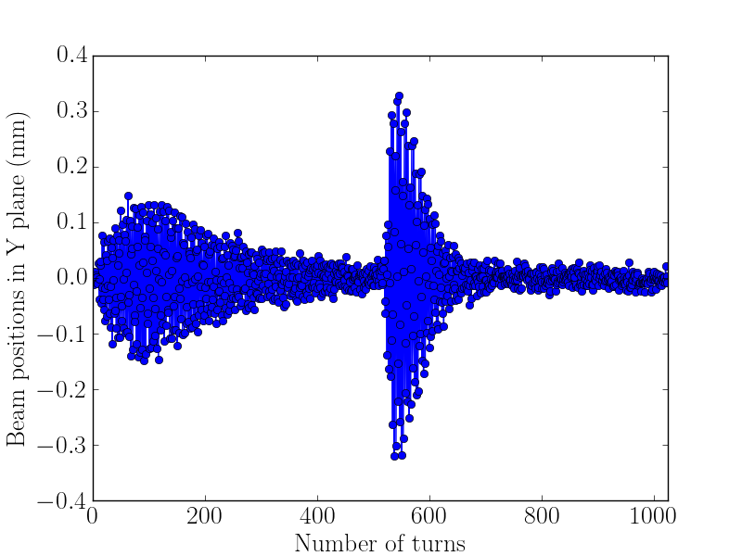
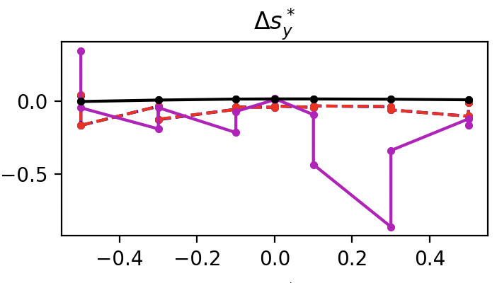
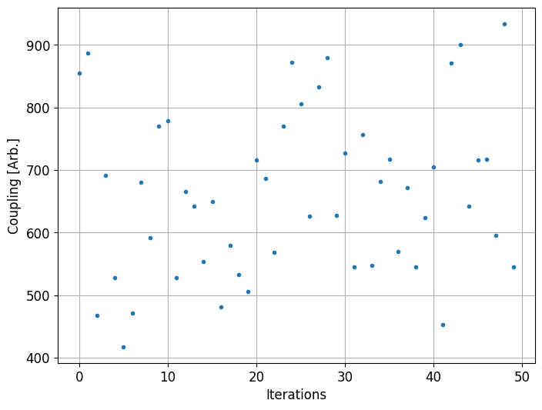
Machine Learning Beam Experiments
IP8 optics tuning with crossing angle and short vertex,
@Xiaofeng Gu, @Will Fung
ML-based Global and Local Coupling Measurement and Correction
@Chuyu Liu, @Xiaofeng Gu
https://github.com/gptune/GPTune
HBPM
VBPM
training
correction
s* measurement vs model

Slide 19
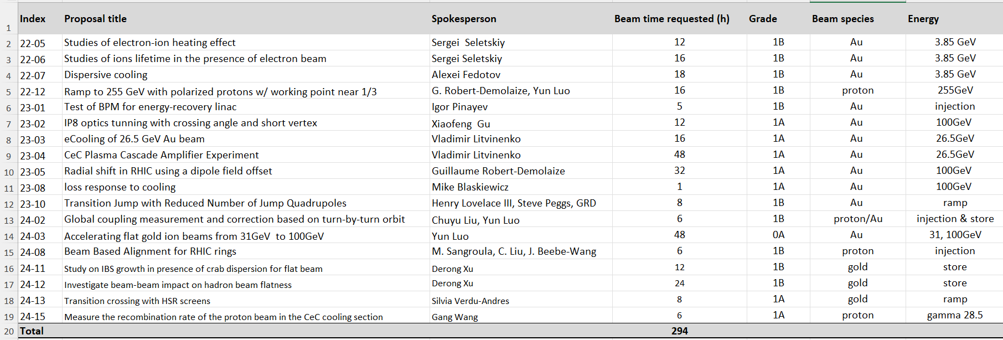
Outlook: Active APEX Proposals
There are 18 proposals active for coming RIHIC’ 25 run, totally 294 hours.

Slide 20
APEX Time Estimate for Run25
As convention, we will have one APEX session every two weeks after physics run is declared. Each APEX session is 16 hours, including 1 hour for back-to-physics, actually 15 hours for experiments each session. Normally APEX sessions take place on Wednesday from 8am-midnight.
Here we assume RHIC start-up 2 weeks before physics is declared.
If we have 18 cryo weeks for Run 25, we will have maximum 8 APEX sessions or 8*16 = 128 hours.
If we have 26 cryo weeks for Run 25, we will have maximum12 APEX sessions or 12*16 = 192 hours.

Slide 21
APEX Time Outside of Available APEX Time in Run25
First we definitely will collect new APEX proposals for run 25, which is not included for this estimate.
We have at least ~294 hours active for run 25, or ~20 APEX sessions ( each session 15 hours beam time).
For 18 weeks of Run 25, we lack 20-8 = 12 sessions or 192 hours (24 shifts, or 8 cryo days).
For 26 weeks of Run 25, we lack 20- 12= 8 sessions or 128 hours ( or 16 shifts, or 5.4 Cryo days )
There is a discussion to have 1-2 weeks of end-of-run APEX.

Slide 22
Summary
APEX in Run 24 was a great success. There were many improvements in planning, experiment execution, and scientific sound results. Thank you!
APEX in Run 25 is critical for the EIC design and its decision making.
We have more beam time request than regular APEX beam time (one APEX session every two weeks). We may have end-of-run APEX sessions which is in discussion.
Most of importance for experimenters: plan early, plan thoroughly, make good use of APEX beam time.
New APEX proposals for Run 25 are open. Please submit at: https://www.c-ad.bnl.gov/APEX/APEX/

