Slide 1
“Injectors” RHIC Retreat 2024
V. Schoefer
11/15/2024

Slide 2
Talk that is
Talks that are not
Polarized protons
Polarization performance
Skew quad resonance correction commissioning
Split/merge user commissioning
Comments about operation in the injectors
No dedicated talks for
Separated discussion of proton/heavy ion performance
OPPIS status/performance
Skew quads (a major new system)
Substantial reliability “challenges”

Slide 3
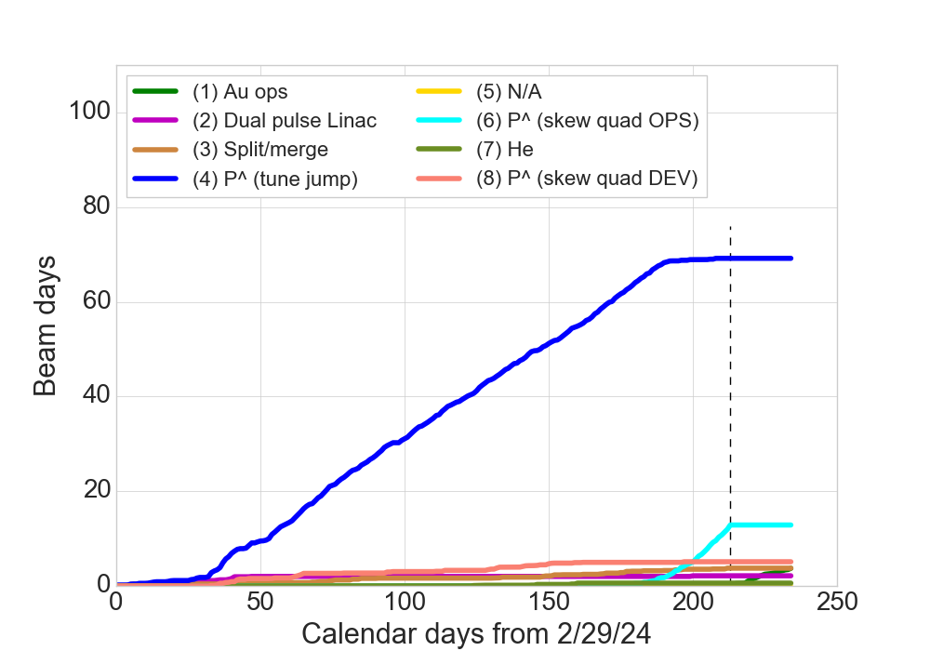
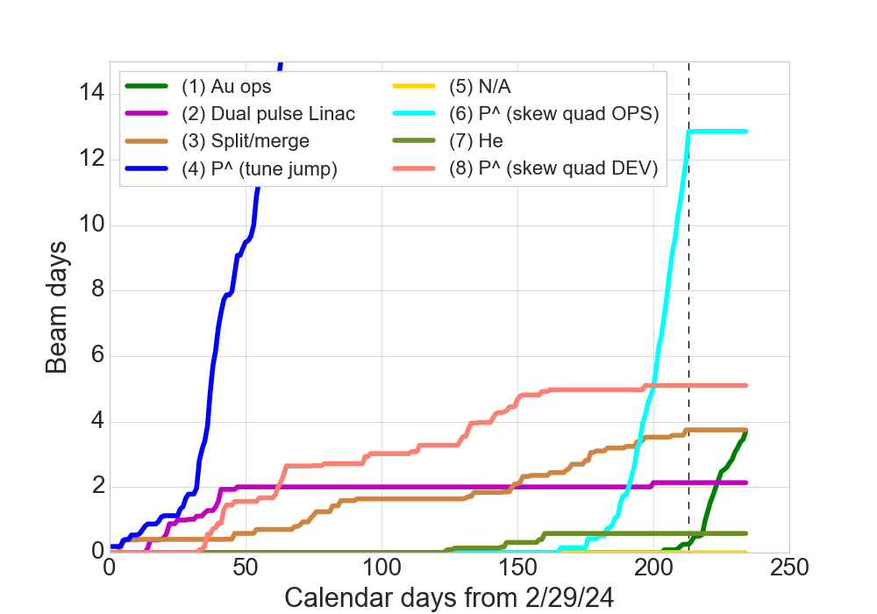
Startup Timeline
Cumulative time with beam at AGS extraction for each user
Nominal plan was for 6 weeks AGS startup time prior to RHIC cooldown (normally 3 weeks for p^)
Extra time planned to allow for additional skew quad commissioning time
Difficulties with OPPIS and cold snake delays polarized operation (and ops with nominal p^ optics) by 3-4 weeks
March: unpolarized beam commissioning.
Split/merge and dual pulse Linac user development
Skew quad installation, power supply hookup and beam-based polarity checks
April: 2 weeks polarized proton setup in AGS (in actuality less than normally planned)
P^ ops (tune jump)
End p-p
P^ ops (skew quad)
P^ ops (skew quad)
“Beam days” = (# of supercycles with beam in AGS) * (supercycle length in days)
P^ dev (skew quads)
Au

Slide 4
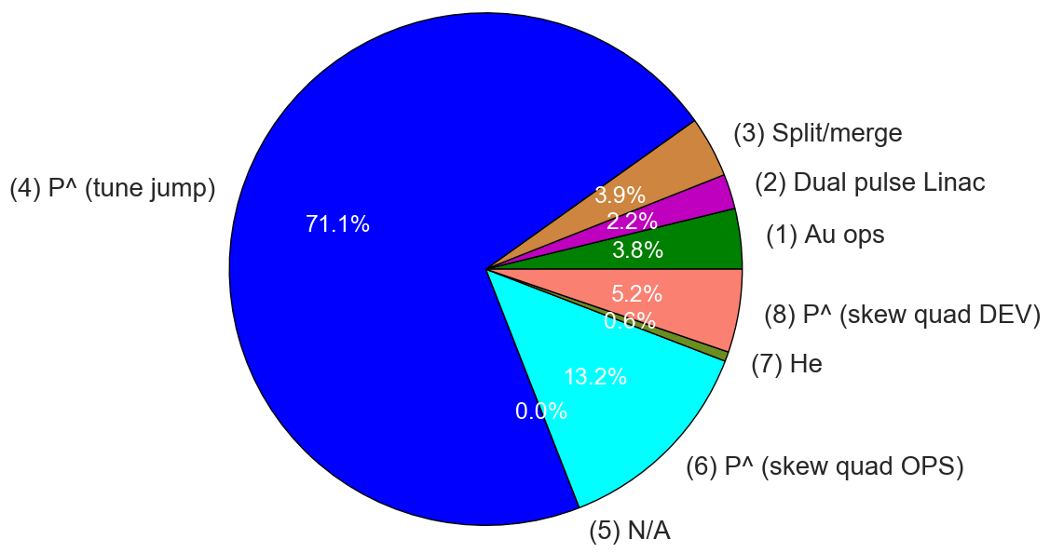
Beam time breakdown
(user number) in parenthesis

Slide 5
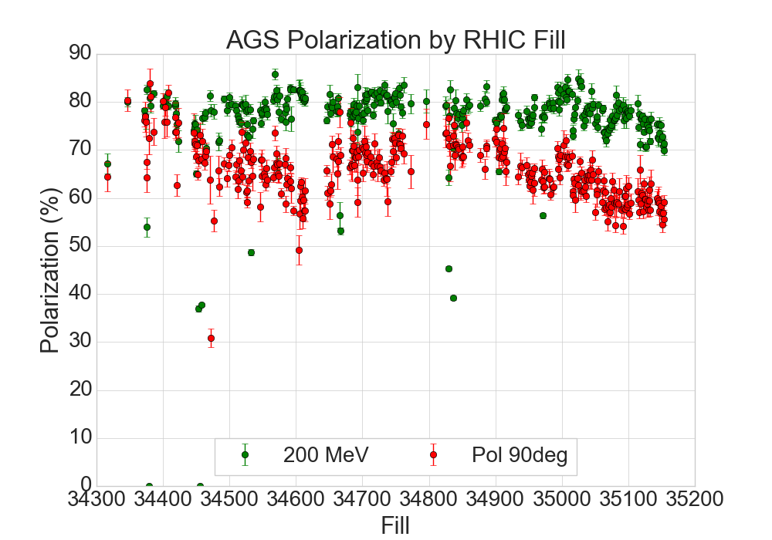
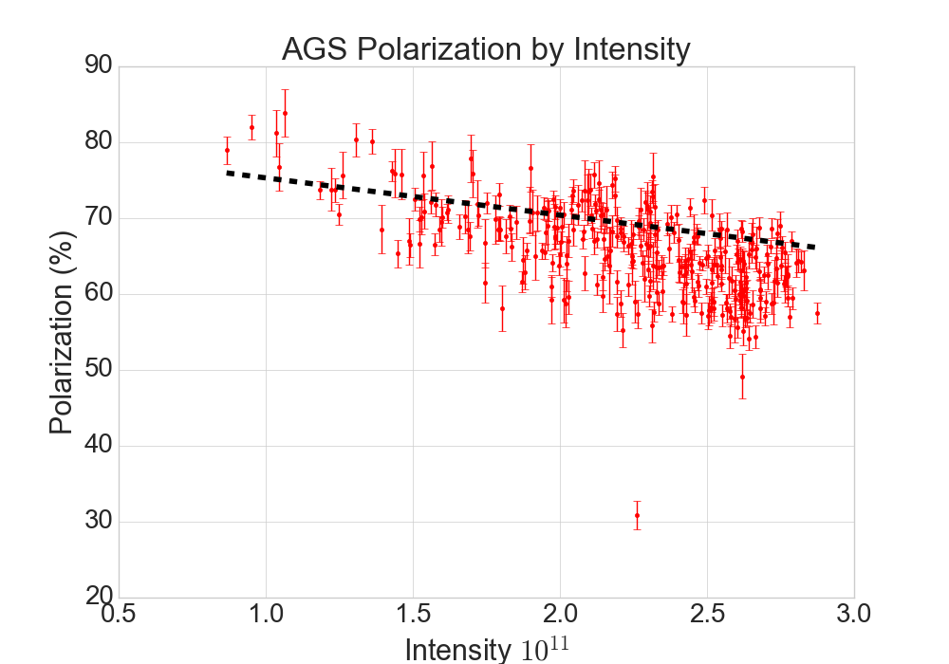
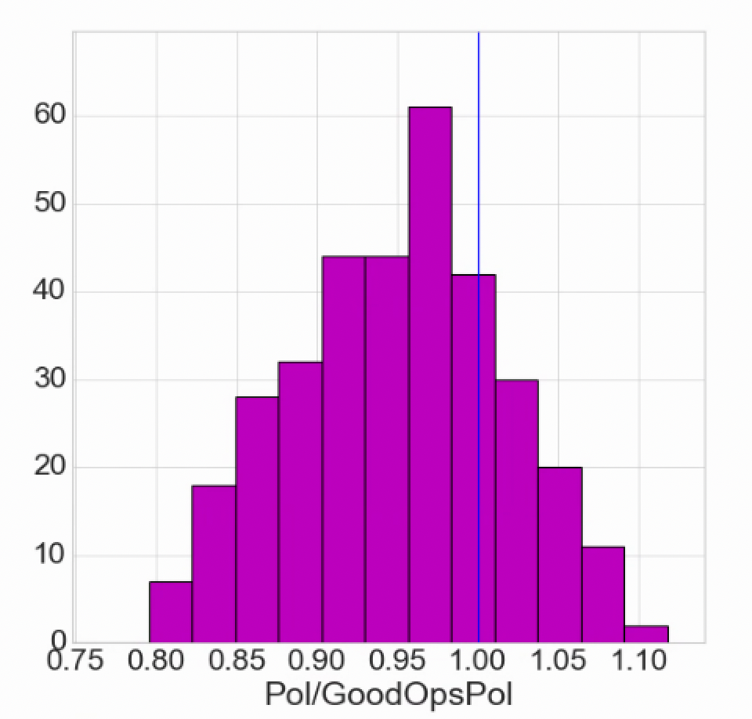
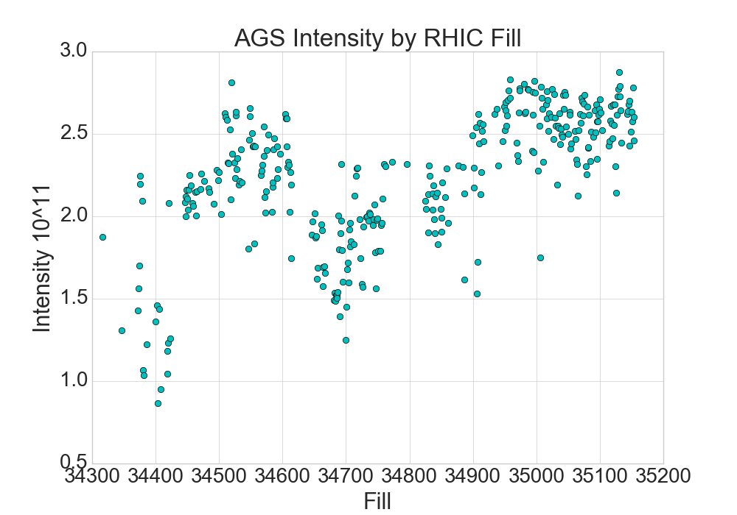
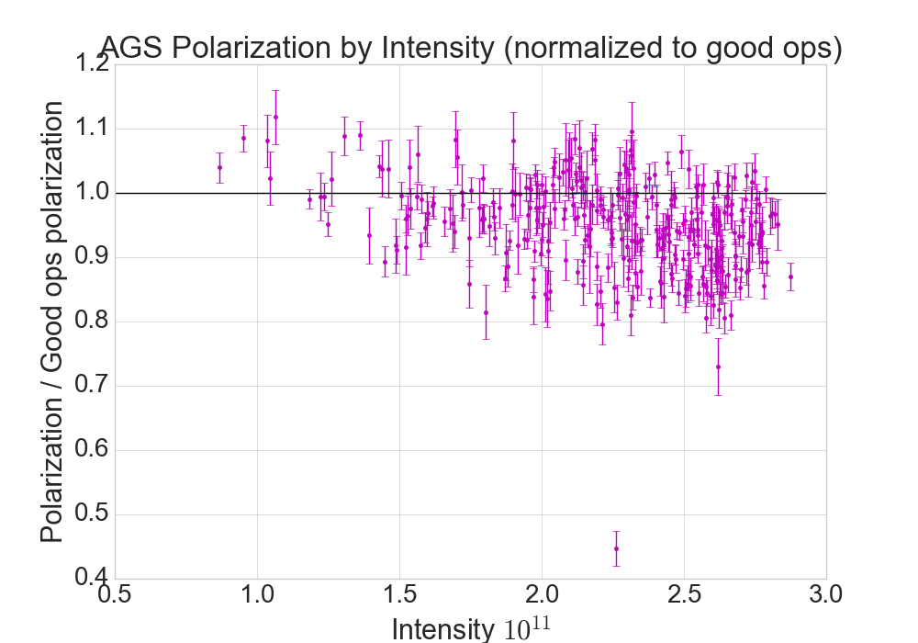
Run 24 Polarization Performance
EIC target region
Dashed line is previously established good operation
Mean polarization performance Run 24: 95% of established optimum, with a sigma of +/-7%

Slide 6
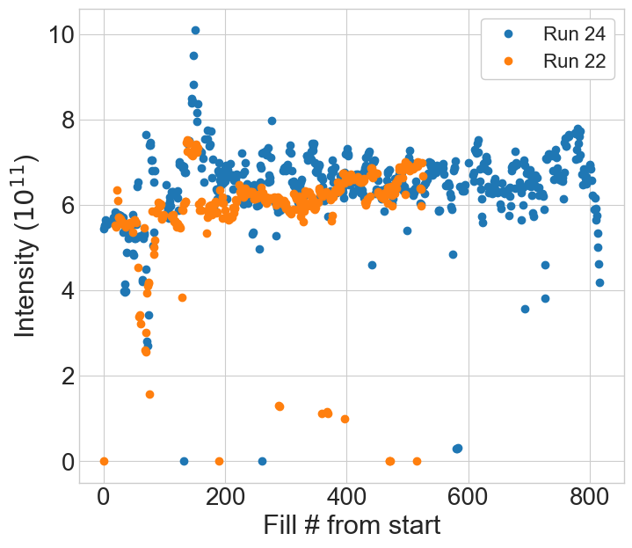
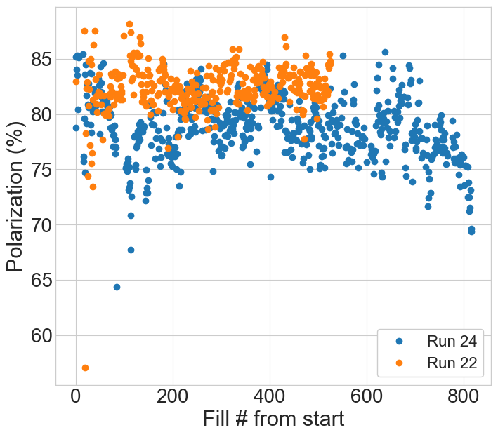
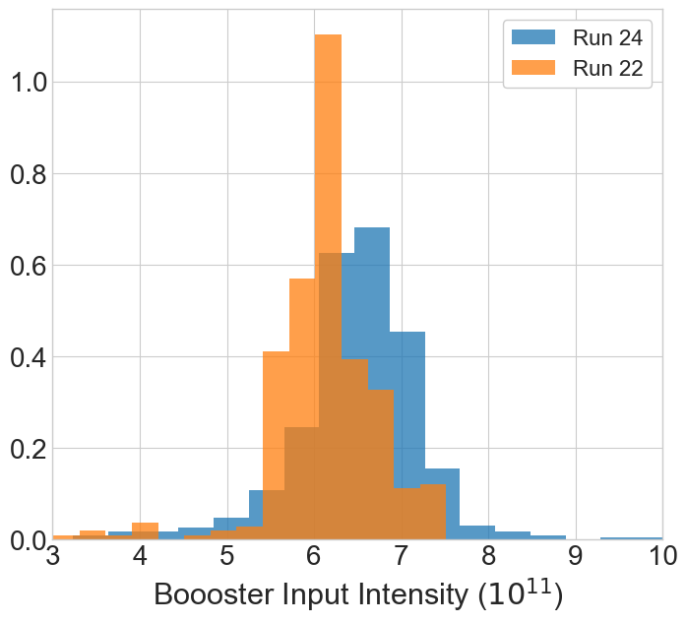
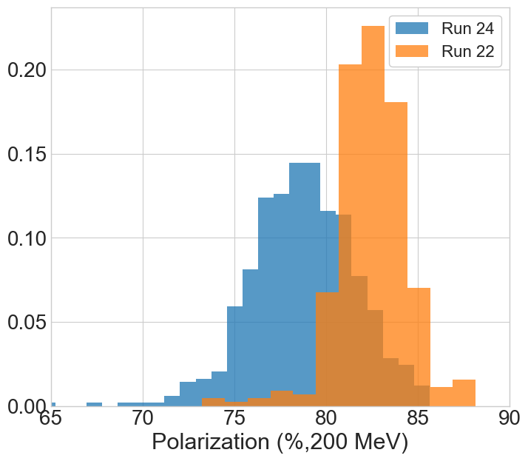
Source performance/stability
Intensity
Polarization
Source intensity comparable to Run 22.
Periodic ~1 wk variation due to Rb fills in Run 24, not in Run 22
Polarization both lower in average (~5% rel) and larger in variation in Run 24, relative to 22
 | Run 22 | Run 24
Pol (mean) | 82.4 | 78.7
Pol (σ) | 2.3 | 2.8

Slide 7
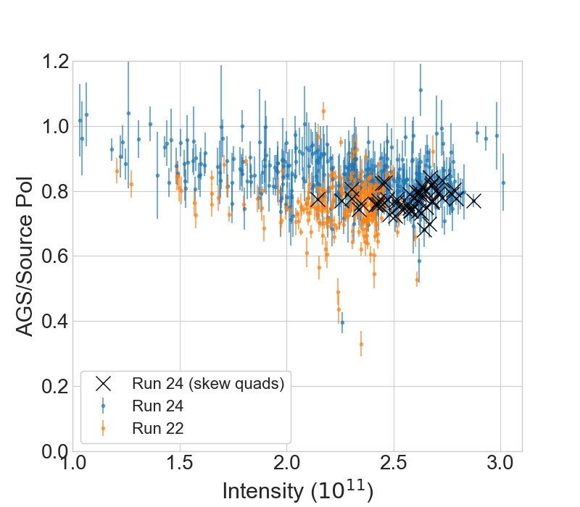
AGS Polarization efficiency AGS Extraction/Source
AGS Polarization/Pol(200 MeV) by Fill
Polarization transmission through AGS slightly better than Run 22 over most intensities
Skew quad fills not obviously different from tune jump at the highest intensities

Slide 8
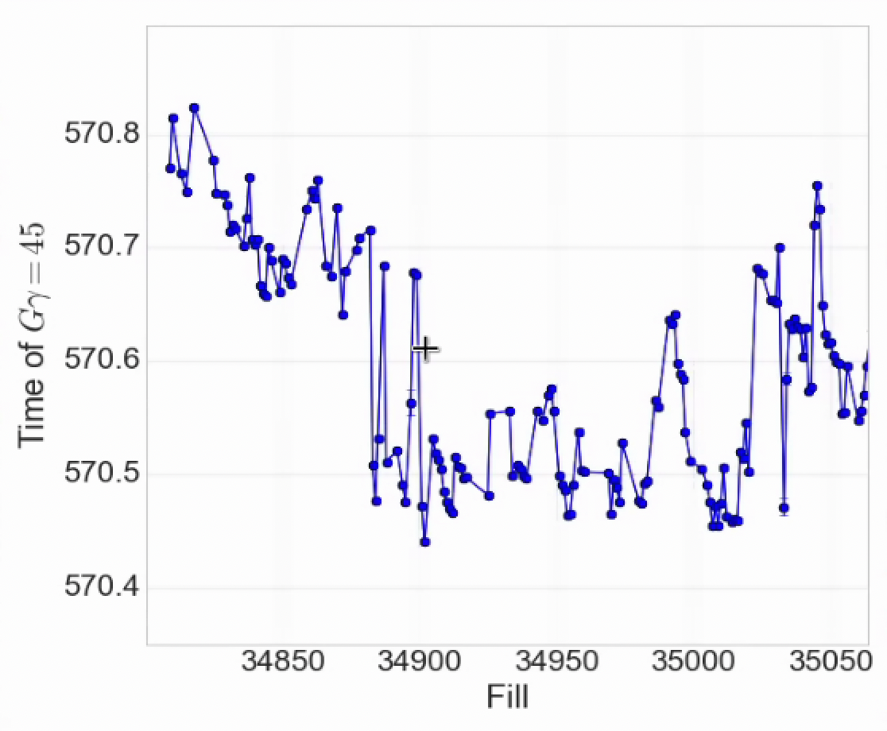
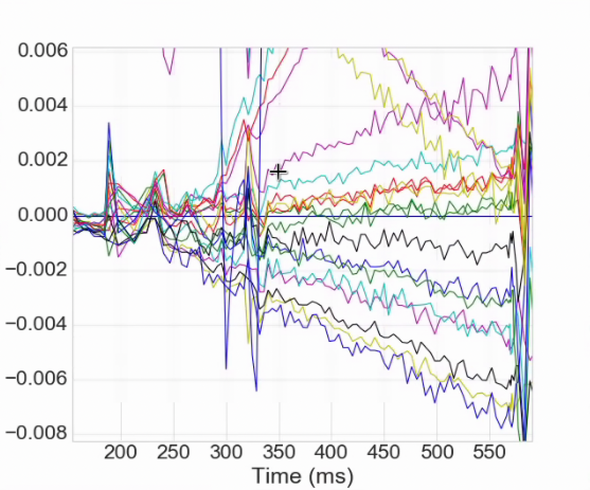
Energy stability
Arrival time at GƔ = 45
Slow drift of the energy as a function of time during the ramp
For tune jump 100 us is significant, 200 us is bad
Tolerance is better with skew quads, but would still prefer stability
Injection matching
Change during a fill is small (drift is ~hours)
Deviation is often linearly increasing during ramp
ML project to improve calibration precision, make online continuous calibration and quantify uncertainty
Conventional analysis of the MM field contribution to this drift
We have a slow software feedback for RHIC energy matching
Consider developing a system for the whole cycle
Change in GƔ during acceleration, fill by fill

Slide 9
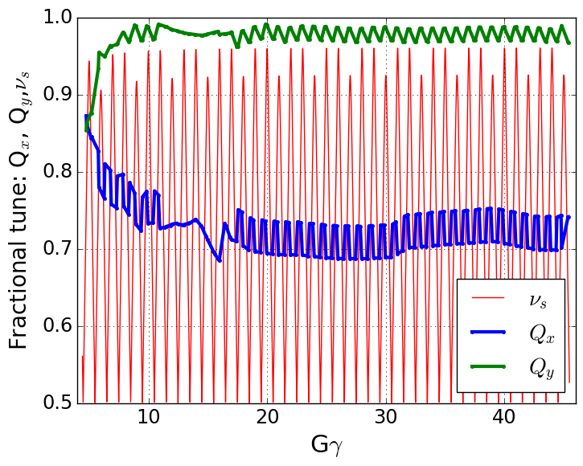
Skew quad commissioning
15 skew quads in AGS
Designed to replace and improve upon the tune jump for correction of horizontal depolarizing resonances
Nov 2023: Magnets #13,14 installed. Final magnet held at power supply vendor for testing
Nov-Apr 8th: Power supplies delivered and connected in phases
Significant ”after market” modifications to each one, mostly to improve p.s. heating
Mar 5th : First 6 magnets powered, ready for testing
Mar-Apr: Beam based polarity checks (zero polarity errors), orbit correction
May 4th: Proof of principle test!
May-Jun: beam-based tests, interleaved with a lot of RHIC setup
July 29th: First demonstration of ramp effect
Sep 9th: RHIC operations with skew quad user
Spin tune gap
Hor resonance crossings
Tune
jump
(pause tune jump near transition)
~About 20 shifts of commissioning time over many calendar weeks

Slide 10
Skew quad commissioning
15 skew quads in AGS
Designed to replace and improve upon the tune jump for correction of horizontal depolarizing resonances
Nov 2023: Magnets #13,14 installed. Final magnet held at power supply vendor for testing
Nov-Apr 8th: Power supplies delivered and connected in phases
Significant ”after market” modifications to each one, mostly to improve p.s. heating
Mar 5th : First 6 magnets powered, ready for testing
Mar-Apr: Beam based polarity checks, orbit correction
May 4th: Proof of principle test!
May-Jun: beam-based tests, interleaved with a lot of RHIC setup
July 29th: First demonstration of ramp effect
Sep 9th: RHIC operations with skew quad user
Spin tune gap
Hor resonance crossings
Tune
jump
(pause tune jump near transition)
Many thanks to Ioannis, Ed, Chirag and others
Fast development and implementation of changes to the p.s. switching.
ZERO problems operating even in August.

Slide 11
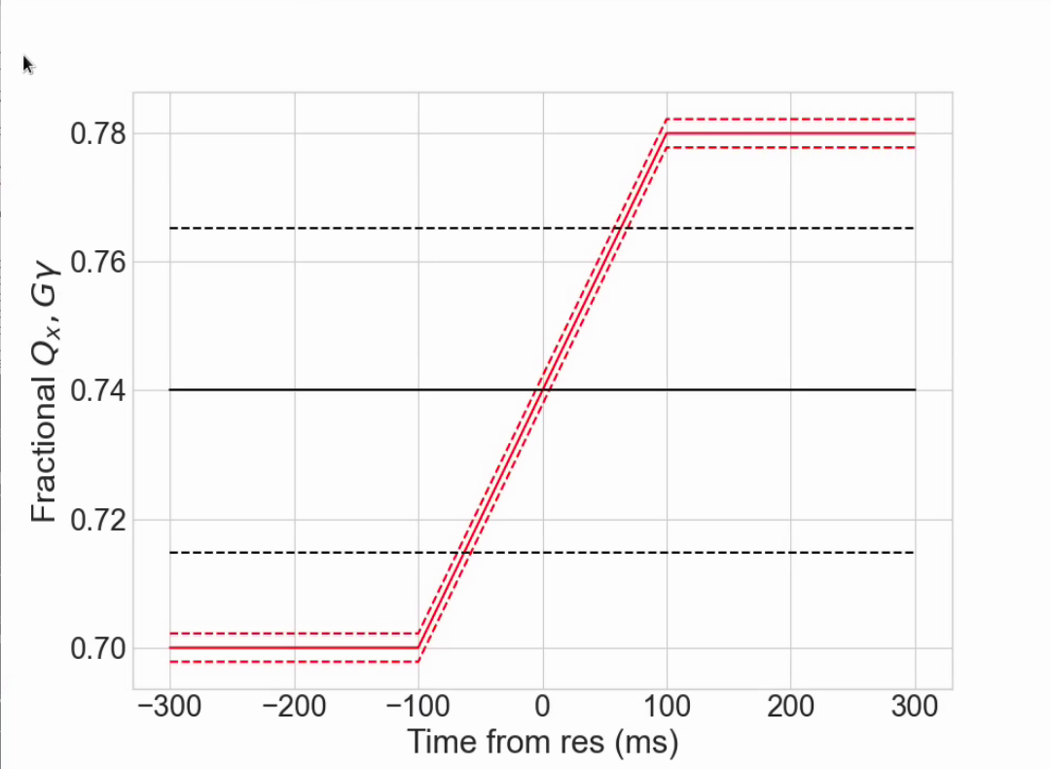
Commissioning: Proof of principle single resonance crossing
At nominal acceleration rate (dGɣ/dθ =4.7 x 10⁻⁵), max polarization loss from a single resonance is 0.1-0.5%
too small to to measure individually
Configure a crossing at fixed energy: just above nominal extraction, with ramped horizontal tune and very slow ramp rate (>100x longer)
Resonance crossing
Parameter | Value
Gɣ | 45.74
dp/p (full base) | 1x10⁻³
Chrom ξ_{x} | 4
ΔQx | 0.08
Tune ramp length [ms] | 200
Crossing rate (⍺) | 1.7 x 10⁻⁷
Slow crossing gives measurable 20-25% relative polarization loss
11

Slide 12
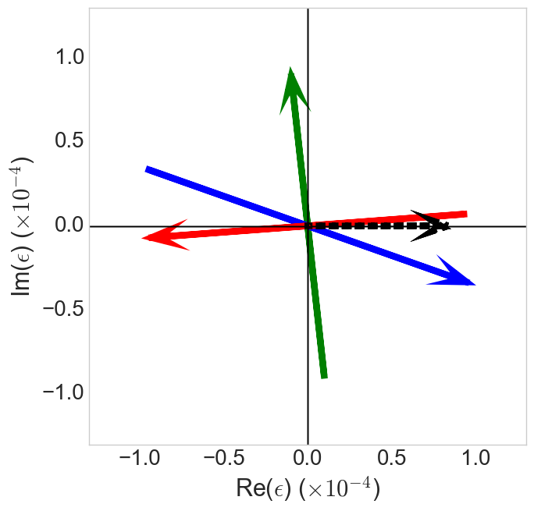
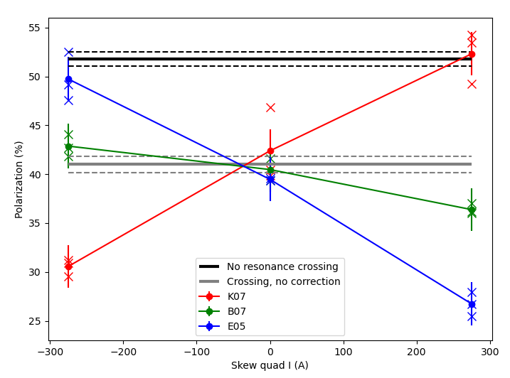
Commissioning: Proof of principle single resonance crossing
Resonance ‘portrait’ at Gɣ = 45.74
Polarization response to skew strength
B07
Snake drive
K07
E05
Select three skew quads with good relative phasing
K07 in phase with snakes
E05 180º from K07
B07 orthogonal to snake drives
Skew quad arrow length is full current range of supply (arrow head is positive)
Phasing of skew quads is as expected
Demonstration of total correction
In anti-correcting phase, expect more loss from simple Froissart-Stora estimate
May be multiple crossings from synchtron motion during long crossing
To be investigated in simulation

Slide 13
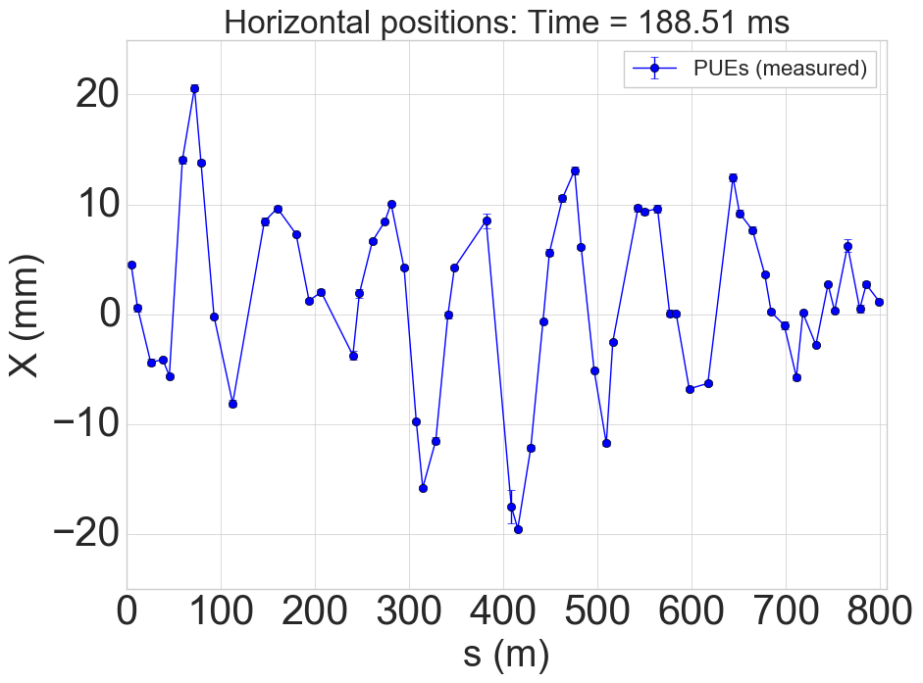
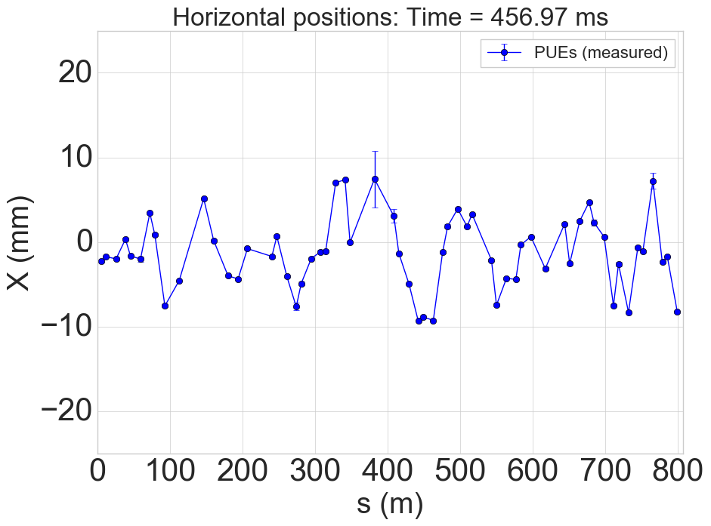
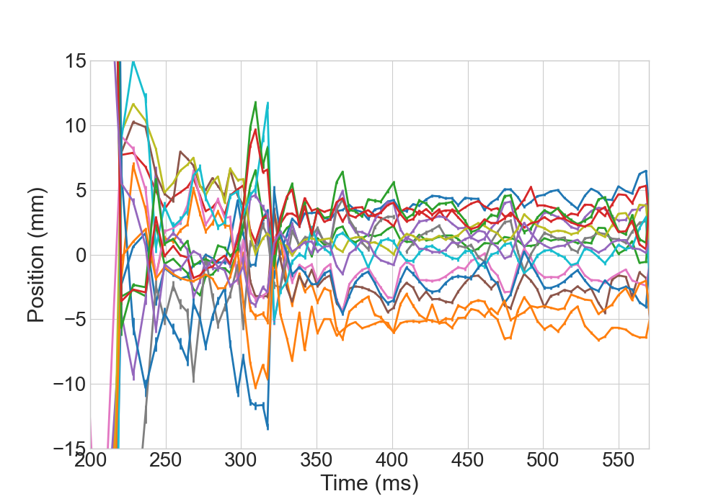
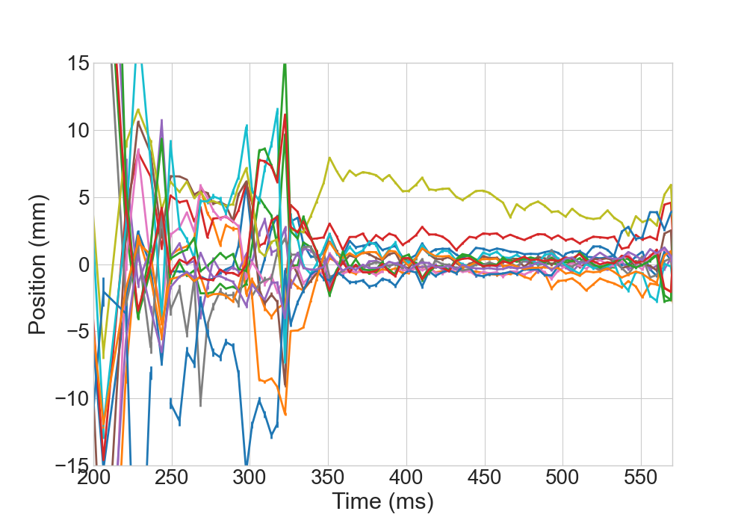
Skew quad during acceleration: Orbit effects
Sample horizontal orbits (at BPMs)
Large horizontal orbit excursions in AGS
High vertical tune (8.985 – 8.991)
Horizontal off-centering in skew quads leads to large vertical orbit changes and beam loss.
Beam-based orbit offsets measured and corrected
Skew quads pulsed, infer offset from vertical orbit change + model
Correction limited by weak steering dipoles
Low energy
High energy
Horizontal position at skew quads, inferred from orbit differences
Before correction
After correction
13

Slide 14
Skew quad during acceleration: Orbit effects
Sample horizontal orbits (at BPMs)
Large horizontal orbit excursions in AGS
High vertical tune (8.985 – 8.991)
Horizontal off-centering in skew quads leads to large vertical orbit changes and beam loss.
Beam-based orbit offsets measured and corrected
Skew quads pulsed, infer offset from vertical orbit change + model
Correction limited by weak steering dipoles
Low energy
High energy
Horizontal position at skew quads, inferred from orbit differences
Before correction
After correction
First generalized orbit correction in AGS
Thanks to Jon Laster and Leve Hajdu for Controls support!
14

Slide 15
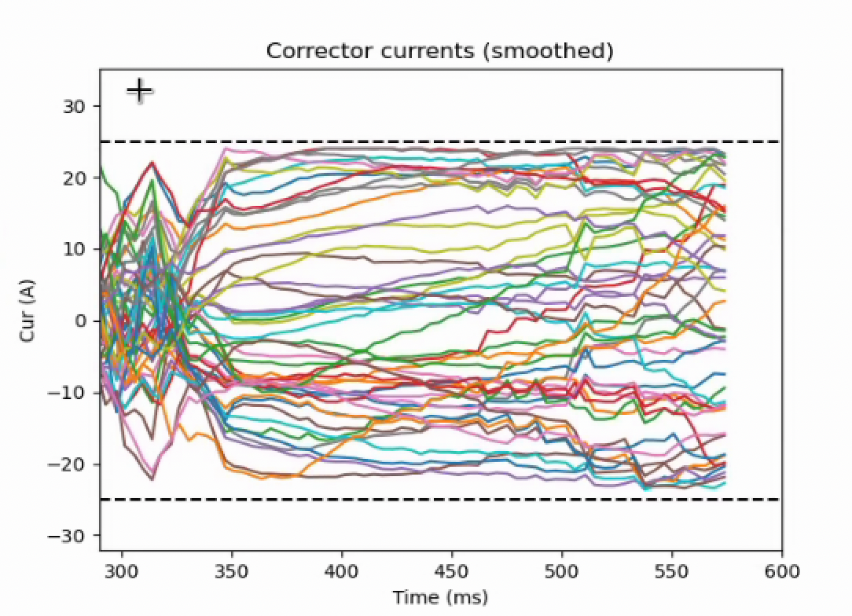
Orbit corrector currents
Centering in skew quads requires maxing out some orbit correctors and nearly maxing others
Global correction would require more than factor of 2 higher currents
High currents make each corrector less reliable, more likely to be single point failure.
Motivates:
Survey realignment
Investigating possibility of upgrades:
Stronger correctors
Additional correctors (possibly 50% more if adding on at each remaining PUE location is possible)
Model/controls work toward global orbit correction
AGS Hor Orbit Corrector Currents

Slide 16
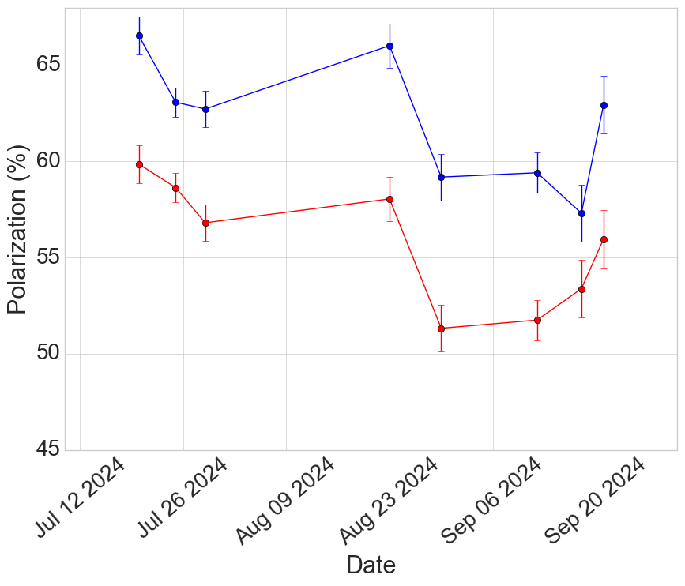
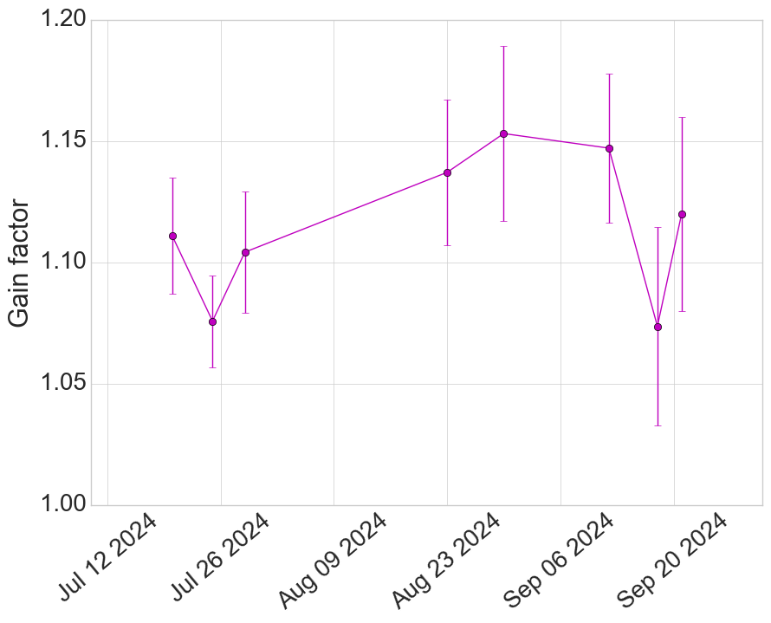
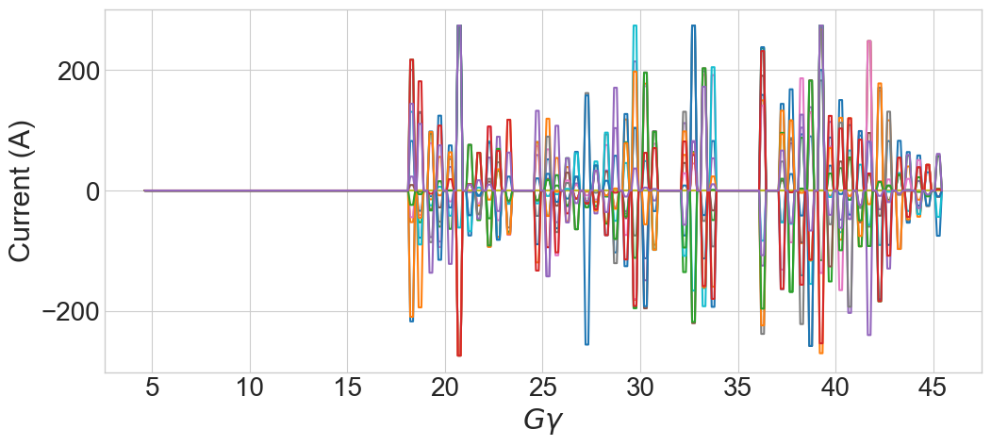
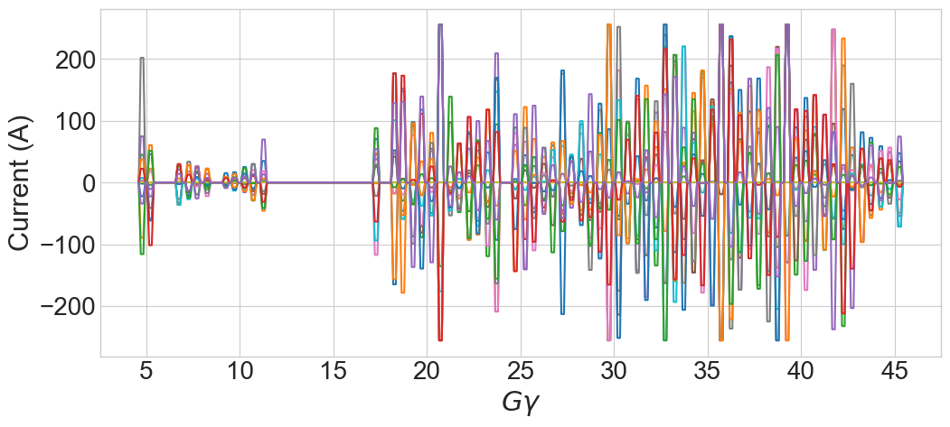
Skew quadrupole commissioning: ramp and polarization
Polarization comparison
Enabling more pulses via
Incremental orbit improvements
Fixing bug in resonance calculation for low energy resonances when Qy not in spin tune gap
Included model-predicted orbit response of the skew quads in the optimization to minimize resulting vertical rms
Resonance strength, |ε| = 0
Tune shift from coupling, ΔQ_{y}< 0.005
Vertical |M_{orm}*(k_{skew}*x_{skew})|_{max} < 1 mm
Mysterious decline in base polarization
Skew quads ON
Skew quads OFF
Skew quad currents
Polarization ratio
Skew Quads ON/OFF
16

Slide 17
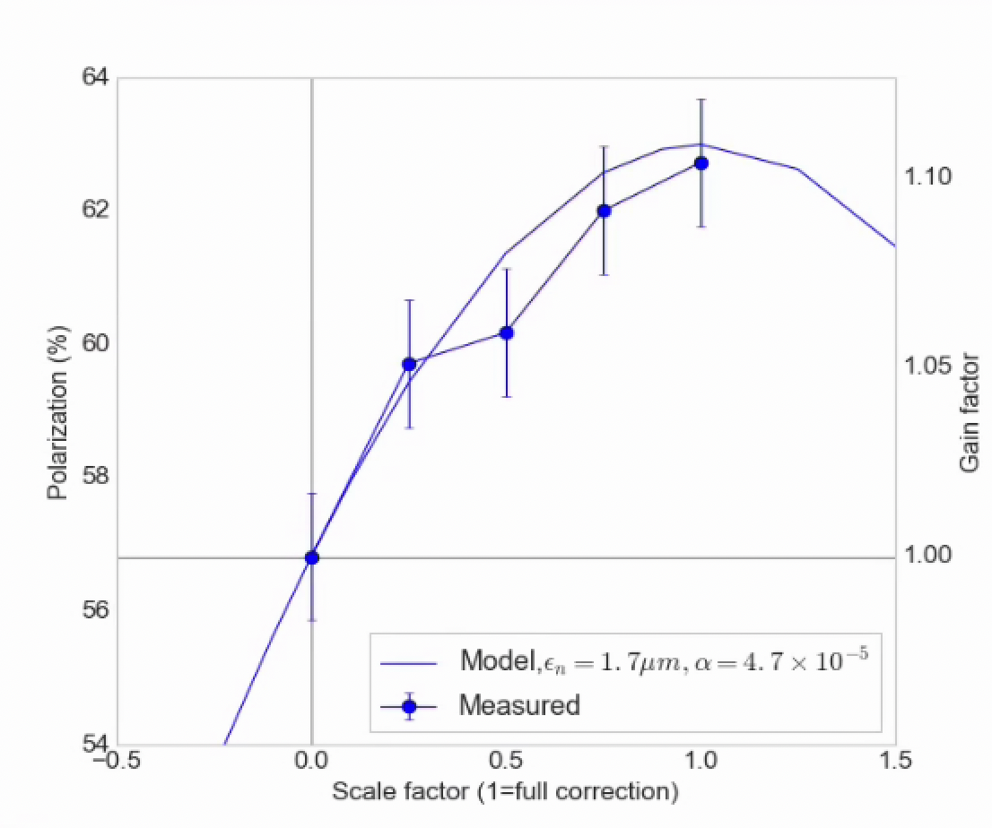
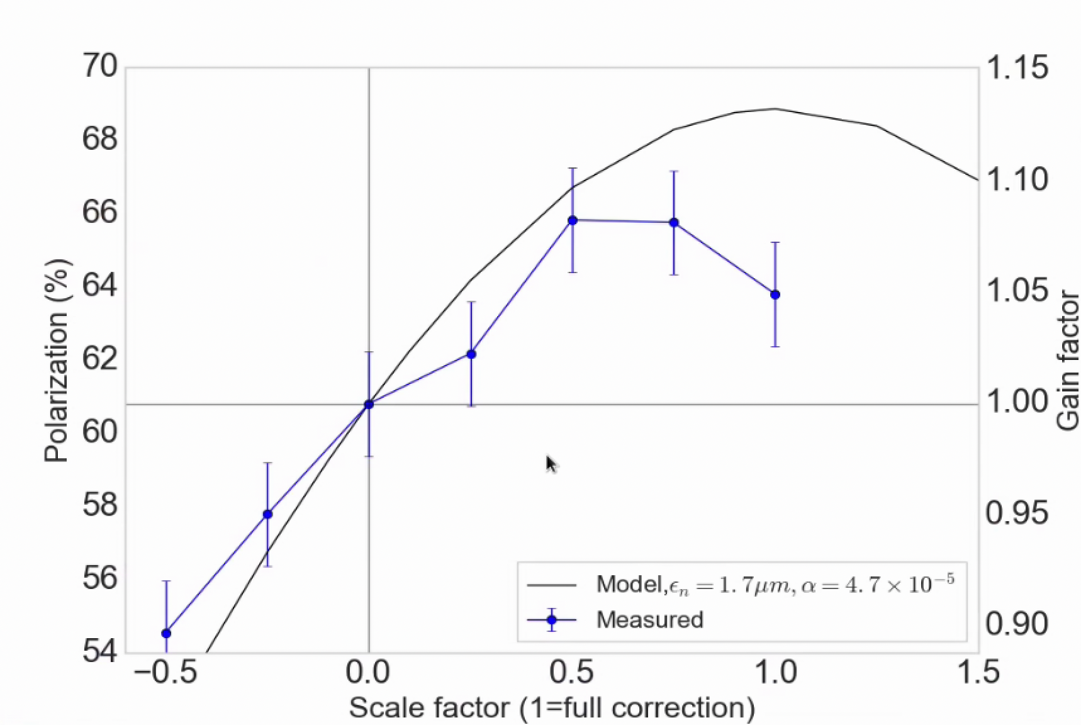
Correction scaling measurements
Correcting only resonance
above transition
Correcting only resonance
above and below transition
Overall scaling of the correction currents from zero to full correction
Agreement with the model is better if only the higher energy (after transition) resonances are corrected
Implies errors in resonance calculation at low energy are still significant
Near 0+ easier to do more harm than good

Slide 18
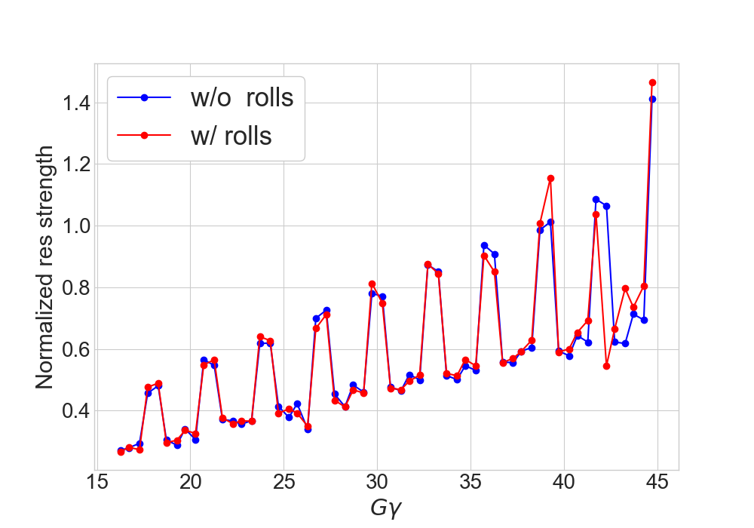
Skew quad status
Commissioning tasks all successful
Successful demonstration of principle and practical implementation on ramp
Polarization gain over base is 12-15%.
To be compared to 8-10% from the tune jump
Operation is robust enough to replace the tune jump as the default system
Where is the rest of the polarization from the skew quads (goal gain factor is 15-20% over base)
1% in the transition ‘gap’
Beta beat likely a small contribution
Next likely culprit is residual coupling
Survey, realignment of AGS magnets planned for next two shutdowns (no alignment before Run 25)
Main magnet roll and vertical sextupole offsets of principal concern
Resonance calculations with 2010 main magnet rolls
Small impact at high energy
Working on the low energy model

Slide 19
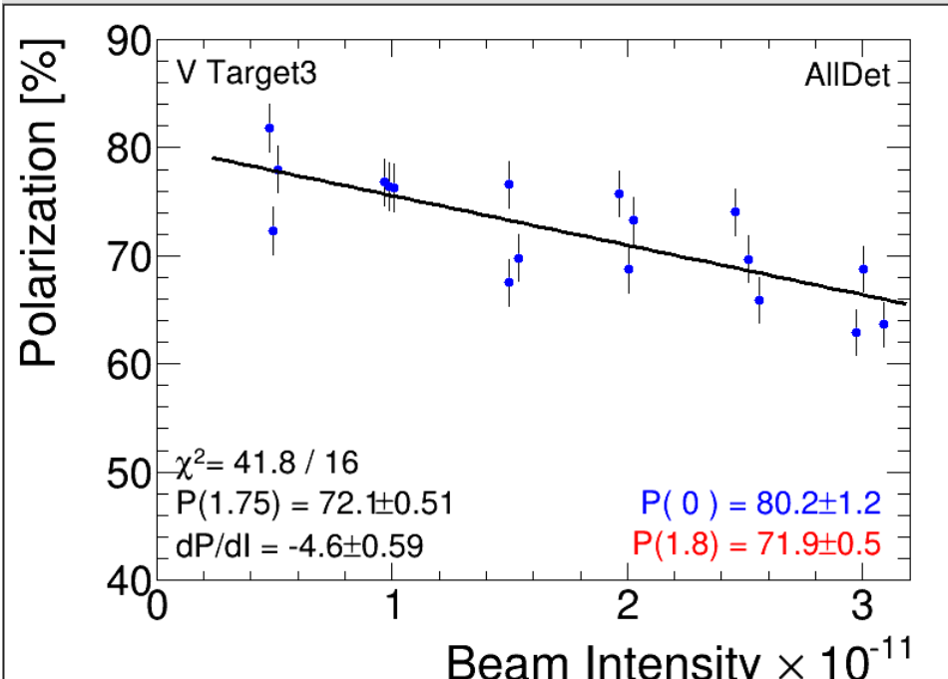
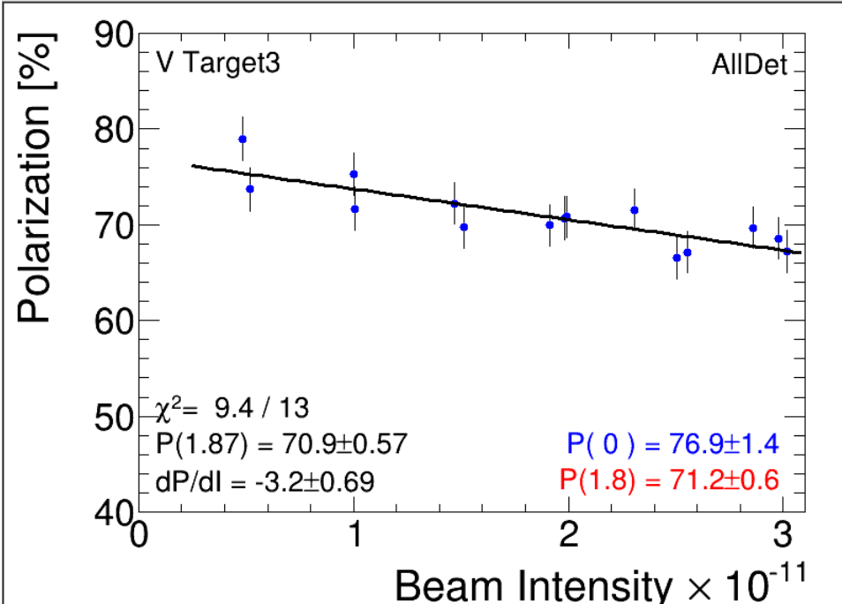
Split/merge setup
Nominal user (single bunch)
Split/merge
Aimed at reducing space charge at AGS injection
Value @ 3x10¹¹ | Single bunch | Split/ merge
Pol (%) | 66.4 | 67.3
Emit hor | 3.1 | 2.6
Emit vert | 3.2 | 2.7
(emit is rms, norm, urad)
Slope dP/dI is less
Emittance is 15% smaller
Polarization is only slightly changed (?!)
Seem associated with the P(0) offset: normally associated with Booster or source
Not so sure this interpretation holds up
Long emit is ~1.2 eVs (+20% from nominal)

Slide 20
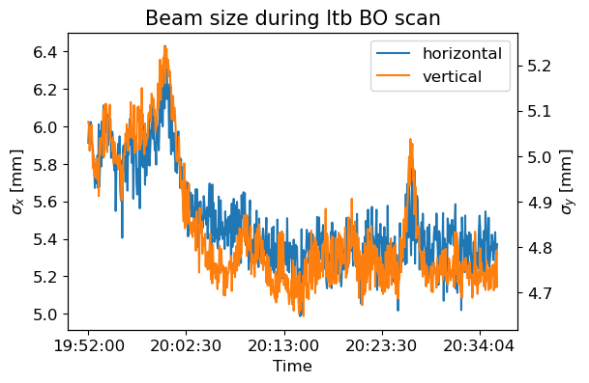
LtB Injection Optimization with ML (Lucy Lin)
Beam sigma (BtA)
Demo on intentionally detuned LtB
Bayesian Optimization algorithm automatically maximizes Booster beam intensity using LtB optics
Higher intensity after fixed scrapers $→$ smaller beam size $→$ higher luminosity $ℒ$
Beam size decrease observed in both planes in the BtA line corresponds to intensity increase
Similar algorithm under development for AGS injection
Minimal model inputs
Likely to help better maintain previously achieved optimum
Not an explicit objective, consequence of improving scrape efficiency
$$ℒ \sim \frac{N^{2}}{β^{∗}ε} \sim \frac{N^{2}}{beam size}$$
Intensity Booster extraction

Slide 21
Injector physics and operations
The number of people who can work independently with beam in the injectors is small
Run 11/12: Commissioning of the tune jump (last major commissioning effort)
Leif (Gg-meter), Woody (power supplies), Yann (physics/simulation), Haixin (polarimeter analysis/data)
Nick T, Kip, Mei, Steve T, Francois, Thomas Roser, Vahid, Vincent, Keith Z
13 people (11 shifters, Keith and Thomas)
Run 24:
Vincent (skew quad commissioning)
Keith (entire split/merge and dual pulse configurations, little/no physics involvement)
Kiel (Run coordinator), Haixin (polarimeter scans/data)
4 people
Limited expertise has consequences:
Beam time in injectors is ‘opportunistic’, with a broad field someone can use it when it arrives (not true if half the injector group is the run coordinator)
Limited attention: Every small “fire” stalls the main efforts
Have not raised levels of automation/robustness commensurately with decrease in personnel (many systems that ran on continuous attention and good will now don’t) (e.g. I did not commission the two new AtR cameras) “The inheritance problem”
The Run 24 operation+development effort really strained our abilities to keep up
Is the current level of support really sufficient to commission an entirely new polarized species? (3He, ~5-6 beam months of 24/7 work identified).

Slide 22
Reliabilities and Capabilities
OPPIS
Periods with unpolarized beam tolerable this year because so sPHENIX priorities
Need to re-establish lines of communication
Used to have agreements with ops about Intensity/Rb temp control to smooth out intensity
AGS Cold snake
Similar: periods with unpolarized beam not counted as ‘failure’ because of unique operating concerns
Example of Injector group comfortably accepting reduced capability
Ramp down now significantly longer: impacts p-Au operation and development efforts (we fill Au first at least….)
AGS Extraction bumps
Workaround for one failed supply
These supplies specifically identified several years ago by operations as a weak point for diagnosis of problems
AGS Tune Meter
1 week failure
On the short list for RHIC->EIC “Middle Ages” overhaul
Example of getting a capability back after >10 years (independent plane control of kick strength)
Multiple multi-hour repair accesses one weekends
Not counted as failure, so largely unnoticed
Not indicative of general reliability

Slide 23
Bottom lines and outlook
Injectors delivered physics for RHIC operation together with two commissioning efforts
Skew quadrupole resonance correction
mature enough to replace the tune jump in future operation
Better gain factor relative to tune jump
Improvements
understanding residual coupling in AGS important
Model of realistic AGS (with errors) , especially low energy
Correcting near transition energy
Survey and alignment of AGS (not for Run 25)
Split/merge
Demonstrated -15% transverse emittances at 3x10¹¹
Small improvement in polarization (might be offset from other sources)
We still don’t understand the emittance evolution in the injectors
Space charge/emittance evolution needs a fairly sustained campaign of physics simulations/measurements
Including everything one would do for a new machine: magnet errors, impedance models etc.
Future operation could start day 1 with a split/merge + skew quad correction setup
Gold is fine. See EBIS talk.

Slide 24
Skew Quad Special Thanks!
Engineering,Design and Installation Team
George Mahler, Ioannis Marneris, Nicholaos Tsoupas, Richard Lynch, Viorel Badea, Dan Lehn, Jimmy Meier
Equipment all worked 100% as expected!
“Making it Happen” Award
Leve Hajdu and Chirag Birla
for excellence in operational support with rapid and continuous on-the-fly solutions!

