Slide 1
RHIC 56 MHz Cavity
Kevin Mernick
RHIC Retreat 2024
November 15, 2024

Slide 2
Outline
Purpose and Intended Operation
History
HOM Dampers
Run16
Rework post-Run16
Run24 Results

Slide 3
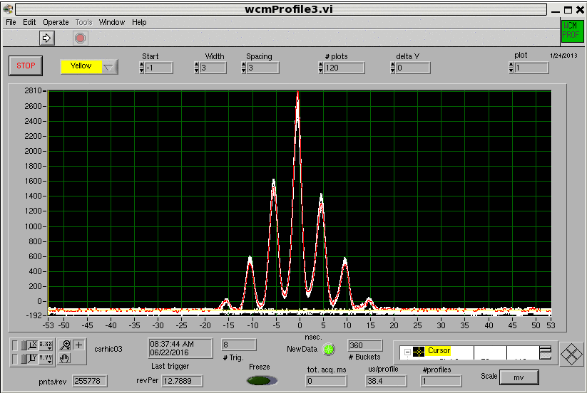
56 MHz Cavity Purpose
After rebucketing, beam diffuses out of the central 197 MHz bucket
With stochastic cooling, this beam is cooled back into 197 MHz buckets, some ends up in “satellite” buckets
The 56 MHz cavity provides additional longitudinal focusing, creating a deeper potential well and minimizing diffusion to the outer satellite buckets

Slide 4
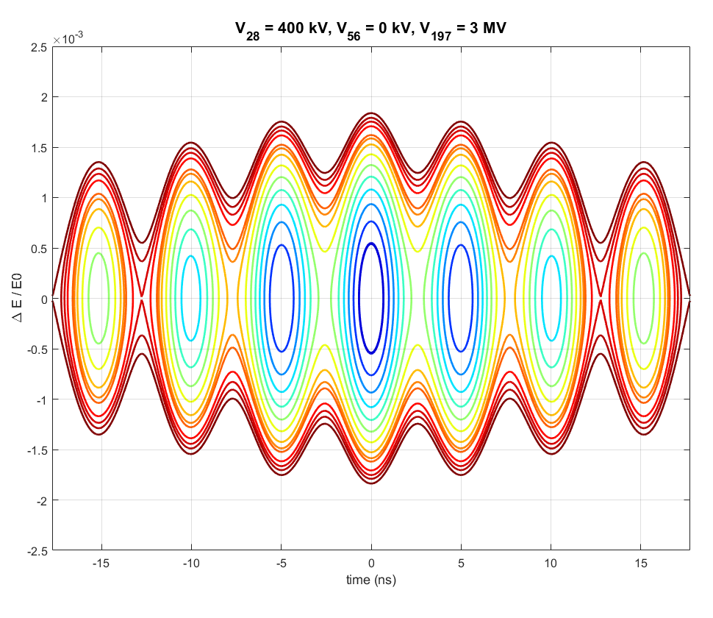
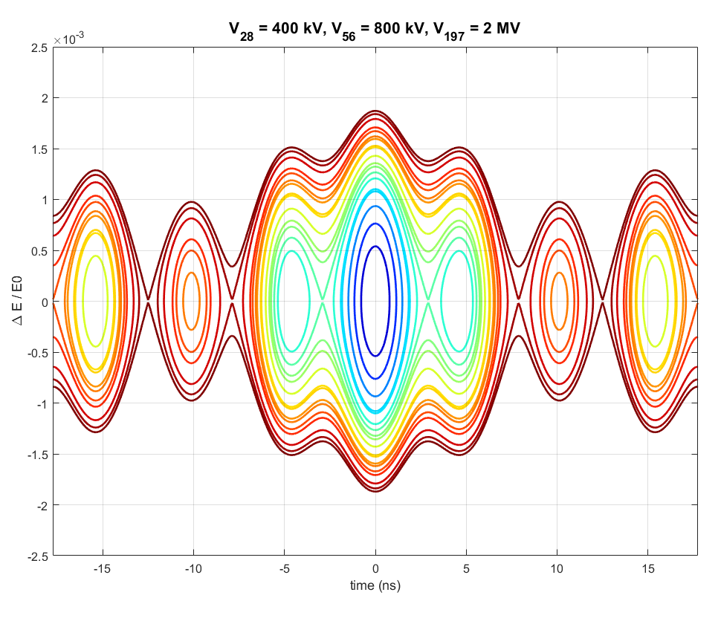
Longitudinal Focusing
Without 56 MHz
With 56 MHz

Slide 5
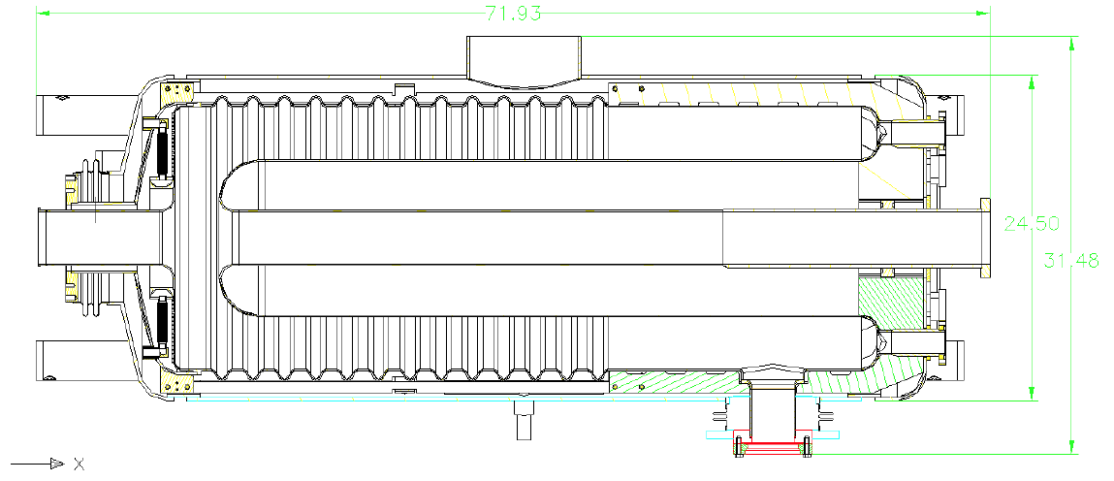
56 MHz SRF Quarter Wave Resonator
8x ports
Fundamental Power Coupler(s)
Field Pickup(s)
HOM Damper(s)
A passive* beam-driven superconducting cavity
The quarter wave (${\text{λ}}/{\text{4}}$) structure also resonates at higher order modes (roughly ${\text{3}\text{λ}}/{\text{4}}$, ${\text{5}\text{λ}}/{\text{4}}$, ${\text{7}\text{λ}}/{\text{4}}$, etc. for longitudinal monopole modes)
* = not really passive – requires significant RF feedback to stabilize voltage
beam
Accelerating Gap
Fundamental Mode Damper

Slide 6
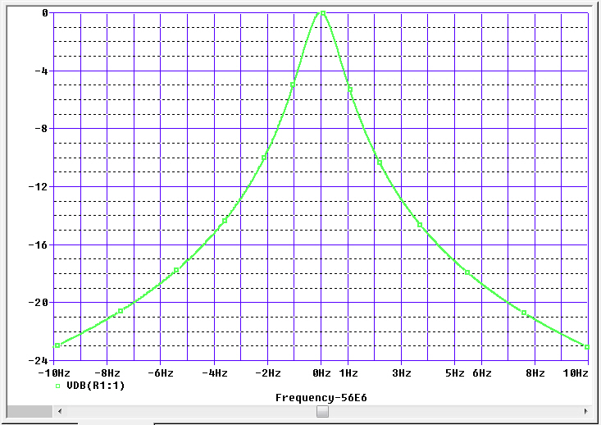
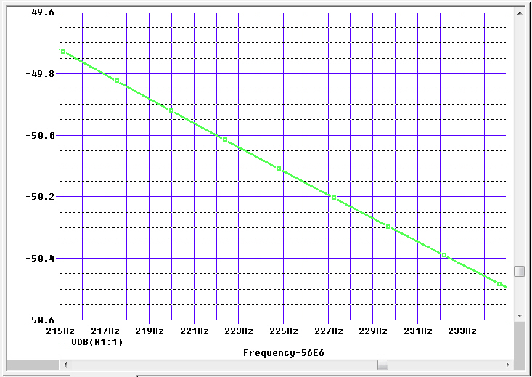
Beam Driven Cavity
Cavity fundamental voltage:
$\left|V_{cav}\right|$=I_{h=720}*$\left|Z_{cav}\right|$_{h=720}
On resonance, cavity impedance is large, would be too much voltage
$$R_{0}=R/Q∙Q_{ext}≈40∙4×{10}^{7}=1.6×{10}^{9}Ω$$
$⇒V_{cav}≈800 MV$
Detuned cavity:
$Z_{cav}=\frac{R0}{1+j\frac{∆f}{BW\text{½} }} ⇒ \left|Z_{cav}\right|≈\frac{\left(\frac{R}{Q}\right)∙f0}{2∙∆f}$ for $∆f≫BW\text{½}$
Cavity detuning regulates voltage (and also gives required 90° phase shift to focus beam)
Impedance
on resonance
Impedance
off resonance

Slide 7
History of 56 MHz Cavity
A journey through past retreats

Slide 8
HOM Damper
From S. Belomestnykh, 2013 RHIC Retreat

Slide 9
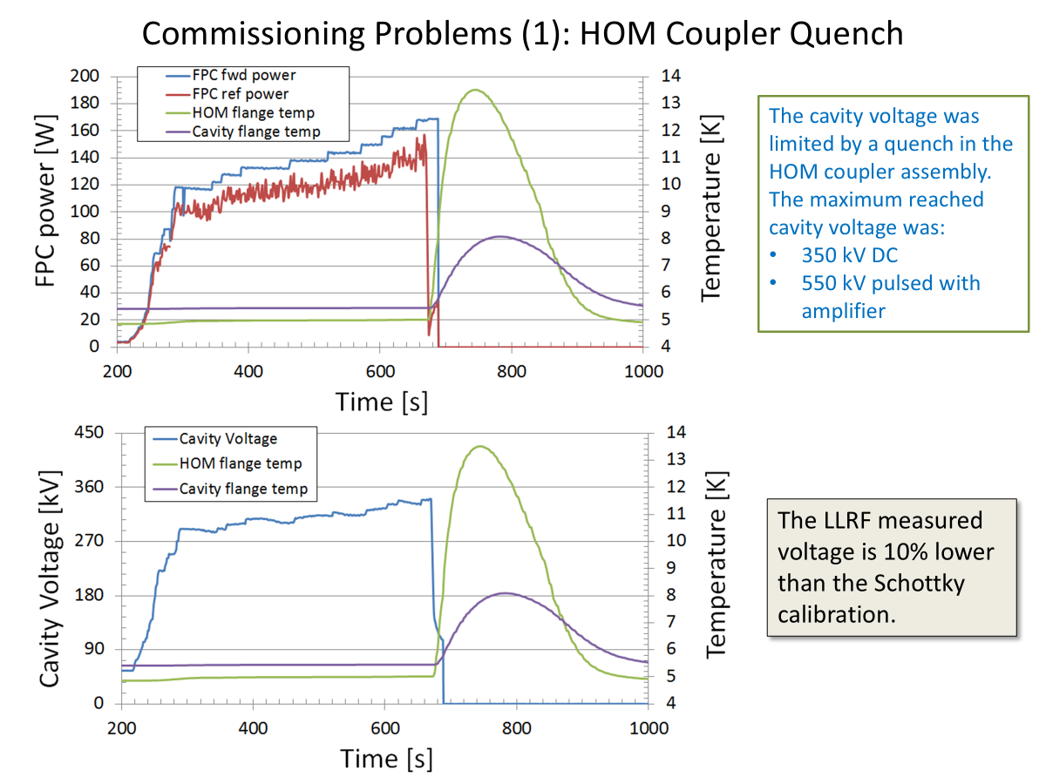
HOM Damper (v1) Quench
From Q. Wu, 2014 RHIC Retreat

Slide 10
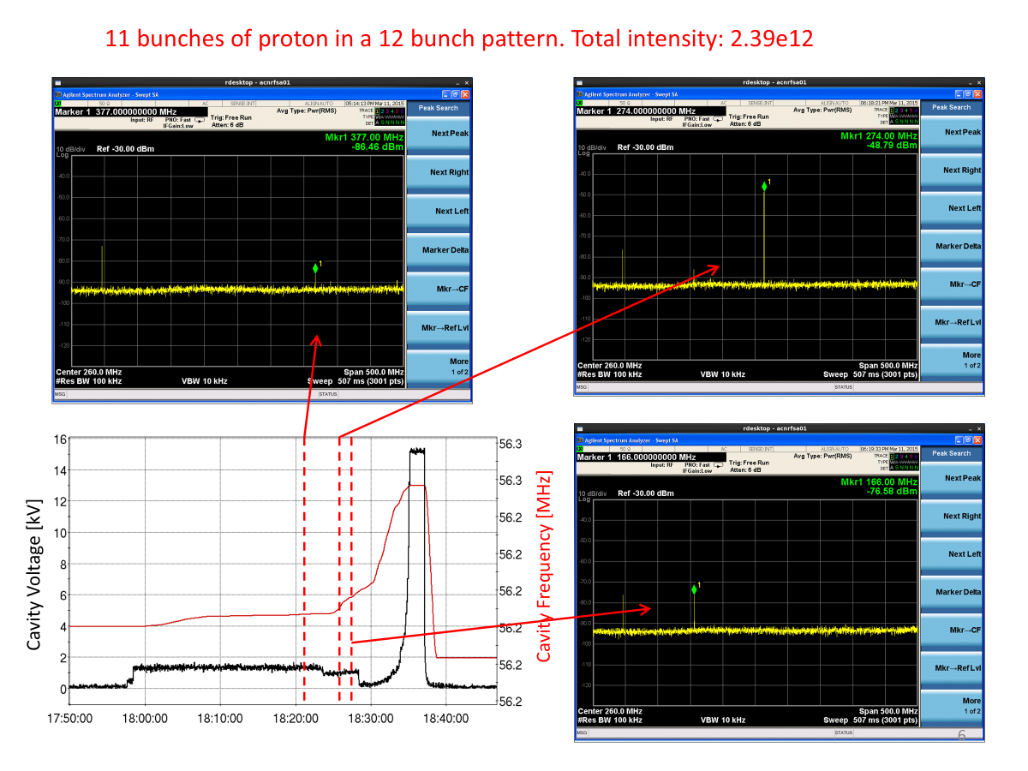
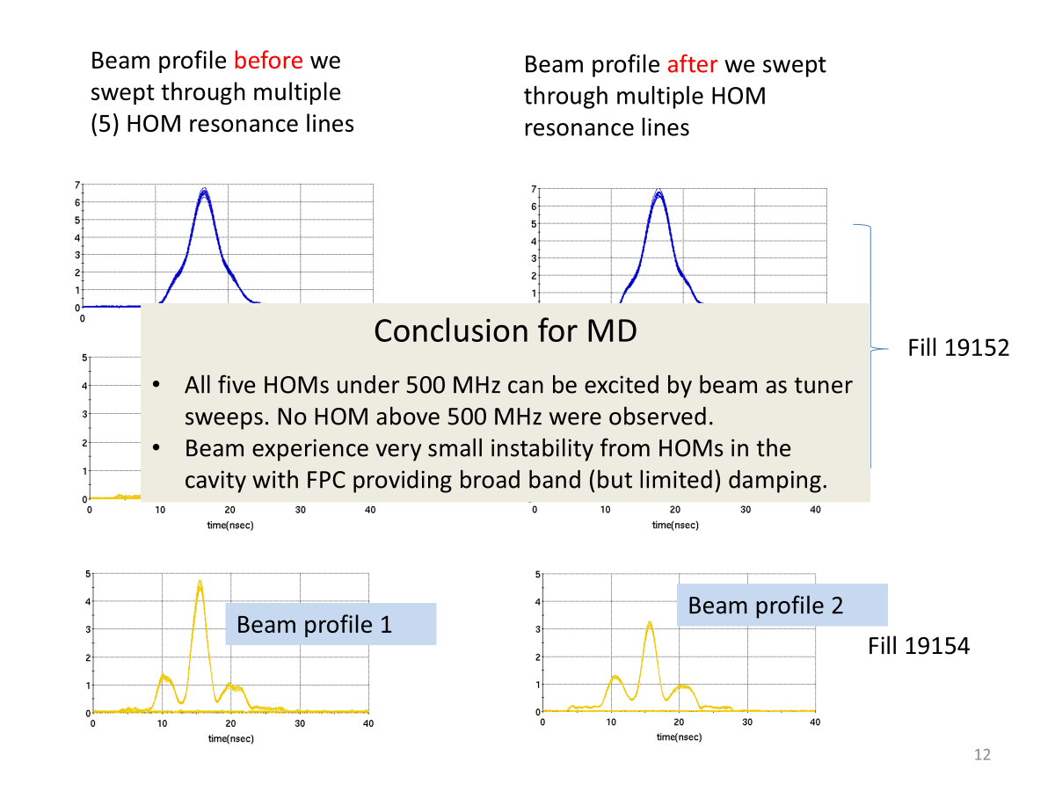
Test Run without HOM Damper
From Q. Wu, 2015 RHIC Retreat

Slide 11
HOM Damper (v2) Quench
From K. Smith, 2016 RHIC Retreat

Slide 12
HOM Damper Removed for Run16
From K. Smith, 2016 RHIC Retreat

Slide 13
Run16 Operation
Coordinated movement of FMD and tuner was able to avoid exciting any beam-destroying HOMs during the process of bringing up the cavity voltage while avoiding excessive voltage and thermal stress on the FMD and cavity

Slide 14
Post-Run17 Modifications
Removal and complete rebuild of cryomodule addressing numerous issues
2 new Fundamental Power Couplers (arcing in insulating vacuum on previous design, greater range of coupling)
New Fundamental Mode Damper (higher power, improved motion control)
Cryo piping, vacuum pumps, add second pickup probe
Cavity cleaned (HPR) and low-particulate assembly
Designs for new HOM dampers were investigated, but RF dissipation for any damper using available ports would be too high
Cavity vertical test in 2019 and cryomodule horizontal test in 2022

Slide 15
Cavity Hardware Modifications
From Z. Conway, 2020 RHIC Retreat

Slide 16
56 MHz Cavity in Run24
A journey back to the present day

Slide 17
Cavity Limitations
There is a hard quench limit just above 1 MV (at 1.02 MV) – based on this, operating voltage should be limited to ~800 kV
FMD and FPC power limits – FMD can handle high power (~100 kW) for short intervals (seconds to minutes), but longer-term response was unknown, FPCs have ~5 kW power limit
Cavity frequency response of fundamental and HOMs to tuner/damper position was remapped this run – it appears to be worse than run16 (there is a smaller, perhaps non-existent, gap between destroying the beam and melting the FMD)

Slide 18
FMD/Tuner Path for Run24
Tuner and FMD motion is different, need to remap the turn-on path
Initial plan was to duplicate “corners” in path based on fundamental mode frequency and Q_{ext} – this would cross ${\text{3}\text{λ}}/{\text{4}}$ HOM with insufficient damping
Modified path adding more steps – more aggressive damping to avoid exciting ${\text{3}\text{λ}}/{\text{4}}$ HOM while skirting high FMD power region

Slide 19
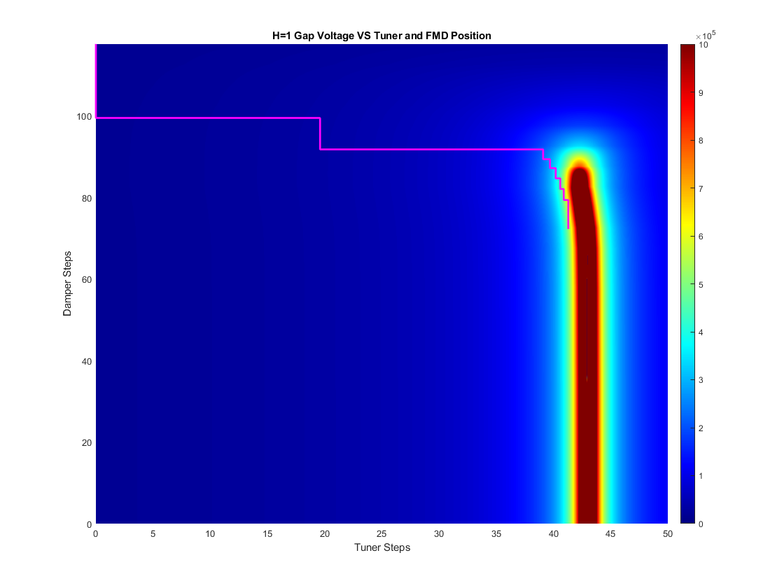
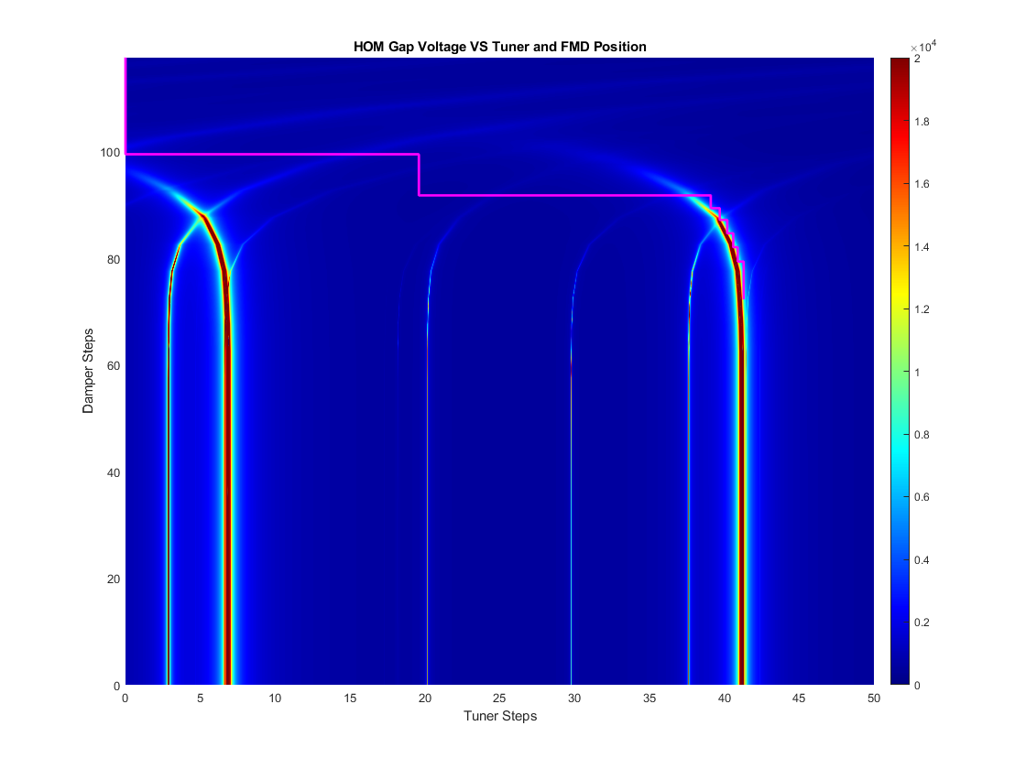
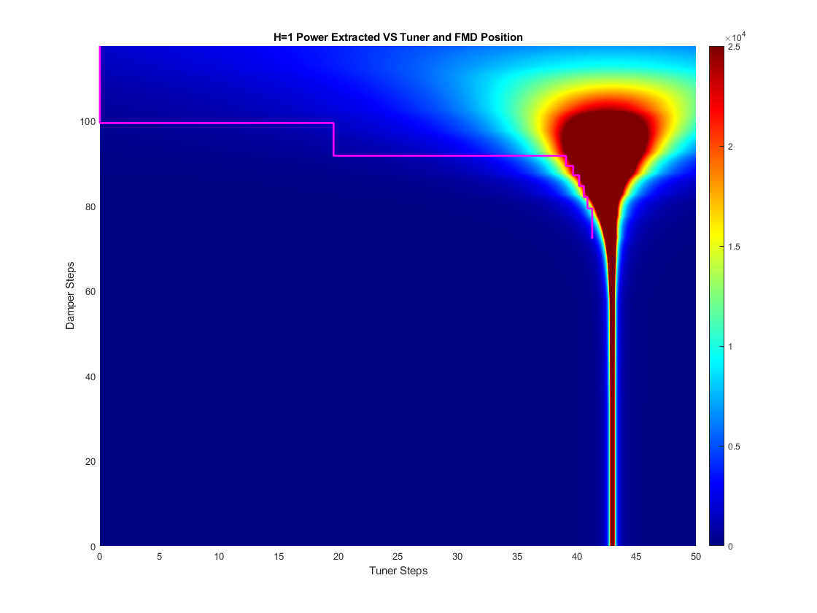
FMD/Tuner Path for Run24

Slide 20
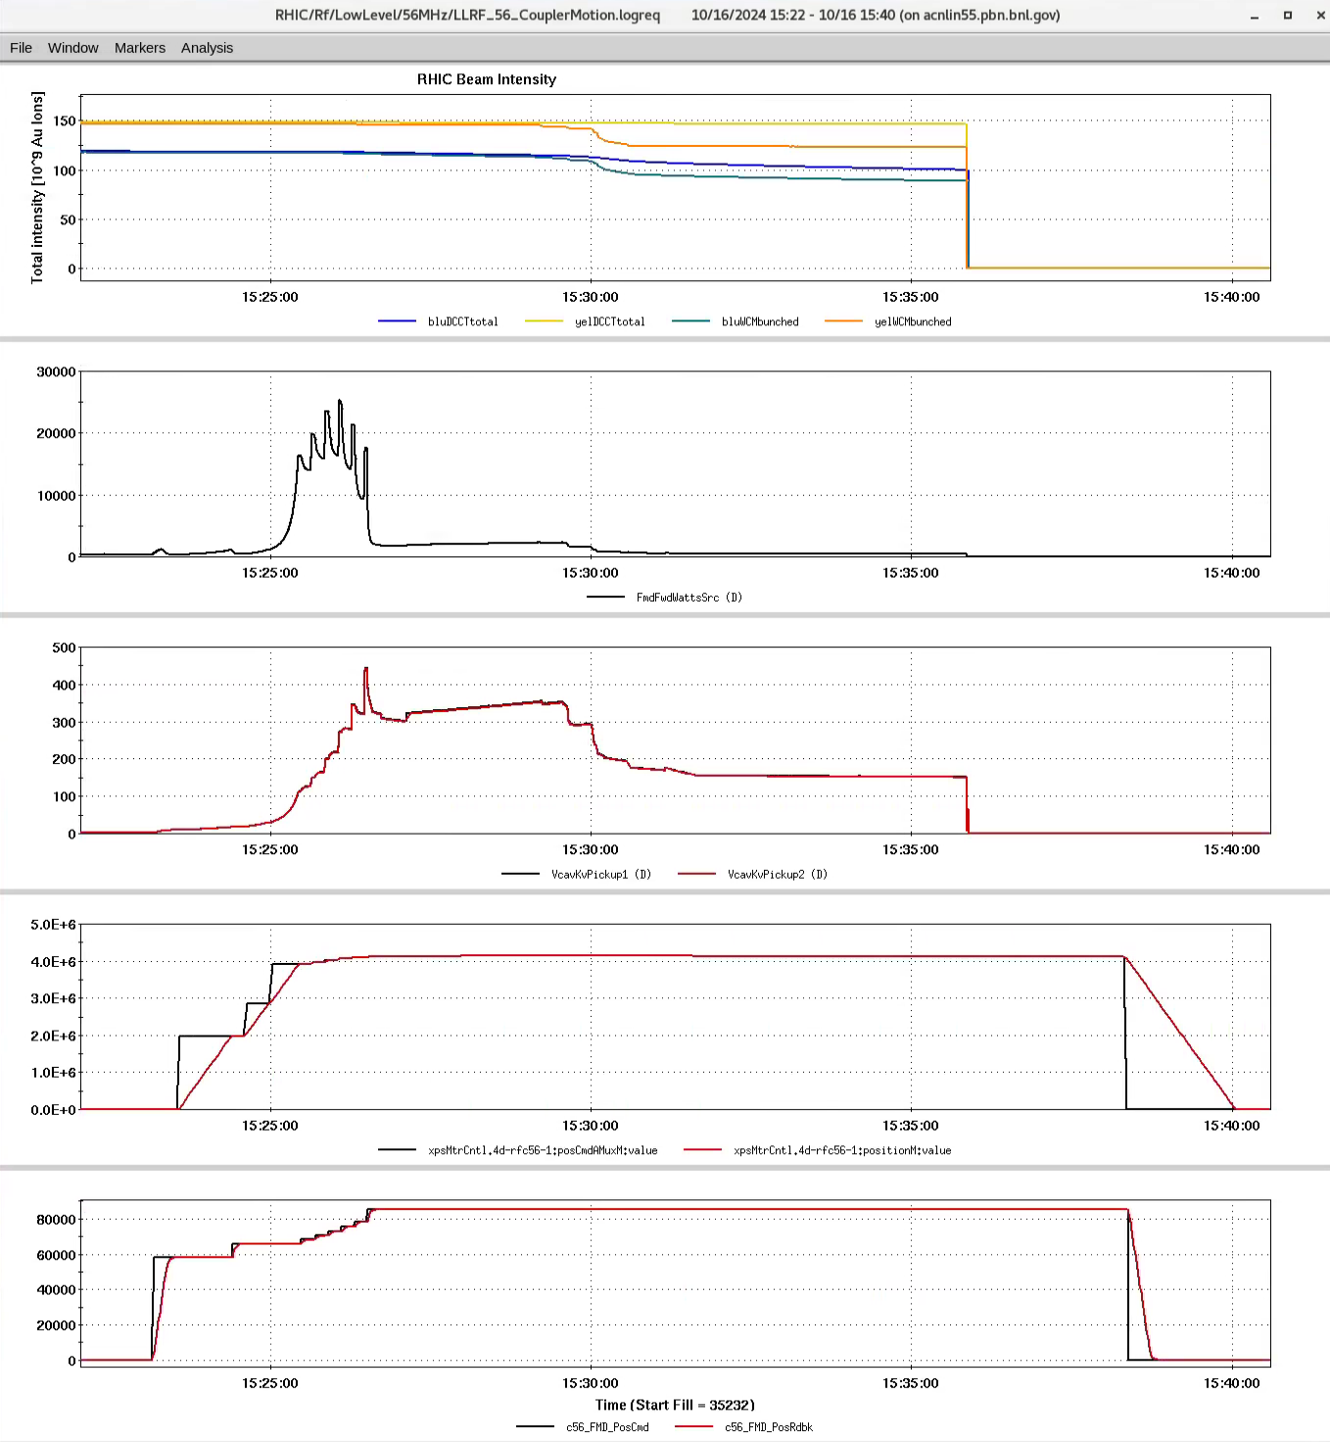
First Beam Test
beam
10/16 – after a couple 12x12 tests, ran 111x111
1.35e9 Y, 1.06e9 B
Ran through turn on path without issue, but when tuning cavity to increase voltage, had an instability
FMD power
Cavity voltage
Tuner position
FMD position

Slide 21
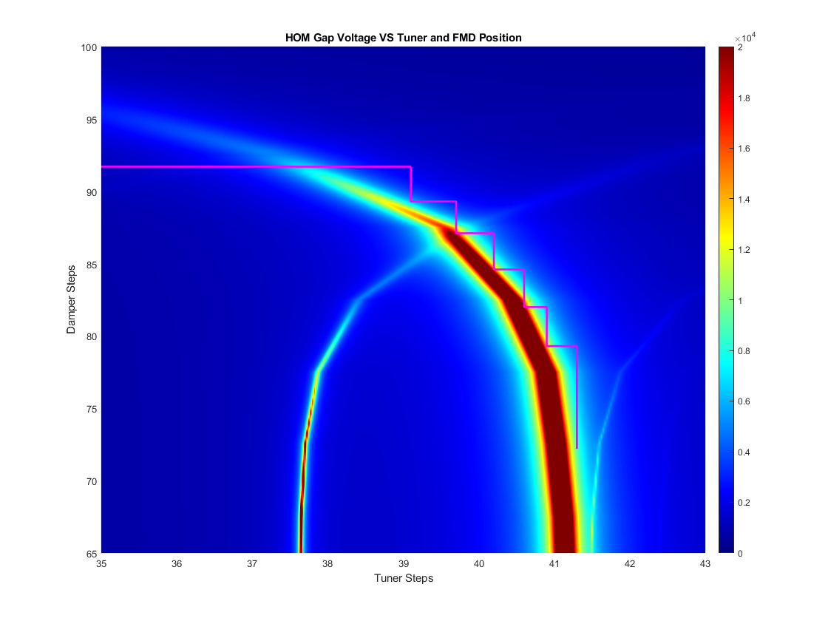
First Beam Test
${\text{7}\text{λ}}/{\text{4}}$ HOM

Slide 22
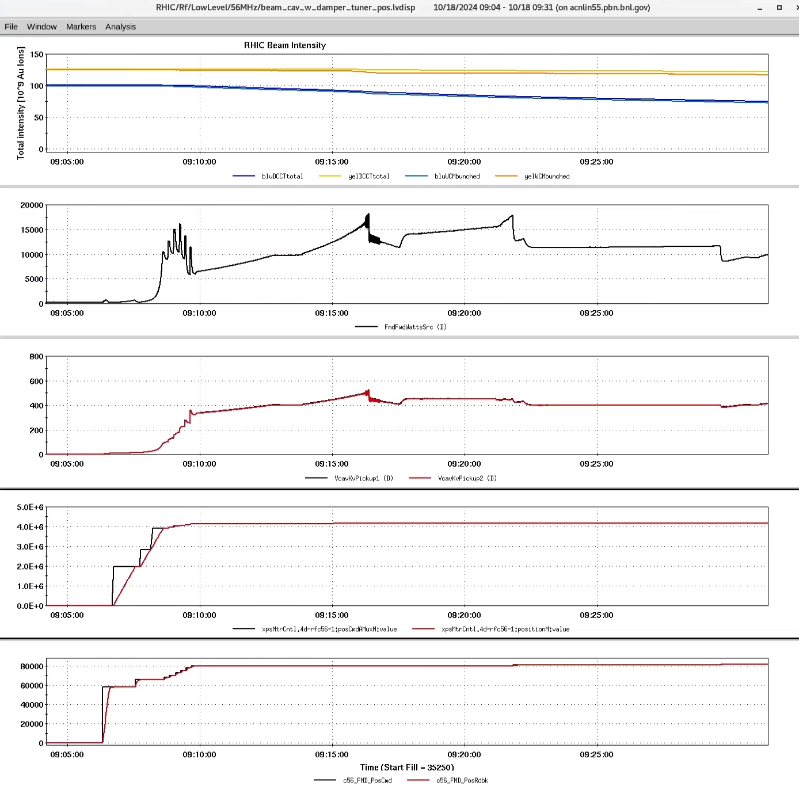
Second Beam Test
10/18 – 111x111
1.14e9 Y, 0.90e9 B
Left FMD further in at last step, higher extracted power
Had issue with voltage stability, LLRF configuration related
More concerning, power runaway on FMD (thermal runaway?)

Slide 23
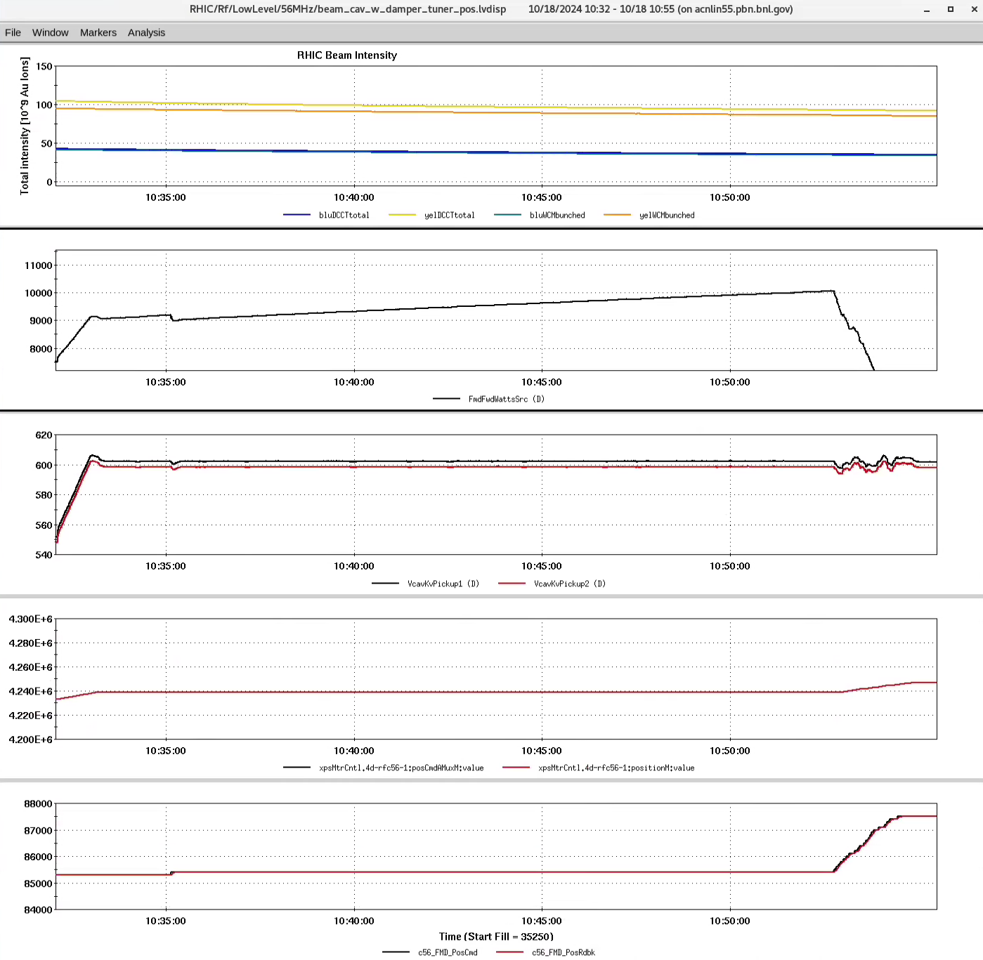
Second Beam Test
Even at lower power, the FMD extracted power continues to run away (or maybe more like walk away)
In 15+ minute test, no sign of reaching equilibrium

Slide 24
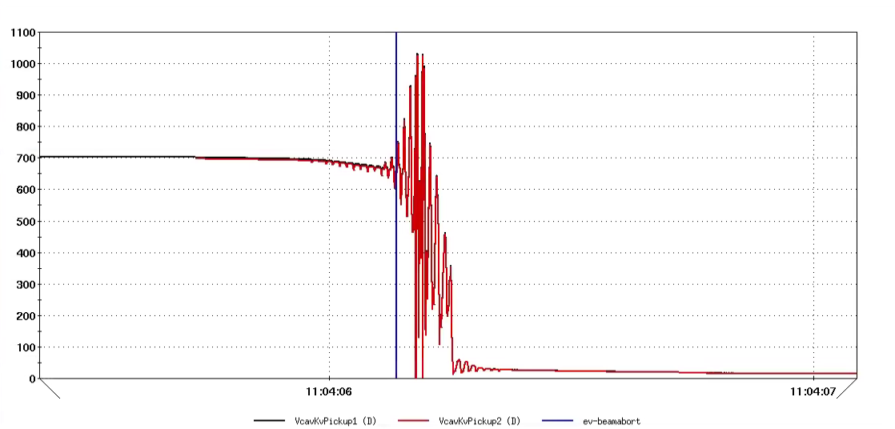
Second Beam Test
Cavity voltage went unstable at the end of the test when we were getting ready to dump beam (we know why and can avoid this particular failure mode in the future)
Abort caused by g8-mlmx.1 loss monitor at sPHENIX (our 56 MHz MPS input didn’t catch it, even though I wrote a feature explicitly to try to detect this type of failure)

Slide 25
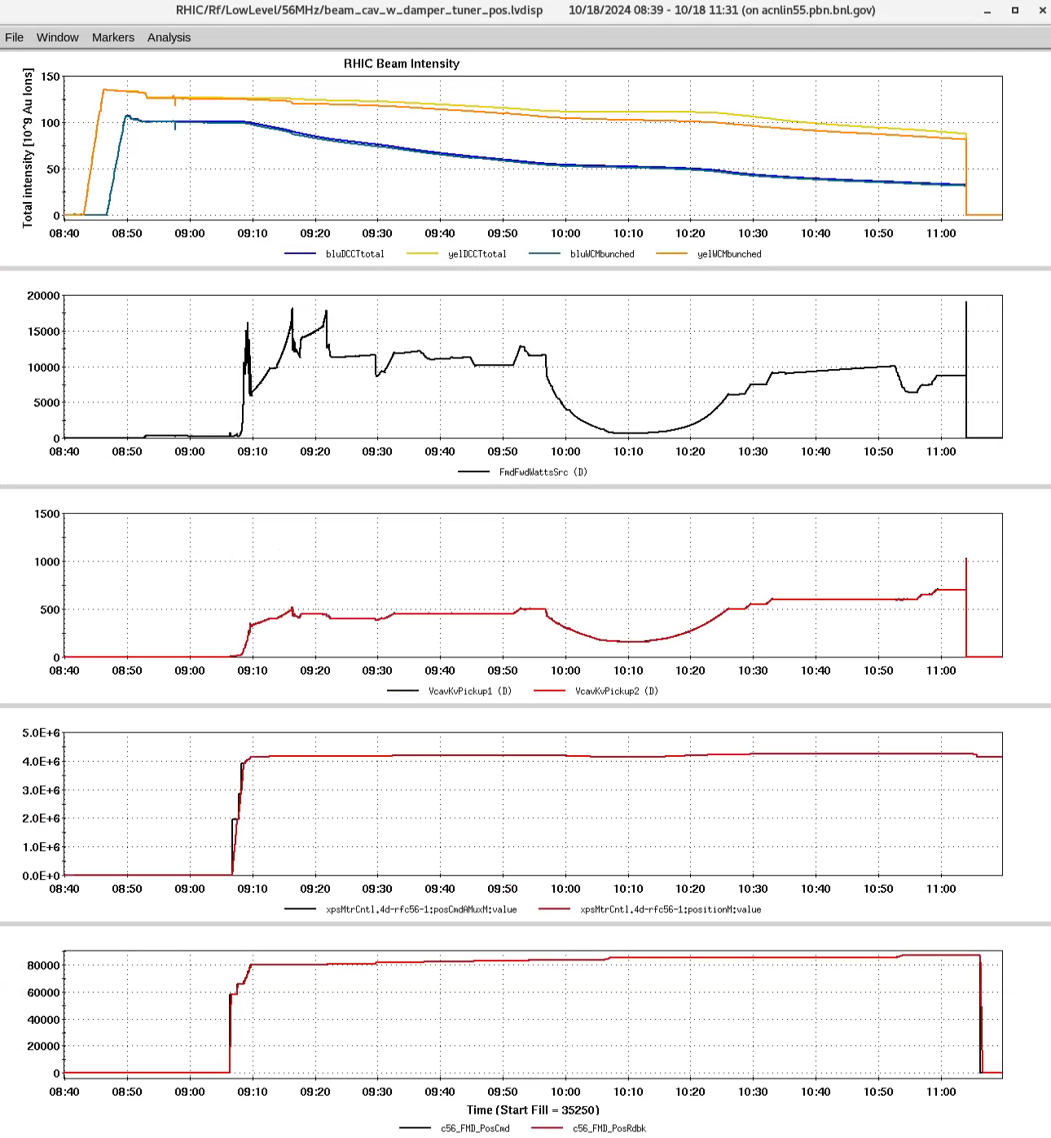
Second Beam Test
Full test store on 10/18

Slide 26
Conclusion
Things went better than I feared, but far from “success”
I don’t know if there is a path to operation of the cavity at nominal Au beam intensity
FMD power dissipation during initial turn-on sequence is function of beam current squared – also might need increased HOM damping at higher beam current which would further increase FMD power
Tuner/damper working point for voltage-controlled operation will be close to exciting ${\text{7}\text{λ}}/{\text{4}}$ HOM – working point is a function of beam current
If we can make it work, I don’t know if we can make it work reliably – this is a system of band-aids on top of band-aids on top of workarounds

Slide 27
Backup Slides
Bigger versions of plots

Slide 31
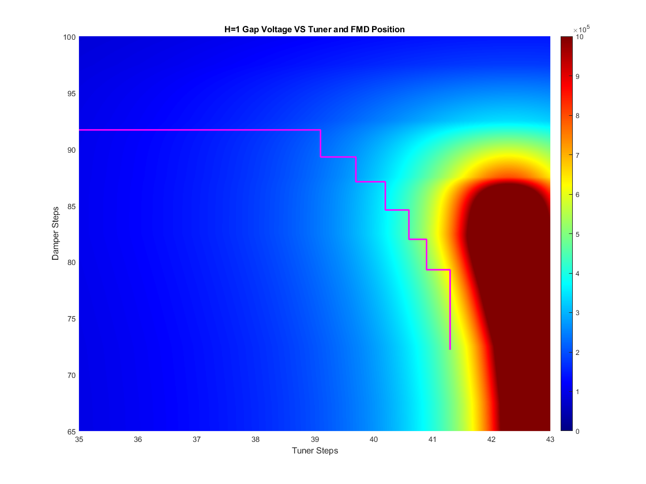

Slide 33
