Slide 1
RHIC Retreat 2024 – Cooling Infrastructure and RHIC R&R
David Chan – C-AD Experimental Support & Facilities Division Head
Friday, 15 November 2024

Slide 2
Outline
Cooling Infrastructure Air Conditioning Systems
  2024 RHIC Run preparation
  Repairs and Replacements during RHIC Run 2024
  RHIC Maintenance Shutdown Work and Preparation for 2025 RHIC Run
Cooling Infrastructure Water Systems
  2024 RHIC Run preparation and Operations
  RHIC Maintenance Shutdown Work and Preparation for 2025 RHIC Run
RHIC R&R
  Project Description
  Scope of Project
  RHIC Maintenance Shutdown Preparation
  Risks, Coordination and Responsibilities
  Timeline, Cost and Assumptions

Slide 3
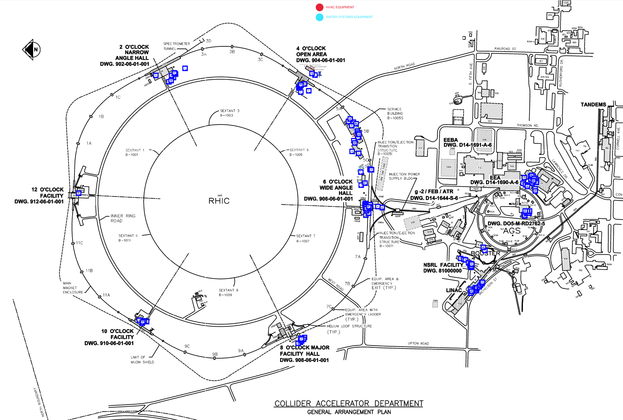
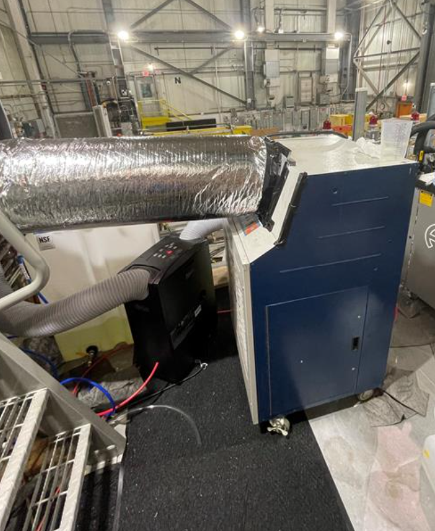
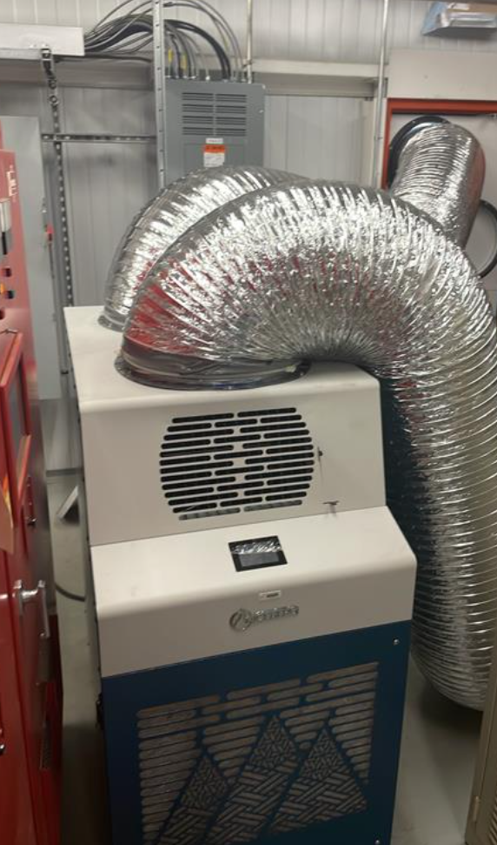
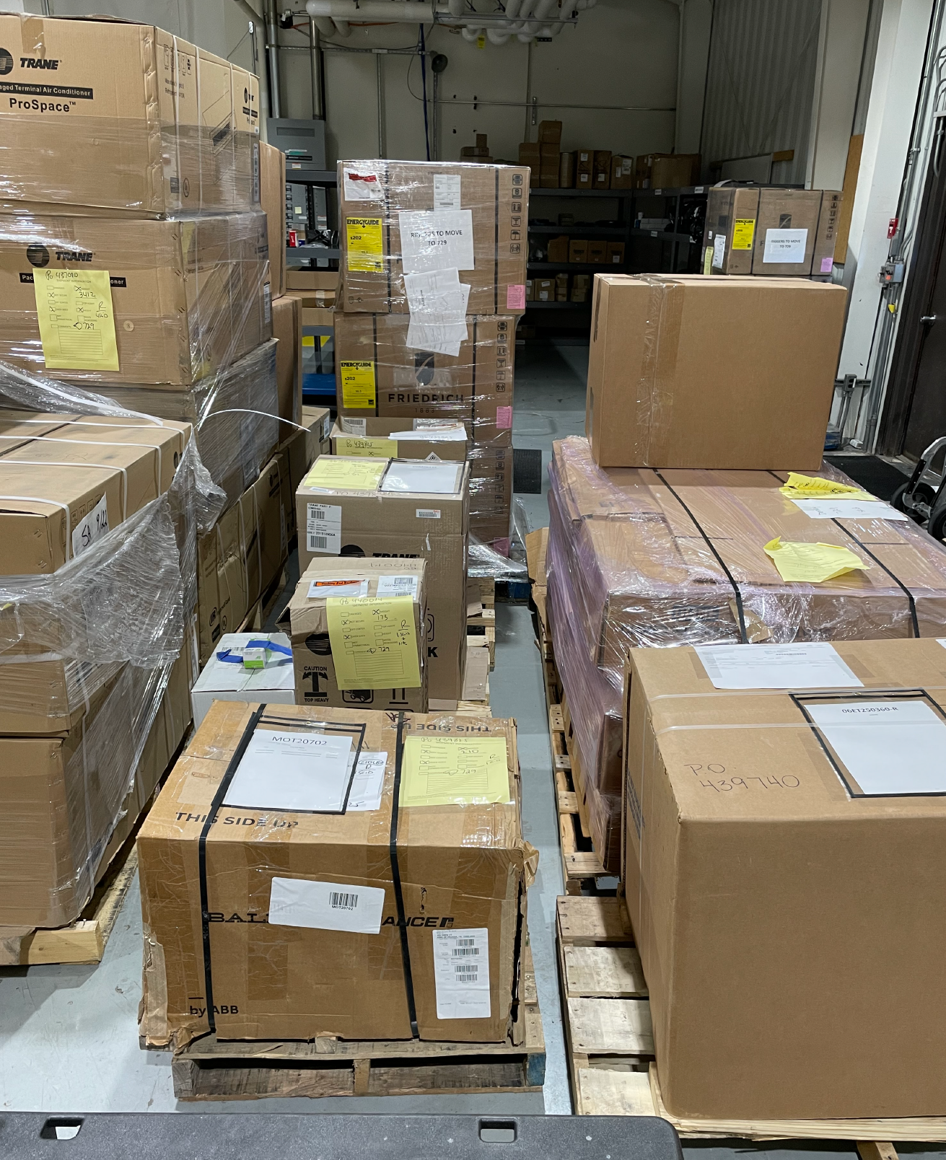
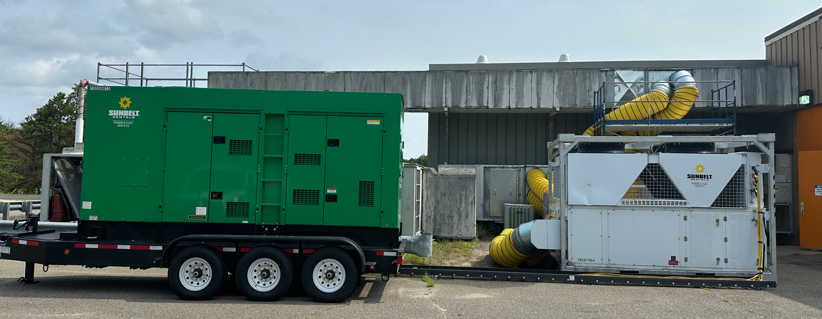
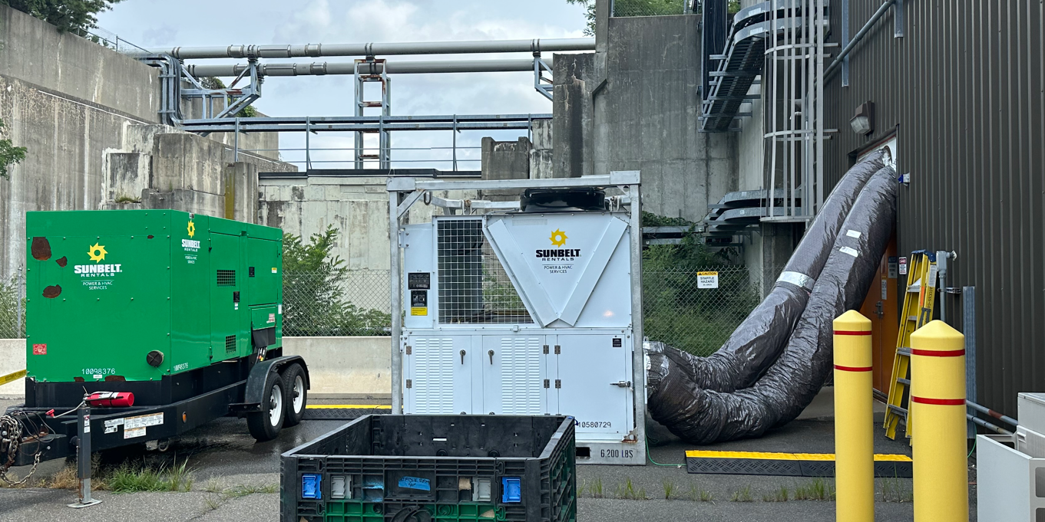
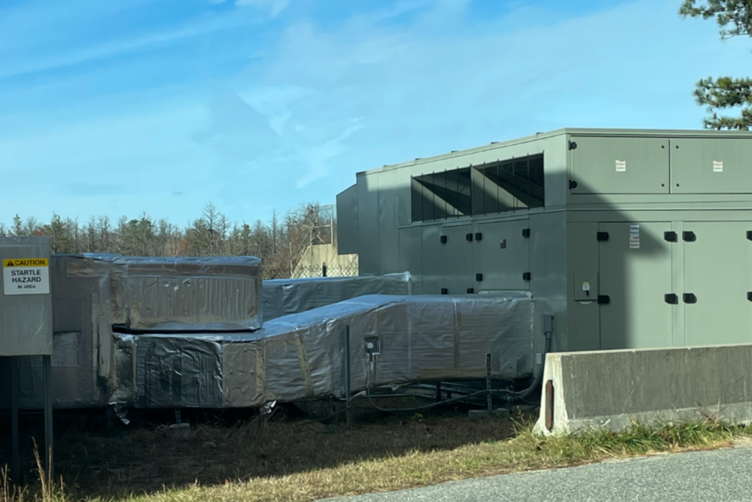
Cooling Infrastructure – RHIC Run 2024
Air Conditioning Systems
2024 Run Preparation - hot summer months
  Dedicate weekend and holiday AC Mechanic support from F&O
  Service contracts through AC unit manufacturers
  Tracking preventative maintenance of critical AC systems prior to RHIC run
  Connect heat generating equipment to exhaust heat to the outside
  Replace failed 1004B AC unit and purchase a spare
  Purchase spare portable AC units for Service Buildings and additional spare portable AC units (air cooled and water cooled) for deployment as needed
  Purchase of spare Split AC units for RHIC Alcoves
  Purchase spare parts for (54) critical AC systems
  Provide for standby spare large capacity monthly rental AC systems with generator power in the event of failure to major AC Systems

Slide 4
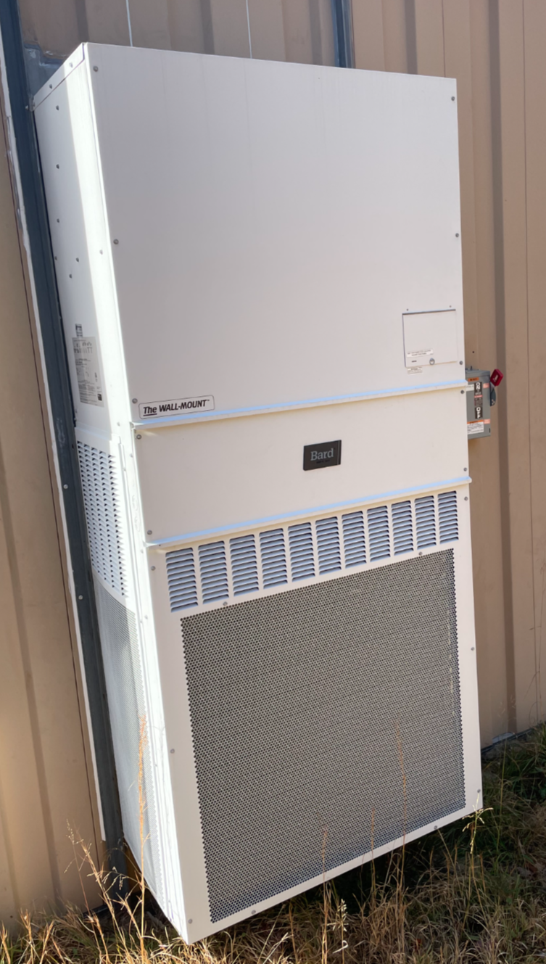
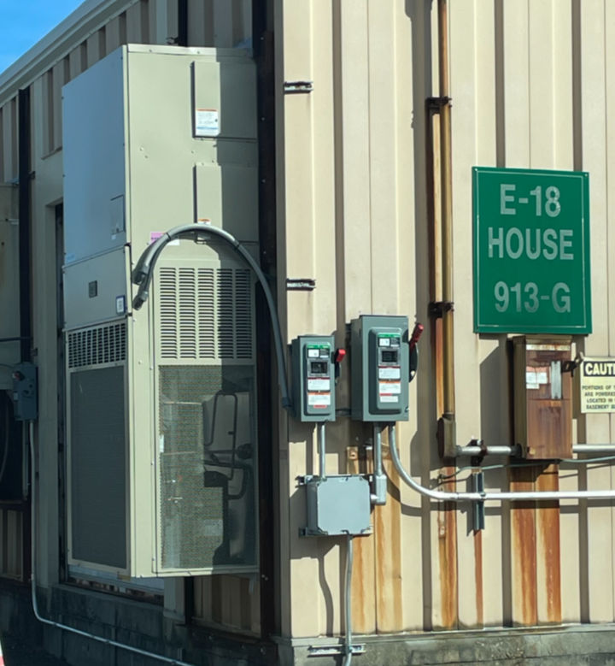
Cooling Infrastructure – RHIC Run 2024
Air Conditioning Systems
  Completed Repairs During RHIC Run (Estimated at approximately 23 systems)
  1000P - condenser Fan Replacement
  1002A - Thermostat Failure
  1008IR - Condenser Fan and Blade Replacement
  1009A - Refrigerant Leak
  RHIC Alcoves – 2C, 5B, 7A, and 9A
  Bard Unit Failures – 1002D, 1002F, 1005E, 1007W, 1010A, 1010B
  sPHENIX - Chiller Coil Replacement, Electrical grounding of IR Split Unit and sPHENIX – Gas Mixing House AC Unit
  1012 – Split AC Unit
  1012 – 50 ton Package Unit Failure
  1004A – Split AC Unit
  1004B – Control Room and High Bay AC Units (Installed prior to 2024 Run)
  1006 – 200 ton Chiller Repaired
  1006 – Rooftop Chiller Repaired
  Completed Replacements During RHIC Run (5 Systems)
  E18- Bard Unit
  A18 Bard Unit
  B18 Bard Unit
  1012 Bard Unit
  1006 Control Room

Slide 5
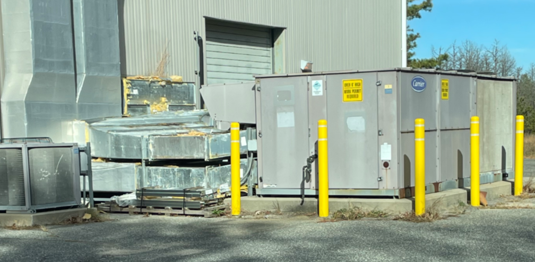
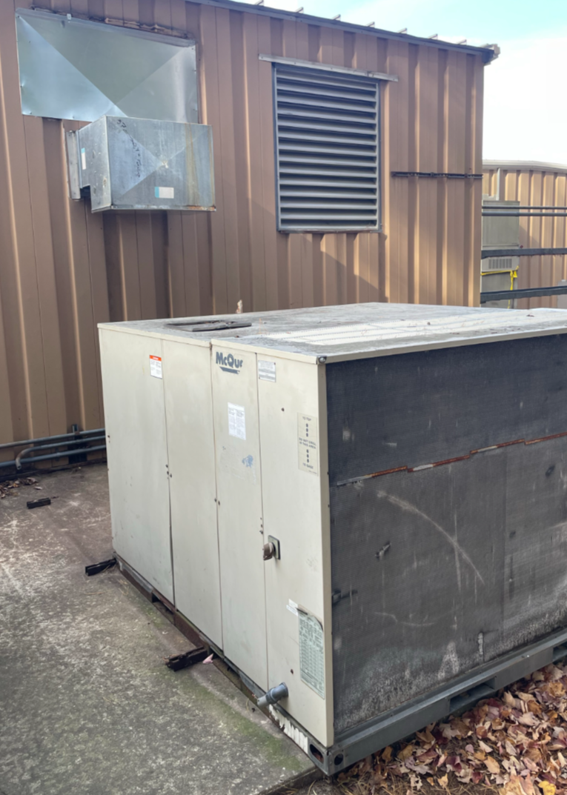
Cooling Infrastructure – RHIC Run 2024
Air Conditioning Systems
  Upcoming RHIC Maintenance Replacements
  1007W – Bard Unit
  1005E – Bard Unit
  1004B – 50 Ton Package Unit
  1004A – 75 Ton Package Unit
  L18A – 12.5 Ton Package Unit
  Alcove Split AC Units – Approximately 15 Units
  RHIC Run 2025 Preparation
  Coordinate with F&O for dedicate weekend and holiday AC Mechanic support
  Revisit remaining service contracts through AC unit manufacturers and increase if necessary
  Check existing spare parts inventory to purchase parts that were used during the previous RHIC Run
  Procure contract to ensure that larger capacity air conditioning systems with portable generators are available for the next run from May through October 2025

Slide 6
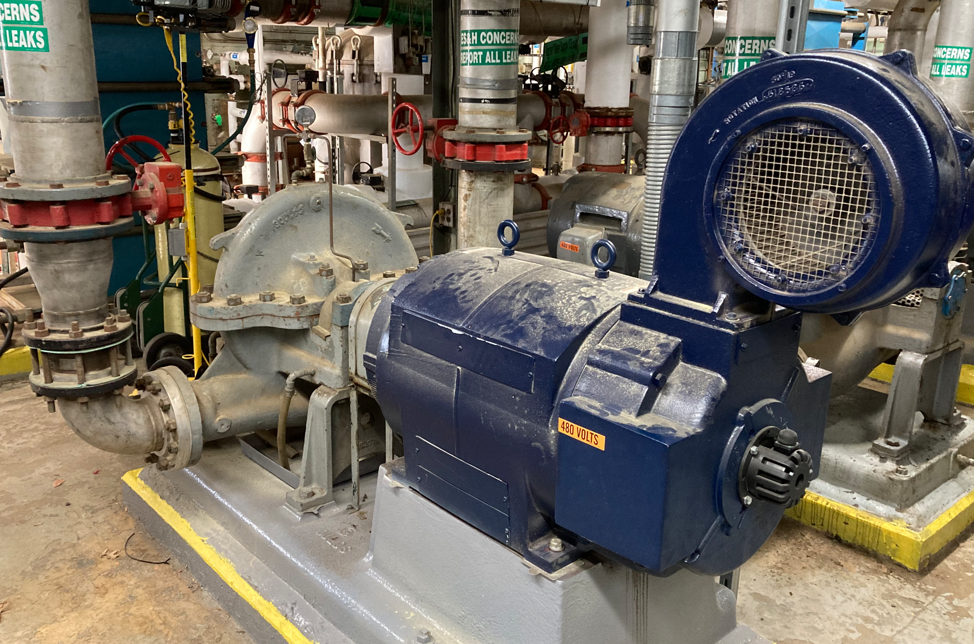
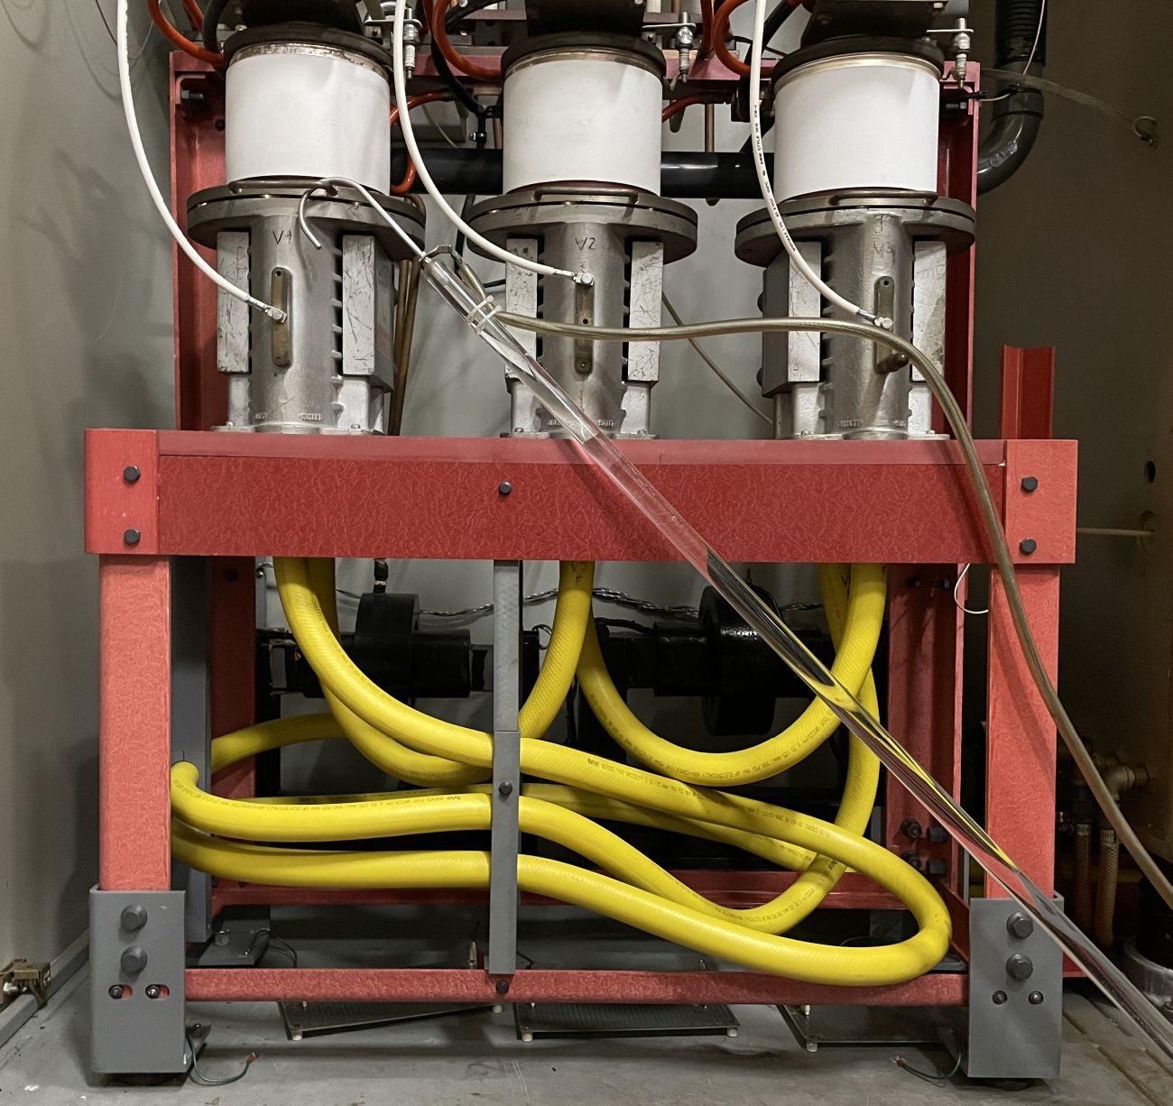
Cooling Infrastructure – RHIC Run 2024
Water Systems
2024 RHIC Run – Pre Run Preparation and Operations through hot summer months
Cleaning of critical water systems heat exchanges to optimize performance
  Booster Main Magnet System
  Booster RF System
Preventative Maintenance for Water Systems Equipment
  Greasing Program for pump and fan motors
  Changing of bag filters (Over 60 systems) and cleaning strainers
  Cooling tower sanitation and cleaning prior to start-up
  Routine maintenance day pump rotations and fan belt checks
  Cleaning and unclogging cooling tower spray nozzles throughout to optimize performance
  Daily inspections of AGS Main Magnet water system
Repairs and Replacements
  Replaced AGS Main Magnet pump motor # 1
  Rebuild of AGS Evaporative Cooler # 5 basin
  Replacement of LINAC modulator flow switch (Total of 18)
  Re-hosed LINAC modulators (Total of 36)
  Repaired water systems pumps (Total of 20)
  Re-piped bag filter manifold at LINAC to add additional filter for RF system

Slide 7
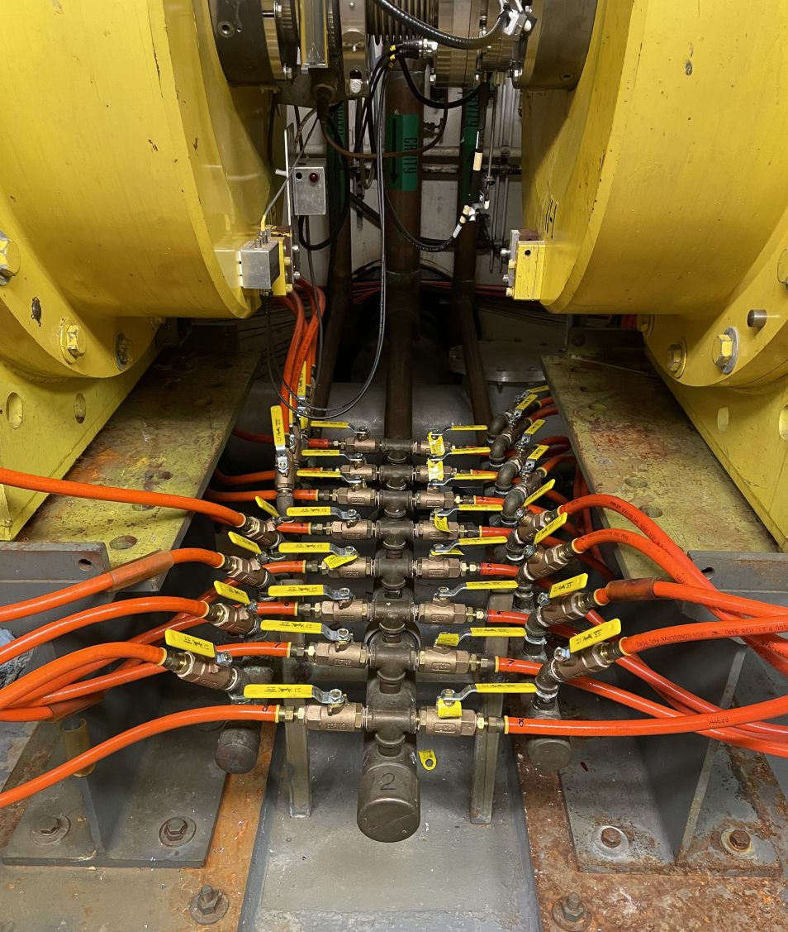
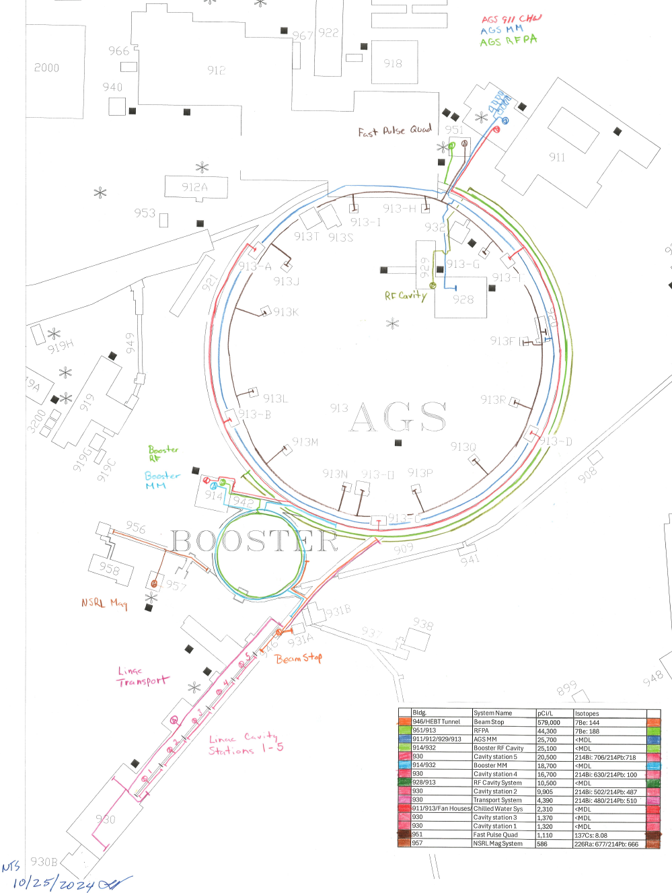
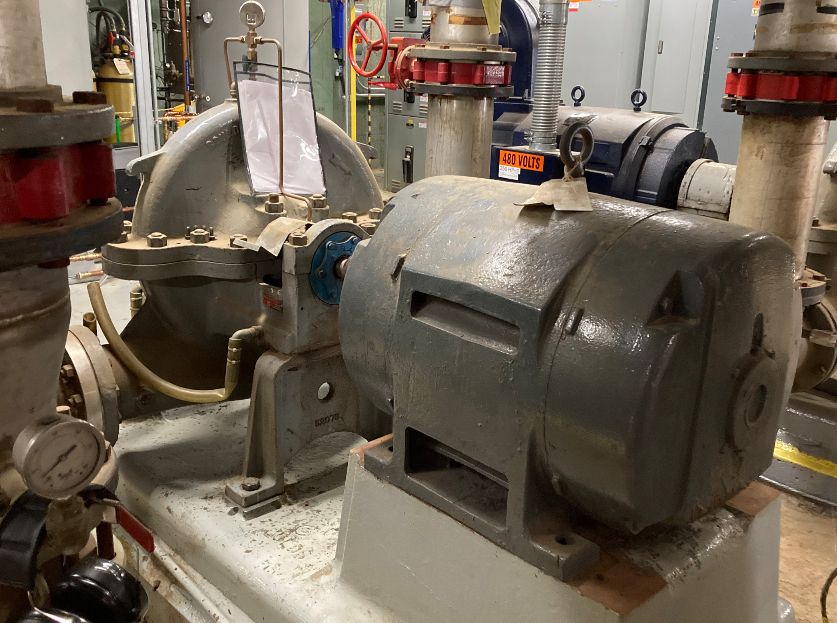
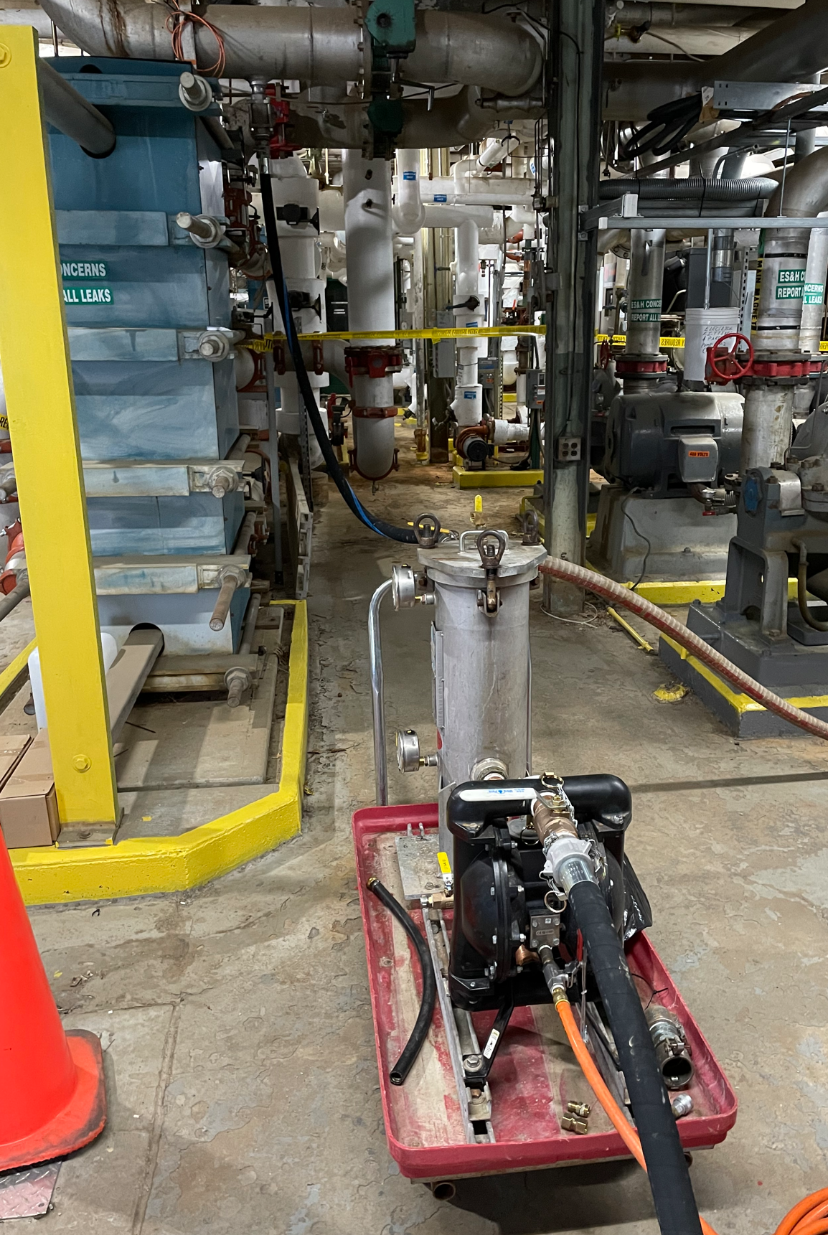
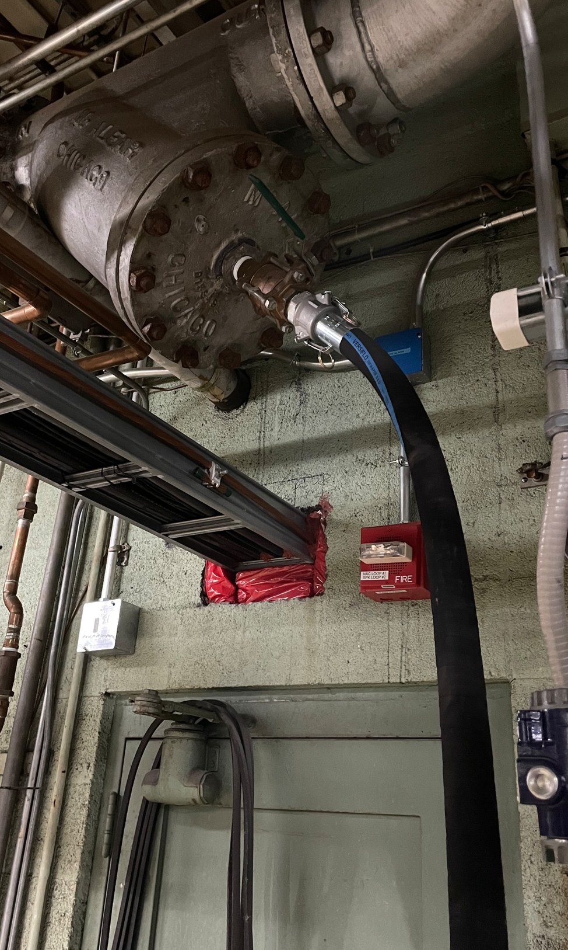
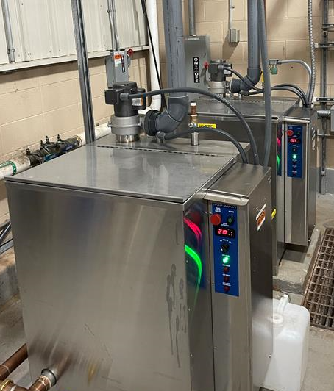
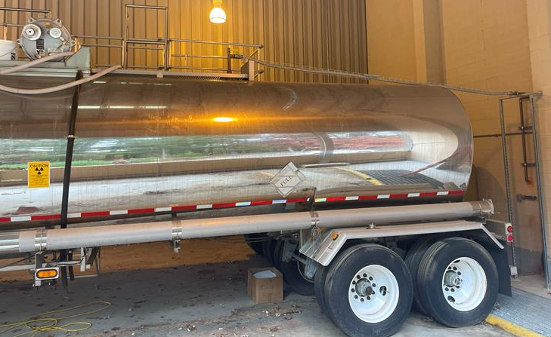
Cooling Infrastructure – RHIC Run 2024
Water Systems
RHIC Maintenance Shutdown Work and Preparation for 2025 RHIC Run
Greasing Program for pump and fan motors
Changing of bag filters (Over 60 systems) and cleaning strainers
Cooling tower sanitation and cleaning
Installation of isolation valves for LINAC Cavity Tanks 1, 2 and 3 for ease of maintenance
Gearbox oil change for cooling tower fans (Total of 10)
Verification of flow switch operation for LINAC modulators
Replacing AGS Main Magnet pump motor # 2
LINAC RF Pump VFD
Tritiated Systems Management – Draining of systems to manage inventory

Slide 8
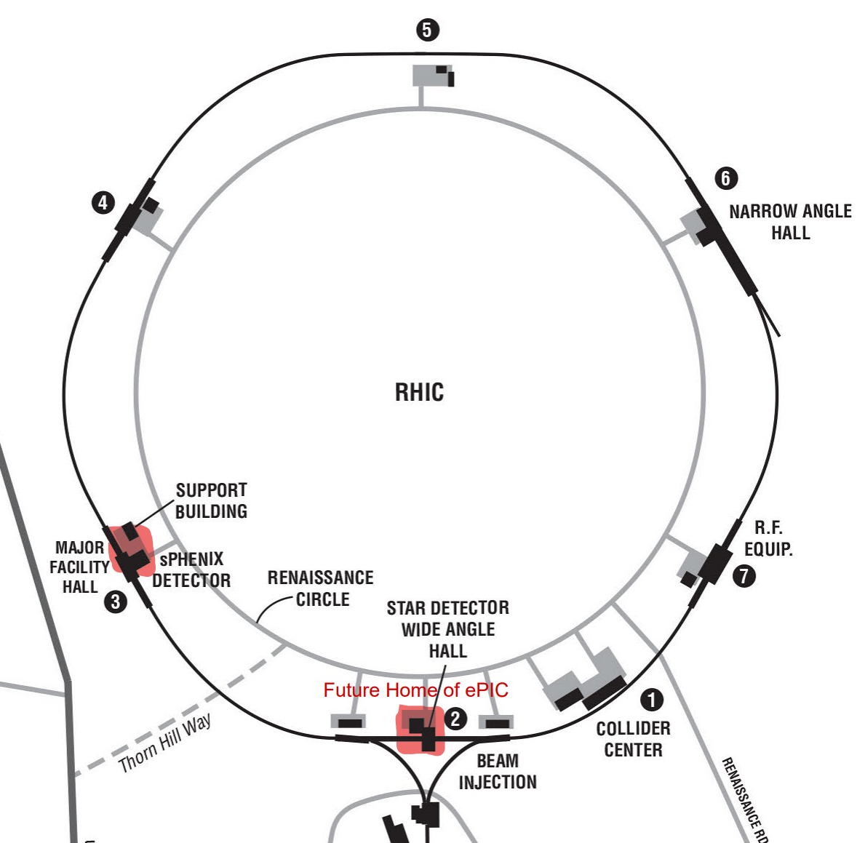
RHIC R&R – Description of Project
Definitions
The first “R” is for REMOVALS that within RHIC to allow for the installation of EIC
The second “R” is for REPURPOSE by EIC and the responsibility of this project is to identify what EIC would like to keep and to turn over to EIC for repurposing
What’s included in the RHIC R&R Project
Accelerator Removals
STAR Removals & Repurposing
sPHENIX Removals and Repurposing
1008 Muon Steel Removal
How does this Benefit the Lab and EIC
To allow for the installation of the ePIC Detector
To allow for ePIC to repurpose components from STAR and sPHENIX – Anticipated cost and time benefit
Removal of Muon steel will allow for flexibility of future EIC needs
Removing Muon steel provides for additional access needs for removals and installation

Slide 9
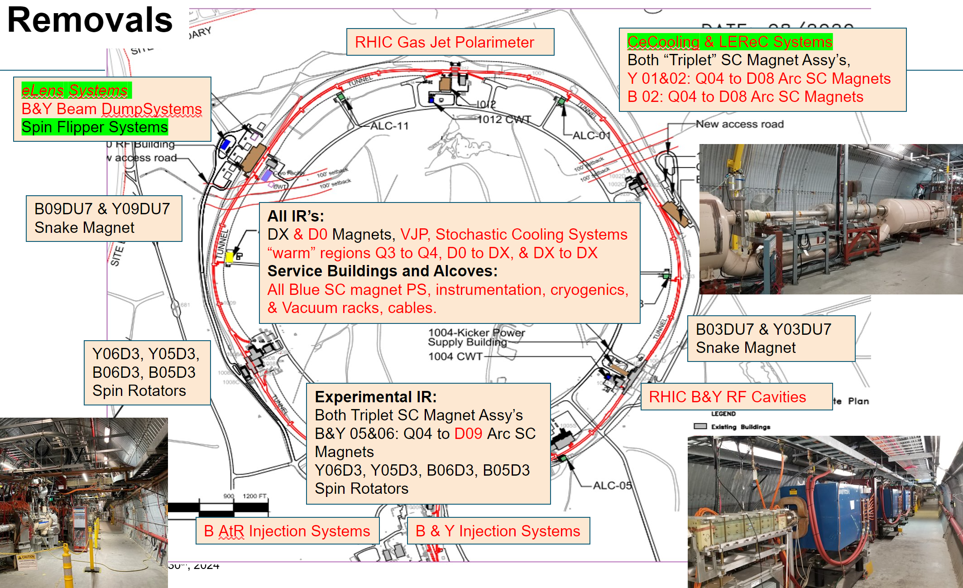
RHIC R&R – Scope of Project
RHIC Accelerator Removals
This project is broken up into twelve (12) areas within the RHIC Ring
Six (6) sections within the RHIC Ring (Arc Sector 01, 03, 05, 07, 09, 11)
Six (6) IR Regions within the RHIC Ring (1002, 1004, 1006, 1008, 1010, 1012)

Slide 10
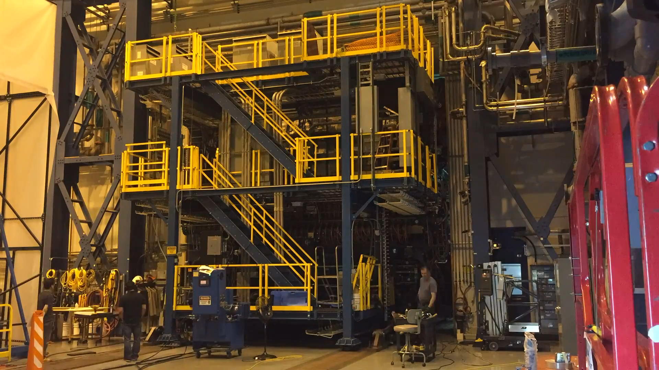
RHIC R&R – Scope of Project
STAR Removals
Prepare and roll out STAR into Assembly Hall
Uninstallation of Endcap Calorimeter
Disassemble Main STAR detector
Dispose, Recycle, Store
  Forward EMCal, Hcal
  Endcap Calorimeter
  Main Detector
  Platform and Structures
Project Management, ESH, Administration, Technical Support, etc.

Slide 11
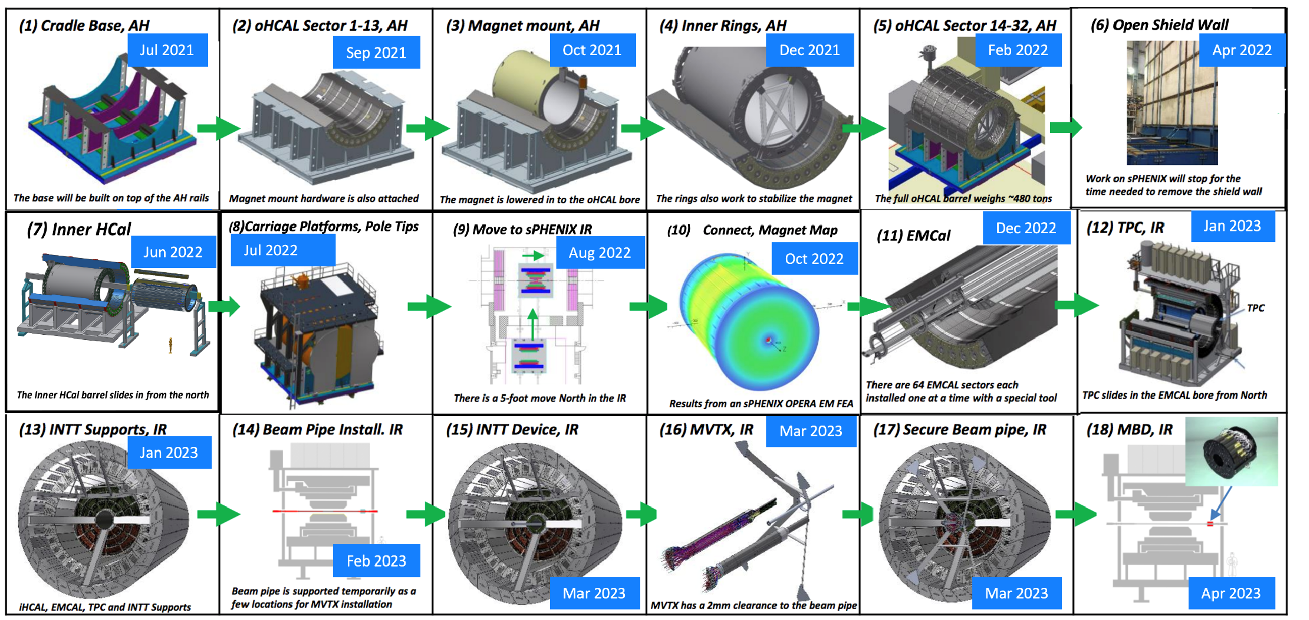
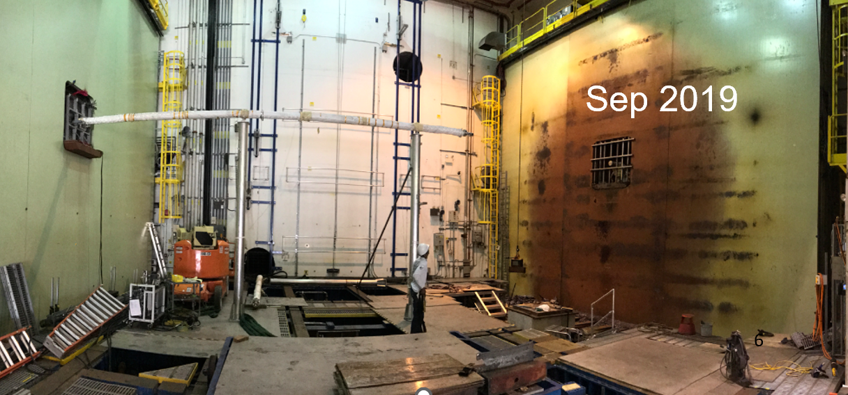
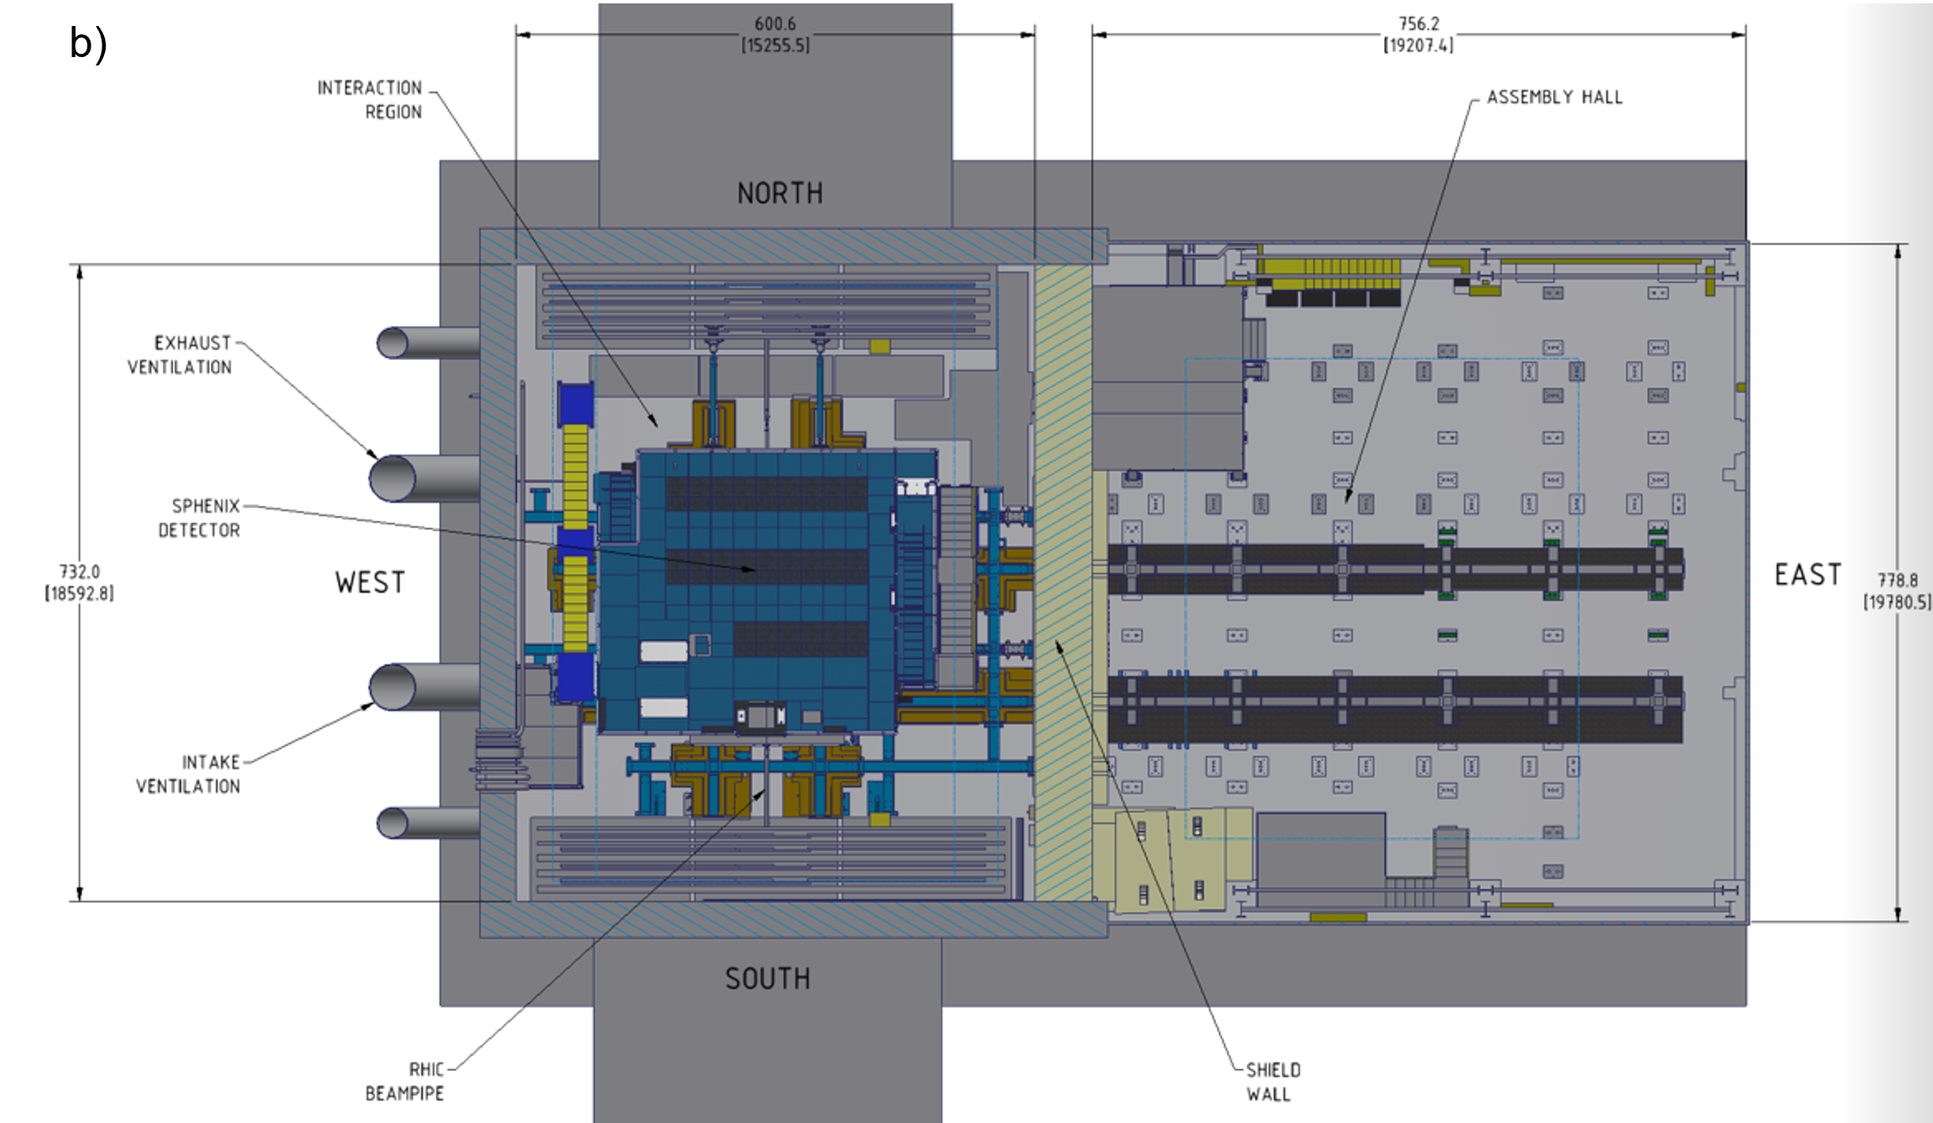
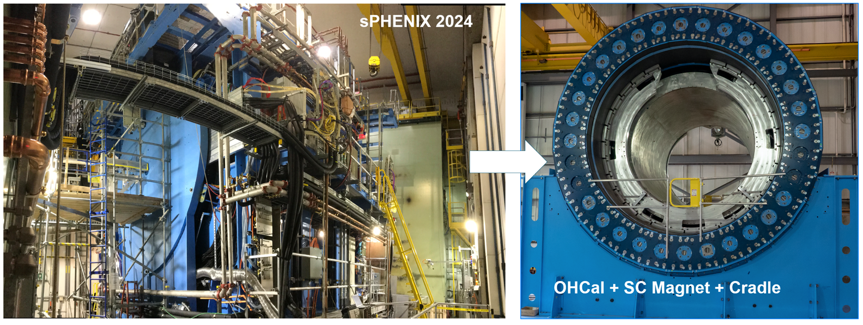
RHIC R&R – Scope of Project
sPHENIX Removal

Slide 12
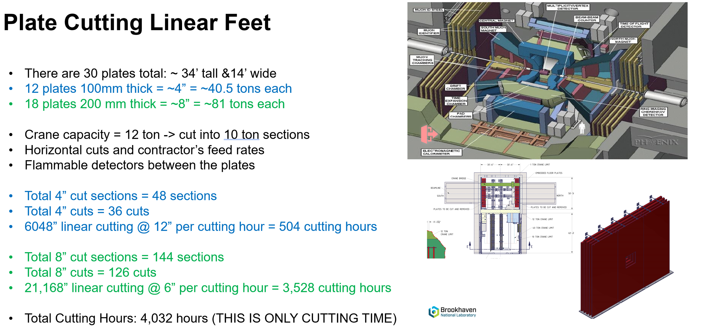
RHIC R&R – Scope of Project
1008 Muon Steel Removal

Slide 13
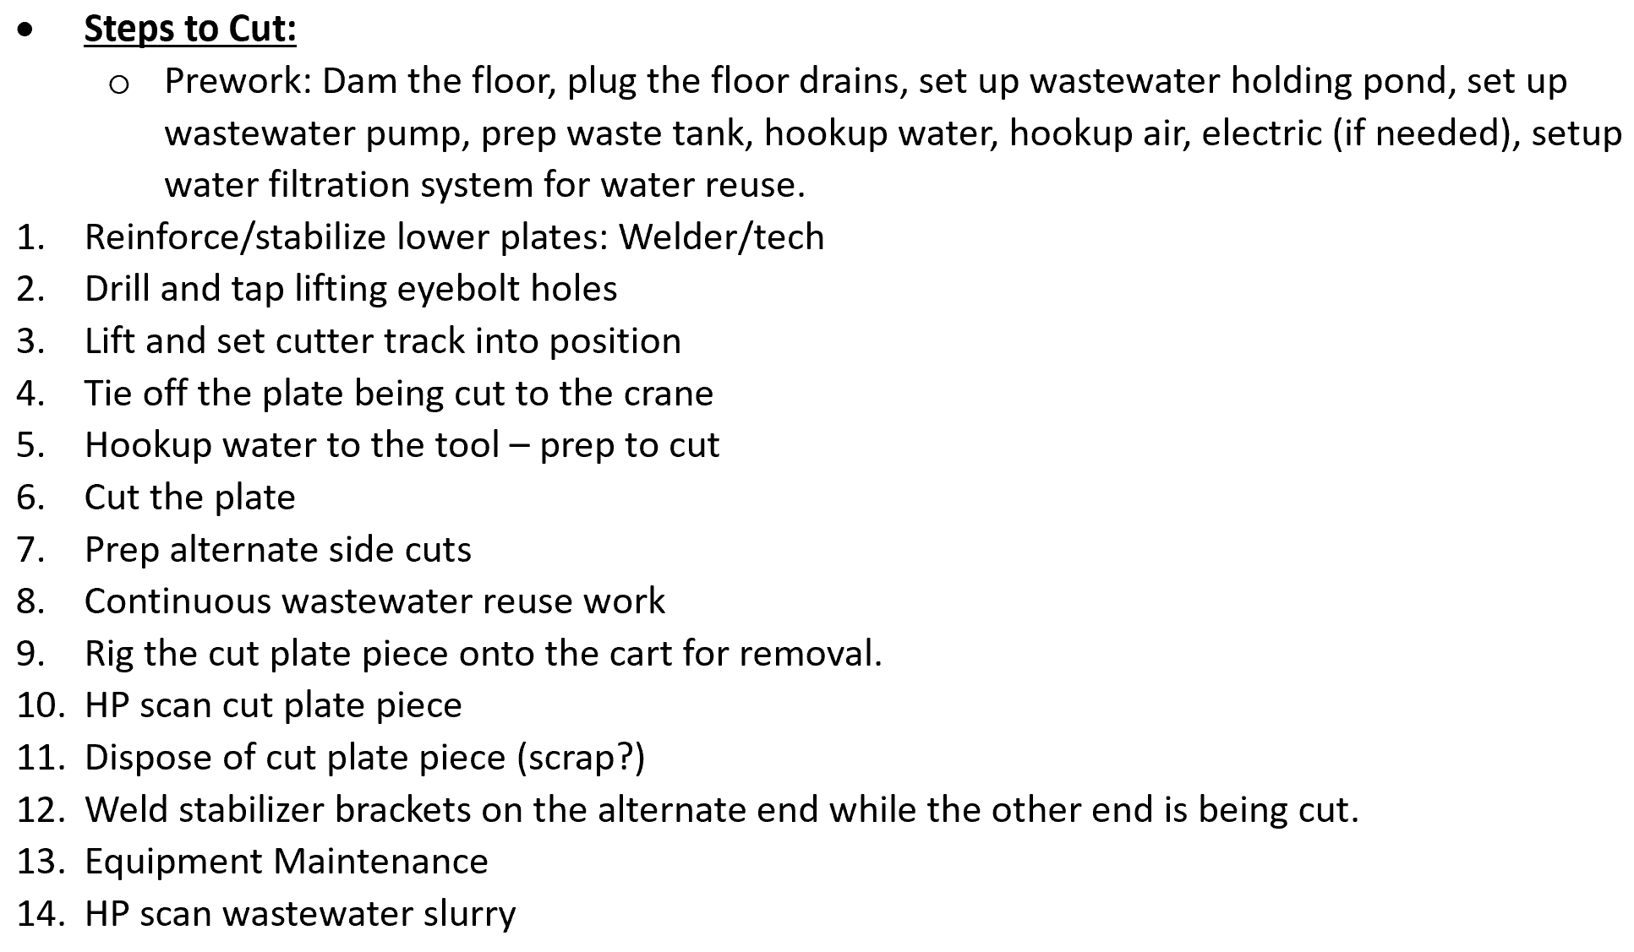
RHIC R&R – Scope of Project
1008 Muon Steel Removal

Slide 14
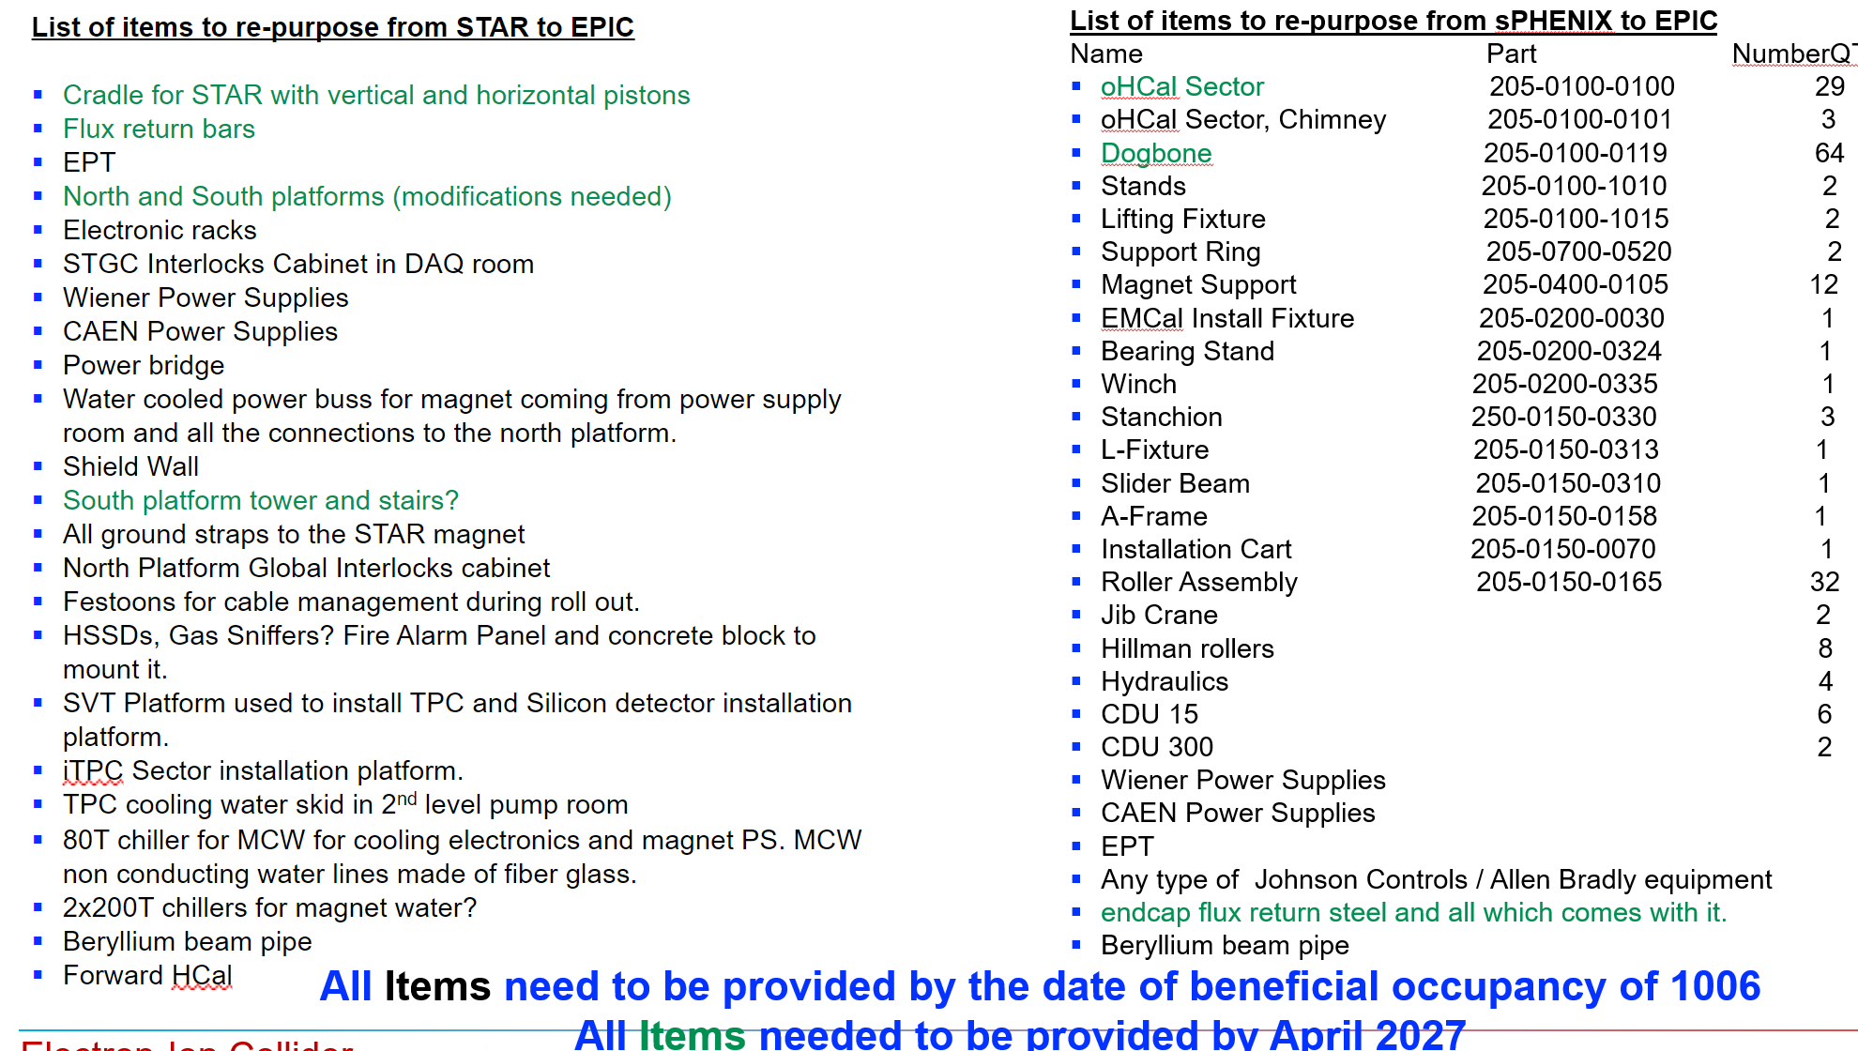
RHIC R&R – Scope of Project
Repurposed Components for ePIC

Slide 15
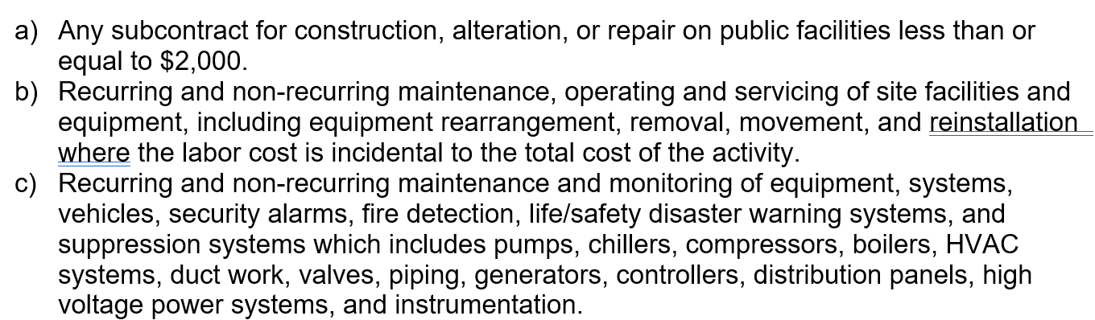
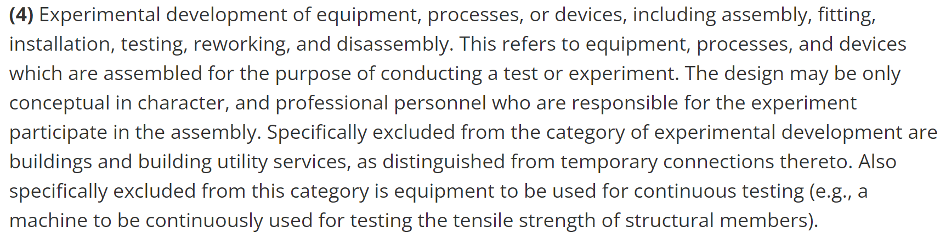
RHIC R&R – RHIC Maintenance Shutdown Preparation
Work Planning, Cost Estimates, Work Permits, Lockout Plans, etc.
E-Lens Removal
Scheduling of priorities – This will be required to be carefully coordinated with EIC
Required purchases in order to start work once the RHIC run is complete (Tools, lifting fixtures, etc.)
Construction Wage Act Screening (Formerly Davis Bacon Act) - All construction-type work done at BNL must have a determination rendered by Department of Energy Brookhaven Site Office (DOE-BHSO) prior to the start of that work. This subject area describes the procedures for screening work for applicability to the Construction Wage Rate Requirements and documenting the determinations according to DOE-BHSO expectations through the use of Construction Wage Screening Documents (CWSD) and logbook entries
A4
A4 - Screening is required to be submitted to SME and BSHO Site Office for Approval

Slide 16
RHIC R&R – Risk, Coordination and Responsibilities
Risk Coordination with EIC
The sequence of steps will be highly dependent on the modifications required for 1006 Assembly Hall and IR Facility. Staffing will be required to shift to areas of need for the duration of the project (Example: When will modifications to 1006 start and when will ePIC need the sPHENIX OHCal)
Allocation of funds to perform work is unknown
Competing demand for resources with Accelerator Dependencies, C-AD Operations and RHIC R&R with the current limited staff – Staff is limited and there is not enough staff to perform all work for all EIC project needs
Responsibilities
RHIC R&R is managed by C-AD Experimental Support & Facilities (ES&F) Division – with anticipated help from EIC, Physics and C-AD Accelerator Division
Accelerator Removals
    Project Lead – Chris Pontieri and Marianna Albanese Along with other representatives from C-AD Accelerator Division (EIC and ES&F)
    Knowledgeable Person – Joe Tuozzolo (EIC)
    Working Removals Team – Provided by CAD
STAR Detector and 1006 Components R&R
    Project Lead – Jameela Middleton (ES&F)
    STAR Knowledgeable Person – JH Lee and supporting staff (Physics)
    STAR Technical Support – Rahul Sharma (ePIC)
    Working Removals Team – Provided by CAD
sPHENIX Detector and Components R&R
    Project Lead – Marianna Albanese (ES&F)
    sPHENIX Knowledgeable Person – Ed O’Brien (Physics)
    Working Removals Team – Provided by CAD and Physics
Removal of Building 1008 IR Muon Steel
    Project Lead – Marianna Albanese (ES&F) with Support from CAD and Physics

Slide 17
RHIC R&R – Timeline, Cost Estimate and Assumptions
RHIC R&R is currently scheduled to begin on January 1, 2026 upon completion of the final RHIC run
  Accelerator Removals – Estimated duration is approximately 24 months ($40.2M)
  STAR – Estimated duration is approximately 18 months ($9.8M)
  sPHENIX – Estimated duration is approximately 24 months ($13.2M)
  Muon Steel – Estimated time of completion is approximately 36 months ($21.5M)
TOTAL = $84.5M
No cost has been included for disposal or recycling
There is an implicit assumption that resources are available to perform this work as needed
Removal of STAR will be prioritized in order to turn over the space to ePIC
Accelerator and Experimental Dependencies needs falls under a separate scope of work and is not part of the RHIC R&R
Duration, staffing and cost is dependent on annual funding

