Slide 1
RHIC 2025 Operations Plan
T Shrey
11/15/2024

Slide 2
Gold Beam Ops
Gold @ 100 GeV, 2 collisions
20-28 weeks
Cooldown .5 weeks
Setup and sPHENIX background work 2 weeks
Ramp-up .5 weeks
Physics 17-25 weeks
Similar conditions to Run 23
2 collisions, levelling at STAR via vertical alignment, abort gap at IP2&8, crossing angle in each IP
This time we know a little more
56 MHz could be driving what was our transition issues. More damping might help, moving the beam tune away from any resonance helps prevent emittance blowup (did this right before the physical blow up of the machine).
We have backed down our max target to 1.8/bunch at physics. I don’t see why we can’t eventually get beyond that.

Slide 3
Gold Items Review
Stochastic Cooling
Ops tuning of SC Fear Factors
Collimator games throughout the store
BBQ and gold
Struggles with ramping gold in FY23 with spurious peaks at transition and resulting emittance blowup
Operational RF:
Injection – 28 MHz
Acceleration – 28 MHz, 201 MHz Landau
Store – 28 MHz, 197 MHz, 56 MHz

Slide 4
Outstanding Issues
Summer operations
Power dips, building AC issues
We did much better in 24 than 23 as far as AC, but the RHIC ps were only working at half current. Gold will push everything.
sPHENIX mVTX backgrounds
Working group continues ideas
It will ultimately be a combination of methods I believe
STAR blue Au78 backgrounds
Not clear that we can fix this and yellow mvtx issue simultaneously
All the new ‘Experts’
Devices/systems have been handed off (sometimes multiple times) over the last decade. The people who are now responsible for things rely on Operations and a (very) small group of people to tell them what to do. Our plate is already full, we cannot be telling experts when their systems are not working correctly. Daily logview checks and subscription service for alarms (even below the level that appear in MCR) need to be utilized.

Slide 5
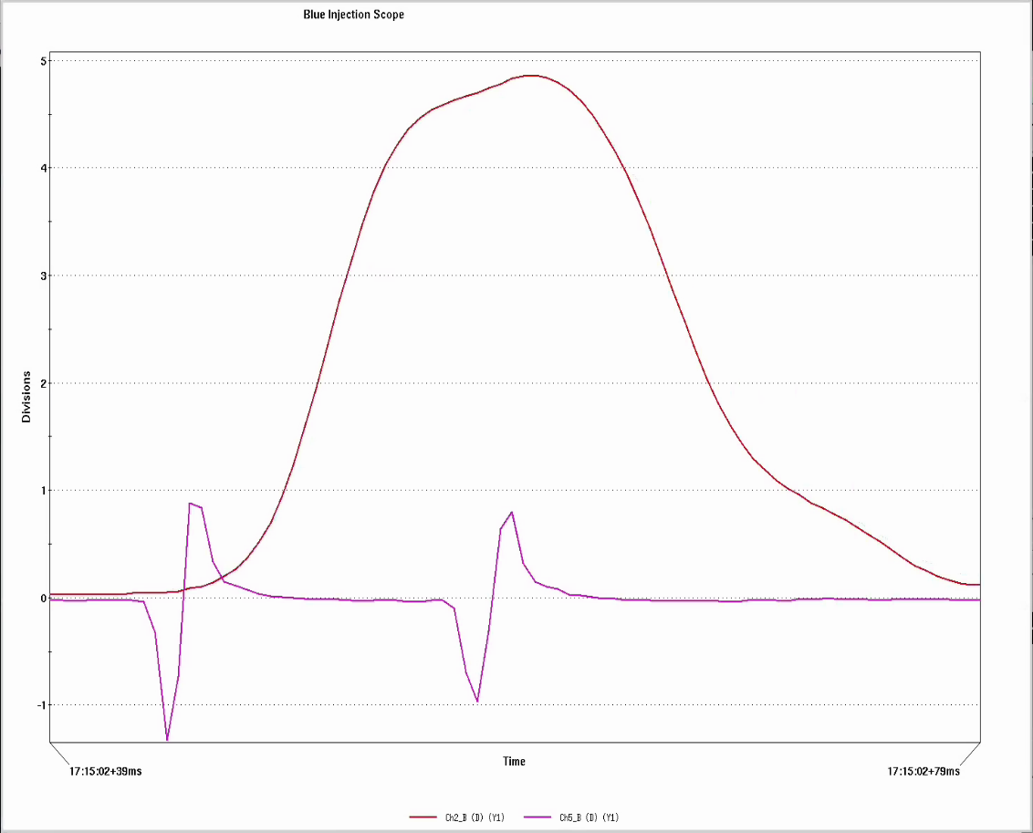
Blue Kicker
Blue injection kicker, module 2 and the beam
If you gave me 4 of these I would be happy (ish)

Slide 6
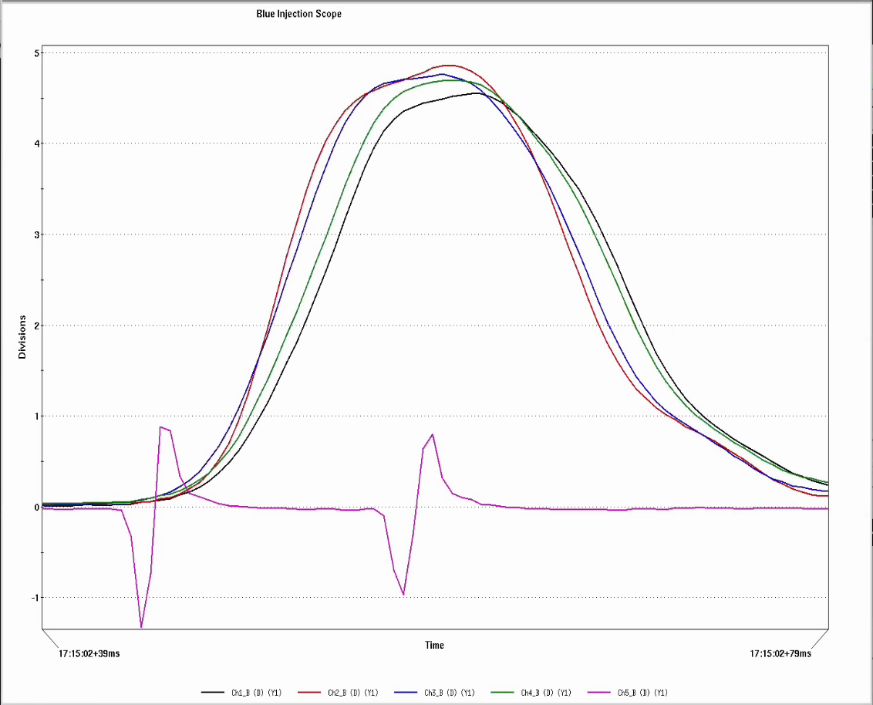
Blue Kicker 2
Blue injection kicker, all modules and the beam
Spread in ramp rates produces a spread in kick time roughly equal to the beam width

Slide 7
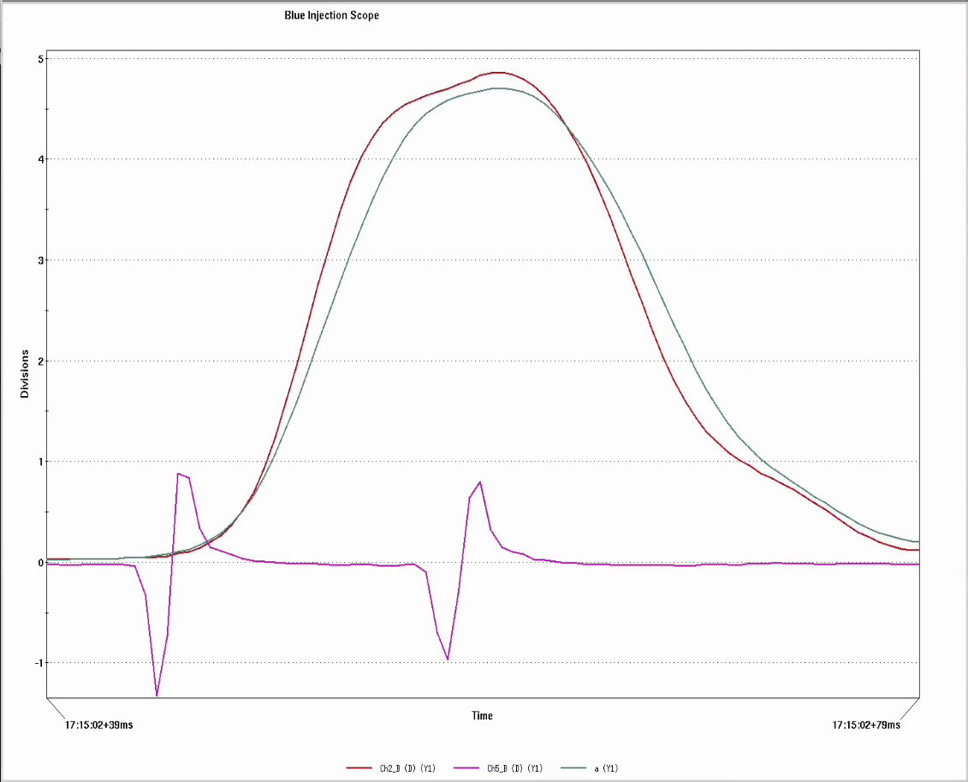
Blue Kicker 3
Blue injection kicker, mod2 vs average of all modules and the beam
Slower rise means less effective kick AND the head of the beam gets less kick than the tail
This system should run all shutdown until we can find settings that get us 4 copies of module 2 without issue.

Slide 8
Proton Beam Ops
Polarized Protons @ 100 GeV, 2 collisions
6 weeks
Setup .5 week
Ramp-up .5 week
Physics 5 weeks
Similar conditions to Run 24
2 collisions, levelling at STAR via vertical alignment, abort gap at IP2&8, crossing angle in each IP
We have known issues with the lattice we used (phase advance silliness left over from Run15 elens setup). A truncated version of the Run22 lattice makes more sense for this run (GRD already built this).
RF
9 MHz (acceleration) and a 197 (landau)
28 MHz rebucketing

Slide 9
Oxygen Beam Ops
Oxygen @ 100 GeV, 2 collisions
2 weeks
Setup .5 week
Physics 1.5 weeks
Expectation is that we will just load up archives
2 collisions, abort gap at IP2&8, crossing angle in each IP

Slide 10
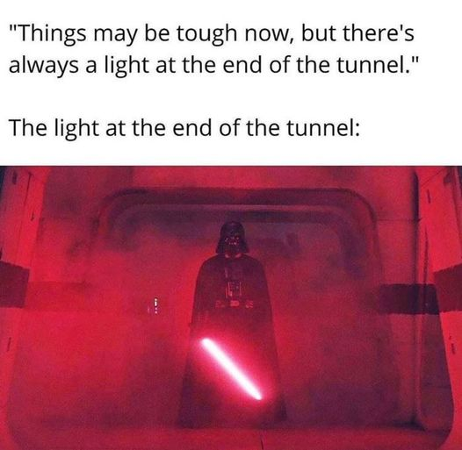
Summary
Matching Run23/24 should not take a great deal of effort.
Schedule: 3/24 cooldown. Maybe. Everything else TBD.

