Slide 1
Shutdown ‘24
Paul Sampson
Date November 15th, 2024

Slide 2
Agenda
General information
Status
Progress
Schedules
Summary

Slide 3
General Information:
Late start due run extension
Duration uncertain
Injector programs ran to November

Slide 4
CAD Status
EBIS running setup
LINAC Booster and NSRL Shutdown began November 1st and continues
AGS, AtR and RHIC Shutdown began October 21st and continues

Slide 5
RHIC HVAC
1004B Package unit #4- replacement for failed coil (warrantee). Work to be completed this month.
1004B Package unit #3- replacement installation
under way.A10 house
L18A package unit replacement underway
1007W Bard until replacement under way
1004A package unit shipping next week
1007 dehumidifier- repairs underway
Alcove units: maintenance, replacement and repair: 1A, 1B, 5A, 5B, 9A, 9B, 11A,11B and 11C

Slide 6
Systems Status:
Cooling towers:
Mandatory cleanings and shutdown, as needed.
Tower 1010 on for sPHENIX 80k circulation**
Tower 7 off, cleaned awaiting contractor for switching gear recall remediation.
All RF systems secured.
Most magnet systems secured, some testing, NSRL and Booster towers on for EBIS tuning.
**Leak found in heat exchanger, isolated, sPHENIX magnet “floating" until remediation completed

Slide 7
Progress so far:
LINAC:
Maintenance progressing on schedule.
Upgrades schedule permitting
55 total jobs submitted and scheduled
EBIS:
Tuning with beam down EtB will continue.
Cathode swap to follow.
Trap aperture change to TBD.

Slide 8
Progress:
EBIS – 19 weeks under way- Setup with beam at present.*
LION – 9 weeks to start in December.
LINAC maintenance continues.
BLIP:
Target cooling upgrades on track for January 24th completion.
Lighting repair ongoing.
Windows replacement in December.
Booster:
Vacuum (10 weeks) Under way.
RF PA replacement under way.
911 chilled water tower: progressing well
AGS : Cable trench remediation Is under way.
RHIC: Y12 valve box repair, locate repair other leaks: Under way
RHIC R&R:
E-Lens: Briefing meeting held, work to start today.

Slide 9
Booster and NSRL:
Vacuum work in BtA & Sectors F going well.
Bakeout as early as next week.
RF A3 PA modification is underway.
911 Chilled water tower replacement installation progressing on schedule (Chilled water for BRF).
NSRL tower temperature control valve replacement after EBIS is shutdown.
E4 Skew Quad installation complete.
36 other jobs approved; work is progressing on schedule.

Slide 10
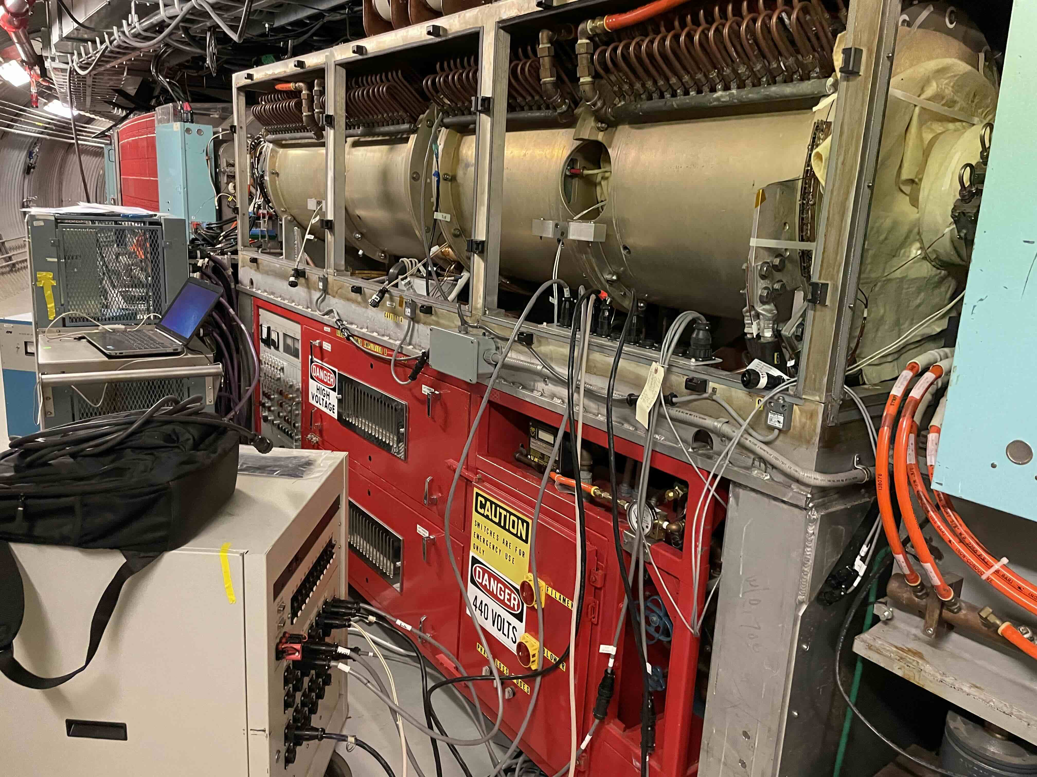

Slide 11
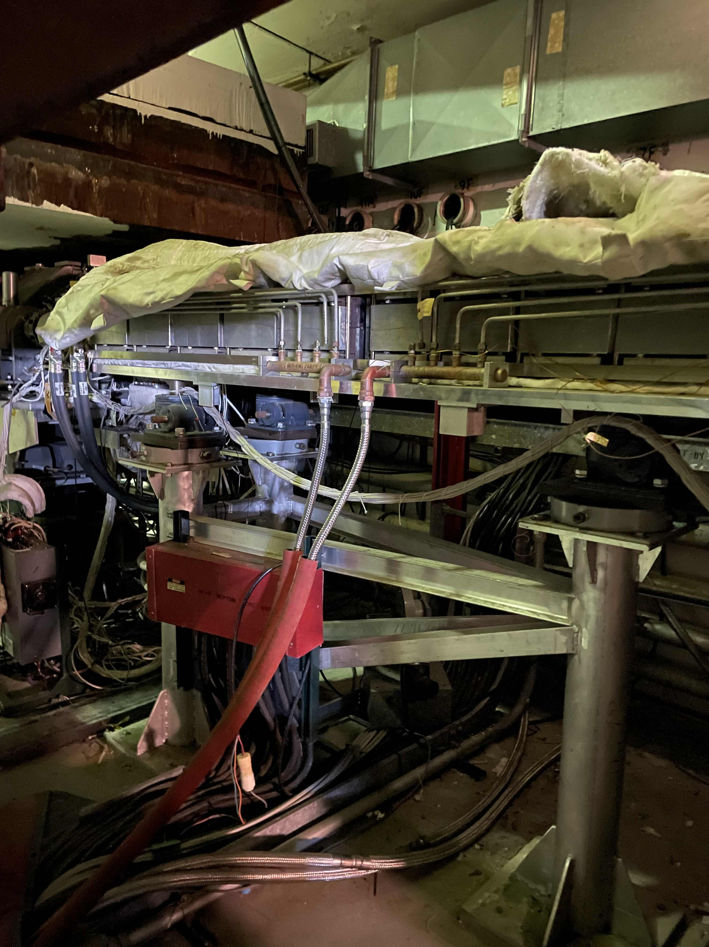

Slide 12
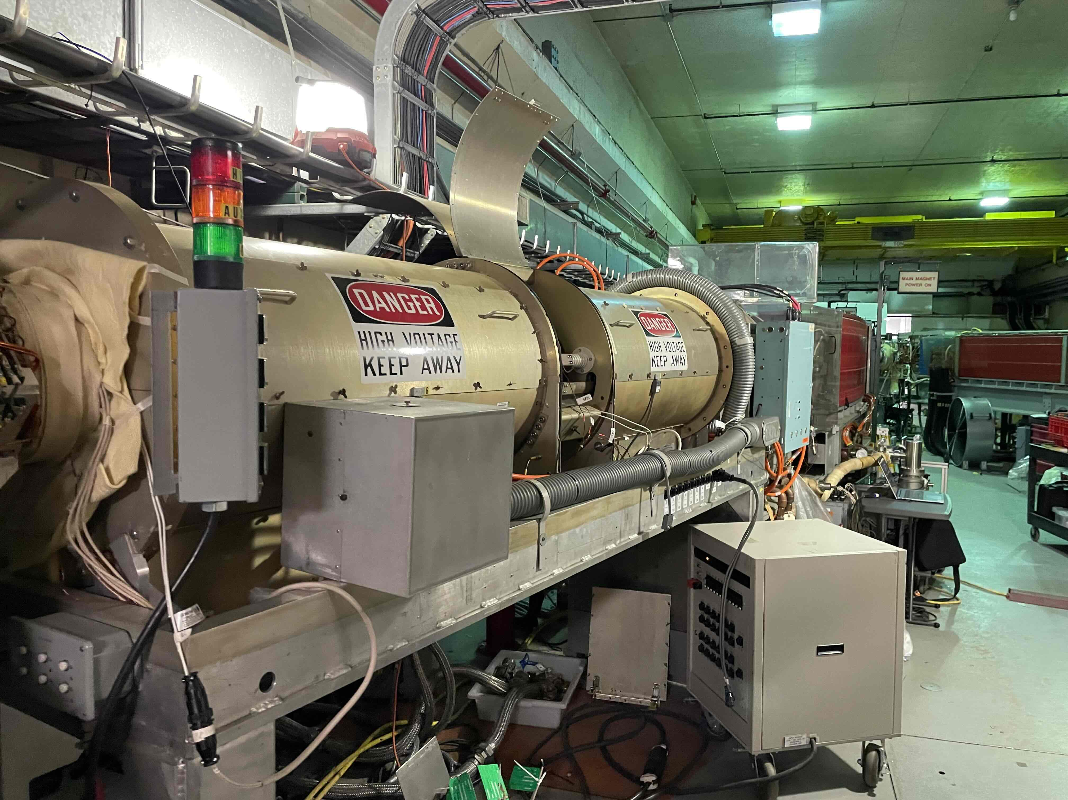

Slide 14
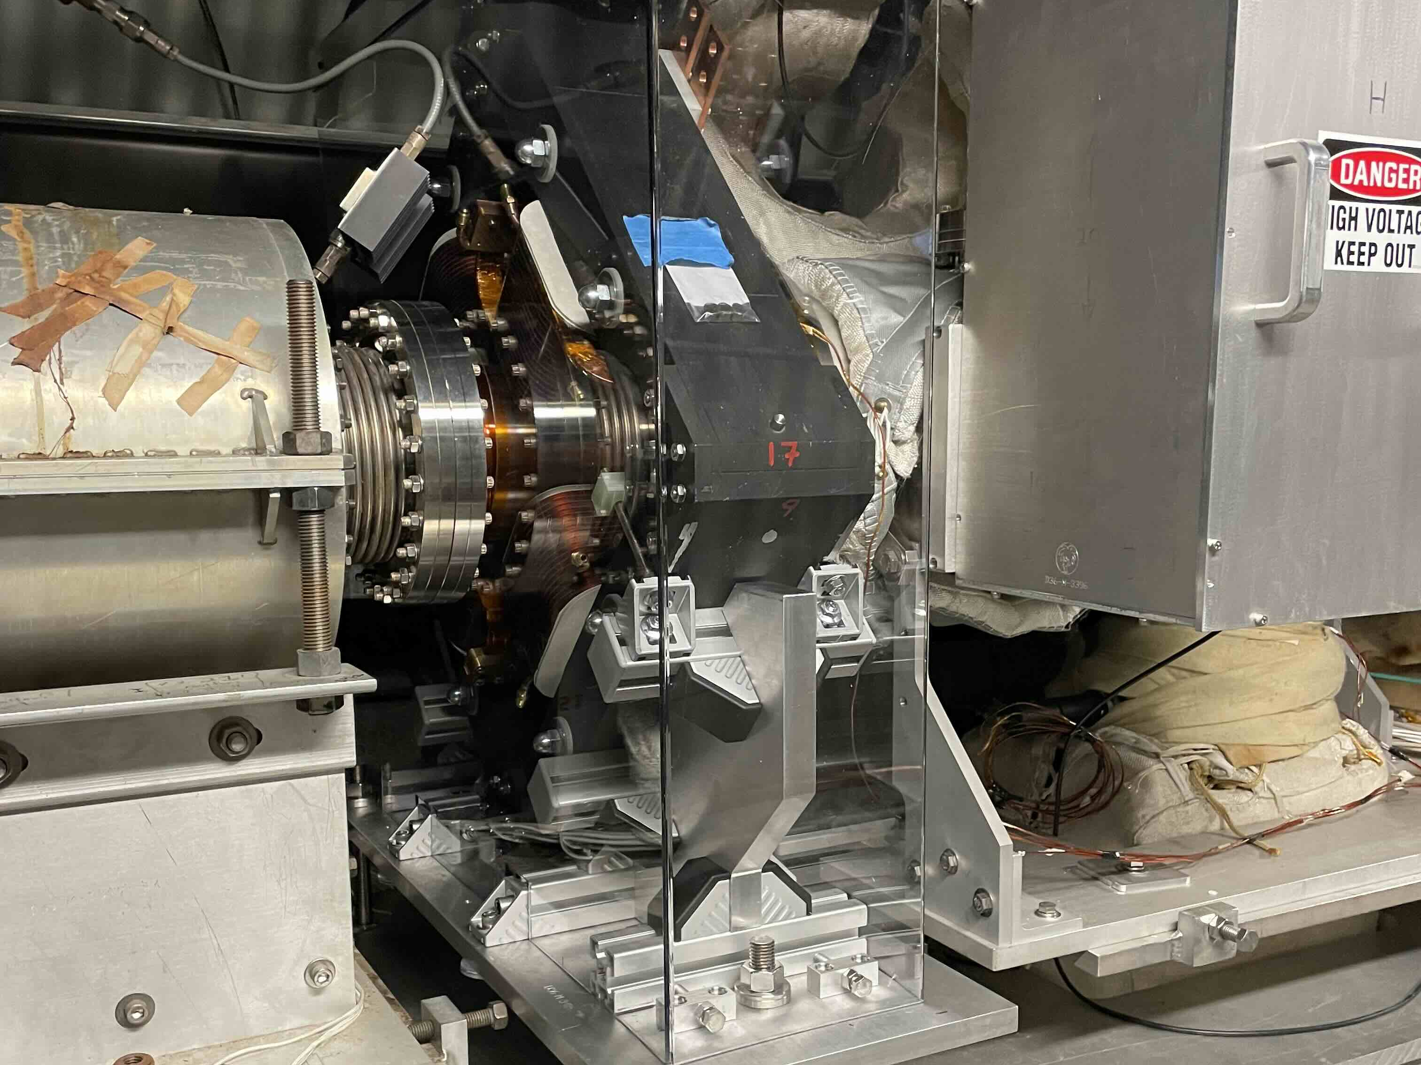

Slide 15
AGS and AtR
L18A trench remediation is underway.
Tunnel lights are on!
RF work completed.
Snake cold head replacement awaiting delivery.
Main Magnet water drained and refilled (tritium remediation).
Annual Maintenance.
45 jobs total scheduled

Slide 16
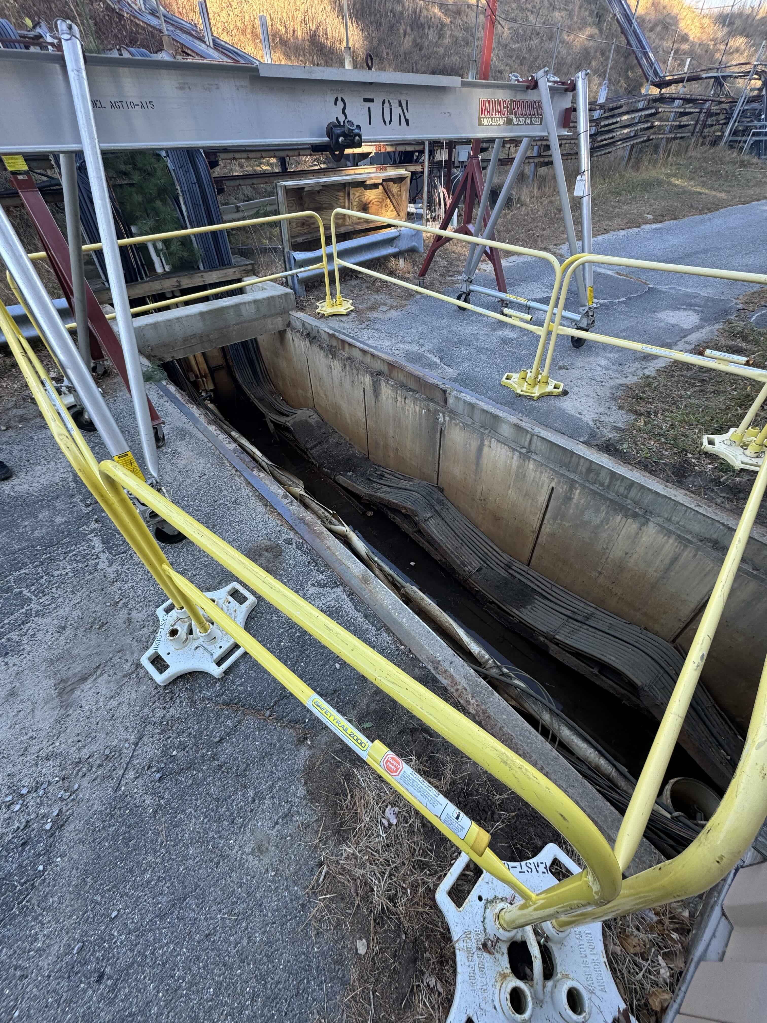

Slide 17
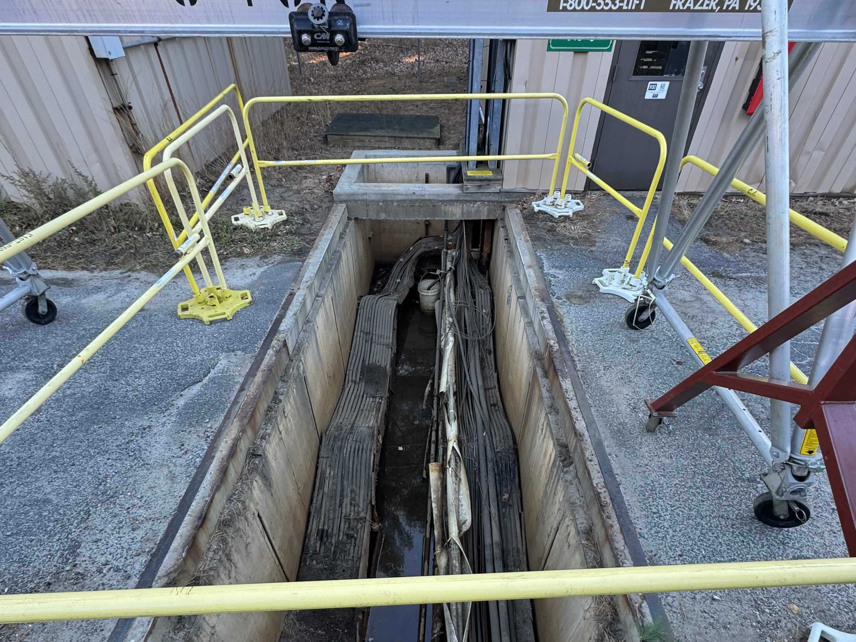

Slide 18
RHIC
Leak detection in the cryogenics system.
Yellow Valve Box 12 leak repairs pending.
e-Lens infrastructure removal started today.
Break vacuum, grind cryogenics only after assessment.
Cryogenics Tower 7 cleaned and shut down.
Switchgear remediation (manufacturer’s recall) to be addressed mid December.

Slide 20
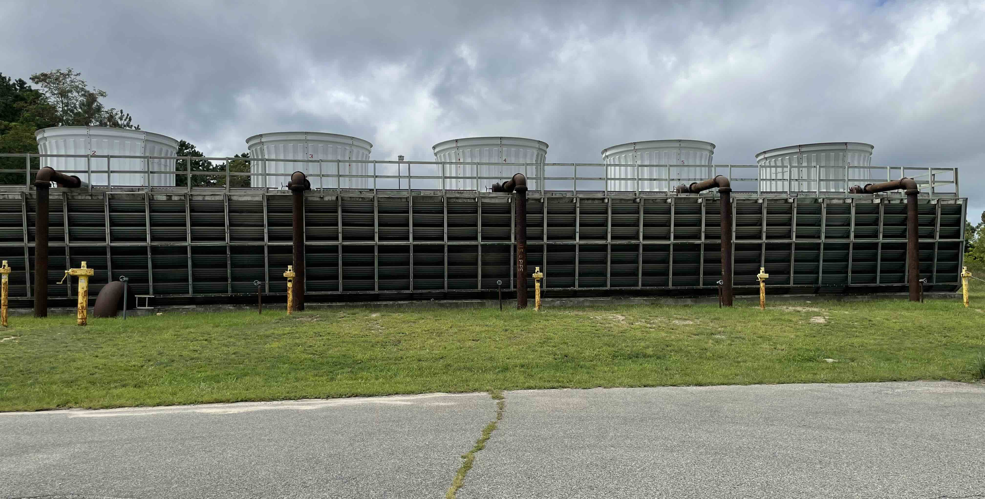
Tower 7

Slide 21
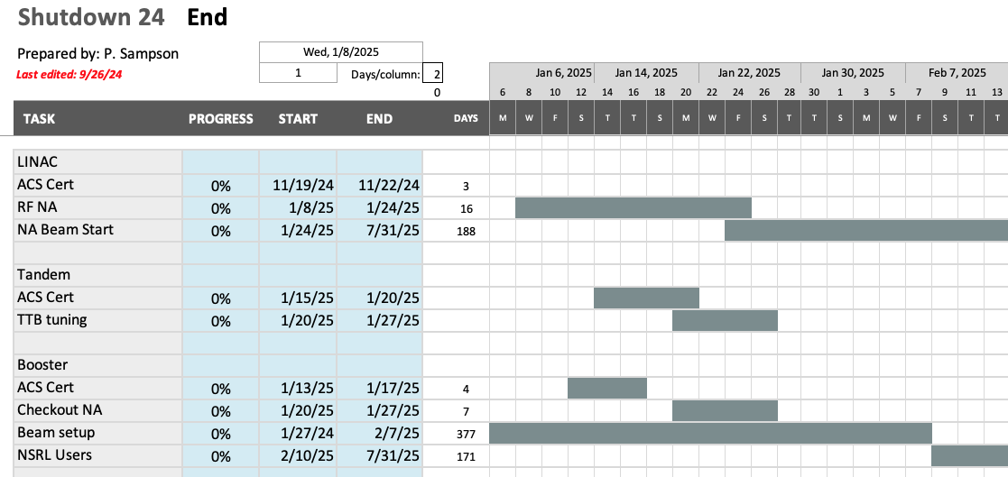
End of shutdown schedule: Injectors

Slide 22
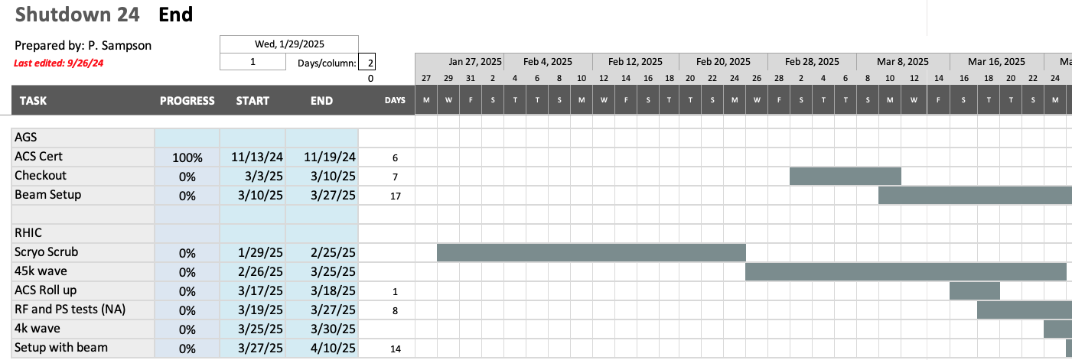
AGS and RHIC start Up

Slide 23
Early scenario?

Slide 24
Full schedules and timelines:
Available on the web “This Week”.
Discussed at meetings:
Supervisor’s meeting (weekly).
Shutdown “Time” Meetings (bi-weekly).
Links:
This Week
Shutdown Status
JRS
Web Status
Overview Project

Slide 25
Summary and comments:
This shutdown is evolving:
Work plans developed are dynamic and made able to adapt.
Large amount of work and coordination.
High risk jobs need careful scrutiny.
Resources:
Supervisor’s meeting (weekly).
Shutdown “Time” Meetings (bi-weekly).
Links:
This Week
Shutdown Status
JRS
Web Status
Overview Project

Slide 26
Thank you

