Slide 1

Quick Analysis of PDHD Pulser Runs for 7.8 & 14 mV/fC gains throughout 30 DAC settings.
Karla Téllez Girón Flores
09/16/2024

Slide 2
Datasets
NP04 TPC Electronics Studies Runs.
Pulser Calibration Runs 28250-28329 from last 07/29 and 07/30.
DAC = 0 - 30.
14 mV/fC & 7.8 mV/fC LArASIC gains.
2 µs CE Shaping Time.
LArASIC Output Mode: Single-ended.
Karla Tellez-Giron-Flores

Slide 3
Procedure
A peak finding algorithm finds and isolates the positive and negative peaks for each channel in data.
Averaging of all pulses for each channel effectively gets rid of most noisy tails.
Fitting waveforms using a two-step process
Pre-fitting using Ideal Electronics Response Function from 0-10 μs.
Fit using New Electronics Response Function from 0-50 μs.
Karla Tellez-Giron-Flores

Slide 4
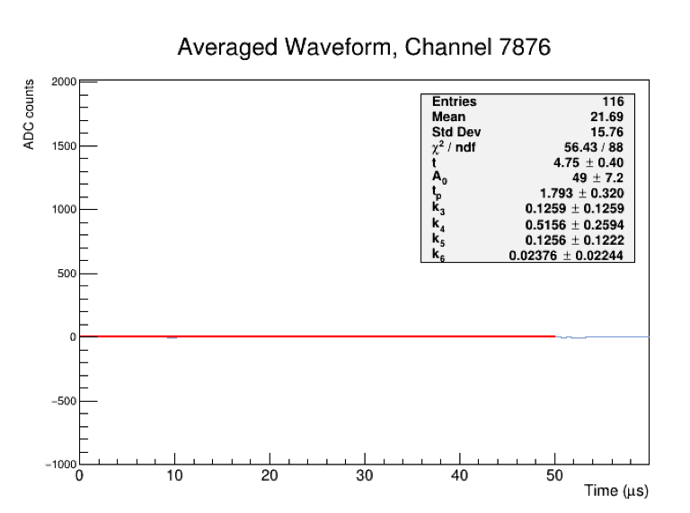
First of all, there are dead channels:
Karla Tellez-Giron-Flores

Slide 5
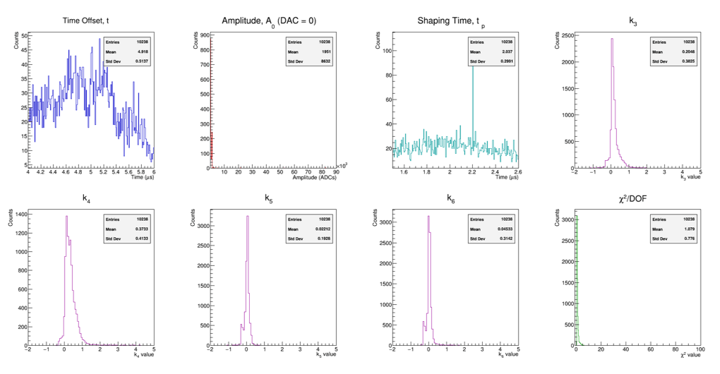
7.8 mV/fC Gain Fit Parameters
Karla Tellez-Giron-Flores

Slide 6
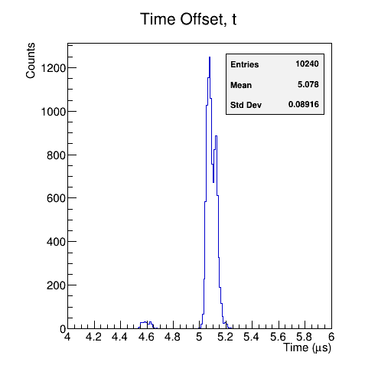
7.8 mV/fC Gain Fit Parameters
Observations
1) 4.6 μs bump in Time Offset distribution
Seen before.
Present throughout all DAC settings and both gains.
Associated to the electronics.
Karla Tellez-Giron-Flores

Slide 7
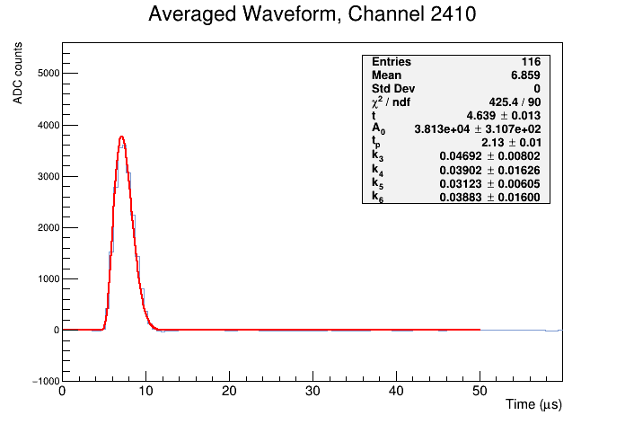
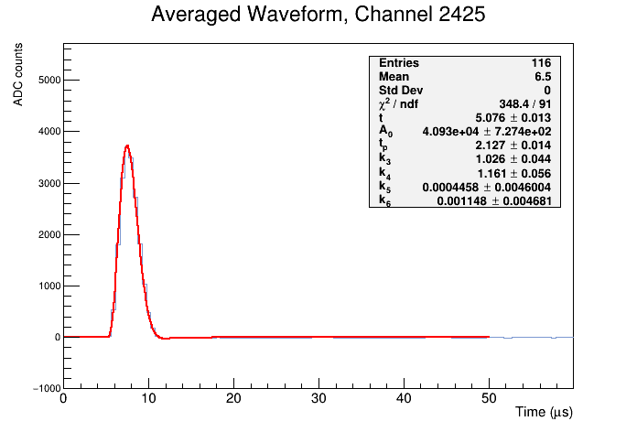
7.8 mV/fC Gain Fit Parameters
Observations
1) 4.6 μs bump in Time Offset distribution
Karla Tellez-Giron-Flores
Notes:
Plots from Run 28265, DAC=15

Slide 8
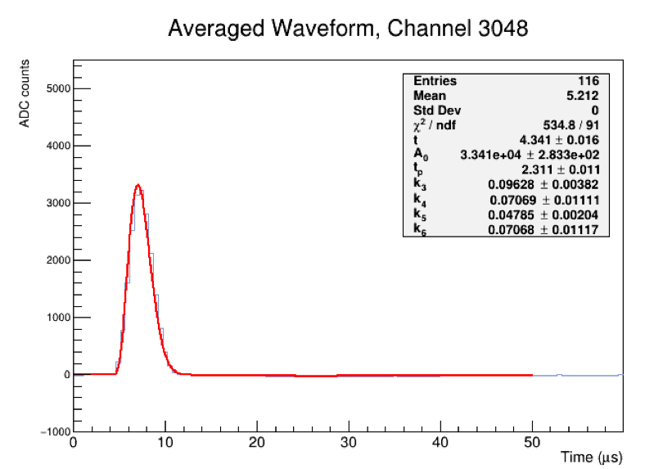
7.8 mV/fC Gain Fit Parameters
Observations
Observed in most DAC settings
Seems like WF amplitude varies for some channels of the same run/DAC setting.
Remember that A₀ has no physical meaning here!
2) Tiny bump in A₀ distribution
Karla Tellez-Giron-Flores
Notes:
Plots from Run 28265, DAC=15

Slide 9
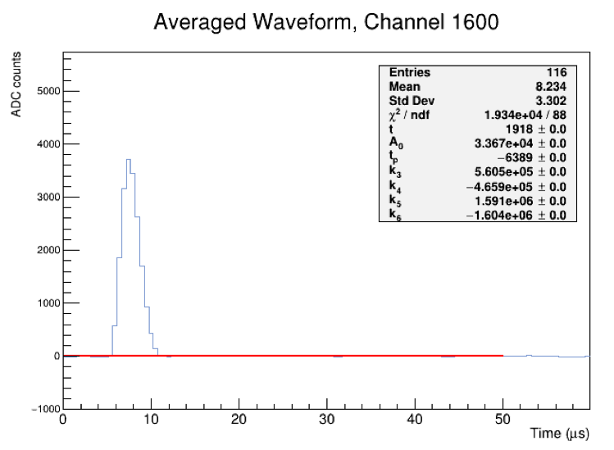
7.8 mV/fC Gain Fit Parameters
Observations
3) Fit fails sometimes 😔
Unfortunately, fit fails on some random channels.
Observed more fit failed instances than with the 14 mV/fC gain.
Will have to revise fitter for this new gain setting.
Karla Tellez-Giron-Flores
Notes:
Plots from Run 28265, DAC=15

Slide 10
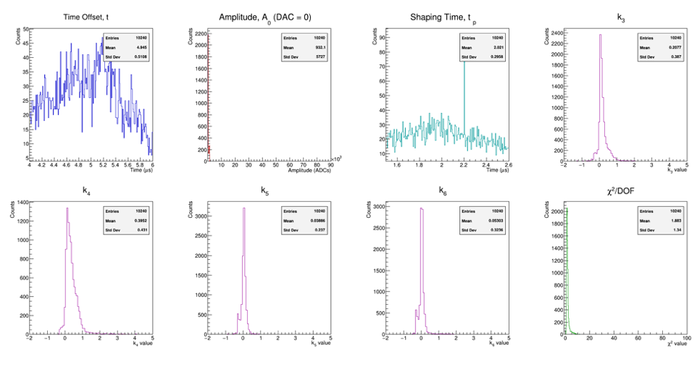
14 mV/fC Gain Fit Parameters
Karla Tellez-Giron-Flores

Slide 11
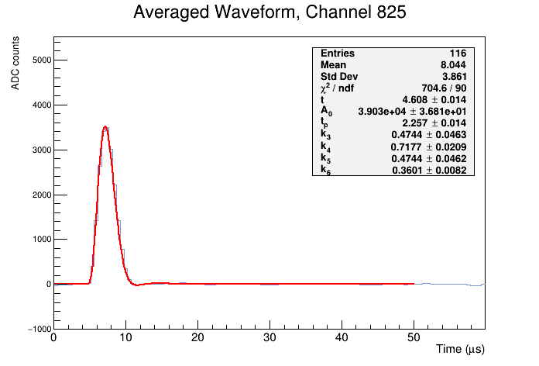
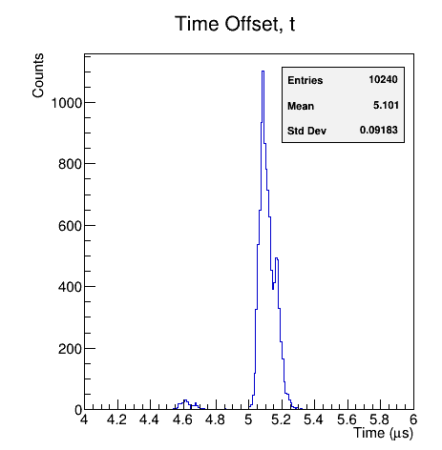
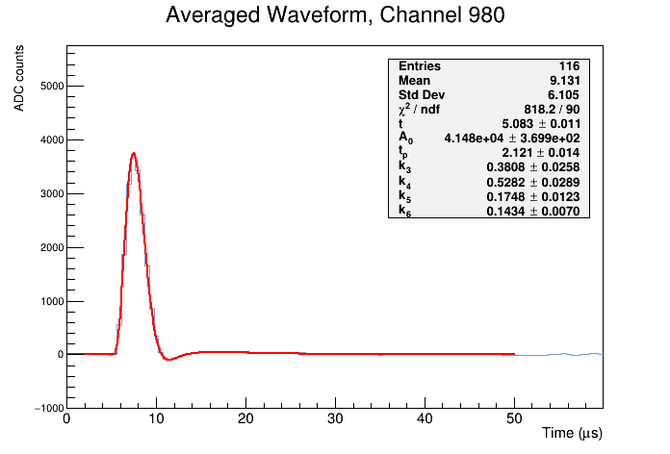
14 mV/fC Gain Fit Parameters
Observations
1) 4.6 μs bump in Time Offset distribution
Karla Tellez-Giron-Flores
Notes:
Run 28309

Slide 12
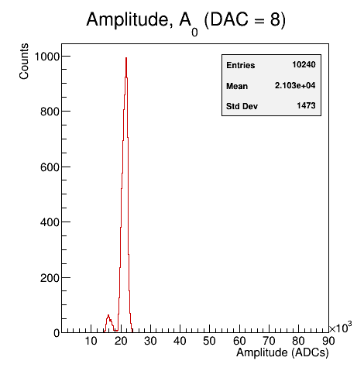
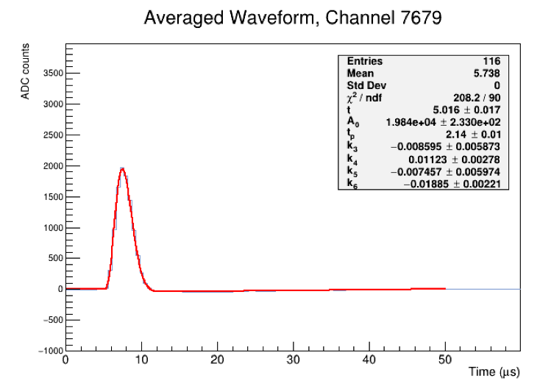
14 mV/fC Gain Fit Parameters
Observations
More noticeable in Run 28299 (DAC=8) but observed in most DAC settings
Seems like WF amplitude suddenly decreases and stays low for a few hundreds of continuous channels.
2) Tiny bump in A₀ distribution
Karla Tellez-Giron-Flores
Notes:
Plots from Run 28299, DAC=8. WF stays low from Ch. 7680 until Ch. 7867 and then goes low again: Ch. 7788-8667 Ch. 8427-8667 Ch. 8748-8827 Ch. 9472-9579 The “long lasting” version of this effect was not observed for the 7.8 mV.fC gain, only here.
Checked raw waveforms and saw the change in amplitude too.

Slide 13
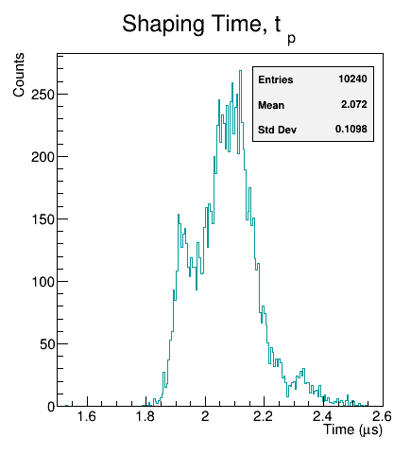
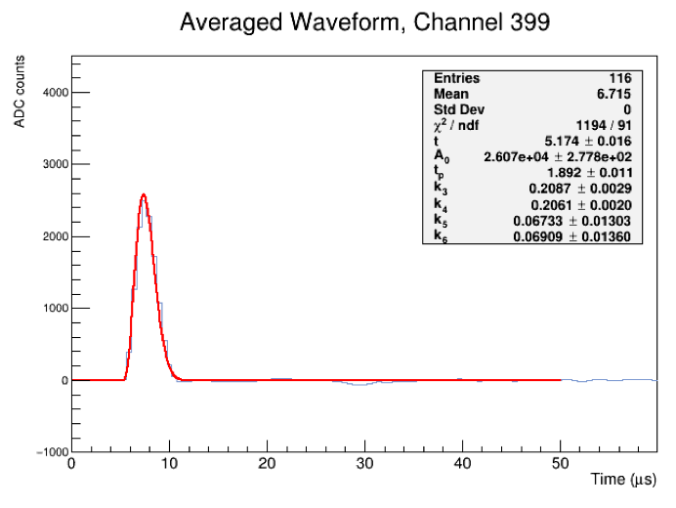
14 mV/fC Gain Fit Parameters
Observations
This happens in Run 28302 (DAC=10).
Seems caused by the same issue as before; WF amplitude suddenly decreases and stays low for a few hundreds of channels (not continuous, though).
3) A strange bump in t_{p} distribution after ~2.27 μs
Karla Tellez-Giron-Flores
Notes:
Plots from Run 28302, DAC=10.
Not such a noticeable bump in A0 distribution, but it’s kind of there. Checked raw waveforms and saw the change in amplitude too.

Slide 14
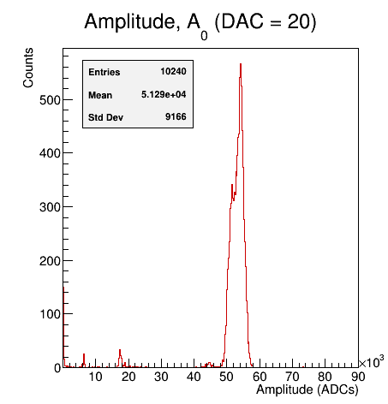
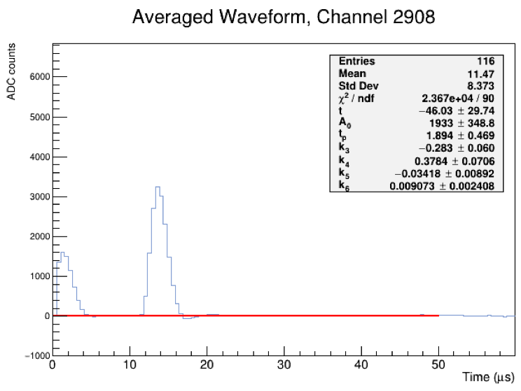
14 mV/fC Gain Fit Parameters
Observations
These type of events occur everywhere throughout the run.
For instance, Ch. 2908-3147 (continuous):
4) Something is wrong with Run 28316 (DAC=20)
This is an issue with the peak finder! Run is fine.
Karla Tellez-Giron-Flores
Notes:
Plots from Run 28316, DAC=20 Other Channels where this happens are: 3868-3947 4028-4107 4640-4735 4832-4927 This is an issue on my end! Check the averaging algorithm

Slide 15
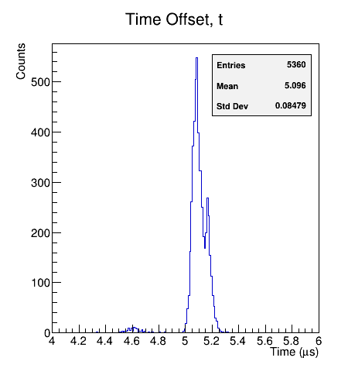
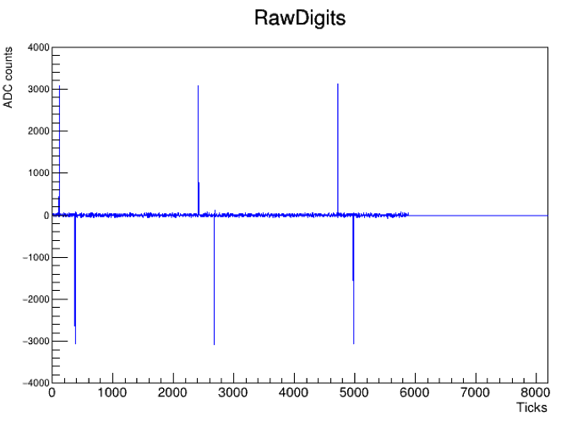
14 mV/fC Gain Fit Parameters
Observations
Channels 5360-5419 died during this run, so fitter stopped working.
This did not happen in subsequent runs.
5) Something is wrong with Run 28306 (DAC=13)
Karla Tellez-Giron-Flores
Notes:
Plots from Run 28306, DAC=13
Roger said that seems like some kind of data issue -the question is just whether it was actually a problem with the DAQ failing to capture data from some data streams. He will check this run later.

Slide 16
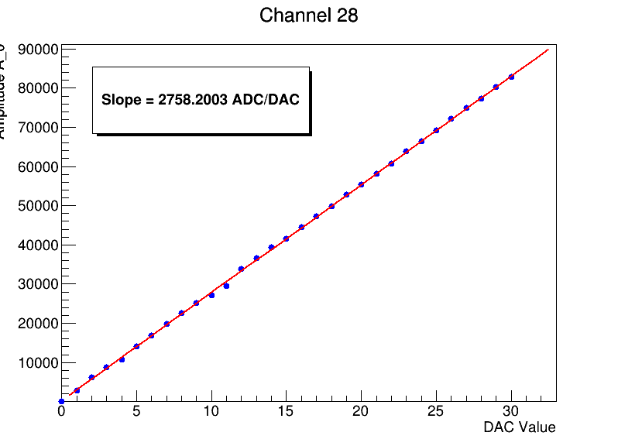
What’s next?
Fix the fitter for the 7.8 mV/fC gain.
Run again for all DAC settings.
Perform the Waveform Correction.
Averaging over events instead of over peaks per channel?
Linearity plots will make more sense after correction is applied.
This week, starting today.
Starting right after fitter is corrected.
This week, after fitter is fixed and while fitter is running for all DACs.
Is this necessary?
Karla Tellez-Giron-Flores

Slide 17
Backup Slides

Slide 18
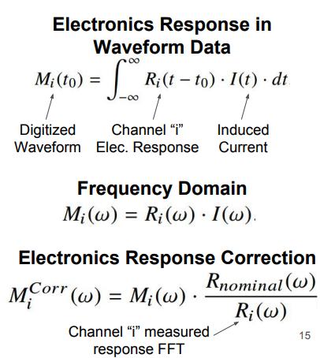
Offline correction of imperfect pole-zero cancellation
Defining a correction based on the measured response.
https://arxiv.org/pdf/1804.02583
Karla Tellez-Giron-Flores

Slide 19
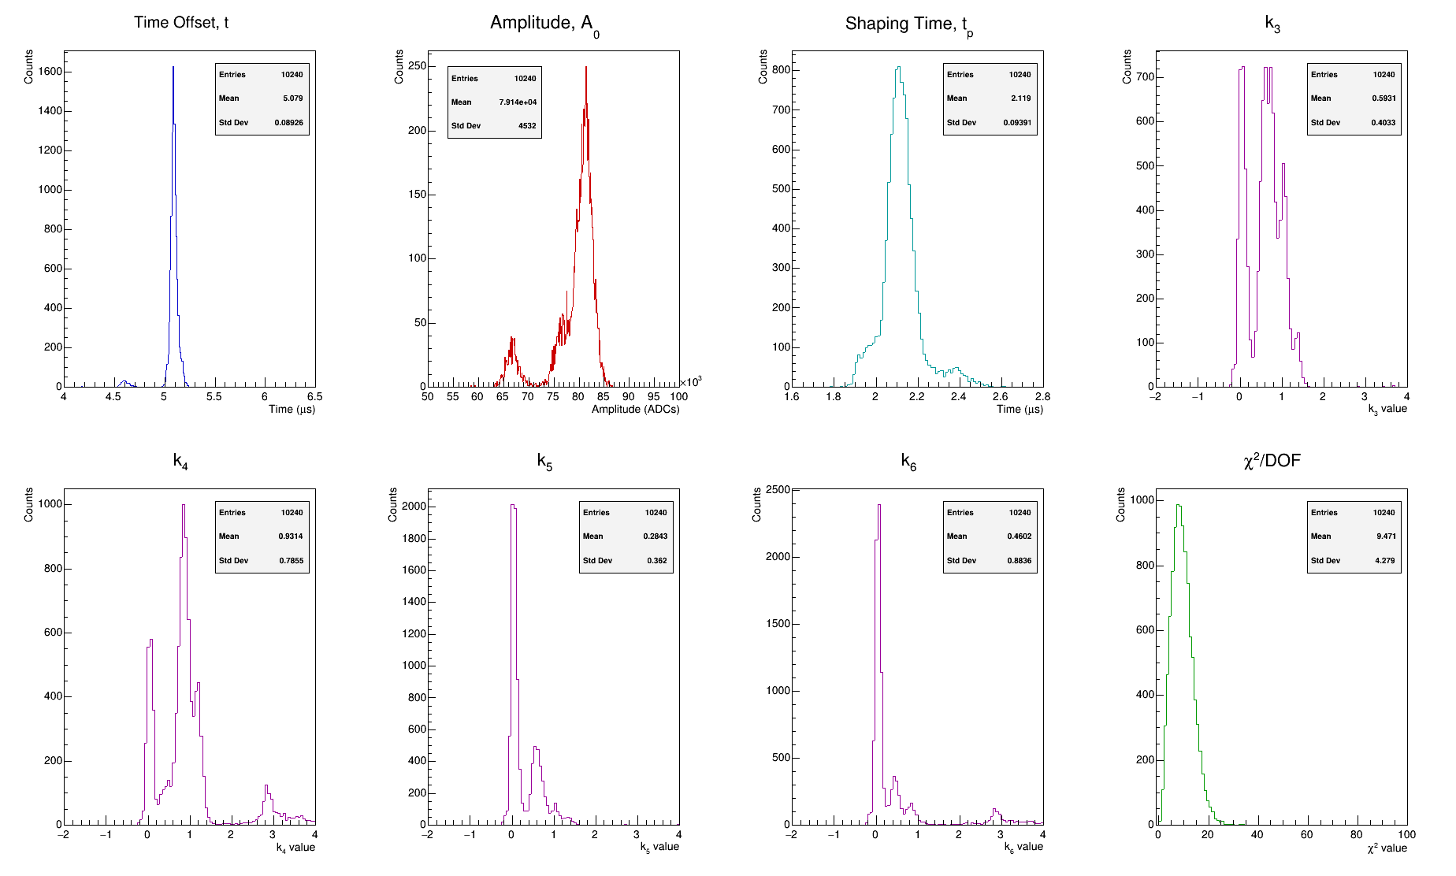
Fitter* Performance PDHD 27872
Karla Tellez-Giron-Flores

