Slide 1
System Clock: 9.85 MHz
ePIC
1. Overall Hardware Design
GTU: Global Timing Unit
  control encoding, status decoding.
  The interface for machine clock source,
  Data acquisition control and monitor etc.
DAM: Data Aggregation Module:
  The clock/control fanout, and status/busy accumulation.
  local control over the RDO boards connected, though the main function of the DAM is for Data Acquisition.
RDO: optical interface of detector ReaDOut
  control decoding, status encoding.
  The clock/control interface to the front end electronics.
  Data collection from Frontend boards, and data transmission to the DAM
FEB:
  Detector dependent Front End / ASIC carrier boards.
Online computer
Status
GTU
GTU 1
Control
EIC
Common
Platform
Clock
Data Acquisition
DAM
(O)100
DAM
DAM
RDO
(O)1000
RDO
RDO
RDO
RDO
FEB
FEB
FEB
GTU distributes 9.85 MHz clock, and DAM reconstructs the 98.5 MHz, or 39.4 MHz clock
1

Slide 2
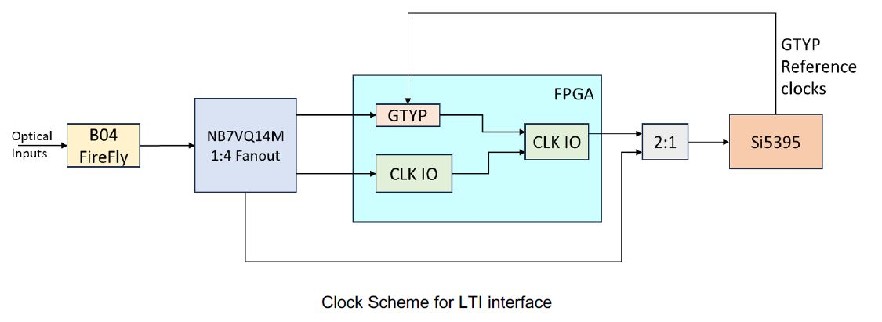
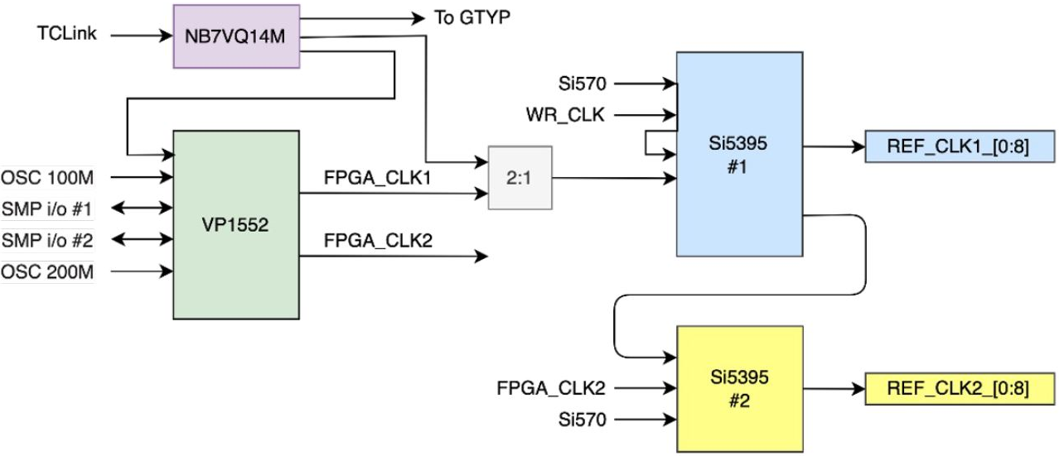
2. DAM FLX155 interface
Dedicated Clock input,
up to three MGT lanes (Tx/Rx)
MTP multimode 850µm optical
* These two diagrams are from FLX155 presentations
2

Slide 3
3. GTU design: Inputs and Outputs
MTP: 4 Tx/4 Rx
MTP fibers, ~10 meters
Clock @ 9.85 MHz
Online computer
Run Control
GTU
Clock, Control, status
DAM
GTU_CONTROL
GBE
MTP
DAM/RDO Status
MTP
Clock, Control, status
DAM
Optional/extra
EIC common platform
Beam synced Clock, orbit
~150
CLOCK distribution
MTP
Clock, Control, status
DAM
LC fibers, ~100 meters
Beam monitor
RDO clock phase
LC
Clock
TOF_RDO
LC
Clock
TOF_RDO
~600
LC
Clock
TOF_RDO
Risk mitigation for extremely stringent requirement by TOF
3

Slide 4
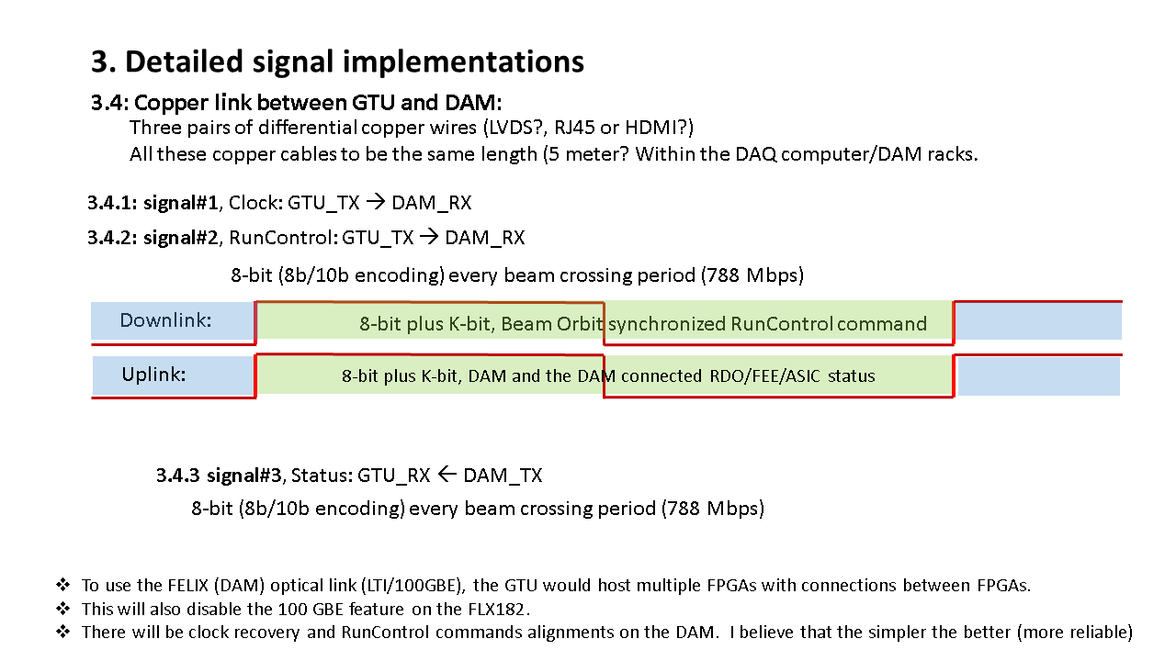
3. GTU design: DAM connection
PCB Transmitters
Clock @ 9.85 MHz
PCB Receiver
GTU
DAM
Downlink
GTU_CONTROL, (min) 8-bits (+ 1 k_bit) @ 98.5 MHz
FPGA Transceivers
FPGA_MGT Transceiver
Uplink
DAM/RDO Status, (min) 8-bits (+ 1 k_bit) @ 98.5 MHz
FPGA Transceivers
To fully use the DAM connection
FPGA_MGT Transceiver
Available on DAM: (MTP, 8 fibers can be used)
  4 MGT (MultiGigabit Transceivers) (One Rx for Clock)
Design on GTU: (MTP, 5 fibers used)
  Clock,
  1 Tx and 1 Rx using FPGA’s MGT;
  1 Tx and 1 Rx using FPGA’s regular IO (HPIO/XPIO)
4

Slide 5
3. GTU design: FPGA selection
Enough GigabitTransceivers (~150)
Enough General IOs, (~600)
FPGA lifetime
 | Versal Primium |  |  | AI Edge | Versal Prime |  | Versal HBM |  | UltraScale plus
FPGA | VP1552 | VP1502 VP2502 | VP1802 VP2802 | VE2802 | VM1802 | VM2302 VM2902 | VH1522, 42, 82 | VH1742 VH1782 | VU9P | VU5/7P
GTY | 68 | 28 | 28 | 32 | 44 | 8 | 68 | 68 | 120 | 80
GTM | 20 | 60 | 140 | 0 | 0 | 36 | 20 | 60 | 0 | 0
Gen_IO | 570 | 570 | 570 | 300 | 506 | 192 | 570 | 570 | 832 | 832
Eval kits | FLX155 |  | VPK180 $18K | VEK280 $7K | VMK180 $9,345 |  | VHK158 $15K |  | VCU118 $9K
The GTM can be used similarly as GTY, but the RxFIFO, and TxFIFO can NOT be bypassed ➔ Delay uncertainly;
GTM internal data width 64/80, minimum 9.5 Gbps ➔ better for faster data throughput (trick: doulble counting, “01011…” @5Gbps is the same as “0011001111……” @10Gbps, or “000111000111111………” @15 Gbps) ;
Single FPGA, AMD Versal Primium VP1802 ACAP for example, can not do 1:1 on the HPIO and MGT;
The three_FPGA configuration is preferred to optimize the cost, and the engineering risk (PCB routing etc.).
5

Slide 6
3. GTU design: functional diagram
EIC
COMMON PLATFORM
Optic transmitter
EIC/ePIC clock & beam orbit info
TOF_RDO_1
jitter cleaner & phase adjustment
1:800 (1:150)
fanout
TOF_RDO_1
~600
TOF_RDO_600
Beam vs clock phase monitoring
Clock phase adjustment
XPIO_1
MGT_1
DAM_1
Optic transceivers
XPIO_2
MGT_2
DAM_2
Run Control
Synchronous
~150
User interface
Run Control computer
XPIO_150
MGT_150
DAM_150
DAM/RDO status configure
FPGAs
GTU
6

Slide 7
3. GTU design: modular design, a 4U(high) x 19U(wide) rack mounted box
GTU base board
Optic transceiver plugin modules (to DAM)
Fits in a 19U wide rack
Takes 4U high space
MTP fiber ports to DAM
Clock
Receiver, control, distribution
19 U wide (max)
Quad optic TRX
Optic Transceiver plugin module
FPGA
Run Control
Memory
‘services’
4 U high (max)
Quad optic TRX
Quad optic TRX
Power
regulators
Quad optic TRX
FPGA (SOM)
Quad optic TRX
Clock fanout
Quad optic TRX
Quad optic TRX
Quad optic TRX
FPGA
Quad optic TRX
Clock fanout
Possible buffers
Quad optic TRX
Quad optic TRX
Power
supplies
Possible choice of Optic Transceivers:
QSFP, Finisar FTL410Q, 40GBASE-SR4
GTU base board
Possible choice of plugin connector: PCIe5x16
All the electrical signals are differential signals (PCB and connector)
The FPGA can be a single piece, or three pieces with fast interconnect.
7

Slide 8
3. GTU design: risk mitigation
Optic Transmitter plugin modules
Clock only, to TOF_RDO (optional)
Clock phase monitoring:
Beam pickup, and digital feedback to GTU
GTU: Phase Correction
Optic transmitter
Optic Transceiver plugin module
Optic transmitter
Power
regulators
4 U high
Optic transmitter
RF-SoC (?)
Optic transmitter
PhaseOrbit (average)
Optic transmitter
Clock fanout
Optic transmitter
Phase#1
Phase#2
Phase#1160
Phase#1
Possible choice of Optic Transmitters:
Samtec FireFly, 12 ch TX,
MTP_12 at GTU
LC at RDO
RDO(area) Clock
Beam pickup
8

Slide 9
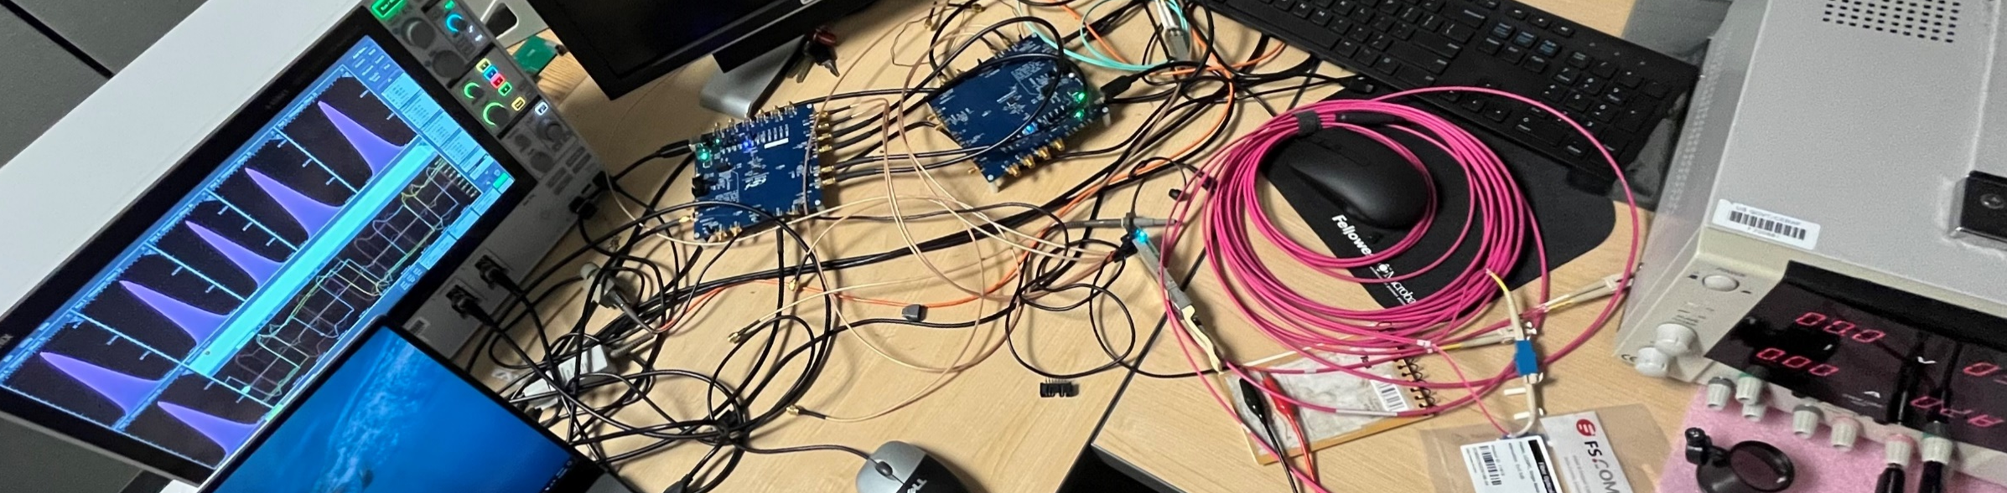
4. 9.85 MHz clock distribution test: setup
10 M loopback ➔ 20 meters
Si5344H
O3: 197 MHz
O1: 9.85 MHz
O2: 98.5 MHz
O0: 39.4 MHz
QSFP
TX0
QSFP
RX0
Si5394A
IN0: 9.85 MHz
O0: 39.4 MHz
O1: 9.85 MHz
O2: 98.5 MHz
O3 → IN3 ZDM
MSO64
CH4
CH3
CH2
CH1
“DAM”
“GTU”
MATH1 = CH1 – CH4, 39.4 MHz clock
MATH2 = CH2 – CH3, 98.5 MHz clock
9

Slide 10
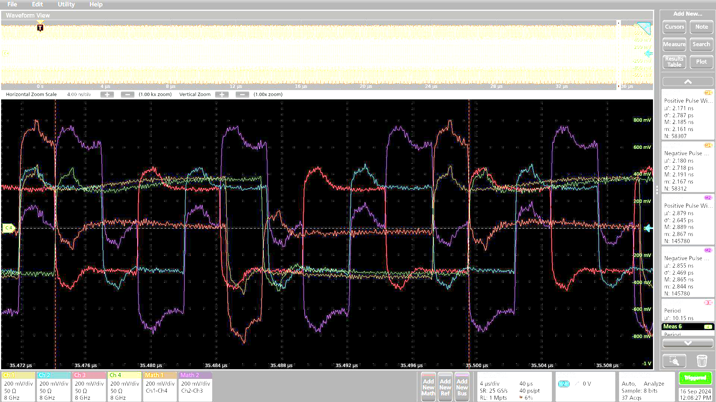
4. 9.85 MHz clock distribution test: Clock jitter measurement method
GTU: Si5344H + QSFP_TX, Distribute the 9.85 MHz clock
DAM: QSFP_RX + Si5394, regenerate 98.5 MHz clock and 39.4 MHz clock from the 9.85 MHz received clock
Positive width
The width (positive or negative) of the MATH is the phase difference between the Si5344 clock (source) and Si5394 clock (regenerated).
Negative width
With accumulation of hours, the FWHM includes the phase drifts over time
10

Slide 11
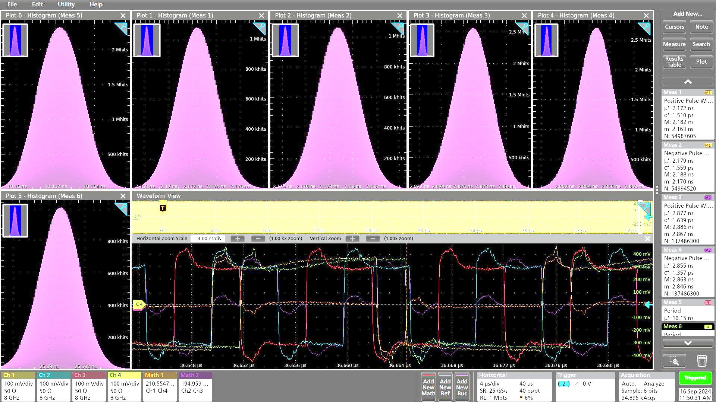
4. 9.85 MHz clock distribution test: some measurement results
Clock: 39.4 MHz
Period: 25.3805ns
MATH1 = CH1 – CH4
Positive width: 2.1725 ns
FWHM: 4 ps
40 µs data: σ: 1.51 ps
Negative width: 2.1788ns
FWHM: 4 ps
40 µs data: σ: 1.56 ps
Clock: 98.5 MHz
Period: 10.1522 ns
MATH2 = CH2 – CH3
Positive width: 2.877ns
FWHM: 3.5ps
40 µs data: σ: 1.64 ps
Positive width: 2.7ns
FWHM: 3 ps
40 µs data: σ: 1.34 ps
* ~ one hour accumulation
11

Slide 12
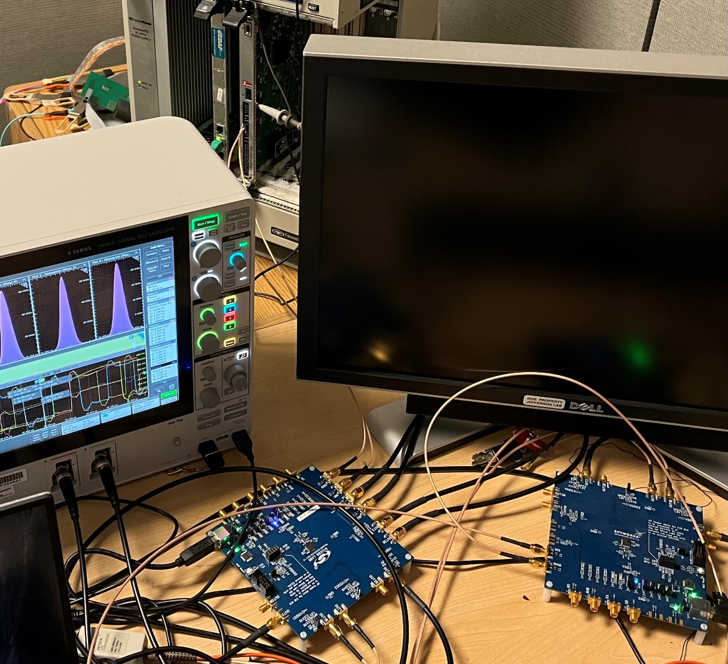
5. “9.615 MHz” clock distribution test: (250 MHz/26)
5.1 AD9510 test: setup
250 MHz osc.
AD9510 (/26)
SY58607 1:2
9.6 MHz
TI
9.6 MHz
Si5394A
Tektronix MSO64
9.6 MHz
38.4 MHz
96. MHz
9.6 MHz
Si5344H
12

Slide 13
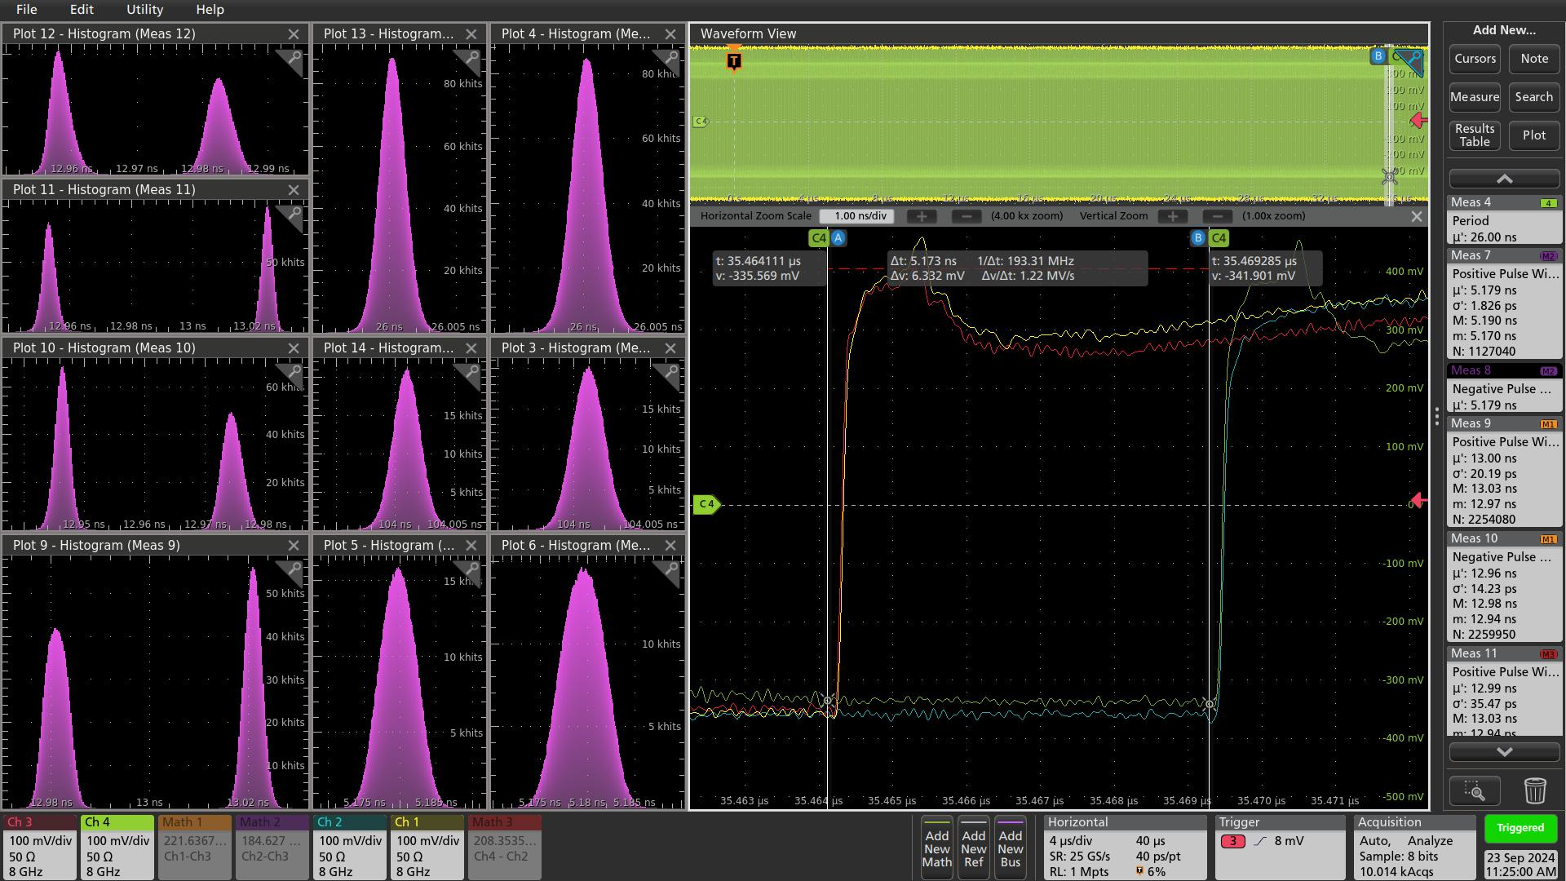
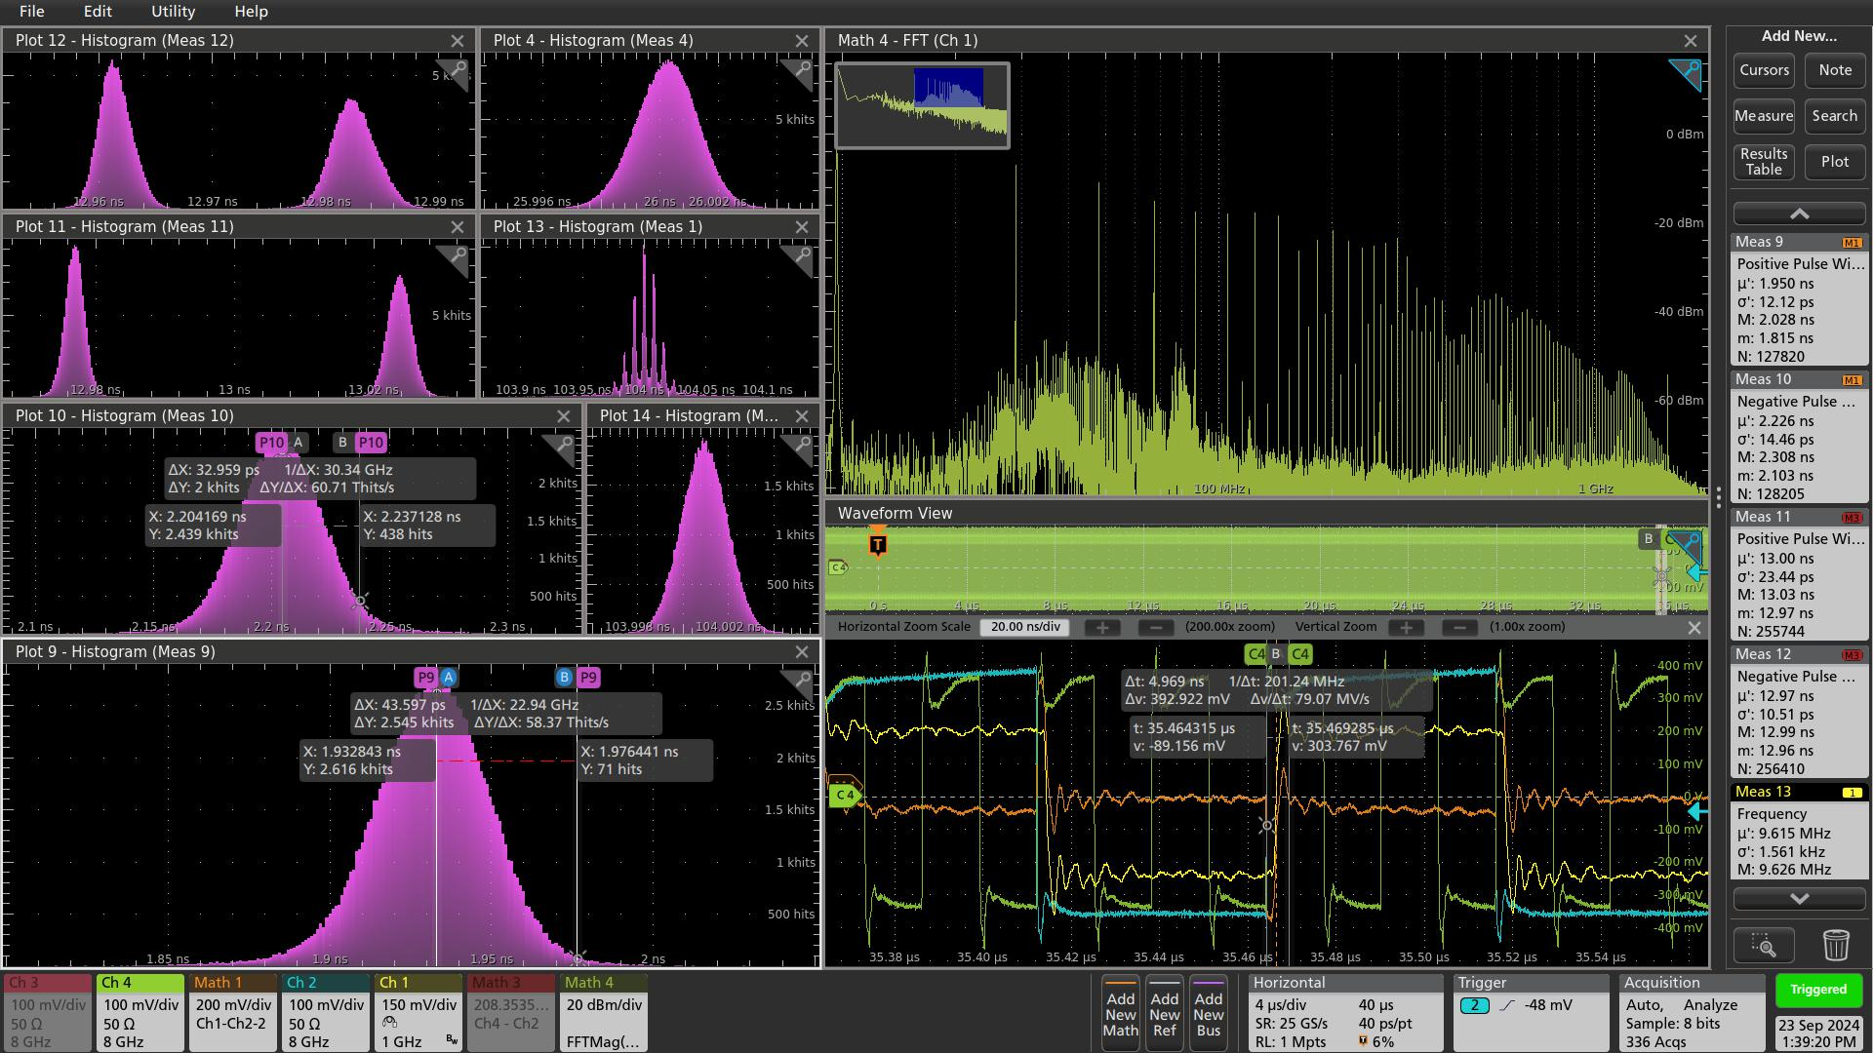
5. “9.615 MHz” clock distribution test: (250 MHz/26)
5.1 AD9510 test: results
Ch2/3
On Si5394A, the 9.6 MHz output clock phase aligned with the input clock in ZDM,
On Si5344H, the 9.6 MHz output clock phase (relative to the input clock) is stable, but powerup/reset dependent (no ZDM capability)
The quality of the clock from TI (9.6 MHz) can not be measurement reliably, because of the probe limitation (no SMA compatible probing point).
Ch1/4
Math1/3
Positive width
Negative width
The clock output jitter is ~ 1 ps, stable FWHM is ~ 2.5 ps
The 38.4 MHz output and the 96 MHz output are aligned with the 9.6 MHz clock output
13

Slide 14
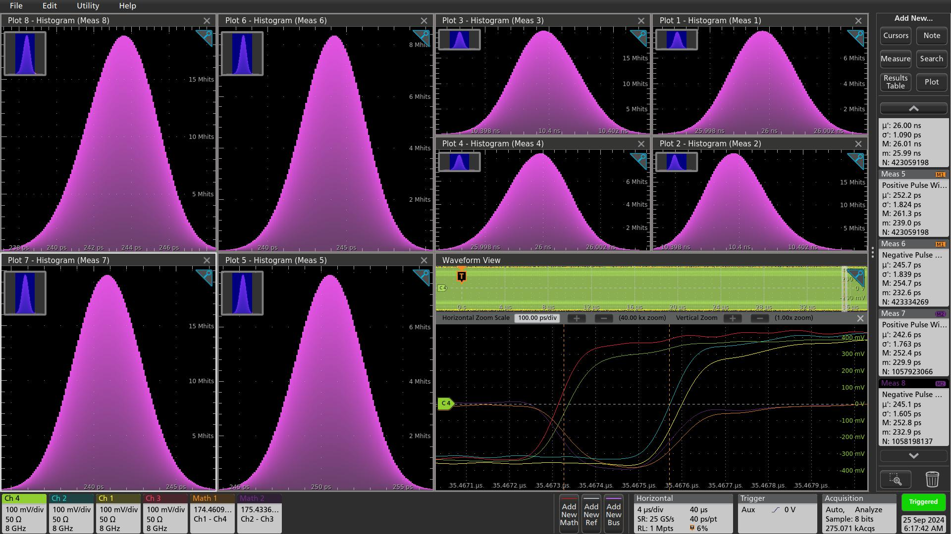
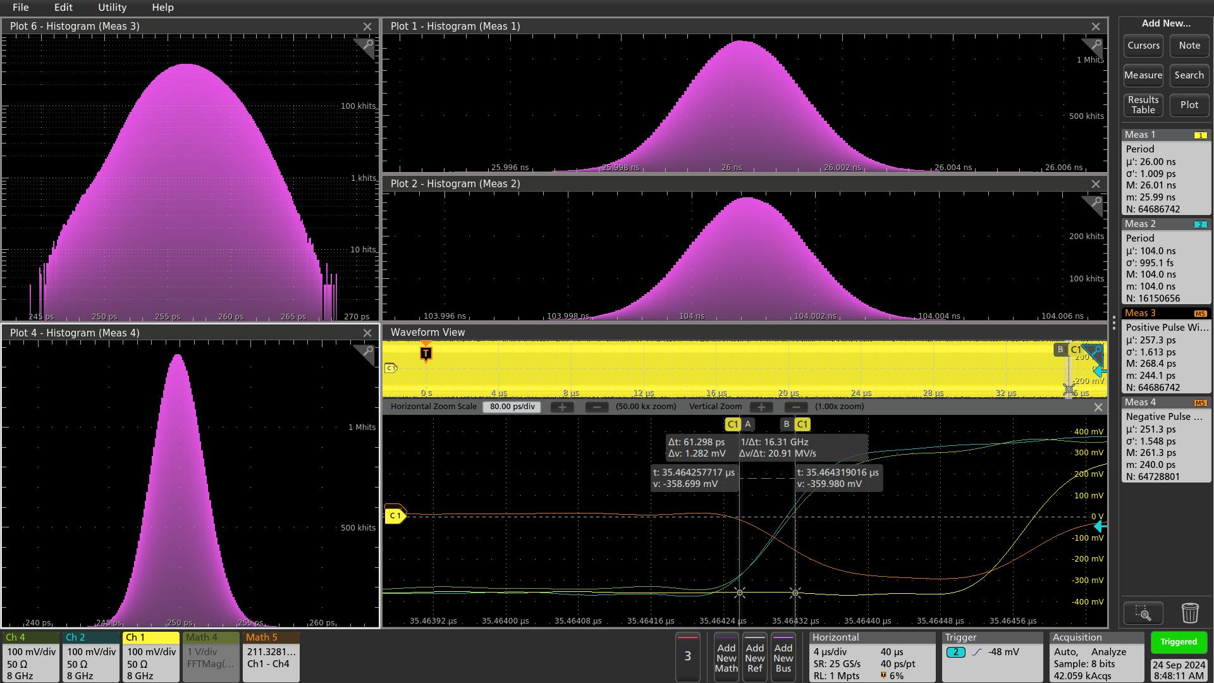
5. “9.615 MHz” clock distribution test: (250 MHz/26)
5.2 “Optic” stability: similar setup as shown in page#9
Ch1/Ch2: Si5344H, BW: 1 KHz; Ch3/Ch4: Si5394A, BW: 2 KHz
Math1: Ch1 – Ch4; Math2: Ch2 – Ch3; Trigger: Si5394A 9.6 MHz output.
Ch1
Ch4
Overnight accumulation (3pm - 8am) in the daq lab, cc/F110
Clock frequencies/Periods are stable,
Clock_96 MHz, period: 10.3998 ns; σ: 1.0 ps; FWHM: 2.5 ps.
Clock_38.4 MHz, period: 25.998 ns; σ: 1.0 ps; FWHM: 2.5 ps.
Phase difference between Si5394 and Si5344 stable,
38.4 MHz, Positive width: Phase_diff: 250.5 ps; σ: 1.8 ps; FWHM: 5 ps, P_P: 22 ps
38.4 MHz, Negative width: Phase_diff: 244.2 ps; σ: 1.7 ps; FWHM: 5 ps, P_P: 22 ps
96 MHz, Positive width: Phase_diff: 240.8 ps; σ: 1.8 ps; FWHM: 5 ps, P_P: 22 ps
96 MHz, Negative width: Phase_diff: 243.6 ps; σ: 1.55 ps; FWHM: 4.4 ps, P_P: 20 ps.
Ch1-Ch4
Positive width
Negative width
Two hours accumulation in my office (8am-10am)
Clock_9.6 MHz, period: 104.001 ns; σ: 1.0 ps; FWHM: 2.5 ps.
Clock_38.4 MHz, period: 26.0002 ns; σ: 1.0 ps; FWHM: 2.5 ps.
Phase difference between Si5394 and Si5344:
Positive width: Phase_diff: 256.5 ps; σ: 1.6 ps; FWHM: 5 ps.
Negative width: Phase_diff: 249.5 ps; σ: 1.5 ps; FWHM: 4 ps.
14

Slide 15
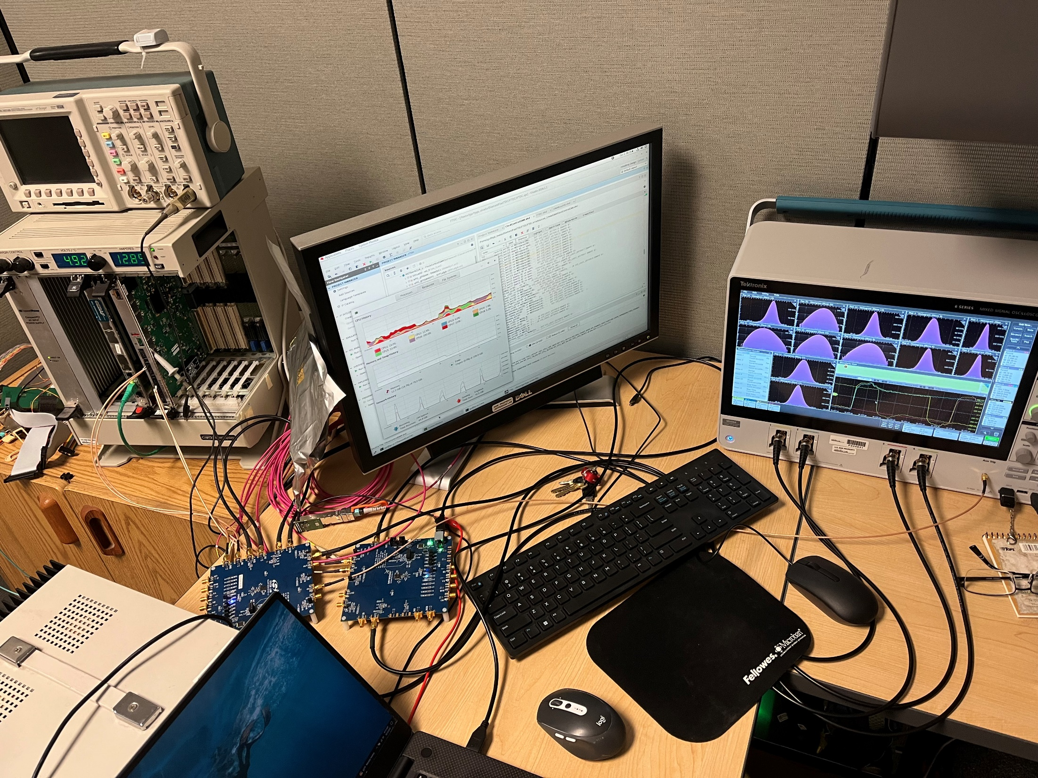
6. “9.85 MHz” clock distribution through test
6.1 More realistic test: setup
TI
MC100 EP90
MC100 EP57
AD9510 (/8)
SY58607 1:2
9.85 MHz
78.8 MHz
9.85 MHz
Si5344H
Tektronix MSO64
Si5394A
9.85 MHz
98.5 MHz
39.4 MHz
9.85 MHz
98.5 MHz
39.4 MHz
Si5344H @78.8MHz
Phase stability (phase shift and jitter): FWHM < 4 ps
12

Slide 16
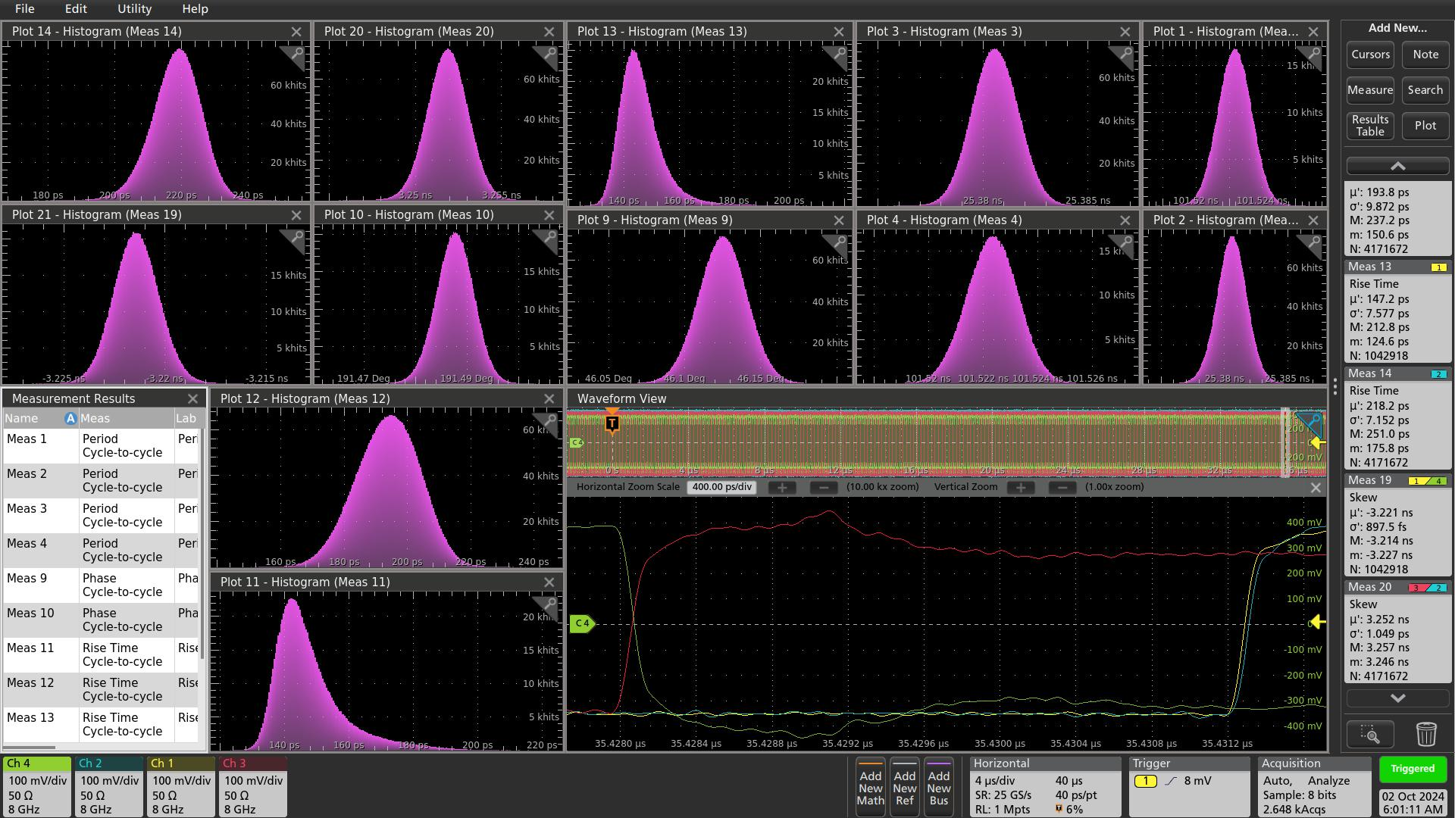
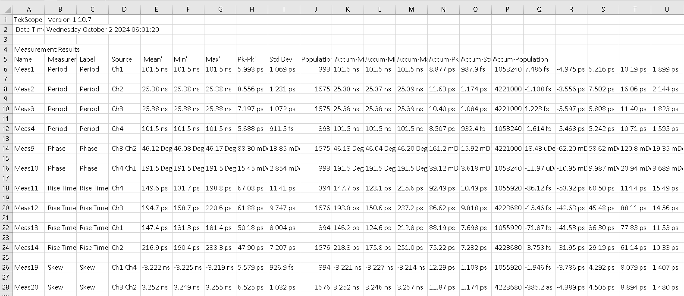
6. “9.85 MHz” clock distribution through test
6.2 More realistic test: 9.85 MHz and 39.4 MHz
Meas19: FWHM_{_Ch1-Ch4} ~ 3 ps
Meas20: FWHM_{_Ch2-Ch3} ~ 3 ps
12

Slide 17
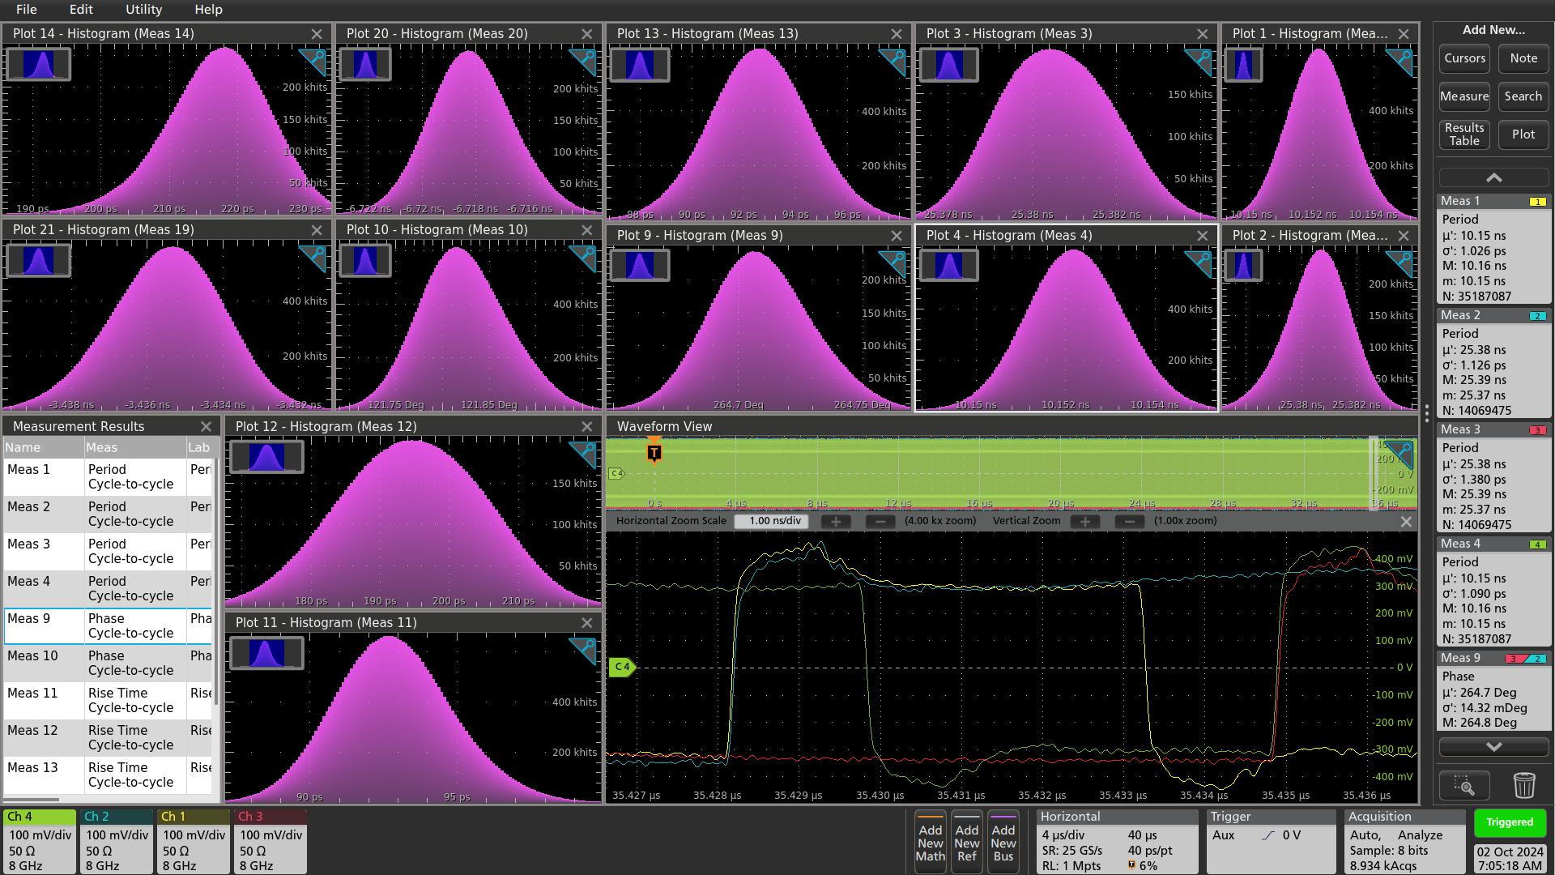
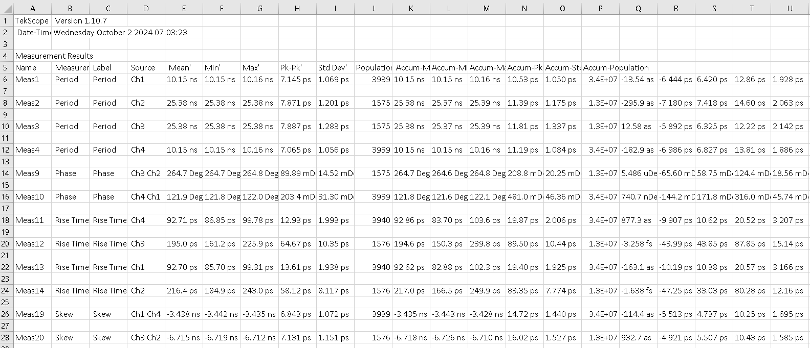
6. “9.85 MHz” clock distribution through test
6.3 More realistic test: 98.5 MHz and 39.4 MHz
Meas19: FWHM_{_Ch1-Ch4} ~ 3.4 ps
Meas20: FWHM_{_Ch2-Ch3} ~ 3.4 ps
12

Slide 18
Backup Slides

Slide 19
1. ePIC clock distribution
GTU: generate the beam orbit synchronized 9.85 Clock, and distribute to the DAM on dedicated fibers. Each orbit is 126 clock cycles, and 10 beam crossing is one clock cycle.
The GTU communicate with DAM on 98.5 MHz clock based protocols (80-bit words for example). Ten 98.5 MHz clock data words form a data packet. Each word has a word_number (from 1 to 10), corresponding to the phase of the 9.85 MHz clock.
DAM: reconstruct the 98.5 MHz from the 9.85 MHz clock. The DAM receives the GTU packets, and align the words to the correct phase of the 9.85 MHz clock. The DAM will also reconstruct the 39.4 MHz clock (or 98.5MHz) used to communicate with LpGBT, or RDO boards.
The benefit of the 9.85 MHz clock from GTU to DAM:
Clock synchronization: All the faster clocks (9.85 * 4 = 39.4 MHz, 9.85 * 10 = 98.5 MHz) in ePIC are synchronized.
Easier MGT synchronization: The 9.85 MHz clock edges on the GTU/DAM can be used to align the data words between the GTU and DAM, as long as the latency variation is less than 100 ns using the word number in the packet.
The GTU_GTM can be used in the similar manner as GTY as the MGT connections can easily be synchronized. In this case, one AMD versal ACAP xcvp1802 can replace the three FPGAs on the GTU base board. But it will be harder to route a 5000-pin FPGA than three 2000-pin FPGAs.
B1

Slide 20
3. GTU design: FPGA selection: PROs and CONs of three ‘single FPGA’ candidate
FPGA | PRO | CON
Versal VP1802 VSVA5601, 570 XPIO, 28 GTY, 140 GTM | Dual core Arm® Cortex-A72; 1:1 GT with DAM | 1:2 Tx to DAM, 1:1 Rx from DAM on XPIO; GTM, harder to control
Versal VH1582 VSVA3697, 570XPIO, 68 GTY, 20 GTM | Dual core Arm® Cortex-A72; Large on-die memory | 1:2 Tx to DAM, 1:1 Rx from DAM on XPIO; 1:3 with DAM on MGT
UltraScale+ VU9P B2104, 702 HPIO, 76 GTY | 1:1 HPIO with DAM Compatible with VU5P, VU7P | No Arm® CPU; 1:2 GTY Older FPGA,
B2

Slide 21
3. GTU design: If the optical transceivers are on the GTU PCB (non-modular design)
12* 12-port transmitter for Clock
12* 12-port transmitter for XPIO
12* 12-port receiver for XPIO
144* MTP to DAM
12* 12-port transmitter for MGT
12* 12-port receiver for MGT
MTP to DAM
MTP to DAM
12-port transmitter for Clock
MTP to DAM
12 sets
12-port transmitter for XPIO
MTP to DAM
12-port receiver for XPIO
MTP to DAM
MTP to DAM
MTP to DAM
12-port transmitter for MGT
MTP to DAM
12-port receiver for MGT
MTP to DAM
MTP to DAM
MTP to DAM
MTP to DAM
B3

Slide 22
3. GTU detailed design: clock ‘area’
ZDM
EIC common platform interface
OSC
IN3
OUT9
Si5395
OUT0
To plugin optic transmitters
98.5 MHz
IN1
9.85 MHz
OUT1
AD9510
IN0
OUT0
OUT2
OUT3
AD5330x
To plugin optic transceivers
BXclock
IN0
OUT4
OUT4
AD5330x
OUT5
Clock phase adjustment
Clock_Sync
SPI
Fanout
I2C
Beam Phase monitoring
Orbit
To FPGAs
FPGA (SOM)
B4

Slide 23
3. GTU detailed design: Power supply
The GTU base board and the optic plugin boards look like a computer system.
A computer power supply can be used to power the GTU. Most of the AMD evaluation boards are designed to use computer power supplies.
The GTU base board can use the AMD evaluation boards as power distribution references (single +12V inputs), This is the proven solutions.
The plugin board can follow the PCIexpress standard, and get the power (+12V, maybe +3.3V) from the connector.
B5

Slide 24
3. GTU detailed design: FPGA selection
There are three FPGAs on the GTU base board working synchronously (Clock frequency: 98.5 MHz, and phase aligned, so that the communications between the FPGAs are exactly one clock cycle delay)
Clock
Receiver, control, distribution
The two FPGAs on the left will be the same with the same firmware. Their main purpose is the connection to the DAM (MGT and regular IO). The possible choice: AMD Ultrascale+ virtex, xcvu5p-2B2104.
FPGA
Run Control
Memory
‘services’
The FPGA on the right will be a SOM (System On Module), which will simplify the GTU base board design. The possible choice is the ALINX ACU7EVC (AMD Zynq UltraScale+ MPSoC, xczu7ev, Quad core Arm® Cortex-A53, Dual-core Cortex-R5, 4 GB DDR4+ for processor, and 4 GB DDR4 for programmable logic, LUTs 230K, RAM 11+27 Mb). The preferred choice is a larger Versal® chip, which should be available in the near future (the V100 with AMD xcve2302 is available now. Dual-core Arm® Cortex-A72, dual-core Arm® Cortex-R5F, 4GB DDR4 memory, LUTs 150,272, RAM 5.4+43.6 Mb). This FPGA is the core of the GTU base board, Run-control, Clock control, user interface, etc.
19 U wide
FPGA (SOM)
Clock fanout
FPGA
Power
supplies
GTU base board
B6

Slide 25
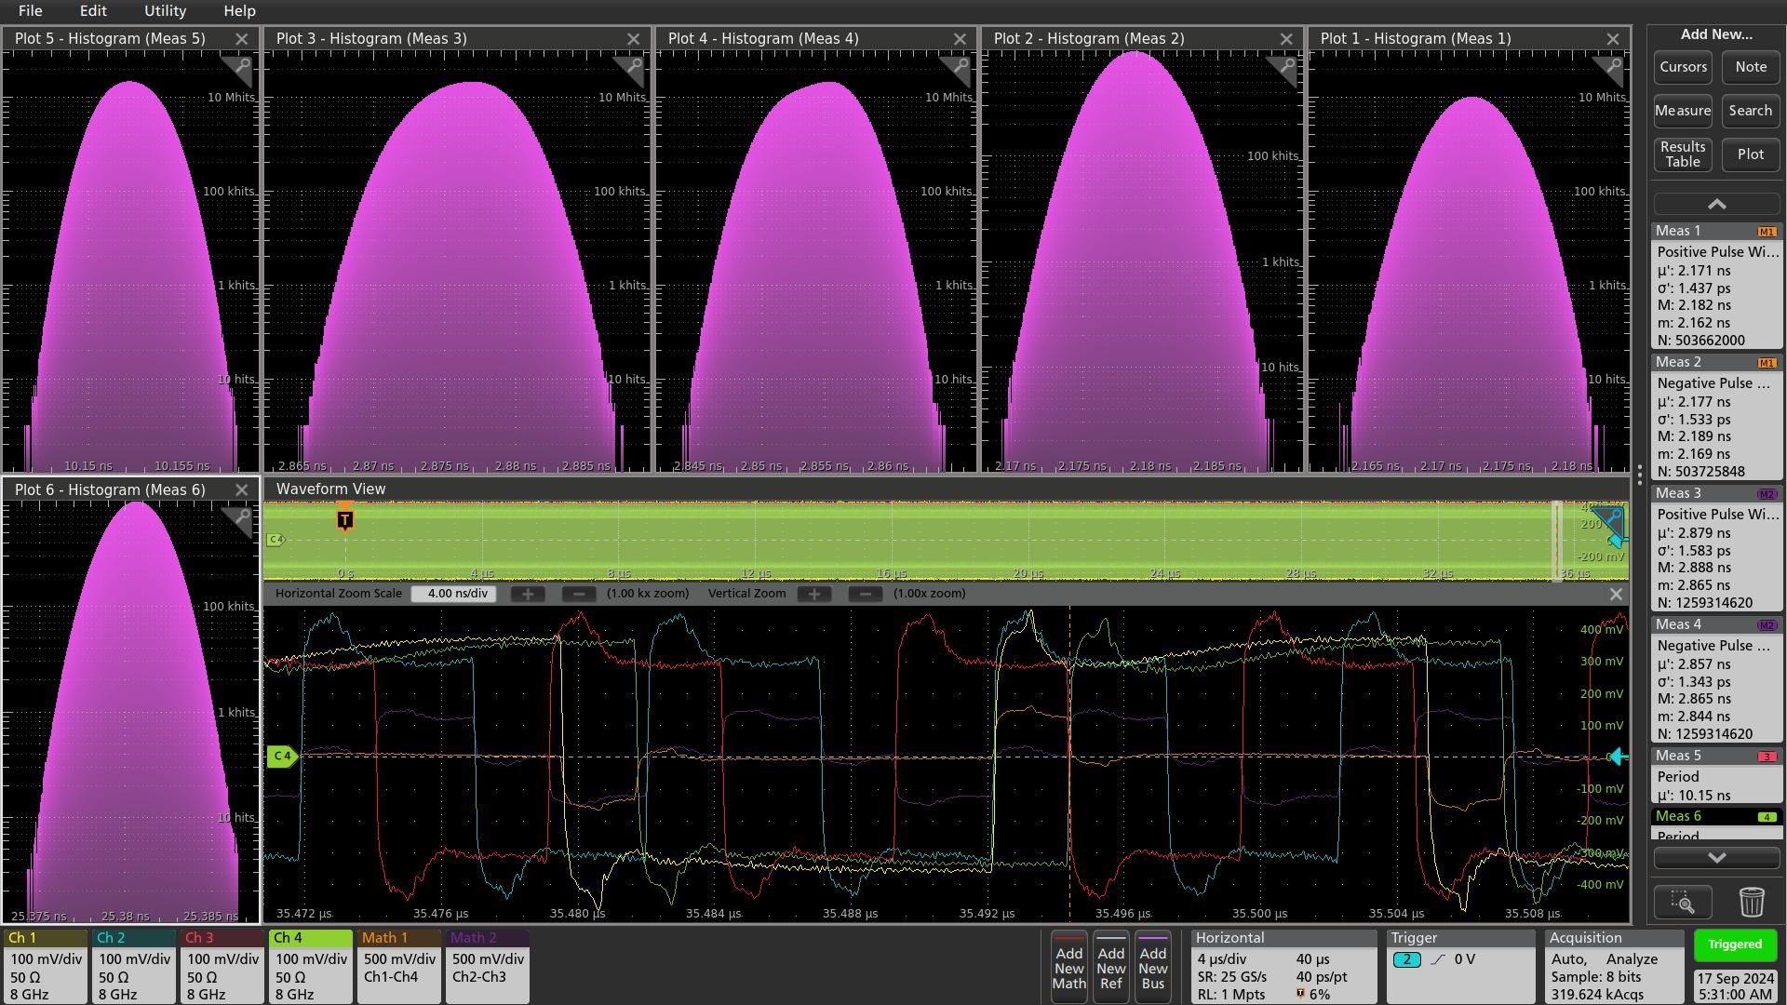
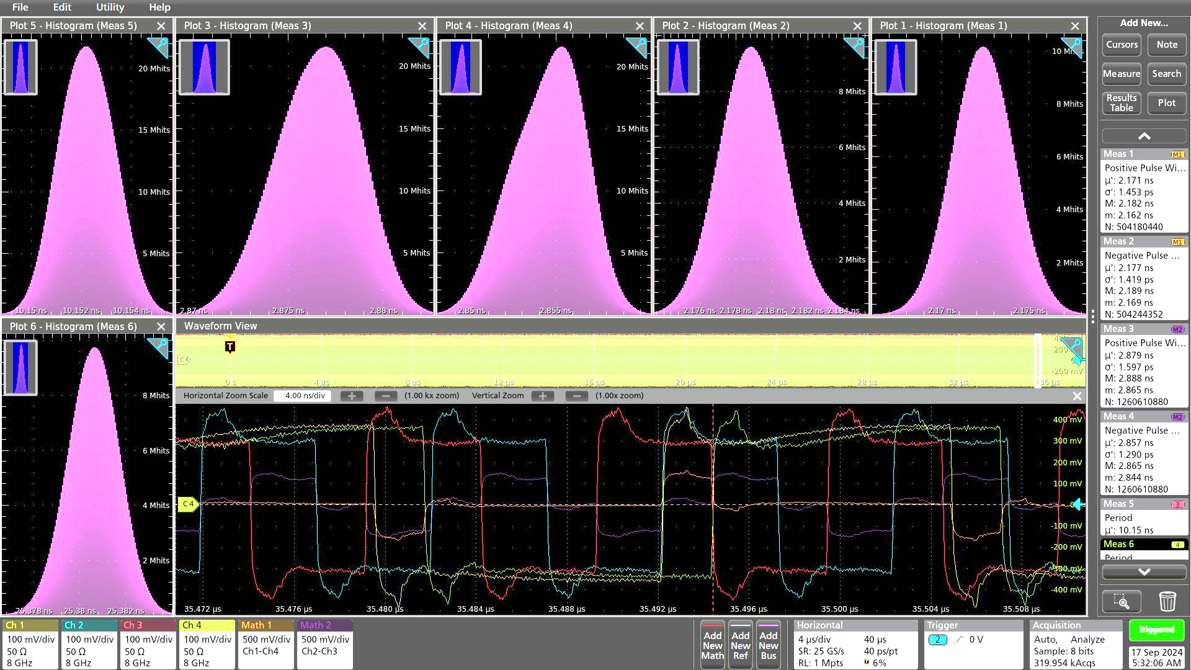
4. 9.85 MHz clock distribution test: Overnight (18 hours) accumulation
Clock: 39.4 MHz
Period: 25.3805ns P_P: 13ps
MATH1 = CH1 – CH4
Positive width: 2.1723 ns
FWHM: 4 ps, P_P: 20ps
40 µs data: σ: 1.45 ps
Negative width: 2.1788ns
FWHM: 4 ps, P_P: 20ps
40 µs data: σ: 1.42 ps
Clock: 98.5 MHz
Period: 10.1522 ns, P_P: 12ps
MATH2 = CH2 – CH3
Positive width: 2.877ns
FWHM: 5ps, P_P: 23ps
40 µs data: σ: 1.60 ps
Negative width: 2.8552ns
FWHM: 5 ps, P_P: 21ps
40 µs data: σ: 1.30 ps
There seems to be a ~2ps shift overnight (FWHM > 2.355 * σ)
B6

Slide 26
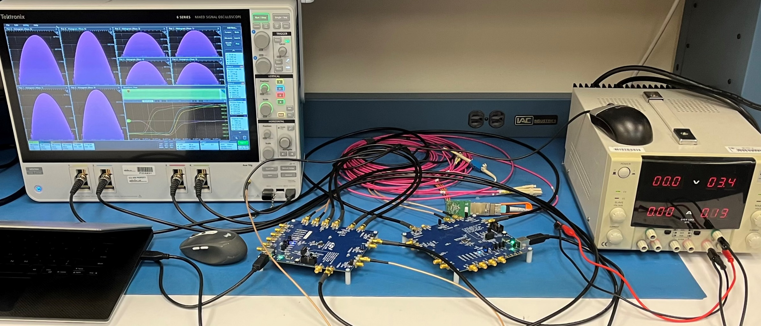
5. CC_F110 test setup
Setup in CC_F110, room (AC) temp 72ºF.
No phase drift (differences of Si5394A outputs and Si5344H outputs) ➔ Fiber and QSFP are stable.
B6

Slide 27
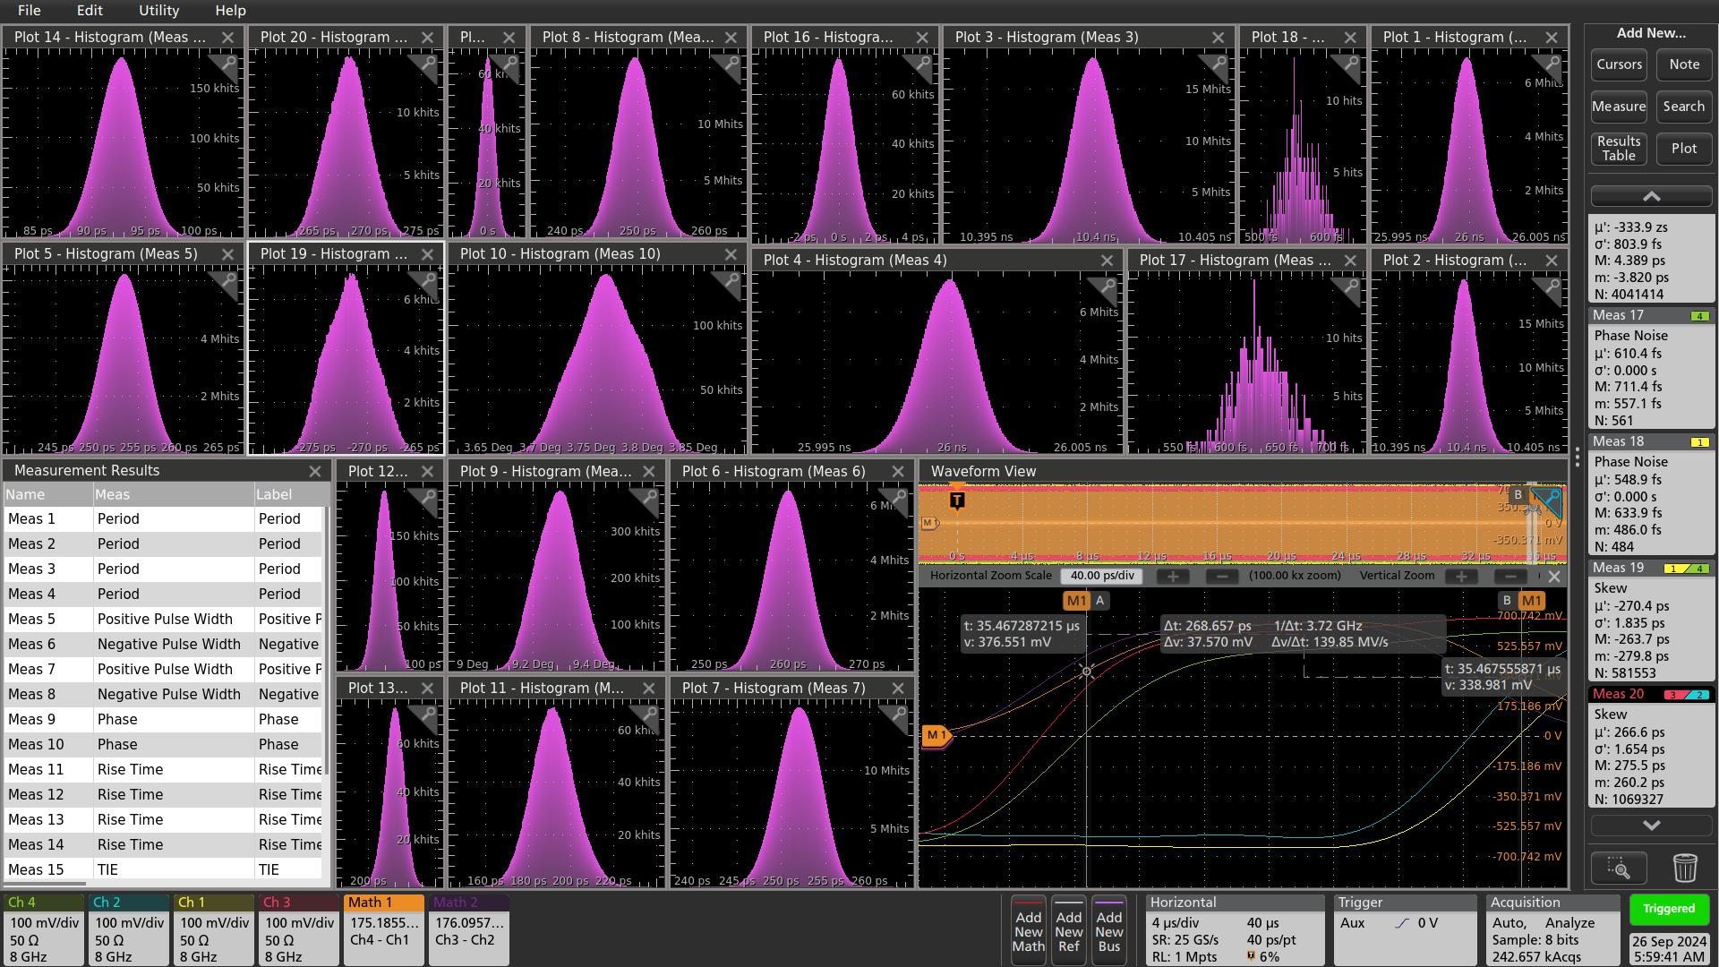
5. CC_F110 test setup
Overnight accumulation (9/25-9/26), very stable
The Phase measurement (meas 9/10), and the skew measurement (meas19/20) gave the similar results as MATH widths measurement (meas 5/6/7/8)
B6

Slide 28
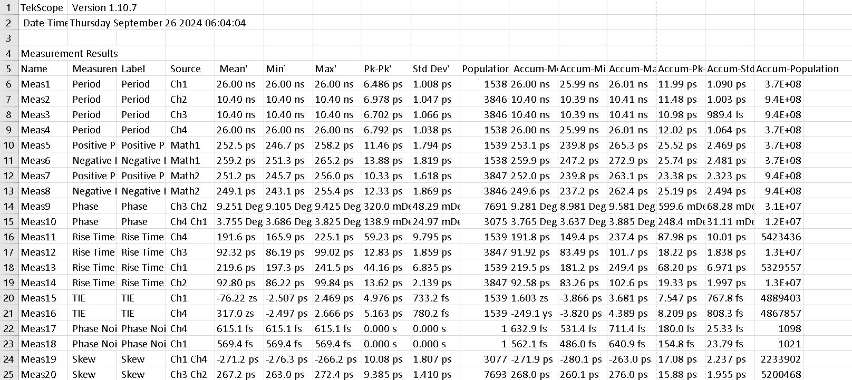
5. CC_F110 test setup
Meas1-8, accumulation is overnight, which the Meas 9-20 accumulation is minutes. This also shows in previous page (diagrams).
The Phase measurement (meas 9/10), and the skew measurement (meas19/20) gave the similar results as MATH widths measurement (meas 5/6/7/8)
B6

Slide 29
5. GTU → DAM communication (to be consistent with earlier proposals)
packet | One packet at 9.85 MHz, or 10 ( one word at 98.5 MHz)
word | 1 | 2 | 3 | 4 | 5 | 6 | 7 | 8 | 9 | 10
Bit(9:0) abcdeifghj- | K28.1_3C 0011111001 x0111110xx | K28.2_5C 0011110101 | K28.3_7C 0011110011 | K28.4_9C 0011110010 | K28.5_BC 0011111010 x0111110xx | K28.6_DC 0011110110 | K28.7_FC 0011111000 x0111110xx | K23.7_F7 1110101000 | K27.7_FB 1101101000 | K28.0_1C 0011110100
Bit(19:10) | GTU_RC | GTU_RC | GTU_RC | GTU_RC | GTU_RC | GTU_RC | GTU_RC | GTU_RC | GTU_RC | GTU_RC
Bit(29:20) | BX(7:0) | BX(15:8) | Obx(7:0) | Obx(15:8) | Orbit(47:0), BX(63:16), etc.
Bit(39:30) | DAM | DAM | DAM | DAM | DAM | DAM | DAM | DAM | DAM | DAM
Bit(79:40) | USER | USER | USER | USER | USER | USER | USER | USER | USER | USER
Bit(9:0): 8b/10b encoded, used as word count, and word alignment in the receiver
Bit(19:10): GTU run-control, 8-bit at 98.5 MHz
Bit(29:20): Clock sync counters,
BX(63:0): Beam Crossing counter;
Obx(15:0): beam crossing counter within the orbit;
Orbit(47:0): Orbit counter
Bit(39:30): DAM specific, 8-bit at 98.5 MHz;
Bit(79:40): User-specific, 32-bit at 98.5 MHz;
DAM needs reformat the packet, and send the relevant information to the RDO at 39.4 MHz, or 98.5 MHz
B7

Slide 30
5. DAM → GTU communication (to be consistent with earlier proposals)
packet | One packet at 9.85 MHz, or ten (single word at 98.5 MHz)
word | 1 | 2 | 3 | 4 | 5 | 6 | 7 | 8 | 9 | 10
Bit(9:0) abcdeifghj- | K28.1/3C 0011111001 x0111110xx | K28.2/5C 0011110101 | K28.3/7C 0011110011 | K28.4/9C 0011110010 | K28.5/BC 0011111010 x0111110xx | K28.6/DC 0011110110 | K28.7/FC 0011111000 x0111110xx | K23.7/F7 1110101000 | K27.7/FB 1101101000 | K28.0/1C 0011110100
Bit(39:10) | Status | Status | Status | Status | Status | Status | Status | Status | Status | Status
Bit(79:40) | RDO/ASIC | RDO/ASIC | RDO/ASIC | RDO/ASIC | RDO/ASIC | RDO/ASIC | RDO/ASIC | RDO/ASIC | RDO/ASIC | RDO/ASIC
Bit(9:0): 8b/10b encoded, used as word count, and word alignment in the receiver
Bit(39:10): DAM status, 24-bit at 98.5 MHz
Bit(79:40): RDO/ASIC status, 32-bit at 98.5 MHz
The Streaming Readout time window will be 65530 (or 6553 if counting on 9.85 MHz), instead of 65536 (2¹⁶) BX.
B8

