Slide 1
EIC Collider Performance
T. Satogata (Jefferson Lab)
Deputy Manager, Accelerator Design and R&D
With thanks to E. Aschenauer, W. Bergan, other EIC colleagues
Uncovering New Laws of Nature at the EIC
November 20, 2024​

Slide 2
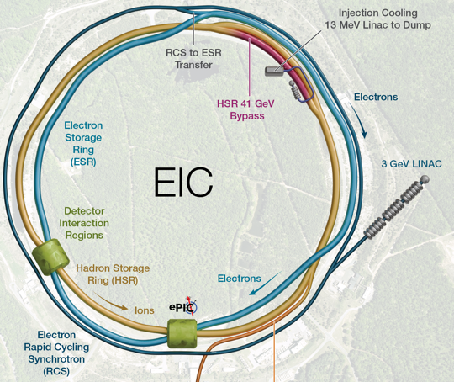
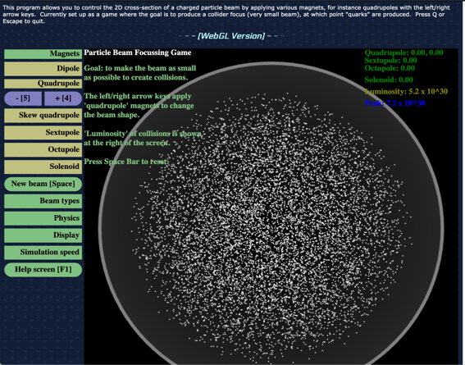
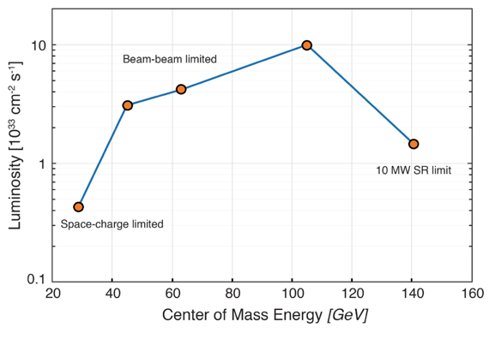
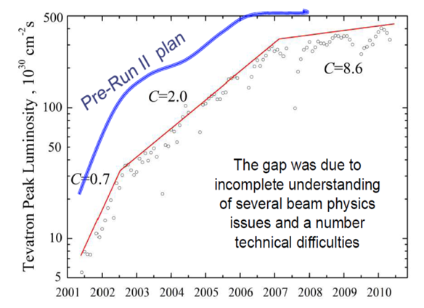
Outline: EIC Collider Performance
Present Design Approach
Parameters for Luminosity
Luminosity Optimization Parameters
  Luminosity demonstration/game
CD-1 Design Luminosity Curve
  Low E_{cm}: Space charge beam dynamics
  Mid E_{cm}: Beam-beam dynamics
  High E_{cm}: Synchrotron radiation power/RF power
Proposed Early Science Program
  Luminosity curves and limits
Luminosity Evolution and Complexity

Slide 3
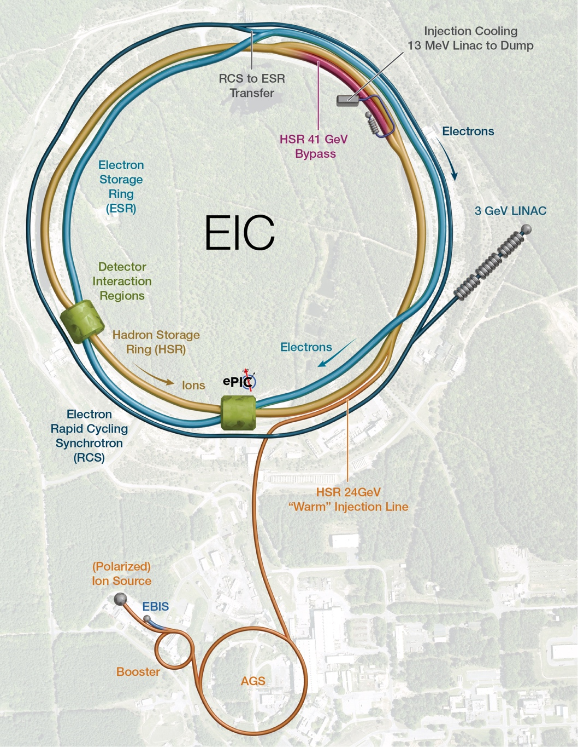


S. Nagaitsev – Sep 2024 MAC
Present EIC Design Approach
Ultimate EIC Performance Parameters:
High Luminosity: L= 10³³ – 10³⁴ cm⁻² s⁻¹
Highly Polarized Beams: 70%
Large Center of Mass Energy Range: E_{cm} = 28 – 140 GeV
Large Ion Species Range: protons – Uranium
Large Detector Forward Acceptance and Good Background Conditions
Possibility to Implement a Second Interaction Region (IR)/Detector
Future 2nd
Detector
Location
Accelerator Status in a glance:
Polarized ion/proton source
Ion injection and initial acceleration systems – Linac (200 MeV), Booster (1.5 GeV), AGS (25 GeV)
Hadron Storage Ring (40-275 GeV) – HSR
Electron Pre-Injector (3 GeV) – EPI
Electron Rapid Cycling Synchrotron (3 GeV – top energy) – RCS
Electron Storage Ring (5 GeV – 18 GeV) – ESR
Interaction Region(s) – IR
Strong Hadron Cooler System – SHC

Slide 4
Luminosity Optimization Parameters
Maximize collision frequency (~90 MHz)
  Limited by kicker rise times
  Limited by parasitic collisions (crabbing)
Maximize particles per bunch (~10¹¹)
  Limited by sources, space charge
  Limited by collective effects
    Interaction of beam with impedances
    Also total currents: I_{1,2}=q_{1,2}N_{1,2}f_{coll} ~1-3A
Minimize beam sizes at IP (~250/25 um)
  Limited by IR focusing, magnets
  Limited by chromatic dynamic aperture
  Limited by emittance growth (IBS)
Every parameter optimized
separately and collectively in the
EIC design
Try multiplying out the given numbers –
should be very close to 10³⁴ cm⁻²s⁻¹

Slide 5

Just For Fun: Final Focus/Luminosity Game
http://stephenbrooks.org/ap/beam2d/
Can you achieve a peak luminosity of
10³⁴ cm⁻² s⁻¹?
Use the [5] and [4] keys to horizontally
focus/defocus)
Click Help Screen for other keys/magnets

Slide 6

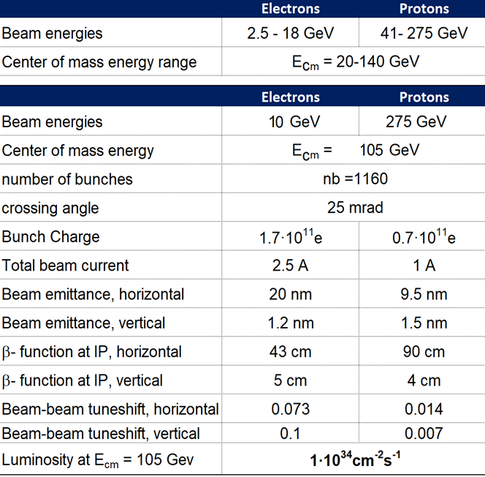
CD-1 Design Luminosity Curve
Beam-beam limited
beam size lumi scaling
10 MW SR limited
Space charge limited
5
5
10
10
e [GeV]
18
41
100
100
275
p [GeV]
275
Result of collective parameter optimization
CM energy and luminosity limiting factors are correlated
  Three fundamental luminosity limiting factors
Later: acceptance and luminosity inversely correlated

Slide 7
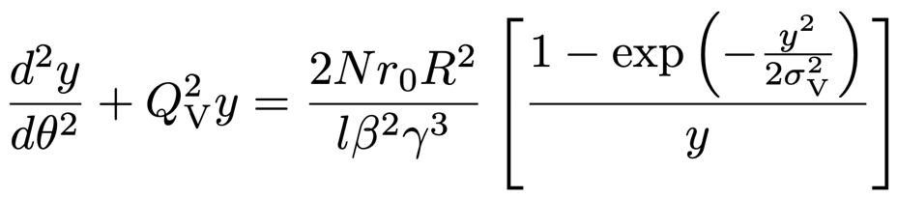
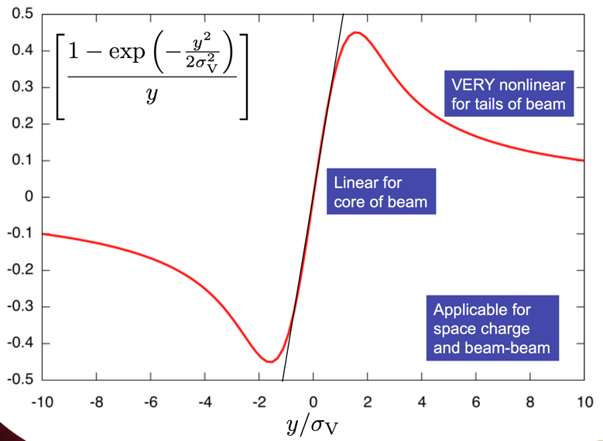

Luminosity at Low E_{cm}: Hadron Space Charge
Dense charged particle bunches electrostatically repel in rest frame
Creates nonlinear space charge force and equation of motion in lab frame
Fortunately scales with 1/γ³ so worst at low energies
  Great example of time dilation
  Limits high-intensity injector emittances
  Force applies continuously within beam
Tolerable linear “space charge tune spread” of 0.05 limits total current of 41 GeV proton beam to ~0.4A.
(IBS: intra-beam hard scattering also contributes)

Slide 8
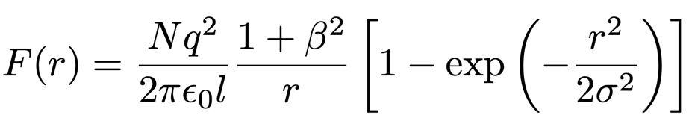

Luminosity at Central E_{cm}: Colliding Beam-Beam Forces
Colliding beams see each other’s collective charge distributions
Creates nonlinear beam-beam force and equation of motion similar to space charge
  BUT now the fields and force are in the lab frame already
  NO benefit of relativistic scaling
  Force applies only once per turn
Tolerable “beam-beam tune spead” of 0.015 limits highest EIC luminosity

Slide 9
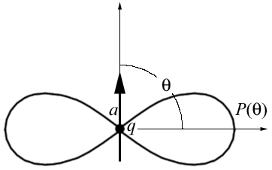
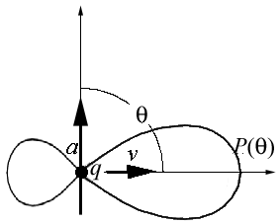
Luminosity at High E_{cm}: Electron Synchrotron Radiation Power
Accelerated charged particles emit photons
  Electrons in synchrotron: radially accelerated
  Synchrotron radiation emitted in forward cone
    Cone opening angle
    Radiated power
  scaling much worse for electrons
    18 GeV e: =3.5x10⁴ vs 255 GeV p: =3x10²
Design: 9 MW @ 18 GeV (facility limit 10 MW)
Expensive: Power must be provided by SRF
Raise electron energy last (e- current limit)
Dipole Radiation
Perpendicular to charge acceleration
Radial
acceleration
Relativistic Boost
Synchrotron Radiation
Relativistically boosted dipole radiation

Slide 10
Accelerator at Day One and Ultimate
EIC for Early Science
Ultimate EIC
RCS:
7nC / bunch change injection scheme
5 – 10 GeV polarized e- to reach 28 nC / bunch and 18 GeV electrons
ESR:
7nC / bunch add more RF cavities to reach 28 nC / bunch
5 – 10 GeV polarized e- and 18 GeV electrons
HSR:
100 – 250 GeV polarized p update PS to reach 275 GeV protons and 110 GeV/u nuclei
100 GeV/u nuclear beams add 41 GeV bypass to get full HSR beam energy capabilities
pre-cooling at injection
Proposal for the Day-One Physics and the initial years of science is driven by
  Start of the promised NSAC/NAS science program
  Alignment with expected order in commissioning the collider and ramp up of performance that comes with gain of operational experience
  Having access to new physics results early to get high impact publications, i.e. PRLs, ……
Proposed Early Science Program incorporates comments from EIC-UG/ePIC Summer Meeting

Slide 11
Proposal for EIC Science Program in the First Years
Year - 1
Year - 2
Year - 3
Year - 4
Year - 5
Start with Phase 1 EIC
New Capability:
Commission electron polarization in parallel
Run:
10 GeV electrons on 115 GeV/u heavy ion beams (Ru or Cu)
Physics:
gives world-wide new data on nPDFs, NFF and a first look on saturation
Start with Phase 1 EIC
Commission electron polarization in parallel
New Capability:
Commission hadron polarization in parallel
Run:
10 GeV electrons on 130 GeV/u Deuterium
Physics:
gives world-wide new data → critical baseline for nPDFs and saturation
free vs. bound proton structure
Run:
Last weeks 10 GeV electrons and 130 GeV polarized protons
Physics:
first look to 3d imaging of the proton
Start with Phase 1 EIC
Commission electron polarization in parallel
Commission hadron polarization in parallel
New Capability:
Commission running with hadron spin rotators
Run:
10 GeV electrons on 130 GeV transverse polarized protons
Physics:
3d imaging of the proton / mass of the nucleon
Run:
Last weeks switch to longitudinal proton polarization
Physics:
first look helicity structure of the proton – unravel quark, gluon and orbital angular contributions
Start with Phase 1 EIC
Commission electron polarization in parallel
Commission hadron polarization in parallel
Commission running with hadron spin rotators
New Capability:
Commission hadron accelerator to operate with not centered orbits
Run:
10 GeV electrons on 100 GeV Au
Physics:
gives world-wide new data on A-dep.of nPDFs, nFF and saturation
Run:
10 GeV electrons on 250 GeV transverse and longitudinal polarized protons
Physics:
3d imaging of the proton at low x
helicity structure of the proton – unravel quark, gluon and orbital angular contributions
Start with Phase 1 EIC
Commission electron polarization in parallel
Commission hadron polarization in parallel
Commission running with hadron spin rotators
Commission hadron accelerator to operate with not centered orbits
Run:
10 GeV electrons on 100 GeV Au
Physics:
gives world-wide new data on A-dep.of nPDFs, nFF and saturation
Run:
10 GeV electrons on 166 GeV transverse and longitudinal polarized He-3
Physics:
3d imaging of the nucleons → flavor separation
helicity structure of the nucleon– unravel helicities for different quark flavors
first look to nuclear binding
Time to install additional ESR RF and HSR PS to
reach design Current and max Energies
E. Aschenauer

Slide 12
Proposal for EIC Science Program in the First Years
Year - 5
Year - 6
Year - 7
Start with Phase 1 EIC
Commission electron polarization in parallel
Commission hadron polarization in parallel
Commission running with hadron spin rotators
Commission hadron accelerator to operate with not centered orbits
Run:
10 GeV electrons on 100 GeV Au
Physics:
gives world-wide new data on A-dep.of nPDFs, nFF and saturation
Run:
10 GeV electrons on 166 GeV transverse and longitudinal polarized He-3
Physics:
3d imaging of the nucleons → flavor separation
helicity structure of the nucleon– unravel helicities for different quark flavors
first look to nuclear binding
Start with Phase 1 EIC
Commission electron polarization in parallel
Commission hadron polarization in parallel
Commission running with hadron spin rotators
Commission hadron accelerator to operate with not centered orbits
New Capability:
Commission ESR & HSR at max. energy and beam currents
Run:
18 GeV polarized electrons on 275 GeV/u polarized (longitudinal & transverse) proton beams
Physics:
3d imaging of the proton at low x
helicity structure of the proton – unravel quark, gluon and orbital angular contributions
Start with Phase 1 EIC
Commission electron polarization in parallel
Commission hadron polarization in parallel
Commission running with hadron spin rotators
Commission hadron accelerator to operate with not centered orbits
Commission ESR & HSR at max. energy and beam currents
New Capability:
Operate HSR with 41 GeV bypass
Run:
5 GeV polarized electrons on 41 GeV transverse polarized proton beams
Physics:
first look to moderate-x 3d imaging and Kaon structure/ mass
E. Aschenauer

Slide 13
Assumptions and Luminosity Calculation
7 nC electron bunch charge compared to 28 nC (CDR)
Constant proton beam IP divergencies are maintained throughout the store by gradual increase of proton IP beta-functions as the beam emittance increases.
The electron IP beta-functions are adjusted accordingly to match electron and proton transverse beam size.
Ion beam is cooled at low energy (24 GeV/u) but no stochastic cooling is used in the store
1 Run is ½ year operation at 80% uptime
2 h store turnaround time
30 min at the beginning of the store is taken by the ESR fill and detector turn-on
Not yet included a ramp of of luminosity through the Run
→ at RHIC: 1st week 25% of projected lumi / week
2nd week 50% of projected lumi / week
3rd week 75% of projected lumi / week
4th week to X week 100% of projected lumi / week
→ First guess for EIC early years (1 to ~5?)
1st week 10% of projected lumi of the run / week
increase by 10% every → 10 weeks to reach projected lumi / week
E. Aschenauer

Slide 14
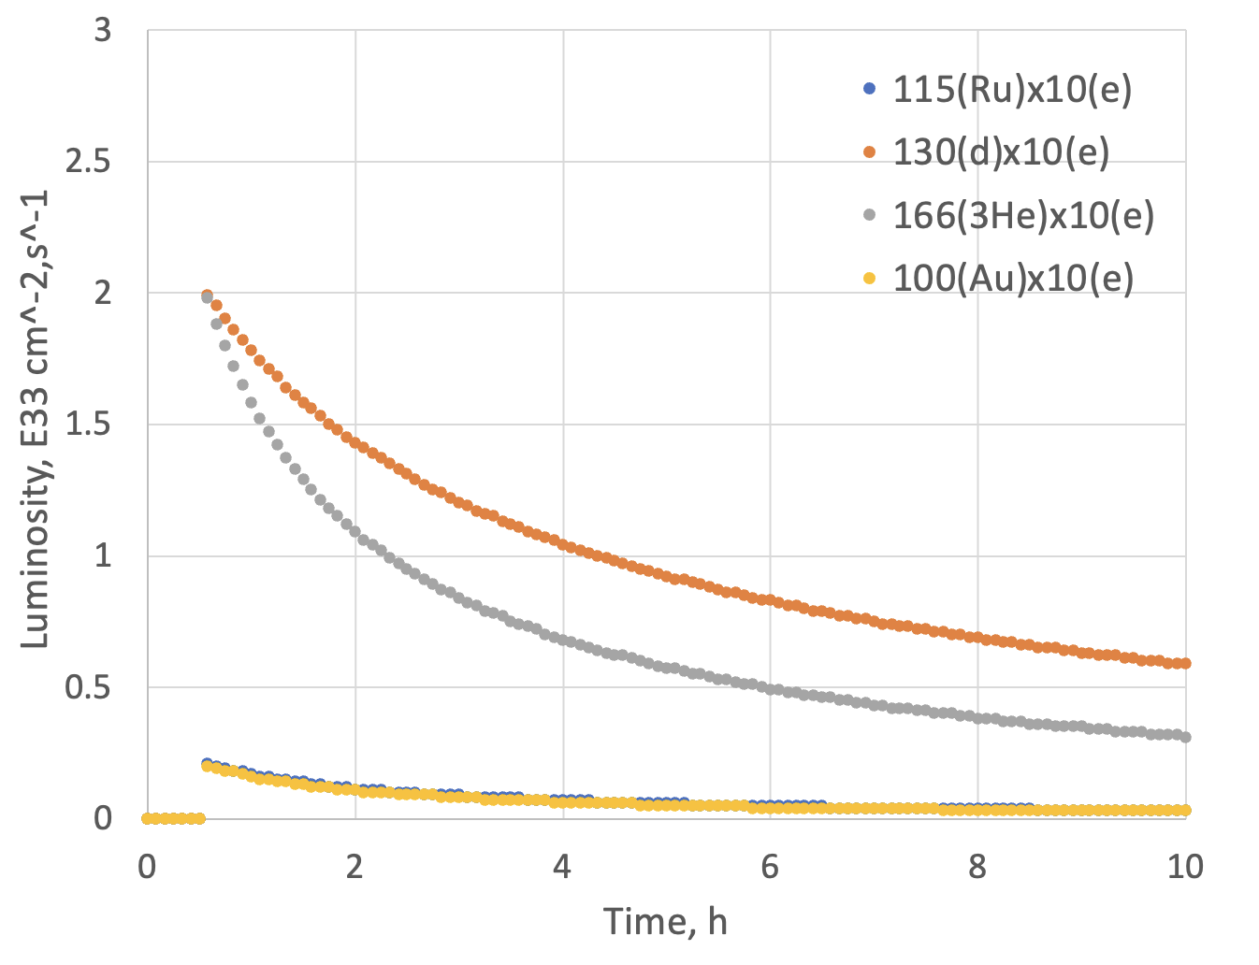
Luminosity eA in Early Years
Possible Beam energies:
electron: 5 GeV, 10 GeV and ultimately 18 GeV
proton: 41 GeV, 100 GeV to 255 GeV ultimately 275 GeV
Au: 41 GeV, 100 GeV to 110 GeV ultimately
A: 41 GeV, 100 GeV to Max ~255 / (A/Z) ultimately ~275 / (A/Z)
 | Lumi per Fill (5 h) | Lumi per Year
10 GeV e x 115 GeV Ru | 1.3 pb⁻¹ | 0.9 fb⁻¹
10 GeV e x 100 GeV Au | 1.2 pb⁻¹ | 0.84 fb⁻¹
10 GeV e x 130 GeV d | 16 pb⁻¹ | 11.4 fb⁻¹
10 GeV e x 166 GeV ³He | 12 pb⁻¹ | 8.65 fb⁻¹
Note:
eA luminosity is per nucleon
E. Aschenauer

Slide 15
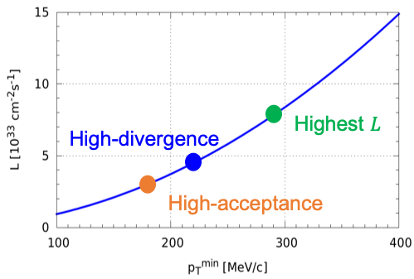
Luminosity ep in Early Years
Possible Beam energies:
electron: 5 GeV, 10 GeV and ultimately 18 GeV
proton: 41 GeV, 100 GeV to 255 GeV ultimately 275 GeV
Au: 41 GeV, 100 GeV to 110 GeV ultimately
A: 41 GeV, 100 GeV to Max ~255 / (A/Z) ultimately ~275 / (A/Z)
High Divergence | Lumi per Fill (5 h) | Lumi per Year
5 GeV e x 250 GeV p | 9.26 pb⁻¹ | 6.48 fb⁻¹
10 GeV e x 250 GeV p | 13.12 pb⁻¹ | 9.18 fb⁻¹
5 GeV e x 130 GeV p | 6.3 pb⁻¹ | 4.36 fb-1
10 GeV e x 130 GeV p | 7.6 pb⁻¹ | 5.33 fb⁻¹
Low Divergence | Lumi per Fill (5 h) | Lumi per Year
5 GeV e x 250 GeV p | 6.81 pb⁻¹ | 4.78 fb⁻¹
10 GeV e x 250 GeV p | 8.8 pb⁻¹ | 6.19 fb⁻¹
5 GeV e x 130 GeV p | 5.8 pb⁻¹ | 4.1 fb⁻¹
10 GeV e x 130 GeV p | 7.1 pb⁻¹ | 4.95 fb⁻¹
Remember:
high divergence: higher lumi, but reduced acceptance
for low forward particle p_{T}^{min}
low divergence: lower lumi, but increased acceptance
for low forward particle p_{T}^{min}
Low-divergence
E. Aschenauer

Slide 16
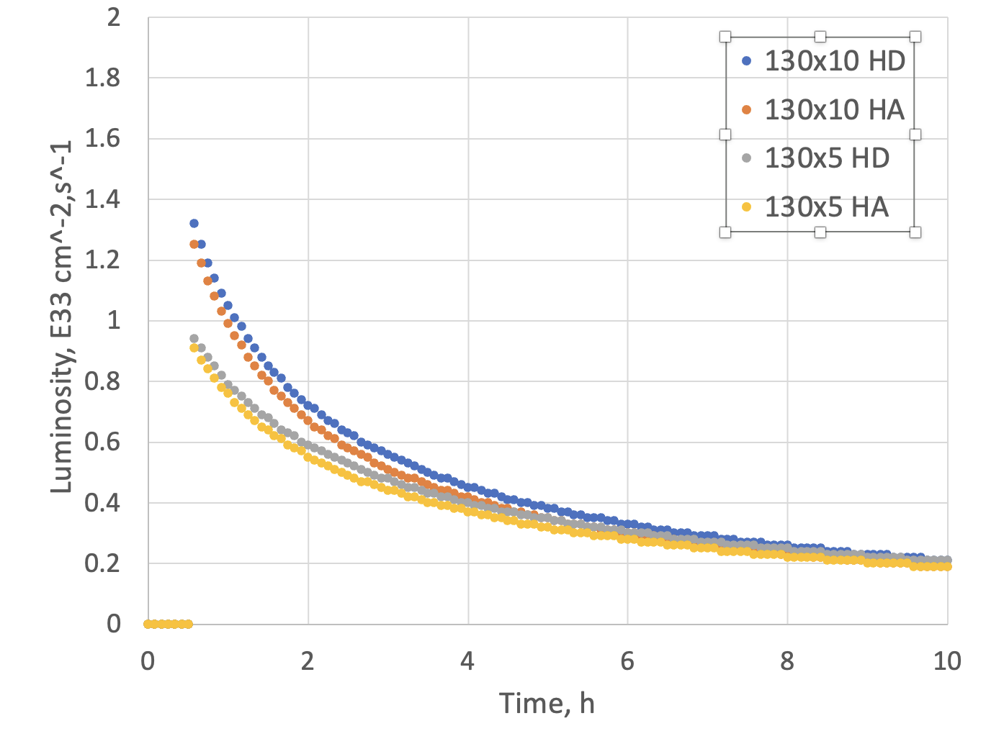
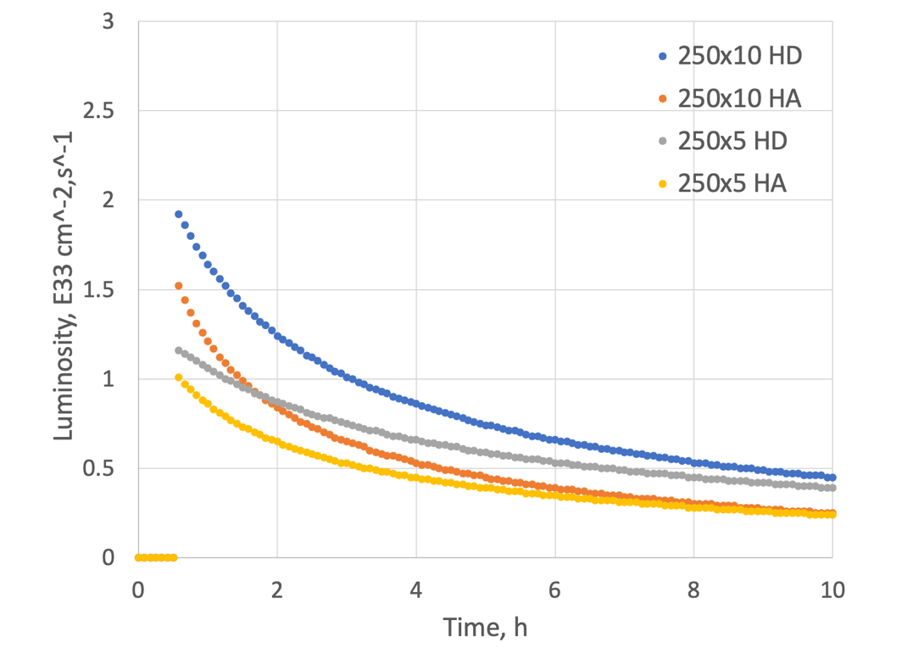
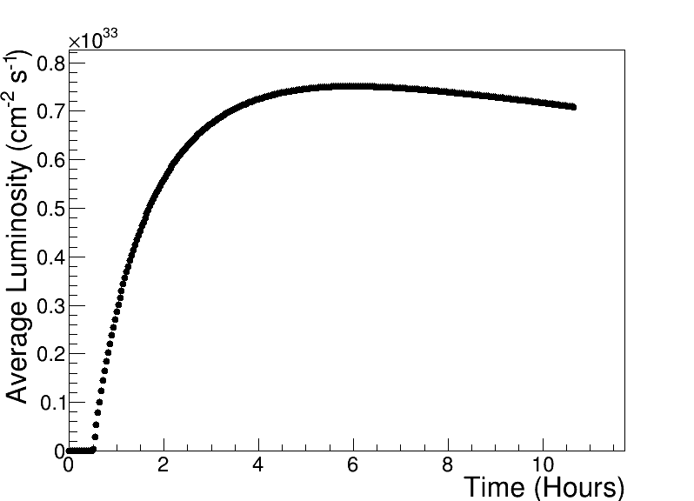
Luminosity ep in Early Years
Compare to HERA peak luminosity
of 5x10³¹ cm⁻² s⁻¹
Max average luminosity:
0.8 x 10³³ cm⁻² s⁻¹ with 5.9 hr store
Store luminosity evolution
250 GeV x 10 GeV
E. Aschenauer

Slide 17
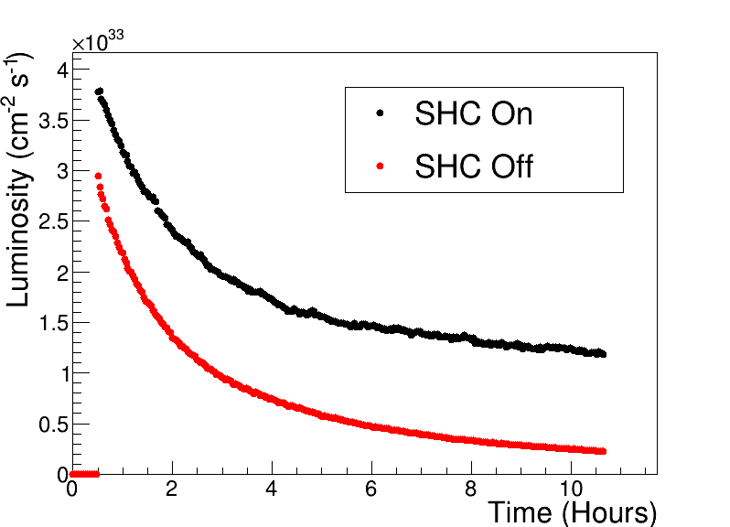
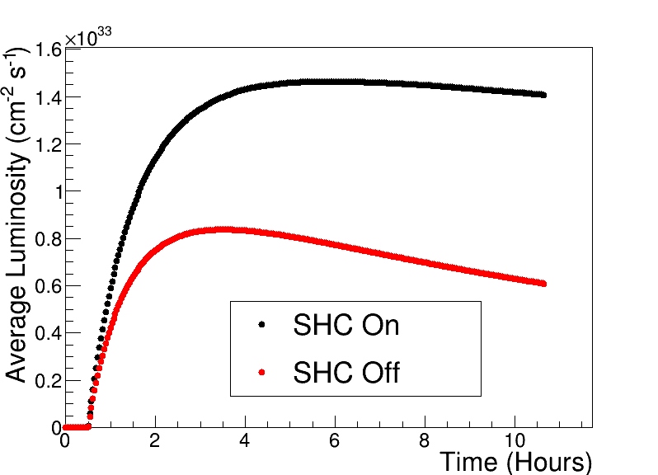
Onwards to Full Luminosity Maturity
After Year 5 will have full bunch current for electrons 7 nA to 28 nA
→ increase in luminosity ~4
Adding Strong Hadron Cooling will increase the integrated current by fill another factor of 2
Example: 10 GeV electrons x 100 GeV protons
Early years of operations will also provide insights and development time for luminosity development
E. Aschenauer

Slide 18
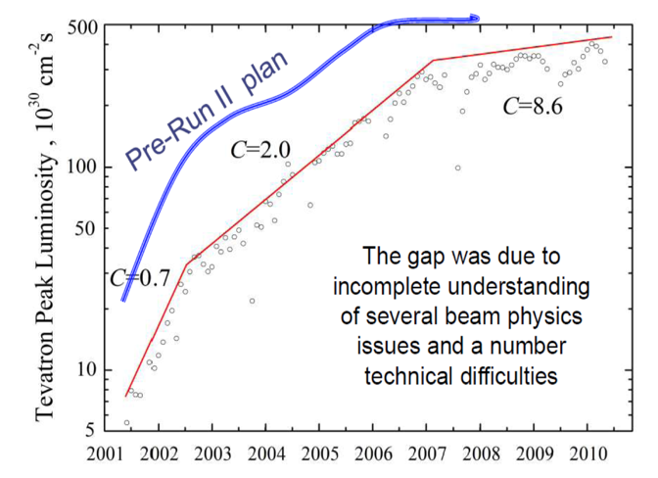
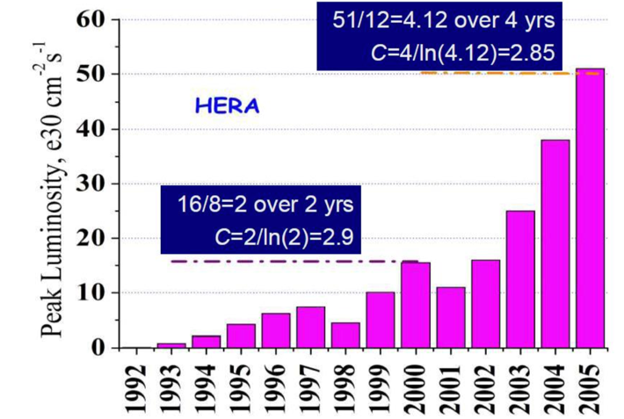
Luminosity Lessons
Tevatron Run-II: design 275x10³⁰
Luminosity ramp-up to design takes years
  Useful paper: arxiv 1202.3950 (V. Shiltsev)
  Contextualizes Tevatron Run-II and early LHC
  Luminosity ramp-up parameter C: complexity
    C: time (years) to increase luminosity by e
    C=2: factor of e luminosity increase in 2 years
  Early commissioning can make quick strides
    C<1 (or <<1) but do not get too exuberant
  Long-term commissioning is usually C~2-3
EIC is an exceptionally complex collider
EIC will most likely take years to reach design luminosities
  We will get there!
HERA: design 15x10³⁰

Slide 19



Slide 20



Slide 21
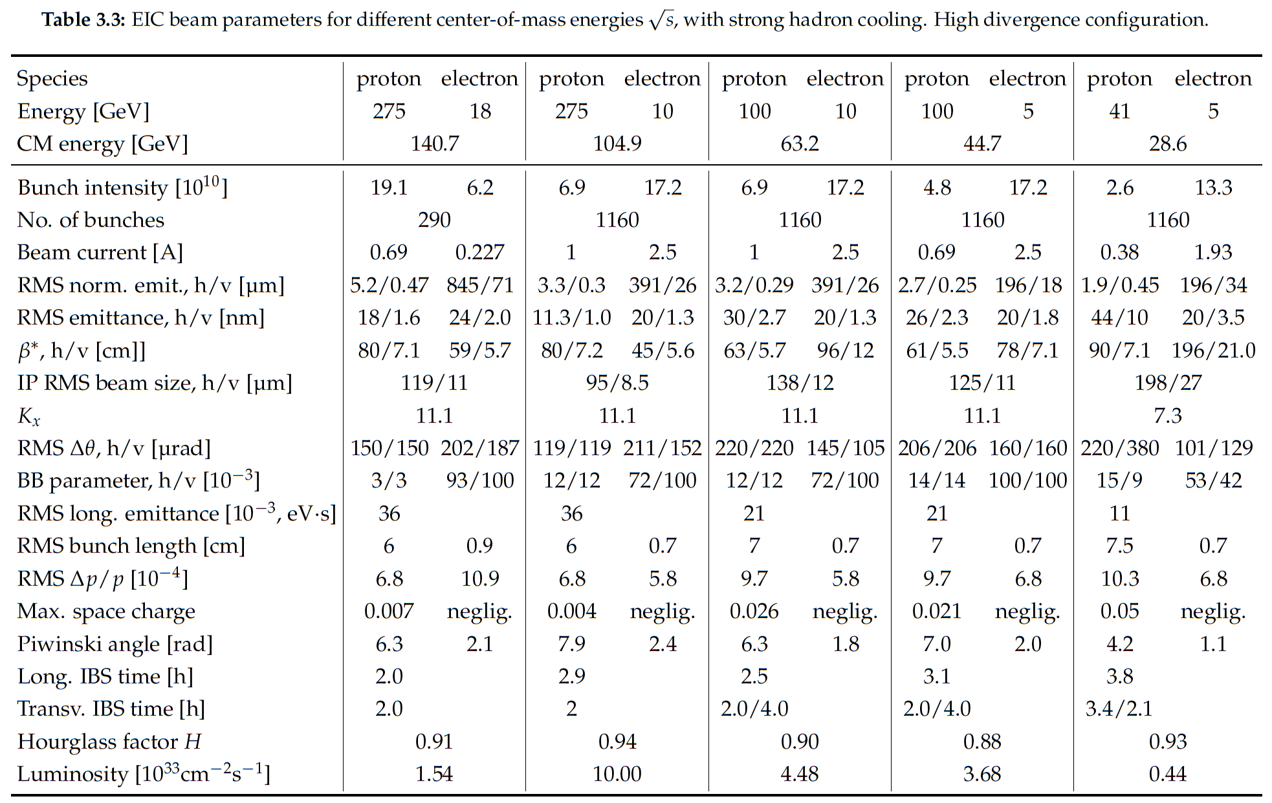

EIC CDR
CD-1 with
SHC

Slide 22
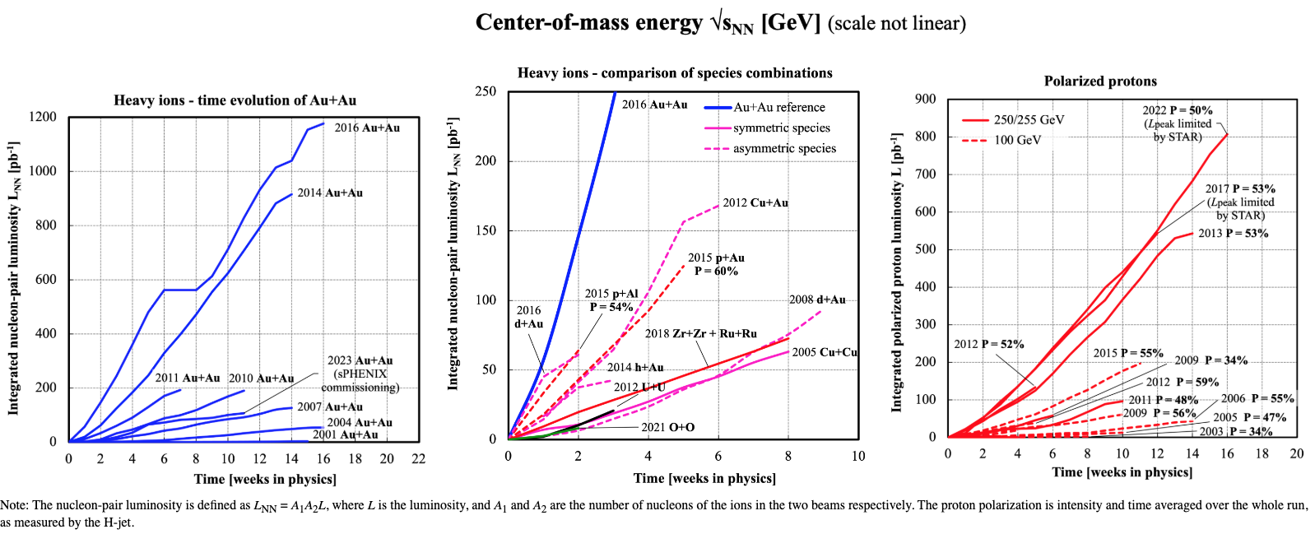
RHIC Runs

Slide 23
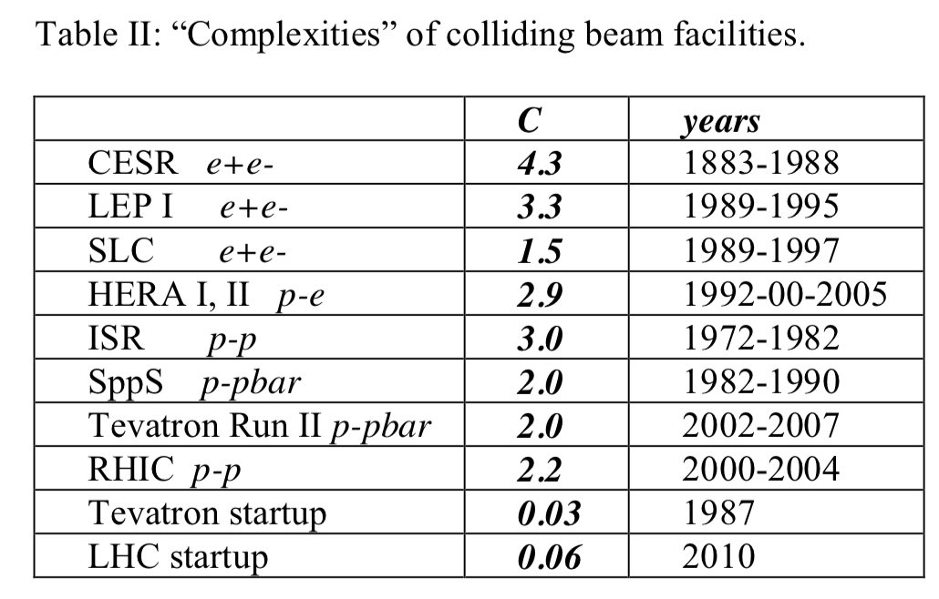
Tabulated Complexities from Shiltsev Paper

Slide 24
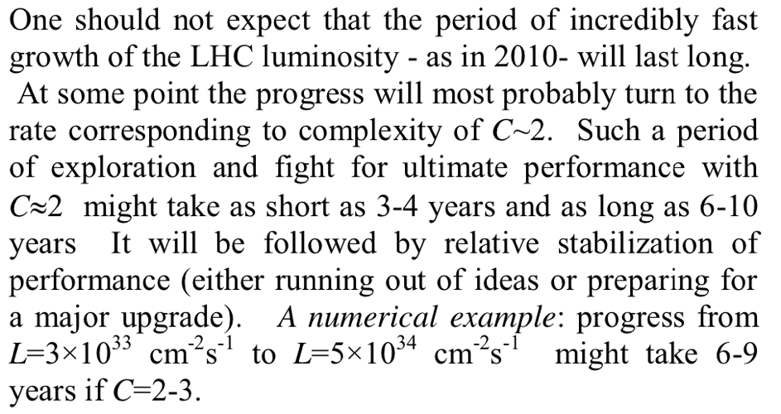
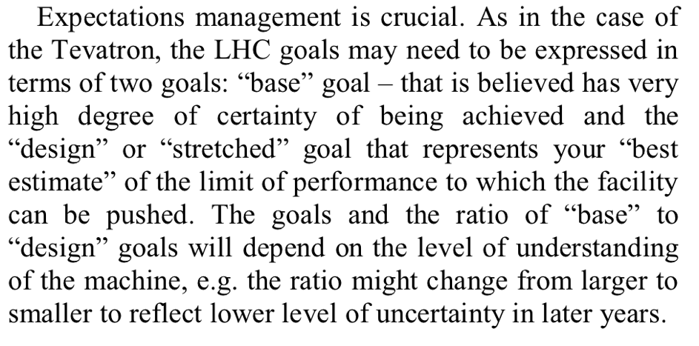
Shiltsev Paper Conclusions
24

