Slide 1

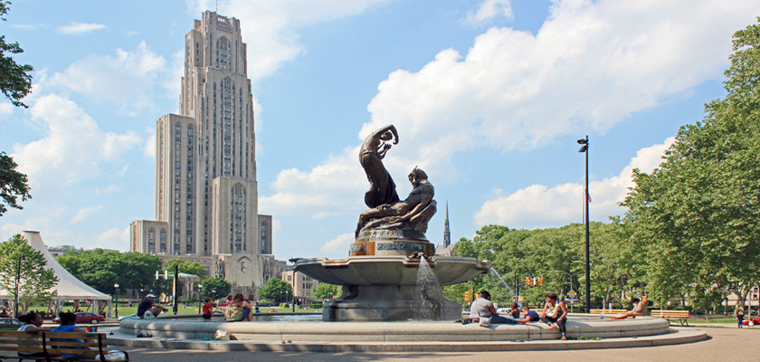
Heavy Neutral Leptons
@ EIC
Tao Han
University of Pittsburgh
Uncovering New Laws of Nature @ EIC
BNL, Nov. 22, 2024

Slide 2
Neutrinos
the most elusive/least known particles in the SM
How many species: 3 𝝂_{L} ’s + N_{R}?
Absolute mass scale:
or a new physics scale:
Mass-ordering?
Flavor oscillations & CP violation?
Non-standard interactions?
Mixing with sterile 𝜈’s?
Portal to dark sector?
m_{𝝂} ~ y_{𝝂} 𝑣 < 1 eV?
M_{majorana} >> 𝑣 ?
6+ Nobel Prizes related to 𝜈’s, more than other discoveries,
and more excitement to come!
→ New Laws of Nature!
See BSM talks: M. Nycz; V. Cirigliano; K. Fuyuto; N. Neil; H. Liu; S. Mantry; S. Trifinopoulos …

Slide 3
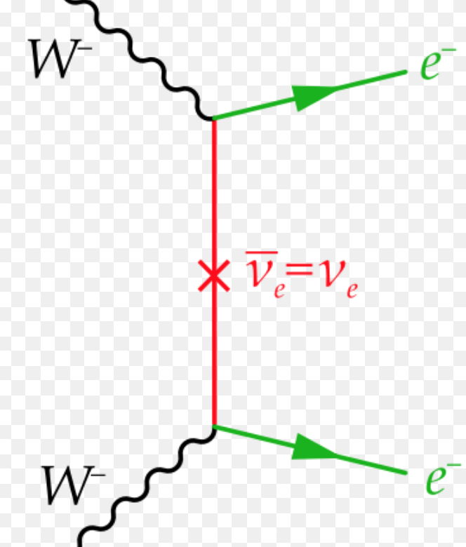
SM as a low-energy effective field theory:
Implications:
Theoretical: 𝜦 → new scale / particles,
implies an underlying (UV) theory!
Observational:
𝚫L=2 → Majorana mass (Majorana neutrinos)
→ Opens the door to BSM 𝜈 physics at low & high energies!

Slide 4
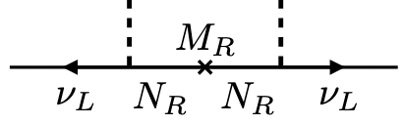
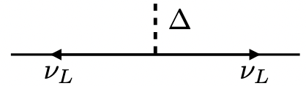
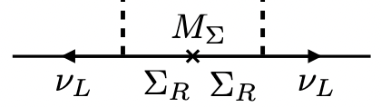
UV-complete theoretical Models:
The Weinberg operator non-renormalizable
→ Need Ultra-Violet completion at/above 𝜦 .
Group representations based on SM SU_{L}(2) doublets:
There are three BSM extensions @ Tree-level:
Type I: Fermion singlets ⊗(L H)_{S}
Type II: Scalar triplet ⊗(L L)_{T}
Type III: Fermion triplets ⊗(L H)_{T}
(There are loop-generated radiative models…)
E. Ma: PRL 81, 1771 (1998).
For recent reviews: Z.Z. Xing: arXiv:1406.7739;
Y. Cai, TH, T. Li & R. Ruiz: arXiv:1711.02180.

Slide 5

Observational Aspects:
the most-wanted process: 𝚫L=2
The crossing diagrams lead to rich processes involving N/T⁰, W⁺_{R}, H⁺⁺

Slide 6
1. Neutrino-less double-beta decay
arXiv:1902.04097, M. Dolinski, A. Poon, W. Rodejohann
Future expts:
SNO+
SuperNEMO
nEXO
CUPID
LEGEND100
Current bound on light neutrino: <m_{ee}> ~ 0.2 eV
Future: <m_{ee}> ~ 0.01 eV

Slide 7
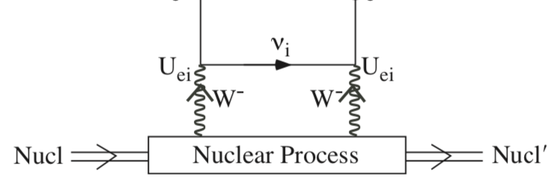



2. 𝛍⁻ - e⁺ conversion
𝛍⁻ e⁺
PDG expt bound:
~
→
for nuclear singlet (triplet)
Near future experiments:
Mu2e (FNAL), COMET (J-PARC)

Slide 8
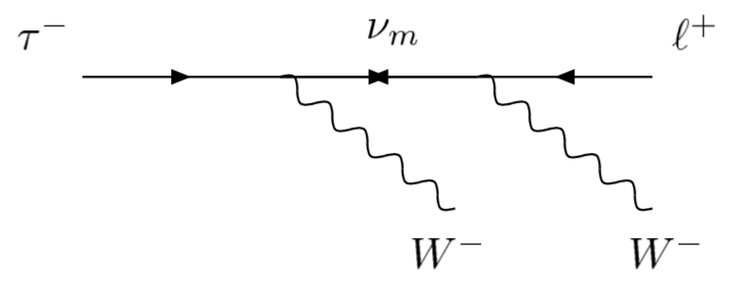
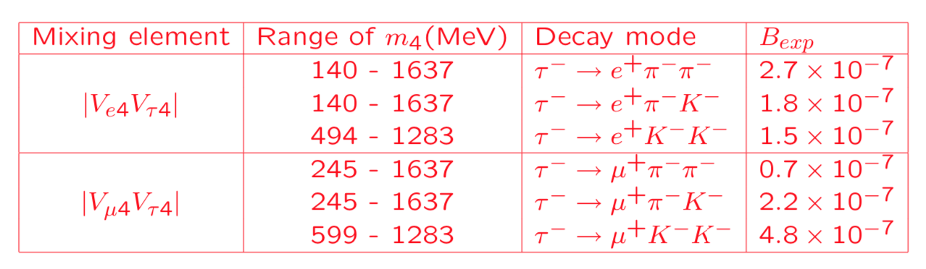

3. 𝛕± lepton decays
On resonance at m_{N}, only V_{4l}² suppressed!
For non-resonance, weaker bound:
< O(1 TeV)
Atre, TH, Pascoli, Zhang, arXiv:0901.3589

Slide 9
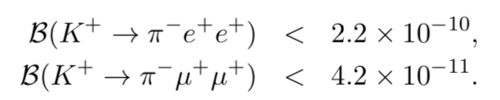
4. 𝛕, K, D, B decays via N: M⁺ → 𝑙⁺ 𝑙⁺ M⁻
CERN NA62, arXiv:1905.07770
LHCb collaboration: arXiv:1401.5361v2.
Atre, TH, Pascoli, Zhang, arXiv:0901.3589,
B. Shuve & M. Peskin, arXiv:1607.04258
BaBar collaboration: arXiv:1503.08267v1.

Slide 10
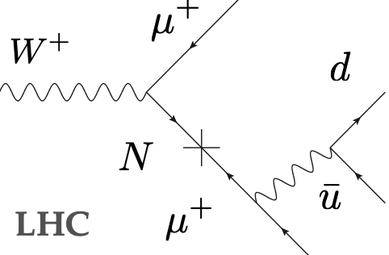
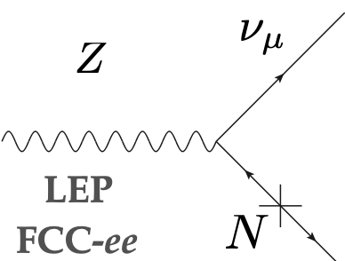
5. HNL (N) at Colliders
(W_{R})
→ being actively searched for at the LHC

Slide 11
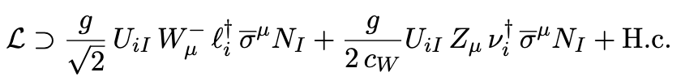
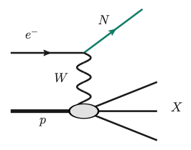
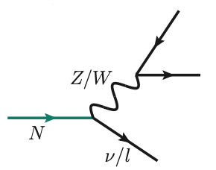
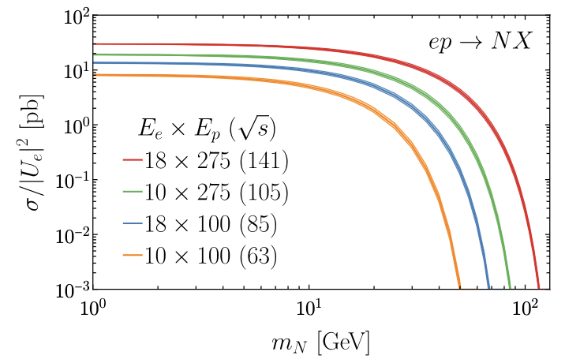
Heavy Neutral Leptons @ EIC
Both in NC and CC:
Production e⁻ p → N X: Decay N → l± W∓ , 𝛎 Z
B. Batell, T. Ghosh, T. Han, K. Xie,
arXiv:2210.09287
𝞼 ~ O(a few fb) @ U²~10⁻⁴

Slide 12
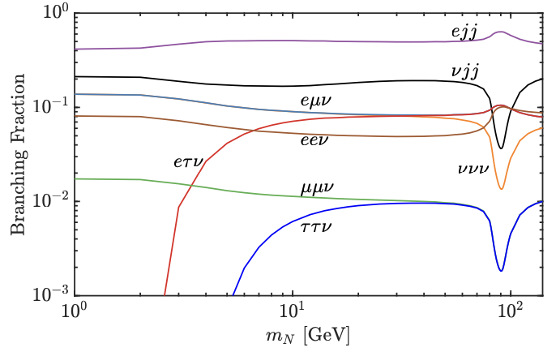
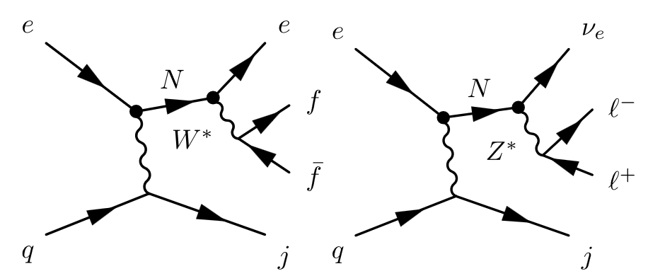
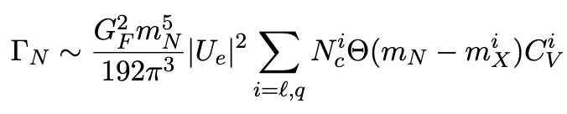
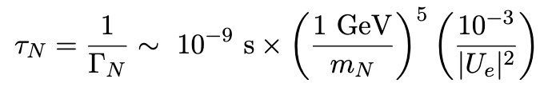
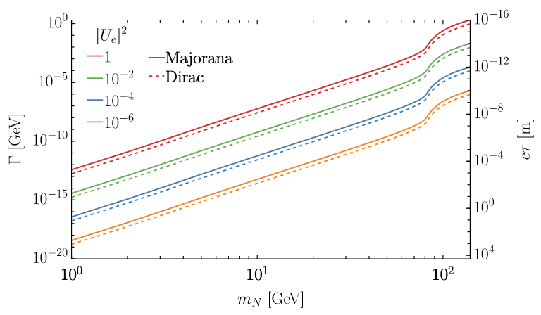
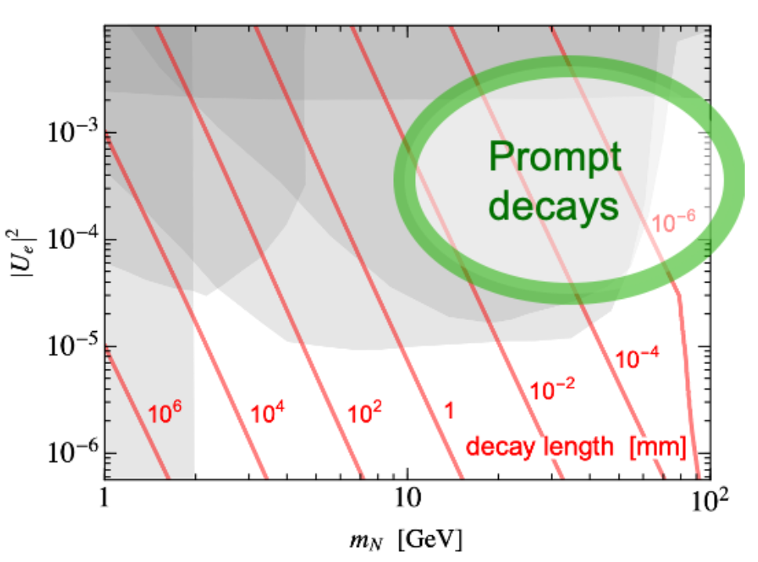
Decay length: N → l± W∓ , 𝛎 Z
(mm)
B. Batell, T. Ghosh, T. Han, K. Xie, arXiv:2210.09287

Slide 13
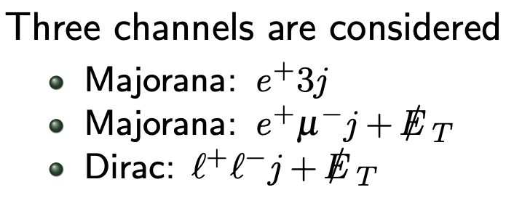

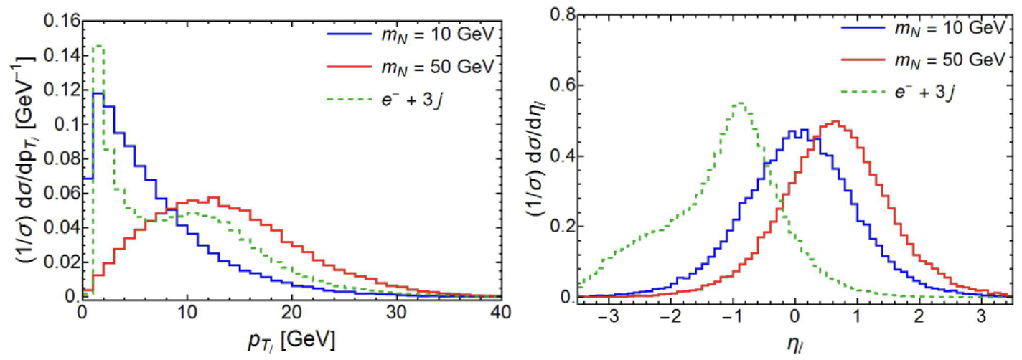
N prompt decay signal:
(1). e⁻ p → N(e⁺ jj’) + j (Majorana 𝛥L=2)
Though NO SM background for e⁺, unless e⁻ fakes e⁺ .
Acceptance cuts:

Slide 14
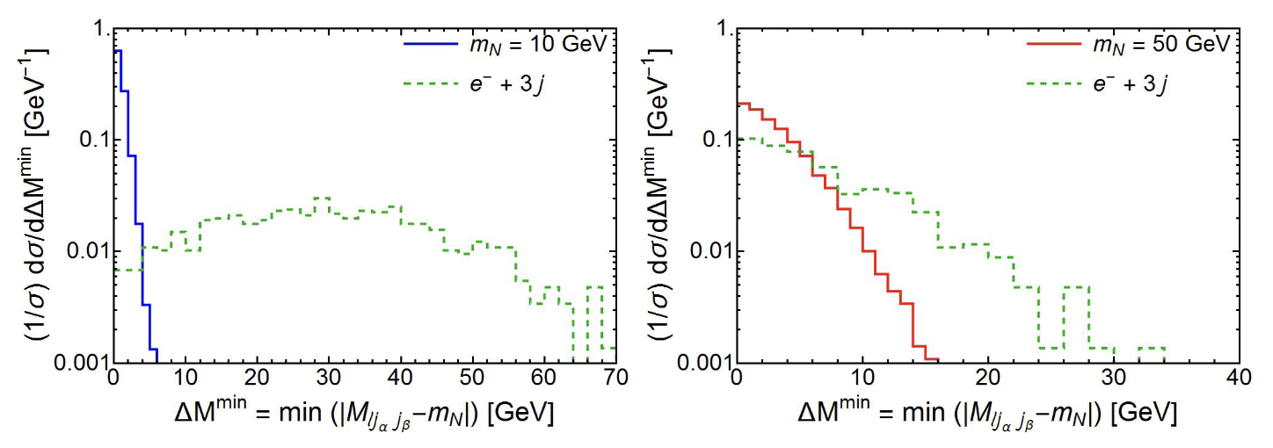
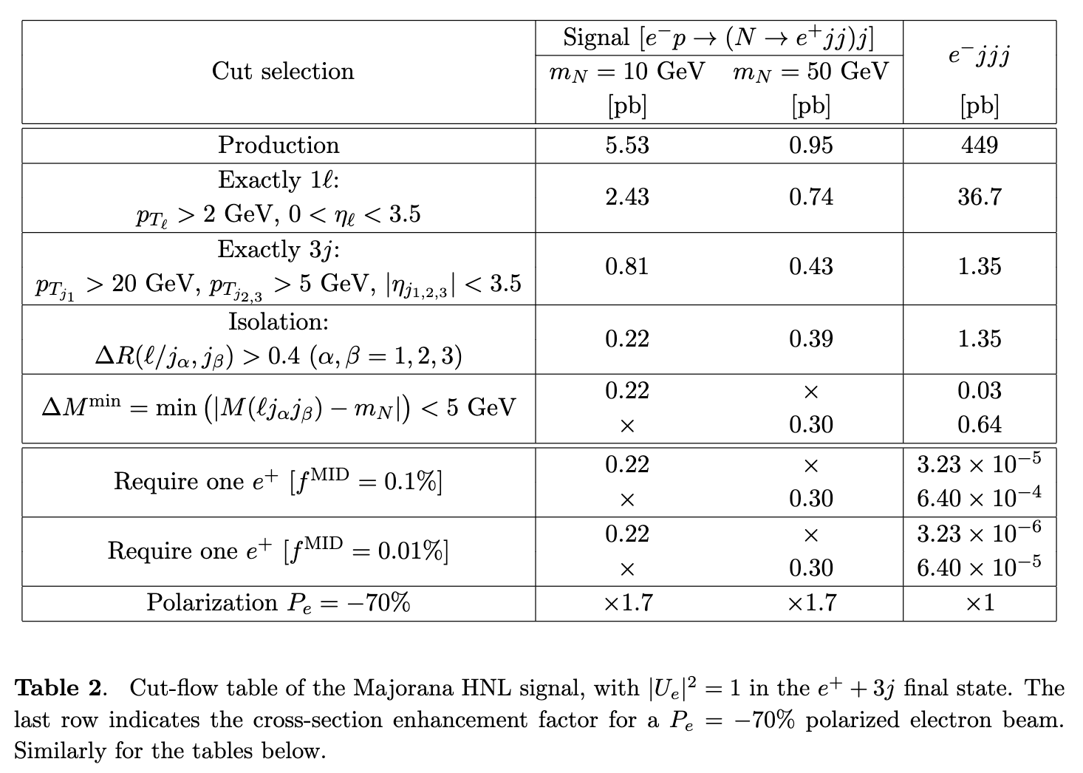
miss ID

Slide 15
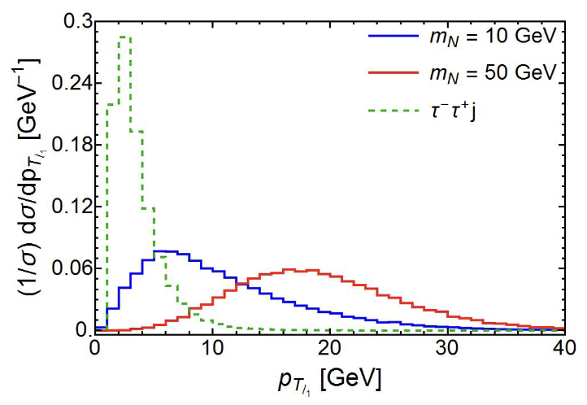
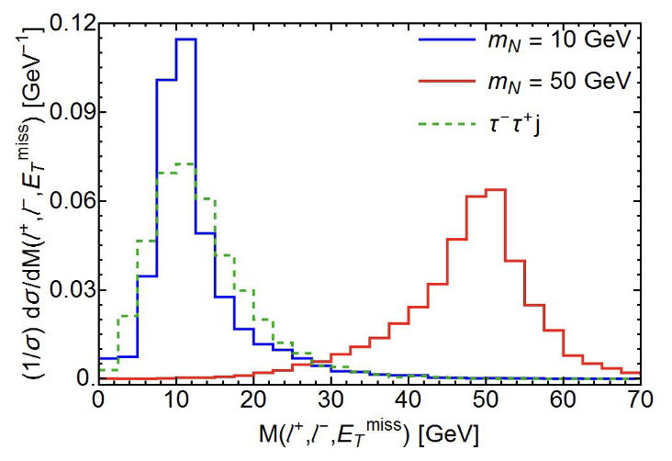
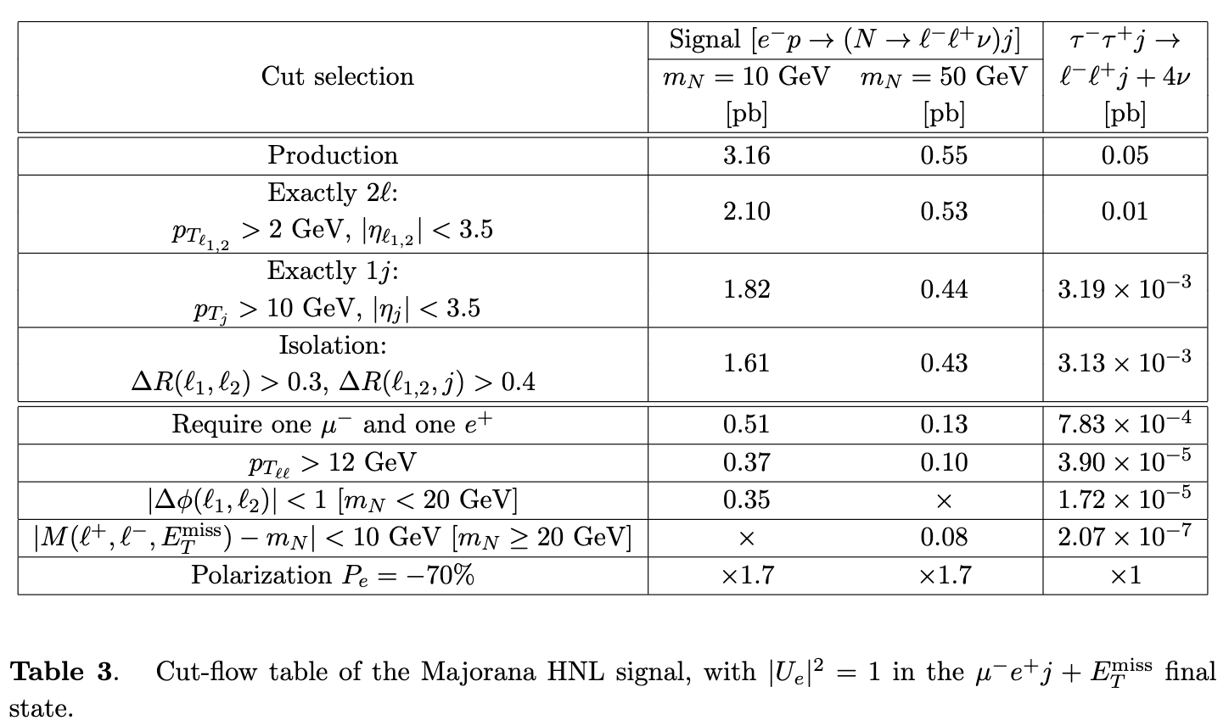
(2). e⁻ p → N(e⁺ 𝛍⁻ 𝛎) + j (Majorana 𝛥L=2)
backgrnd
signal

Slide 16
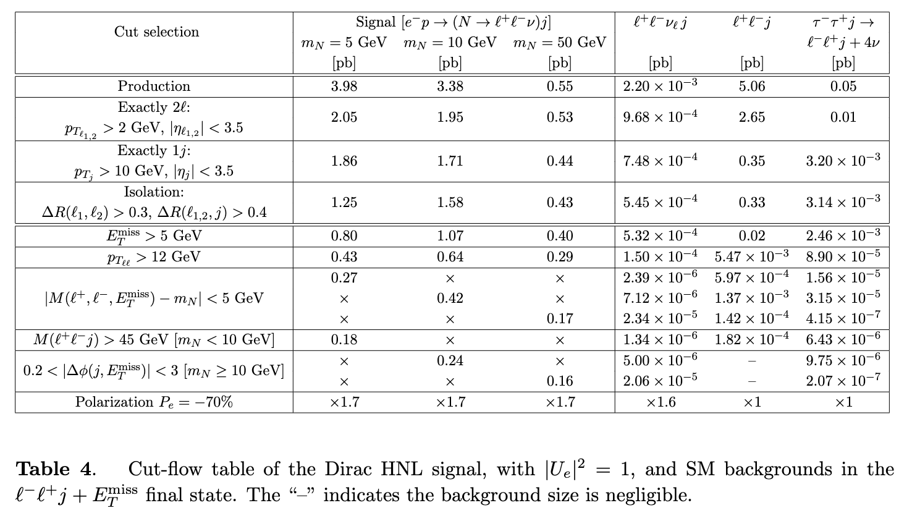
(3). e⁻ p → N(e⁻ 𝛍⁺ 𝛎) + j (Dirac-like 𝛥L=0)
More SM backgrounds to e⁻

Slide 17
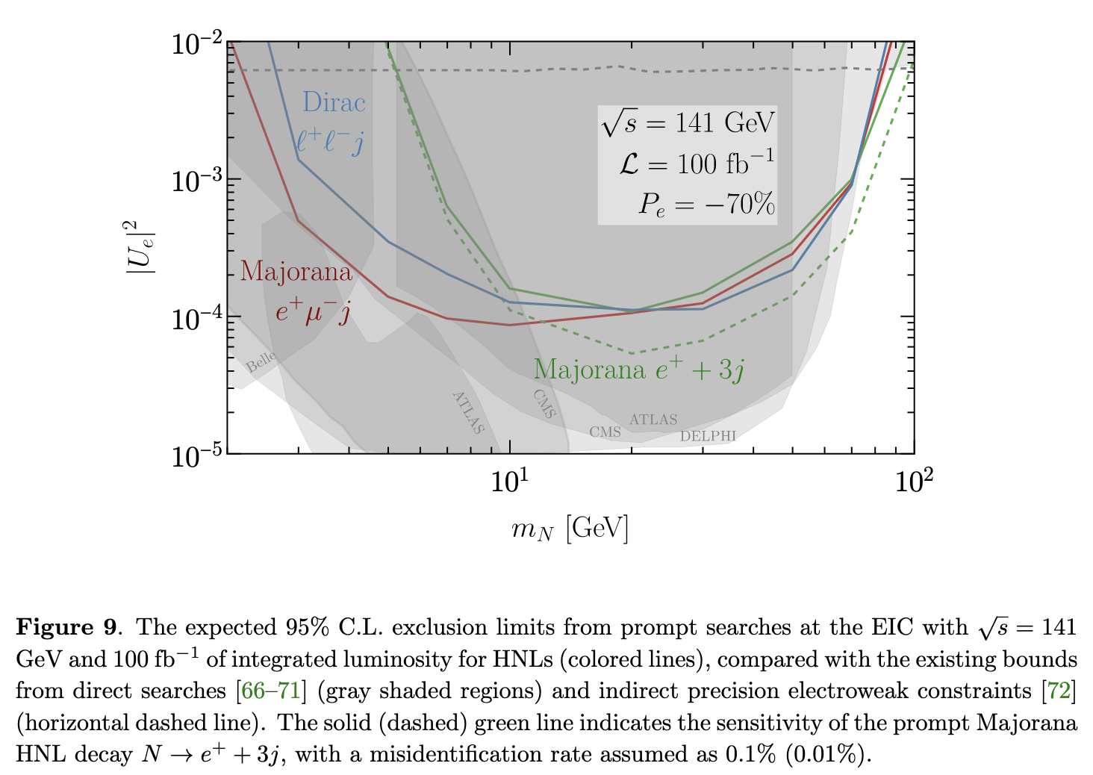
Summary for the prompt decay search
EIC: N → l± W∓ , LHC: DY W∓ → N l±
W threshold
Other bounds from “Physics Beyond Colliders” report, arXiv:1901.09966

Slide 18
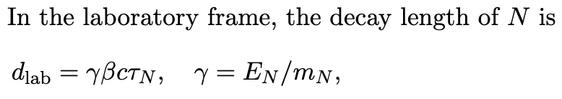
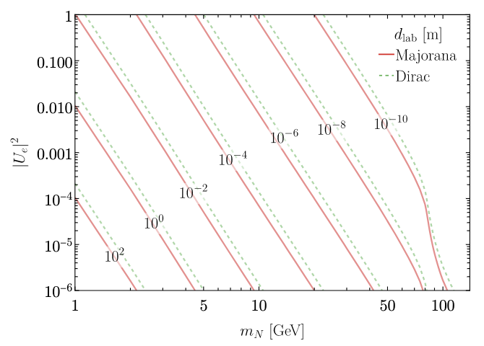
Long-lived particle N (LLP)
Assuming the detector coverage: r = 0.4 m, l = 1.2 m
and displaced impact parameter: d_{T} = 2 (20) mm
Displaced decay
Invisible decay

Slide 19
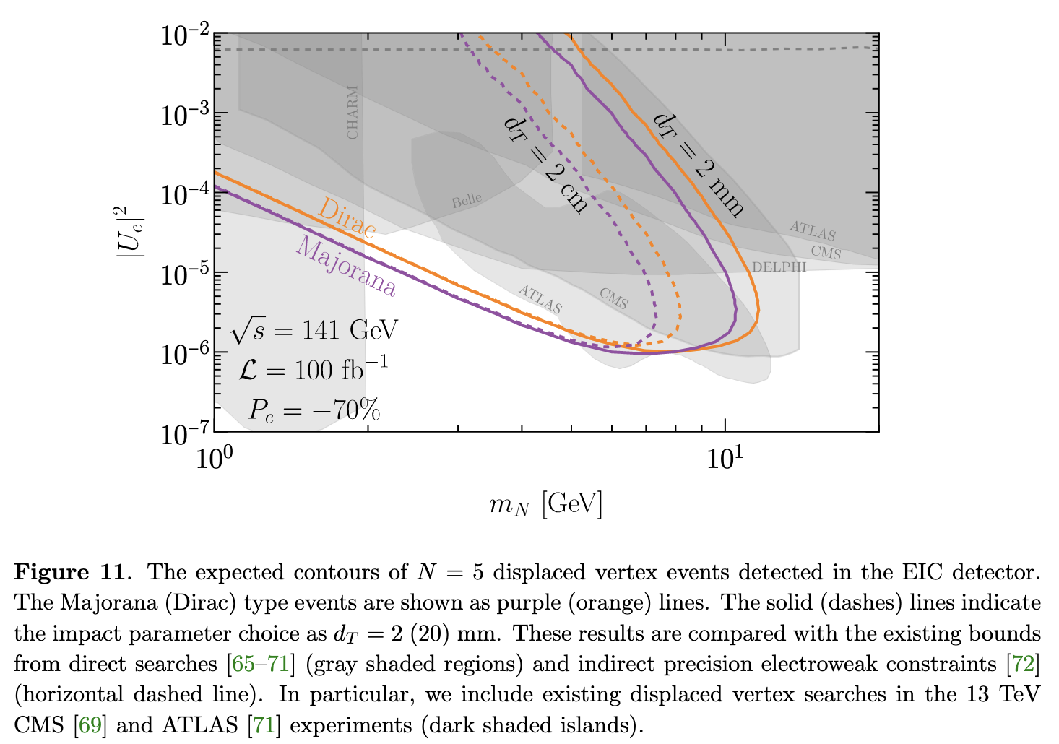
Summary for LLP decays:
N → e± 𝛍∓ 𝛎, e± jj’

Slide 20
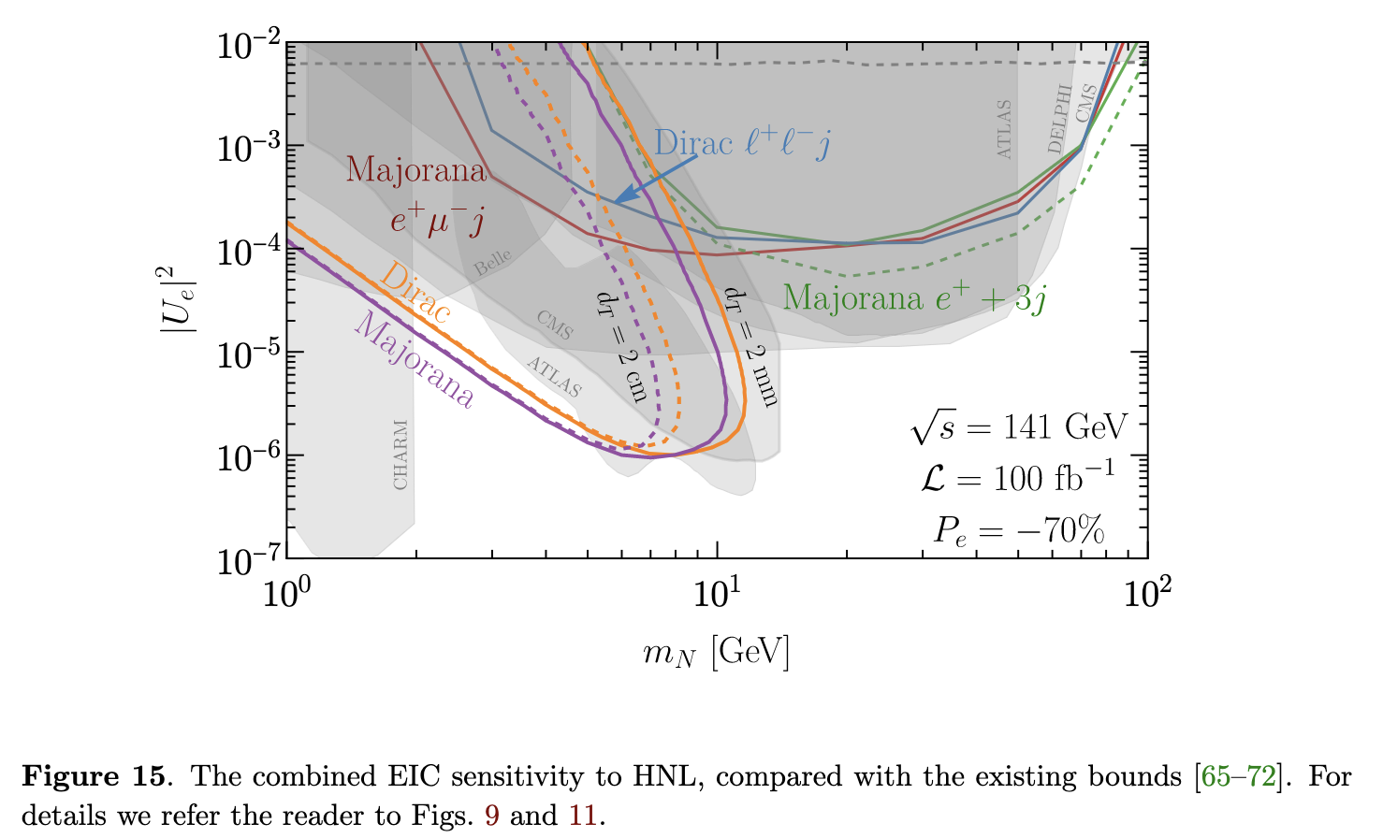
Summary plot for both prompt & LLPs
B. Batell, T. Ghosh, T. Han, K. Xie, arXiv:2210.09287

Slide 21
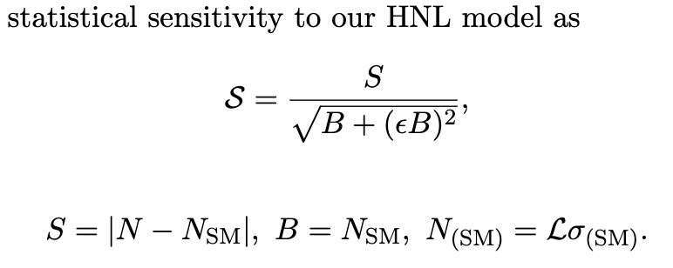
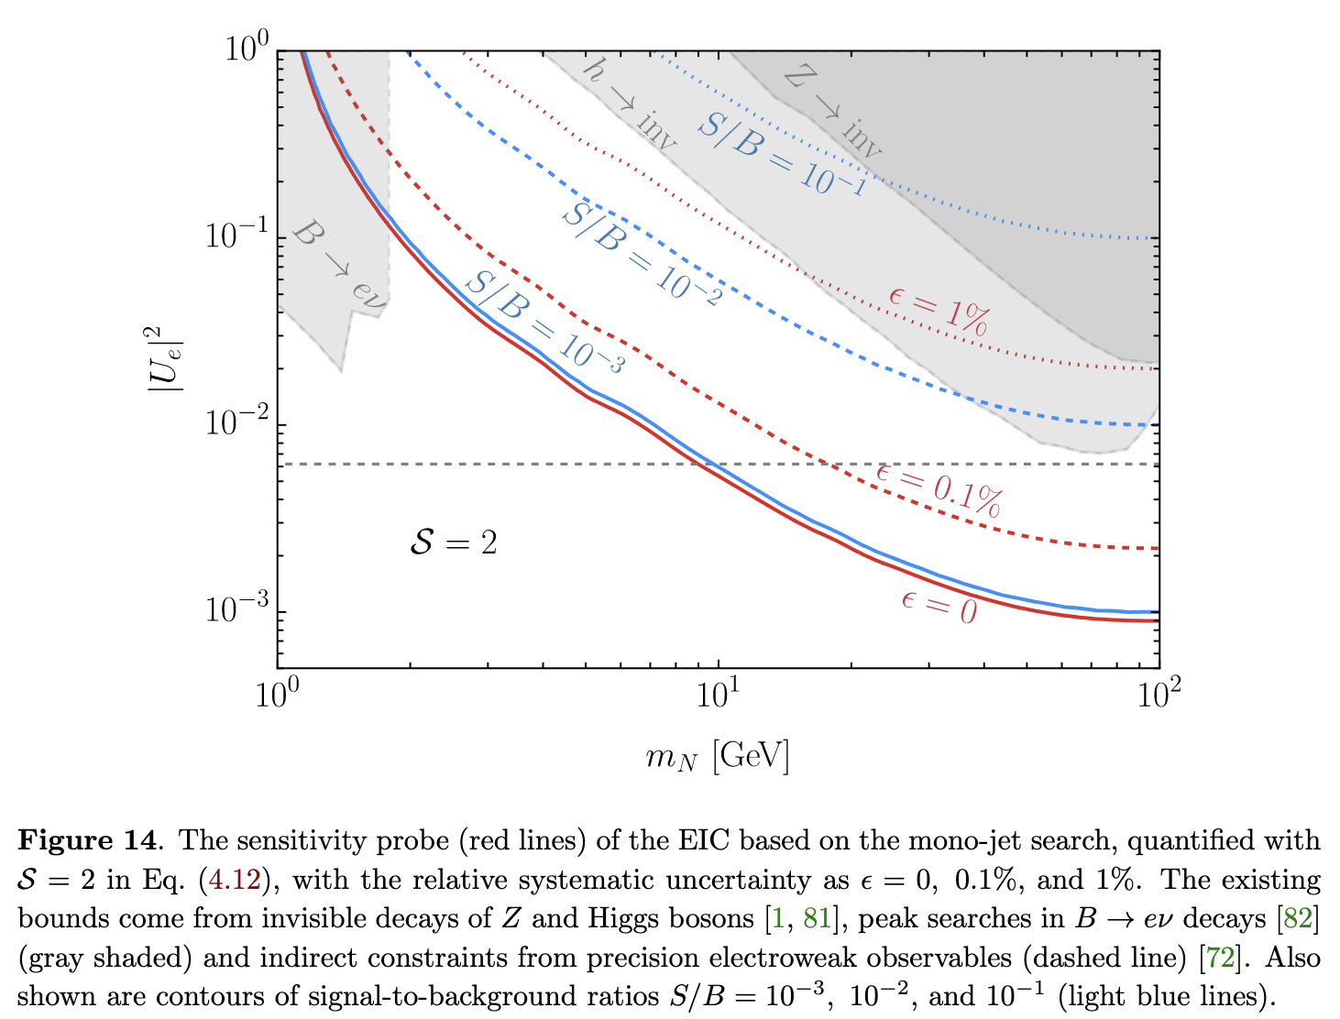
N very long-lived, invisible passing through the detection:
e⁻ p → missing N + j: Mono-jet events
No shape difference, rely on event counting …

Slide 22
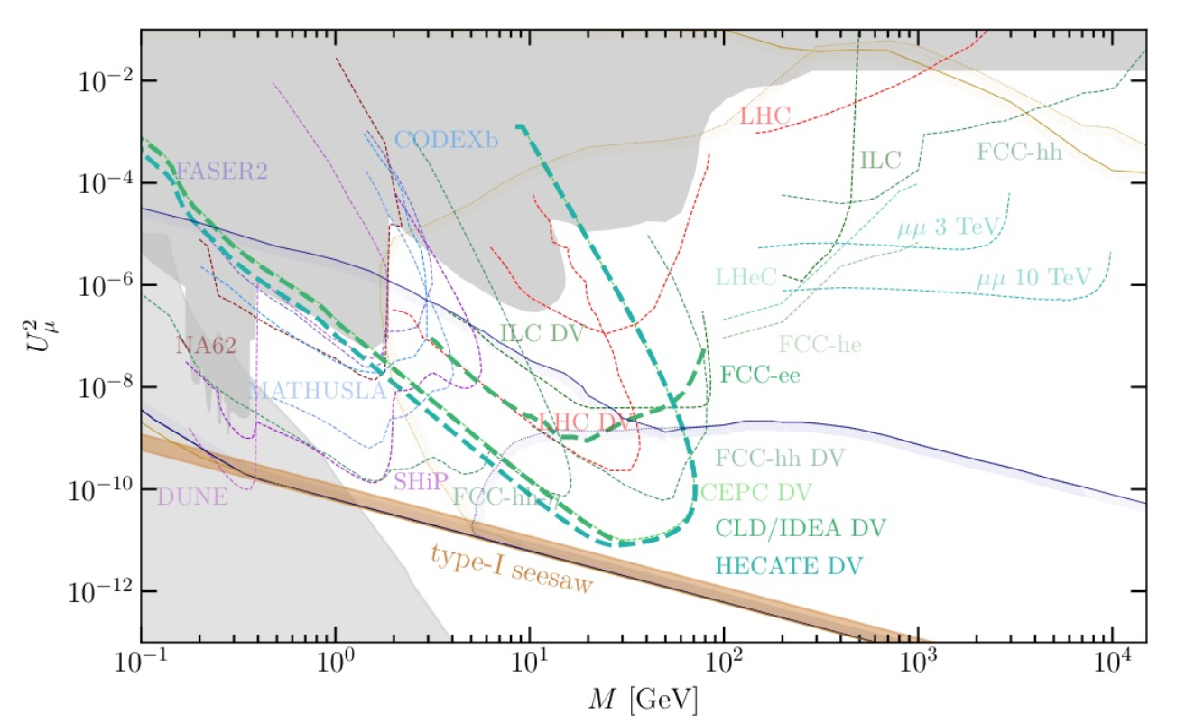
Significant efforts in searching for N
(https://arxiv.org/pdf/2203.08039)

Slide 23
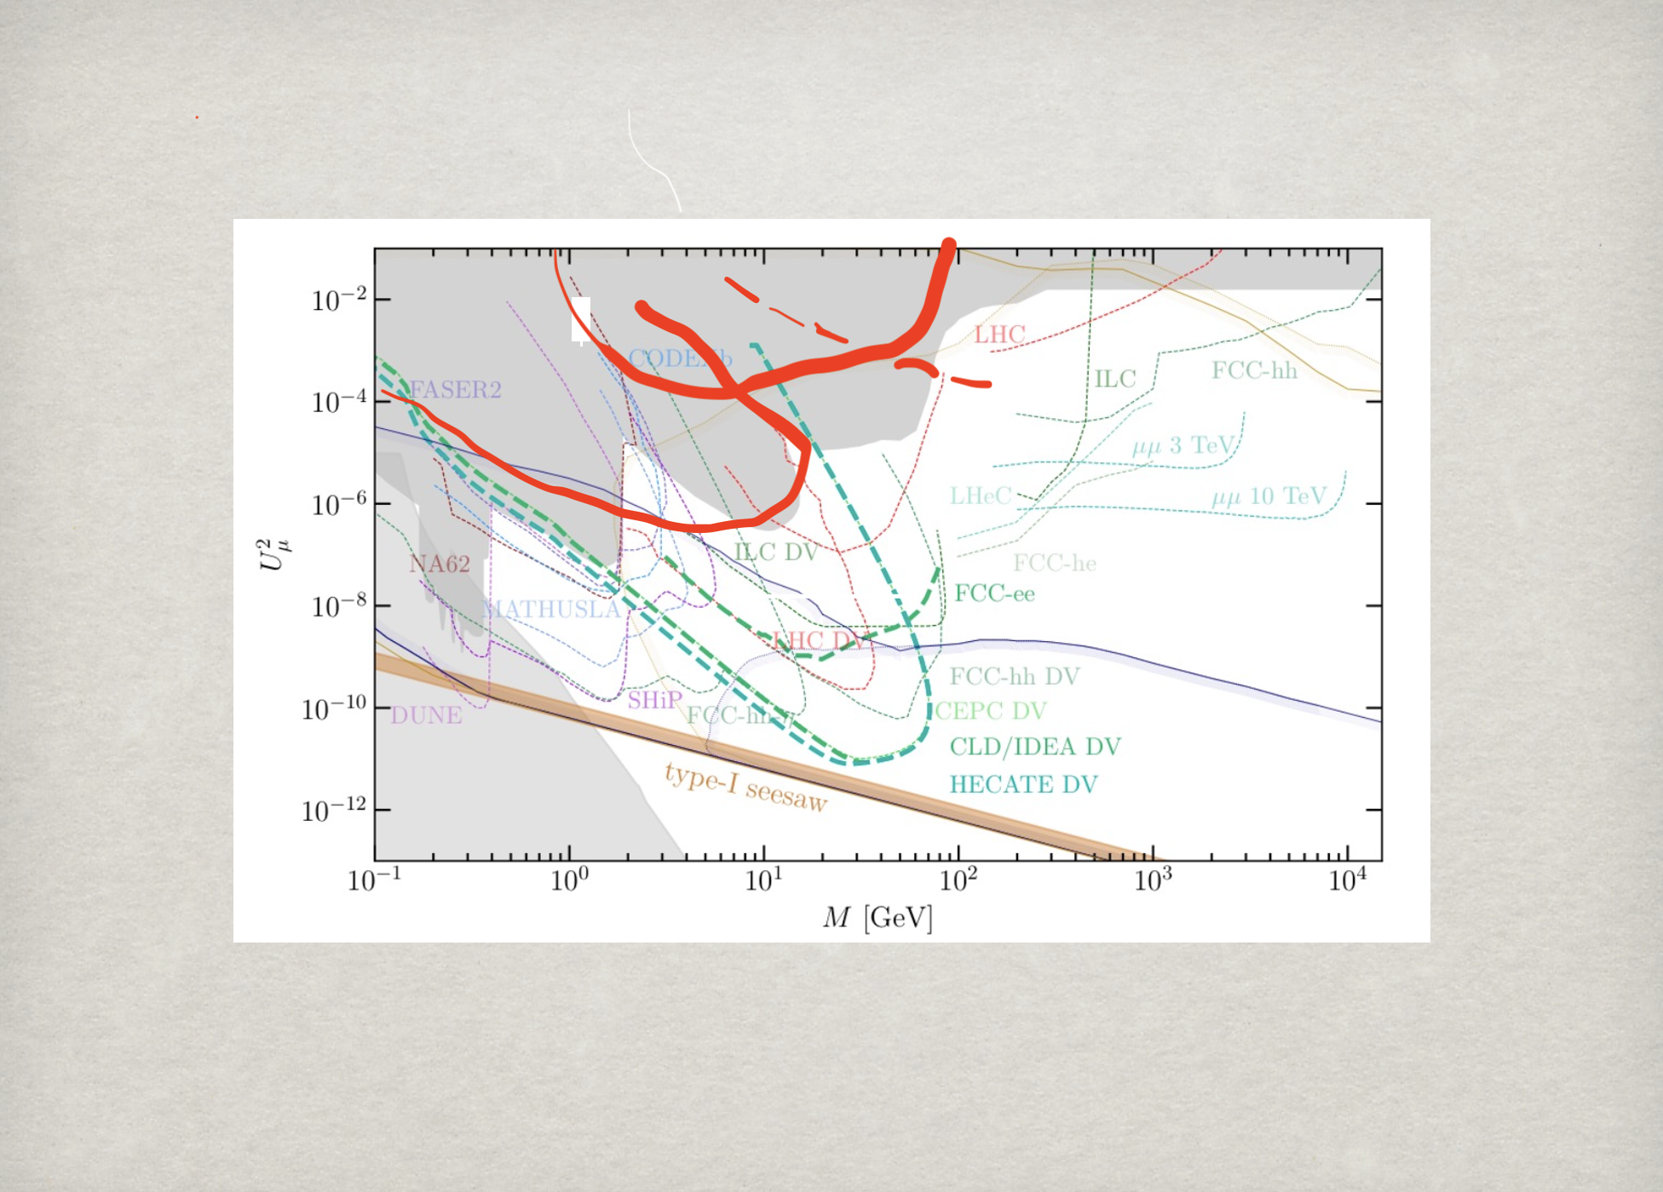
EIC can be complementary to
the low-energy oscillation and high-energy colliders
prompt decay
quasi stable N
LLP

Slide 24
Summary
EIC will open up a new QCD frontier
EIC also has potential to seek for BSM new physics,
complementary to LHC & other experiments
Snowmass White paper: arXiv:2203.13199
We studied HNL signals at EIC: all flavors e±, 𝛍±, 𝛕±
in particular for the Majorana nature.
Prompt decay signal: M_{N} ~1 – 100 GeV, U²_{eN} ~10⁻³
Displaced vertex signal: M_{N} ~O(few GeV), U²_{eN} ~10⁻⁵
Invisible decay mono-jet signal: 2𝞼 sensitivity
Exciting journey ahead!

Slide 25

Thank you: Sally, Hooman, Nicole …
for a great workshop & the hospitality!

Slide 27

Type I Seesaw: Singlet N_{R} ’s – Sterile neutrinos
Dirac plus Majorana mass terms:

Slide 28
Type I Seesaw features:
😀 Existence of N_{R} (possibly low mass*)
are from oscillation experiments
a free parameter: could be accessible!
🙁 But difficult to see N_{R}:
The mixing is typically small, mass wide open:
Fine-tune or hybrid could make it sizeable.
“Inverse seesaw”
Casas and Ibarra (2001);
A. Y. Smirnov and R. Zukanovich Funchal (2006);
A. de Gouvea, J. Jenkins and N. Vasudevan (2007);
W. Chao, Z. G. Si, Z. Z. Xing and S. Zhou (2008).

Slide 29
A Variation: Inverse seesaw #
Inverse Seesaw:
Small Majorana mass μ_{s} renders the Dirac mass M_{D} Yukawa couplings & N mixings sizable!
* 𝛎 Majorana-like; N Dirac-like.
# R. Mohapatra, J. Valle (1986)

Slide 30
Type II Seesaw: No need for N_{R}, with Φ-triplet*

Slide 31
Radiative Seesaw Models*
New fields + (Z₂) symmetry → no tree-level mass terms
Close the loops: Quantum corrections could generate m_{𝝼} .
Suppressions (up to 3-loops) make both m_{𝝼} and M low:
With (Majorana) mass scale 𝛍
Generic features:
New scalars: ϕ⁰, H±, H±±, …
→ BSM Higgs physics, possible flavor relations
Additional Z₂ symmetry → Dark Matter 𝜼
h⁰ →𝜼𝜼 invisible!
* Zee (1980, 1986); Babu (1988); Ma (2006), Aoki et al. (2009).

Slide 32
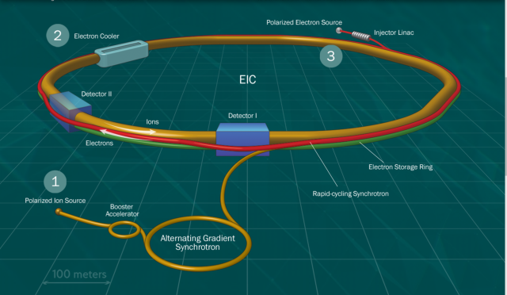
Introduction to EIC
The Electron-Ion Collider (EIC) at BNL
CM energies: 20 – 100 (140) GeV
Luminosity: 10³³⁻³⁴ /cm²/s (10-100 fb⁻¹/yr, 10 -1000 times of HERA)
Polarized electron ~ 70%; light A ~ 70%
Range of nuclear targets: proton/deuteron/gold/uranium
See, Silvia Dalla Torre talk; arXiv:1212.1701, 2103.05419

Slide 33
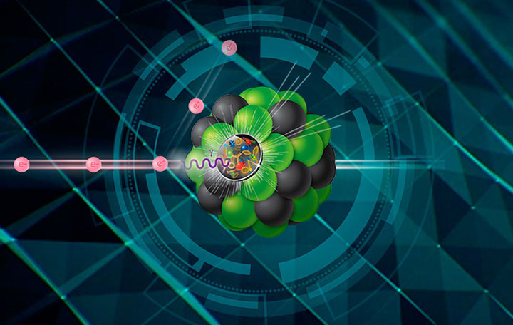
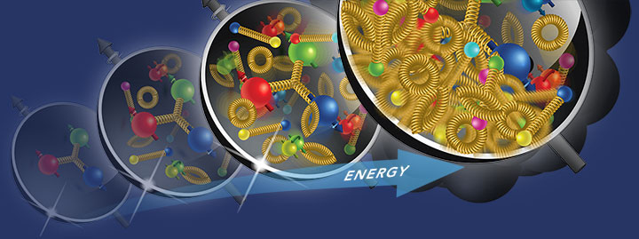
The primary physics goal of EIC
3D tomographic imaging of parton structure
Precise determination of quark/gluon momentum distributions & contributions to proton spin
Exploration of novel phases of nuclear matter at high densities
Other physics opportunities
Precision EW physics: coupling constants
Fundamental symmetries: parity, flavor, etc.
arXiv:1212.1701, 2103.05419, 2305.14572; Snowmass White paper: 2203.13199

Slide 34
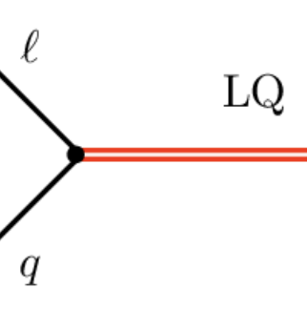
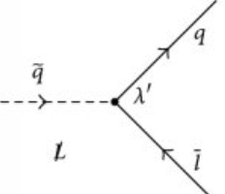
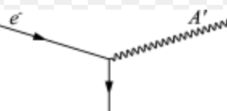
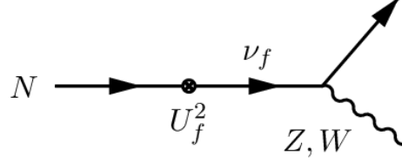
BSM physics @ EIC
Although lower energies than HERA & LHC,
there are many BSM scenarios accessible
Lepto-quarks:
Squarks from R-parity violation:
Light neutral gauge boson: “Dark force”
Light neutral fermion: “sterile neutrino”
… …
Instead, I will take a “signature driven” approach …
arXiv:1212.1701, 2203.13199

Slide 35
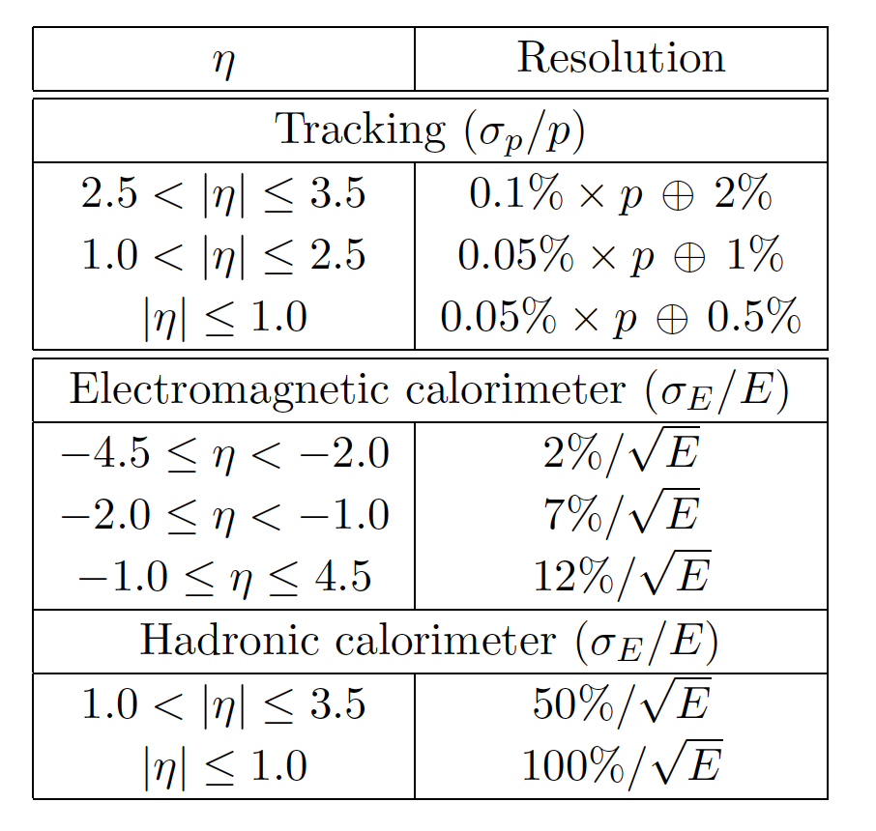
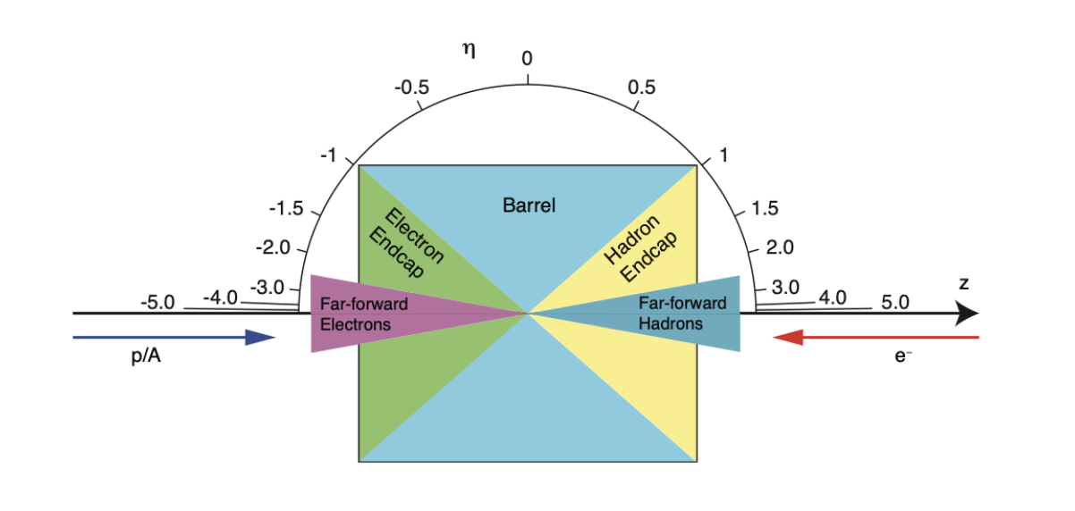
Detector capacity
Multi-purpose detector(s)
Good hermitic coverage of electron/hadron endcaps
Good tracking/calorimeters resolutions
http://www.eicug.org/web/sites/default/files/EIC_HANDBOOK_v1.2.pdf

