Slide 1
Agenda
(https://indico.bnl.gov/conferenceDisplay.py?confId=2490)
Status Reports / Discussion:
Steel preparation ⇒ See next page
Power Supply Preparation/Dump Resistor
P. Rosas: No work done last week. Tue. morning one Tech worked on the PS (not sure for how long when he wrote) … Plan to work in mid-Nov. to mid-Dec. to finish, if nothing else breaks down.
Quench Protection / DAQ Preparation
Z. Altinbas: Plan to do the noise measurement (for the PXIe system) that Carl asked for.
Cryo Preparation
Valve Box Extension (the end of Oct. ?)
Mag. Measurements

Slide 2
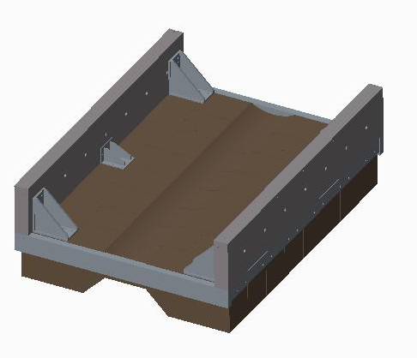
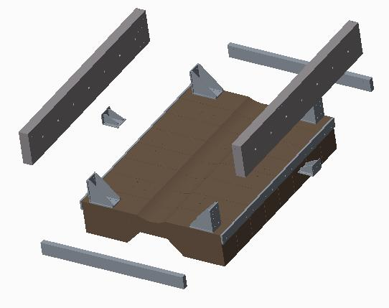
sPHENIX HIGH FIELD TEST RETURN STEEL STATUS
LEFT AND RIGHT SIDE BOTTOM SIDE WALLS COMPLETE
IF RIGGERS ARE AVAILABLE NEXT WEEK, WE WILL BE ABLE TO ASSEMBLE THE SIDE WALLS
HOLES IN MIDDLE BRACKETS NEED TO BE OPENED FOR LARGER BOLTS
END WALL SHIMS ARE PRESENTLY BEING DRILLED
Jon told us: We need welders to cut and put up the end walls, which has just become possible (since yesterday).
10/25/16

