Slide 1
sPhenix Cryogenic System
10/26/2016

Slide 2
CONFIGURATION
e lens compressor Loop
can be used for initial cooldown and summershutdown 100K hold
5 g/s during summershutdown 100K hold
Sextant 8/9 S-header operate at ~ 2 bar.
Maximum 9 g/s from RHIC 45K wave for cooldown
Heatexchanger with small heater
Non heater exchanger option TBC. [Large heater]
Continue with engineering calcs and report

Slide 3
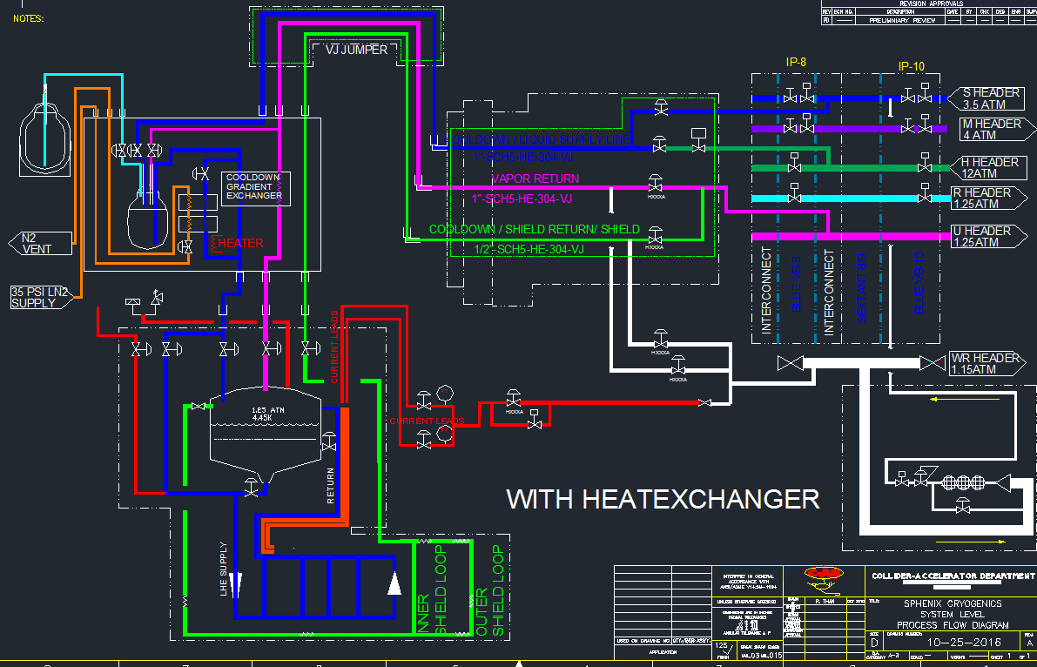
Overall System Diagram

Slide 4
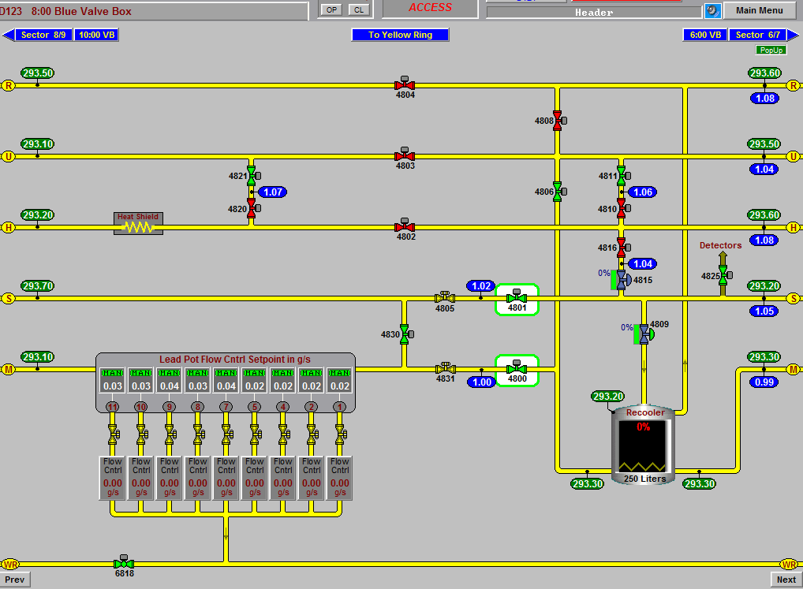

Slide 5
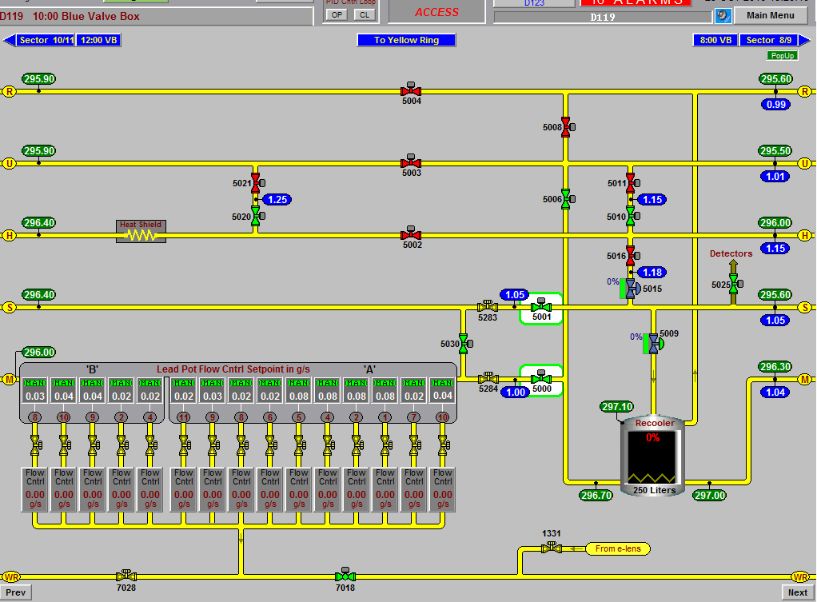

Slide 6
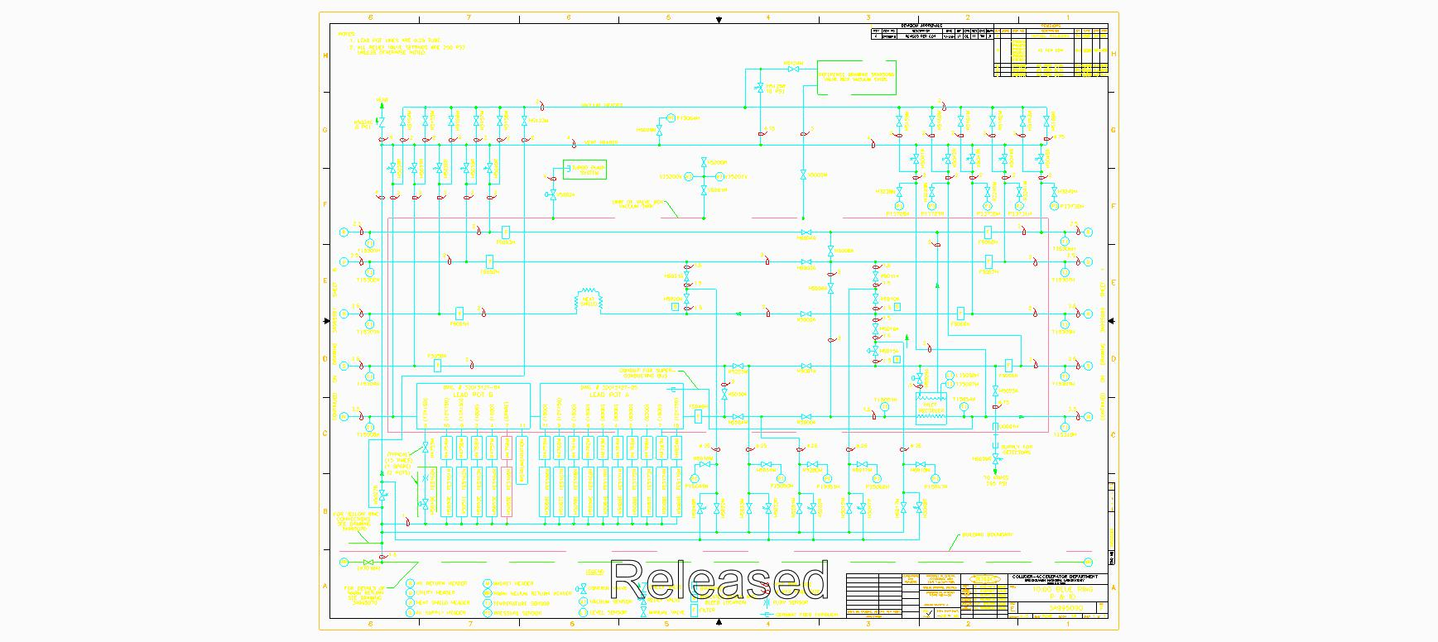

Slide 7
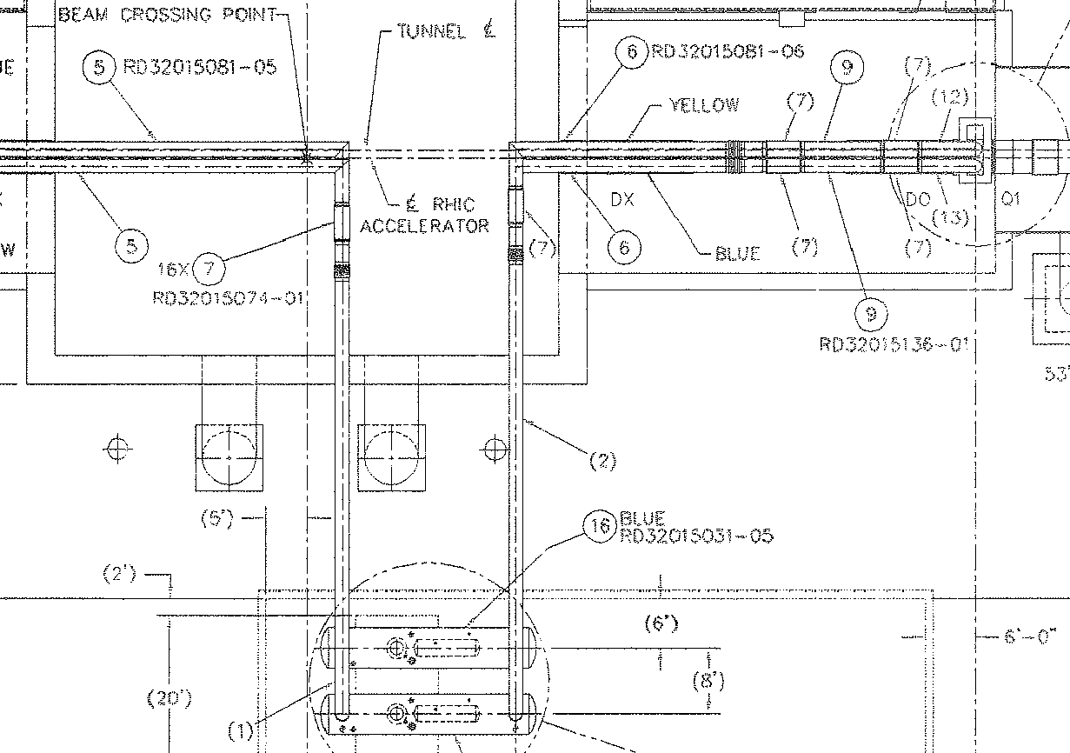
SPHENIX: MAGNET: Cryogenics System diagram: RHIC Interface Option

Slide 8
