Slide 1
Initial discussion about shower energy reco
Wenqiang Gu
Helpful discussion with Jay, Xin, Haiwang, Xuyang

Slide 2
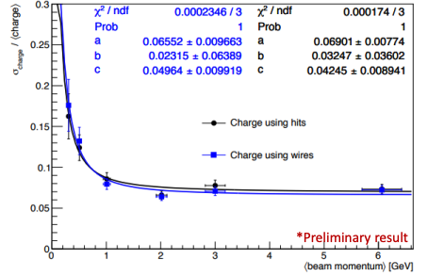
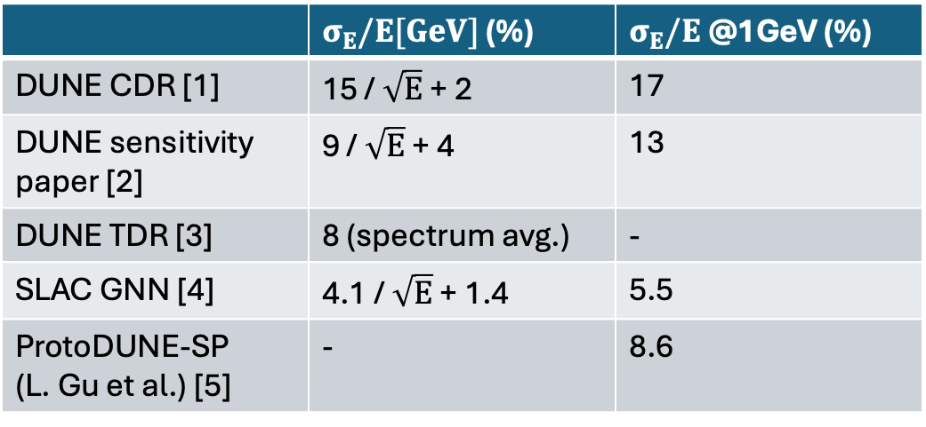
EM shower reco resolution
 | $σ_{E}/E[GeV]$ (%) | $σ_{E}/E$ @1GeV (%)
DUNE CDR [1] | 15 / $\sqrt{E}$ + 2 | 17
DUNE sensitivity paper [2] | 9 / $\sqrt{E}$ + 4 | 13
DUNE TDR [3] | 8 (spectrum avg.) | -
SLAC GNN [4] | 4.1 / $\sqrt{E}$ + 1.4 | 5.5
ProtoDUNE-SP (L. Gu et al.) [5] | - | 8.6
The main challenges are:
Clustering/containment of shower activities
Correction of recombination model at low energy
[1]: arXiv:1512.06148 [physics.ins-det]
[2]: arXiv:2006.16043 [hep-ex], arXiv:2109.01304 [hep-ex]
[3]: arXiv:2002.03005 [hep-ex]
[4]: arXiv:2007.01335 [physics.ins-det]
[5]: DUNE DocDB #30975 (poster) #24842 (technote)
ProtoDUNE-SP (L. Gu et al.)

Slide 3
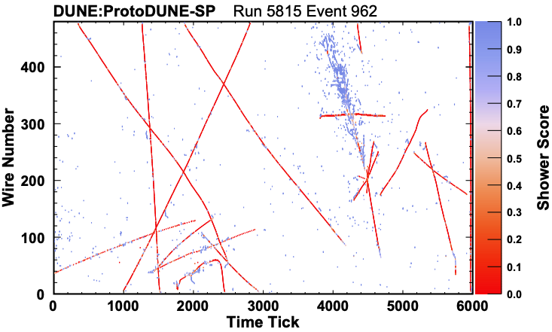

Wire-Cell shower energy estimator?
Electron shower energy can be estimated from charge “blips” (dQ_{i}) with correction factors
DocDB #24842
Option 1: charge from 2D deconvolution (e.g., W plane):
w/ vs. w/o DNN ROI
Option 2: charge from Wire-Cell’s 3D charge solver
CNN: shower score at hit level
Eur.Phys.J.C 82 (2022) 10, 903

Slide 4
Options for shower energy reco
WC SigProc (w/ vs w/o DNN ROI) + Pandora Shower Selection + GaussHits
WC SigProc + Pandora Shower Selection + GaussHits projection to WC Blob
Use blob charge from charge solving for shower energy reco
Use 2D measurement for shower energy reco
WC SigProc + Port WCP Shower Selection + WC Shower Energy reco
WC SigProc + Completely new Shower Selection + WC Shower Energy reco

