Slide 1

Quick Analysis of PDHD Pulser Runs for 7.8 & 14 mV/fC gains throughout 30 DAC settings.
(Fixing issues)
Karla Téllez Girón Flores
09/23/2024

Slide 2
Datasets
NP04 TPC Electronics Studies Runs.
Pulser Calibration Runs 28250-28329 from last 07/29 and 07/30.
DAC = 0 - 30.
14 mV/fC & 7.8 mV/fC LArASIC gains.
2 µs CE Shaping Time.
LArASIC Output Mode: Single-ended.
Karla Tellez-Giron-Flores

Slide 3
Procedure
A peak finding algorithm finds and isolates the positive and negative peaks for each channel in data.
Averaging of all pulses for each channel effectively gets rid of most noisy tails.
Fitting waveforms using a two-step process
  Pre-fitting using Ideal Electronics Response Function from 0-10 μs.
  Fit using New Electronics Response Function from 0-50 μs.
Karla Tellez-Giron-Flores

Slide 4
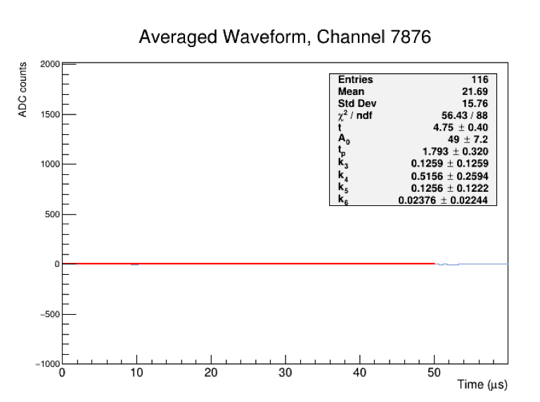
First of all, there are dead channels:
Removed from the dataset!
Karla Tellez-Giron-Flores

Slide 5
7.8 mV/fC Gain Subtleties
(Corrected)
Karla Tellez-Giron-Flores

Slide 6
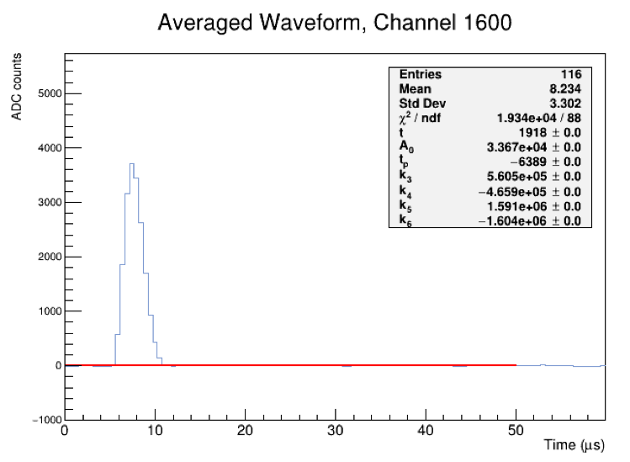
7.8 mV/fC Gain
Problem
Solution
Fit is VERY sensitive to k-parameters.
New fitter fits the waveform twice and picks the best fit.
A bit slow, but more effective than previous fitter.
(See next few slides for results.)
3) Fit fails sometimes 😔
Implemented new fitting strategy.
Run 28265, DAC=15
Karla Tellez-Giron-Flores
Notes:
Plots from Run 28265, DAC=15
Observations when fixing the fitter:
Most failed cases seem to not have an undershoot.
Tried other failed instances: DAC = 12, 30 and 4, and failed fits look similar to the DAC=15 setting.
Now trying a new fitter with two fit options: one for deep undershoots and another one for not-so-deep undershoots (k-parameters).

Slide 7
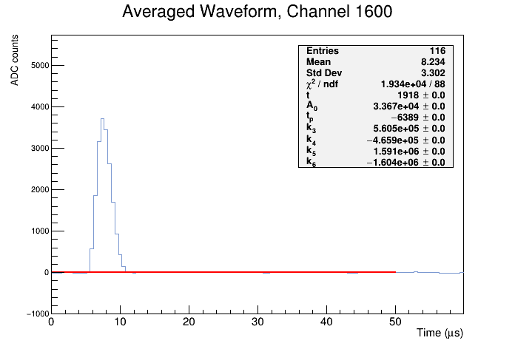
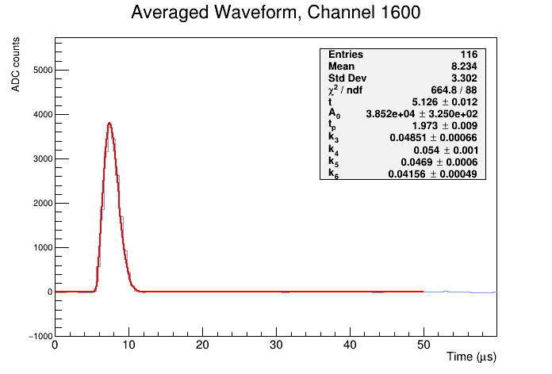
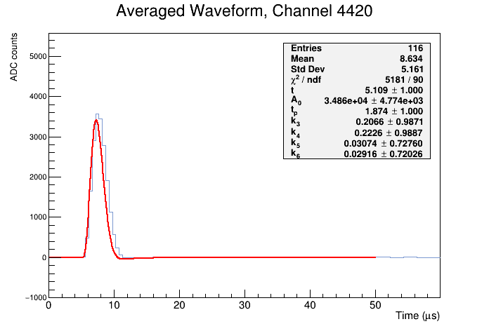
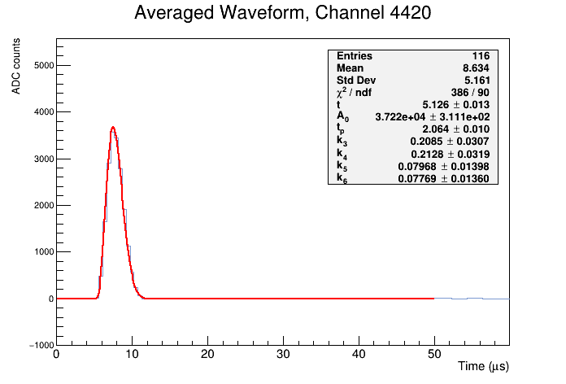
7.8 mV/fC Gain (Improved Fitter)
Before
After
Before
After
Notes:
Plots from Run 28265, DAC=15
New fitter seems to handle all cases well.

Slide 8
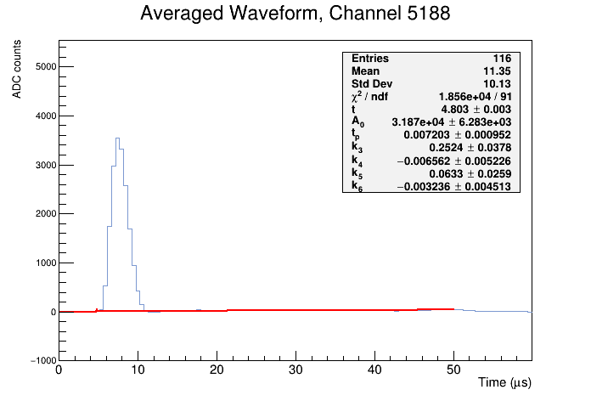

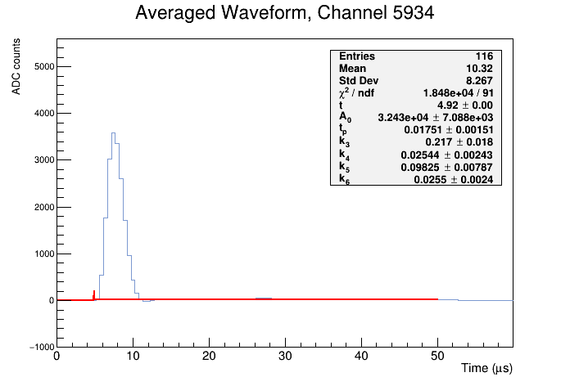
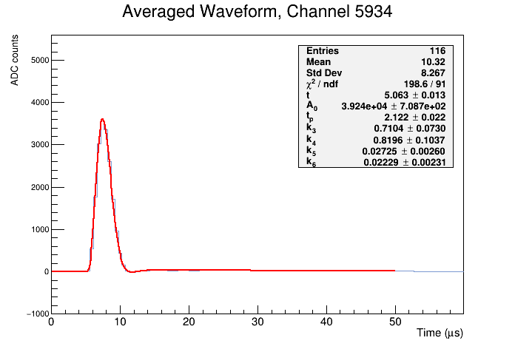
7.8 mV/fC Gain (Improved Fitter)
Before
After
Before
After
Notes:
Plots from Run 28265, DAC=15
New fitter seems to handle all cases well.

Slide 9
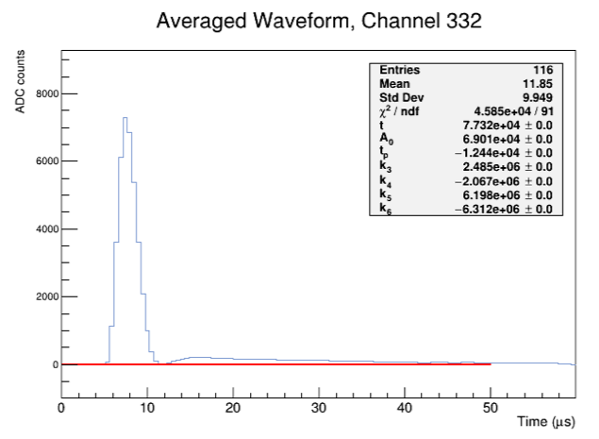
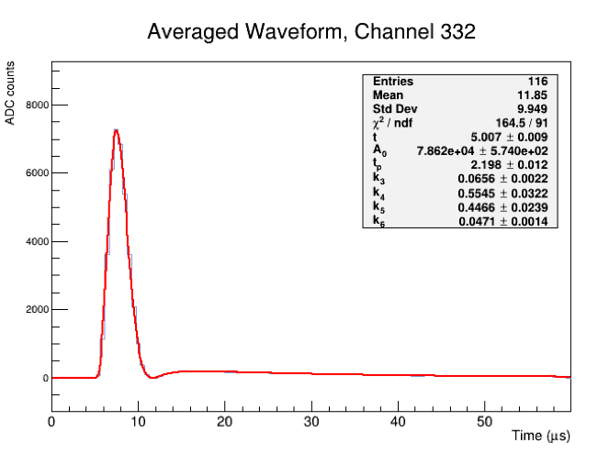
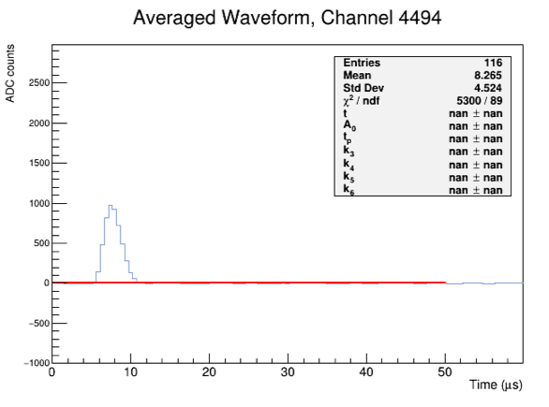
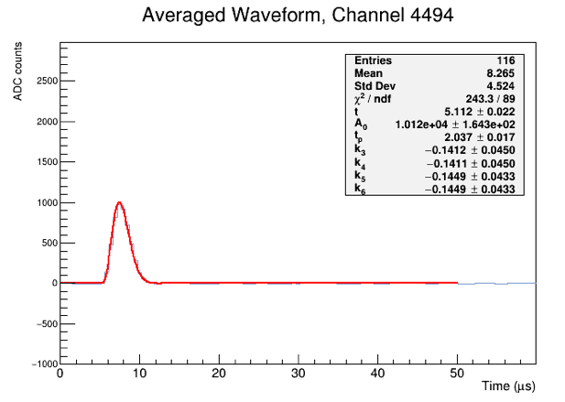
7.8 mV/fC Gain (Improved Fitter)
Before
After
Run 28286, DAC=30
Before
After
Run 28254, DAC=4
Notes:
(Top) Plots from Run 28286, DAC=30, 7.8 gain
(Bottom) Plots from Run 28254, DAC=30, 7.8 gain
New fitter seems to handle all cases well.

Slide 10
14 mV/fC Gain Subtleties
(Corrected)
Karla Tellez-Giron-Flores

Slide 11
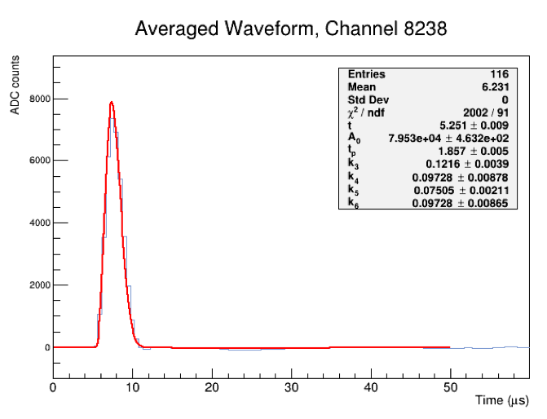
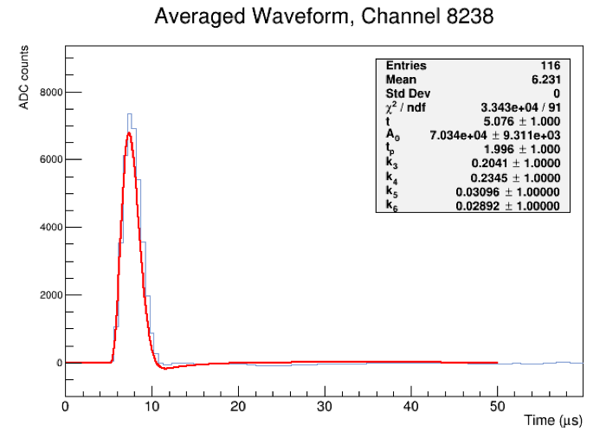
14 mV/fC Gain (Improved Fitter)
Before
After
Run 28329, DAC=30
Notes:
Plots from Run 28286, DAC=30, 7.8 gain
New fitter seems to handle all cases well.

Slide 12
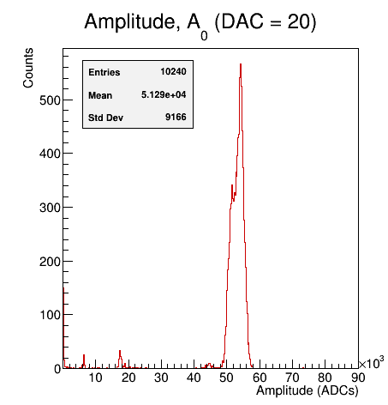
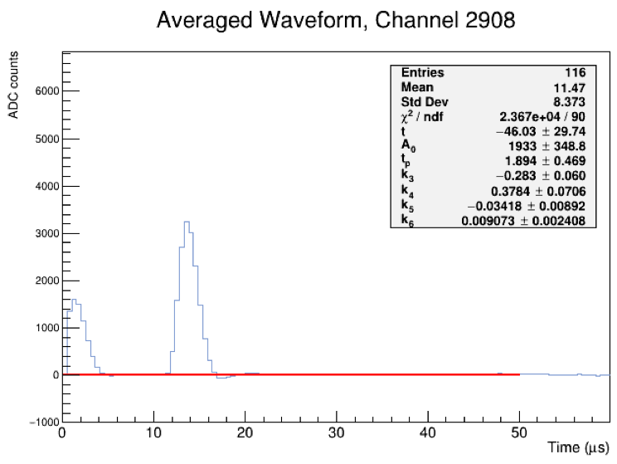
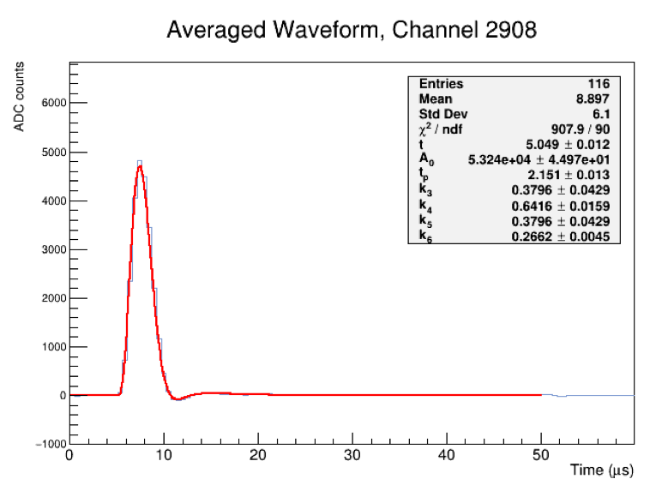
14 mV/fC Gain
Problem
Solution
The first pulse of these channels starts very close to zero
4) Something is wrong with Run 28316 (DAC=20)
Fixed the peak finder to discard pulses that are too close to 0.
Karla Tellez-Giron-Flores
Notes:
Plots from Run 28316, DAC=20
Other Channels where this happens are:
3868-3947
4028-4107
4640-4735
4832-4927
This is an issue on my end! Check the averaging algorithm

Slide 13
14 mV/fC Gain
Solution
The first pulse of these channels starts very close to zero
Is this normal?
According to Roger, yes.
The rate at which the records of the electronics are saved is not a clean multiple of the rate at which the pulses are injected and there is currently no effort to synchronize the time window to the pulse timing (but it will happen at some point).
Fixed the peak finder to discard pulses that are too close to 0.
Karla Tellez-Giron-Flores
Notes:
Plots from Run 28316, DAC=20
Other Channels where this happens are:
3868-3947
4028-4107
4640-4735
4832-4927
This is an issue on my end! Check the averaging algorithm

Slide 14
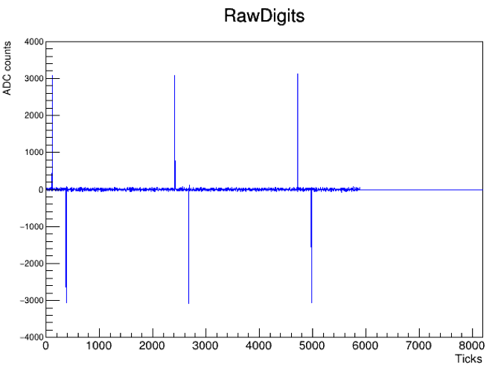
14 mV/fC Gain
Problem
Solution
Channels 5360-5419 died during this run, so fitter stopped working.
This is a known DAQ issue that is in the works.
5) Something is wrong with Run 28306 (DAC=13)
Discarding bad channels of this run.
Karla Tellez-Giron-Flores
Notes:
Plots from Run 28306, DAC=13
Roger said that seems like some kind of data issue -the question is just whether it was actually a problem with the DAQ failing to capture data from some data streams. He will check this run later.

Slide 15

What’s next?
Running again for all DAC settings.
Perform the Waveform Correction.
Trying to find explanations to:
  The sudden change in waveform amplitude we observed during some runs.
  The double peak structure we see in some of out fit parameter distributions.
Karla Tellez-Giron-Flores

Slide 16
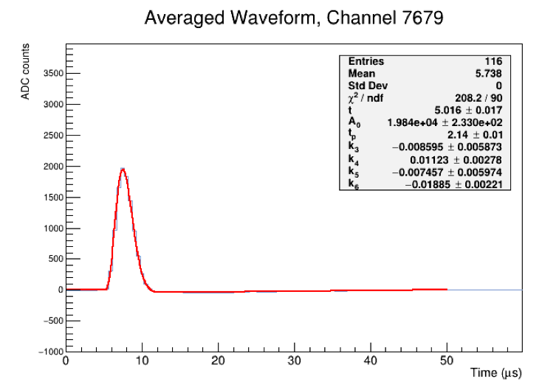
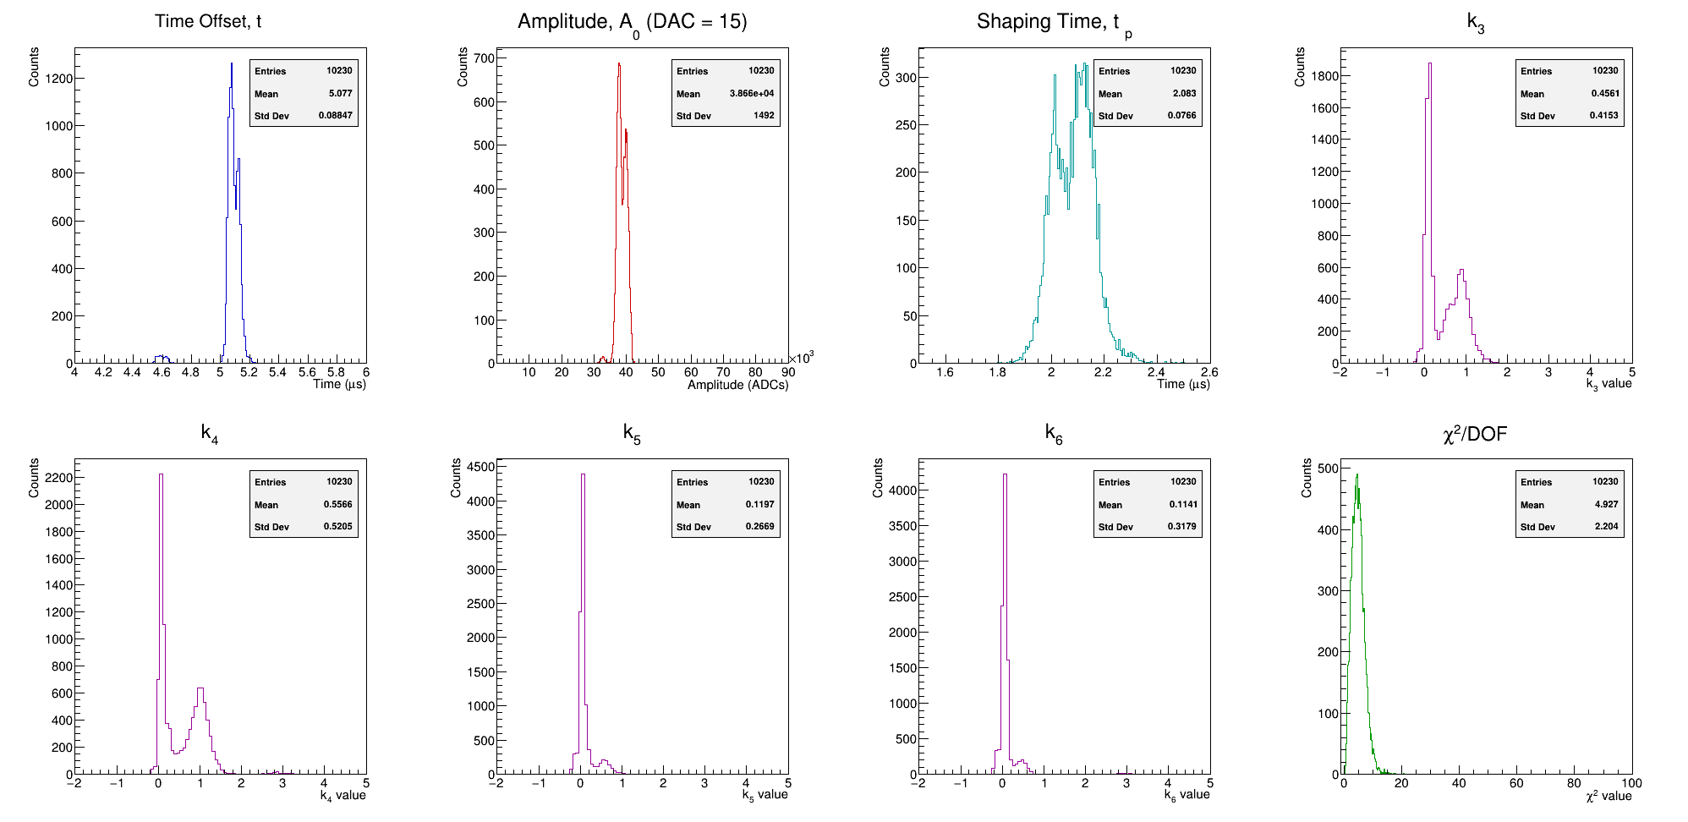
What’s next?
Running again for all DAC settings.
Perform the Waveform Correction.
Trying to find explanations to:
  The sudden change in waveform amplitude we observed during some runs.
  The double peak structure we see in some of out fit parameter distributions.
Karla Tellez-Giron-Flores

Slide 17
Backup Slides

Slide 18
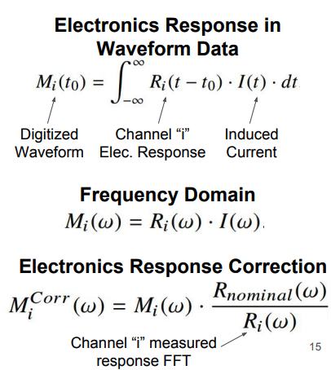
Offline correction of imperfect pole-zero cancellation
Defining a correction based on the measured response.
https://arxiv.org/pdf/1804.02583
Karla Tellez-Giron-Flores

Slide 19
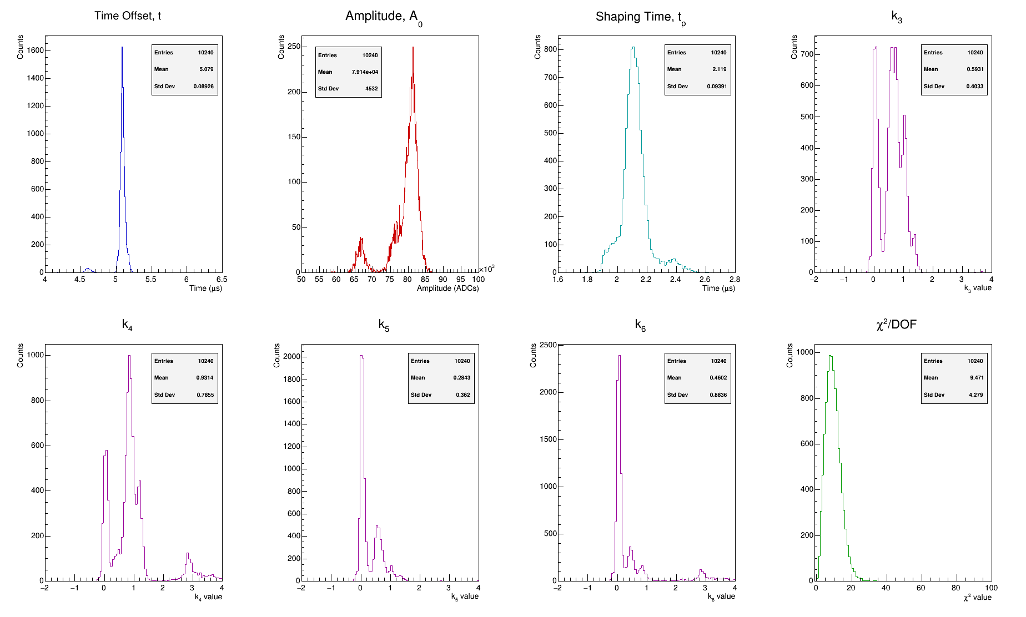
Fitter* Performance PDHD 27872
Karla Tellez-Giron-Flores

