Slide 1
Potential U.S. scope in a future collider program (Accelerator)
Tor Raubenheimer & Vladimir Shiltsev
SLAC & NIU
Nov. 8, 2024

Slide 2
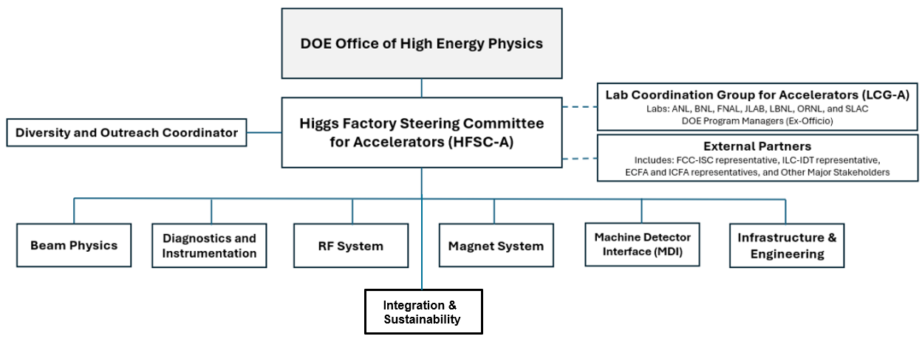
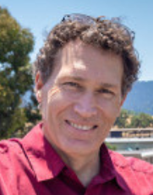
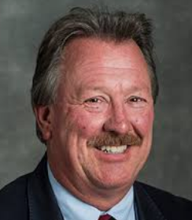
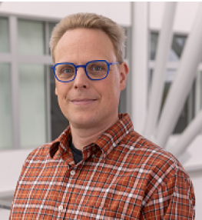
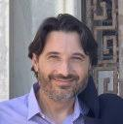
Higgs Factory Steering Committee – Accelerator
Tor Raubenheimer (SLAC)
Steve Gourlay (FNAL)
Matthias Liepe (Cornell)
Jean-Luc Vay (LBNL)

Slide 3
HFSC – Acc Status
Charged by DOE at end of August
Created the Laboratory Coordination Group
    ANL Philippe Piot
    BNL Wolfram Fischer
    FNAL Sam Posen
    JLAB Andrei Seryi
    LANL Steve Russell
    LBNL Cameron Geddes
    ORNL Fulvia Pilat
    SLAC Mei Bai
Ready to start inviting L2 leaders

Slide 4
Higgs Factory Consortium Committee
HFCC should coordinate efforts in the following areas:
  Physics and technical feasibility studies, including any associated design and R&D efforts, to advance detector concepts and accelerator designs for a future e+/e- Higgs factory;
  Prioritization and stewardship of the national R&D efforts;
  Development of the pre-project R&D scope that will be required to initiate a project;
  Conceptualization of the software and computing for the experiments and accelerator;
  Develop various funding models that will be required to support the R&D efforts
  Ensure collaborations by the U.S. with our partners are cost-effectively carried out to advance the future Higgs factory initiatives.

Slide 5
Thoughts on the HF-Acc program
The US national labs and universities have substantial expertise to contribute to an off-shore Higgs Factory
  Work with collaborations to identify high profile topics on which US can take leadership
  Find efforts that build US R&D capability while delivering for the collaboration
  Scale of Higgs Factory contribution will require major industrial engagement
  Engage the US laboratory community broadly
  Scale should be a significant fraction of the total project cost
Vladimir will describe some options of technical contributions

Slide 6
Next Steps
Develop the organization in the US
Work with FCC and ILC managements to understand R&D opportunities
Work with DOE HEP on future funding support for accelerator activities
Immediate goal is to complete the FCC Feasibility Study and ILC Cost update
Longer-term goal is to develop R&D program, including undertaking pre-project R&D, leveraging unique capabilities that support and advance FCC while also developing industry
First meeting will be January 15/16, 2025 at Fermilab
Further announcements will be made as the organization is put together!

