Slide 1
INTT analysis workshop update
Jaein Hwang on behalf of INTT students 2024/09/25

Slide 2
General update
Workshop date : Nov. 19 ~ 29 (UPDATE)
Survey OPEN! Deadline : (Oct. 27 due to hotel accommodation.) https://forms.gle/BgU3wcBWdCTGVKQX9
Indico also opened. https://indico.bnl.gov/event/24622/
It is better to think about your(students) workplan during Korea workshop
Suggest to make workplan before coming to workshop

Slide 3
Google form for workshop
Survey OPEN! Deadline : Sep. 27 due to hotel accommodation. Sooner is Better of course ☺
(will be circulated in INTT mailing list.)
Necessary for accommodation & seeking the place for workshop in Korea Univ.
https://forms.gle/BgU3wcBWdCTGVKQX9

Slide 4
Schedule table(bigger one at last page)
What do we want to get during 2024 workshop?
Fun4All framework
INTT related coresoftware
Active Learning/teaching between students

Slide 5
Schedule table(bigger one at last page)
DAY 1
Student session 1. intro : Self introduction + work plan
Fun4All tutorial : who(TBD) will give a lecture? Can we detail which parts we need? with PhD assistants : Cheng-Wei, Joseph, Jaein which parts? - F4A with triggered/streaming readout(structure of F4A ... autogen.sh compiling) - Github/Git(Joseph) - Condor

Slide 6
Schedule table(bigger one at last page)
DAY 2
INTT Commissioning + Run23/24 review(Genki?) INTT wiki intro. (Akitomoto?) : How to write/add info in INTT wiki? any structure? INTT wiki documentation(everyone) : We should document our work in wiki (before you graduate!)
Coresoftware reviews INTT software tools(Event combining->TRKR HIT->TRKR Cluster) CDB(Hot channel map, Survey map, Felix channel map) InttMapping(Online, Offline, Rawdata) F4A w/coresoftware Adding other Calo system in F4A framework (like EMCal and MBD.. etc) sPHENIX-MC

Slide 7
Schedule table(bigger one at last page)
DAT 4 - Student presentation(2+5)
- status report (2mins) - discussion (5mins) DAY 9
Student presentation(15+5)
Motivation
Progress report
Next step
Q&A / comments (5mins)

Slide 8
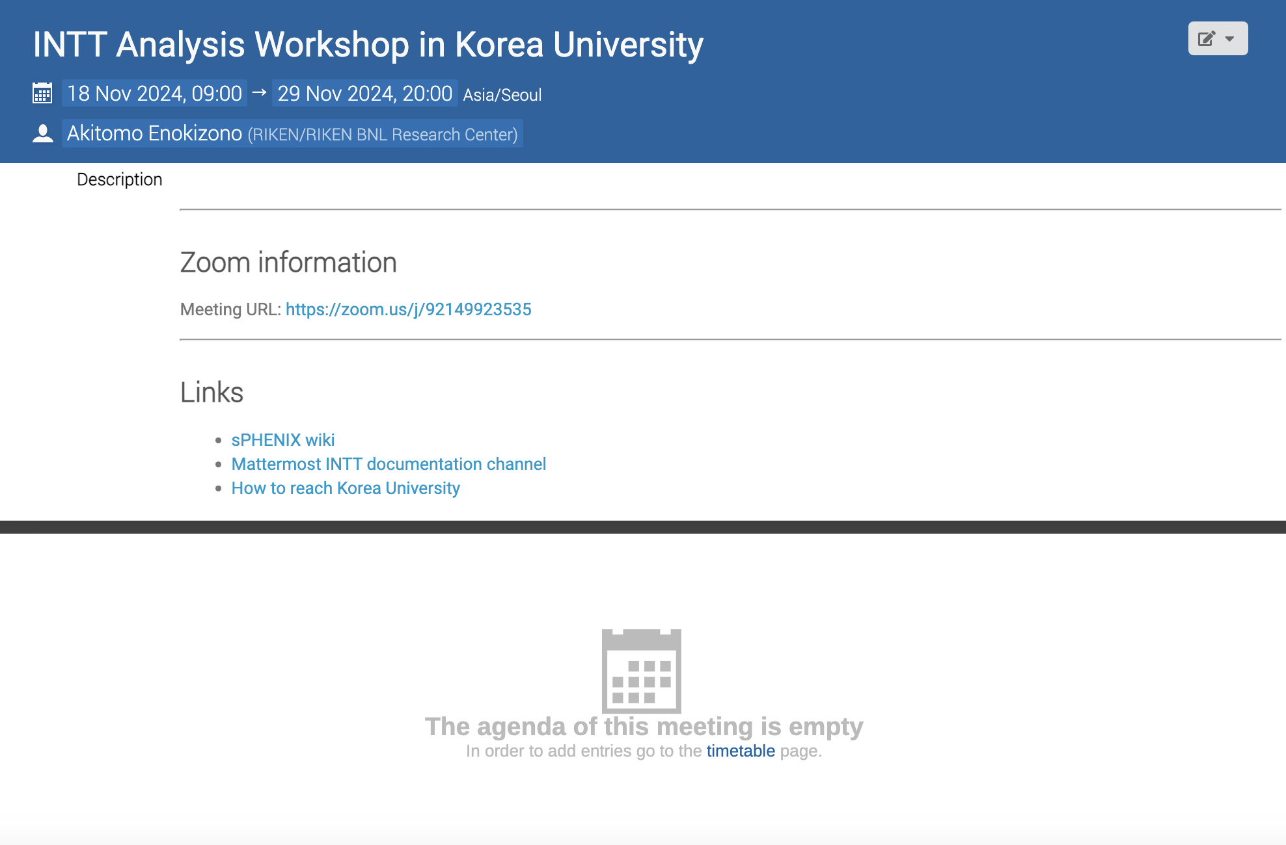
Indico link
https://indico.bnl.gov/event/24622/
Totally empty for now ☺
Let’s fill up!
Anyone interested in making poster? (Tomoya Kato)

Slide 9
 | 9 |  | 10 |  | 11 |  | 12 |  | 13 |  | 14 |  | 15 |  | 16 |  | 17
Day 1 (Nov. 19) | Coming to Korea Univ. | Welcome / paperwork | Opening | Student session 1, intro. (5 min) |  |  | Lunch time |  |  | Fun4All tutorial |  |  |  | Break | Fun4All tutorial |  |  | Work summary
Day 2 (Nov. 20) |  | INTT commissioning review | INTT wiki intro. / INTT wiki documentation |  |  |  |  |  |  | Coresoftware review |  | F4A w/ coresoftware |  |  | F4A w/ coresoftware
Day 3 (Nov. 21)
Day 4 (Nov.22) |  |  |  |  |  |  |  |  |  | Student session 2 (2+5)
Day 5 (Nov. 25) |  |  |  |  |  |  |  |  |  |  |  |  |  |  |  |  |  | Work summary
Day 6 (Nov. 26)
Day 7 (Nov. 27)
Day 8 (Nov. 28)
Day 9 (Dec. 29) |  |  |  |  |  |  |  |  |  |  | Student presentation 3, final (20 min) |  |  |  |  |  |  | Closing

