Slide 1
Plans for Early Science
E.C. Aschenauer (BNL)
Co-Associate Director for the Experimental Program
Jlab EIC Meeting
September 20, 2024​

Slide 2
Accelerator at Day One and Ultimate
RCS:
7nC / bunch change injection scheme
5 – 10 GeV polarized e- to reach 28 nC / bunch and 18 GeV electrons
ESR:
7nC / bunch
5 – 10 GeV polarized e- add more RF cavities to reach 28 nC / bunch and 18 GeV electrons
HSR:
100 – 250 GeV polarized p update PS to reach 275 GeV protons and 110 GeV/u nuclei
100 GeV/u nuclear beams add 41 GeV bypass to get full HSR beam energy capabilities
pre-cooling at injection add strong hadron cooling to achieve ultimate beam parameters
and integrated luminosity
Proposal for the Day-One Physics and the initial years of science is driven by
  Start of the promised NSAC/NAS science program
  Alignment with expected order in commissioning the collider and ramp up of performance that comes with gain of operational experience
  Having access to new physics results early to get high impact publications, i.e. PRLs, ……

Slide 3
Proposal for EIC Science Program in the First Years
Year - 1
Year - 2
Year - 3
Year - 4
Year - 5
Start with Phase 1 EIC
New Capability:
Commission electron polarization in parallel
Run:
10 GeV electrons on 115 GeV/u heavy ion beams (Ru or Cu) Physics:
gives world-wide new data on nPDFs and a first look on saturation
Start with Phase 1 EIC
Commission electron polarization in parallel
New Capability:
Commission hadron polarization in parallel
Run:
10 GeV electrons on 130 GeV/u Deuterium
Physics:
gives world-wide new data → critical baseline for nPDFs and saturation
free vs. bound proton structure
Run:
Last weeks 10 GeV electrons and 130 GeV polarized protons
Physics:
first look to 3d imaging of the proton
Start with Phase 1 EIC
Commission electron polarization in parallel
Commission hadron polarization in parallel
New Capability:
Commission running with hadron spin rotators
Run:
10 GeV electrons on 130 GeV transverse polarized protons
Physics:
3d imaging of the proton / mass of the nucleon
Run:
Last weeks switch to longitudinal proton polarization
Physics:
first look helicity structure of the proton – unravel quark, gluon and orbital angular contributions
Start with Phase 1 EIC
Commission electron polarization in parallel
Commission hadron polarization in parallel
Commission running with hadron spin rotators
New Capability:
Commission hadron accelerator to operate with not centered orbits
Run:
10 GeV electrons on 250 GeV transverse and longitudinal polarized protons
Physics:
3d imaging of the proton
at low x
helicity structure of the proton – unravel quark, gluon and orbital angular contributions
Start with Phase 1 EIC
Commission electron polarization in parallel
Commission hadron polarization in parallel
Commission running with hadron spin rotators
Commission hadron accelerator to operate with not centered orbits
Run:
10 GeV electrons on 166 GeV transverse and longitudinal polarized He-3
Physics:
3d imaging of the nucleons → flavor separation
helicity structure of the nucleon– unravel helicities for different quark flavors
first look to nuclear binding
Time to install additional ESR RF and HSR PS to
reach design Current and max. Energies

Slide 4
Proposal for EIC Science Program in the First Years
Year - 5
Year - 6
Year - 7
Start with Phase 1 EIC
Commission electron polarization in parallel
Commission hadron polarization in parallel
Commission running with hadron spin rotators
Commission hadron accelerator to operate with not centered orbits
Run:
10 GeV electrons on 166 GeV transverse and longitudinal polarized He-3
Physics:
3d imaging of the nucleons → flavor separation
helicity structure of the nucleon– unravel helicities for different quark flavors
first look to nuclear binding
Start with Phase 1 EIC
Commission electron polarization in parallel
Commission hadron polarization in parallel
Commission running with hadron spin rotators
Commission hadron accelerator to operate with not centered orbits
New Capability:
Commission ESR & HSR at max. energy and beam currents
Run:
18 GeV polarized electrons on 110 GeV/u Au (Pb) beams
Physics:
ultimate x-Q² reach for saturation physics
Start with Phase 1 EIC
Commission electron polarization in parallel
Commission hadron polarization in parallel
Commission running with hadron spin rotators
Commission hadron accelerator to operate with not centered orbits
Commission ESR & HSR at max. energy and beam currents
New Capability:
Operate HSR with 41 GeV bypass
Run:
5 GeV polarized electrons on 41 GeV transverse polarized proton beams
Physics:
first look to moderate-x 3d imaging and Kaon structure/ mass

Slide 5
Updated Proposal to account for Comments
during EIC-UG/ePIC Summer Meeting

Slide 6
Proposal for EIC Science Program in the First Years
Year - 1
Year - 2
Year - 3
Year - 4
Year - 5
Start with Phase 1 EIC
New Capability:
Commission electron polarization in parallel
Run:
10 GeV electrons on 115 GeV/u heavy ion beams (Ru or Cu)
Physics:
gives world-wide new data on nPDFs, NFF and a first look on saturation
Start with Phase 1 EIC
Commission electron polarization in parallel
New Capability:
Commission hadron polarization in parallel
Run:
10 GeV electrons on 130 GeV/u Deuterium
Physics:
gives world-wide new data → critical baseline for nPDFs and saturation
free vs. bound proton structure
Run:
Last weeks 10 GeV electrons and 130 GeV polarized protons
Physics:
first look to 3d imaging of the proton
Start with Phase 1 EIC
Commission electron polarization in parallel
Commission hadron polarization in parallel
New Capability:
Commission running with hadron spin rotators
Run:
10 GeV electrons on 130 GeV transverse polarized protons
Physics:
3d imaging of the proton / mass of the nucleon
Run:
Last weeks switch to longitudinal proton polarization
Physics:
first look helicity structure of the proton – unravel quark, gluon and orbital angular contributions
Start with Phase 1 EIC
Commission electron polarization in parallel
Commission hadron polarization in parallel
Commission running with hadron spin rotators
New Capability:
Commission hadron accelerator to operate with not centered orbits
Run:
10 GeV electrons on 100 GeV Au
Physics:
gives world-wide new data on A-dep.of nPDFs, nFF and saturation
Run:
10 GeV electrons on 250 GeV transverse and longitudinal polarized protons
Physics:
3d imaging of the proton at low x
helicity structure of the proton – unravel quark, gluon and orbital angular contributions
Start with Phase 1 EIC
Commission electron polarization in parallel
Commission hadron polarization in parallel
Commission running with hadron spin rotators
Commission hadron accelerator to operate with not centered orbits
Run:
10 GeV electrons on 100 GeV Au
Physics:
gives world-wide new data on A-dep.of nPDFs, nFF and saturation
Run:
10 GeV electrons on 166 GeV transverse and longitudinal polarized He-3
Physics:
3d imaging of the nucleons → flavor separation
helicity structure of the nucleon– unravel helicities for different quark flavors
first look to nuclear binding
Time to install additional ESR RF and HSR PS to
reach design Current and max. Energies

Slide 7
Proposal for EIC Science Program in the First Years
Year - 5
Year - 6
Year - 7
Start with Phase 1 EIC
Commission electron polarization in parallel
Commission hadron polarization in parallel
Commission running with hadron spin rotators
Commission hadron accelerator to operate with not centered orbits
Run:
10 GeV electrons on 100 GeV Au
Physics:
gives world-wide new data on A-dep.of nPDFs, nFF and saturation
Run:
10 GeV electrons on 166 GeV transverse and longitudinal polarized He-3
Physics:
3d imaging of the nucleons → flavor separation
helicity structure of the nucleon– unravel helicities for different quark flavors
first look to nuclear binding
Start with Phase 1 EIC
Commission electron polarization in parallel
Commission hadron polarization in parallel
Commission running with hadron spin rotators
Commission hadron accelerator to operate with not centered orbits
New Capability:
Commission ESR & HSR at max. energy and beam currents
Run:
18 GeV polarized electrons on 275 GeV/u polarized (longitudinal & transverse) proton beams
Physics:
3d imaging of the proton at low x
helicity structure of the proton – unravel quark, gluon and orbital angular contributions
Start with Phase 1 EIC
Commission electron polarization in parallel
Commission hadron polarization in parallel
Commission running with hadron spin rotators
Commission hadron accelerator to operate with not centered orbits
Commission ESR & HSR at max. energy and beam currents
New Capability:
Operate HSR with 41 GeV bypass
Run:
5 GeV polarized electrons on 41 GeV transverse polarized proton beams
Physics:
first look to moderate-x 3d imaging and Kaon structure/ mass

Slide 8
Assumptions and Luminosity Calculation
7 nC electron bunch charge compared to 28 nC (CDR)
Constant proton beam IP divergencies are maintained throughout the store by gradual increase of proton IP beta-functions as the beam emittance increases.
The electron IP beta-functions are adjusted accordingly to match electron and proton transverse beam size.
Ion beam is cooled at low energy (24 GeV/u) but no stochastic cooling is used in the store
1 Run is ½ year operation at 80% uptime
2 h store turnaround time
30 min at the beginning of the store is taken by the ESR fill and detector turn-on
Not yet included a ramp of of luminosity through the Run
→ at RHIC: 1st week 25% of projected lumi / week
2nd week 50% of projected lumi / week
3rd week 75% of projected lumi / week
4th week to X week 100% of projected lumi / week
→ First guess for EIC early years (1 to 5(?))
1st week 10% of projected lumi of the run / week
increase by 10% every → 10 weeks to reach projected lumi / week

Slide 9
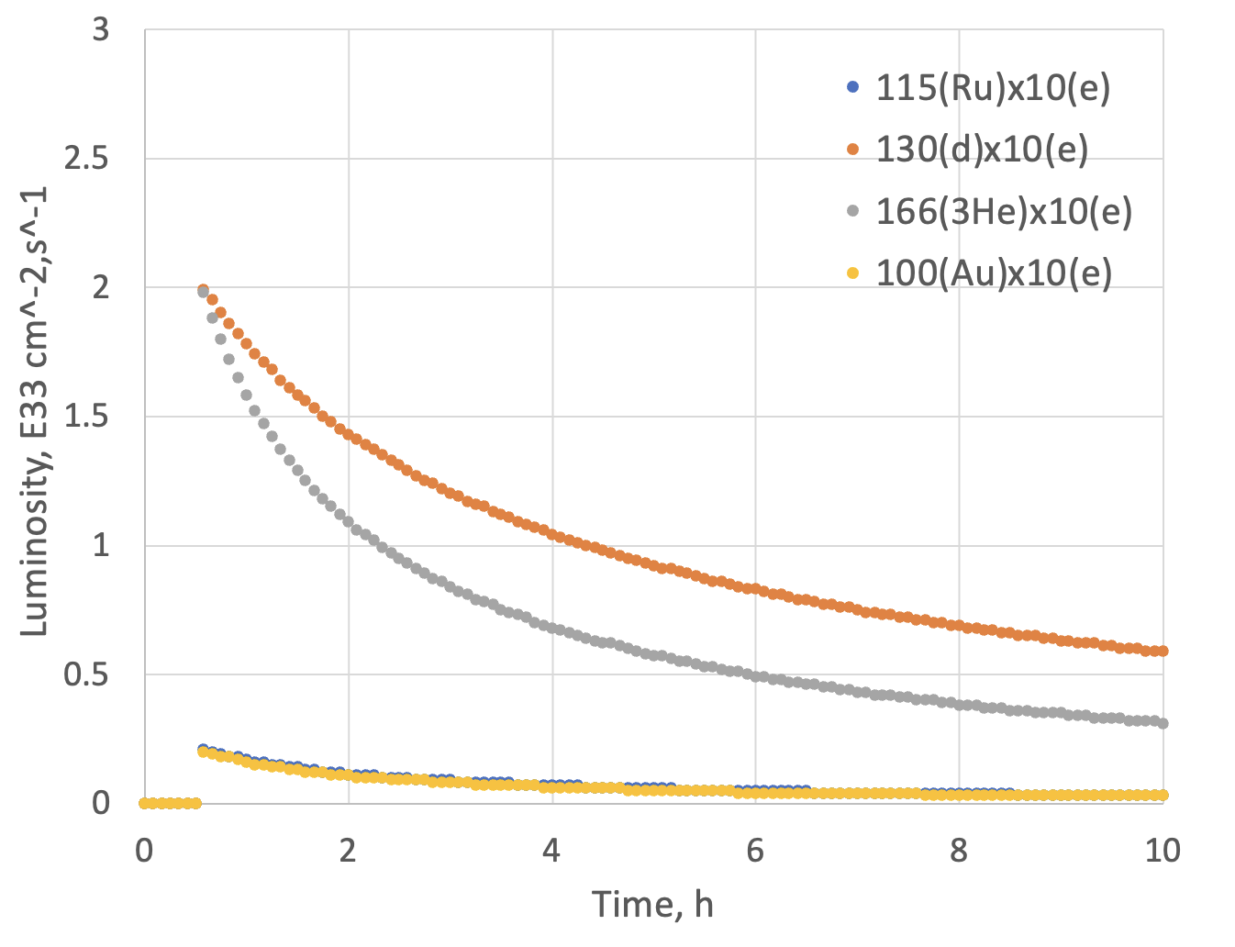
Luminosity eA for Phase-I
Possible Beam energies:
electron: 5 GeV, 10 GeV and ultimately 18 GeV
proton: 41 GeV, 100 GeV to 255 GeV ultimately 275 GeV
Au: 41 GeV, 100 GeV to 110 GeV ultimately
A: 41 GeV, 100 GeV to Max ~255 / (A/Z) ultimately ~275 / (A/Z)
 | Lumi per Fill (5 h) | Lumi per Year
10 GeV e x 115 GeV Ru | 1.3 pb⁻¹ | 0.9 fb⁻¹
10 GeV e x 100 GeV Au | 1.2 pb⁻¹ | 0.84 fb⁻¹
10 GeV e x 130 GeV d | 16 pb⁻¹ | 11.4 fb⁻¹
10 GeV e x 166 GeV ³He | 12 pb⁻¹ | 8.65 fb⁻¹
Note:
eA luminosity is per nucleon

Slide 10
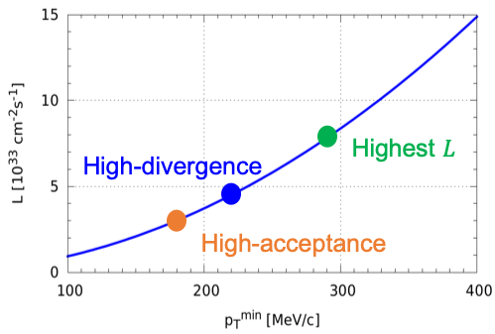
Luminosity ep for Phase-1
Possible Beam energies:
electron: 5 GeV, 10 GeV and ultimately 18 GeV
proton: 41 GeV, 100 GeV to 255 GeV ultimately 275 GeV
Au: 41 GeV, 100 GeV to 110 GeV ultimately
A: 41 GeV, 100 GeV to Max ~255 / (A/Z) ultimately ~275 / (A/Z)
High Divergence | Lumi per Fill (5 h) | Lumi per Year
5 GeV e x 250 GeV p | 9.26 pb⁻¹ | 6.48 fb⁻¹
10 GeV e x 250 GeV p | 13.12 pb⁻¹ | 9.18 fb⁻¹
5 GeV e x 130 GeV p | 6.3 pb⁻¹ | 4.36 fb-1
10 GeV e x 130 GeV p | 7.6 pb⁻¹ | 5.33 fb⁻¹
Low Divergence | Lumi per Fill (5 h) | Lumi per Year
5 GeV e x 250 GeV p | 6.81 pb⁻¹ | 4.78 fb⁻¹
10 GeV e x 250 GeV p | 8.8 pb⁻¹ | 6.19 fb⁻¹
5 GeV e x 130 GeV p | 5.8 pb⁻¹ | 4.1 fb⁻¹
10 GeV e x 130 GeV p | 7.1 pb⁻¹ | 4.95 fb⁻¹
Remember:
high divergence: higher lumi, but reduced acceptance
for low forward particle p_{T}^{min}
low divergence: lower lumi, but increased acceptance
for low forward particle p_{T}^{min}
Illustration
Low-divergence

Slide 11
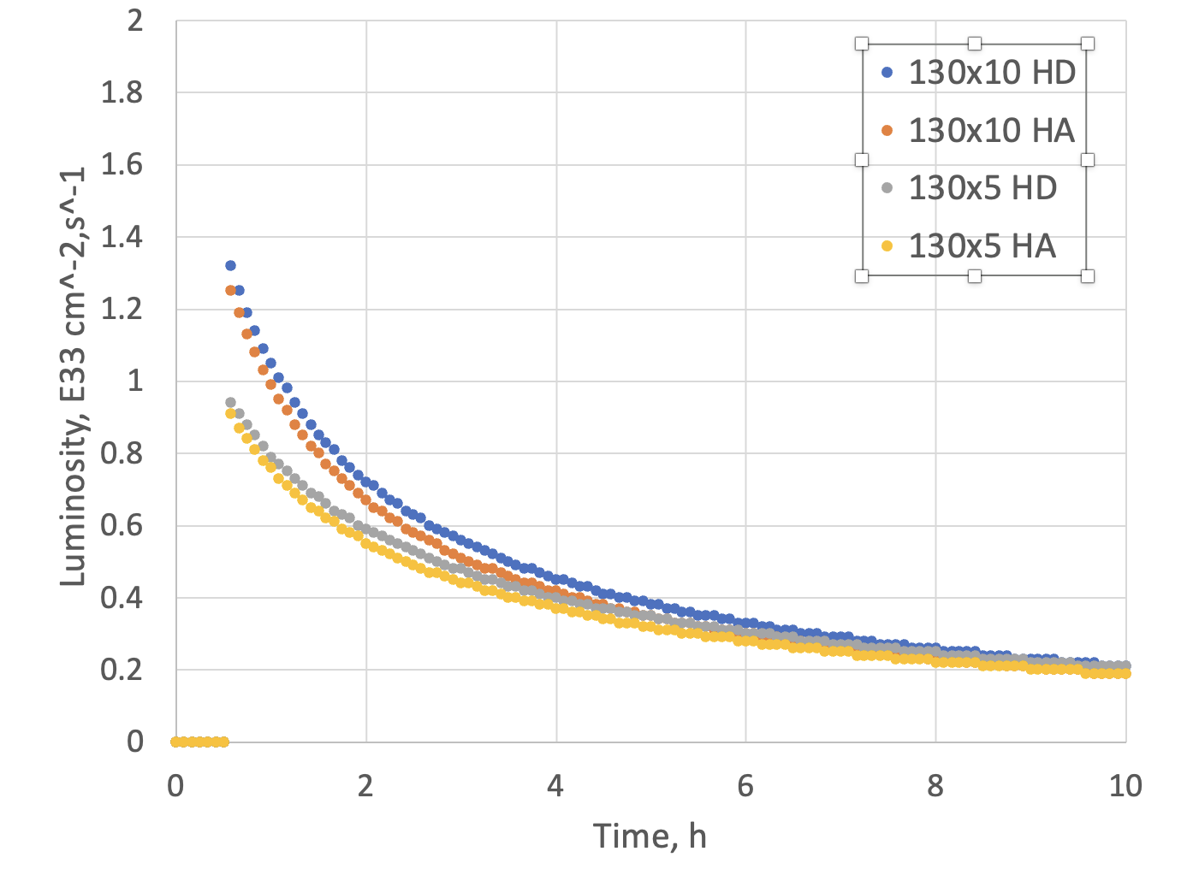
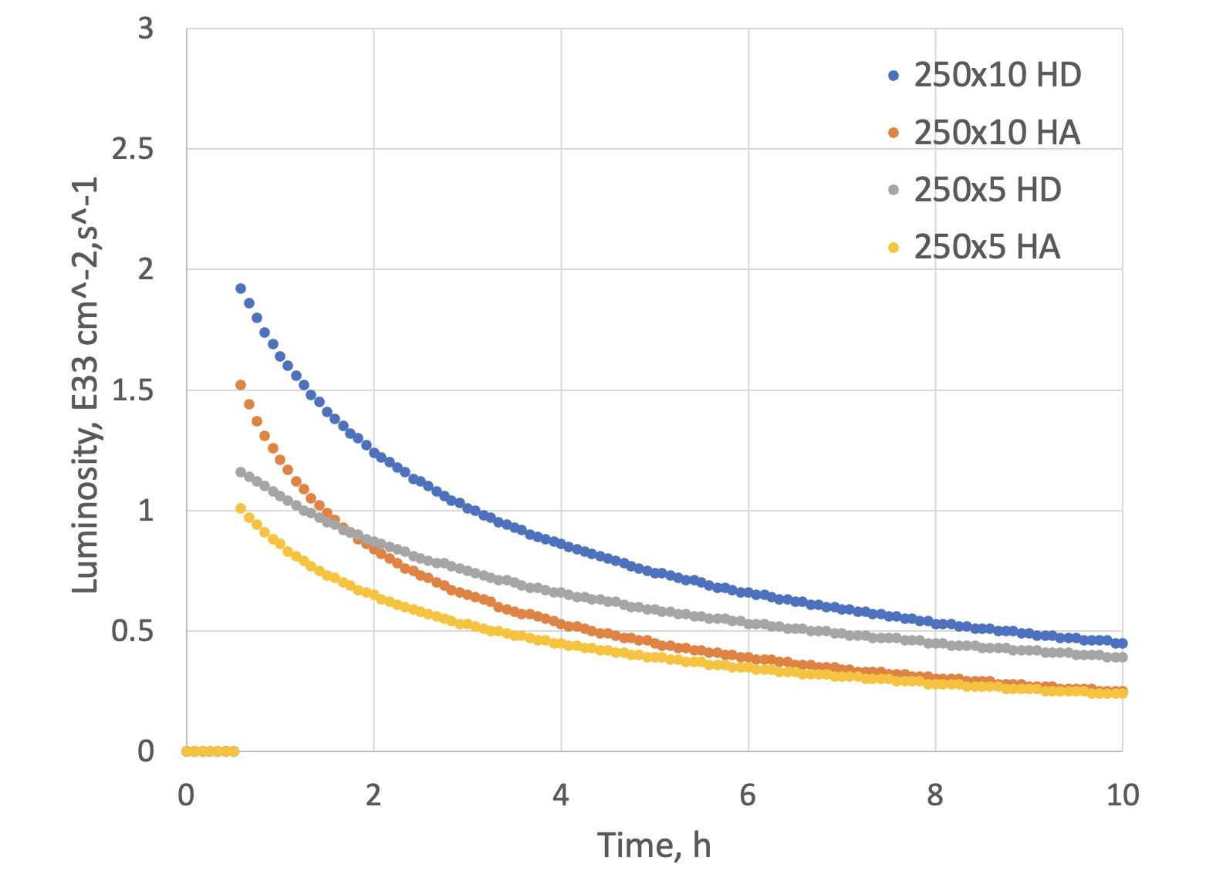
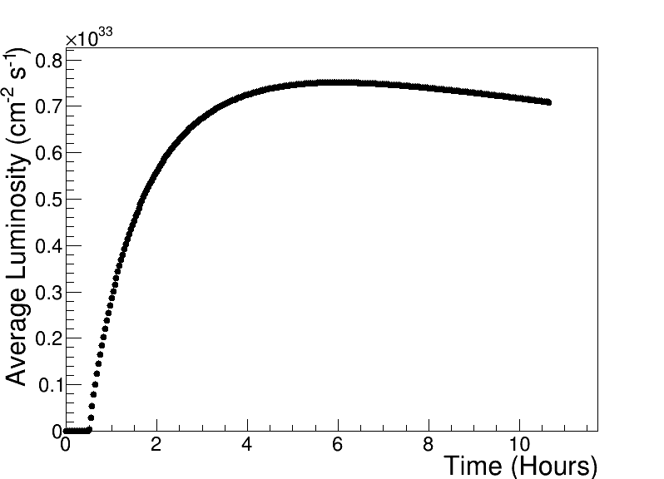
Luminosity ep for Phase-1
Compare to HERA peak luminosity
of 5x10³¹cm⁻²sec⁻¹
Max average luminosity without SHC: 0.8 x 10³³ cm⁻² s⁻¹ with 5.9 hr store
250 GeV x 10 GeV

Slide 12
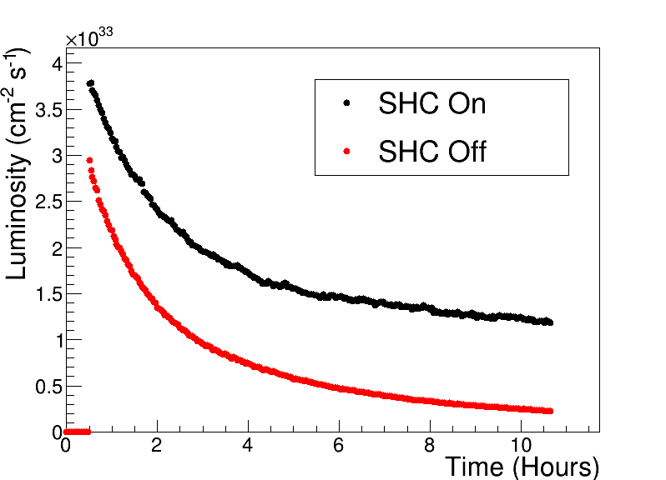
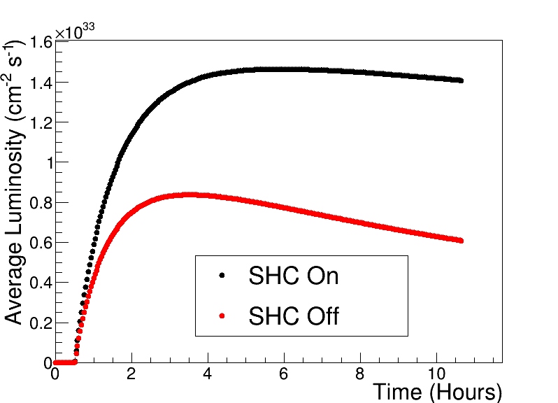
What comes next
After Year 5 will have full bunch current for electrons 7nA to 28 nA
→ increase in luminosity ~4
Adding Strong hadron Cooling will increase the integrated current by fill another factor of 2
Example 10 GeV electrons x 100 GeV protons

Slide 13


Slide 14


Slide 15
Initial thoughts on the EIC Commissioning Strategy
Use the same beams as for Year-1 ‘First Science’
Prefer ~130 GeV/u, which corresponds to a ‘centered’ hadron beam (path length difference ΔR ~ 0, this is achieved for a beam where Z ~ 0.5A).
Do not want to exceed the present RHIC maximum dipole fields (corresponds to 250 GeV protons or 833 T-m)
  At present, the limit is due to the DX magnets (combining dipoles at the IRs). These will be removed for EIC and the main dipoles are capable of 275 GeV proton field (needs new PS).
Unpolarized Electrons
Since the electron revolution frequency is fixed, the hadron orbit must be adjusted with energy to keep the collisions synchronized.
→ Our proposal for Year-1 ‘First Science’ would be to
run Ruthenium or Copper ions. Both already used
in RHIC.
3He
p
Zr
d
Au,
p
U
Ru
Cu

Slide 16
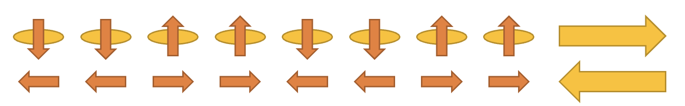
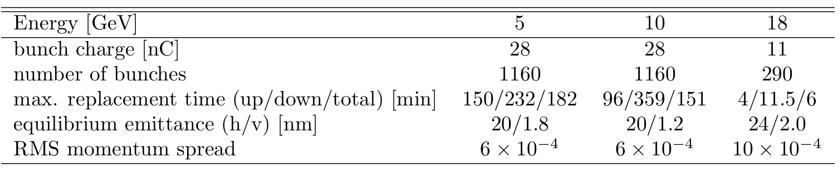
Initial thoughts on the EIC Commissioning Strategy
Science Requirement for Polarisation:
need high polarization (~70%) → experimental uncertainties proportional to 1/(P_{e}²P_{A}²L) or 1/(P_{e/A}²L) depending on measurements (single or double spin dependent observables)
if electron polarization is required, it needs to be always longitudinal → requires ESR spin rotators
to limit systematics → optimum would be to have arbitrary spin patters for both HSR and ESR
HSR: have trains of 4 bunches with the same spin direction​
ESR: using RCS allows for arbitrary spin patters in the ESR through replacements
Running at 5 and 10 GeV electrons:
we want polarization as early as possible,
depolarization is small → max allowable replacement time for 10 GeV 360 mins (85% → 70%) for the preferred polarization state and 96 mins for opposite direction
→ proposal run only the preferred spin state per fill → backup to swap out option in case backgrounds at detector
would be high
  Consequence: need to flip the ESR spin rotators between fills to keep systematics small → possible; optics does not depend on spin rotator polarity and in the shadow of filling the HSR we change spin rotator polarity in ESR
Maximum replacement times (= max. allowable storage times in ESR) are based
on 85% injected polarization and 70% time averaged polarization

Slide 17
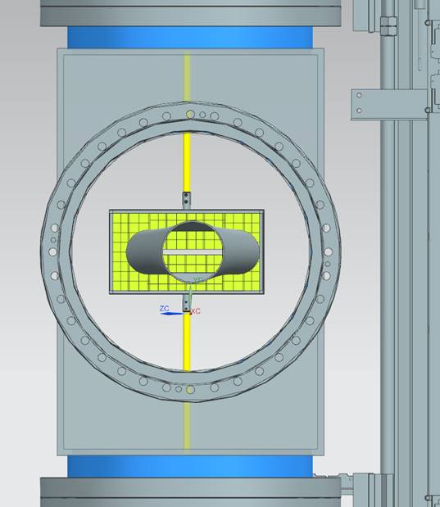
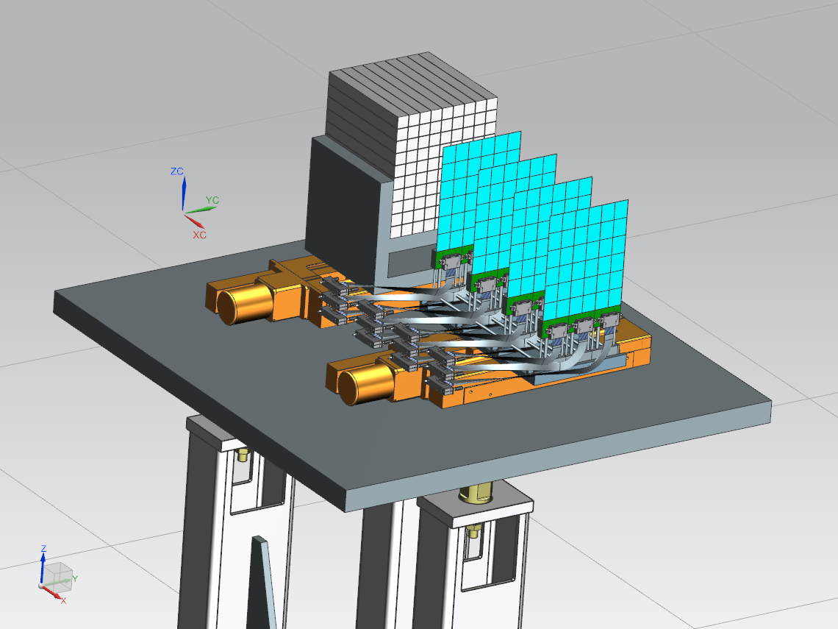
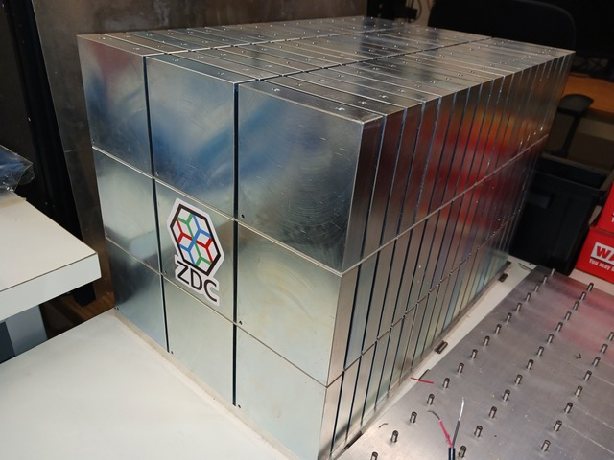

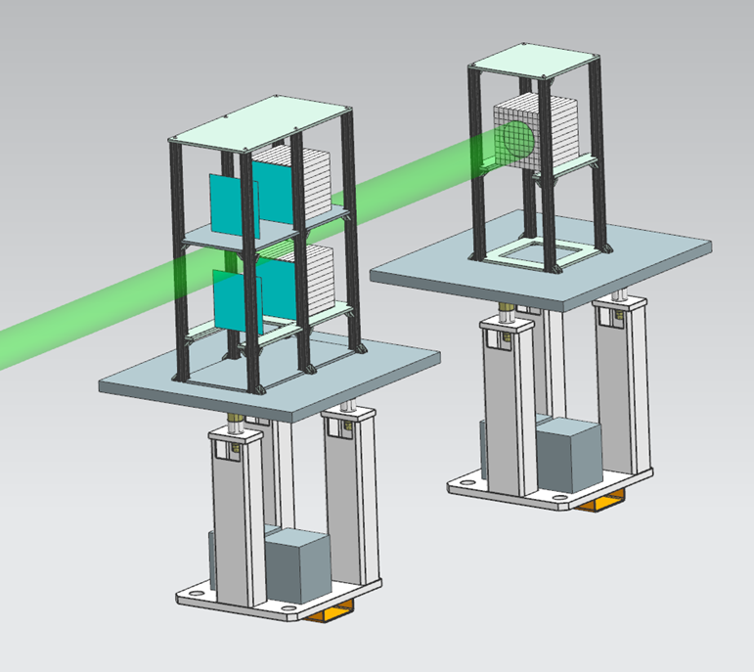
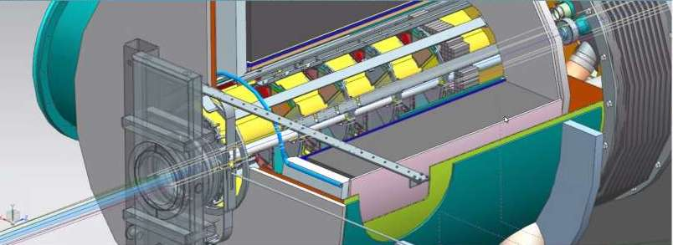
ePIC Far-Forward/Far-Backward Detectors
Low-Q2 Taggers
Zero Degree Calorimeter
e beam
Roman Pots and
Off-Momentum Detectors
B0 Magnet Sectrometer
p/A beam
Luminosity System
 | Particles | Angle [mrad] |  | Distance from IP
B0-tracker | Charged particles Photons ( tagged) | 5.5 - 20 |  | ca 6-7 m
Off-momentum | Charged particles | 0-5.0 | 0.4< xL< 0.65 | ca 23-25 m
Roman Pots | Protons Light nuclei | 0*-5.0 | 0.6 < xL< 0.95 | ca 27-30 m
ZDC | Neutrons Photons | 0-4.0 (5.5) |  | ca 35 m

