Slide 1

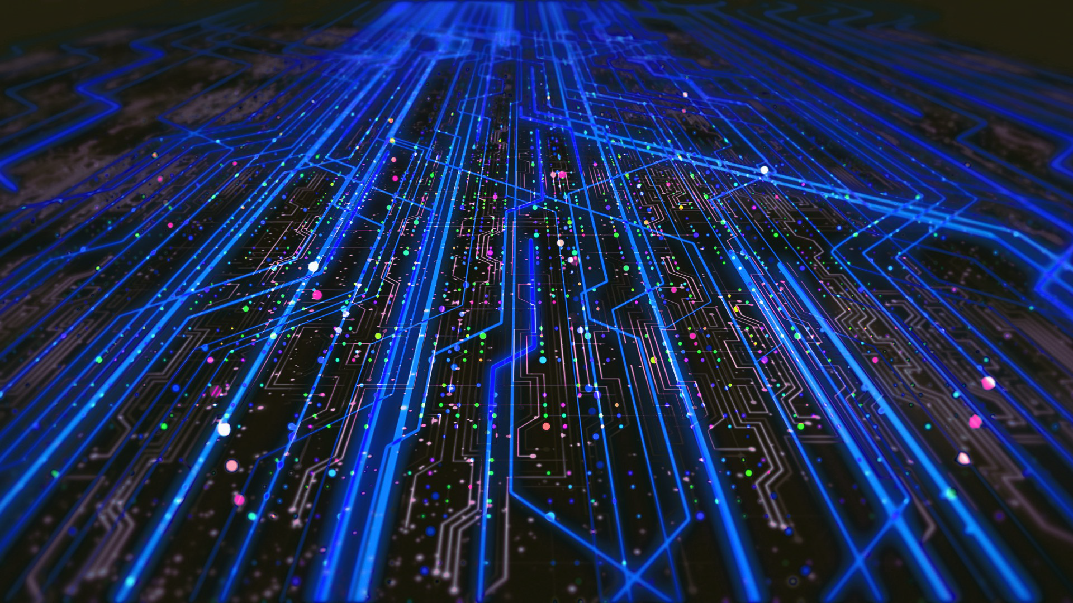

Determination of Diffractive PDFs from HERA Data using Neural Networks and impact of EIC Pseudodata
Hadi Hashamipour- INFN Cosenza
Nov. 04, 2024
Exclusive, Diffraction, & Tagging Meeting
Centro Nazionale di Ricerca in High-Performance Computing, Big Data and Quantum Computing

Slide 2
Outline:
Motivation
What has been done so far
What is the plan for future
Why this studies are connected to ePIC.

Slide 3
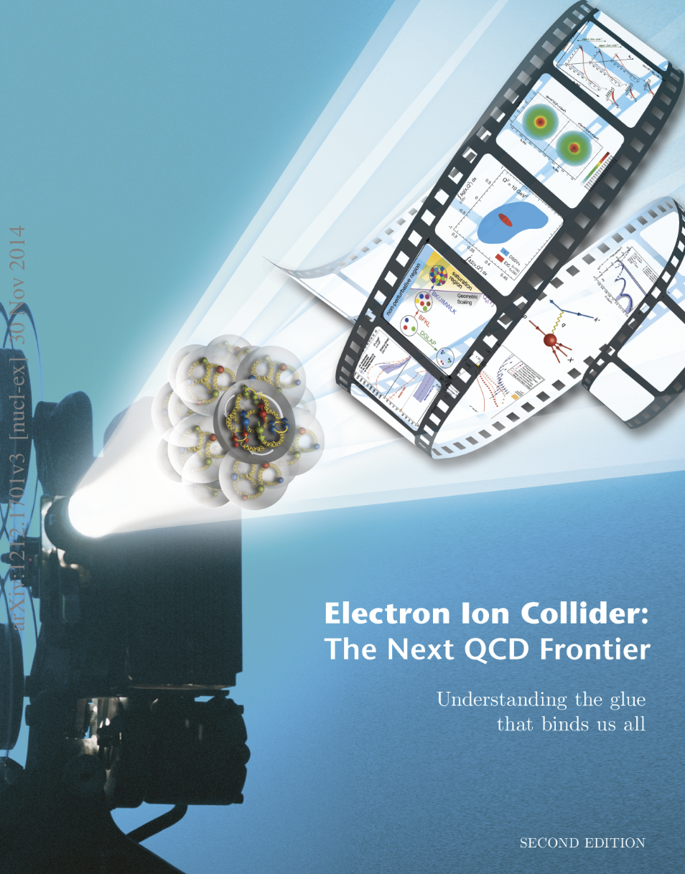


Motivation

Slide 4
Introduction
Diffractive processes, ep → epX, where X represents hadronic final state, have been studied extensively in the H1 and ZEUS experiments at the electron-proton (ep) collider HERA.
At HERA, a substantial fraction of up to 10-15% of all ep DIS interactions proceeds via the diffractive scattering process initiated by a highly virtual photon.
The main sources to constrain the diffractive PDFs are the inclusive diffractive DIS data measured at HERA.

Slide 5
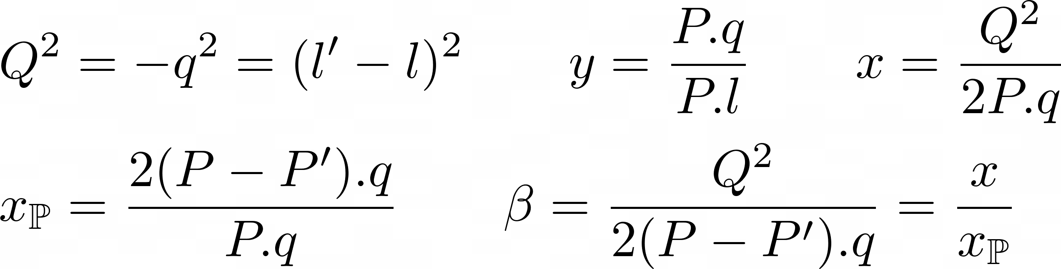
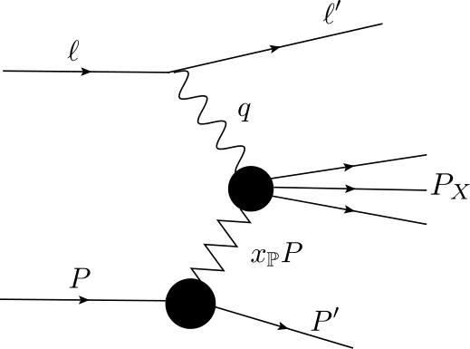
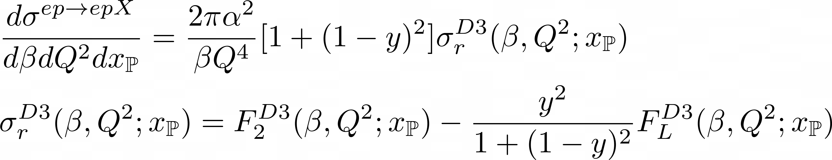
Cross Section
Triple differential Cross section
Using the factorization theorem on Fracture functions
Fracture functions: An Improved description of inclusive hard processes in QCD Phys. Lett. B 323, 201 (1994)

Slide 6
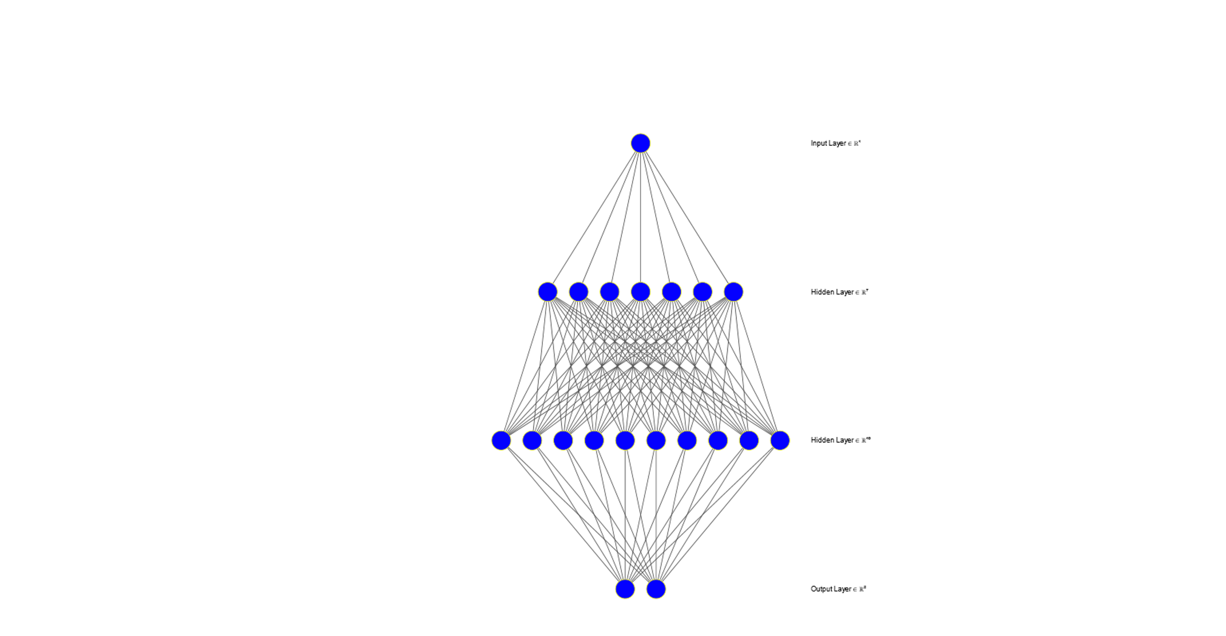
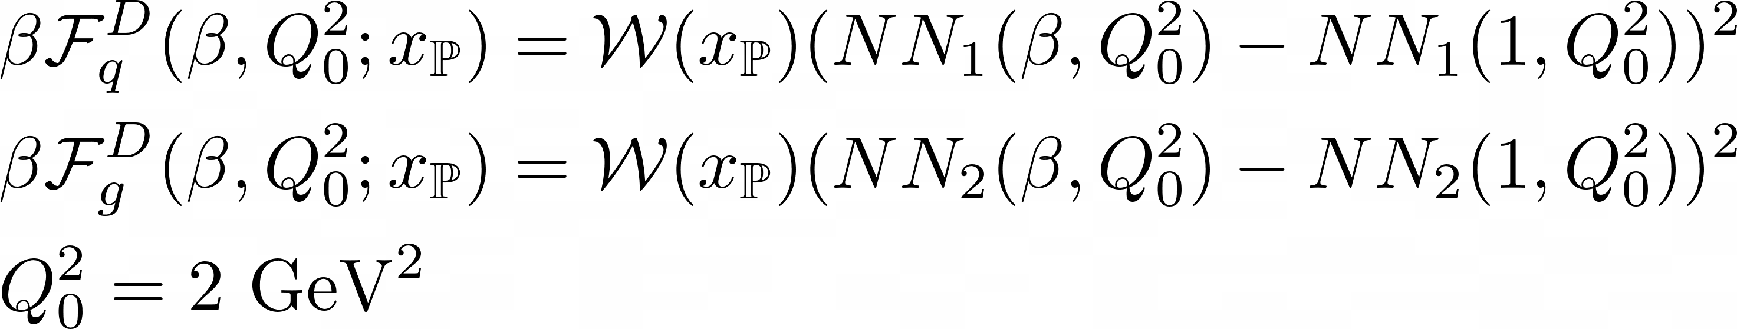
Neural Network Approach to Parameterization
A Feed-forward neural network with two hidden layers used to parametrize diffractive distributions.
Benefits of using NNs: flexibility, no need for strict theoretical assumptions.

Slide 7
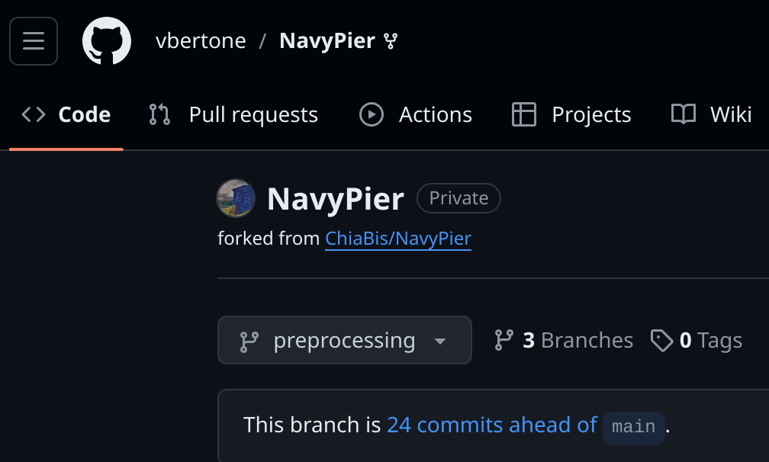
DPDF analysis: Computational Tools
Code Name: NavyPier
Programming Language: C++
Based On: APFEL++
Used for DGLAP evolution and convolution integrals.
Core Functionalities:
  DGLAP Evolution: Solves equations related to PDFs using APFEL++.
  Convolution Integrals: Computes integrals using APFEL++.
  Parameterization: Utilizes a feed forward NN library NNAD.
Optimization Tool: Uses Google’s CERES Solver to minimize the chi-squared function.
Uncertainty Estimation: Implements the Monte Carlo replica method.

Slide 8
Diffractive DIS data sets
F. D. Aaron et al. [H1 Collaboration],
Measurement of the diffractive longitudinal structure function FLD at HERA. Eur. Phys. J. C 72, 1836 (2012).
F. D. Aaron et al. [H1 Collaboration],
Measurement of the diffractive longitudinal structure function FLD at HERA. Eur. Phys. J. C 71, 1836 (2011).
F.D. Aaron et al. [H1 Collaboration],
Inclusive measurement of diffractive deep-inelastic scattering at HERA. Eur. Phys. J. C 72, 2074 (2012).
F.D. Aaron et al. [H1 and ZEUS Collaborations],
Combined inclusive diffractive cross sections measured with forward proton spectrometers in deep inelastic ep scattering at HERA.
Eur. Phys. J. C 72, 2175 (2012).

Slide 9
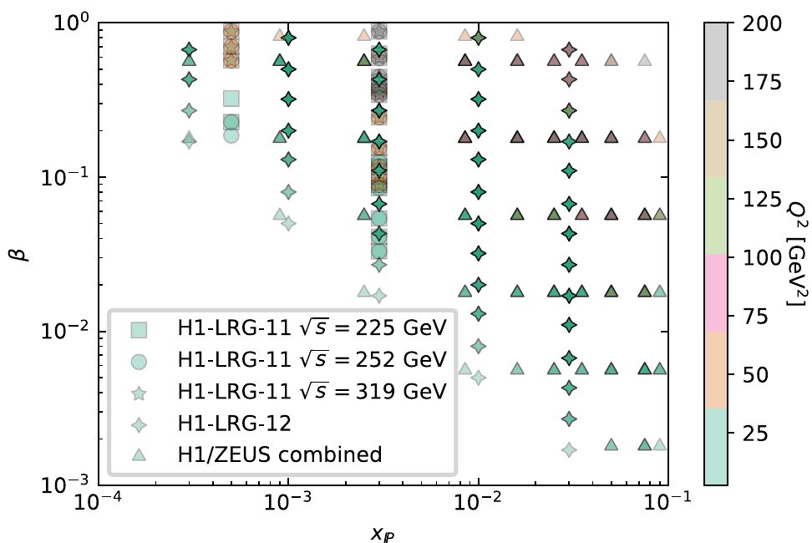
Training the Neural Network
NN trained using HERA reduced cross-section data. NN adjusts weights iteratively, learning the correct mapping between input momentum fraction and DPDFs.
Optimization: Chi-squared minimization between predicted and observed diffractive cross-sections.
We use H1 Large rapidity gap data and H1/Zeus combined proton spectrometer data.
Kinematical cuts:
  β ≤ 0.80
  Q² > 8.5 GeV² for all the datasets
  After the cuts we have 301 datapoints
  Total chi-squared over number of datapoints: 0.88

Slide 10
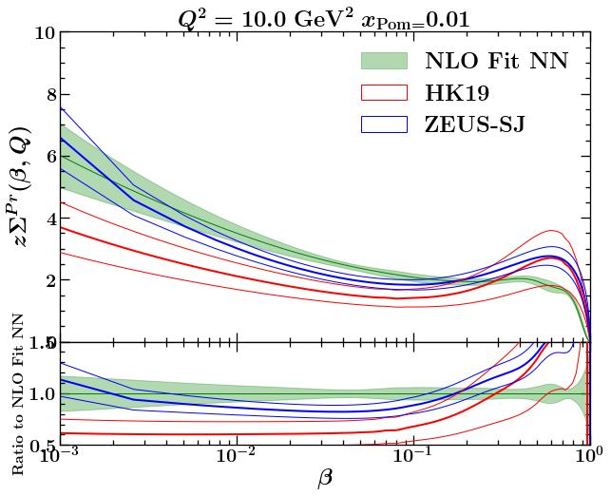
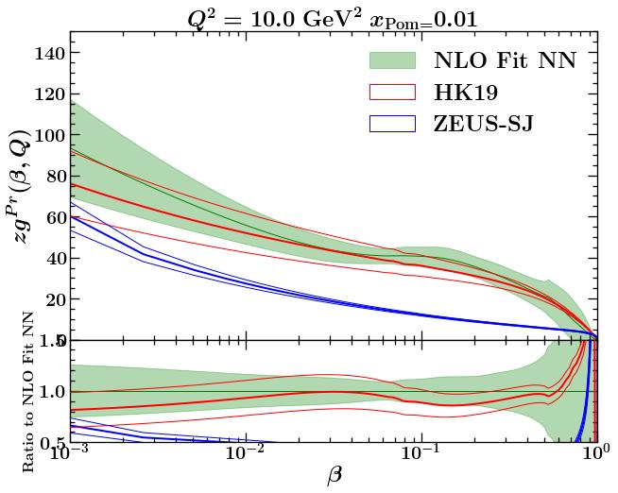
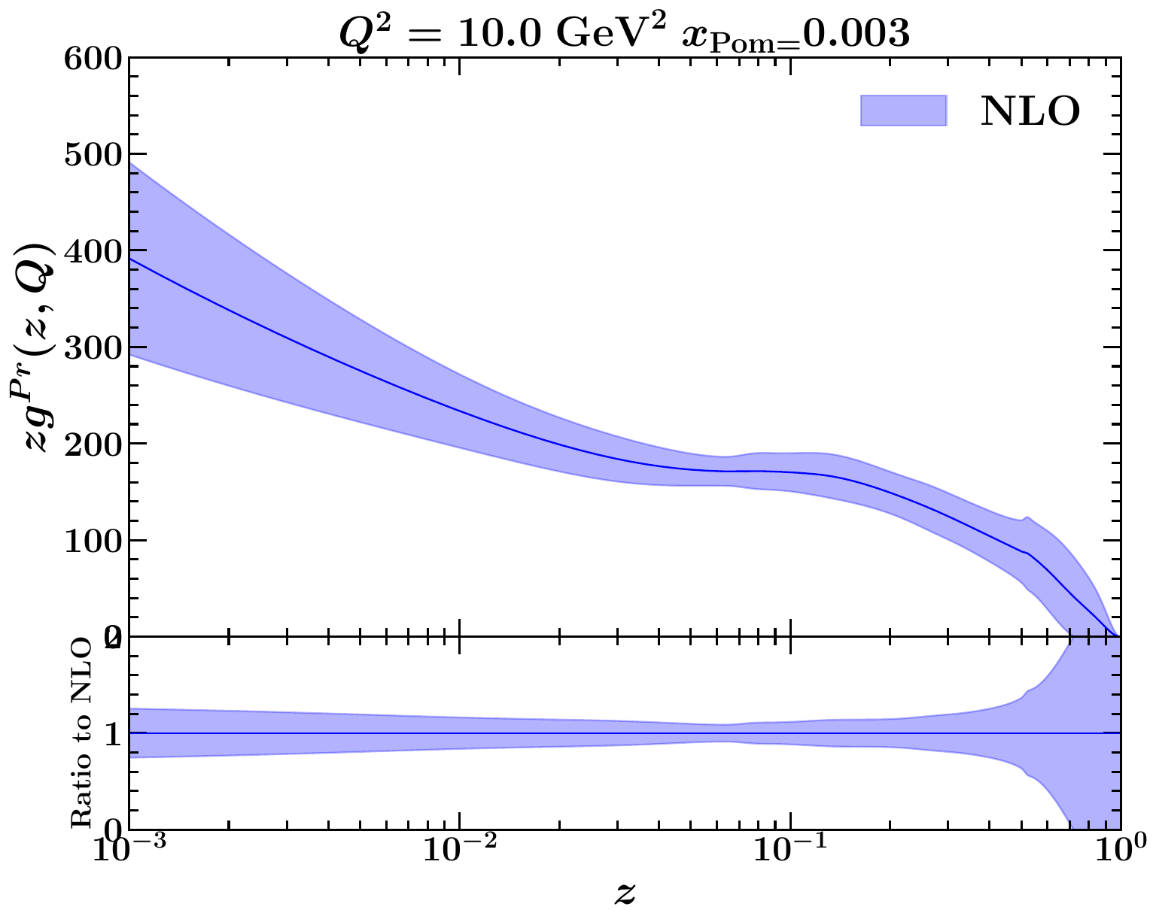
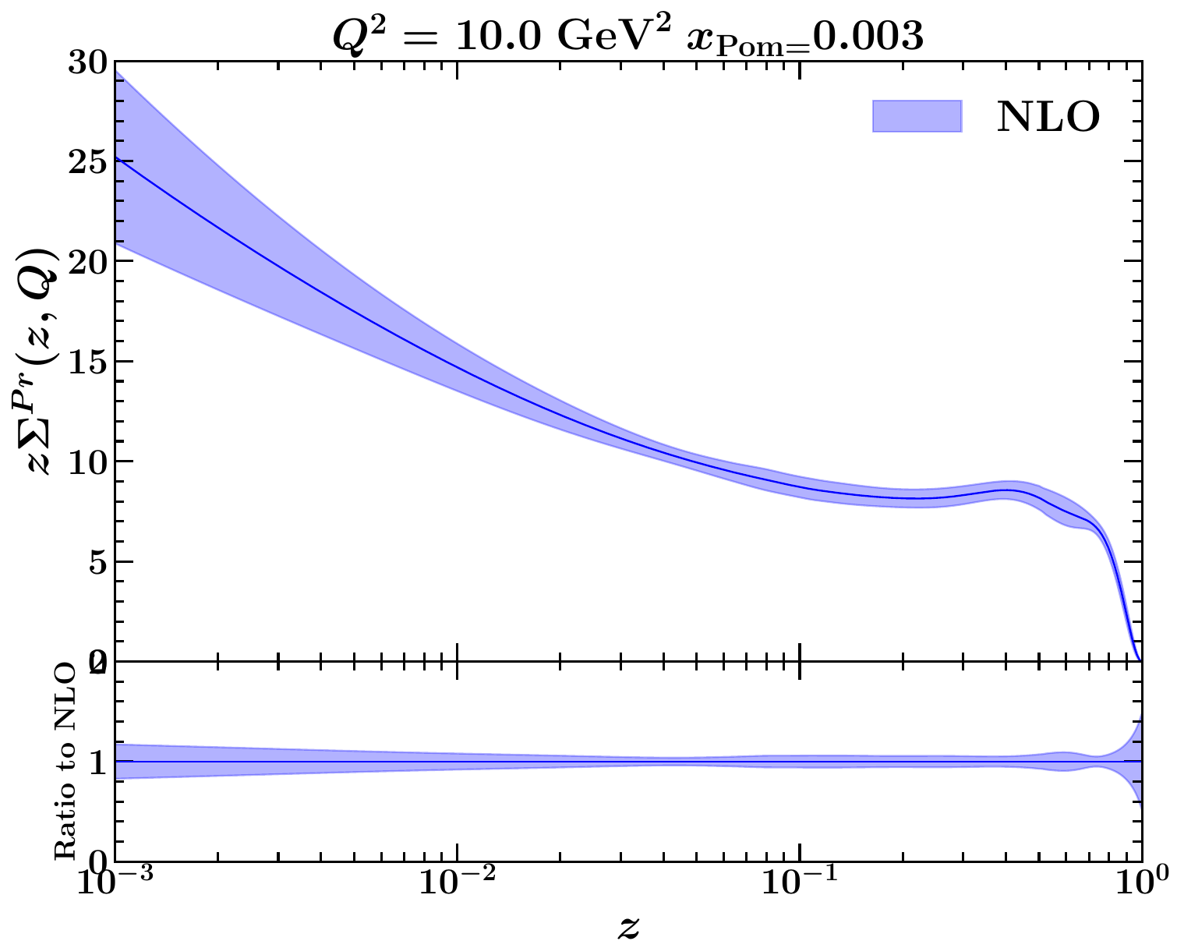
Results
NN results show a fair matching with previous DPDF determinations.
Monte Carlo method applied for uncertainty estimation: generating pseudo-datasets (replicas) to calculate central values and uncertainties.
HK19 : PRD99 , 054007 (2019)
ZEUS-SJ: NPB831, 1 (2010)

Slide 11
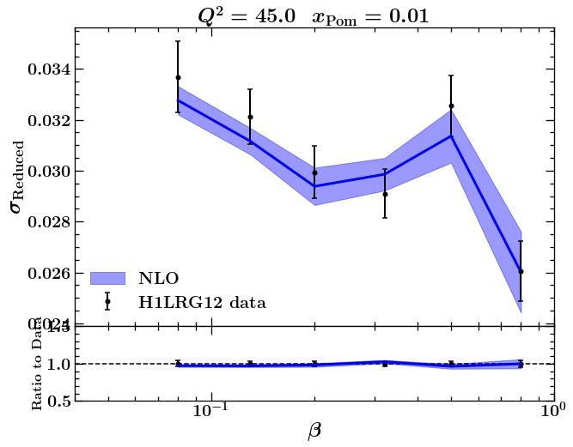
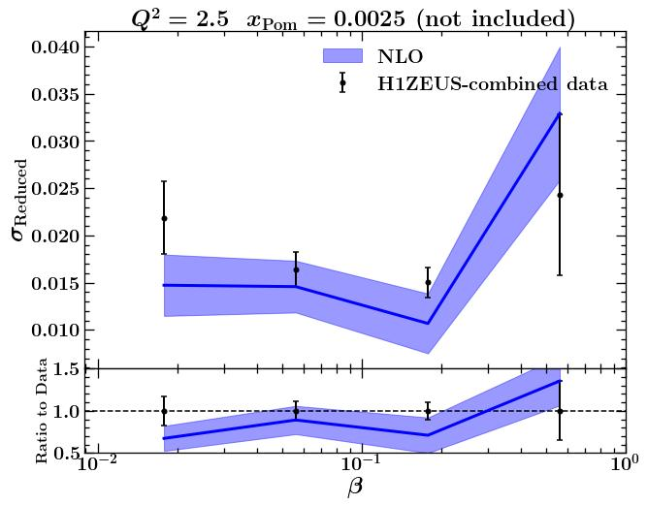
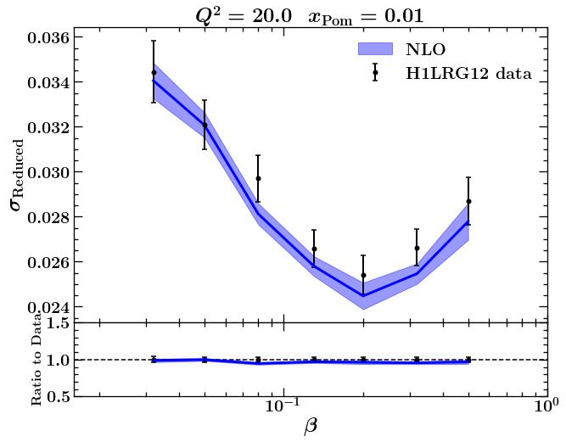
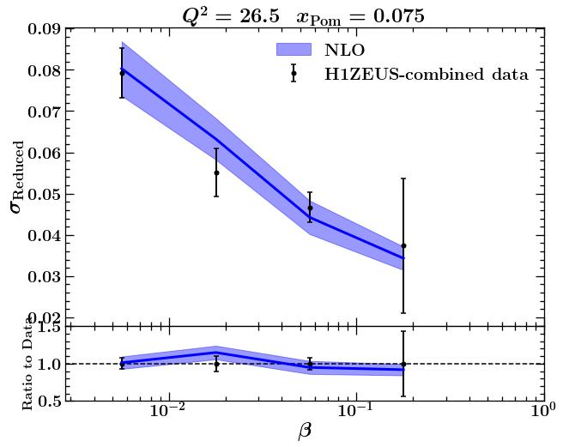
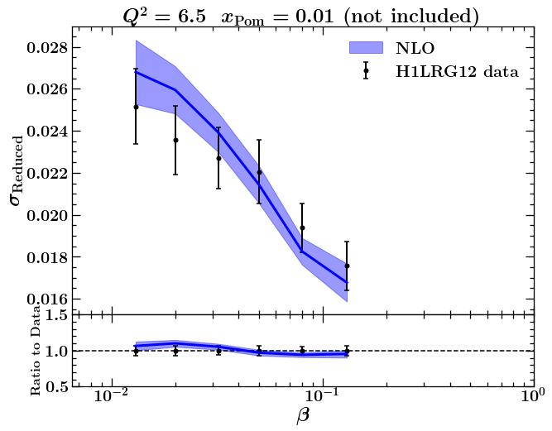
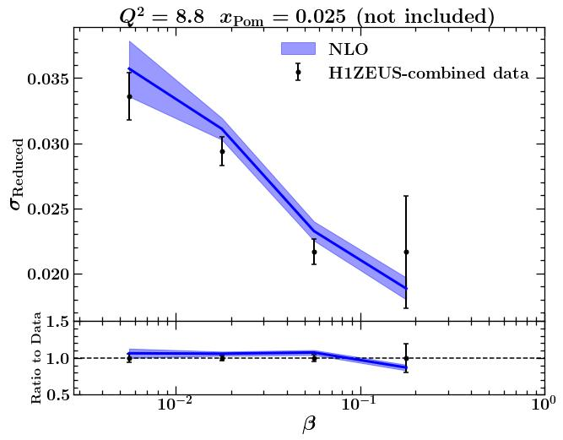
Results
Fair agreement between data and NN predictions.

Slide 12
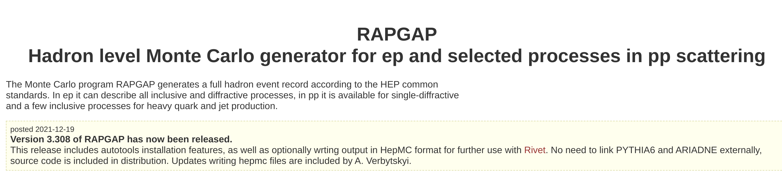
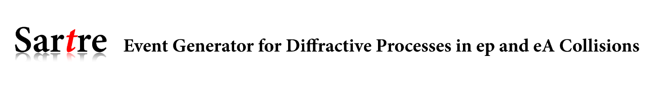
Monte Carlo Event Generators:

Slide 13
Pseudo-Analysis at ePIC
Planned pseudo-analysis goals, including:
  Detector performance plots: Focus on reduced cross-section measurements.
  Impact study: Fitting ePIC pseudodata alongside HERA data to assess precision improvements.
Event Generation and Simulation
Planned goals, including:
  Using RAPGAP (for ep collisions) and SARTRE (for ep and eA collisions- work in progress).
Estimation based on 10 fb^{-1}= 10^7 nb^{-1} luminosity and sigma = 4.22 nb:
number of events:
4.22 (nb) * 10^7 (nb-1) =~ 4.2x10^7 events
42 million events as mock data.
42 million events as MC data, totaling 84 million events.
Proton momentum : 100 GeV
Electron momentum : 10 GeV

Slide 14
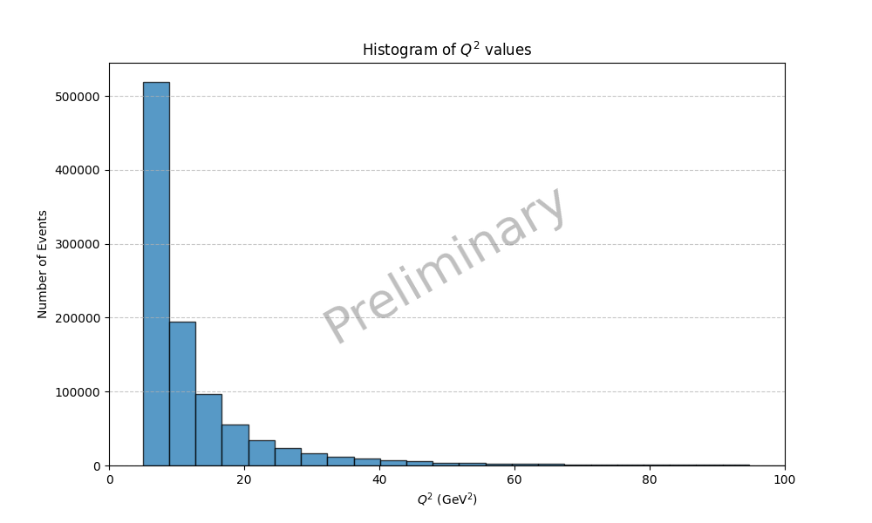
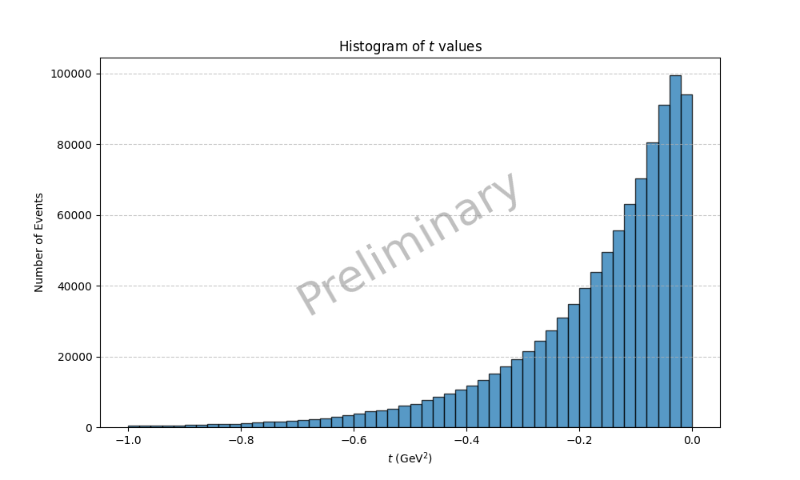
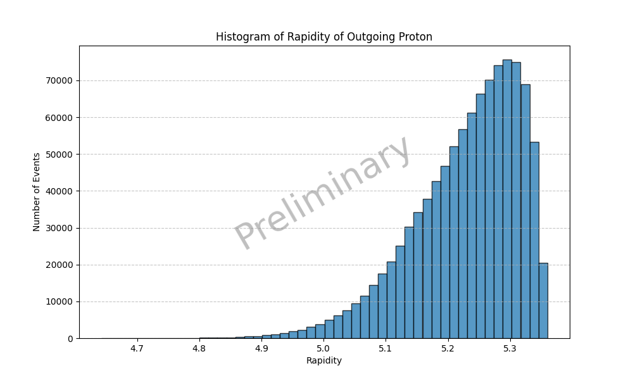
Preliminary results (control distributions):
Q^2 Distribution:
  low momentum transfer, typical of diffractive/elastic scattering
t Distribution:
  proton retains much of its initial momentum
Rapidity of Outgoing Proton:
  Proton remains near the original beam direction
Overall:
  Dominant forward-scattering component with minimal momentum transfer, characteristic of diffractive and elastic processes

Slide 15
Conclusions and Future Directions
NN approach offers a robust and flexible alternative parameterization of DPDFs.
Confirms reliability of existing models and opens new avenues for future studies at the Electron-Ion Collider (EIC).
NN-based parameterization is a powerful, data-driven tool for advancing diffractive PDF determination.
Simulations using RAPGAP and HepMC provide a starting point for evaluating detector performance and carrying out impactful inclusive DIS pseudo-analyses.
We think neural network parameterization, combined with new pseudodata from ePIC, will improve the precision and reliability of DPDF extraction beyond current limits.
Using RAPGAP v 3.310, 1M events , output format HepMC; Next: 42M + 42M events, analysis and reconstruction

Slide 16
Thank You!
Centro Nazionale di Ricerca in High-Performance Computing, Big Data and Quantum Computing

