Slide 1
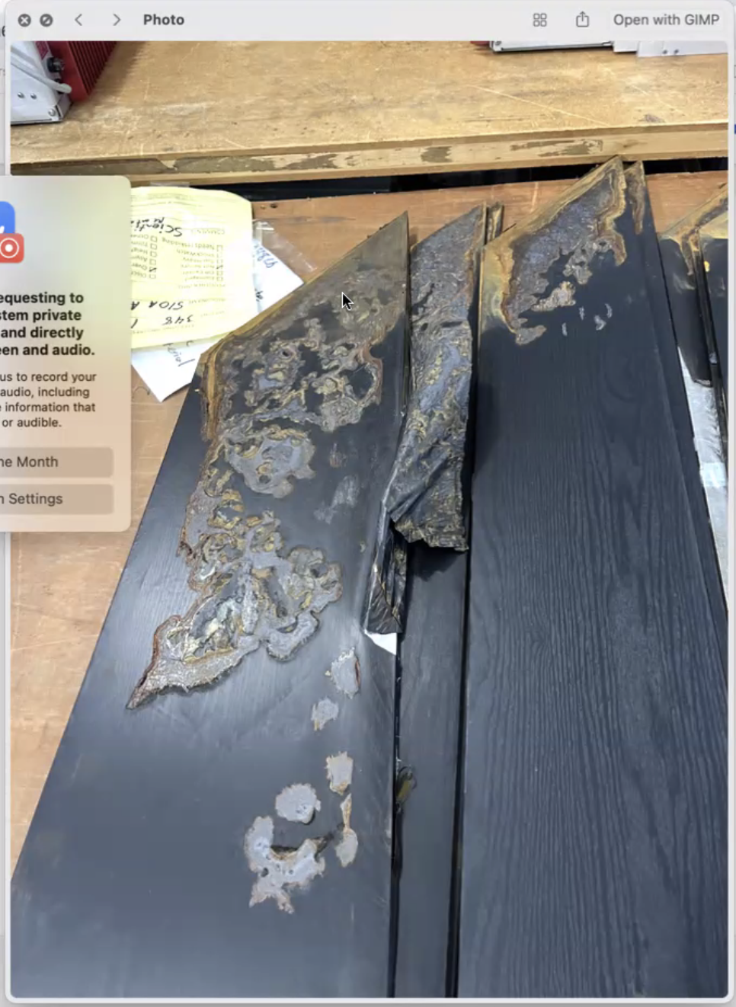
Prototype status
Highbay status?
Norbert’s travel plans (Norbert, Martin)?
SiPM order (account number: Oleg)

