Slide 1
Field response check
Xuyang Ning, Wenqiang Gu
09/30

Slide 2
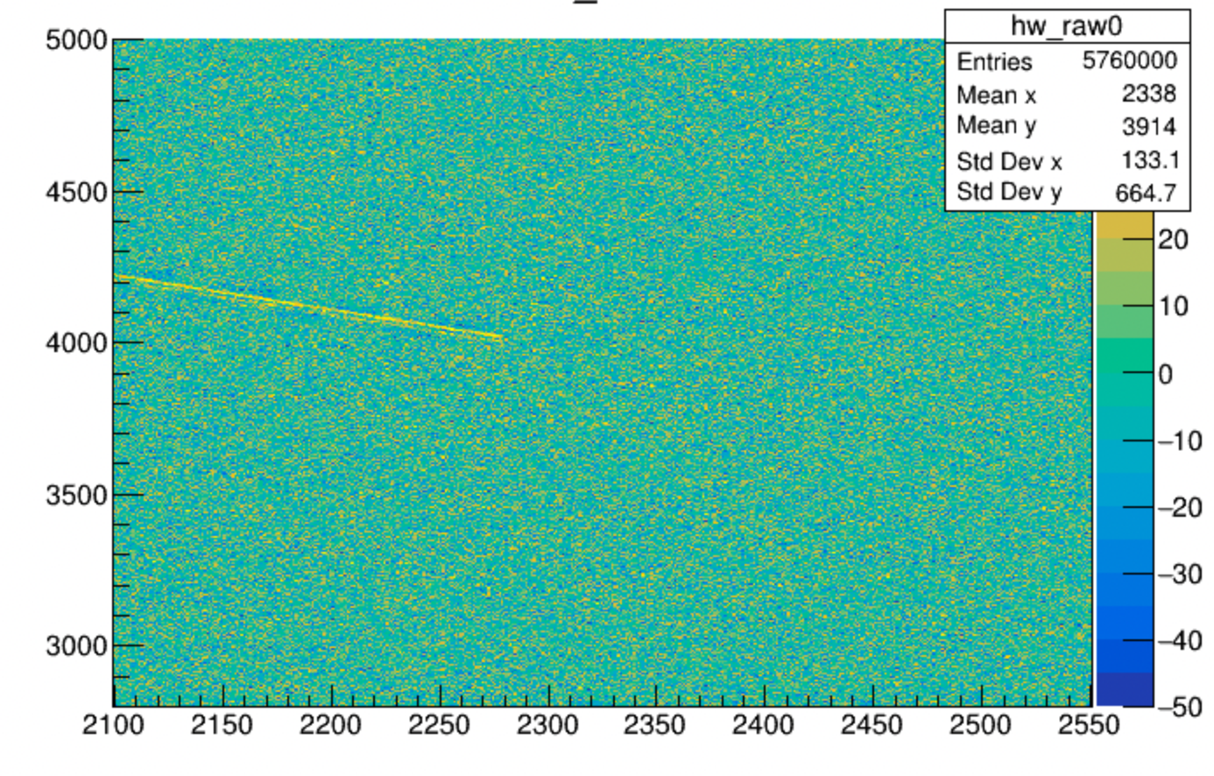
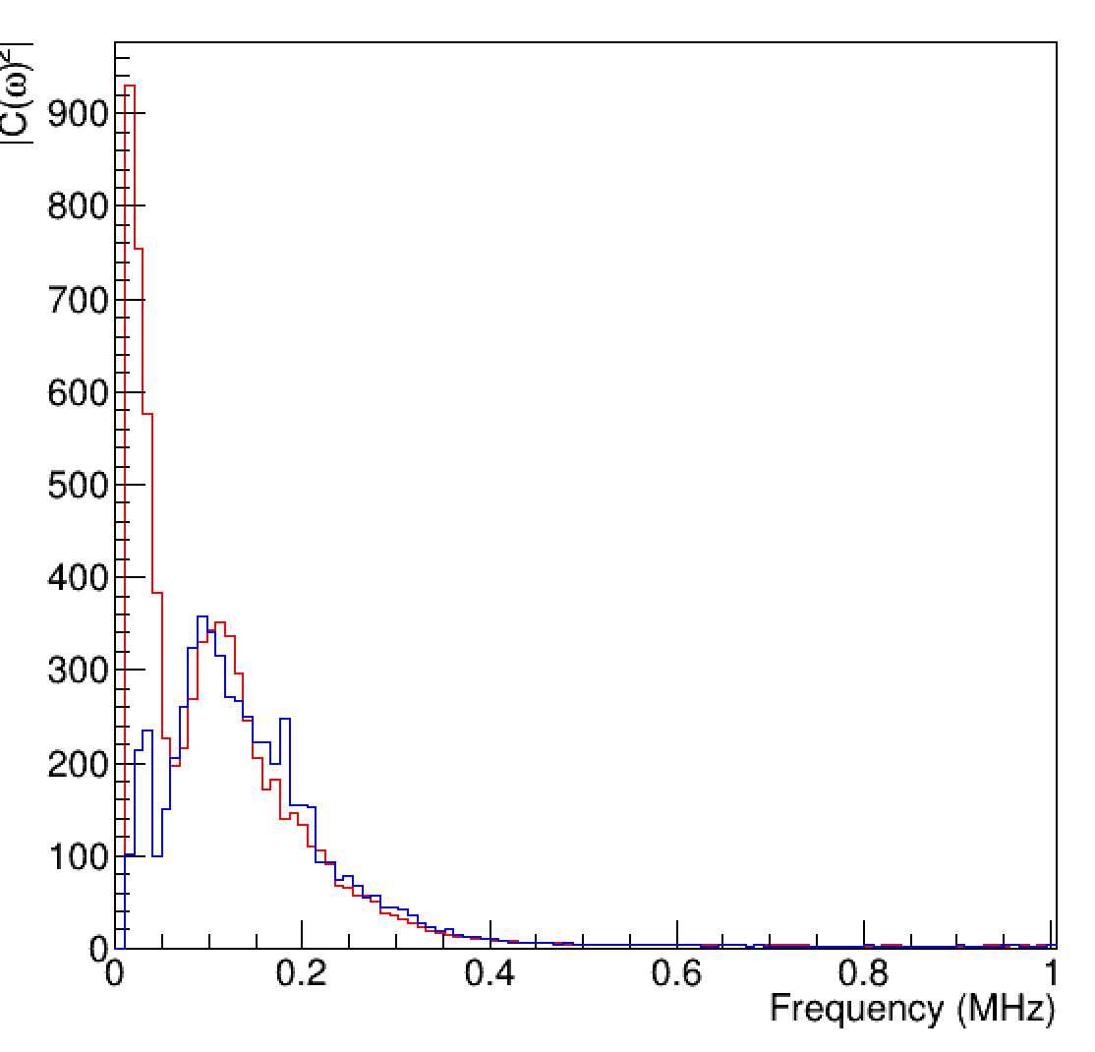
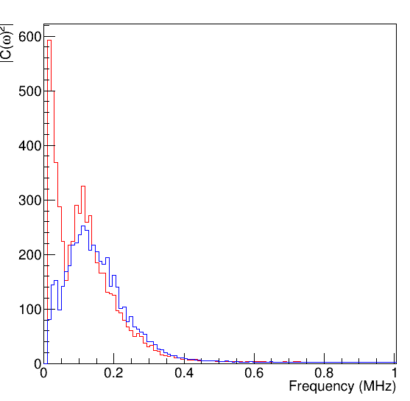
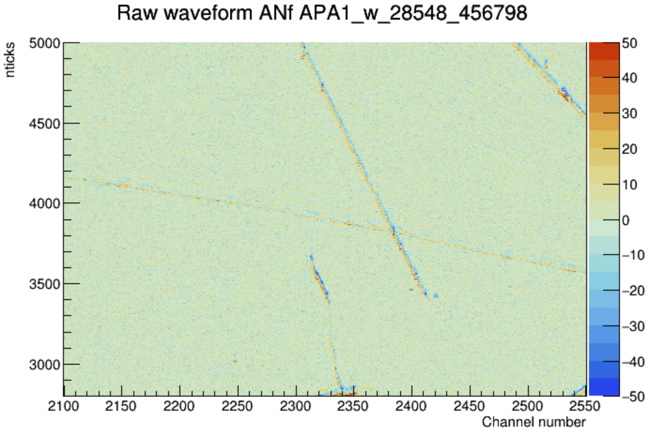
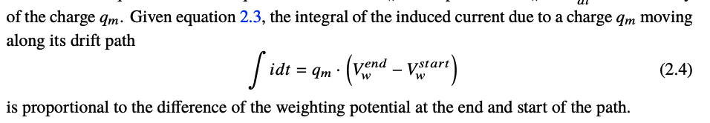
Power spectra comparison
Simulation
Data
Field response now has more collection effect compared to the data.
Derive the DC component from data, which should be the electron collection.
Data
arXiv:1802.08709

Slide 3
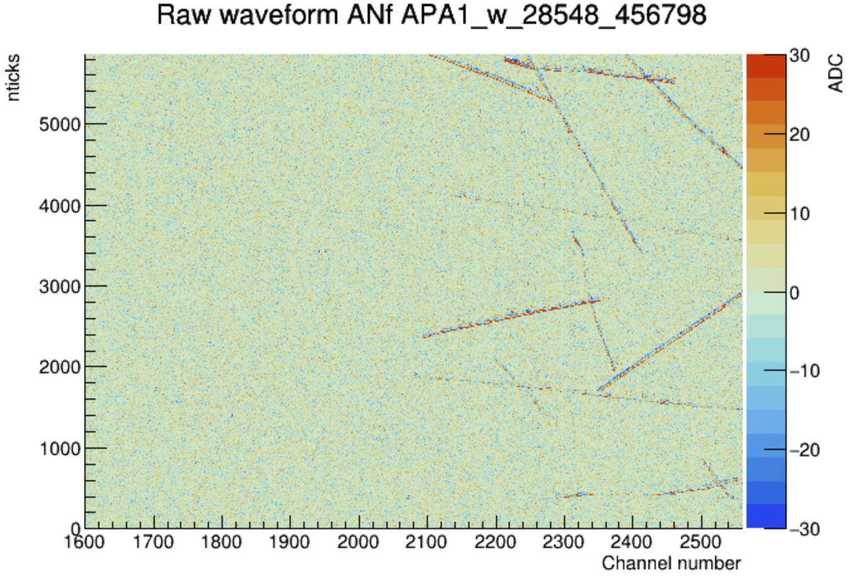
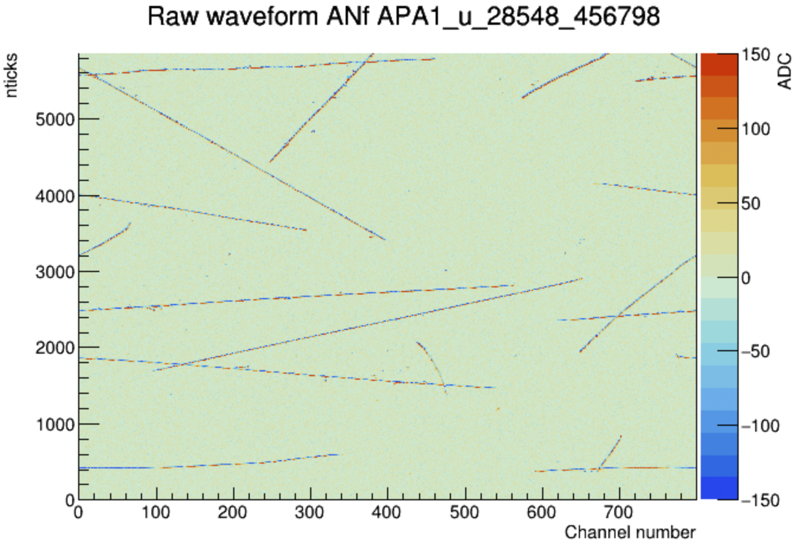
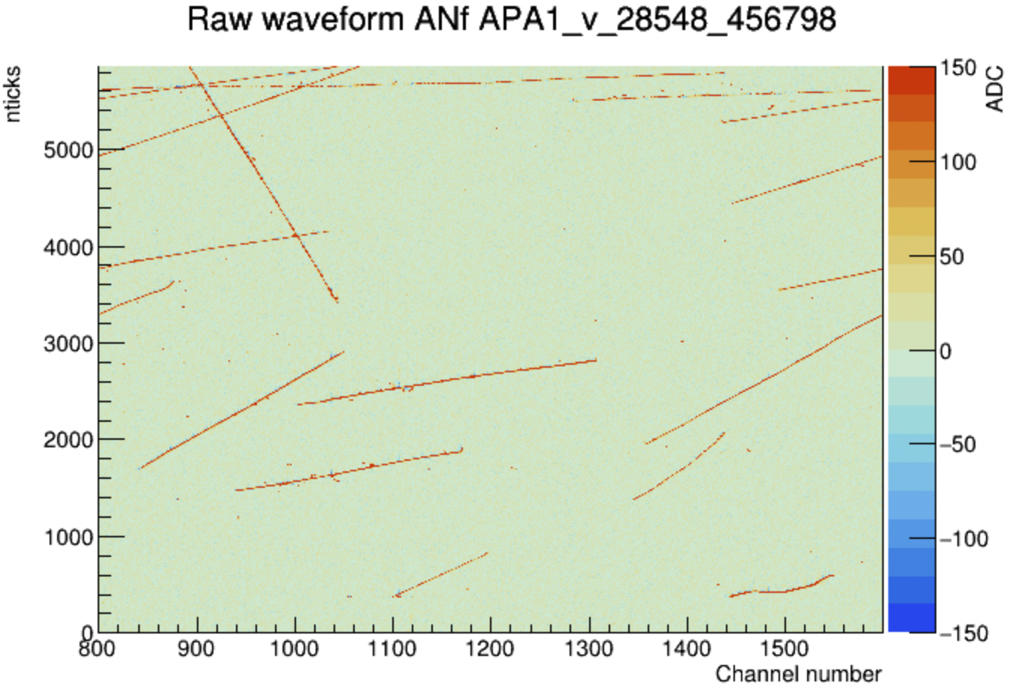
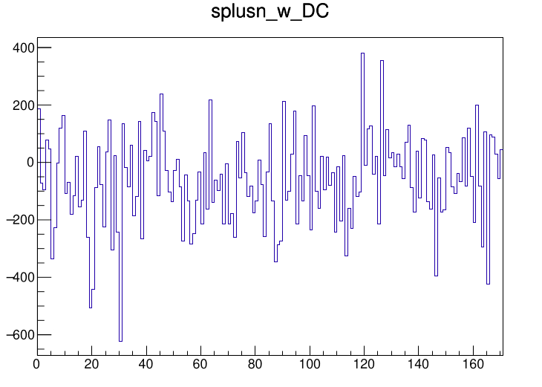
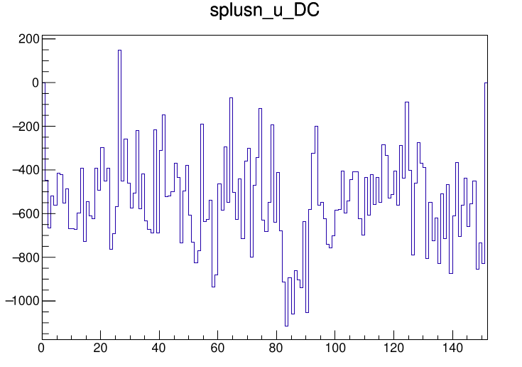
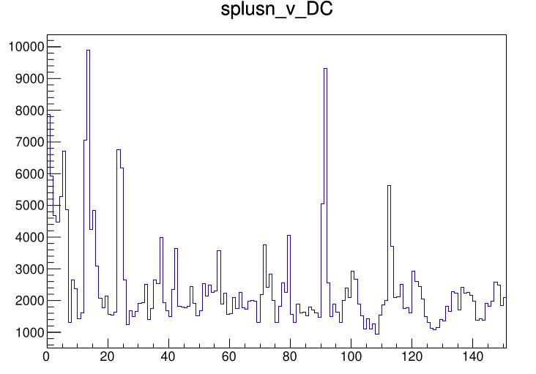
APA1; beam
3800-4100
w
u
v
2170-2340
0-80
730-800
840-990
ADC
average DC = -540.23 ADC
average DC = 2421.6 ADC
average DC = -61.2865 ADC
channel
channel
channel

Slide 4
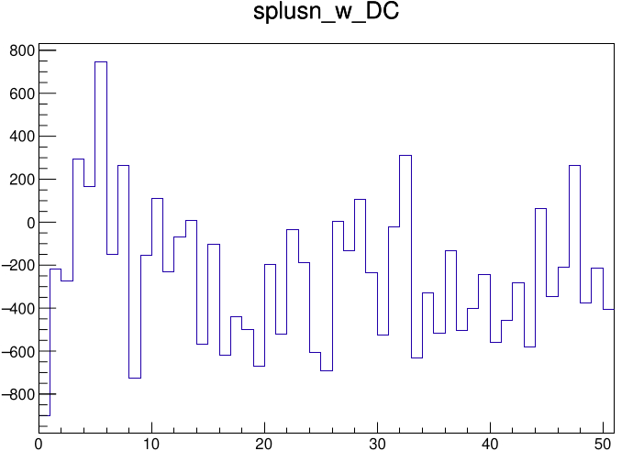
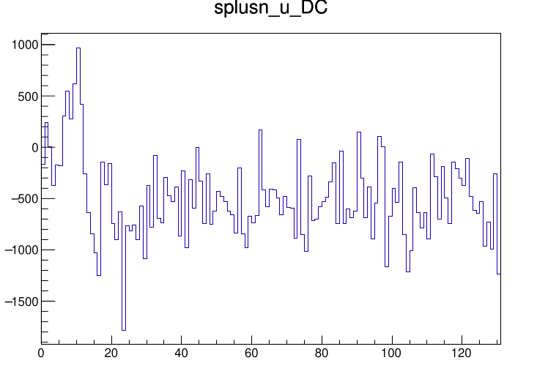
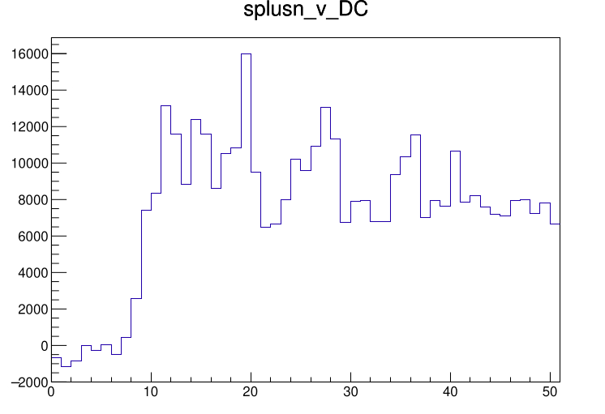
APA1; large angle
4300-5000
w
u
v
2300-2350
110-240
940-990
ADC
average DC = -247.412 ADC
average DC = -497.26 ADC
average DC = 7469.73 ADC
channel
channel
channel

Slide 5
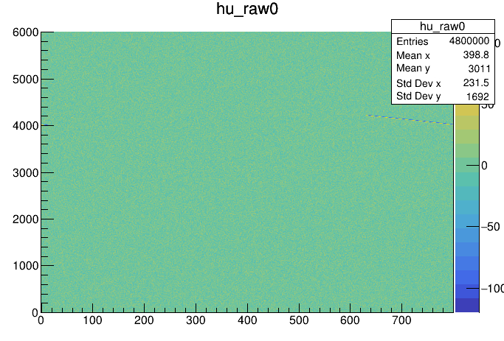
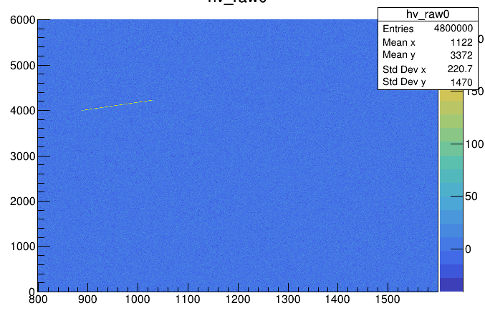
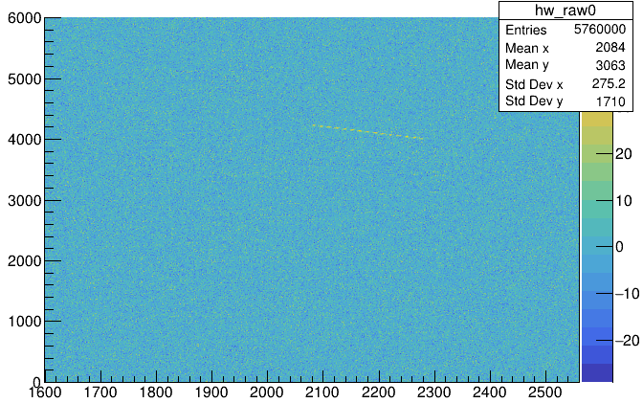
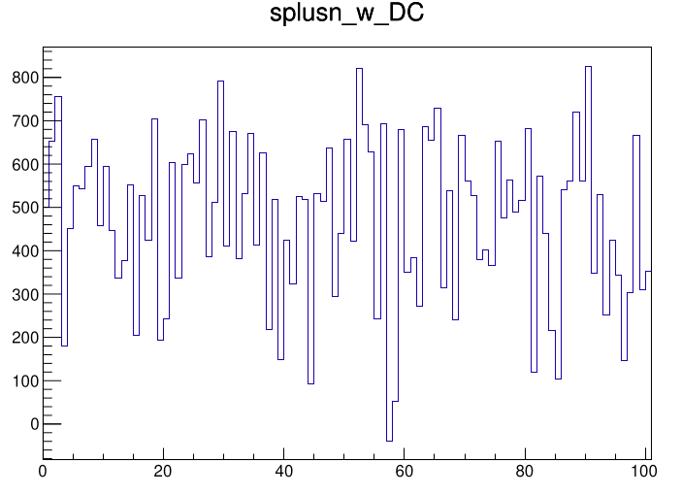
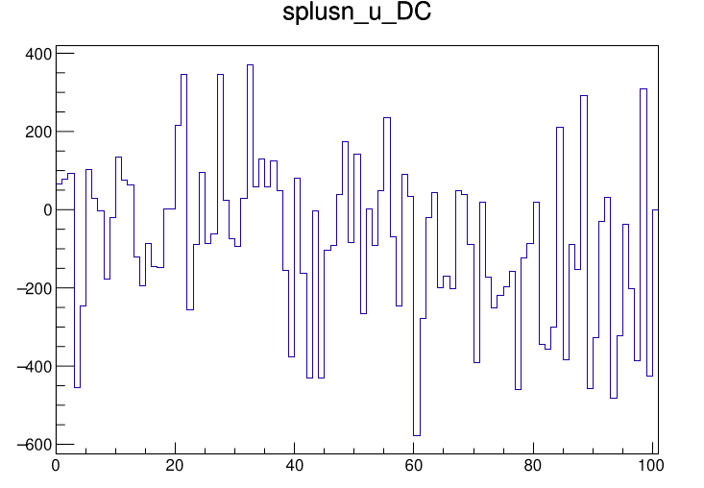
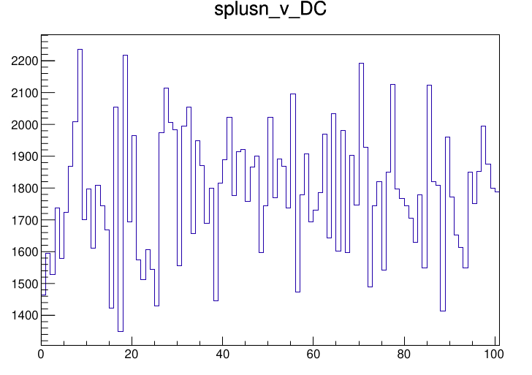
Simulation
w
u
v
average DC = 471.11
average DC = -82.2132
average DC = 1784.71
channel
channel
channel

Slide 6
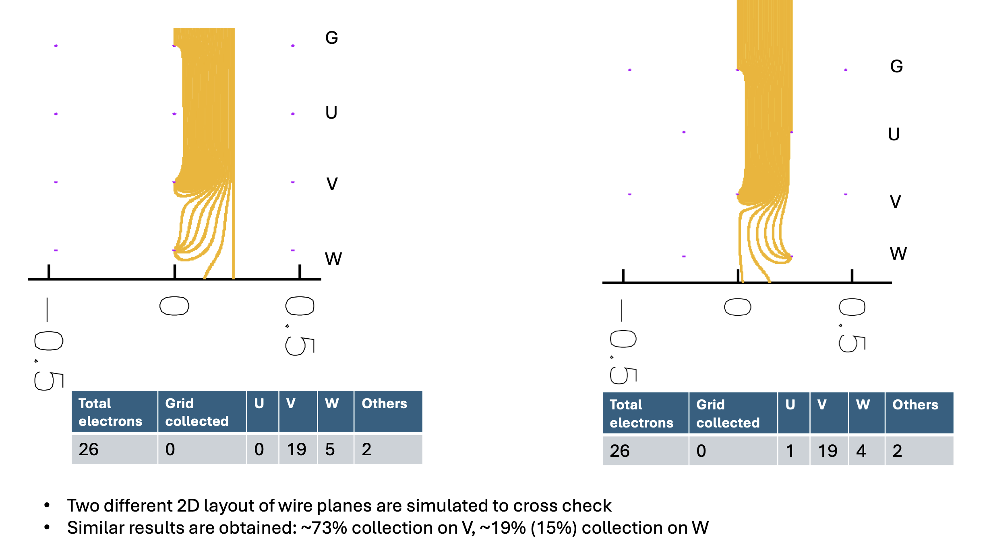

Slide 7
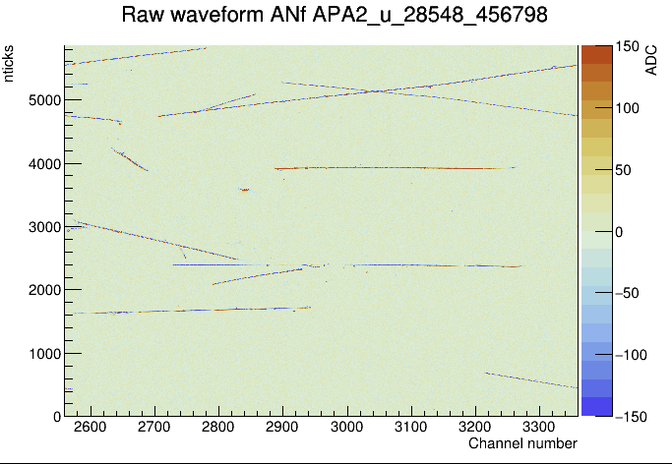
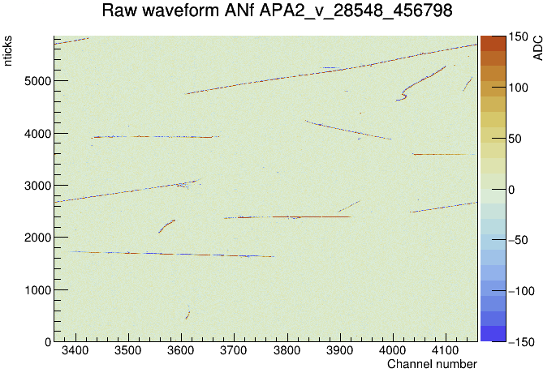
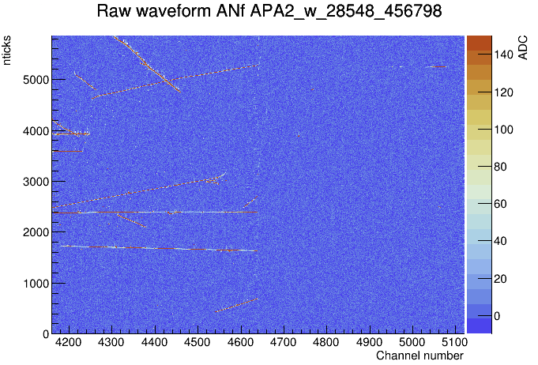
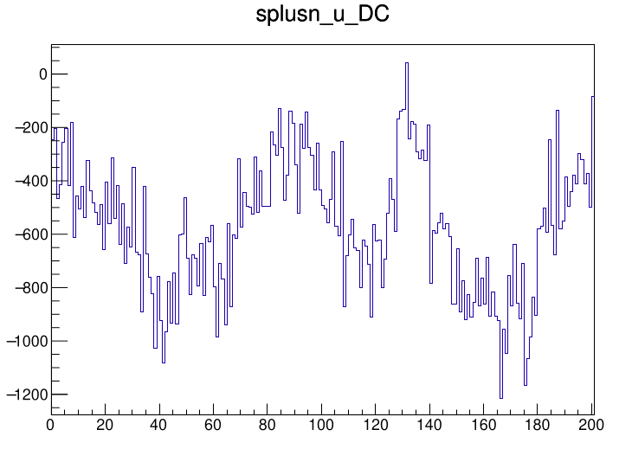
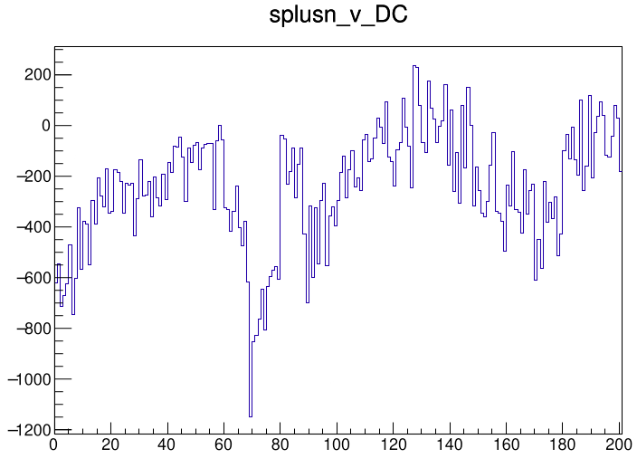
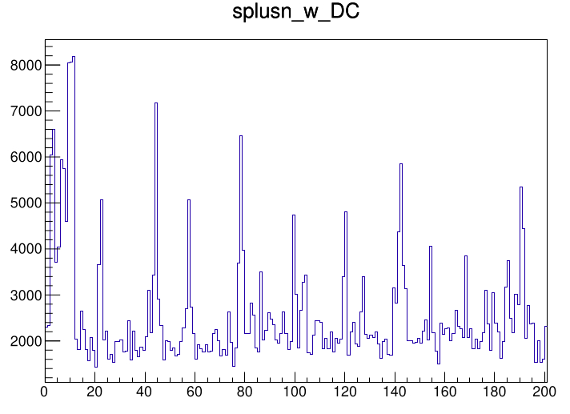
Normal situation: APA2
ADC
average DC = 2564.36
average DC = -569.9
average DC = -244.343
channel
channel
channel

Slide 8
Backup

Slide 9
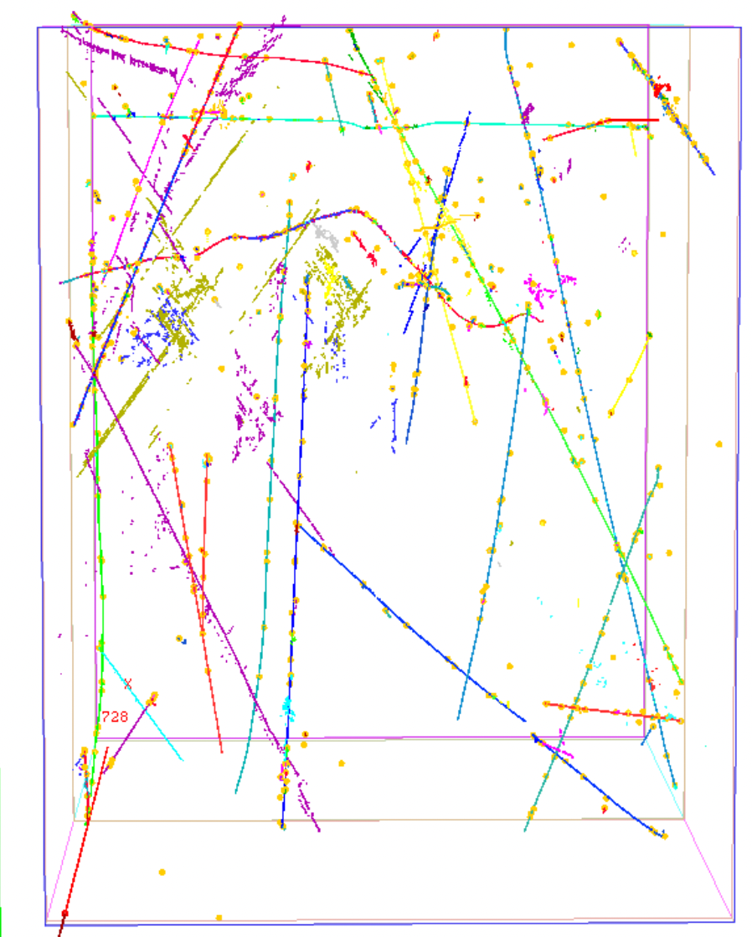
From Leigh’s recontruction:
Start: (-157, 604, 129)
Direction: (0.286548,-0.880757,-0.377037)

Slide 10
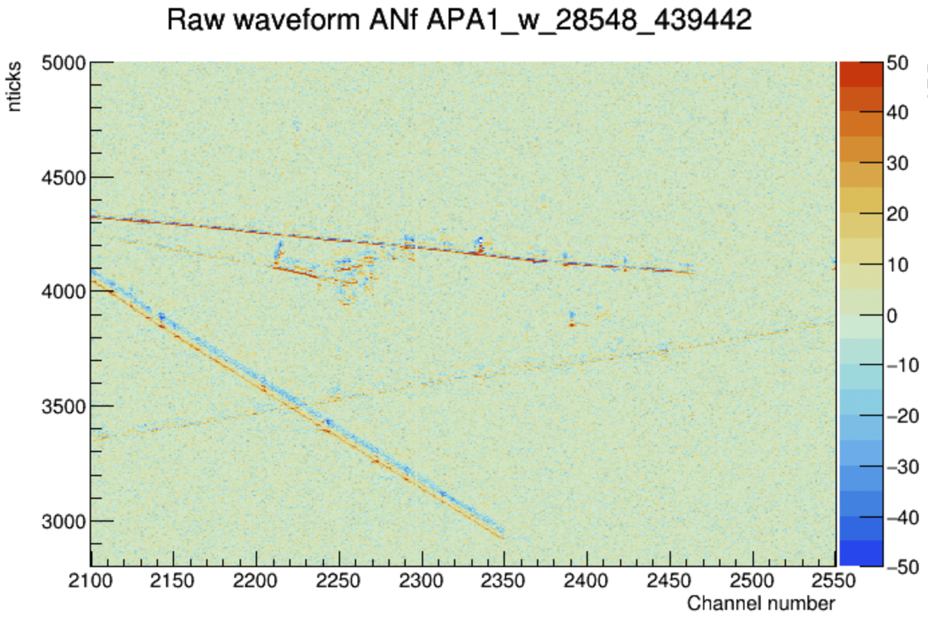
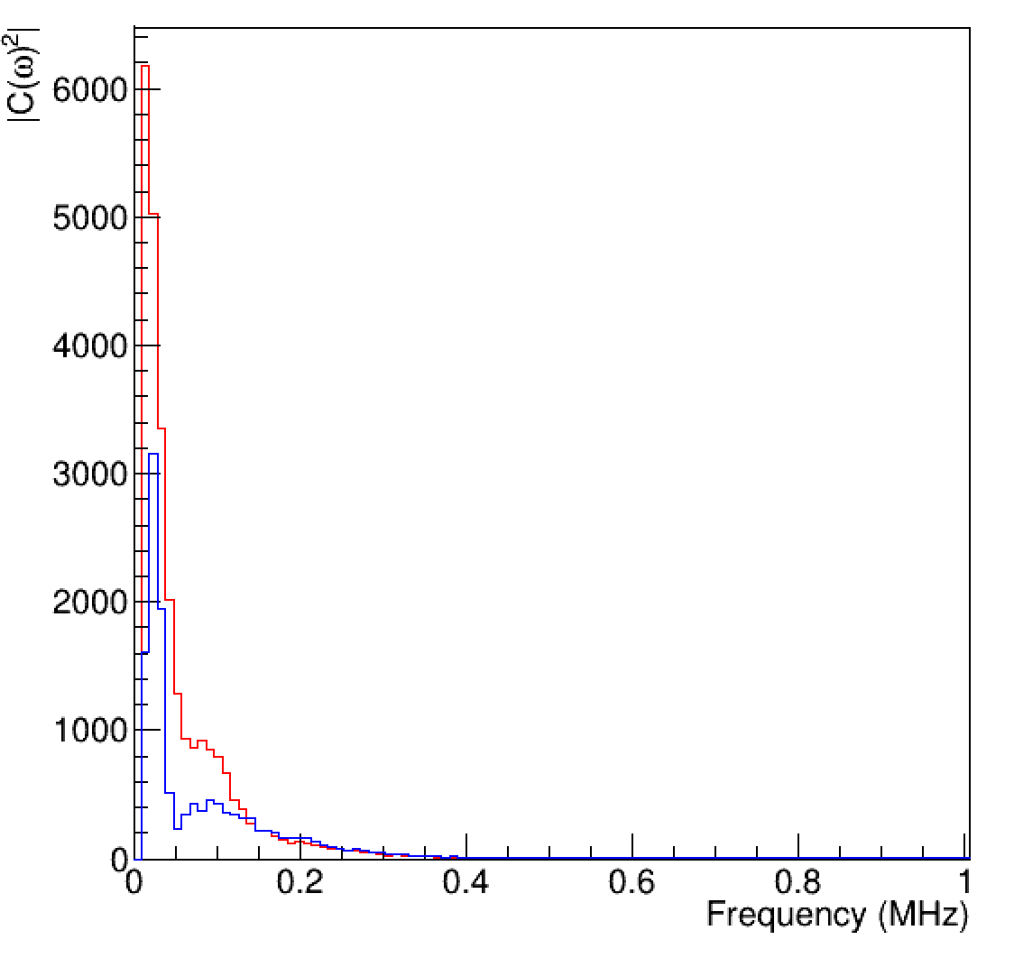
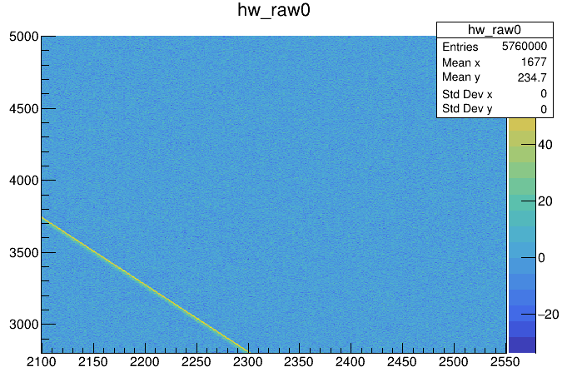
Simulation
Data
A bug is found from last time but doesn’t change the conclusion.

