Slide 1

Barrel Module Assembly Ideas
S. Mazza (originally from Matthew Gignac)
July 15th 2024

Slide 2
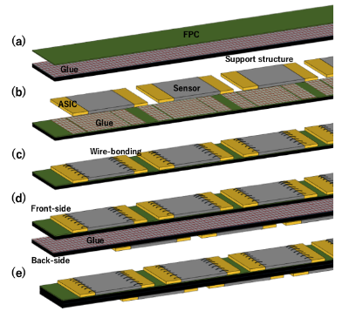
Double-sided design
Double-sided stave design
Sensor Chips
Cooling pipe

Slide 3
Alternative bTOF design
An alternative design can solve both of these problems if we use both sides!
Drawbacks: limits sensors to two segments (or relatively long, overarching bonds to inner segments), and bonding needs to be performed with sensitive components on backside
ASICs have direct contact to cooling structure → easier to cool and no temperature gradients introduced onto the sensor surface
Overlap between sensors can be chosen to eliminate acceptance gaps!

Slide 4

Demonstrator project
Goal: build a thermo-mechanical stave demonstrator to:
  Test assembly procedure
  Test thermal proprieties of the stave, e.g. temperature gradient
Project flow:
  Purdue and ORNL will fabricate two half staves co-cured with Flex
  UCSC will glue, verify positioning (metrology) and wirebond sensors (HPK new production) and silicon heaters (https://www.topline.tv/PST.html).
  Heathers (1x1cm) have embedded temperature sensor and a series of bond pads to be paired with sensor.
  Purdue or ORNL will assemble the two half staves with cooling pipe
  UCSC will perform electric and thermal tests with a custom setup to be built (dry box with connection). The component will be controlled by a board to be designed by UCSC (mostly Arduino or RasPi)
Envisioned size:
  3 sensors, or up to 7 sensors to match the existing mini-staves that are being produced by the Purdue group (depending on the availability of sensors).

Slide 5
Project status
ORNL supported by eRD for flex development (money available)
UCSC and Purdue supported by PED request from Jlab (money coming soon)
Meeting today to decide next steps, starting activities soon. Hopefully first results in 6 months.

Slide 6
Additional slides

Slide 7
Expected Power from ASICs
Each readout hybrid will service 4 sensor segments
  Each sensor segment will have 64 channels → 256 channels per readout hybrid / sensor
Depending on the choice of ASIC, the power consumption may vary
  Target was 1 mW/channel, but this may not be feasible
As agreed during the collaboration meeting, we can assume 4 mW/channel
  1.024 W per readout hybrid or sensor
  For thermal mechanical stave: 6 sensors/hybrids x 1.024 W = 6.144 W
  For half-sized staves: 32 sensors/hybrids x 1.024 W = 32.77 W
  For full-sized staves: 64 sensors/hybrids x 1.024 W = 65.54 W

