Slide 1
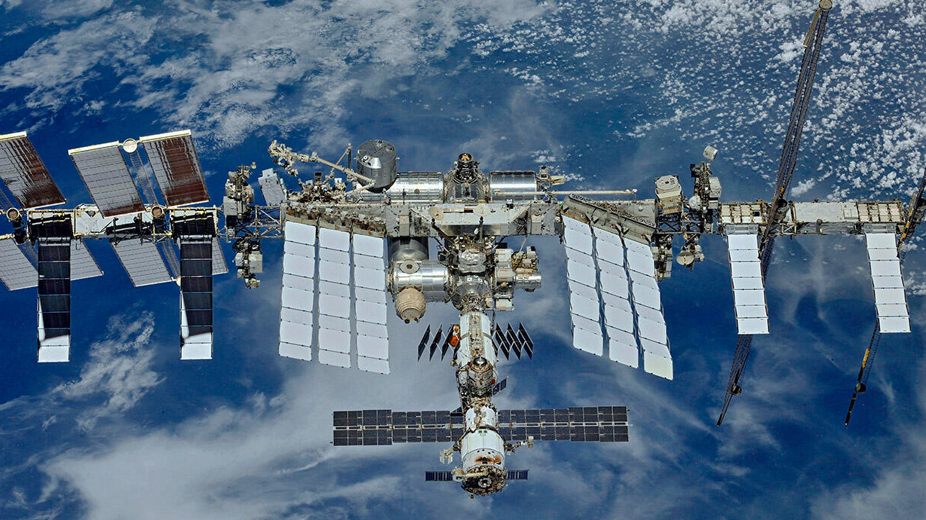
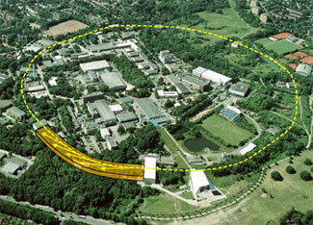
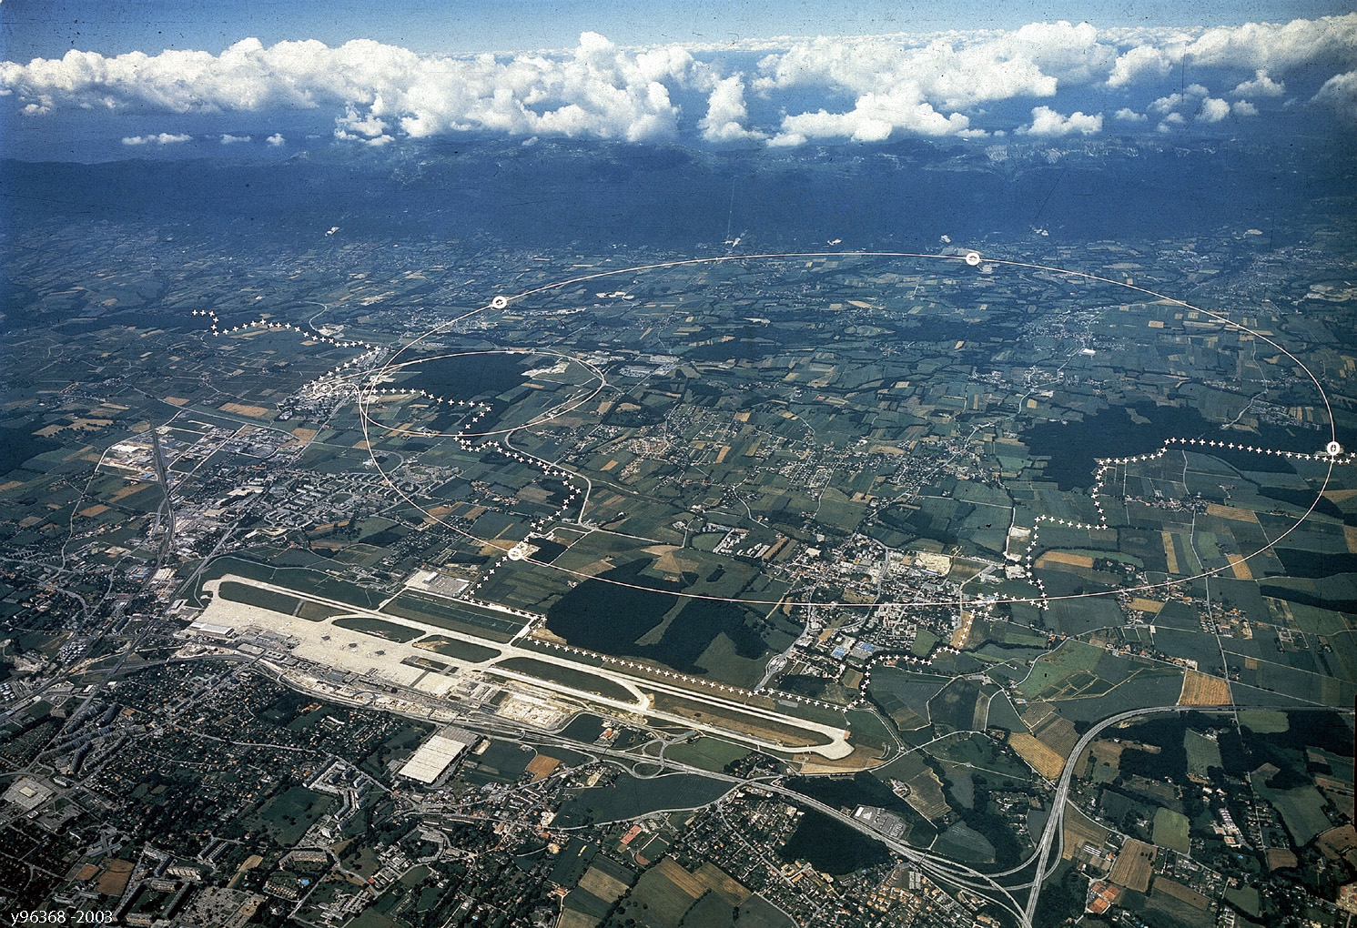
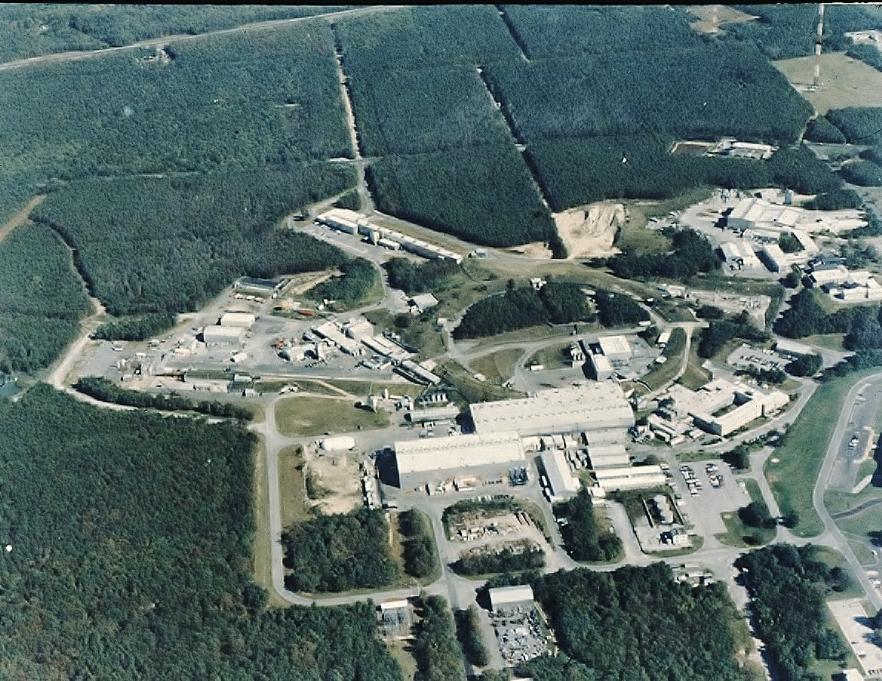


The November Revolution and
Fifty Years of Electron and Positron Physics
Space Station
AMS
DESY
Brookhaven
CERN
Nov. 22, 2024
S. Ting

Slide 2
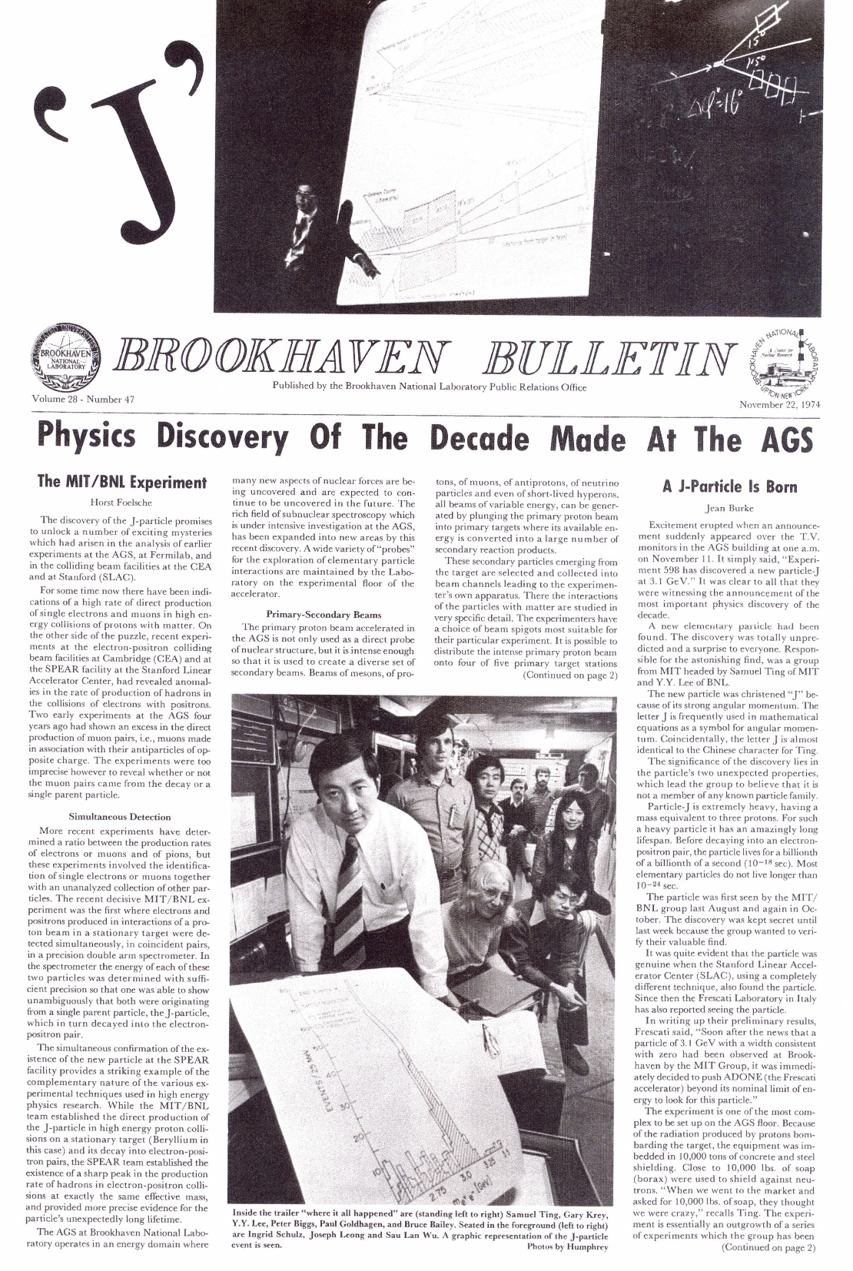
Nov 22, 1974, Brookhaven Bulletin
2

Slide 3
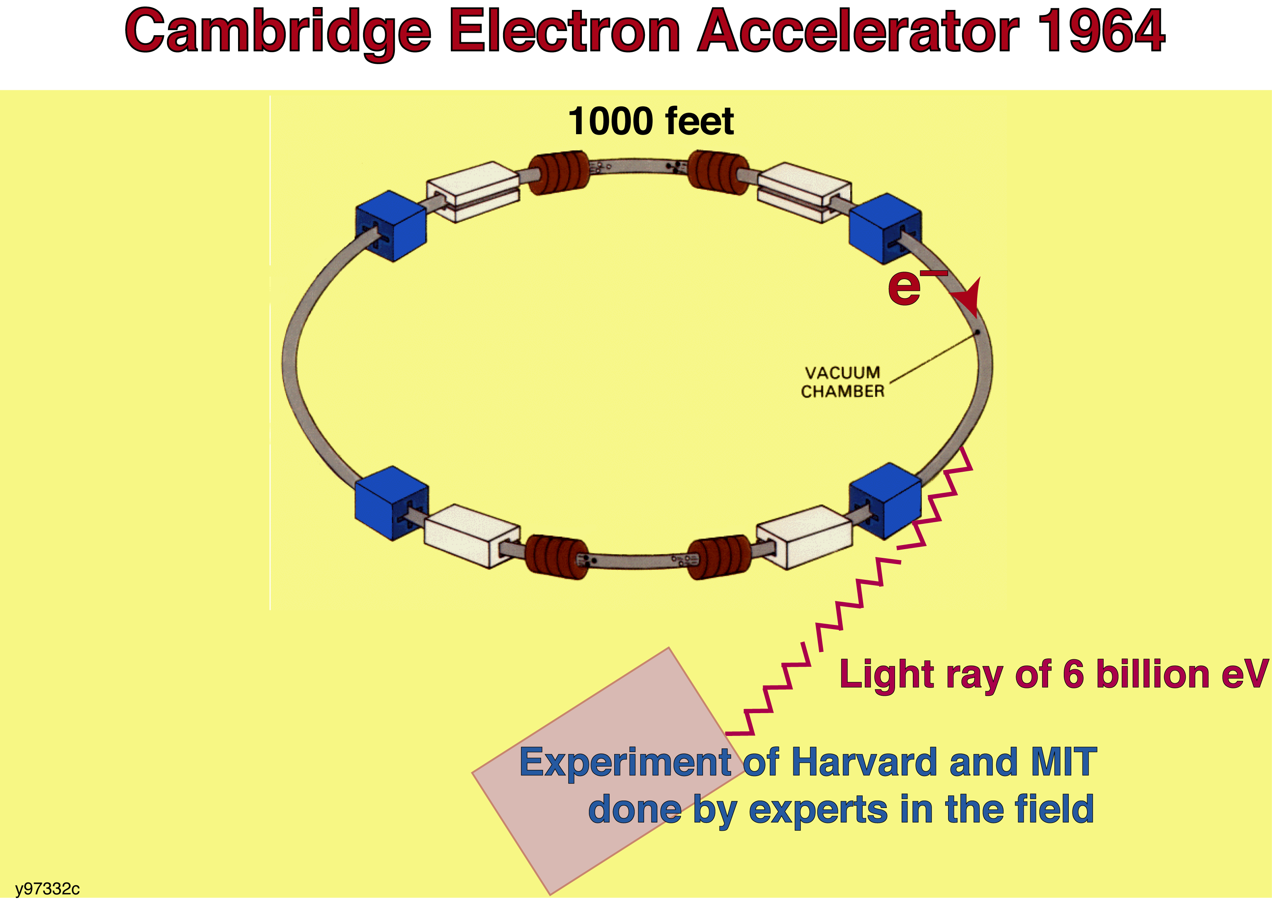
Experiments leading to the discovery of a new form of matter:
First Experiment - Measuring the size of electrons
Modern Electromagnetic Theory (QED) requires that electrons have no measurable radius (Feynman, Schwinger, Tomonaga - 1948)
The theory agreed well with all experiments until a 6 GeV electron accelerator
(CEA) provided a most sensitive measurement of the size of the electron.
The Harvard experiment was done by the world’s leading experts in the field
who had spent many years to develop the technology.
1000 feet
CEA
(Harvard and MIT)
e⁺
γ
Δp
Nucleus
e⁻
Highest energy electron accelerator
Δp · Δr ≈ ħ
Harvard experiment
3

Slide 4
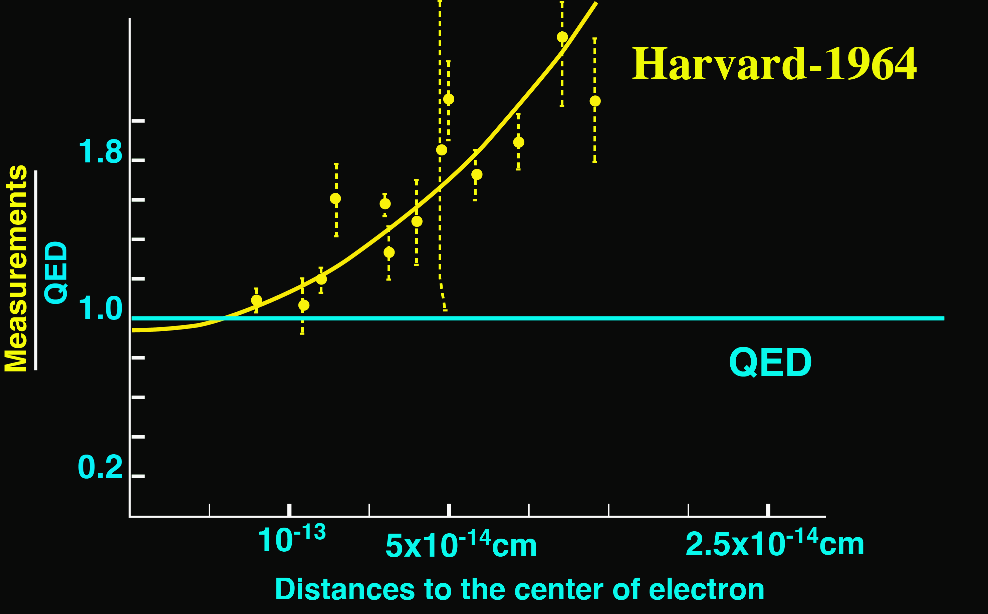
This data shows that the electron has a radius of ~ 10⁻¹³ to 10⁻¹⁴ cm.
Most importantly, this experiment was independently
confirmed by a group at the Cornell Electron Accelerator.
4

Slide 5
Since those results touch upon the foundation of Modern Physics,
I decided to perform the experiment with an independent method
At that time, I knew nothing about electron physics,
so I received no support in the U.S.
I decided to move to
the newly built 6 billion electron-Volt electron accelerator (DESY)
in Hamburg, Germany
to re-measure the size of the electron
5

Slide 6
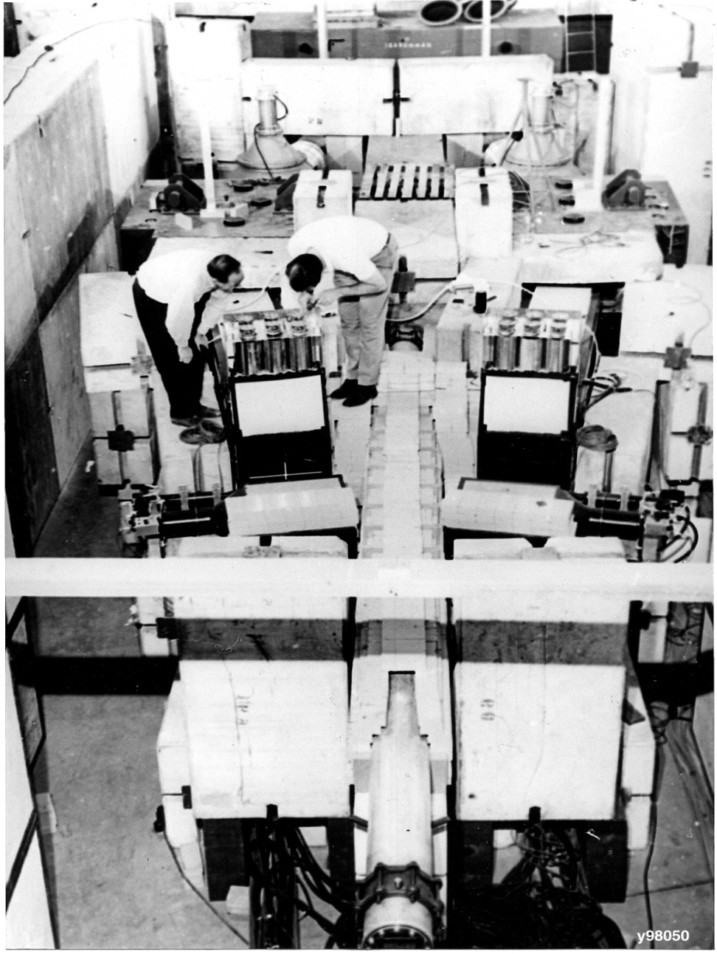
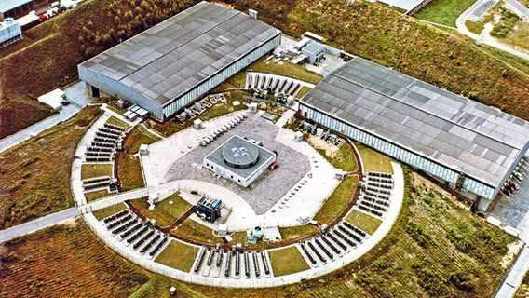
1965-1972: First set of experiments at DESY 6 GeV electron accelerator
Measuring electron-positron pairs (1966)
6

Slide 7

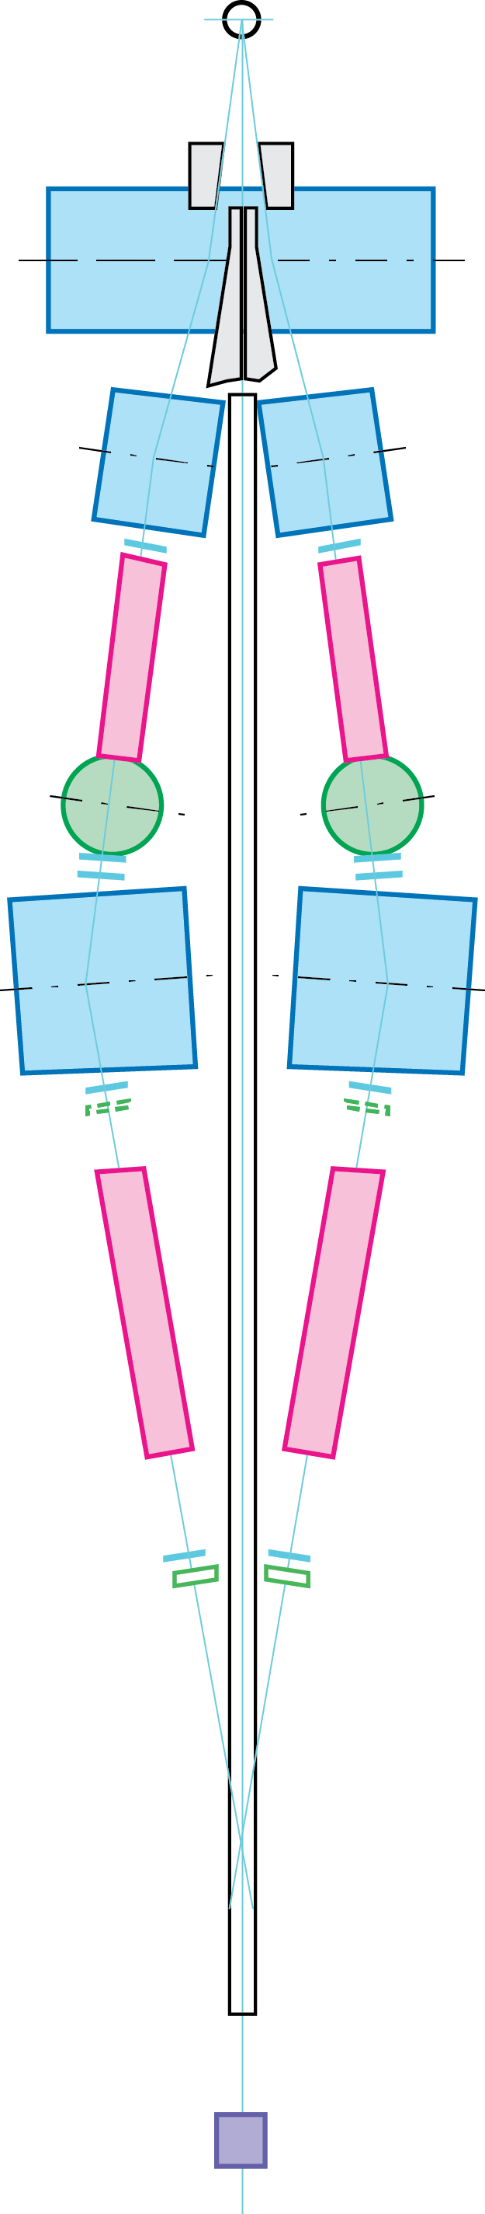
10¹¹ 𝛾/second
Unique features
Target
Backgrounds
n, 𝛾, 𝜋
T
6 GeV
None of the detectors see the target so they are not exposed to neutrons or gamma-rays backgrounds.
The acceptance is defined by counters,
not by the aperture of the magnet.
Using two Cherenkov counters on each arm separated by magnets to identify e±.
The background e± produced from interactions in the first counter are swept away by magnets
and the e± identification of the two counters are independent.
Using Dipoles magnets and counters to measure the momentum (P).
Using calorimeters to measure the energy (E).
To reject large pion background, require E=P.
Dipole Magnets
Cherenkov
Scintillation
Counters
identify electrons
measure
momentum
(P)
Cherenkov
Hodoscopes
Calorimeter
measure energy
(E)
identify electrons
PRL 18, 65 (1967)
PRL 161, 1344 (1967)
7
QM
7

Slide 8
After 8 months our group completed the experiment at DESY and discovered that:
The electron indeed has no measurable size: Radius < 10⁻¹⁴ cm
Measurements
QED
QED
Distance to the center of the electron
This result was first announced in 1966 at the “Rochester” conference at Berkeley
(now known as the International Conference on High Energy Physics).
On this occasion I met W.K.H. Panofsky, Dick Feynman, and I.I. Rabi.
I maintained close contact with them for many years.
8

Slide 9
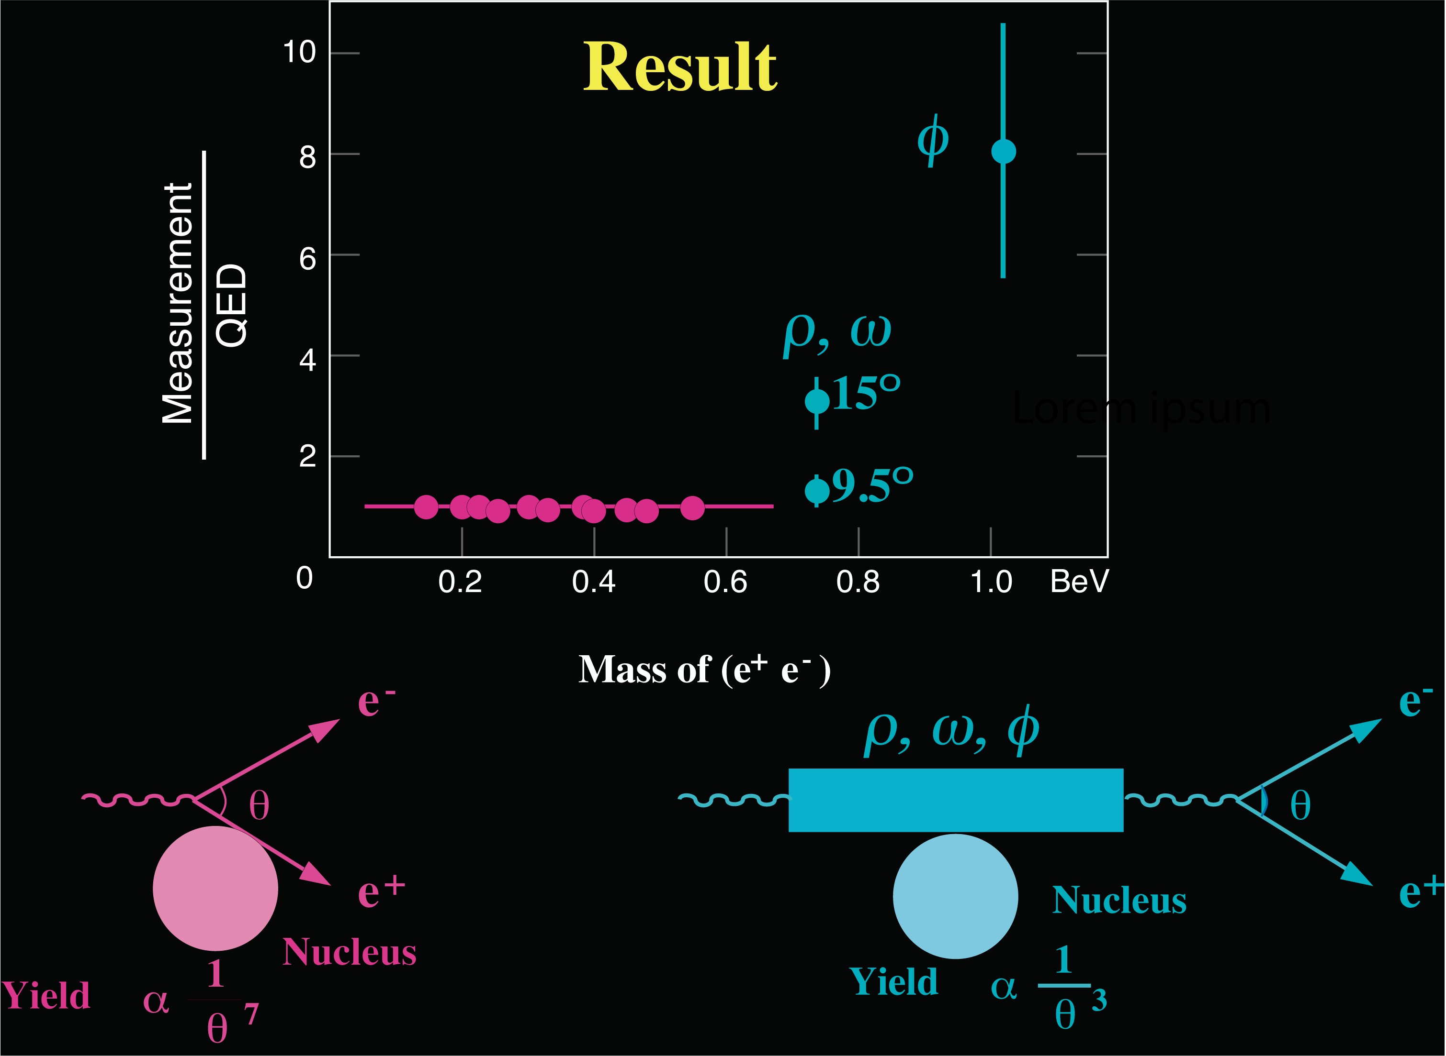
Experimental Results on Photons and Heavy Photons
QED
9

Slide 10
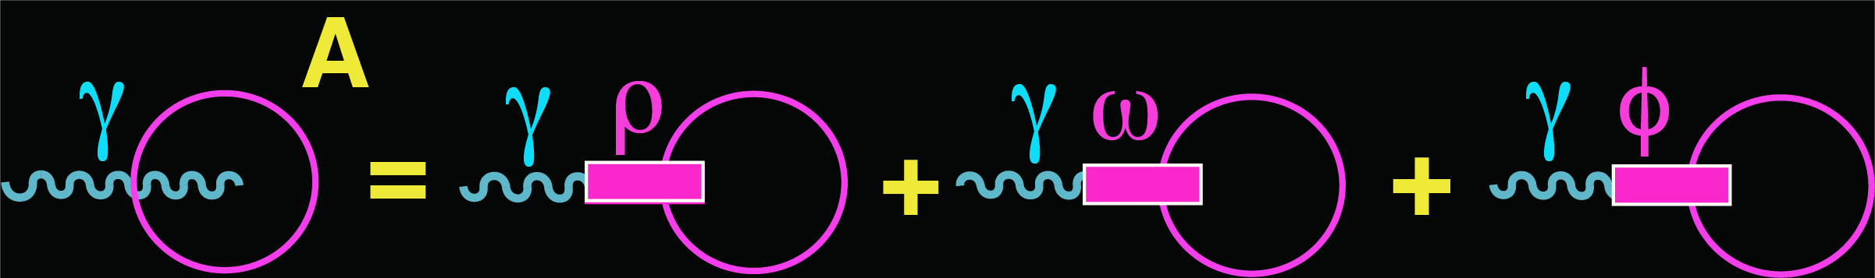
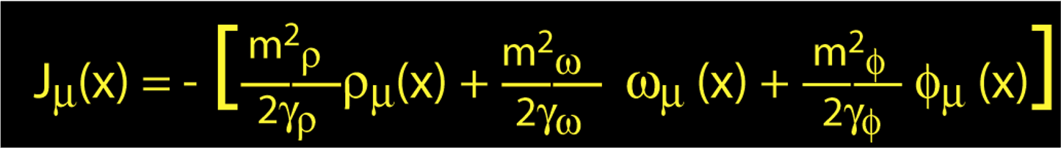
Second Experiment: Photons and Heavy Photons
Photons and Heavy Photons have the same quantum numbers
J = 1 C = -1 P = -1
This is known as the Vector Dominance Model
Experimental question: what is the relationship between Photons & Heavy Photons?
10

Slide 11
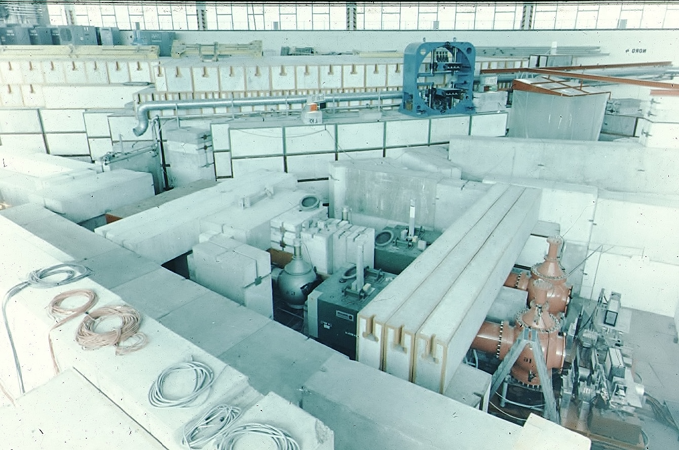
I joined MIT in 1968 and started Heavy Photon Experiments at DESY
with major improvements in coordinate and momentum resolution and in particle identification
Strong and continuous support from
AEC, ERDA, DOE,
France, Germany, Italy, Spain, Switzerland, …
Cherenkov Counter
Counter
Magnet
Cherenkov Counter
Counter
Calorimeter
11

Slide 12
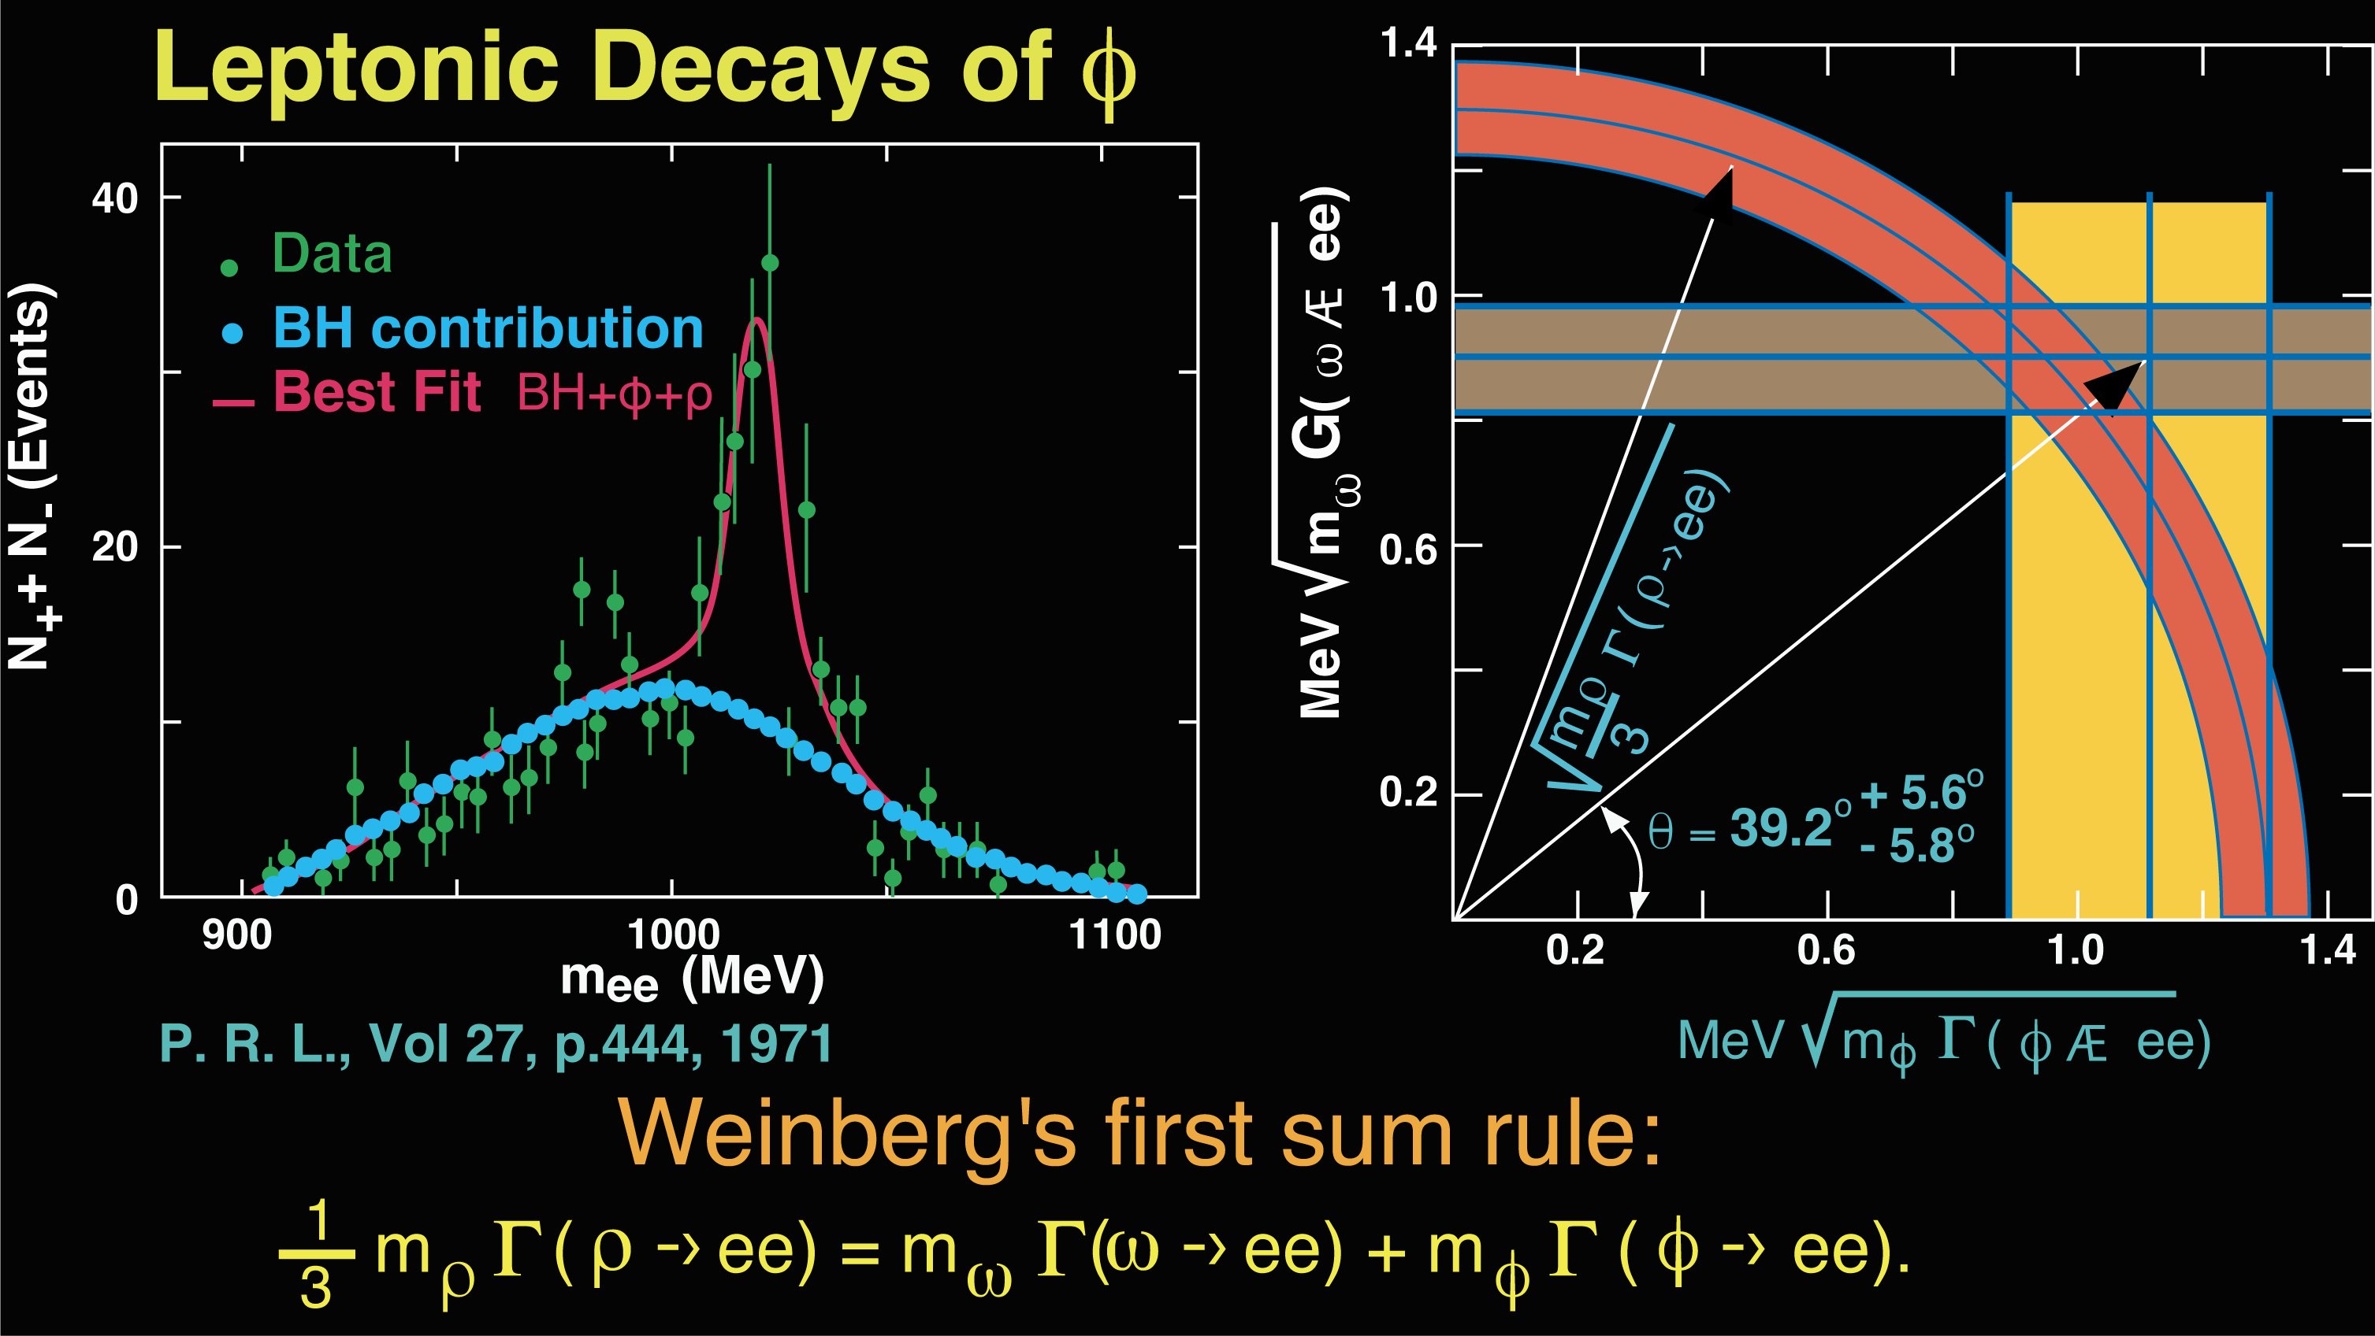
Result: Verification of Weinberg’s first sum rule
Leptonic decays of φ
𝜌
φ
→
𝛚
→
12

Slide 13
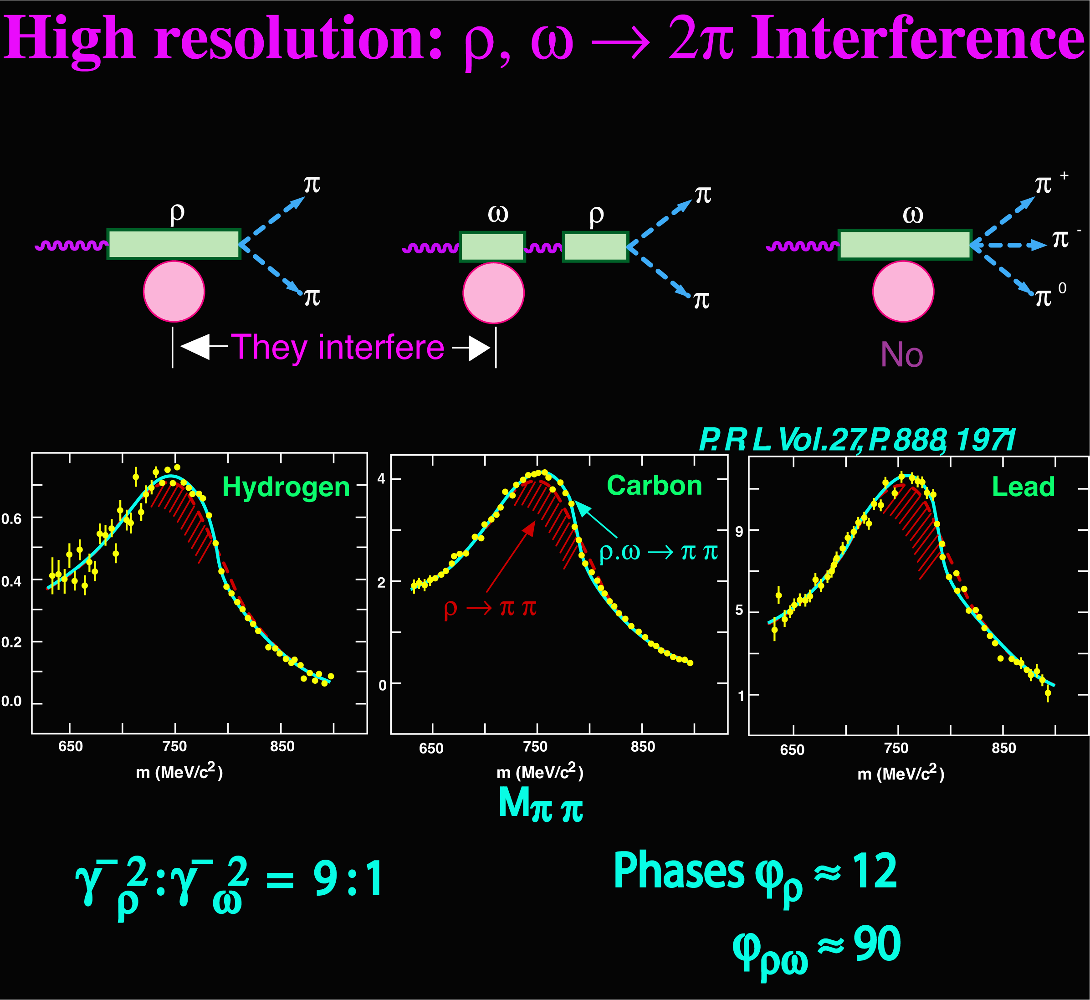
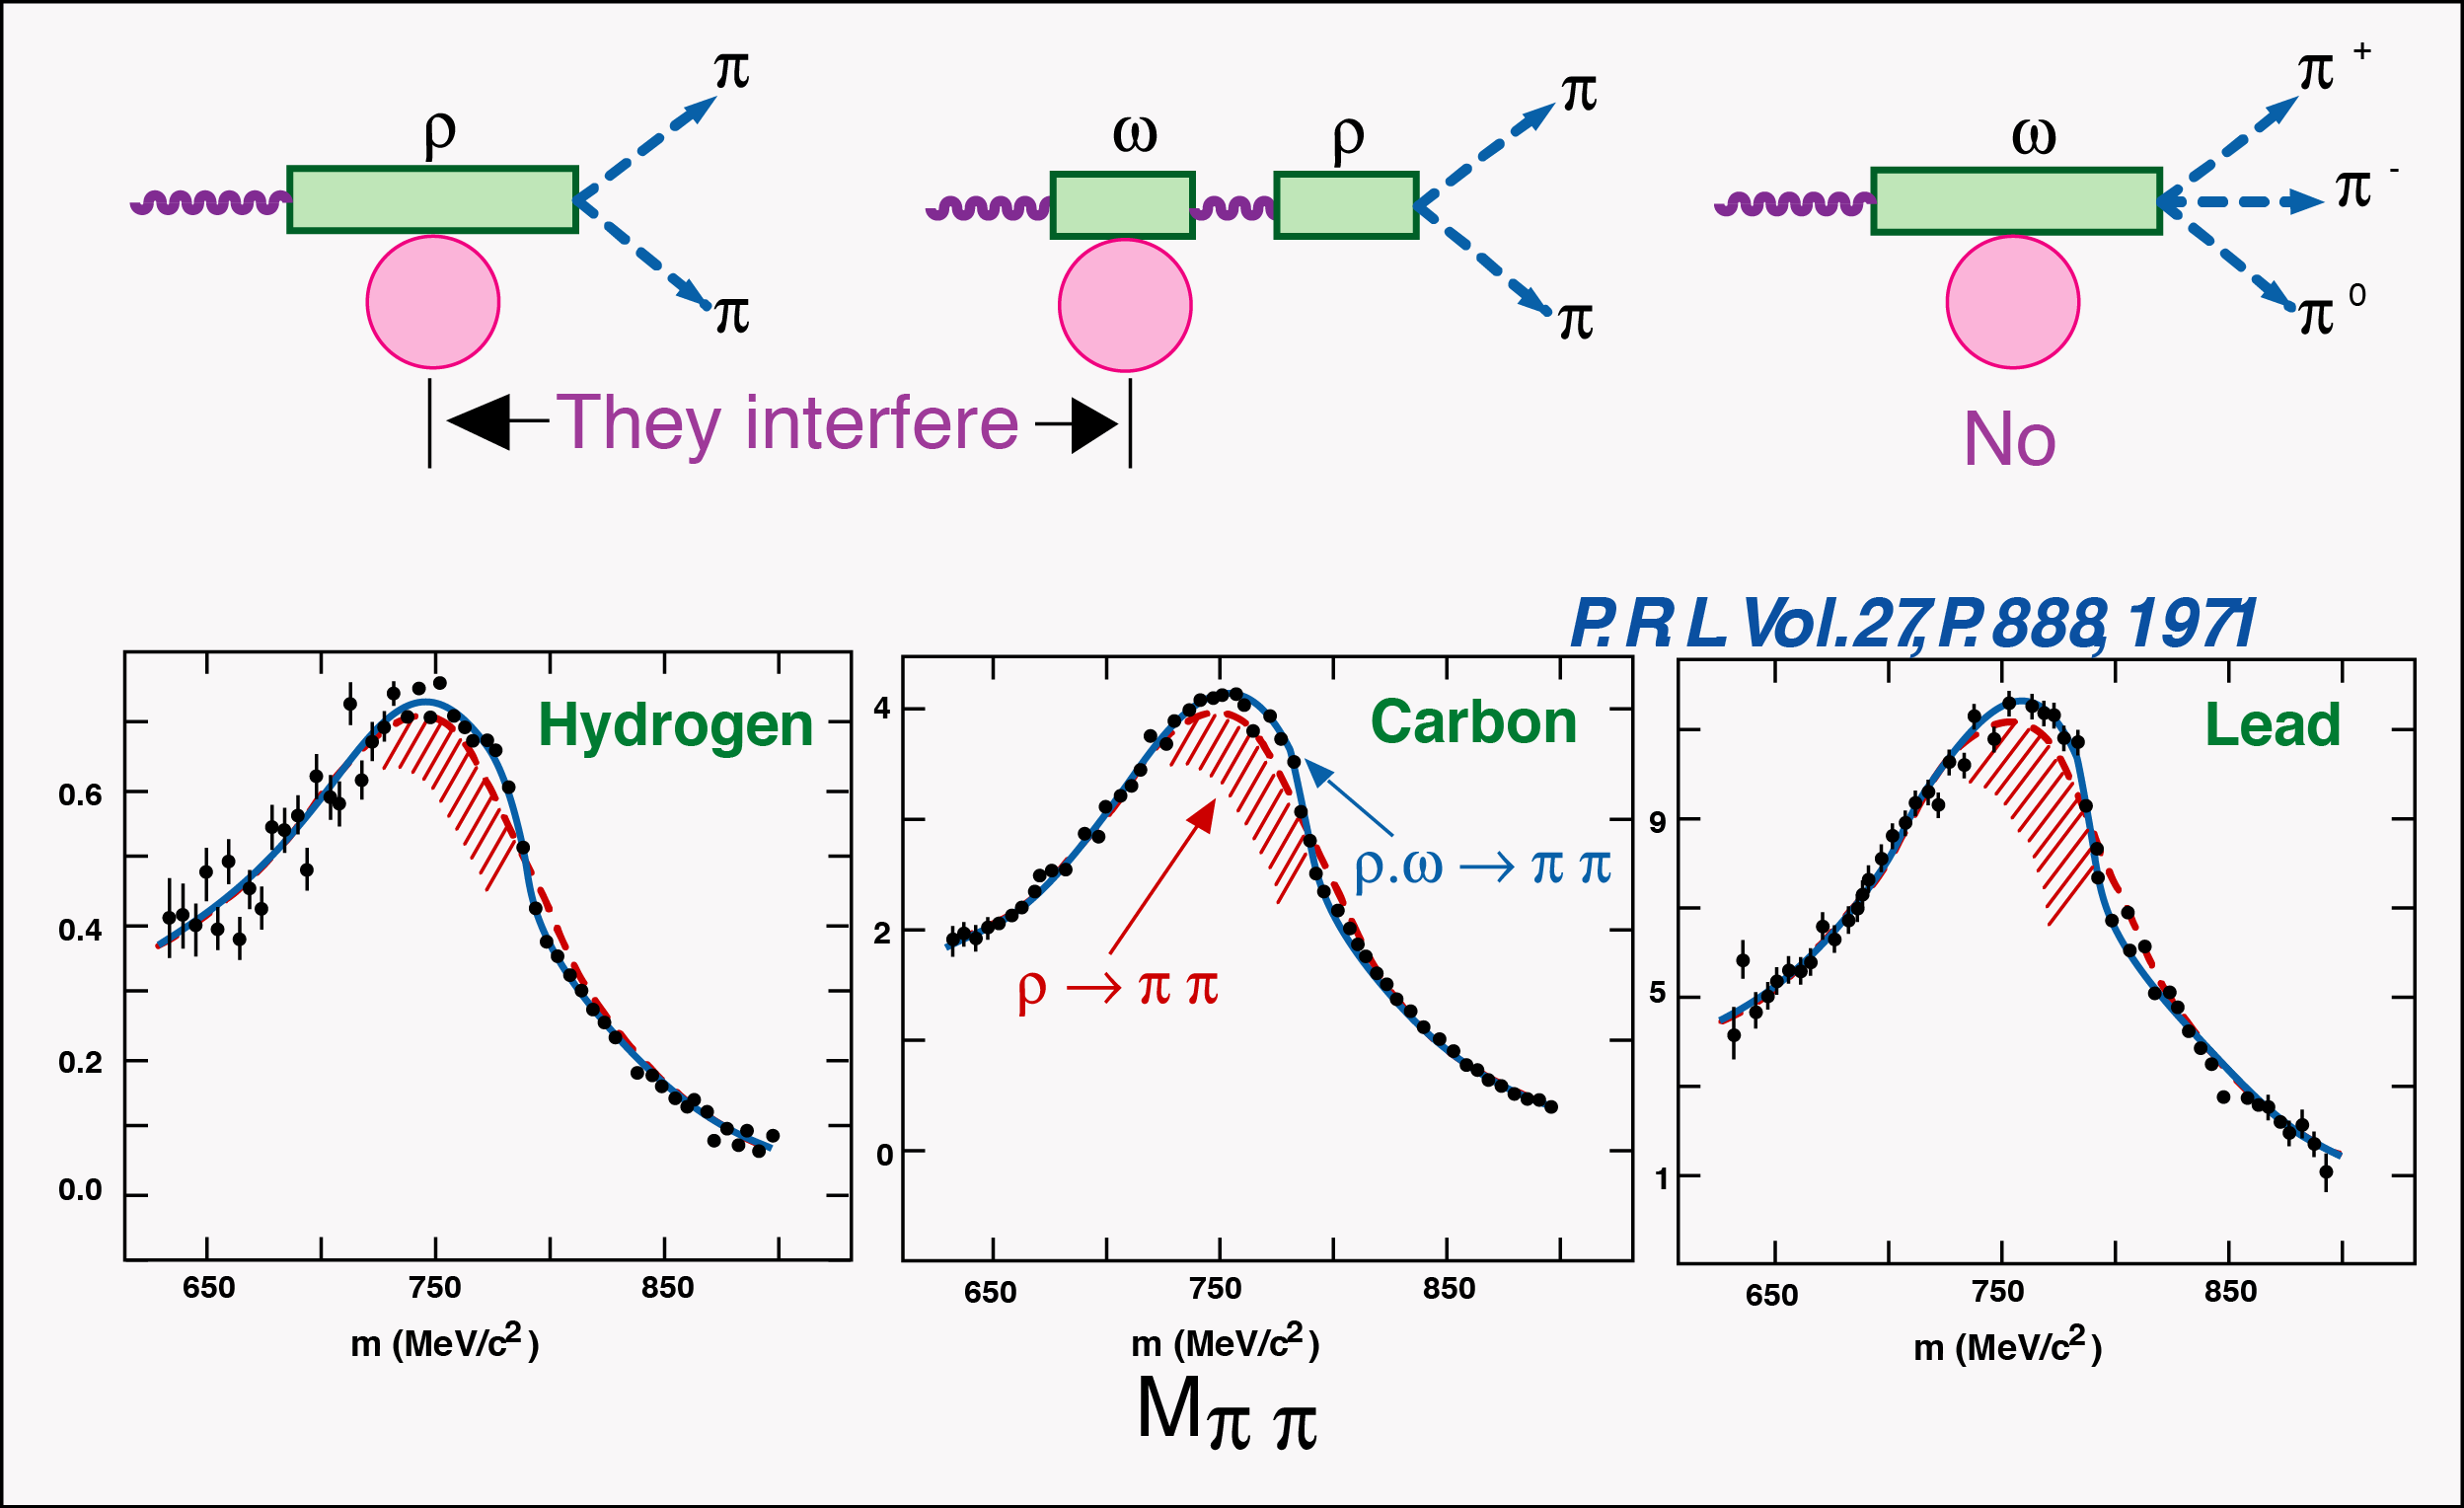

Experiments on Forbidden $ω→2π$ Decays
No Interference
I = 1
I = 0
⊗
Interference
+
S. L. Glashow, P.R.L. 7, 469 (1961),
J. Bernstein and G. Feinberg, Nuovo Cimento 25, 1343 (1962)
M. Gordin, P.L. 30B, 347 (1969)
R. G. Sachs, P.R. D 2, 133 (1970) + …
J. Steinberger, P.R.L. 12, 517 (1964), BR< 0.1%
$ω→2π$
had never
been observed
13

Slide 14
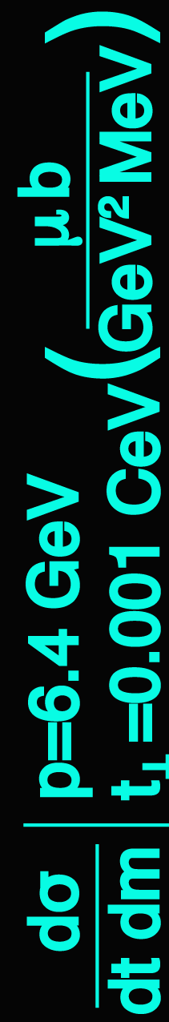
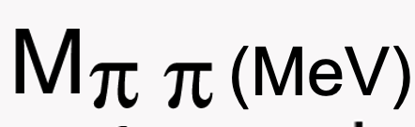
Result: Observation of Forbidden $ω→2π$ Decays
P.R.L. 27, 888 (1971)
(MeV)
P.R.L. 27, 888 (1971)
with U. Becker, W. Busza, M. Chen, R. Marshall, G. H. Sanders et al.
14

Slide 15
Third Experiment: Discovery of the J particle
We learned that photons and heavy photons
do transform into each other.
Question: Why should there be only three heavy photons
all at mass ~ 1 GeV?
To go to higher mass we moved to a higher energy accelerator
15

Slide 16
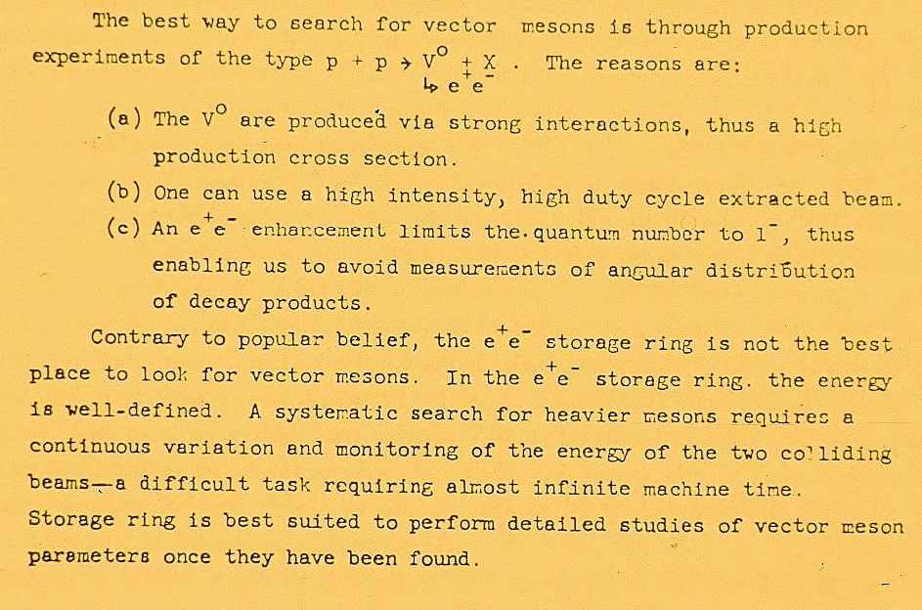
Page 4 of Proposal AGS E598 (1972) to Brookhaven National Lab
16

Slide 17
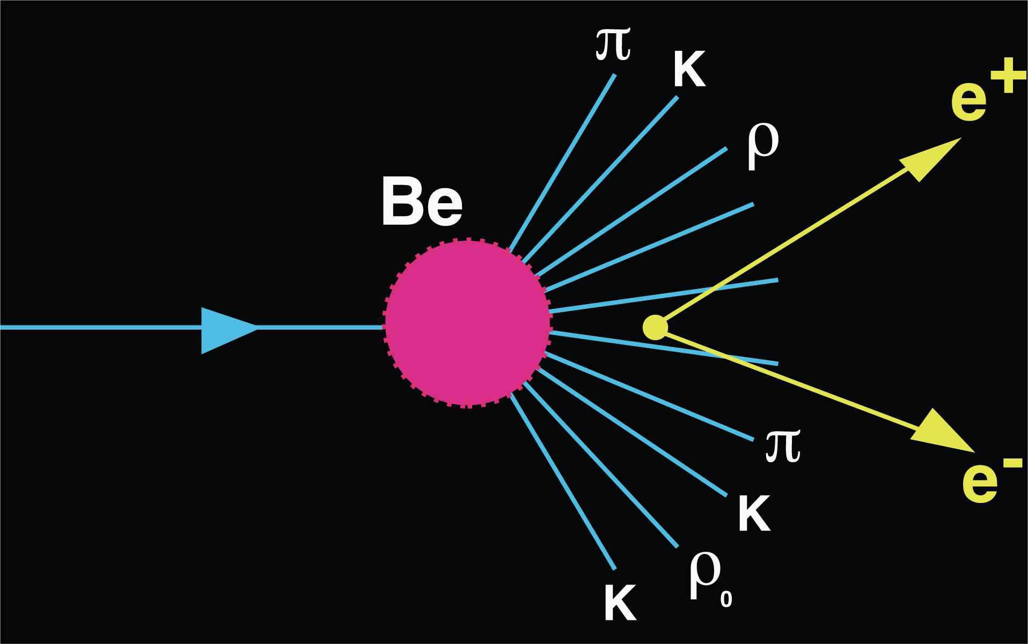

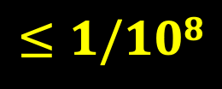
Brookhaven experiment
AGS E598
10¹² particles/sec
multiplicity
10
e⁺e⁻
10¹² protons/sec
$$≤1/108$$
10%
target
$$ππ$$
Require 1/10¹⁰ rejection
30 GeV
During a rainstorm over New York city there are 10 billion rain drops/sec.
Try to find the one drop that is red.
17

Slide 18
This experiment was not popular
with the physics community:
  Most physicists believed that the search for heavy photons
  was not the most interesting research subject
  Few believed that such a difficult experiment could be
  carried out successfully
The proposal was rejected by most of the laboratories.
It was finally accepted by
Brookhaven National Laboratory
18

Slide 19
“During the construction of our spectrometers, and indeed during the entire experiment, I encountered much criticism. The problem was that in order to gain a good mass resolution it was necessary to build a spectrometer that was very expensive. One eminent physicist made the remark that this type of spectrometer is only good for looking for narrow resonances —and there are no narrow resonances.”
The discovery of the J particle: A personal recollection
(delivered on the occasion of the presentation of the 1976 Nobel Prizes in Physics).
Rev. Mod. Phys. , Vol. 49, No. 2, April 1977
However, I received strong support from BNL, MIT and AEC (now DOE)
19

Slide 20
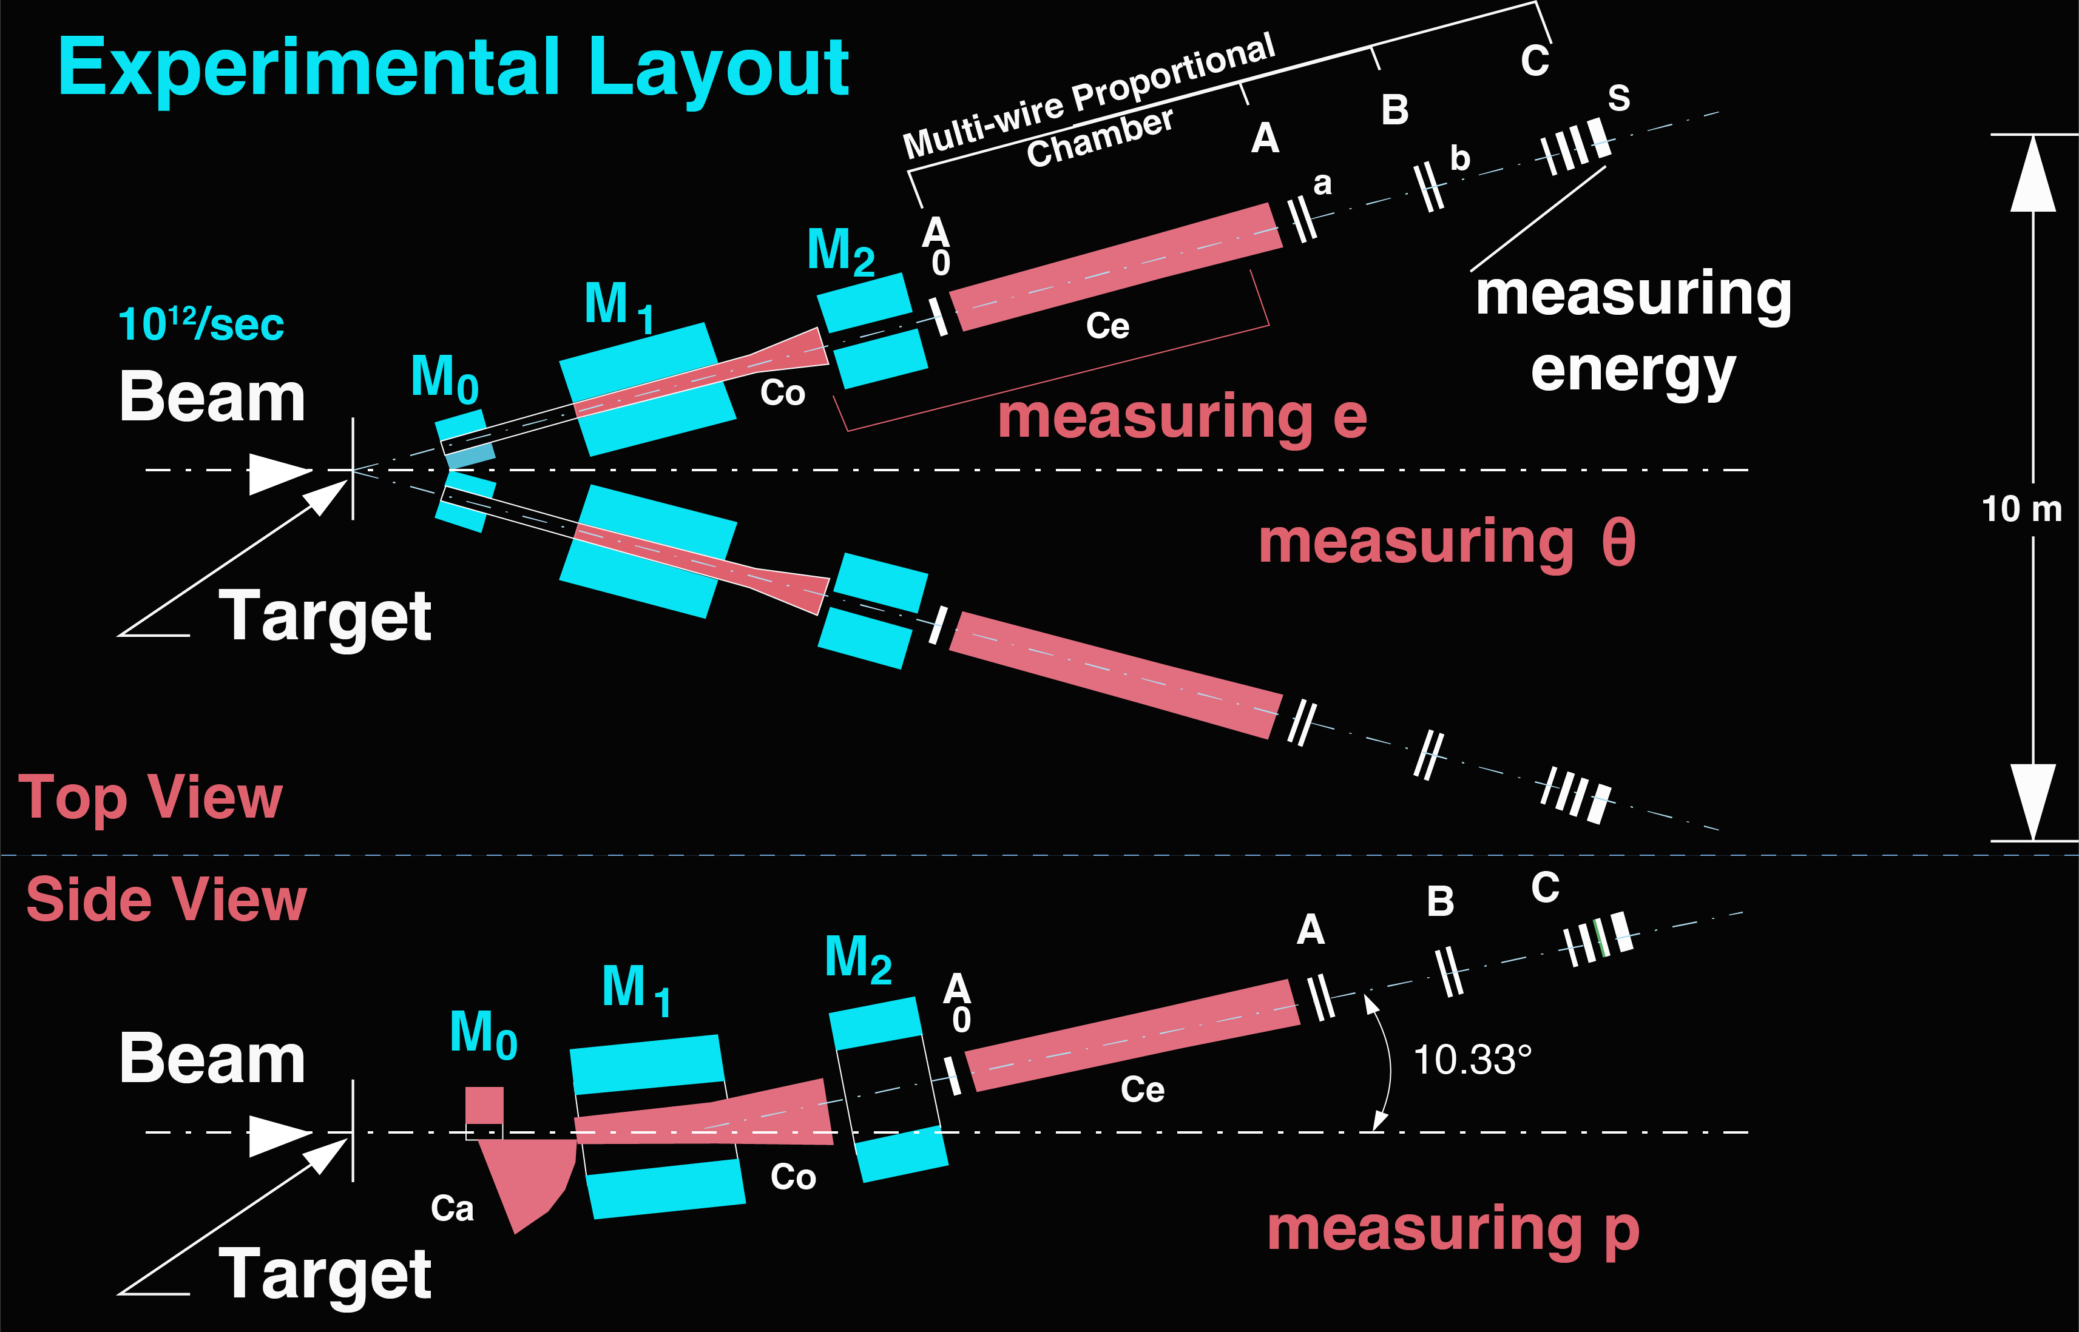
Top View
Proportional Chambers
measuring θ
Shower
Counter
Dipole Magnets
Counters
10¹² /sec
C_{e}
C₀
Cerenkov counters
Side View
measuring p
C_{e}
C₀
The detector follows the design of the first experiment at DESY
20

Slide 21
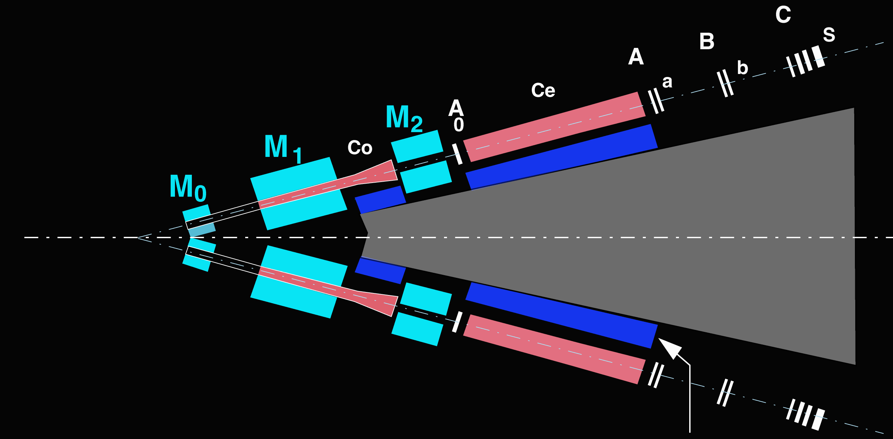
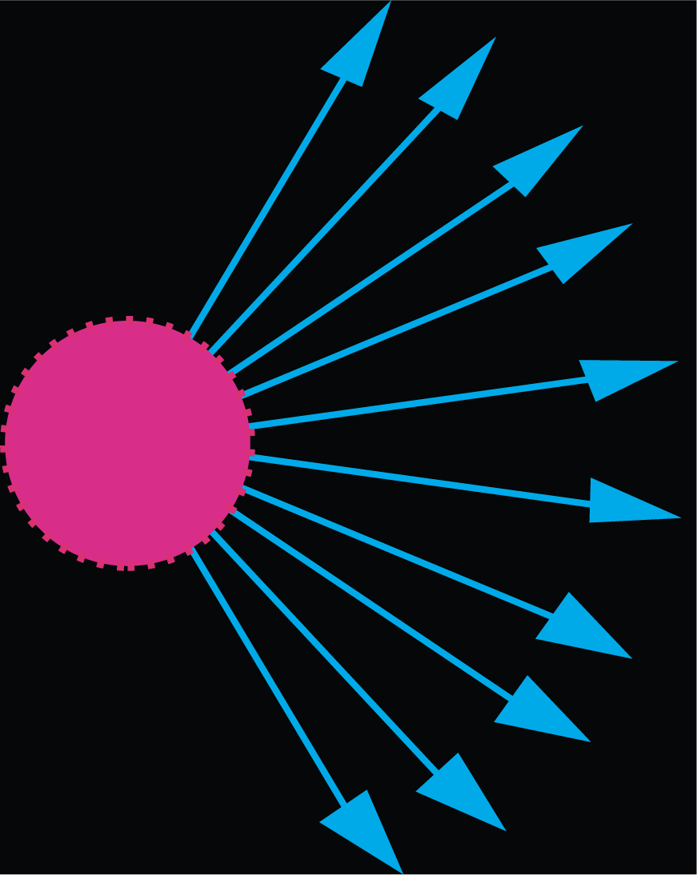
Radiation Protection
10¹²
Proton
/sec
Shielding:
10,000 tons of concrete
10¹² particles
are produced
each second
+ 5 tons of ²³⁸U
+ 100 tons of lead
+ 5 tons of soap
21

Slide 22
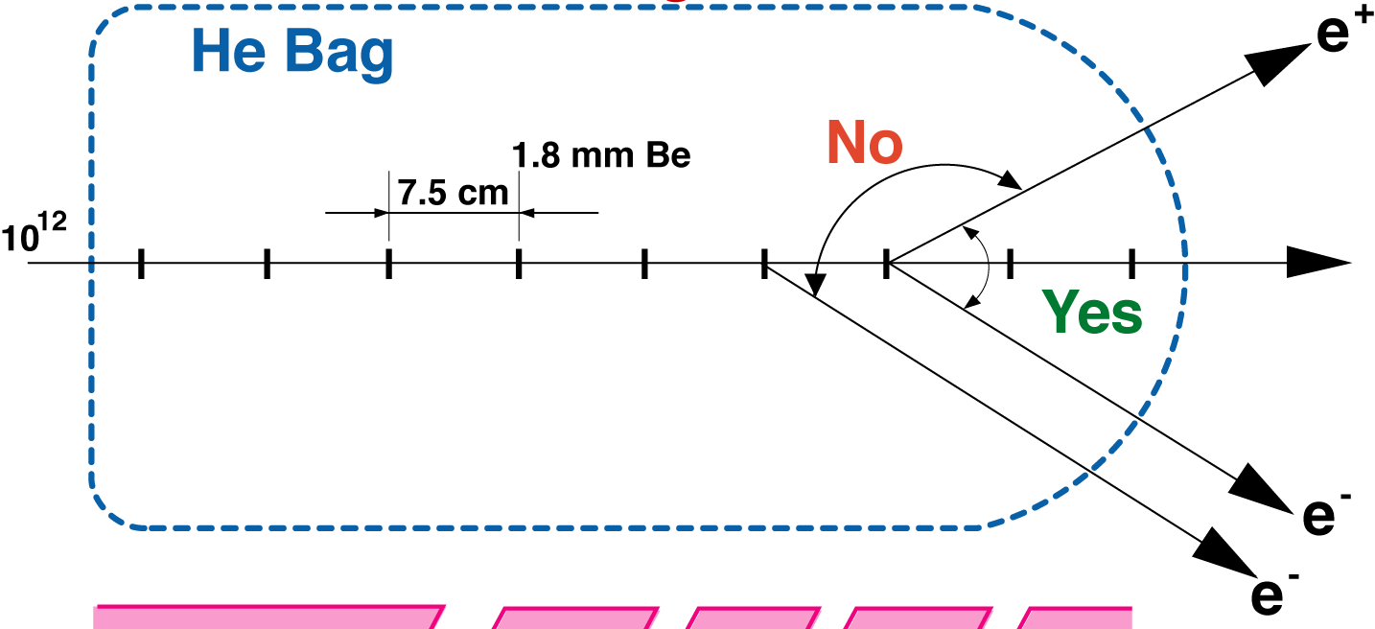
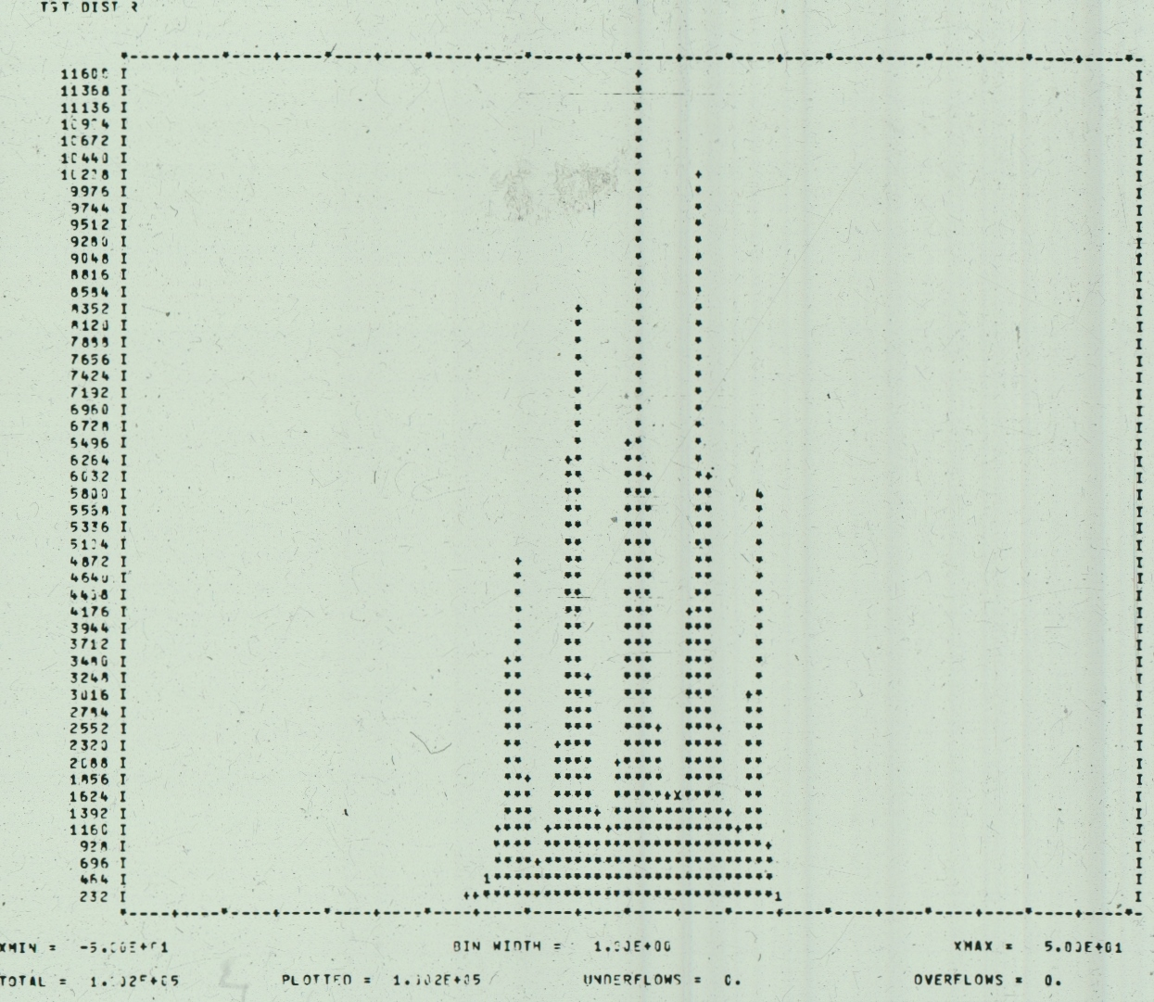
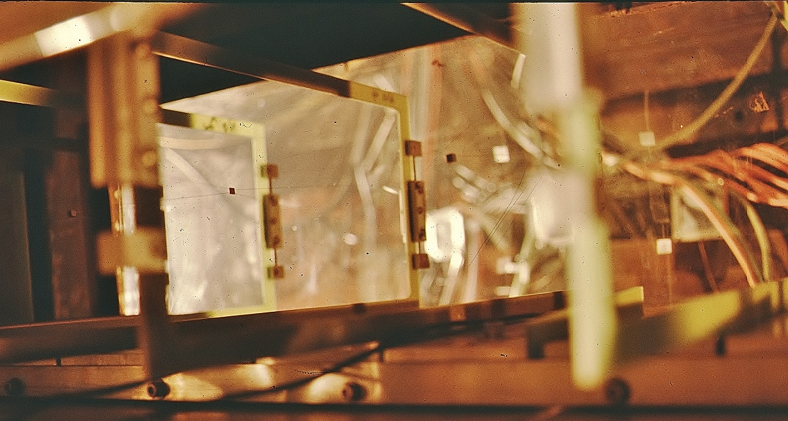
Separate thin targets to reduce the background
Background
  Target Event distribution
Signal
22

Slide 23

The Magnets
For each magnet, the field is measured with 3-D Hall probe, a total of 10⁵ points.
The detector is smaller than the magnet aperture, the detector defines the acceptance.
The magnets bend charged particles to an angle such that the detectors are not exposed to photons or neutrons from the target.
e–
Detector
e–
Magnet
Neutrons, ɣ
Side view
23

Slide 24
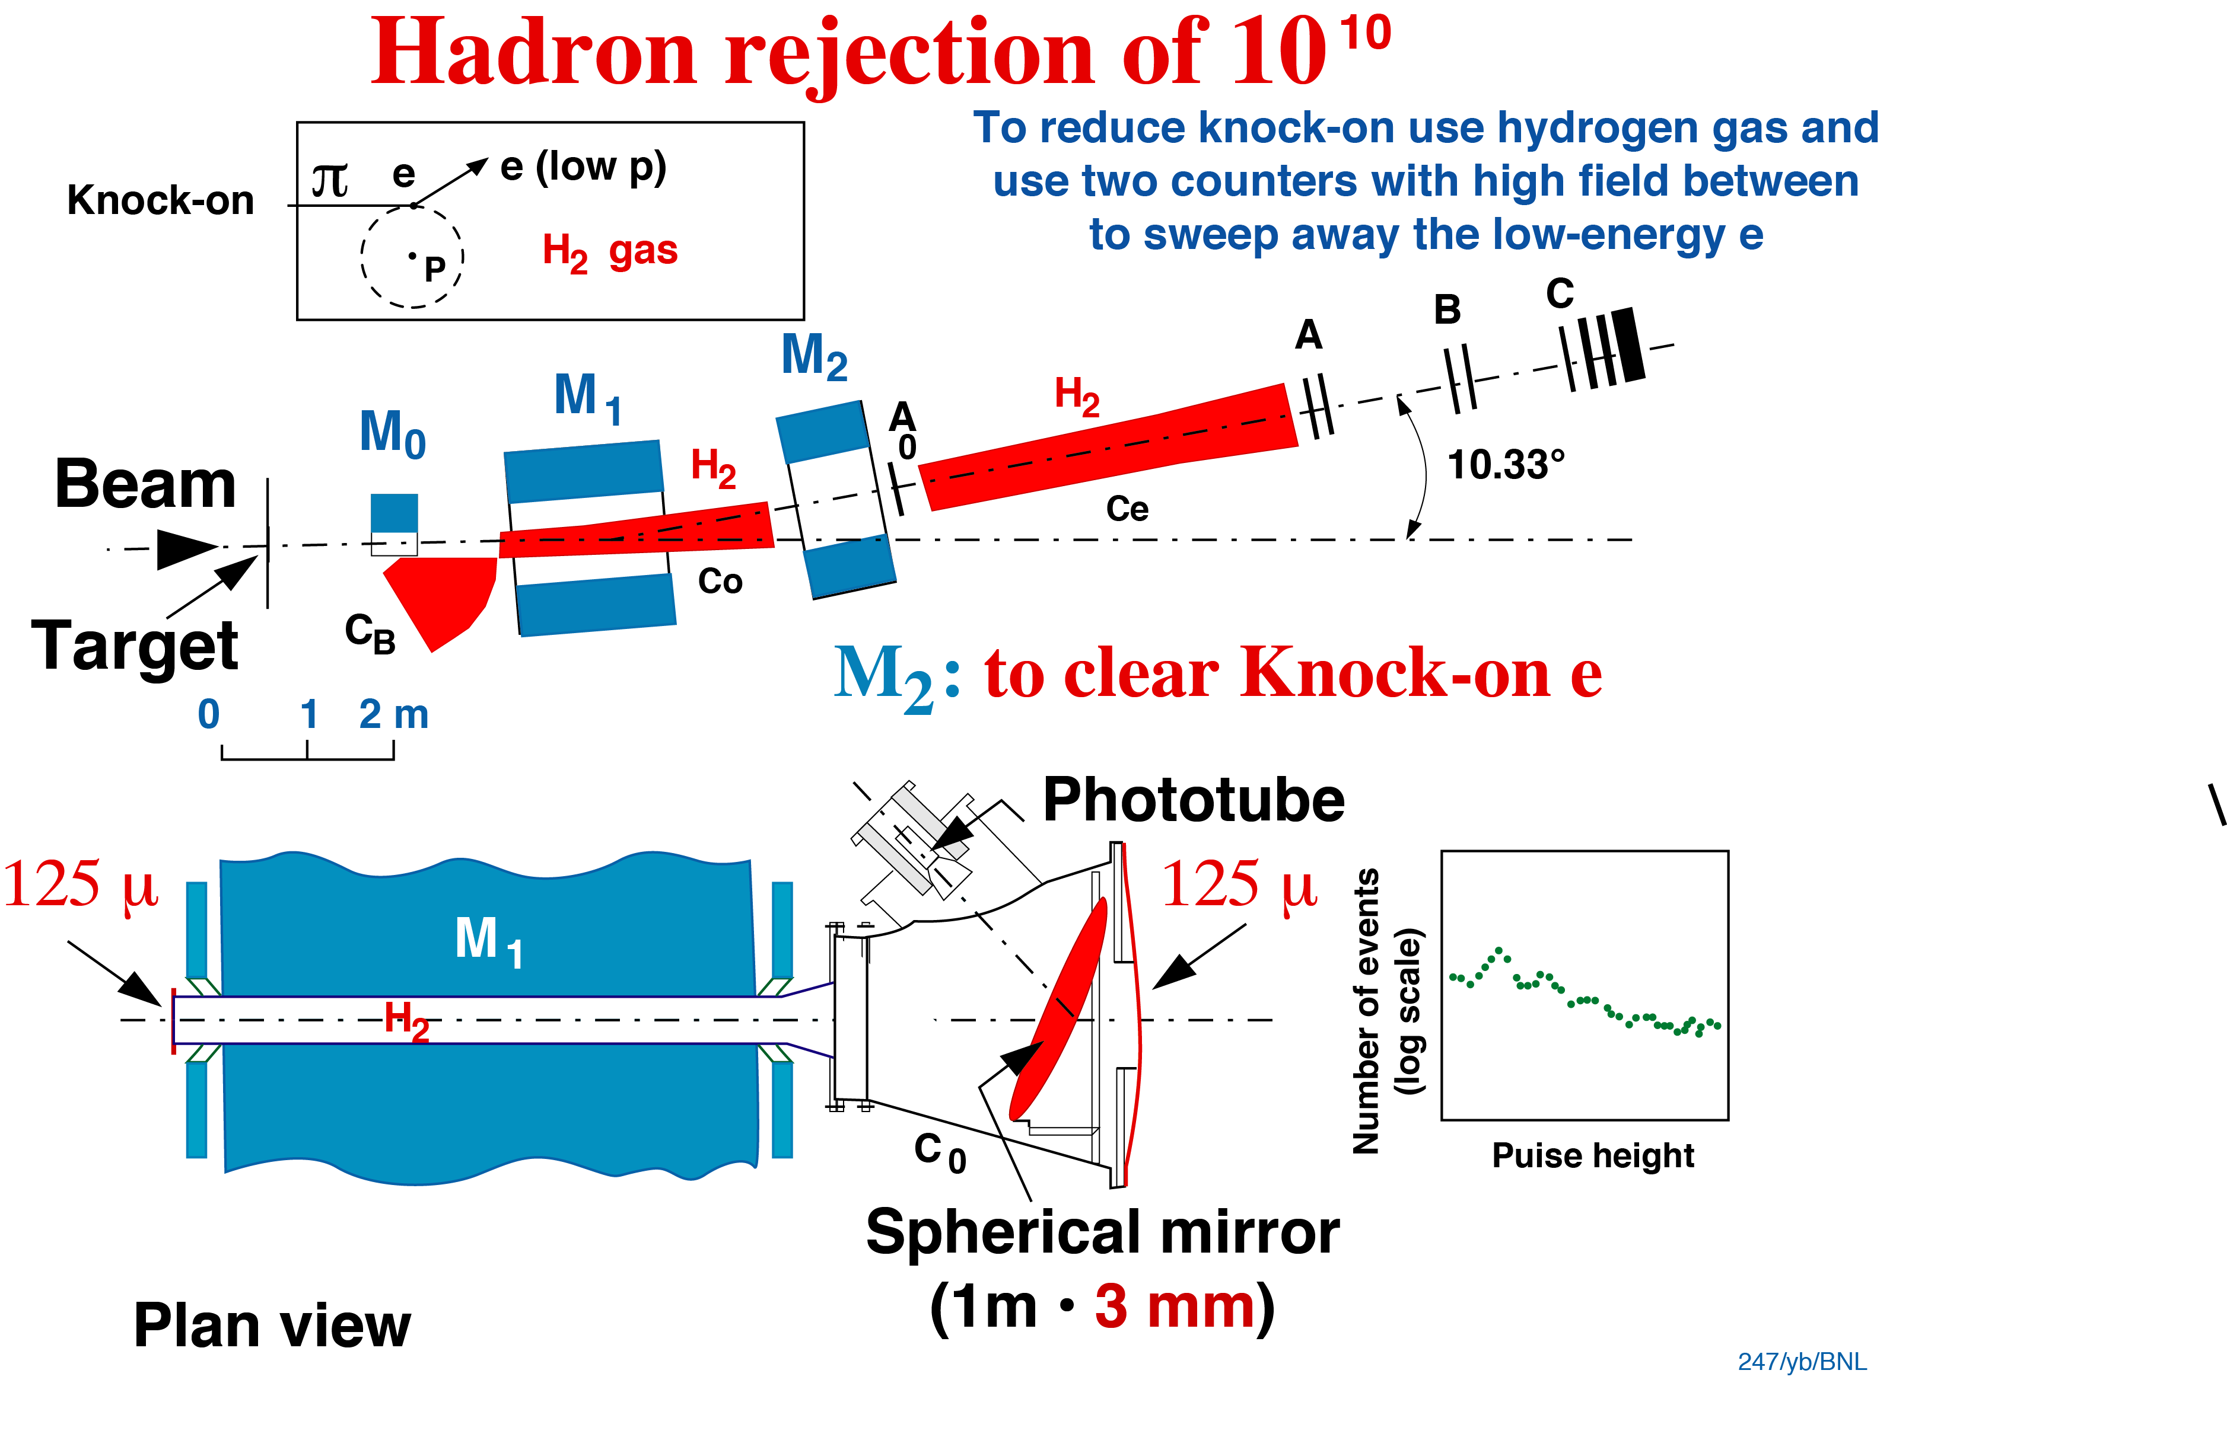
Hadron Rejection of 10¹⁰
^{Co or Ce}
A₀
Ca
knock-on background
𝝅
H₂ gas
e
Co or Ce
p
To reduce knock-on electrons, use H₂
The H₂ counter Co in the magnet is followed by another H₂ counter Ce behind the second magnet. The separation of the two counters Co, Ce by the strong magnet M₂ ensures that the minute number of knock-on electrons produced in the first counter Co are swept away
and do not enter the second counter
All the inner surfaces of the Cherenkov counters are black to reduce scattered light
24

Slide 25
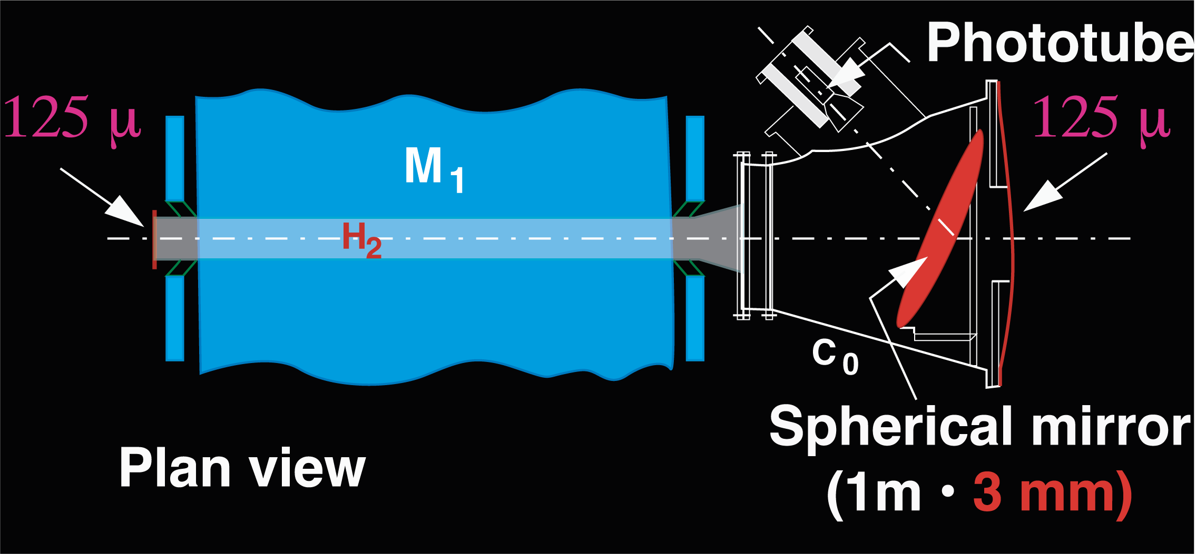
The 𝛑-e separation was achieved by four
sensitive Cherenkov Counters Co, Ce
125μm
125μm
Designed with minimum material by J. J. Aubert, S. Ting, and M. Vivargent
The mirrors were made at the Precision Optical Workshop at CERN
25

Slide 26
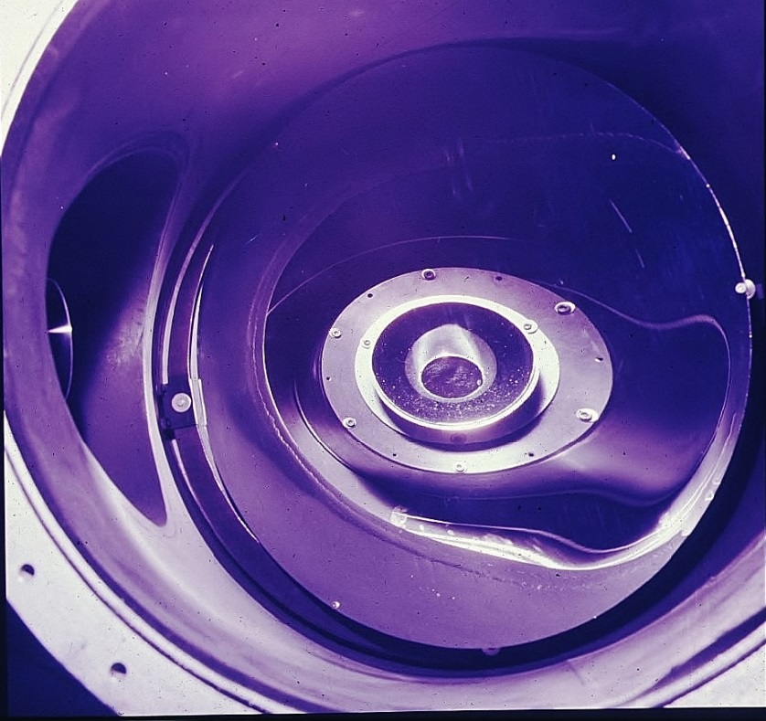
Spherical Mirror
1 photoelectron
→
2 photoelectrons
→
Pulse height
26

Slide 27
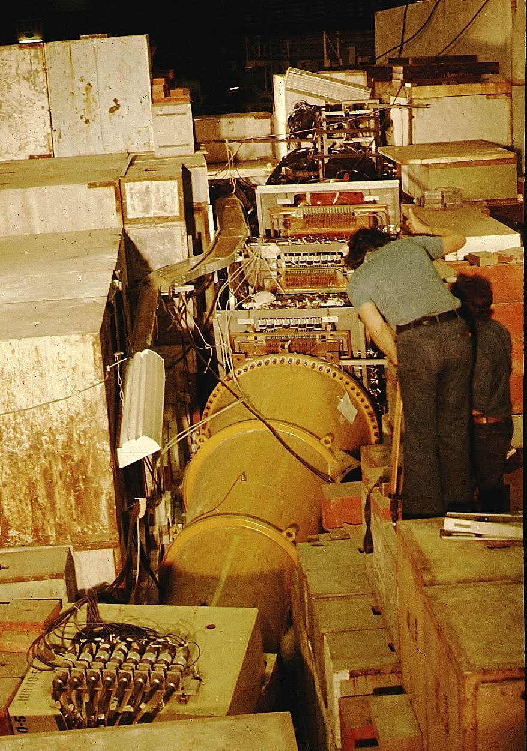
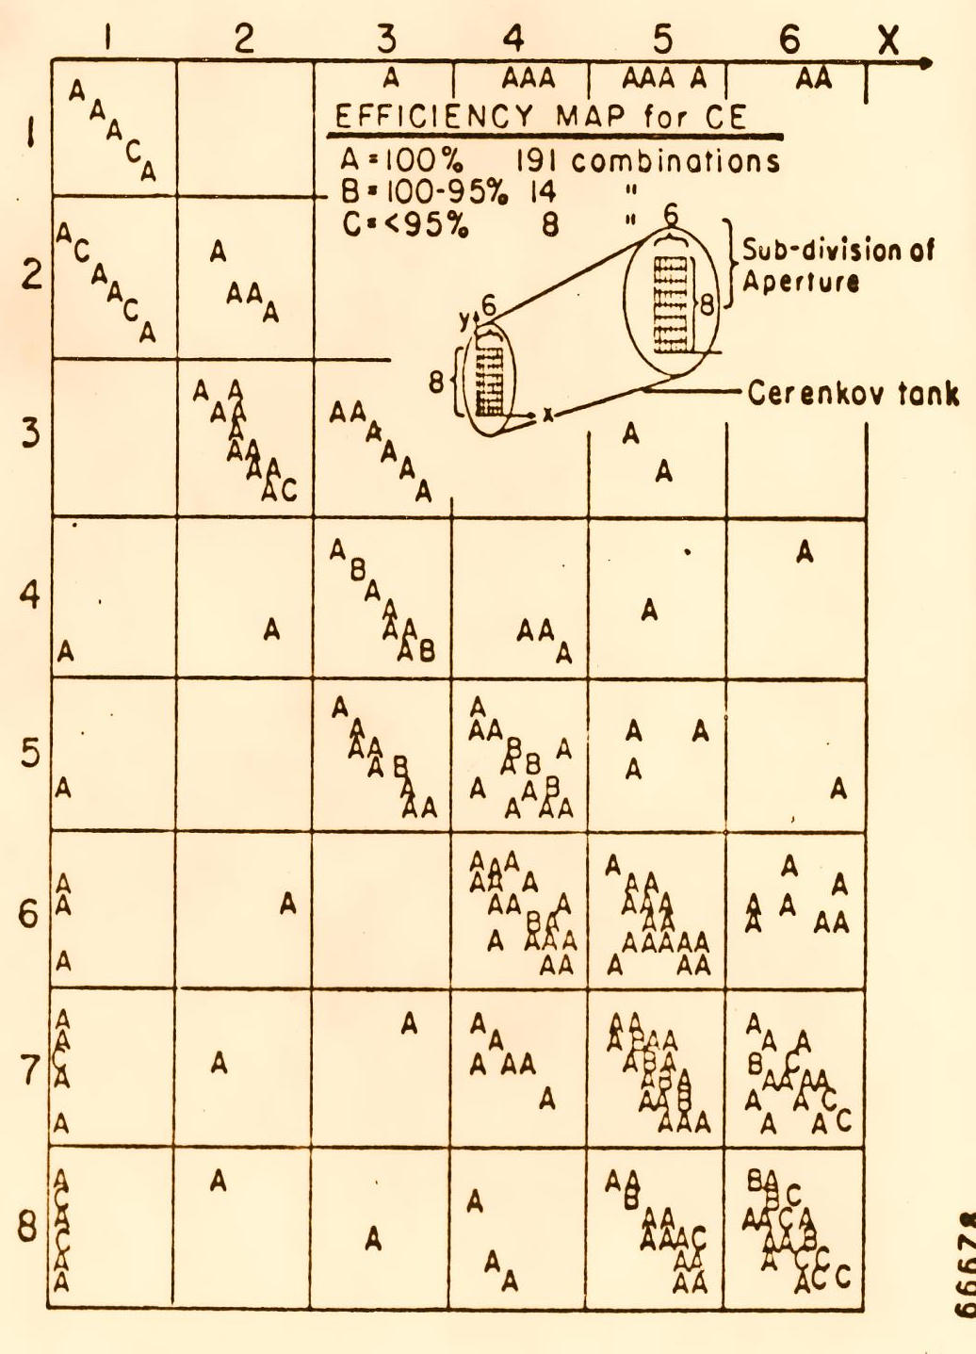
Ensure the efficiency of the Cherenkov counter is 100%
Cherenkov Ce
27

Slide 28
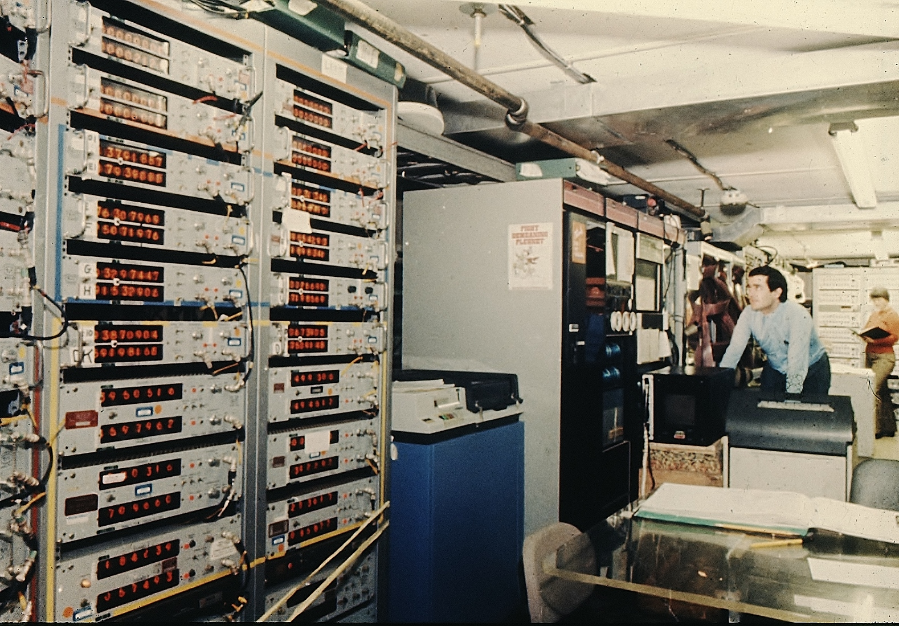
J. J. Aubert made major contributions to the experiment.
Founder of the ANTARES project and Director-General, IN2P3, France
28

Slide 29
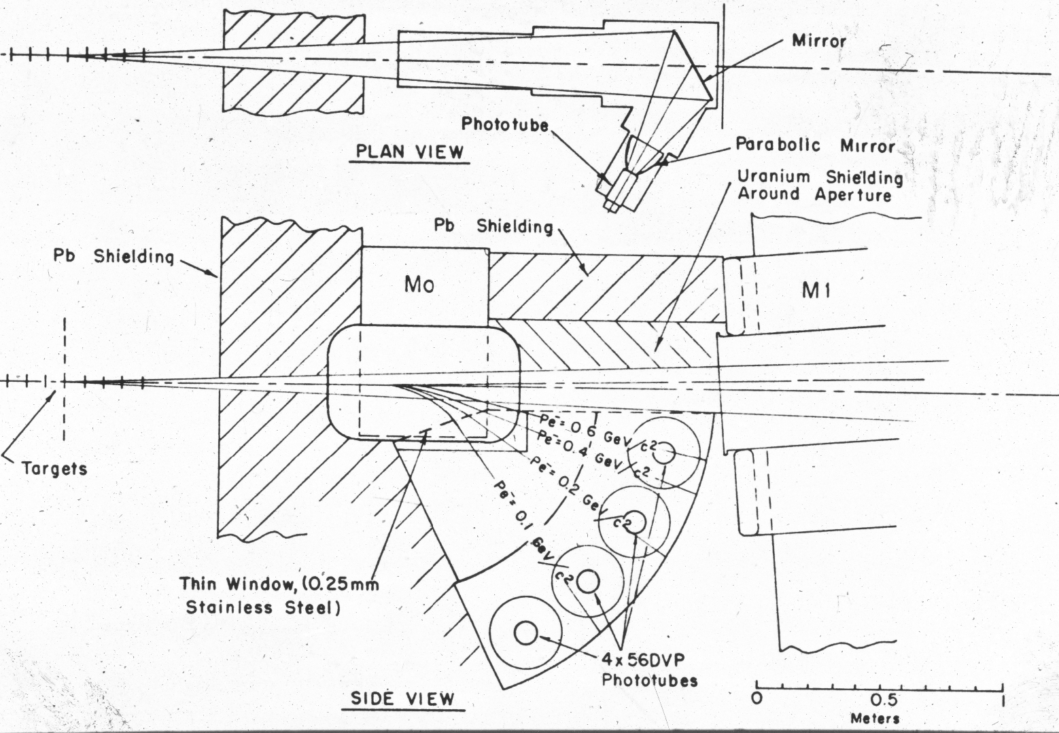
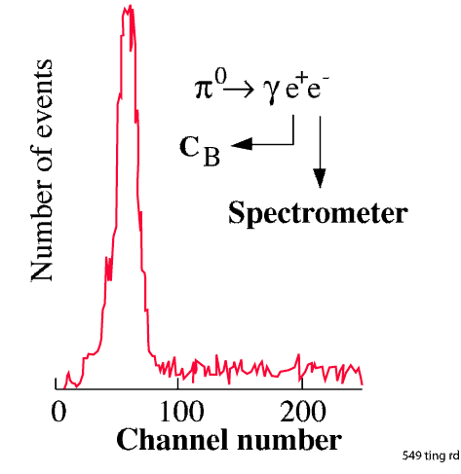

Detector calibration with a pure electron beam
C_{A}
M0
M1
e–
C₀
Co, Ce
Pe⁻ = 0.6 GeV/c²
Pe⁻ = 0.4 GeV/c²
Pe⁻ = 0.2 GeV/c²
Pe⁻ = 0.1 GeV/c²
e⁺
C_{A}
29

Slide 30
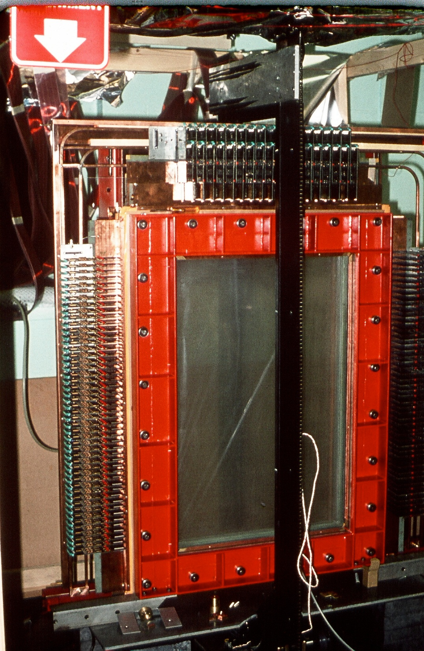
Position Detectors
designed by the
late Professor UJ Becker, MIT
To sort out multi-tracks,
the chambers
have 3 planes 60º apart
60°
a₁
a₂
b₁
b₂
a₃
b₃
a₁ + a₂ + a₃ = b₁ + b₂ + b₃
Exhibited at the Smithsonian Institute
Washington, D.C.
30

Slide 31
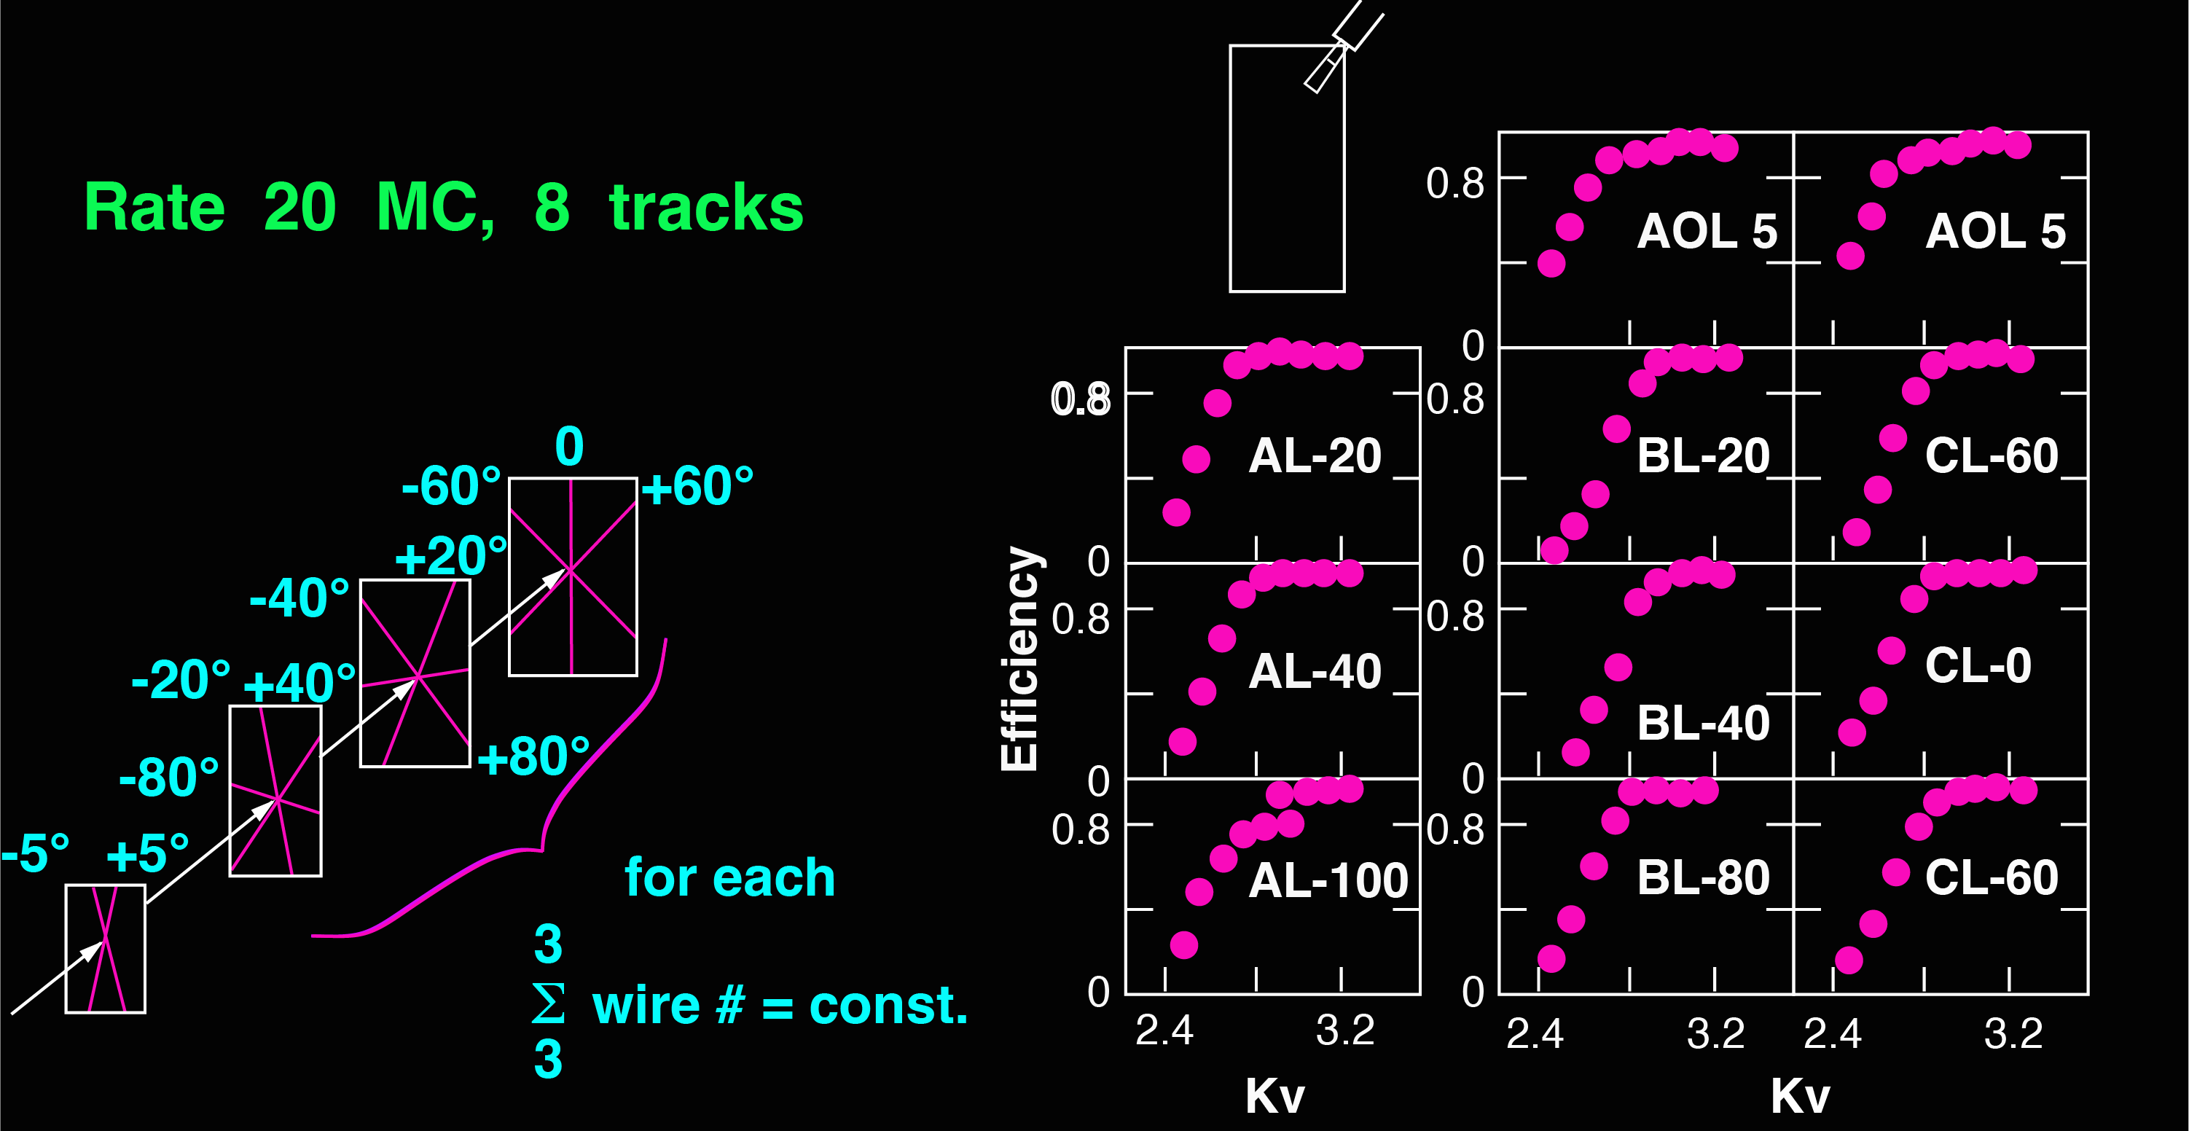
Position Detectors – accuracy 1 mm
10⁴ wires, working at low voltage to prevent radiation damage
Rate 20 MHz
C
B
A
Ao
31

Slide 32
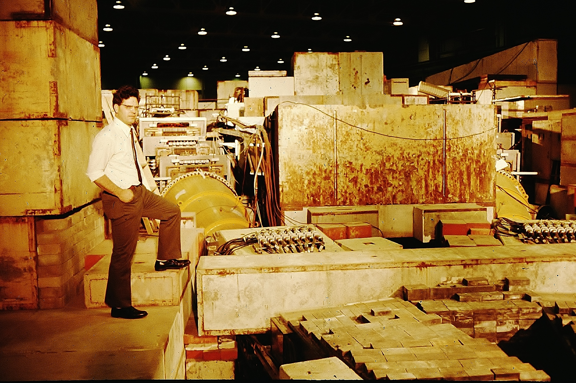
C
B
A
Professor UJ Becker
with precision tracker planes
32

Slide 33
In the early summer of 1974 we took some data in the high-mass region of 4-5 GeV. However, analysis of the data showed very few electron-positron pairs.
By the end of August we tuned the magnets to accept an effective mass of 2.5-4.0 GeV. Immediately we saw clean, real, electron pairs.
But most surprising of all is that most of the e⁺e– pairs peaked narrowly at 3.1 GeV [Fig. 12(a)]. A more detailed analysis shows that the width is less than 5 MeV!
Rev. Mod. Phys. , Vol. 49, No. 2, April 1977
33

Slide 34
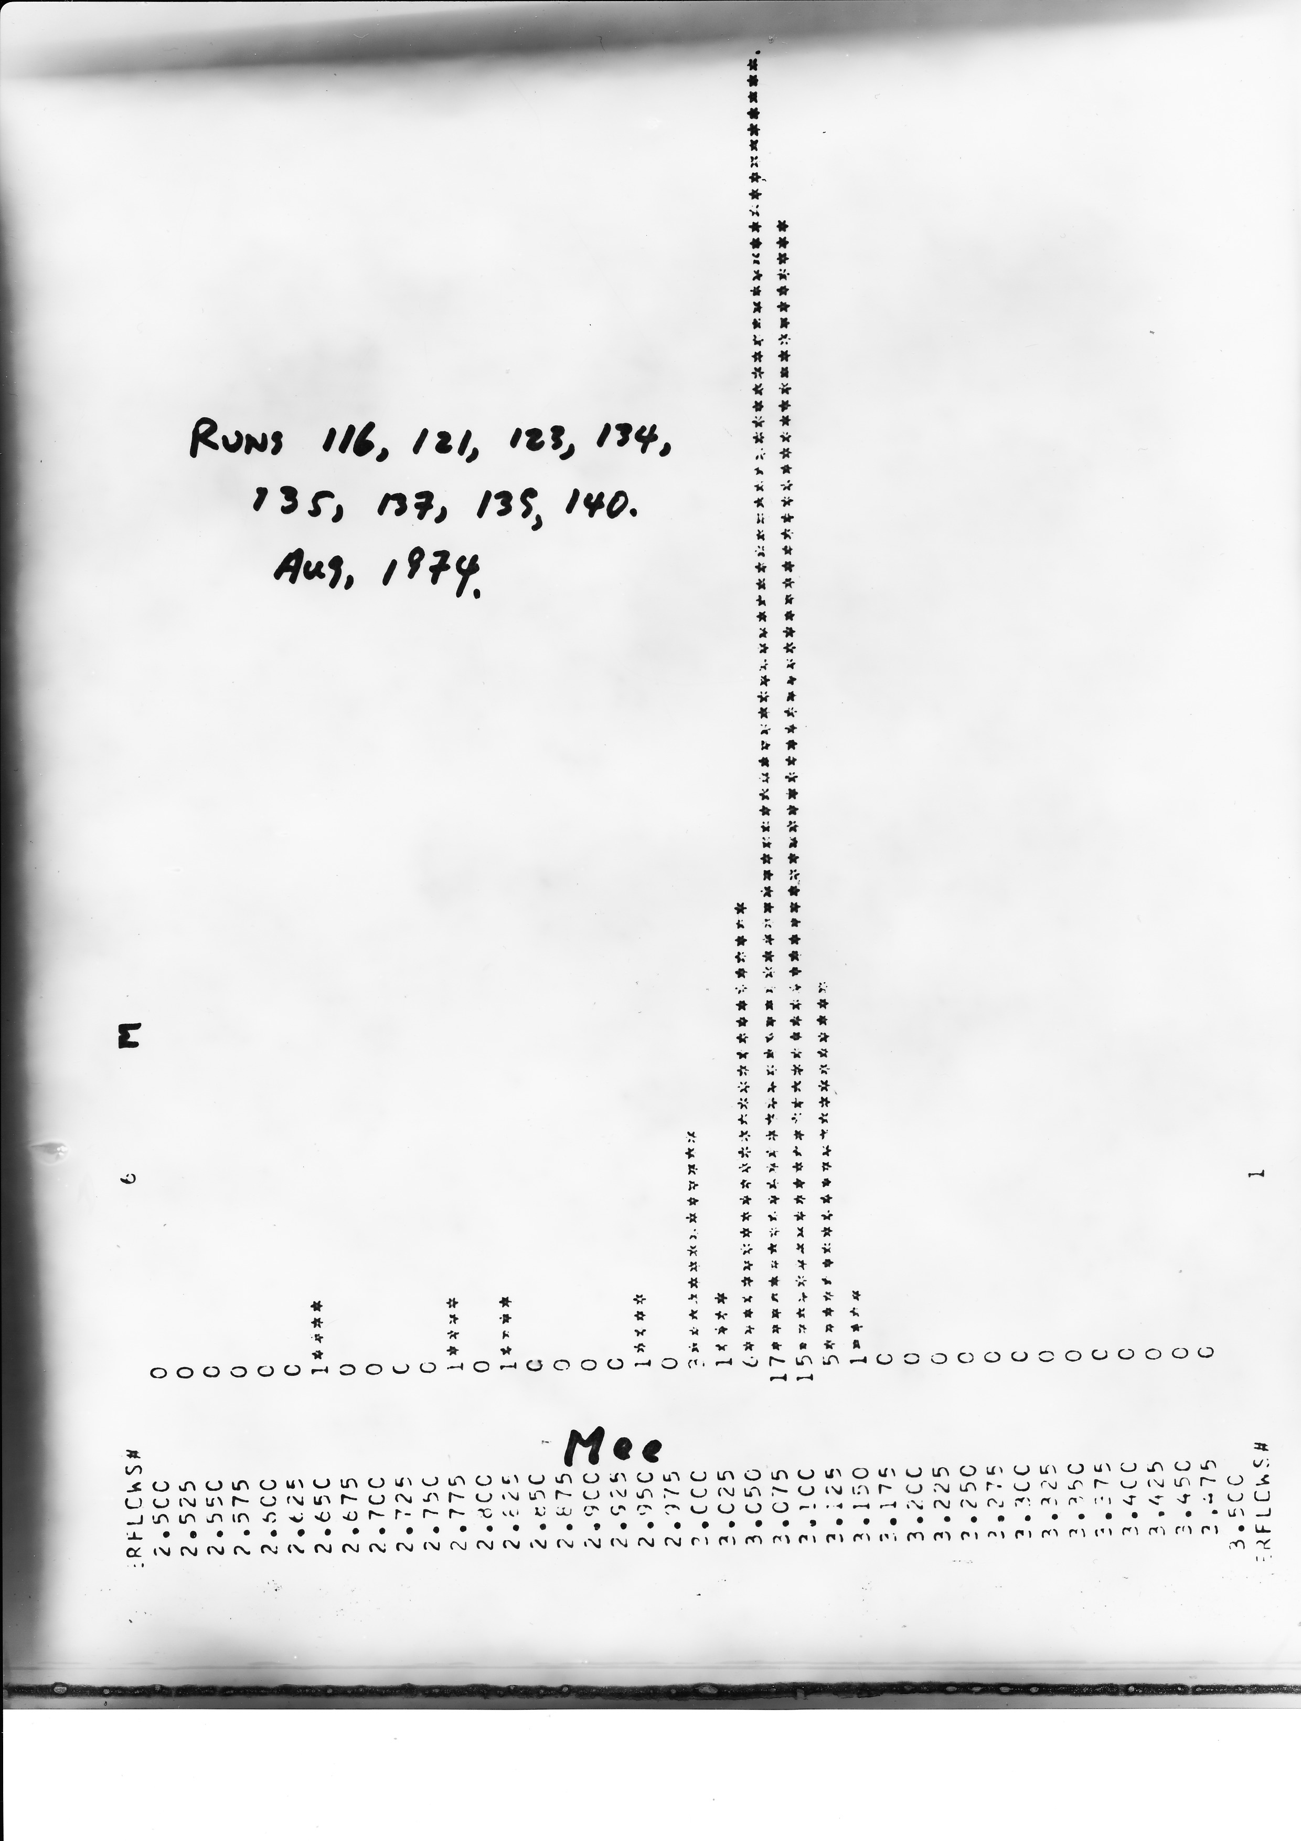
First data
showing an unexpected peak at 3.1 GeV
34

Slide 35
Throughout the years, I have established certain practices in the group with regard to experimental checks on our data and on the data analysis. I list a few examples:
(i) To make sure the peak we observed was a real effect and not due to instrumentation bias or read-out error of the computer, we took another set of data, at a lower magnet current. This has the effect of moving the particles into different parts of the detector. The fact that the peak remained fixed at 3.1 GeV [Fig. 12(a)] showed right away that a real particle had been discovered.
Rev. Mod. Phys. , Vol. 49, No. 2, April 1977
35

Slide 36
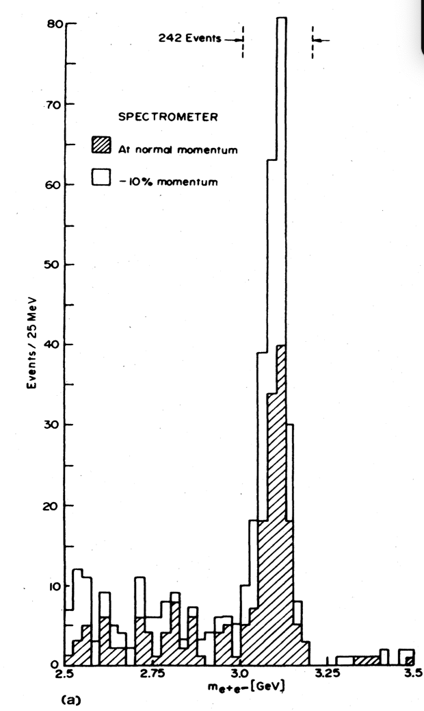
FIG. 12 (a) Mass spectrum for events in the mass range 2.5 < m_{ee} < 3.5 GeV/c. The shaded events correspond to those taken at the normal magnet setting, while the unshaded ones correspond to the spectrometer magnet setting at -10% lower than normal value.
Rev. Mod. Phys. , Vol. 49, No. 2, April 1977
36

Slide 37
(ii)
Two independent groups analyzed the data, starting from the reduction of raw data tapes, to form their own data summary tapes,
Two sets of Monte Carlo acceptance calculations,
Two sets of event reconstruction,
Two sets of data corrections,
Two sets of results which must agree with each other.
Two independent approaches have reached the same conclusions.
One analysis group was led by U. Becker, T. Rhodes, and W. Toki,
and the other by Min Chen
(iii) …
These and many other checks convinced us that we had observed a real massive particle.
Rev. Mod. Phys. , Vol. 49, No. 2, April 1977
37

Slide 38
I was considering announcing our results during the retirement ceremony for V. F. Weisskopf, who had helped us a great deal during the course of many of our experiments. This ceremony was to be held on 17 and 18 October 1974. I postponed the announcement for two reasons.
First, there were speculations on high-mass e⁺e– pair production from proton-proton collisions as coming from a two-step process: p + N → 𝜋 + ⋯ where the pion undergoes a second collision 𝜋 + N → e⁺ + e– + ⋯. This could be checked by a measurement based on target thickness. The yield from a two-step process would increase quadratically with target thickness, whereas for a one-step process the yield increases linearly. This was quickly done
Rev. Mod. Phys. , Vol. 49, No. 2, April 1977
38

Slide 39
Second, we realized that there were earlier Brookhaven measurements (Leipuner et al.1975) of direct production of muons and pions in nucleon-nucleon collisions which gave the 𝜇/𝜋 ratio as 10⁻⁴, a mysterious ratio that seemed not to change from 2000 GeV at the ISR down to 30 GeV.
This value was an order of magnitude larger than theoretically expected in terms of the three known vector mesons, 𝜌, 𝜔, and 𝜑, which, at that time, were the only possible "intermediaries" between the strong and electromagnetic interactions. We then added the J meson to the three and found that the linear combination of the four vector mesons could not explain the 𝜇/𝜋 ratio either.
This I took as an indication that something exciting might be just around the corner, so I decided that we would make a direct measurement of this number.
Rev. Mod. Phys. , Vol. 49, No. 2, April 1977
39

Slide 40
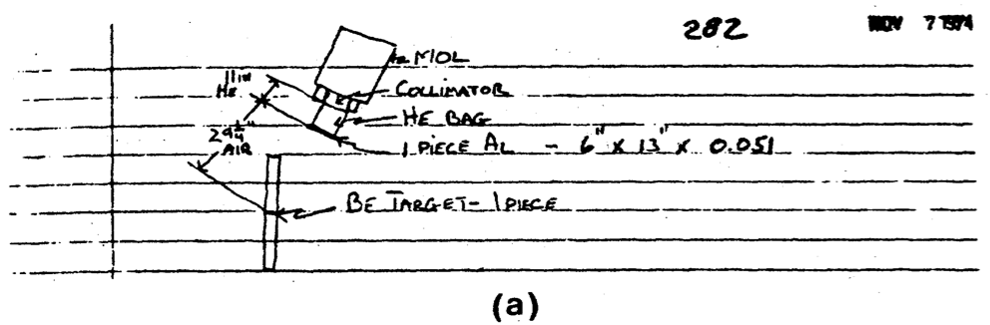
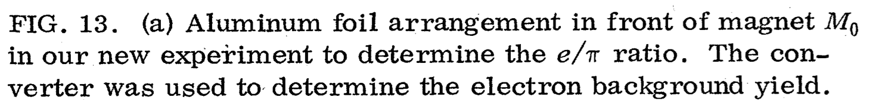
Since we could not measure the 𝜇/𝜋 ratio with our spectrometer, we decided to look into the possibility of investigating the e–/𝜋– ratio.
On Thursday, 7 November, we made a major change in the spectrometer (see Fig. 13) to start the new experiment to search for more particles.
Rev. Mod. Phys. , Vol. 49, No. 2, April 1977
40

Slide 41
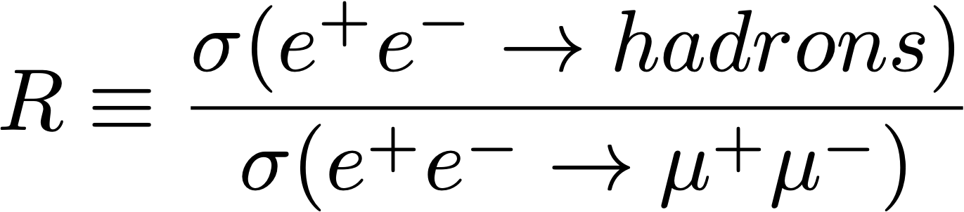
Alvaro De Rujula, “When the Standard Model was Ignored”
at The Rise of Particle Physics, Sapienza University of Rome, Sep. 23, 2024
41

Slide 42
On 6 November I paid a visit to G. Trigg, Editor of Physical Review Letters, to find out if the rules for publication without refereeing had been changed. Following that visit, I wrote a simple draft in the style of our quantum electrodynamics paper of 1967 (Asbury et al. 1967). The paper emphasized only the discovery of J and the checks we made on the data without mention of our future plans.
On 11 November we telephoned G. Bellettini, the Director of Frascati Laboratory, informing him of our results.
Rev. Mod. Phys. , Vol. 49, No. 2, April 1977
42

Slide 43
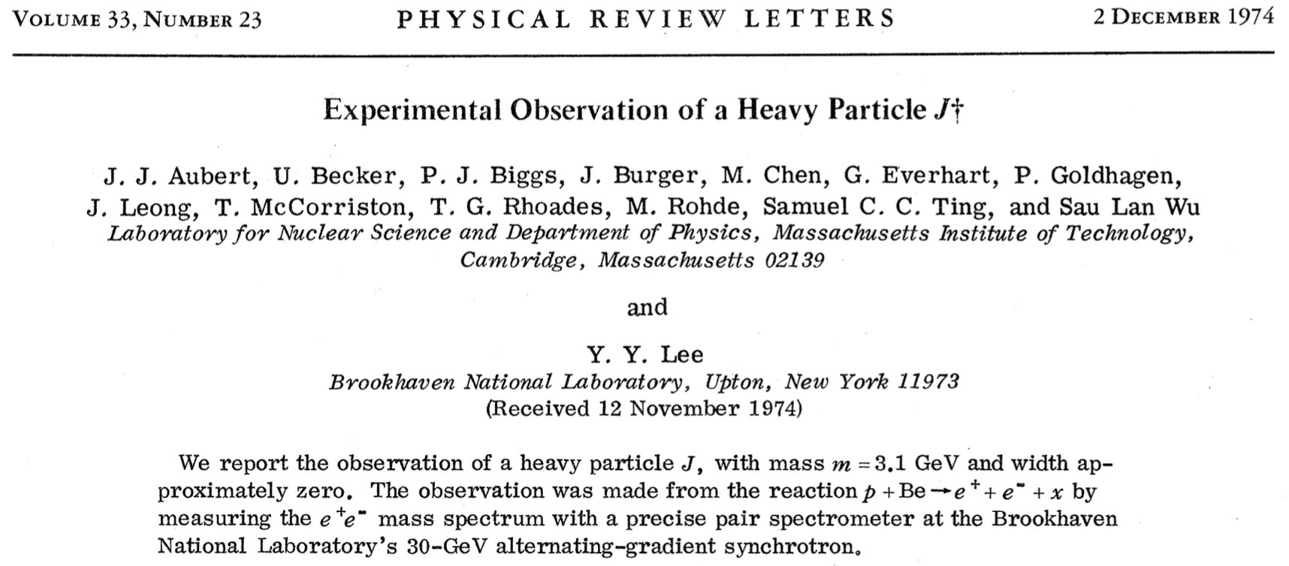
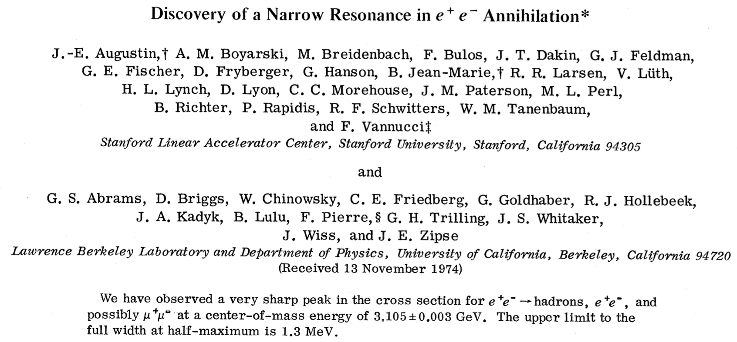
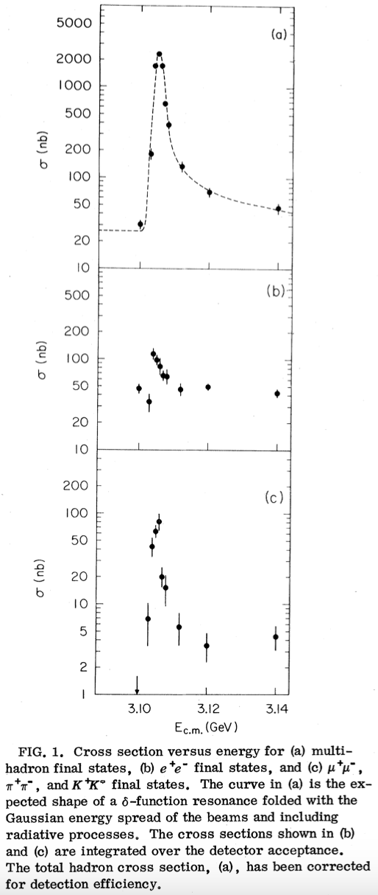
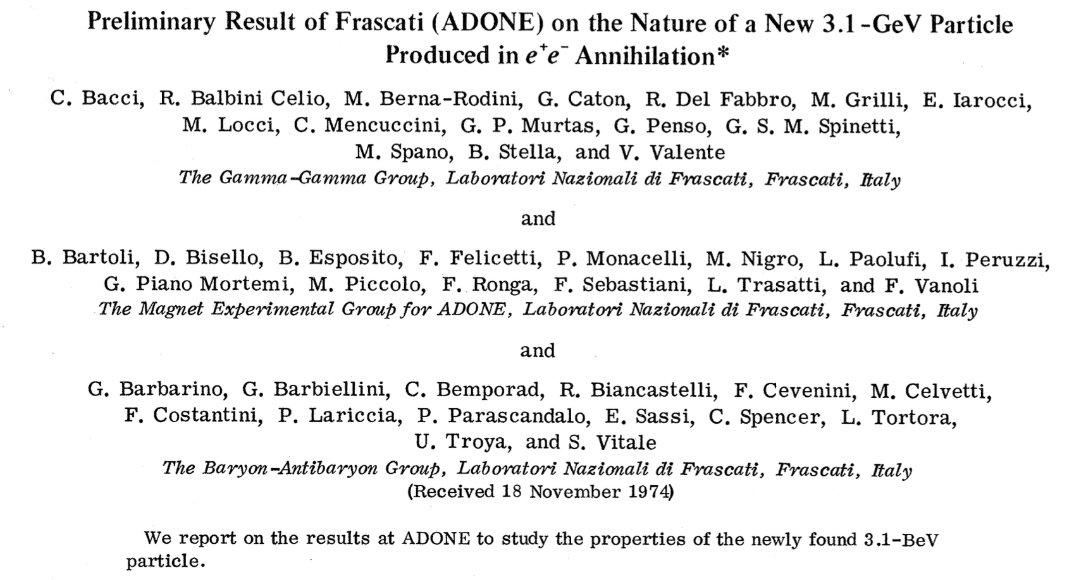
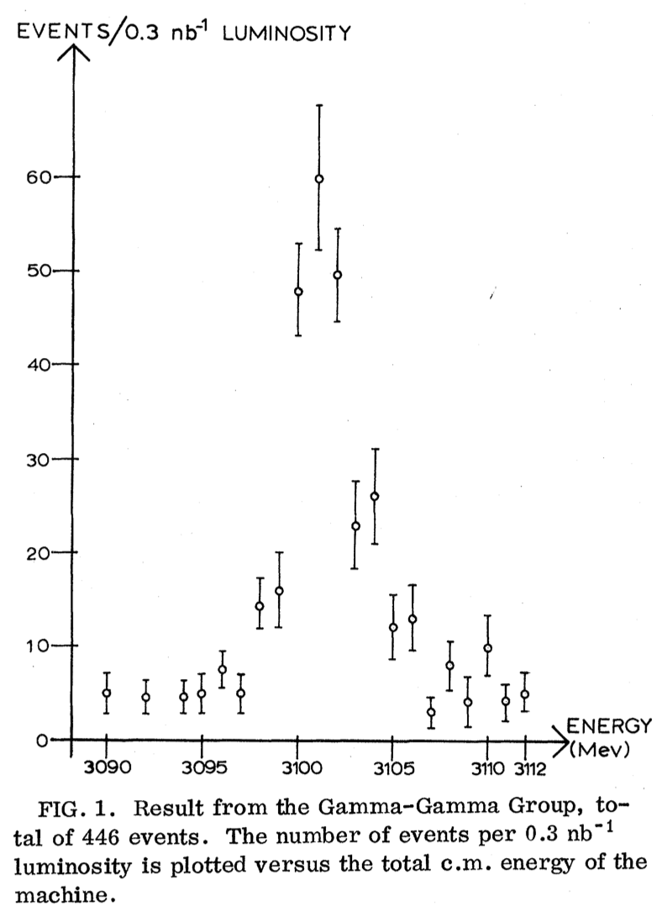
November Revolution 1974
Nov. 12
Nov. 13
Nov. 18
43

Slide 44
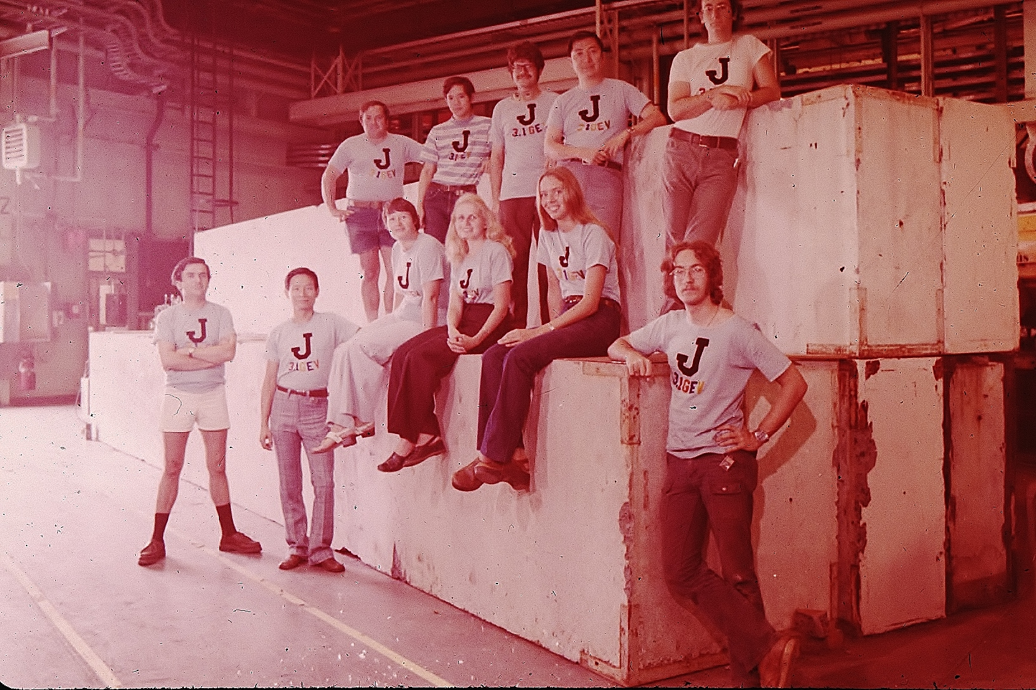
Members of the J-Particle Group
44

Slide 45




The unique properties of the J particle are:
Its lifetime is 10,000 times longer than other particles.
This implies the J particle is a new kind of matter
The spectrum is similar to positronium: This implies the
J particle is made up of a new kind of Quark-Antiquark.
Positronium transitions
J/psi transitions
from SLAC
from DESY
45
Alvaro De Rujula, Sapienza University of Rome, Sep. 23, 2024

Slide 46

The discovery of the J particle confirmed the existence of the charmed quark
predicted by S. Glashow, J. Iliopoulos, L. Maiani.
The BNL proposal for the search for heavy photons (AGS E598)
didn’t mention the GIM mechanism as a motivation
46

Slide 47

Dec. 10, 1976 - Stockholm
47

Slide 48

Attending the Nobel ceremony, Dec. 10, 1976
with key MIT physicists, M. Chen, U. Becker, J. Burger
48

Slide 49

49

Slide 50






Understanding this new form of matter:
Tau-Charm Factories in the World
10³⁵
BEPCII
10³³
Luminosity [cm⁻²s⁻¹]
BEPC
CESRc
10³¹
DORIS I
10²⁹
VEPP-4M
SPEAR
ADONE
10²⁷
Yifang Wang, IHEP
50

Slide 51
30 new hadrons discovered at BESIII from charmed meson production and decays
51

Slide 52



Electrons at Higher Energy
46 Billion Electron Volt Collider at DESY, Germany
e⁻
MARK J
Experiment
e⁺
Circumference 7km
52

Slide 53




53

Slide 54



The earliest confirmation of electroweak theory
Measuring e⁺e– →𝜇⁺𝜇– forward-backward asymmetry
+
+
QED
Electroweak
P.R.L. 48, 25 (21 June 1982)
54

Slide 55

55

Slide 56


Discovery of Gluons at PETRA, Germany
jet (charged and neutral hadrons)
Physics Today, February 1980 (p.17)
jet
jet
Each jet contains charged and neutral hadrons. There are many sources of three jet events.
By measuring many three jet events, we discovered that their distribution agrees with QCD predictions.
56

Slide 57


Electron-Positron Physics at even higher energies:
L3 Experiment at CERN (1982-2003)
L3
100 GeV
Positron
100 GeV Electron
CERN
57

Slide 58

Magnet: 10,000 tons iron
Calorimeter: 300 tons uranium
from the Soviet Union
58

Slide 59




Important Results
2. Model independent
number of neutrinos
1. Dependence of the coupling “constants” on energy
e⁺ e– →ννγ
Nν = 2.98 ± 0.064
α ⁻¹(Q2)
Phys. Lett. B 476 (2000) 40
Phys. Lett. B 536 (2002) 217
Phys. Lett. B 587 (2004) 16
59

Slide 60

60

Slide 61

Electrons and Positrons at highest energies: AMS on the Space Station
Charged cosmic rays have mass,
they are absorbed by the 100 km of Earth’s atmosphere
(10m of water)
The properties (±Z, P) of charged cosmic rays cannot be studied on the ground.
To measure cosmic ray
charge and momentum requires
a magnetic spectrometer in space
Cosmic Rays
100km
Atmosphere
Shower
61

Slide 62









AMS is a space version of a precision detector used in accelerators
Transition Radiation Detector (TRD)
identify e⁺, e⁻
Upper TOF measure Z, E
1
TRD
Magnet identify ±Z, P
Upper TOF
2
Silicon Tracker
measure Z, P
3-4
Tracker
5-6
7-8
Lower TOF
Anticoincidence Counters (ACC) reject particles from the side
RICH
9
Ring Imaging Cerenkov (RICH)
measure Z, E
ECAL
Electromagnetic Calorimeter (ECAL)
measure E of e⁺, e⁻
Lower TOF measure Z, E
10,880
photosensors
62
Notes:
62
62
62

Slide 63




Before AMS
Properties of Cosmic Rays
AMS
Helium
Carbon
Oxygen
Primaries
Rigidity [GV]
Secondaries
Rigidity [GV]
63

Slide 64




Spectroscopy of cosmic ray nuclei
Lithium
H
AMS, with 240 billion events,
precise spectroscopy of cosmic ray nuclei
He
C
Li
B
O
Be
N
Beryllium
Ne
Mg
Si
F
Na
Al
S
Fe
Ar
Ca
Cr
P
Cl
K
Ti
V
Mn
Sc
Ni
Boron
Co
Separation
between H and He
is better than 1 in 10⁹
Separation
between Fe and Co
is better than 1 in 10²

Slide 65


Latest Results on cosmic elementary particles: e+, e−, and p
Interstellar Medium
Cosmic Ray
p, He, …
Supernovae
Dark Matter
Cosmic Ray
e+, p, …
from Dark Matter
e+, p
from Collisions
Dark Matter
e+ spectrum
Pulsars
AMS
e+ from Pulsars
65

Slide 66

Low-energy positrons come from cosmic ray collisions
High-energy positrons must come from a new source
?
Cosmic Ray
Collisions
e+
Energy [GeV]
66

Slide 67





The positron flux is the sum of low-energy part from cosmic ray collisions
plus a high-energy part from pulsars or dark matter with a cutoff energy
Existence of cutoff at
99.9998% CL
e+
Dark
Matter
Pulsars
e+
e+
Dark Matter
Cosmic Ray Collisions
Energy [GeV]
$Φ\left(E\right)=(E^{2}/{\hat{E}}^{2}$)
[${ C}_{d}{\left({\hat{E}}/{E_{1}}\right)}^{γ_{d}}$
+
$C_{s}{\left({\hat{E}}/{E_{2}}\right)}^{γ_{s}}exp(−{\hat{E}}/{E_{s}})$ ]
67
Notes:
Match formula colors the lines. Remove green band

Slide 68


AMS Positron Spectrum to 2030
AMS Current Data
Dark Matter (1.5 TeV)
Positrons from
Dark Matter
Positrons from
Cosmic Ray Collisions
J. Kopp, PRD 88, 076013 (2013)
Astrophysical Journal 729, 106 (2011)
AMS 2030
Dark Matter
Positrons from
Dark Matter
J. Kopp, PRD 88, 076013 (2013)
Positrons from
Cosmic Ray Collisions
Astrophysical Journal 729, 106 (2011)
200
By 2030, AMS will ensure that the high energy positron spectrum drops off quickly in the 0.2-2 TeV region and the highest energy positrons only come from cosmic ray collisions as predicted for dark matter collisions
68
Notes:
12.5 years

Slide 69



AMS Result on the electron spectrum
The spectrum fits well with two power laws (a, b) and a source term like positrons
6.2x10⁷ e–
Positrons
98.8% CL
99.99% CL
by 2030
Power law b
e– from collisions negligible
$$Φ_{e^{−}}\left(E\right)=\frac{E^{2}}{{\hat{E}}^{2}}(C_{a }{\hat{E}}^{γ_{a}}+C_{b}{\hat{E}}^{γ_{b}}+Positron Source Term)$$
Solar
Power law a
Power law b
New sources, like Dark Matter or Pulsars, produce equal amounts of e+ and e–
69

Slide 70

Cosmic Antiprotons and Positrons
Above 60 GeV, the p and e⁺ fluxes have identical rigidity dependence
e⁺
p
1.2M p
4.2M e⁺
e⁺
e⁺
p
p
The identical behavior of positrons and antiprotons above 60 GeV
excludes the pulsar origin of positrons
60
Energy [GeV]
70
Notes:
12.5 years

Slide 71
Latest AMS Results on Heavy Antimatter
Matter is defined by its mass M and charge Z.
Antimatter has the same mass M but opposite charge –Z.
D, He, C, O …
Antimatter Star
TRD
AMS on ISS
Upper TOF
Tracker
Lower TOF
RICH
ECAL
AMS is a unique antimatter spectrometer in space
71

Slide 72


Anti-⁴Helium Candidate
Current Matter and Antimatter
By 2030, AMS will have additional measurements
in the study of antimatter: anti-deuterons,
anti-helium, anti-carbon, and anti-oxygen.
Charge= −2.05 ± 0.05
Mass = 3.81 ± 0.29 GeV/c²
⁴He: Charge = +2
Mass = 3.73 GeV/c²
72

Slide 73






AMS Upgrade
New 4+4m²
Silicon Tracker Planes
increase
acceptance
to 300%
transported to ISS via SpaceX 34
April 2026
Canadarm
+74K
channels
final
installation
by
astronauts
AMS
International Space Station (ISS)
73
73

Slide 74

Scientific American, May 2011
The discovery of the J particle at BNL 50 years ago opened up a new realm of physics.
Space is the ultimate laboratory. Space provides particles with the highest energies.
AMS results require the development of a new model of the cosmos.
I want to thank BNL and DOE for supporting my research
74

