Slide 1
“The Intensity of Astonishment”: Celebrating Two BNL Discoveries
Robert P. Crease
Department of Philosophy
Stony Brook University
Notes:
What rivets historians’ attention?

Slide 2
BNL After a Quarter-Century…
An experiment in science management
Two generations of major facilities: BGRR & HFBR, Cosmotron & AGS
Interdisciplinary research: isomers, 2 neutrinos, neutrino helicity, L-dopa, salt and hypertension, Protein Data Bank, solar neutrinos….
Technical innovations: Alternating gradient principle for accelerators, undermoderated core for reactors, Chasman-Green lattice for SR sources….
Physics discoveries: associated production, K_{L} particles, Ω-….
Proposals for two novel kinds of machines
Notes:
The experiment was working.

Slide 3
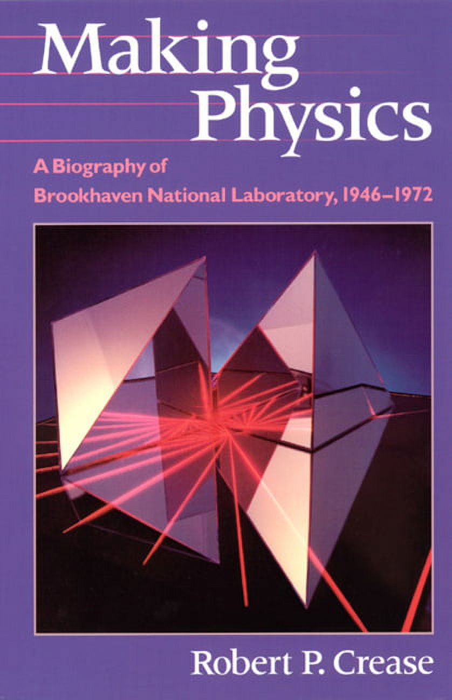
Notes:
Commercial interruption

Slide 4
PHASE TRANSITION
New director
New government manager
New scale of size, cost, collaborations
New competition with other labs: Fermilab, Argonne, CERN

Slide 5
AGS # 181, AGS #598
Two experiments of this time illustrate BNL’s scientific importance, institutional flexibility, and personal drama.
Notes:
Particularly revealing episodes.

Slide 6
Particles Behaving Badly
BNL had discovered K_{L} particles, which decay primarily into 3 pions.
In the early 1960s, Adair’s experiment at the Cosmotron sees K_{L}s produce two pions. Impossible.
Nothing makes the K_{L} → 2 πs disappear.
“God can’t do such a dumb thing.”
“Anomalous Regeneration of K₁⁰ Mesons from K₂⁰ Mesons” (1963)

Slide 7
AGS Proposal #181 “Proposal for K⁰₂ Decay and Interaction Experiment”
Fitch, Cronin & Turlay
April 1963: Proposal submitted
May 1963: Proposal approved
June 1963: Experiment set up and run in “Inner Mongolia”
July 1963: Experiment completed
Mid-1963 - mid-1964: Data analyzed.
Notes:
Notice the schedule. Few labs could match.

Slide 8
AGS Proposal #181 “Proposal for K⁰₂ Decay and Interaction Experiment”
Adair: “Fitch and Cronin have to be wrong.”
August 1964: International “Rochester” conference in Dubna, Soviet colleague suggests culprit a trapped fly.
“Evidence for the 2π Decay of the K₂⁰ Meson,” (1964)

Slide 9
AGS Proposal #181 “Proposal for K⁰₂ Decay and Interaction Experiment”
Adair: “Fitch and Cronin have to be wrong.”
August 1964: International “Rochester” conference in Dubna, Soviet colleague suggests culprit a trapped fly.
Q: What properties must such a fly have?
“Evidence for the 2π Decay of the K₂⁰ Meson,” (1964)

Slide 10
AGS Proposal #181 “Proposal for K⁰₂ Decay and Interaction Experiment”
Adair: “Fitch and Cronin have to be wrong.”
August 1964: International “Rochester” conference in Dubna, Soviet colleague suggests culprit a trapped fly.
Q: What properties must such a fly have?
A: Denser than uranium.
“Evidence for the 2π Decay of the K₂⁰ Meson,” (1964)
Notes:
Either a major physics discovery or a major entomological discovery.

Slide 11
AGS Proposal #181 “Proposal for K⁰₂ Decay and Interaction Experiment”
Nobel Lectures, 8 December 1980
“I am always astonished when a simple apparatus, designed to ask the right question of nature, receives a clear response.”
Cronin, “CP Symmetry Violation: The Search for its Origin”
“Lewis Thomas, whose essays on science grace our literature, has written, ‘You measure the quality of the work by the intensity of the astonishment.’ After 16 years, the world of physics is still astonished by CP and T noninvariance.”
Fitch, “The Discovery of Charge Conjugation Parity Asymmetry”
Notes:
So 181 shows both importance of exploratory experiments & those with focused aim.

Slide 12
Adair’s Regrets?
“No man having put his hand to the plow, and looking back, is fit for the Kingdom of God” (Luke 9:62).

Slide 13
AGS Proposal #598 “Proposal for K⁰₂ Decay and Interaction Experiment”
Ting, Becker, Chen et al.
January 1972: Proposal submitted
May 1972: Proposal approved
Fall 1973: Installation begins
August 1974: Data taken

Slide 14
AGS Proposal #598 “Proposal for K⁰₂ Decay and Interaction Experiment”
September 1974: Analysis shows a huge peak instead of a hill. But decided to wait.

Slide 15
AGS Proposal #598 “Proposal for K⁰₂ Decay and Interaction Experiment”
September 1974: Analysis shows a huge peak instead of a hill. But decided to wait.
Q. “Suppose you have a net to catch a butterfly, and you catch an elephant instead; how do you move?”

Slide 16
AGS Proposal #598 “Proposal for K⁰₂ Decay and Interaction Experiment”
September 1974: Analysis shows a huge peak instead of a hill. But decided to wait.
Q. “Suppose you have a net to catch a butterfly, and you catch an elephant instead; how do you move?”
A. “Damned carefully!”

Slide 17
AGS Proposal #598 “Proposal for K⁰₂ Decay and Interaction Experiment”
September 1974: Analysis shows a huge peak instead of a hill. But decided to wait.
Q. “Suppose you have a net to catch a butterfly, and you catch an elephant instead; how do you move?”
A. “Damned carefully!”
October 1974: More data with peak. Dissembled its existence. Wanted to secure net.
After convincing AGS control room for more beam time, on Halloween Ting rewarded them with carved pumpkin full of beer.
11 November 1974: The elephant nearly escaped. 2 teams announce particle, J/psi, at 3.1 GeV.

Slide 18
AGS Proposal #598 “Proposal for K⁰₂ Decay and Interaction Experiment”
Nobel Lecture, 11 December 1976
“I was very much puzzled … and wanted to know how many particles existed.”
Ting, “The Discovery of the J Particle: A Personal Recollection”
Just how many elephants were there? Not satisfied with an elephant in the hand….
“It was as if one found in some remote region of the earth a human race whose life expectancy was not 70 but rather 70 000 years!”
-- G. Preparata
Not many experimenters would have thought to look for that, not many labs would have been willing to support such a quest.

Slide 19
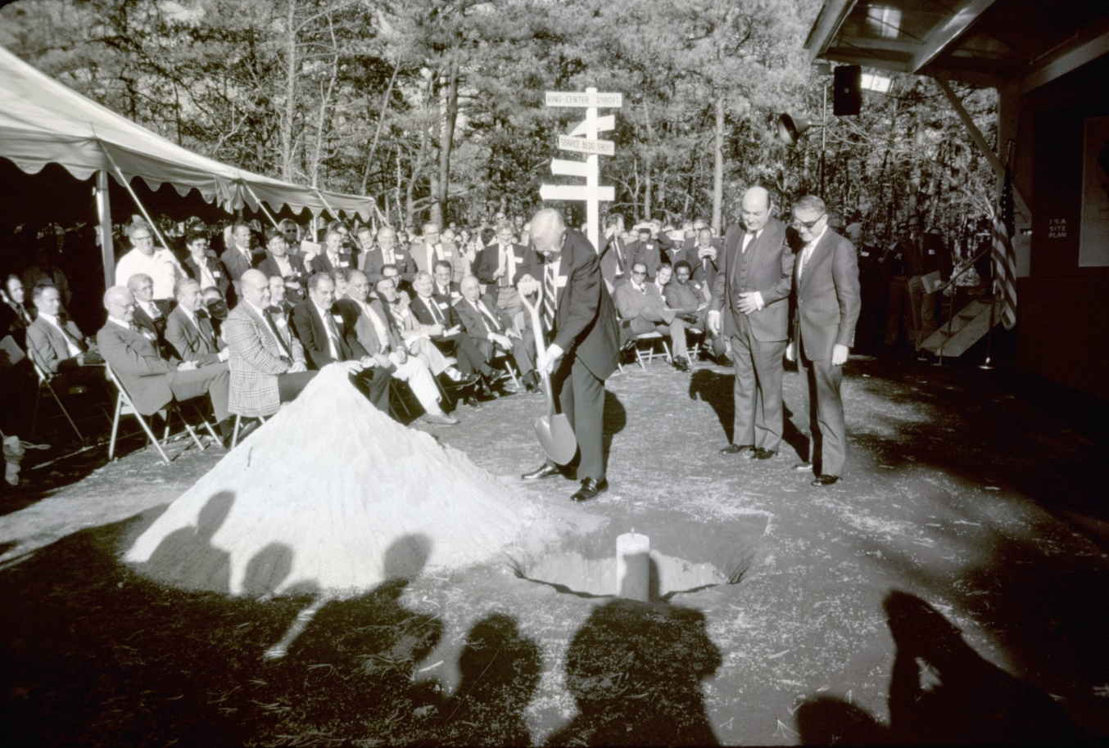
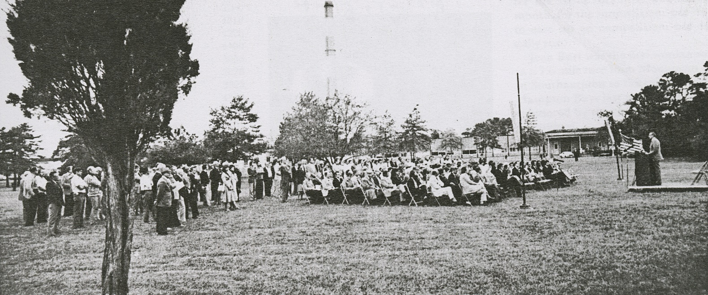
BNL’s Next Quarter-Century…
High Point:
Groundbreakings of
ISABELLE, NSLS

Slide 20
BNL’s Next Quarter-Century…
Low Point:
Cancellation of ISABELLE
Near-cancelation of NSLS

Slide 21
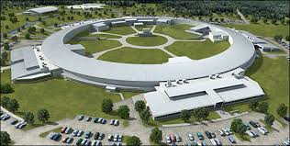
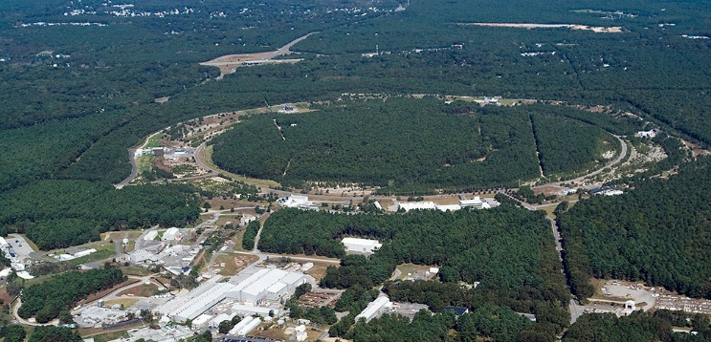
BNL’s Next Quarter-Century…
Challenges:
New Government Manager: DOE
Loss of PDB
New Environmental Regulations
But:
NSLS morphed into NSLS II
ISABELLE morphed into RHIC

Slide 22
“The Intensity of Astonishment”: Celebrating Two BNL Discoveries
Robert P. Crease
Department of Philosophy
Stony Brook University

