Slide 1
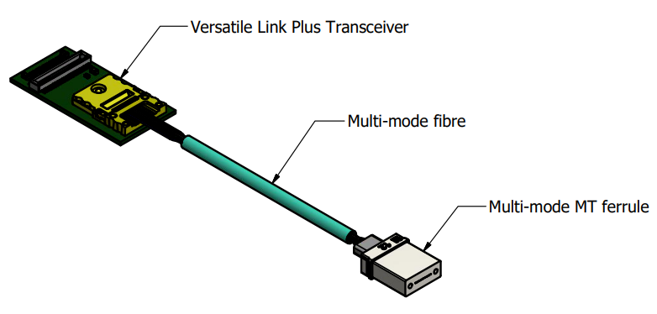
VTRX+ Pigtail Length Determination - Preliminary Fiber Routing Implementation
Fibers to DAQ
FEB or RDO
VTRX+
Fiber Trunk
Fiber Aggregation:
In-line or panel
Fiber Patch/Feedthrough/Disconnect Panels
(fixed to detector)
Detector
Feedthrough options for MTP fiber connectors/ferrules: Single, 1x4, 1x6 and 2x8.

Slide 2
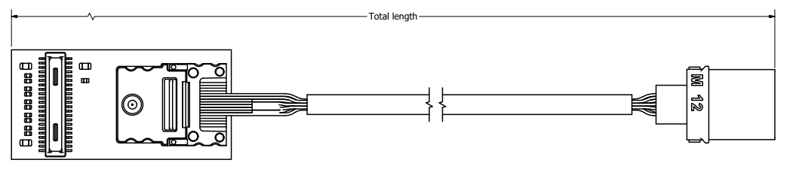
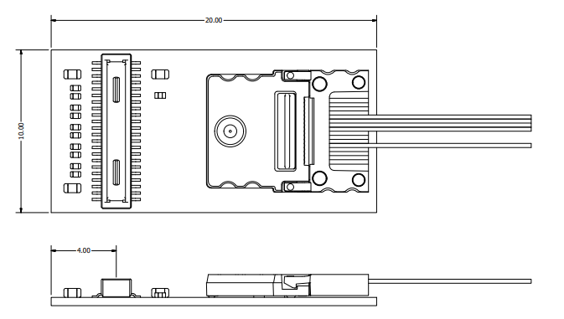
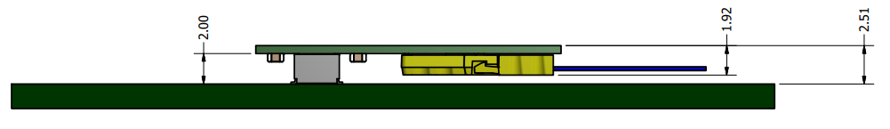
VTRX+ Dimensions

Slide 3
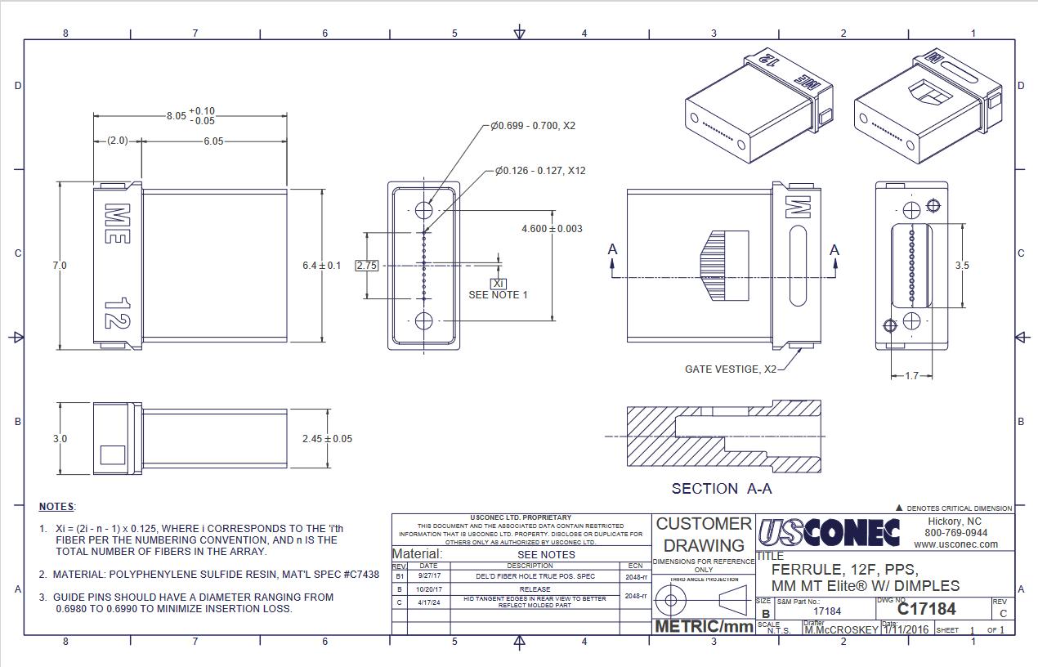
MTP Fiber Ferrule (up to 12 fibers; VTRX+ only has 5 fibers on the pigtail)

Slide 4
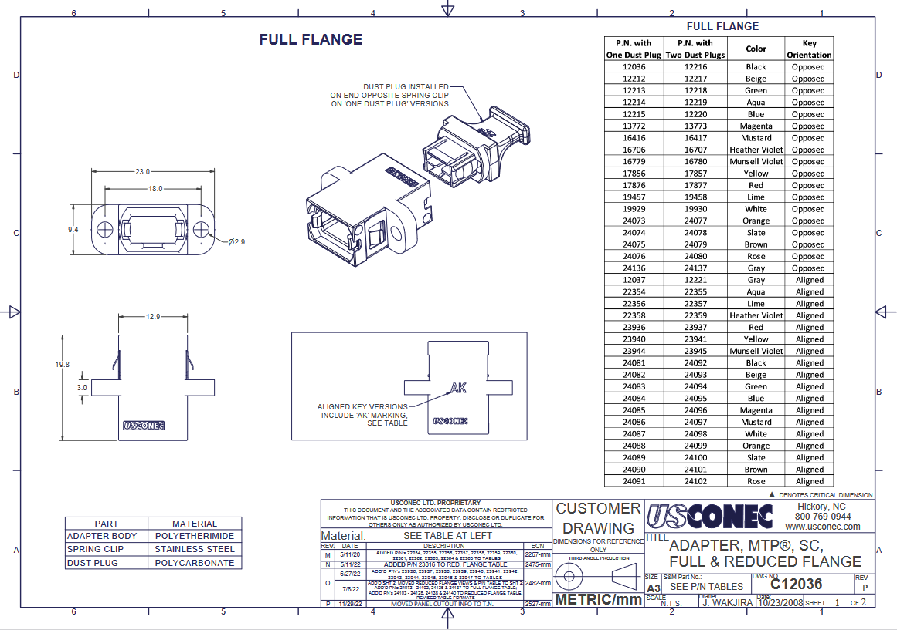
Adapter – single MTP panel feedthrough

Slide 5
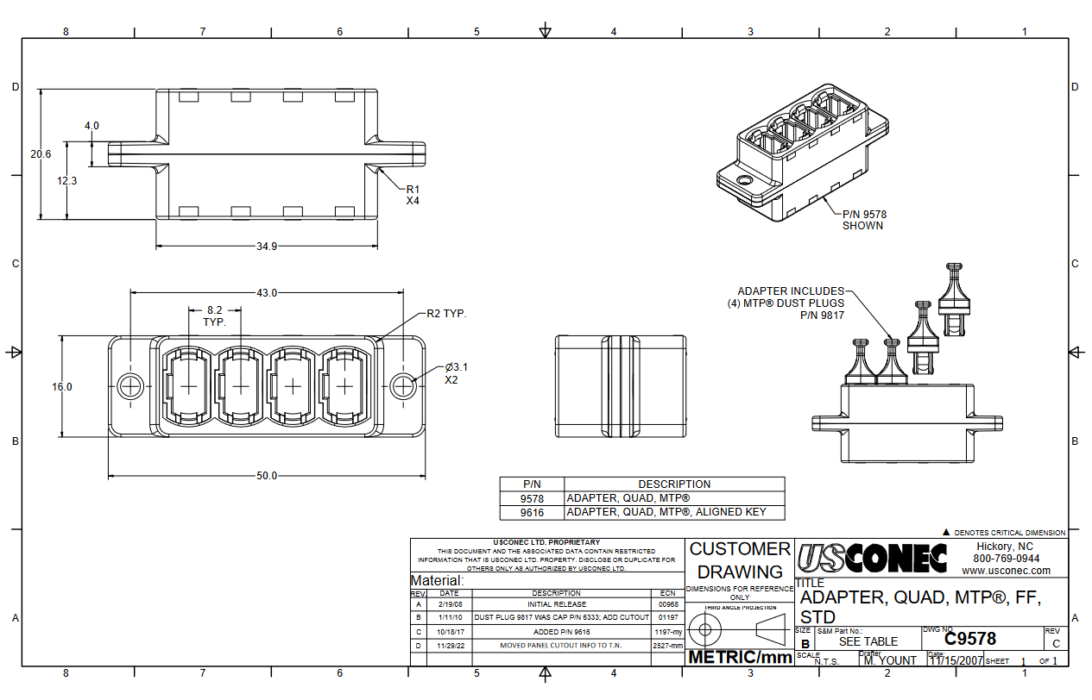
Adapter – 1x4 MTP panel feedthrough

Slide 6
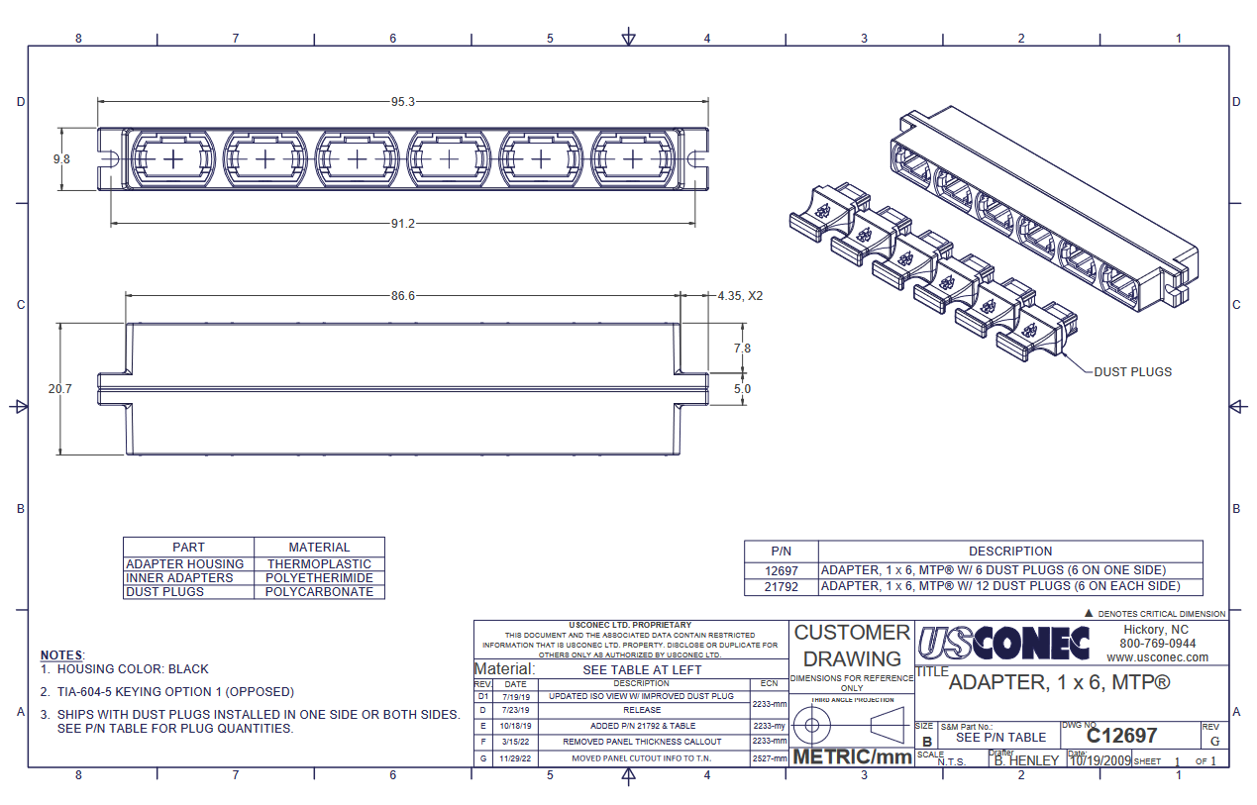
Adapter – 1x6 MTP panel feedthrough

Slide 7
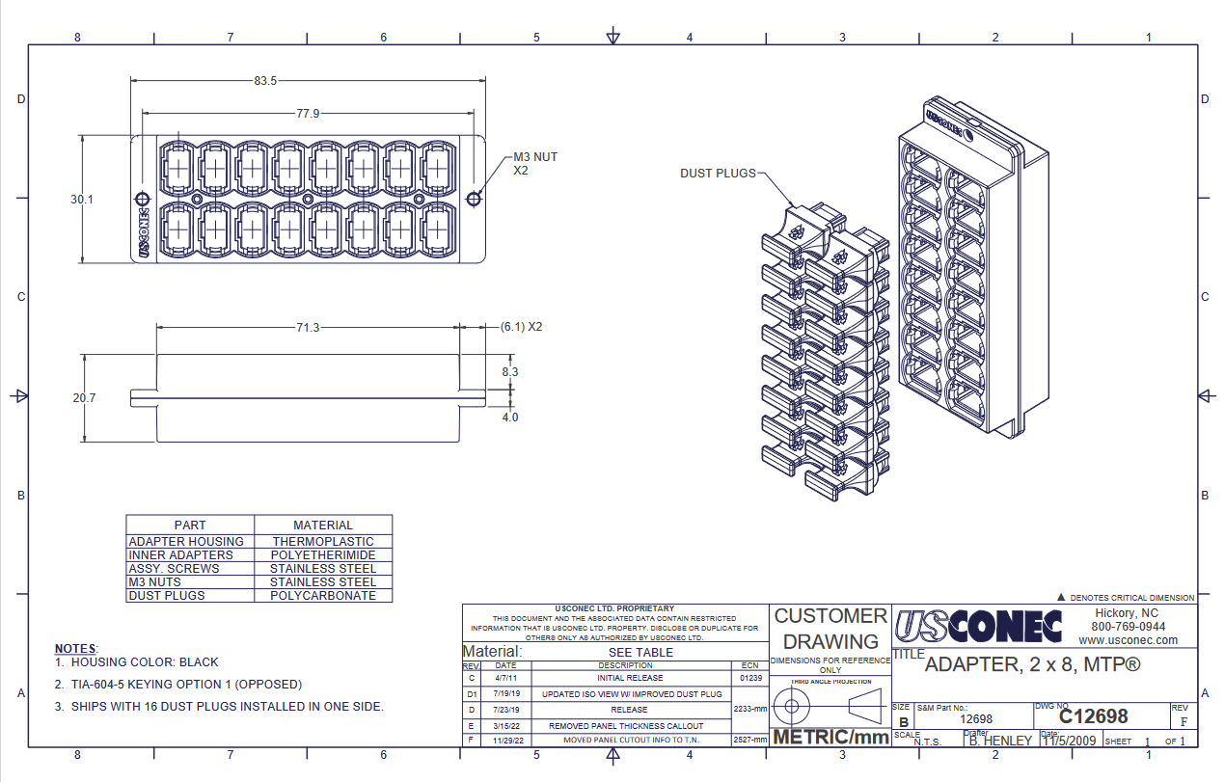
Adapter – 2x8 MTP panel feedthrough

