Slide 1
Meet the DSCs: MPGD
10/02/2024
Seungjoon Lee

Slide 2
BOT – Current status
Received initial design from CERN based on the current BOT design (Drift & GEM foils, uRWELL + PCB)
Assuming Hirose 140 pin connector.
Couple of iterations are expected before the final order.
MPGD chamber assembly & test process is still studied (nonreversible assembly)
=> Trying to find a method to test detector before the final glueing then glue the chamber without moving parts to prevent contamination. (feeding glue through gap/channel)

Slide 3
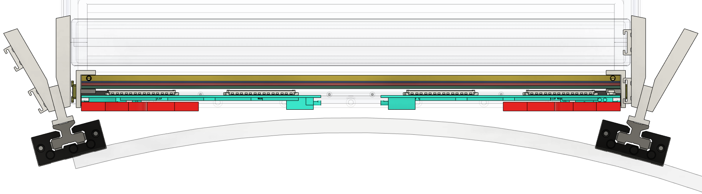
BOT - Services
Extra space for service
MPGD assembly is now flipped => Service line is facing CF tube
Utilize space between CF tube => Reserve more space for service
Detector position moved ~1 cm away from IP

Slide 4
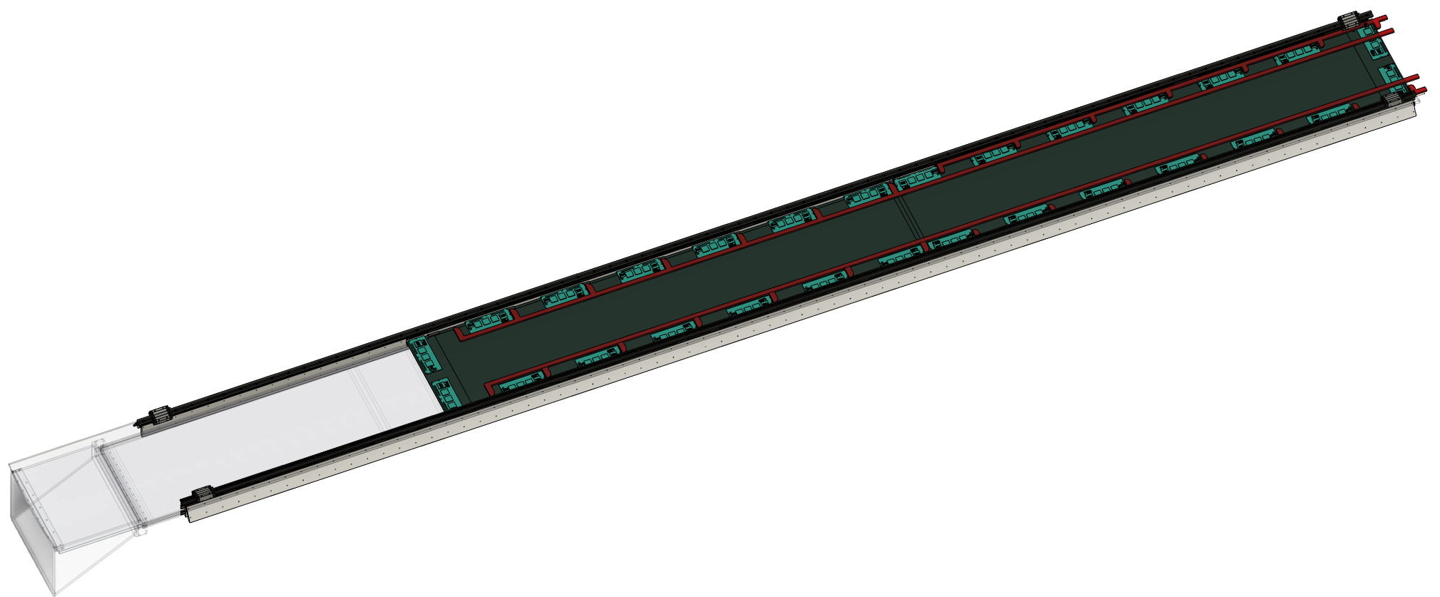
BOT - Services
All service lines
Fiber, HV, LV, Gas
Module at 6 o'clock
If cold gas cooling is sufficient and service line is too tight on the right side, then feeding cold gas for cooling from the left side (under DIRC) is possible
? Question: Is there any designed air flow for cooling for the whole EPIC detector?

Slide 5
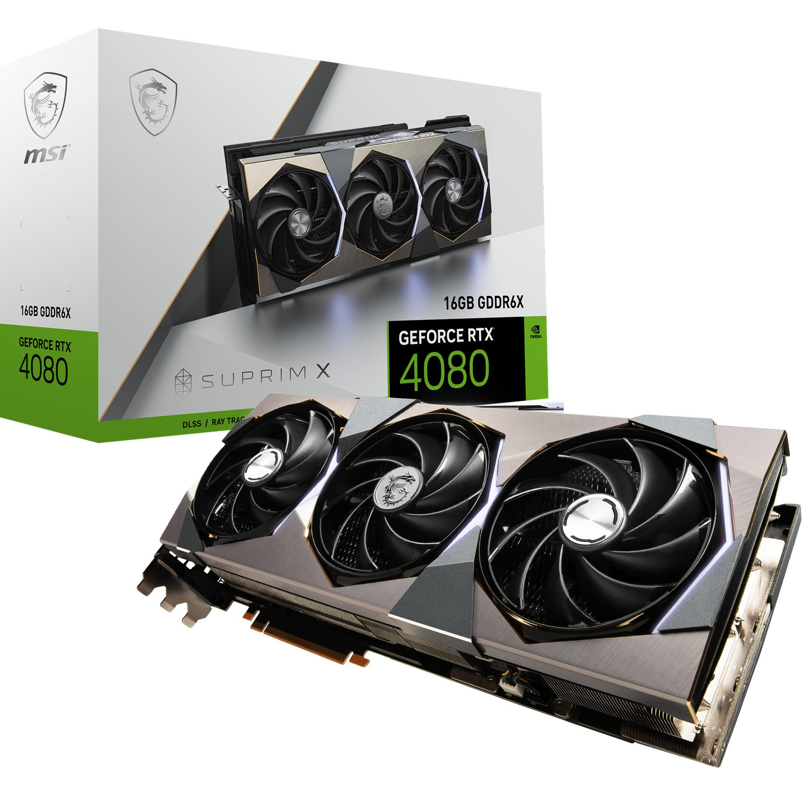
BOT – Service requirement
14 FEBs per module
= Total 28 FEBs (~300W) per sector
28 VTRX+ cable
2~8 high voltage
28 low voltage
4 Gas lines (chamber)
High-end graphics card (RTX4080)
300W at full load

Slide 6
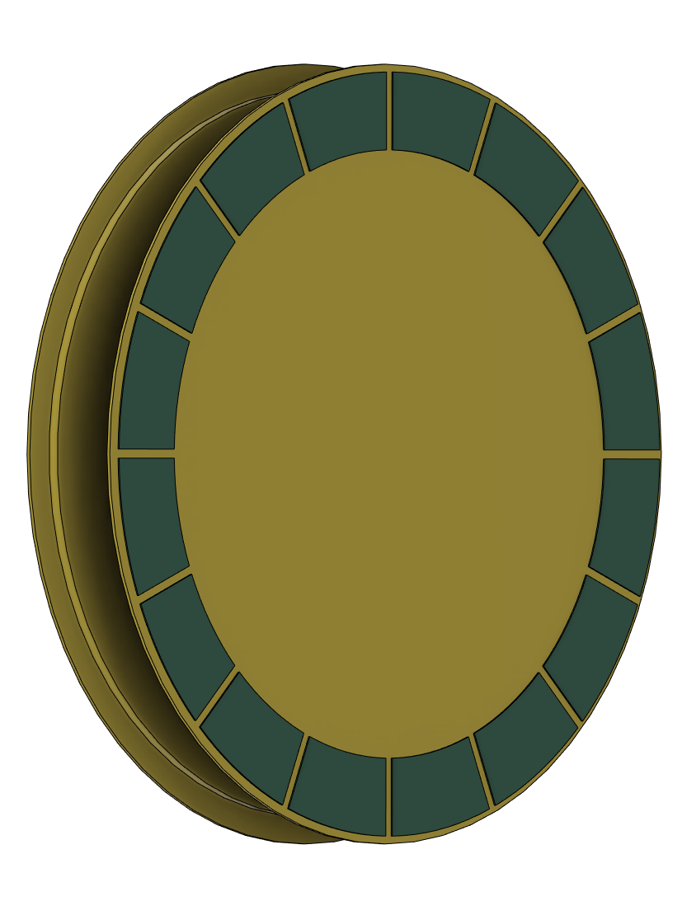
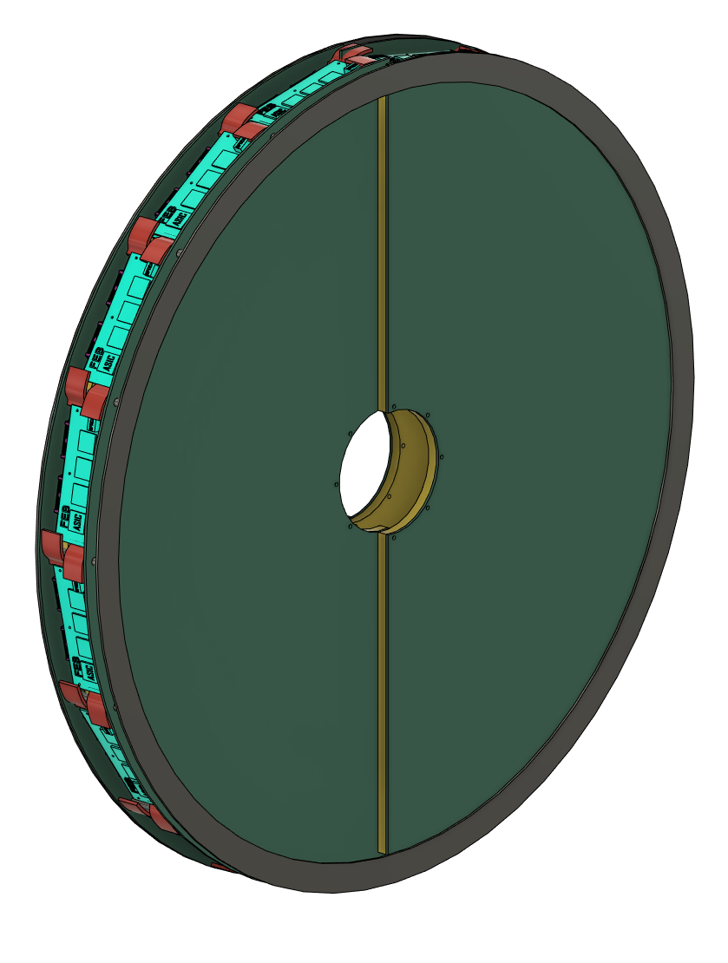
ECT – Current Design
FEB
MPGD service area
Decision point
FEBs on the back side of chamber
Accommodate more FEBs
Material budget on MPGD
More room on service area
FEBs between chamber at 90 degrees
Limited number for FEBs
Less material budget on MPGD
Tight service area for MPGD

Slide 7
ECT - Service
Current FEB specification
1 VTRX+, 1 LV
~10 watt power consumption
Forced air cooling preferred.
Any cooling gas flow designed within the CF tube ?
Current MPGD specification – half circle
Thin gap, 1 mm strip pitch: 8 FEBs
uTPC, 0.5 mm strip pitch: 16 FEBs
1-2 HV, 2 Gas lines.

Slide 8
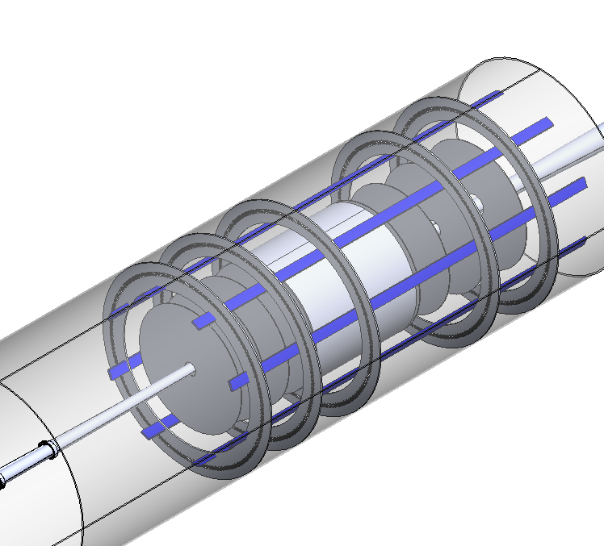
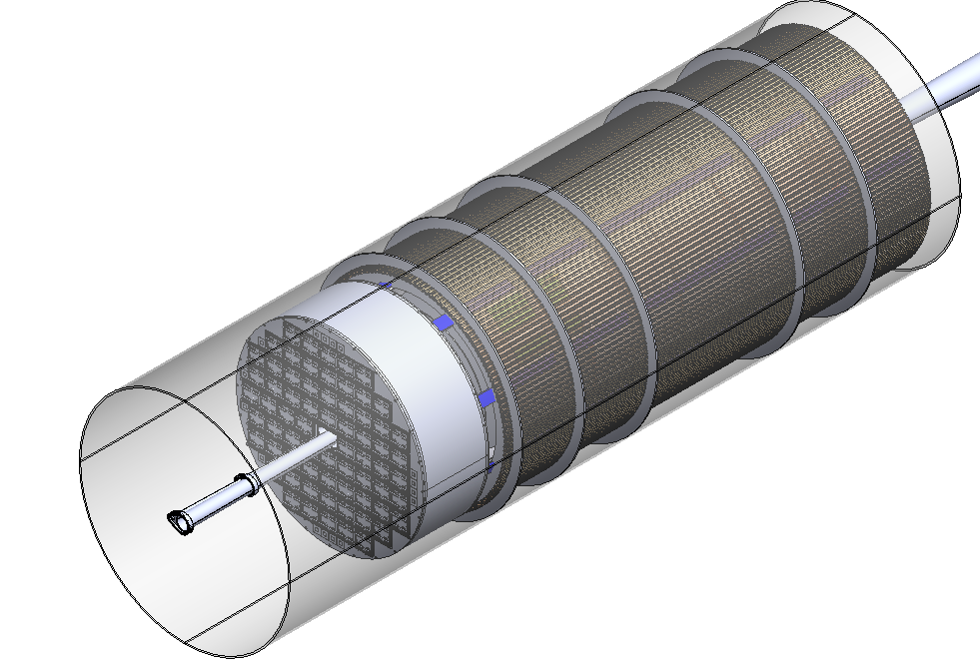
ECT - Installation
Integration sequence
11. All the services and wiring is pulled out till the ends of CF tubes
12. pfRICH and EMCAL in installed in the CF tube
Needs “blocks” & brackets to avoid damaging the GST by EMCAL
10. The outer discs of MPGDs come in next
HOW??
pfRICH

Slide 9
Possible options
If whole IB rails (+beam pipe) can come out halfway on each side
ECT disc frame can be mounted and assemble ECT outside of CF tube
If IB rail + beampipe must stay inside
=> How can we assemble ECT? ECT cannot be slide in because of beampipe
Need more clarification for designing ECT frames + mount

