Slide 1
List
BNL | : | Steven Andrade, | Stephen Boose, | Daniel Cacace, | Raul Cecato, | Donald Pinelli,
 | : | Rachid Nouicer, | Robert Pisani, | Nick Seberg, | Antonio Verderosa,
JAEA | : | Shoichi Hasegawa
Korea Univ. | : | Byungsik Hong, | Jaein Hwang
Nara Women’s Univ. | : | Manami Fujiwara, | Takashi Hachiya, | Mahiro Ikemoto, | Mai Kano, | Nao Morimoto,
 | : | Maya Shimomura, | Hinako Tsujibata,
National Central Univ. | : | Kai-Yu Cheng, | Chia-Ming Kuo, | Cheng-Wei Shih, | Wei-Che Tang,
National Taiwan Univ. | : | Tzu-Chuan Huang, | Rong-Shyang Lu, | Yu-Chen Ou, | Lian-Sheng Tsai,
RIKEN, RBRC | : | Yasuyuki Akiba, | Akitomo Enokizono, | Itaru Nakagawa, | Genki Nukazuka, | Yuko Sekiguchi
Rikkyo Univ. | : | Yusuke Fujino, | Tomoki Harada, | Tomoya Kato, | Takahiro Kikuchi, | Ryota Shishikura,
 | : | Hayato Yanagawa
Purdue Univ. | : | Joseph Bertaux, | Wei Xie,
TIRI | : | Takashi Kondo
ver Oct/2024

Slide 2

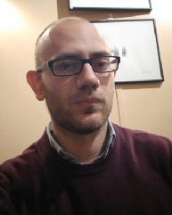



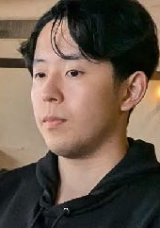
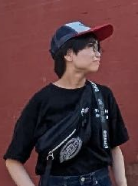
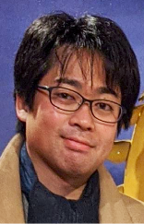



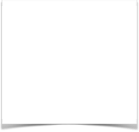





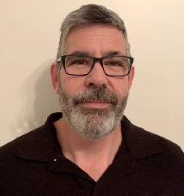
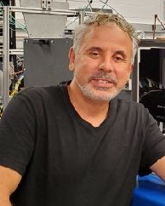
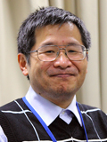
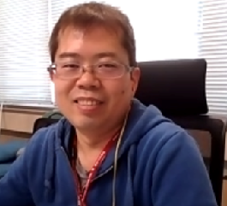
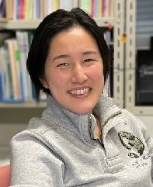
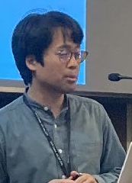
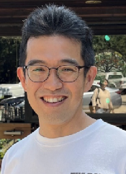
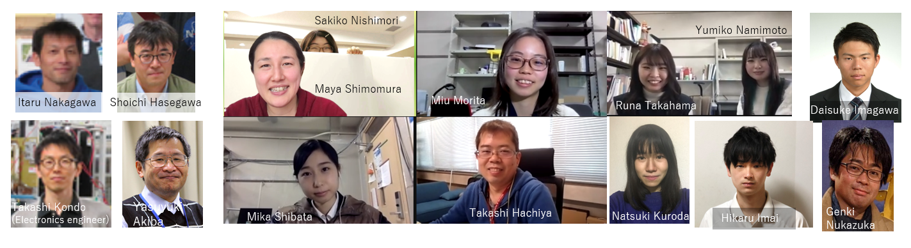
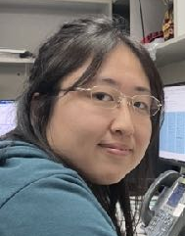



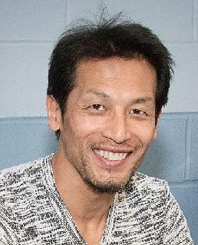







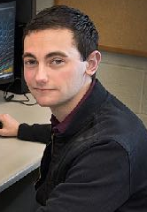
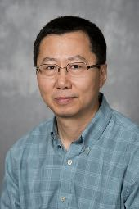
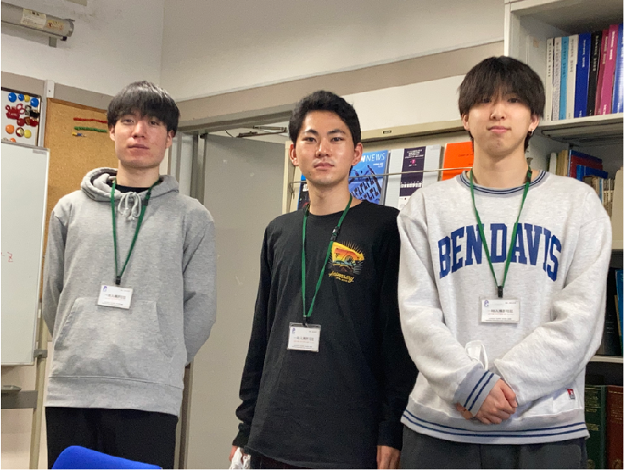
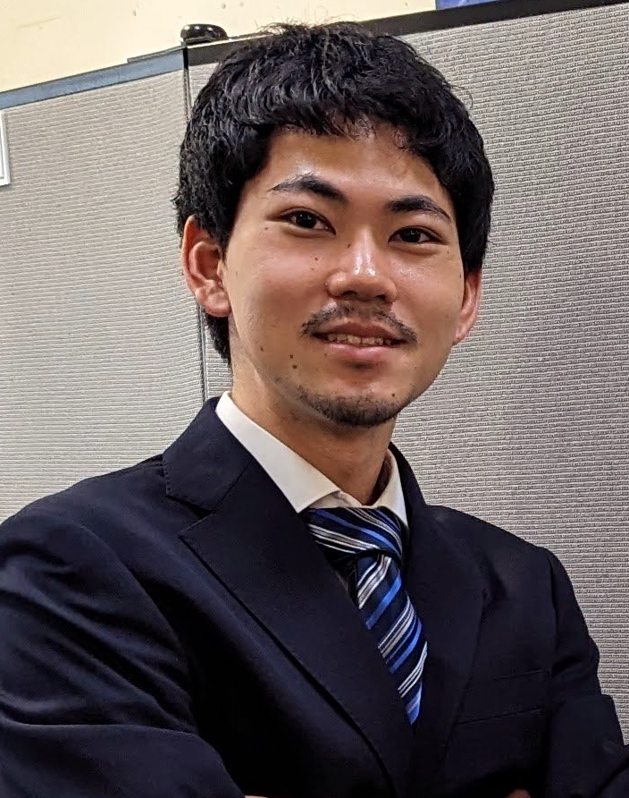
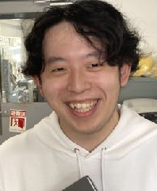
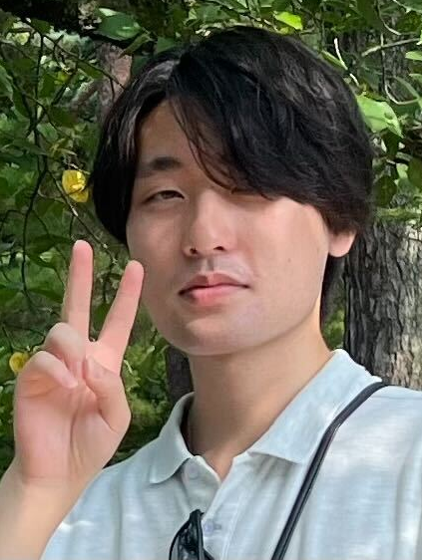


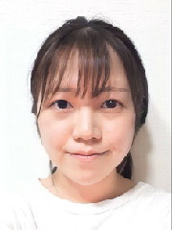
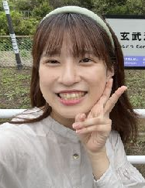
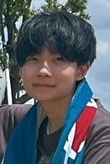
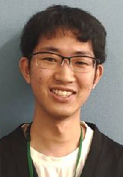

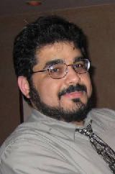


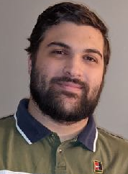

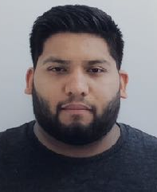






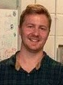
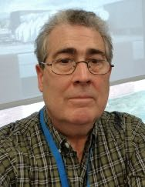
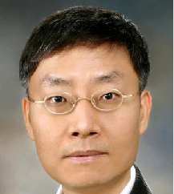
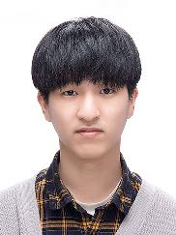
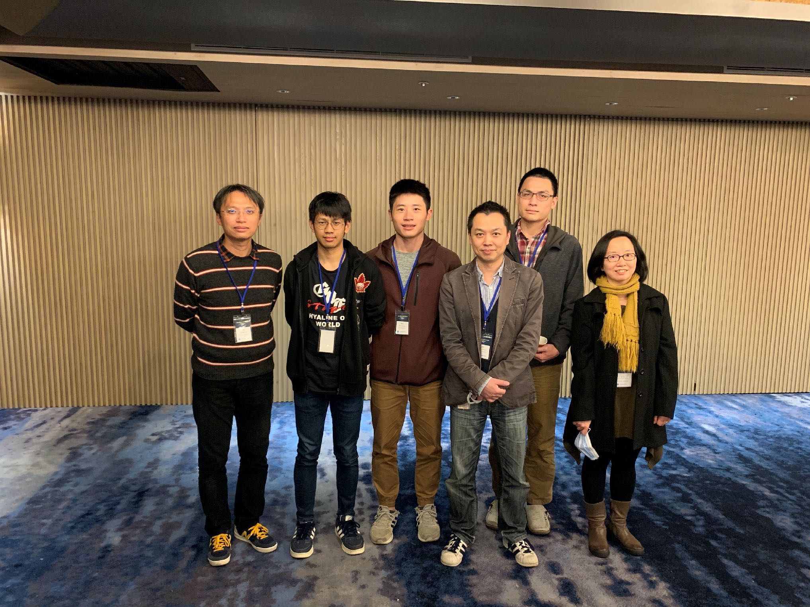

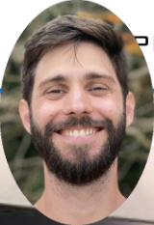











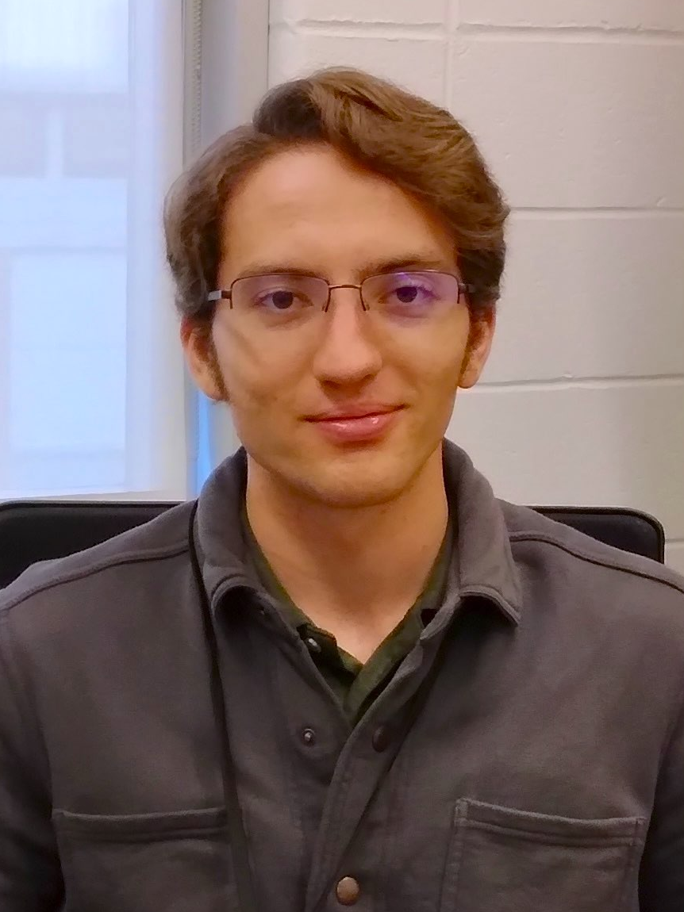
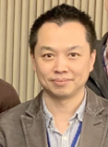
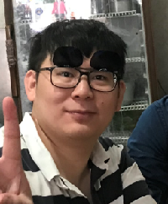
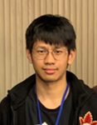
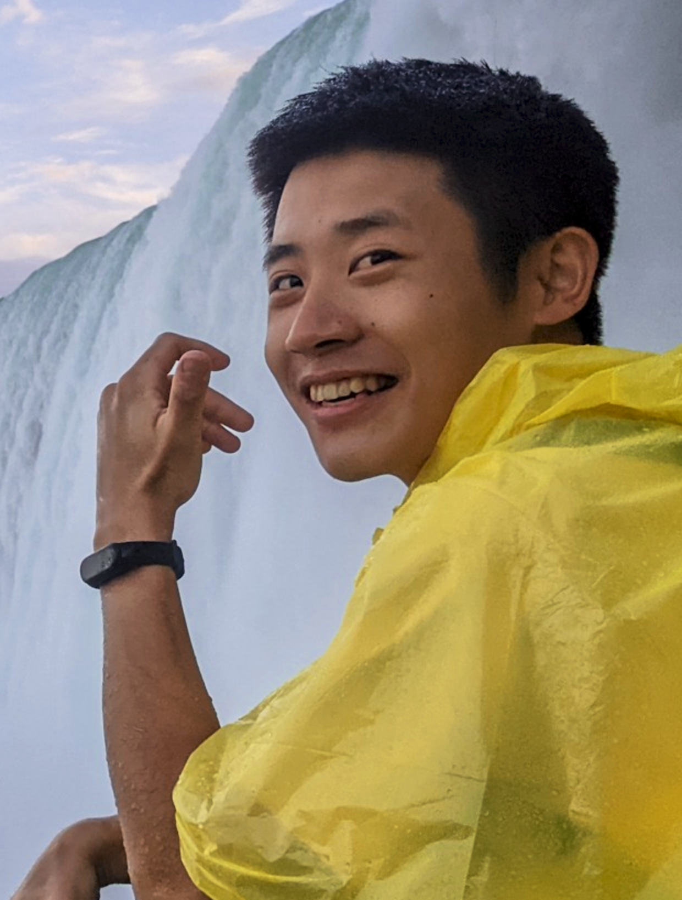
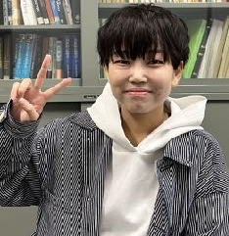
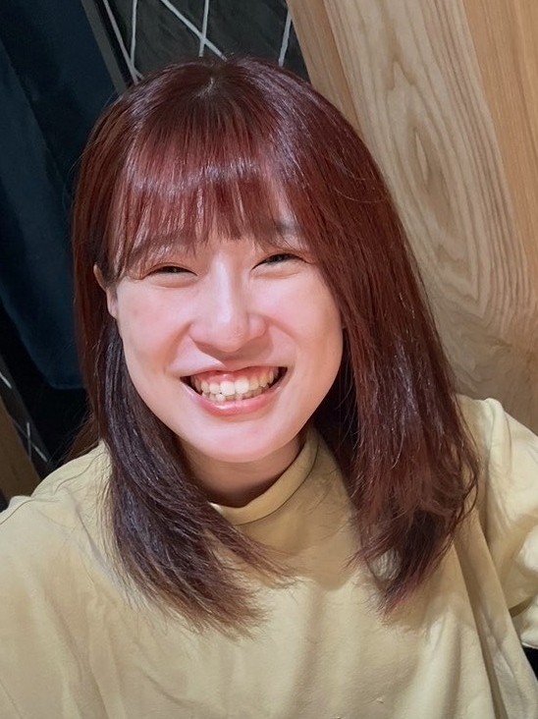
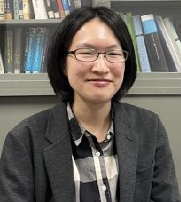
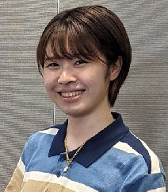
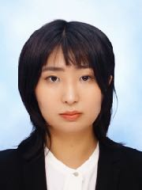
INTT Collaboration
Milan Stojanovic
Donald Pinelli
Rachid Nouicer
Yasuyuki Akiba
Takashi Hachiya
Maya Shimomura
Genki Nukazuka
Akitomo Enokizono
Shoichi Hasegawa
Yuko Sekiguchi
Rikkyo Univ.
Yusuke Fujino,
Tomoki Harada,
Tomoya Kato,
Takahiro Kikuchi,
Ryota Shishikura
Dan Cacace
Wei Xie
Itaru Nakagawa
Ryota Shishikura
Tomoya Kato
Takahiro Kikuchi
Tomoki Harada
Hayato Yanagawa
Yusuke Fujino
Kazuma Fujiki
Yuka Sugiyama
BNL
Steven Andrade, Stephen Boose,
Daniel Cacace, Raul Cecato,
Donald Pinelli, Rachid Nouicer,
Robert Pisani,Nick Seberg,
Antonio Vederosa
TIRI
Takashi Kondo
Korea Univ.
Byungsik Hong,
Jaein Hwang
JAEA
Shoichi Hasegawa
Robert Pisani
Takashi Kondo
Purdue Univ.
Joseph Bertaux,
Wei Xie,
National Taiwan Univ.
Rong-Shyang Lu, Jenny Huang,
Lian-Sheng Tsai, Ou-Wei Cheng
RIKEN, RBRC
Yasuyuki Akiba, Akitomo Enokizono,
Itaru Nakagawa, Genki Nukazuka, Yuko Sekiguchi
Antonio Vederosa
National Central Univ.
Chia-Ming Kuo, Kai-Yu Cheng,
Cheng-Wei Shih, Wei-Che Tang
Nara Women’s Univ.
Manami Fujiwara, Takashi Hachiya,
Mahiro Ikemoto, Mai Kano,
Nao Morimoto, Maya Shimomura,
Hinako Tsujibata
Steven Andrade
Nick Seberg
Stephen Boose
Byungsik Hong
Jaein Hwang
Lian-Sheng Tsai
Jenny Huang
Raul Cecato
Joseph Bertaux
Chia-Ming Kuo
Rong-Shyang Lu
Kai-Yu Cheng
Wei-Che Tang
Ou-Wei Cheng
Cheng-Wei Shih
Hinako Tsujibata
Mai Kano
Manami Fujiwara
Mahiro Ikemoto
Nao Morimoto

