Slide 1
^{RCS Compton Update}
Dave Gaskell
Jefferson Lab
November 6, 2024

Slide 2
Simple rate, measurement time estimates
Average analyzing power:
→ Average value of asymmetry over acceptance
Energy-weighted:
→ Energy deposited in detector for each helicity state
Differential:
→ Measurement of asymmetry bin-by-bin vs. energy, etc.
Assuming 80% polarization, <P_{laser}>= 6mW, 300 μm beam spot size…, → time for 1% measurement
E_{beam} | A_{avg} | T_{avg} | A_{energy} | T_{energy} | A_{diff} | T_{diff}
5 | 4.51% | 243 s | 5.78% | 148 s | 5.48% | 164 s
10 | 7.79% | 92 s | 10.15% | 54 s | 9.56% | 61 s
18 | 11.29% | 51 s | 14.91% | 29 s | 13.96% | 33 s

Slide 3
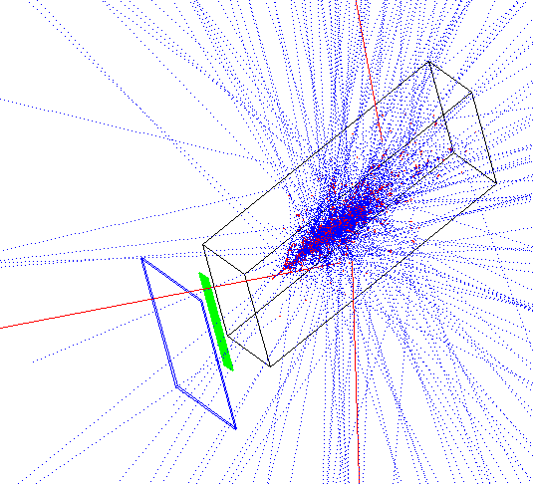
GEANT3 Simulations
Originally assumed a Cherenkov-style detector with number of photoelectrons proportional to number of particles incident on detector
Not easy to build such a detector with needed granularity
Switched to diamond detector – record total energy deposited in each strip for a single laser strip
Detector components:
1 mm W converter
500 strip diamond detector, 1 x 5 cm
W/SciFI calorimeter (not really relevant here)
Simulation = 100,000 backscattered photons
Assuming 10,000 photons/laser pulse = 10 laser pulses

Slide 4
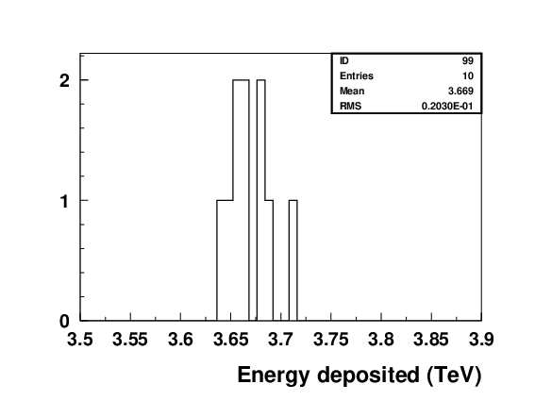
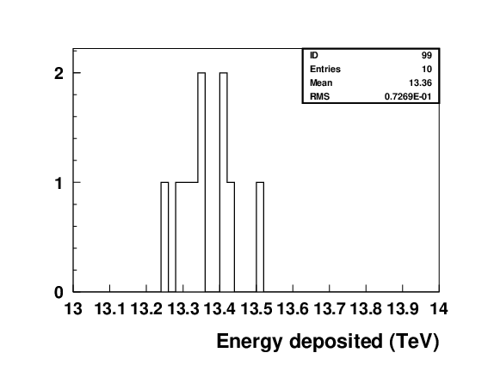
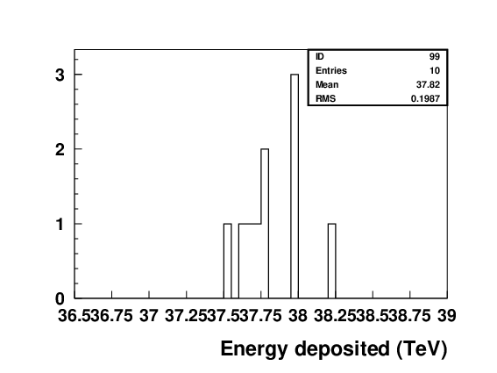
Energy deposited in Photon Detector
Assuming ~10,000 backscattered photons per laser pulse, large amount of energy deposited in photon calorimeter:
5 GeV → 3.7 TeV
10 GeV → 13.4
18 GeV → 37.8 TeV
5 GeV
Energy per laser pulse
18 GeV
10 GeV

Slide 5
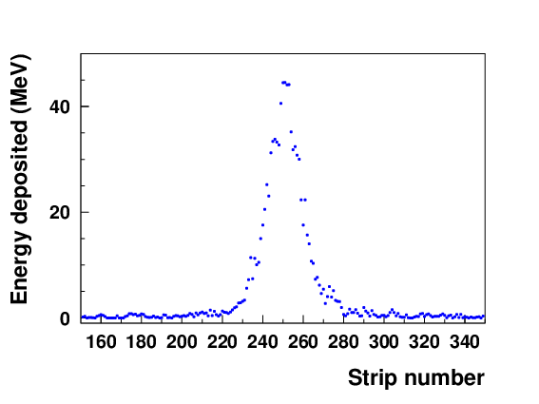
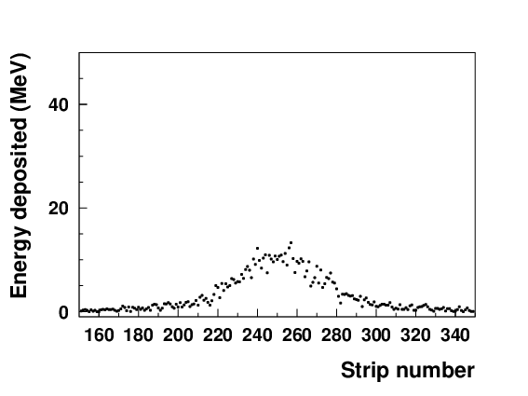
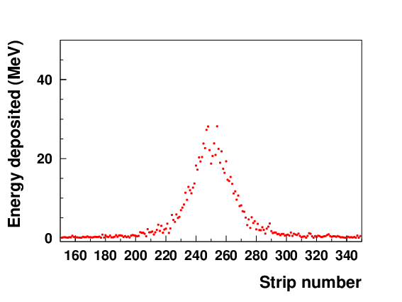
Energy Deposited in Diamond Strips
18 GeV
5 GeV
10 GeV
2 cm

Slide 6
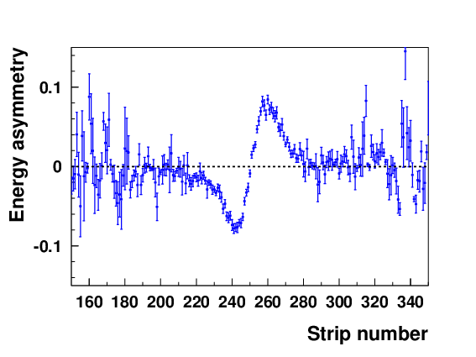
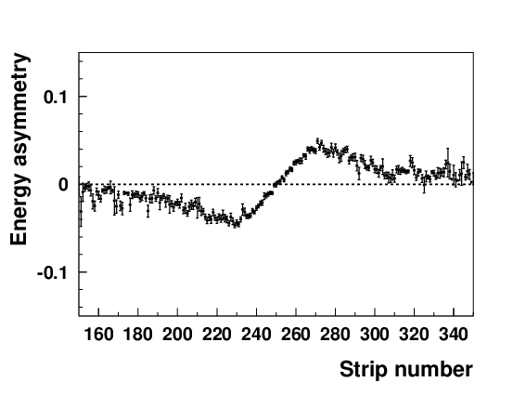
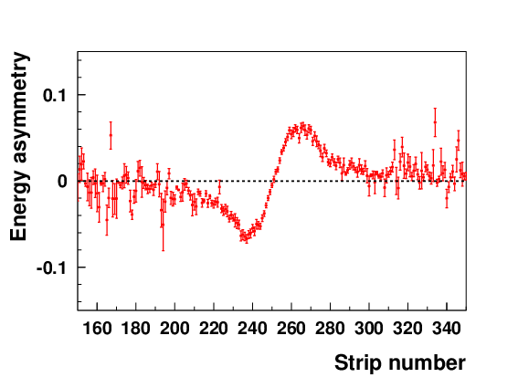
Energy Asymmetry
Transverse polarization will be extracted using asymmetry in energy deposited in each strip
18 GeV
5 GeV
10 GeV

Slide 7
RCS to-do list (still)
Get realistic beam parameters for RCS laser IP
  Due to RCS design questions, this will probably not be soon
Add 5 GeV, 10 GeV
Perform robust estimates of measurement times using this technique
Add another plane for measurement of out in-plane polarization
Check sensitivity to residual longitudinal polarization

