Slide 1
NASA 21st Annual Review of the NSRL Performance: 1/2023 – 9/2024 NSRL Operations
Mike Sivertz
20 November 2024

Slide 2
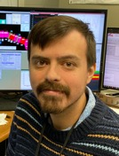
NSRL Operations Team
Mike
Sivertz
Xiaodong
Jiang
Scientific
Operations
Administrative
(not NSRL funded)
Trevor
Olsen
Jessica
Gasparik
David
Inzalaco
Malcolm
McCarthy
Cassandra
McCormick
Wendy
Morrin

Slide 3
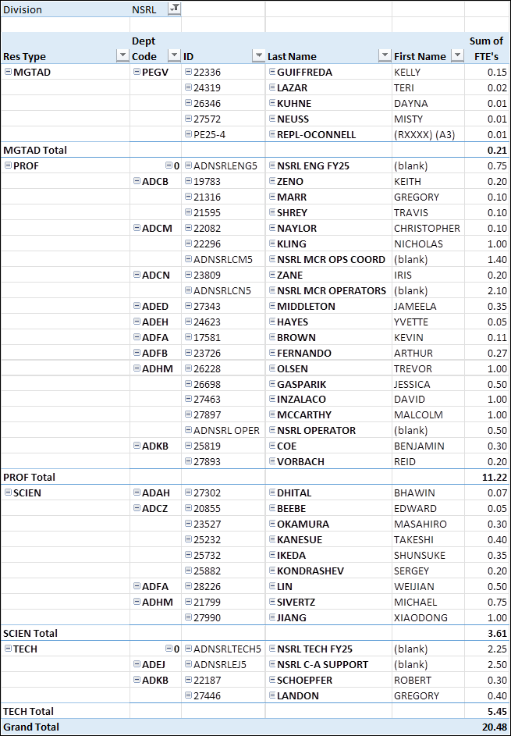
All NSRL related Labor: 20.48 FTE
GUV Center total: 0.21 FTE
MCR Operations Coordinator: 1.4 FTE
MCR Operators: 2.1 FTE
NSRL Ops: 3.5 FTE (Jessica is half time)
EBIS & LION Support: 1.8 FTE
NSRL Scientists: 1.75 FTE (Mike is 0.75)
Generic CAD Tech Support and Rad Techs: 4.75 FTE

Slide 4
Capabilities of NSRL Operations Personnel
Xiaodong Jiang: Deputy Principal Investigator for NSRL
Hired 4/15/24,
taking solo shifts since 9/24,
owner of a CRADA for ion fragmentation measurements,
co-PI on a research grant to test AI inference susceptibility with NSRL beam.
Trevor Olsen: NSRL Operator
Hired 1/2019 for operations,
taking solo shifts as of 1/2022 until 7/2024.
Working with Kevin Brown to develop a model for the NSRL beam dynamics from the Booster to the Target Room.
Jessica Gasparik: NSRL Operator, shared with Environment and Climate Sciences Department since 10/2023
Hired 10/2020 for operations
Taking solo shifts as of 9/2021
Data acquisitions system expert
Authoring papers on DAQ, Time of Flight, and Beamline secondaries
David Inzalaco: NSRL Operator
Hired 1/2023 for operations
Taking solo shifts as of 9/2023
Shipping coordinator (responsible for receiving and shipping 113 shipments this past year.)
Authoring papers on Thermal neutron shielding, Spread Out Bragg Peak
Malcolm McCarthy: NSRL Operator
Hired 1/2024 for operations
Taking solo shifts as of 8/2024
Builder of Booster interface apps
Updating NSRL web pages
Authoring papers on Neutron beam studies, Calibration Correlations and Time of Flight energy measurement
Petra Adams: MCR Operations Coordinator
Cross trained for NSRL operations
Not yet approved for solo shifts

Slide 5
Impact of EBIS Performance due to Additional Tandem Hours
History
NSRL was down for the summer of 2022 to allow for the Extended EBIS installation. The fall run, 22C, was going to use the Tandem as ion source, except DOE shut down Tandem.
The fall run of 2022 was nearly completely cancelled. A handful of users, NASA and non-NASA, were accommodated by starting up the LINAC to provide protons.
EEBIS was not ready for the 23A startup. We began using Tandem ions for electronics testing in January through the end of March. Radiobiology testing was scheduled to begin 19 April 2023, but the EEBIS was operating in a limited low charge state mode.
EEBIS could not provide Fe ions in the 20+ charge state, so in order to deliver the GCRSim, Tandem was called into service again to provide Fe beam.
In addition, the same charge state deficiency affected the Ti beam, limiting the Ti energy to 650 MeV/n instead of the canonical 1000 MeV/n.
The Helium beam normally uses the 2+ charge state, which was unobtainable from EBIS, so we ran 1+ He ions at 250 MeV/n. This allowed contaminants in the beam (Carbon, Oxygen) to be delivered simultaneously. To filter out the contaminants, we ran the Helium at higher energy and inserted degrader to both reduce the He energy to 250 MeV/n and range out the C and O.
In this way NSRL needed to make use of the Tandem until the end of May when EBIS shut down for vacuum work. This additional use of Tandem, from January through May, was at an additional cost of approximately $2.25M. In June NSRL opened for electronics testing using EBIS only for the ion source.

Slide 6
Impact of EBIS Performance due to Additional Tandem Hours
History (continued)
In the fall of 2023, the LINAC was off as usual, requiring the Tandem to provide protons for the NASA radiobiology. NASA and electronics testing continued until 1 December 2023 when NSRL shut down for maintenance until 8 January 2024.
In January electronics testing including MDA began again using EBIS as ion source. On 15 April the NASA radiobiology run 24AB began. Since LINAC was running, no Tandem usage was needed. Radiobiology continued until 21 May.
Electronics testing restarted at that time using EBIS running continuously until the end of September 2024, except for a two week break in July to allow EBIS time to tune Au beam for RHIC. This effort was ultimately unsuccessful, and RHIC running in late 2024 would require Au ions from Tandem which impacted NSRL operations in 24C and necessitated a 4 month shutdown (November 2024 – March 2025) to allow for the rebuild of the EBIS Long Trap.
Fire in the EBIS solenoid power supply delays the maintenance/upgrade work. Revised schedules still being determined.
Three occasions when a biology experiment was compromised and one electronics test was ruined. In every case, better attention to operations would have prevented the error. In every case, better communication with NASA would have made improved the situation. Additional operational safeguards have been implemented to prevent repeats of these errors. Ultimately successful operations relies upon the undivided attention of the NSRL staff. We are all committed to doing a better job in the future.

Slide 7
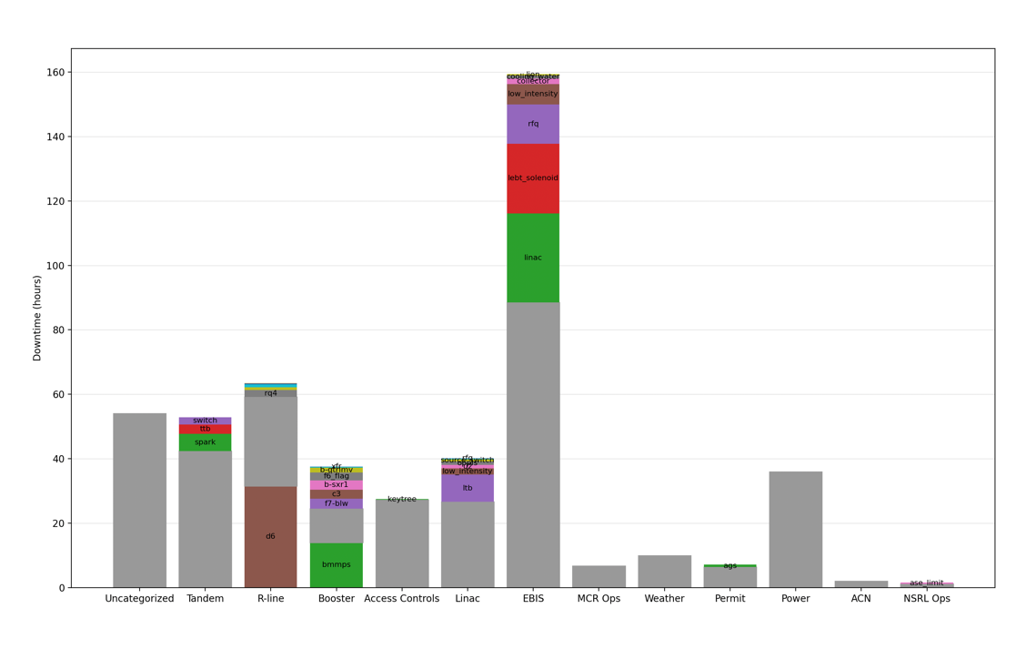
Downtime: 2023 - 2024

Slide 8
NASA Hours of Running
Campaign | NASA Hours | Non-NASA Hours | Total (including Set-Up and Down Time)
Run 23A/B | 151:26:16 | 553:46:25 | 1289:55:29
Run 23C | 189:06:38 | 987:07:55 | 1720:38:05
Run 24A/B | 52:59:29 | 750:19:00 | 1303:09:29

Slide 9
MDA / TRMC Activity during the reporting period
MDA ran from 13 Feb – 25 March 2023 351 hours
21 Aug – 30 Sept 2023 340 hours
12 Feb – 2 March 2024 266 hours
TRMC ran from 3 June – 15 June 2024 216 hours
21 June 2024 (make up day)
2 July 2024 (make up day)
9 Sept – 28 Sept 2024 210 hours
Total Jan 2023 – 30 Sept 2024 1383 hours
For a detailed report on the revenue accrued from non-NASA users, please see Wendy’s report.

Slide 10
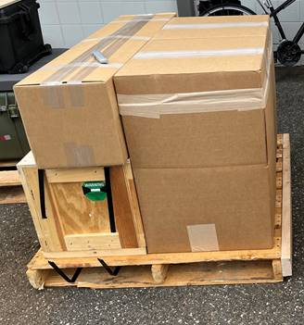
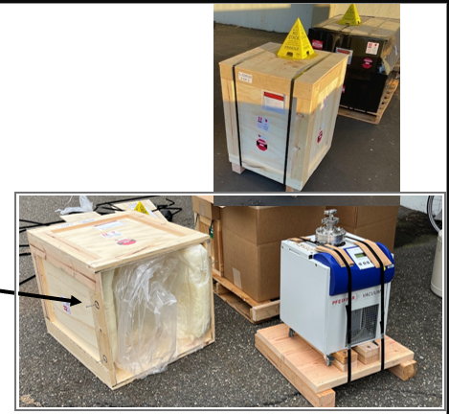
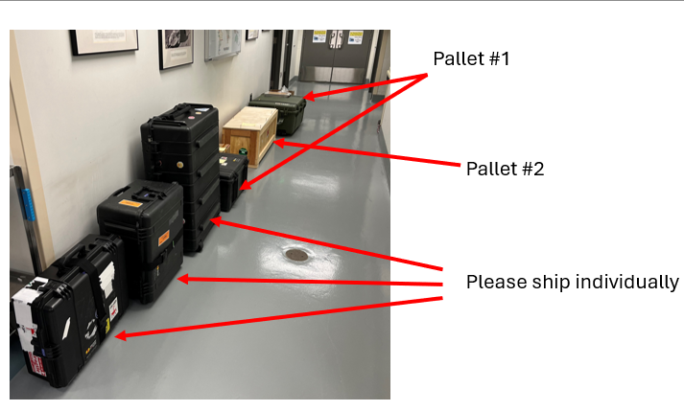
Shipping to/from NSRL
Shipping to and from NSRL for electronics testers has grown to be a huge job. Cassandra and David have
taken it on, from tracking incoming shipments, storing and unpacking them when they arrive. Separately
monitoring activated materials from many groups at the same time, and packing everything up when it is
all ready to go out. Packing, strapping, wrapping, palletizing, rigging…

