Slide 1
NSRL Upgrades
Mike Sivertz
20 November 2024

Slide 2
EBIS rebuild and
LION-II Installation Status and Commissioning

Slide 3
EBIS Rebuild and
LION-II Installation
Status and
Commissioning
(details)

Slide 4
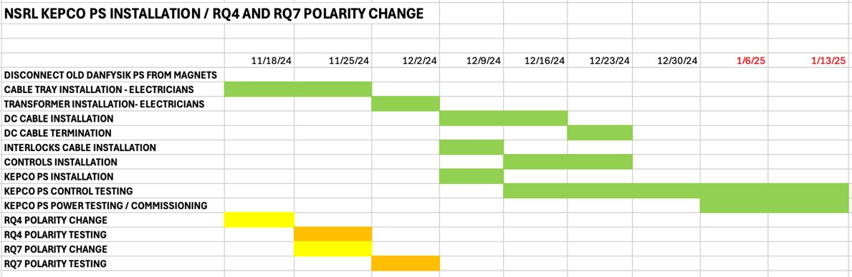
R-Line Power Supply Upgrade

Slide 5
RFQ Pulsed Power Amplifier Cost and Schedule
Specifications Quote
After months of searching
for a replacement/spare
power supply for the RFQ
Linac, a manufacturer was
found willing to quote on
the job.
Cost: $771,750/each
Lead Time: 18 months or
3 years (?)

Slide 6
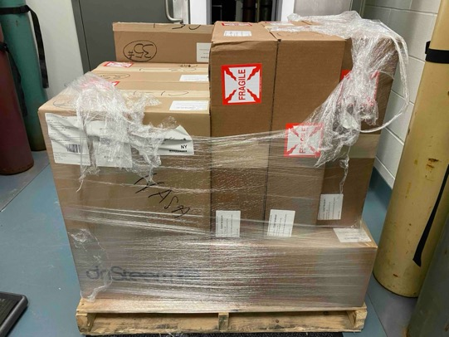
AC for Animal Rooms
Completed.
Humidifiers waiting to be installed.
We have operated for ~21 years with a
single humidifier serving all 3 animal rooms.
Soon each room will have its own temperature
and humidity controls.
Scheduled for installation: 1 March 2025.

Slide 7
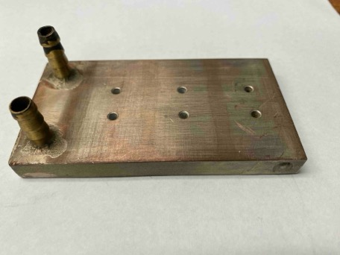
Heat Sink Replacement for the D-6 Magnet Power Supply
The D-6 magnet in the Booster is used to extract beam from the accelerator and deliver it down the NSRL beamline. It is powered by 108 circuit boards, each with 6 high power transistors (FETs) on the card. The transistors need to be cooled, so they are mounted on a solid copper heat sink with a cooling water channel machined into it. The water channel leaks over time, dripping water onto the FETs, shorting out the card, and often the water drips down shorting out any cards beneath the leaking one.
An attempt was made 3 years ago to redesign the heat sinks. After replacing all 108 it was discovered that the new heat sinks injected a large noise into the power supply, overloading
the FETs, shorting them out. The new heat sinks were removed, and the old heat sinks were remounted. New heat sinks of the old design were machined, without the feature that develops a leak. We have been swapping old for new whenever there is a leak, but over the break we will swap out all the old heat sink so the D-6 power supply will not be subject to leaks any more. Completion date: 31 Dec 2024.

Slide 8
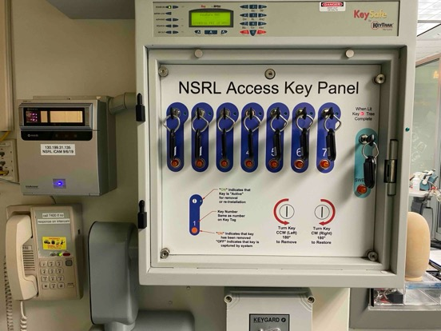
Access Controls Upgrade
Information from Jonathan Reich, Access Control
The KeyTrak key tree system currently in use is no longer supported by the manufacturer. We need to plan for its replacement.
For the large project of completely replacing the NSRL Access Control System (ACS) which has equipment that is unsupported by Rockwell, we were expecting to upgrade the NSRL ACS as well as the operatorless access subsystem at the NSRL Beam Gate.
The materials cost for this full replacement would be approximately $150k, the labor cost would be approximately $250k, total project cost would be about $400k +/- 10%.
This will begin with walkdowns, design of layout, design of components, and logic. We will also evaluate updating the User Controlled Access system as part of the total upgrade.

Slide 9
GCR Sim Cut Off Chamber
&
1024 Pixel Chamber
Have been put on hold for now.
Mechanical construction is largely complete.
(Jon Hock retired)
Readout electronics not being developed.
(Steven Jao out on disability)
The need for these detectors is being re-evaluated.

Slide 10
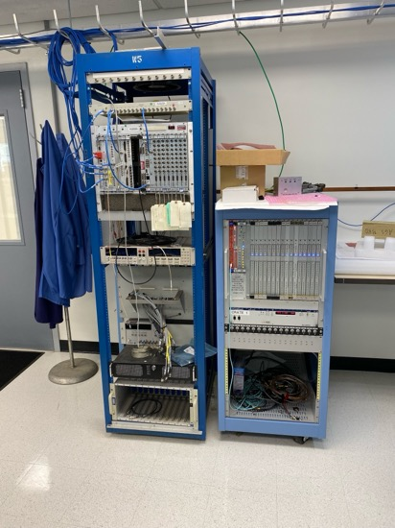
NSRL Control System Development and Test Station
The NSRL Control System and
Dosimetry Development Test Stand
is set up in Building 925 and
operating for code development
and testing of new components.
As the new control system code is
written, it will undergo testing first
before porting over the NSRL.

Slide 11
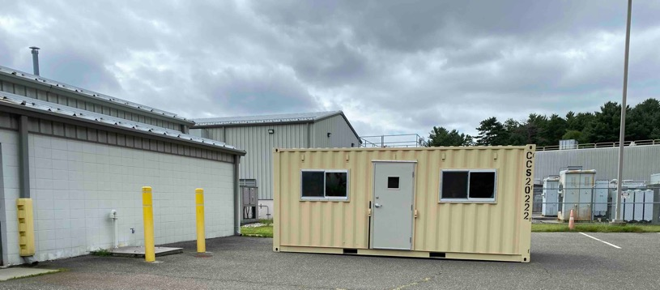
Trailer Corridor / Walkway Estimate
Trailer situated,
leveled,
powered,
ready for occupancy.
Design and cost of
walkway to/from
NSRL not completed.

Slide 12
Trailer at 958
Considerations regarding the Corridor to Building 958

Slide 13
Trailer Location
The corridor between the Trailer and the
Building 958 restricts access to Septic sump,
the Utility Hall, and the Standpipe for Firefighting.
If an enclosed walkway were built, it would make
the only access to the “Percival” doorway through
the Trailer.
Trailer
Corridor
This is the door we plan to enter and exit
the building from the trailer.

Slide 14
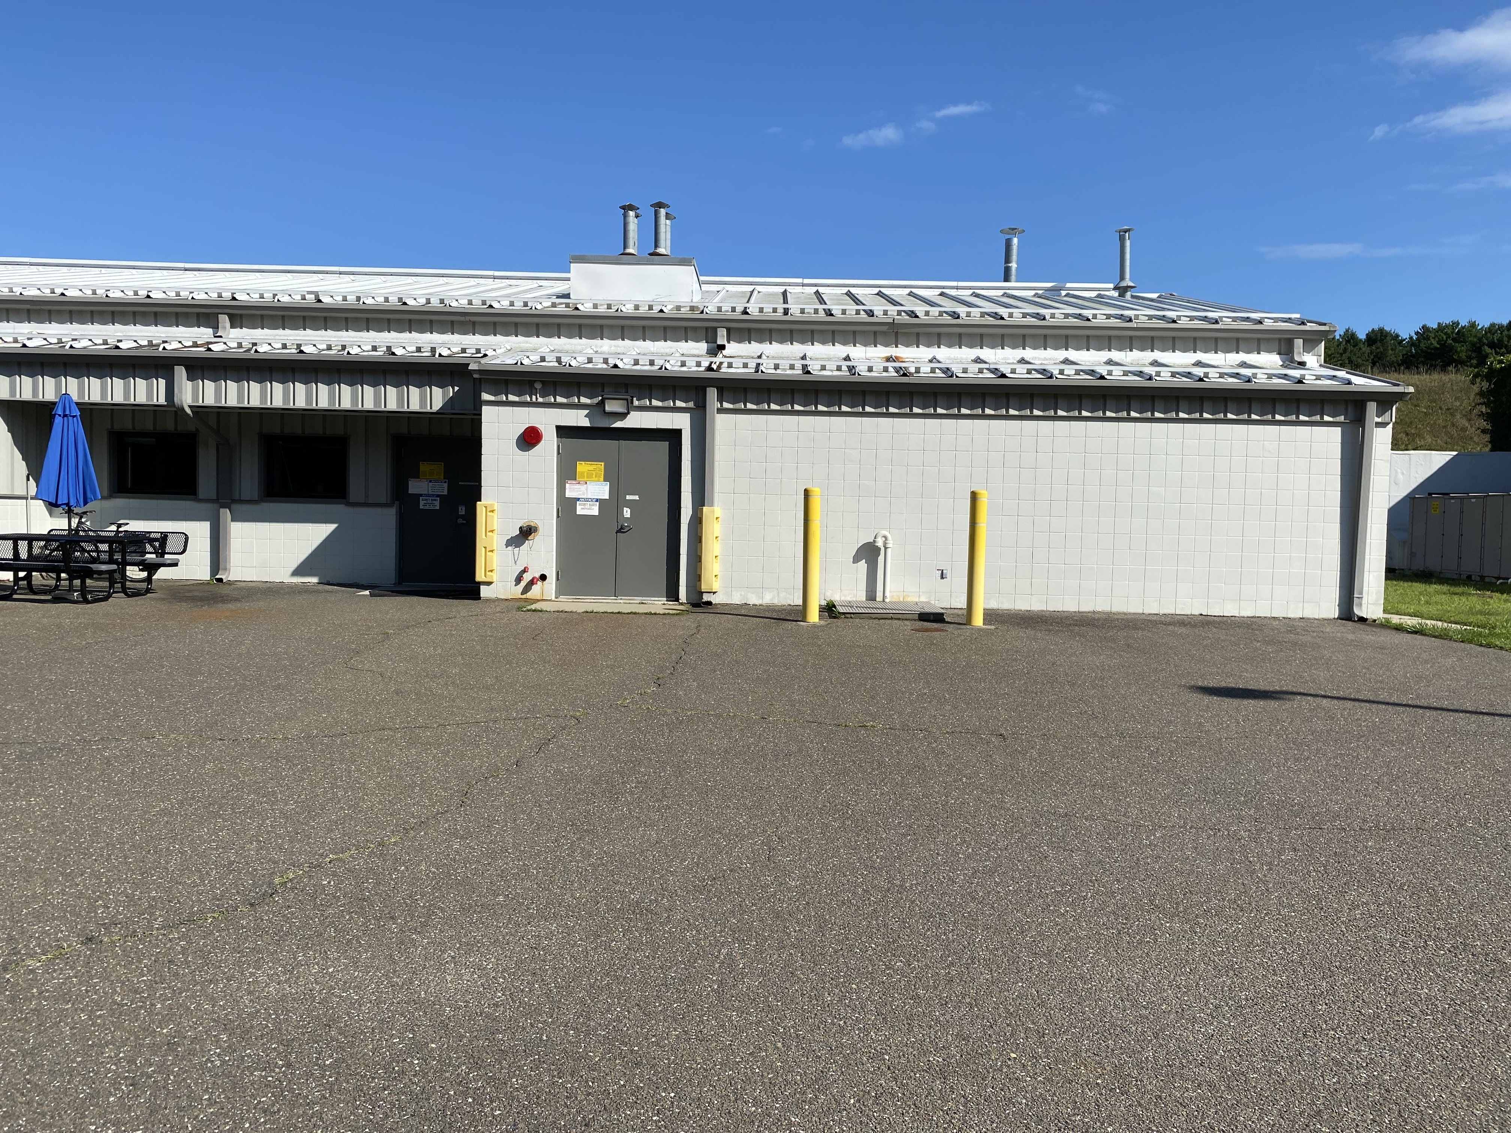
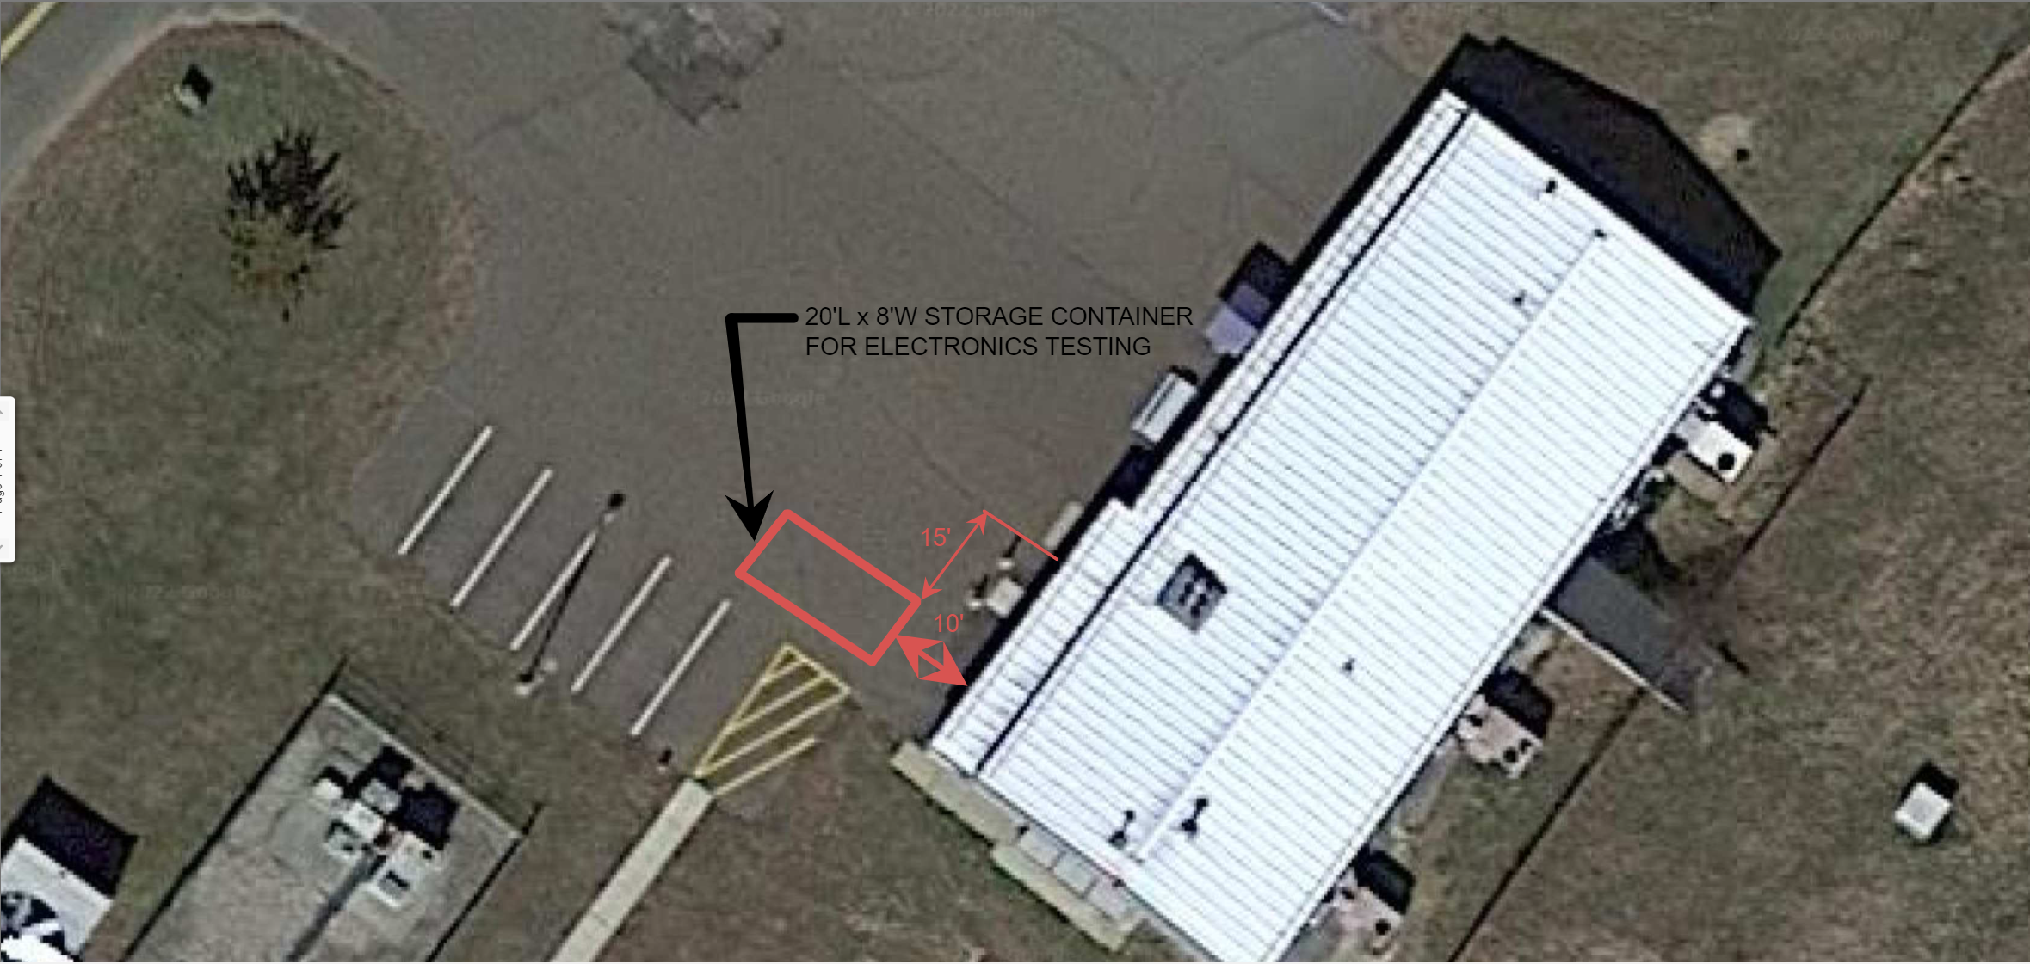
Trailer Location

Slide 15
Trailer Location
Access to
septic sump
This is the door we plan
to enter and exit
the building from the trailer.
Access to the utility corridor
Trailer Footprint
Standpipe:
For firefighter access

Slide 16
Trailer Location
Trailer
Corridor
If the Trailer were to be located on the North side,
then the corridor restricts access to the Animal
Side doorway, and the main doorway.
This is the door we plan to enter and exit
the building from the trailer.

Slide 17
Unfilled Orders, Procurement Status, Timing,
Contract Close Out, Invoicing
We have the following outstanding commitments and/or expected trades charges for the remainder of the Improvements work:
Approximately $2,032 (fully-burdened) remaining in open commitments (project 24445)
  If they do not cost before 12/31/24, these will be moved to FY25
Assigned trades work costs that need to be moved to the Improvements account (27229) for work on the AC, MSP & Kepco Power Supplies
  we have been waiting for the remainder of the hours to provide power to the MSP and for the updated FY25 rates; but these will be charged to 27229 before 12/31
  this is expected to be a little over $30K
Workorder for the estimate for the walkway/awning between the MSP & Bldg 958 – Improvements project, 27229
  Expected to be completed and charged to 27229 before 12/31

