Slide 1
NSRL Future
Mike Sivertz
20 November 2024

Slide 2
Beam operation priorities: NSRL vs RHIC experiments
Rule #1: RHIC experiments always take the top priority, NSRL waits quietly for its turn.
RHIC Experiment Modes NSRL Experiment Modes
Commissioning:
Beam development/
Detector development
Parasitic:
lucky if you get anything.
Science Production
Stable beam in RHIC, AGS, Booster, Injector
Commissioning:
Beam development/Experiment set-up
Science Production
Stable beam in Booster, Injector
and at the NSRL beamline

Slide 3
Proton source alternatives
LINAC when it is running. Peak intensity ~2E11 protons/spill
Tandem when LINAC is not running. Peak intensity ~1E10 p/spill
Attempts made to deliver protons from EBIS. Although EBIS was capable of producing a beam of protons, there was never any successful capture of the protons in the Booster. This was due to the inability of the Booster to operate at a low enough and stable enough magnetic field to get the 2 MeV protons to circulate prior to acceleration.
To get protons from EBIS into the Booster, they need to have at least the rigidity of Helium beams. To get higher rigidity, increase the energy or increase the “mass”.
Masahiro has some good ideas…

Slide 4
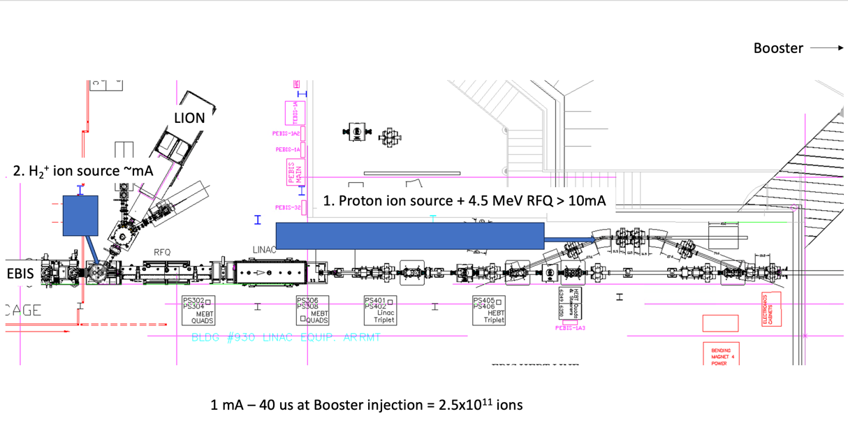
Two proposals for protons from EBIS

Slide 5
Proton Injector using ³He⁺ beamline

Slide 6
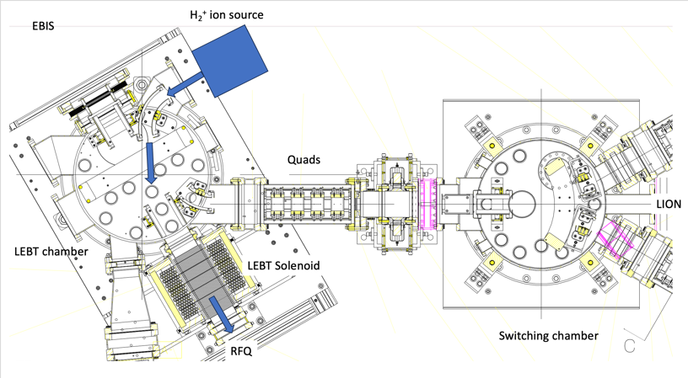
Molecular H₂⁺ using EBIS beamline (but not EBIS)
To EBIS
To Booster

