Slide 1
NASA Space Radiation Laboratory
(NSRL)
Contract Closeout Review
11/20/2024
Prepared by: Wendy Morrin

Slide 2
Contract Summary—80JSC020T0003
Period of Performance: CY2020-FY2024 Operations
($ Thousands)

Slide 3
Funding Summary—80JSC020T0003
Period of Performance: CY2020-FY2024 Operations
($ Thousands)

Slide 4
Contract Status (80JSC020T0003) as of 10/31/2024
($ Thousands)

Slide 5
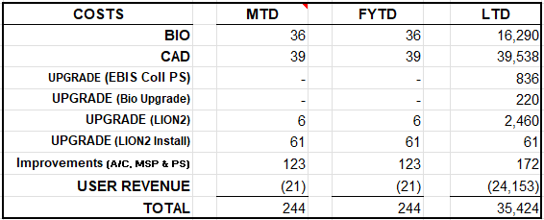
Budget vs. Costs to Date by Dept.
(80JSC020T0003) ($ Thousands)

Slide 6
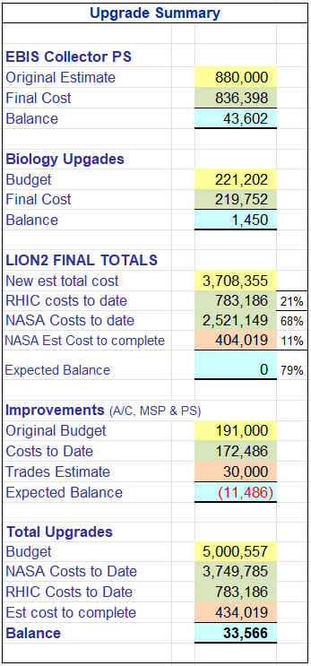
Upgrades

Slide 7
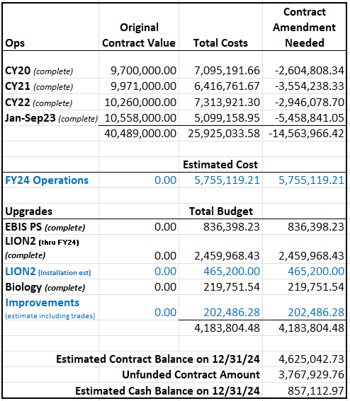
Original Contract Value vs Costs to Date
(80JSC020T0003)

Slide 8
Unfilled orders plus costs
Procurement status, timing with contract close out/invoicing
Unfilled orders
  Only about $6K in commitments remain in Operations
    They will either be costed prior to 12/31/2024, or the commitments will be moved to the FY25 accounts
Procurement status – Improvements
  Purchases for A/C, Modular Storage Pod (MSP) & Kepco Power Supplies – COMPLETE
  The only costs remaining are the Trades charges for the installation & set-up, and the estimate for the walkway/awning from Bldg. 958 to the MSP
LION2 Installation
  Work is continuing, but has been delayed due to a fire in the EBIS building
  No charges will be allowed on the account for this contract beyond 12/31/2024.
    Possible timing issue with work done after 12/18, due to timecard period lockout; also weekly employees whose last week of Dec won’t be charged until Jan

Slide 9
Contract Summary
Contract 80JSC020T0003 covers operations through 12/31/24
  Cash on hand is ~$1.3M as of 10/31/2024
    $1,160.7K for C-AD
      ~$3K in commitments remaining from Operations
      $465.2K was set aside for the LION2 installation
        $404K remains - to be completed by 12/31/2024
      NSRL Improvements (A/C, Modular Storage Pod (MSP) & Kepco Power Supplies) – purchases are COMPLETE. The following costs remain:
        Approximately $30K of assigned trades
        Cost for Trades to provide an estimate to build the walkway/awning from Bldg. 958 to the MSP
          All to be completed by 12/31/2024
      None of the above upgrade costs are included in the FY25 rate structure
    $136.4K for Bio
      There is about $3.4K in commitments remaining

Slide 10
Maintained stable rate structure
1/1/23-9/30/23
EBIS was down for an extended period, from January 2023 through May 2023. As a result, NSRL needed to rely on Tandem, instead. This resulted in an additional $2.25M in unexpected cost that year.
An additional challenge was that MDA scheduled 1,000 hours of beamtime and only ran 692 (prompting a change in policy to charging for scheduled hours)
  Despite this challenge, the user rates were kept steady, and the variance was held at ~5%.
  This was accomplished by delaying some purchases and some LION2 work
    The original estimate was
      NASA – 1,200 hours, Users – 1,800 hours
    The actual hours were:
      NASA – 800 hours, Users – 1,367

Slide 11
Maintained stable rate structure
FY2024
NSRL had the pleasant surprise of a glut of self-pay user hours
This allowed for the addition of several improvement purchases, including the purchase of the Modular Storage Pod and the Kepco Power Supplies and the pre-payment of a large portion of the D&D
The User Rates were maintained, with less than a 2% variance
      The original estimate was
        NASA – 1,200 hours, Users – 1,375 hours
      The actual hours were:
        NASA – 601 hours, Users – 2,099

Slide 12
Self Pay Users

Slide 13
New Contract
80JSC024TA024
FY2025-FY2028

Slide 14
Contract Summary - 80JSC024TA024
Period of Performance: FY2025-FY2028 Operations
($ Thousands)

Slide 15
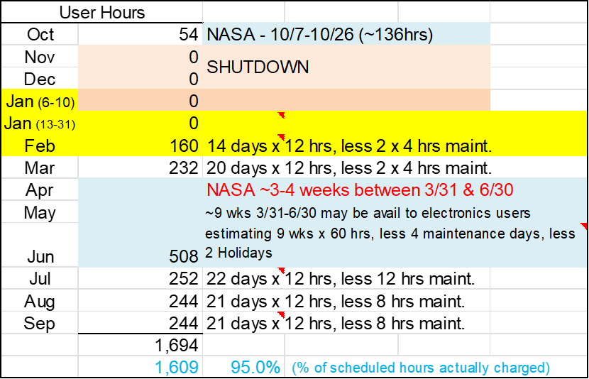
FY25 User Rates
Calculation for available hours
for self-pay users

Slide 16
FY2025 Estimates for Costs & Revenue by Month

