Slide 1
Electronics and DAQ WG Meeting 10/10/2024
Agenda
Announcements
Pre-TDR review process
Next week lpGBT in FEB/RDO?
Issues That came up preparing for pre-TDR Draft
More descriptive FEB / RDO Labeling System
FEB / RDO distinctions and part in protocol
lpGBT vs FPGA
Clock’s
Readout Cartoons and counts
Positions of Electronics for Radiation Estimates

Slide 2
Pre-TDR Review Process:
In Zenodo:
"EIC preTDR - Chapters 2 and 8, DRAFT, Version0.1".
Directions for getting into the ePIC “Community” on Zenodo are listed in the general meeting talk:
(https://indico.bnl.gov/event/22602/contributions/88353/attachments/55269/94564/ePIC%20Collaboration%20News%2014%20June%202024%20rev2.pptx ),
slides 10 and 11.
There are internal reviewers, but everyone is encouraged to read and give feedback to the collaboration at:
https://forms.gle/iBtcGrFCbdRaRuuF9
Feedback deadline is October 20th

Slide 3
A) FEB/RDO names?
Issues That came up preparing for pre-TDR Draft
More descriptive FEB / RDO Labeling System
RDO

Slide 4
Should we make a more descriptive naming scheme for FEB/RDOs?
A) FEB/RDO names?
Type |  | Technology | Clock |  | #In |  | Down BW (gbs) |  | #Out |  | UP BW (gbs) |  | Version | Total
AGG | - | L | 40 | : | 16 | / | 1.28 | - | 1 | / | 4.18 | - | 1 | AGG-L-40:16/1.28-1/4.18-1
AGG | - | F | 100 | : | 32 | / | 0.08 | - | 1 | / | 10 | - | 1 | AGG-F-100:32/0.08-1/10-1
 |  | L=lpGBT F=FPGA
CMS
Jermiah Mans’
Presentation to TIC:
Detector Database
(Construction
planning DB)
Is this something we should do? Are there any existing schemes? opinions about what to encode?

Slide 5
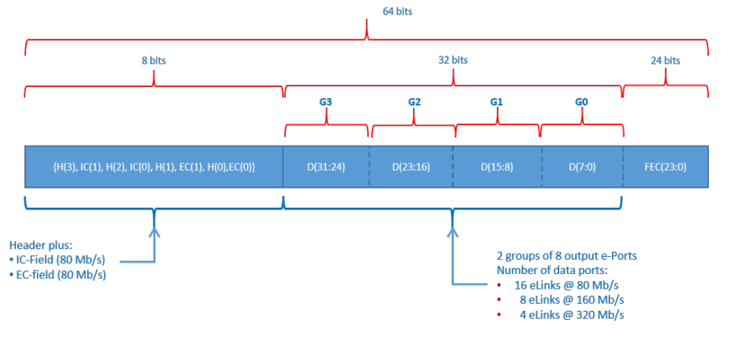
B) Protocol Impact of lpGBT
V0.1 Data frames: Downlink: 64bits – 10.15ns
uplink: 64bits – 10.15ns (Frame definition TBD ~6.4 Gb/s) (8 Gb/s raw)
V0.1 ALCOR (VTRX+) Downlink: 32bits – 10.15ns (Frame definition TBD ~3.2 Gb/s) (4 Gb/s raw)
uplink: 64bits – 10.15ns (Frame definition TBD ~6.4 Gb/s) (8 Gb/s raw)
lpGBT: Downlink: 64bits – 25.375ns
uplink: 256bits – 25.375ns
Positional # of bits x 40MHz → Translated to serial line bits/sec
On each elink
(2 → 80 Mb/sec, 32 → 1.28 Gb/sec)

Slide 6
B) Protocol Impact of lpGBT
Periodic Sync
CMD
Offset to BX based units
FEB
100MHz Frames
RDO
100MHz Frames
Periodic Sync
CMD
100Mhz Frames
100 Mhz Frames
GTU
Time Tag in100 MHz based units
Relative to Last Sync
40MHz Frames
100Mhz Frames
100 Mhz Frames
FEB
40MHz Frames
RDO
40MHz Frames
40MHz Frames
Time Tag in 40 MHz based units
Relative to Last Sync
“FEB” -> “RDO”
Positional bit fields is wasteful (lots of NOP) So must be different from RDO/DAM link protocol
Offset + scaling to BX based units
lpGBT
is always
“FEB”
Need to rethink commands. Ex. no BX needed/ or even defined here
Handle as much messaging in DAM as possible,
Lighten the protocol to the RDO.

Slide 7
C) Readout Cartoons
ETOF
Flat over Sensor
Plane
Come up with a format
Sensor Plane
South Platform
DAQ Room
How many Sensors?
Staves?
BPOL?
Heat/cooling
Service Hybrid
On Det
Patch
RDO
DAM
A Powerpoint Slide for each detector
An excel sheet with the total number of each component
An excel tab for each component / spec etc…
DSCs should supply info – but either Electronics and DAQ or TIC should organize it.
X,Y,Z positions of each type of electronics (or a specified range of values)
AC-LGAD Sensors
EICROC
Bump Bonded to Sensor
Up to 2xlpGBT
VTRX+
Pigtails
X(cm)
UltraScale+
FPGA
Fiber. up to 48 RDO / DAM
VTRX+
Fiber
(XX)
SFP+
Power?
Cooling?
Power Supply
Connector on Stave
To connector on Service
Hybrid
(differential serial 160Mhzx28 up)
(differential serial 80Mhzx28 down)
Up to 28 ASICs / Service Hybrid
Power
Cables

Slide 8
D) Positions of Electronics
Possibly related to previous. We need x,y,z positions for electronics…

