Slide 1
Electronics & DAQ WG
Fernando Barbosa (JLab)
24 October 2024

Slide 2
Welcome & News
News – TDR, Director’s Review, …
VTRX+ Fiber Routing – Fernando, Jin, Irakli
Power Distribution – Tim, Irakli
lpGBT – Tonko
RDOs – Norbert, Gabor, Miklos
AOB

Slide 3
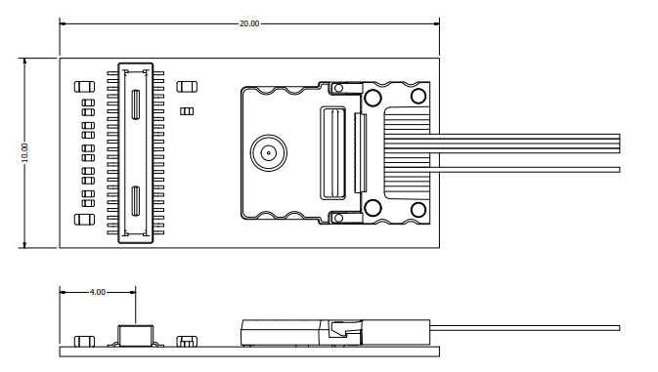
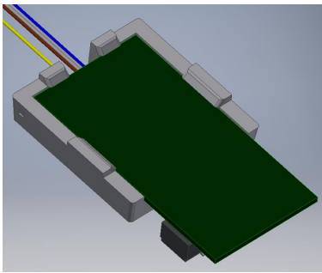
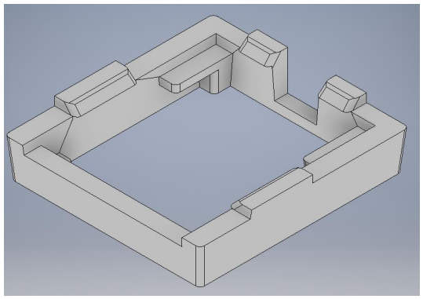
VTRX+ Dimensions
Clip = support

Slide 4
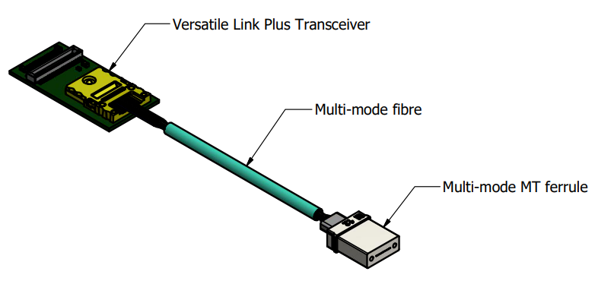
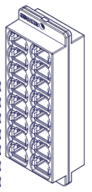
VTRX+ Pigtail Length Determination - Preliminary Fiber Routing Implementation
Fibers to DAQ
FEB or RDO
VTRX+
Fiber Trunk
Fiber Aggregation:
In-line or panel
Fiber Patch/Feedthrough/Disconnect Panels
(fixed to detector)
Detector
Feedthrough options for MTP fiber connectors/ferrules: Single, 1x4, 1x6 and 2x8.

Slide 5
Routing Options:
VTRX+
If up to 2 m
MT
A)
If longer than to 2 m
B)
Coupler
C)
FEB
Min ~ 30 mm
R
Specify any length
* Short pigtail w/ coupler attached to FEB. Suggested by Irakli.
R > 15 mm

