Slide 1
ePIC Phone Book Access and Policies
10/30/2024
J. Lajoie

Slide 2
Action Items …
Action items after 10/10 call with Alexei Klimentov, Peter, Silvia and JGL
  JGL to find 10-20 people to test access to Phone Book through federated login (InCommon Comanage):
    What problems do people run into? How do we streamline instructions?
  ePIC to define desired access and granularity
    Work with Ad-hoc Collab. Tools and CC Leadership
    Write down requirements and pass along to SDCC via Alexei for implementation
    Following slides deal with the question of phone book access

Slide 3
Experience with InCommon Comanage
Ultimately 3/10 with unresolved issues:
  Yongsun Kim (Sejong U): Sejong not in list of institutions in Comanage
  Charles Hyde (ODU): 3-4 step process but was able to connect
  Sylvester Joosten (ANL): Failed, had to enroll, added ORCID and wait to be approved. Able to access in private browser.
  Asmita (IITB): Failed, asks for BNL login?
  Francesco Bossu: Failed, CEA error message.
  Pietro (INFN): Previously registered INFN, all good.
  Hamlet (YERPHI): A.I. Alikhanyan National Science Laboratory (AANL) not in institution list
  Rachel Montgomery (Glasgow): Had to register in Comanage, took a few days for approval but worked.
  Paul Newman (Birmingham): Same experience as reported by Rachel.
  Carlos Munhoz Camacho (IJCLab): Works except for "Representatives" tab (access denied)

Slide 4
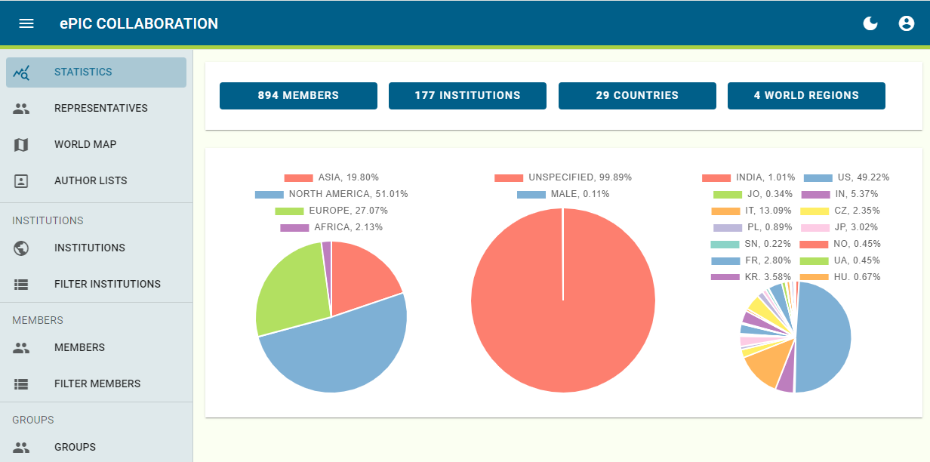
ePIC Phone Book is “live”
Currently available at epic-eic.org
Federated (InCommon Comanage) required to verify identity
  Question: Why InCommon Comanage instead of InCommon Federation?
  Collaboration already familiar with InCommon Federation (Indico)
Full access available once identify verified by Comanage
  Includes member information
  and members per institution
  Member information currently
  just name, email and institution –
  BUT database has capability
  to store much more

Slide 5
Levels of Access
What levels of access do we want?
  Is it OK that anyone (ePIC and non-ePIC) can access member and institution information?
    This is how it is done for EICUG and sPHENIX, for example
    Do we want a public and ePIC-member level of access?
  What granularity do we want for ePIC members?
    What information about users and institutions do they get to see?
Comments:
  Right now we store very little information in the Phone Book. We need to be practical, let’s not get lost in protecting information we don’t currently plan to store, as we add information we can update the policy.
  If we have to twist ourselves in knots to protect some information, then maybe we should question the wisdom of storing it?
  Concern is primarily over demographic information for individuals
    Gender identity frequently raised as a concern – useful to have for aggregated statistics, but needs to be protected for individuals.

Slide 6
Draft Idea for Levels of Access
Define access levels, and allowed access at each level. Anything not explicitly allowed is not available.
  Protects new information as it is added.
Suggested access levels:
  PUBLIC:
    Ability to search for name and get email and institution, or search by email and get name and institution
  ePIC MEMBER:
    An “ePIC member” is defined by being present and active in the ePIC Phone Book
    Full ability to view name, email, institution, and WG/DSC affiliation of members
    Can view membership by institution
  ePIC CC MEMBER:
    As ePIC Member, but can view all information for their individual members of their institution
  ePIC MANAGEMENT:
    Defined as SP and CC leadership (should this include more, coordinators, etc.?)
    Full access to view all member information (including demographic information?)
  ADMIN:
    Full read/write access to all information, individual and institution

Slide 7
Comments/Questions on Access
Am I making things too complicated by distinguishing between “PUBLIC” and “ePIC MEMBER” access. Other collaborations (EICUG and sPHENIX, for example) don’t do this?
  Simpler is always better, but an institution’s individual membership in ePIC might be sensitive?
Would like to present this as a proposal for discussion at 11/1 General Meeting.

