Slide 1
mRICH Performance Study Angular Resolution
Cheuk-Ping Wong
Georgia State University
11-04-2016

Slide 2
Outline
number of sigma (separation power) of mRICH
Source of error of measuring Cherenkov Angle of a simple RICH detector
Errors in mRICH lens based design
Number of sigma from simulation result of mRICH
Feasibility of proximity focusing design

Slide 3
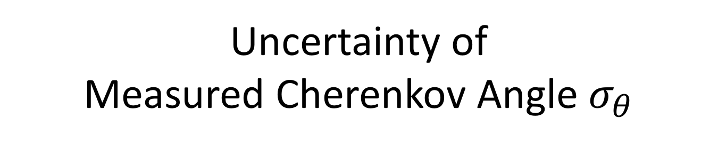
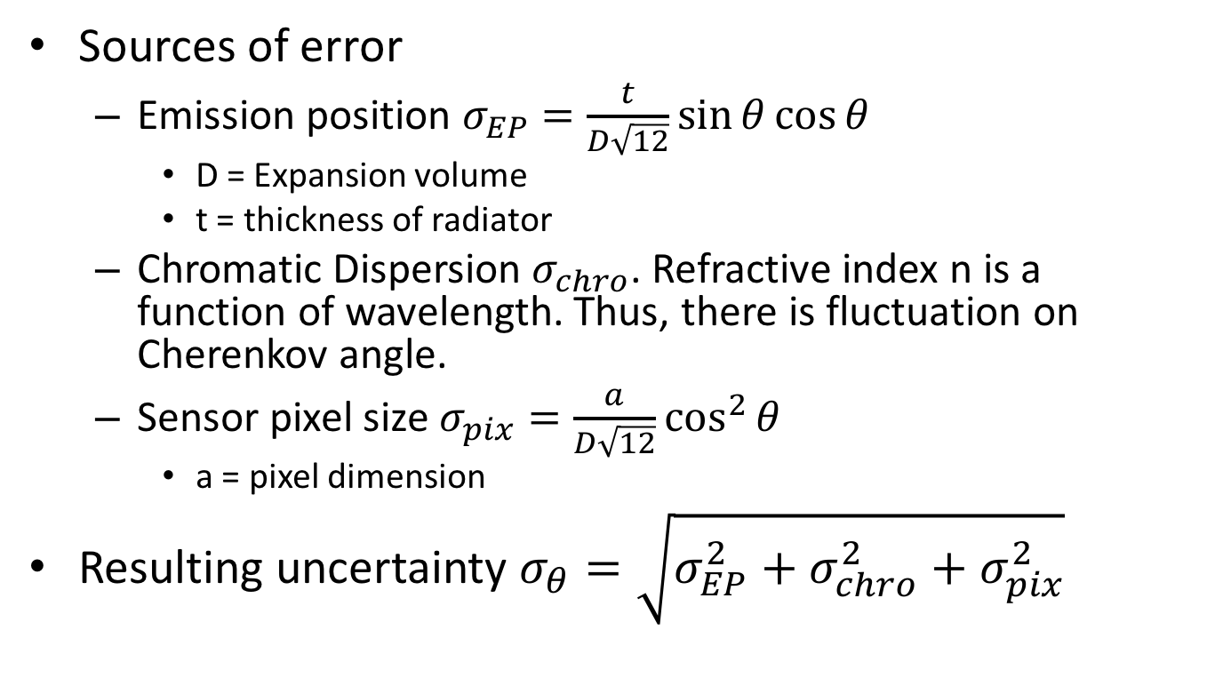
Uncertainty of Measured Cherenkov Angle $σ_{θ}$
Sources of error
Emission position $σ_{EP}=\frac{t}{D\sqrt{12}}\sin{θ}\cos{θ}$
D = Expansion volume
t = thickness of radiator
Chromatic Dispersion $σ_{chro}$. Refractive index n is a function of wavelength. Thus, there is fluctuation on Cherenkov angle.
Sensor pixel size $σ_{pix}=\frac{a}{D\sqrt{12}}\cos^{2}{θ}$
a = pixel dimension
Resulting uncertainty $σ_{θ}=\sqrt{σ_{EP}^{2}+σ_{chro}^{2}+σ_{pix}^{2}}$
Mitja Predikaka, Hybrid Avalanche Photo detector for Belle II ARICH Detector, December 27, 2014

Slide 4
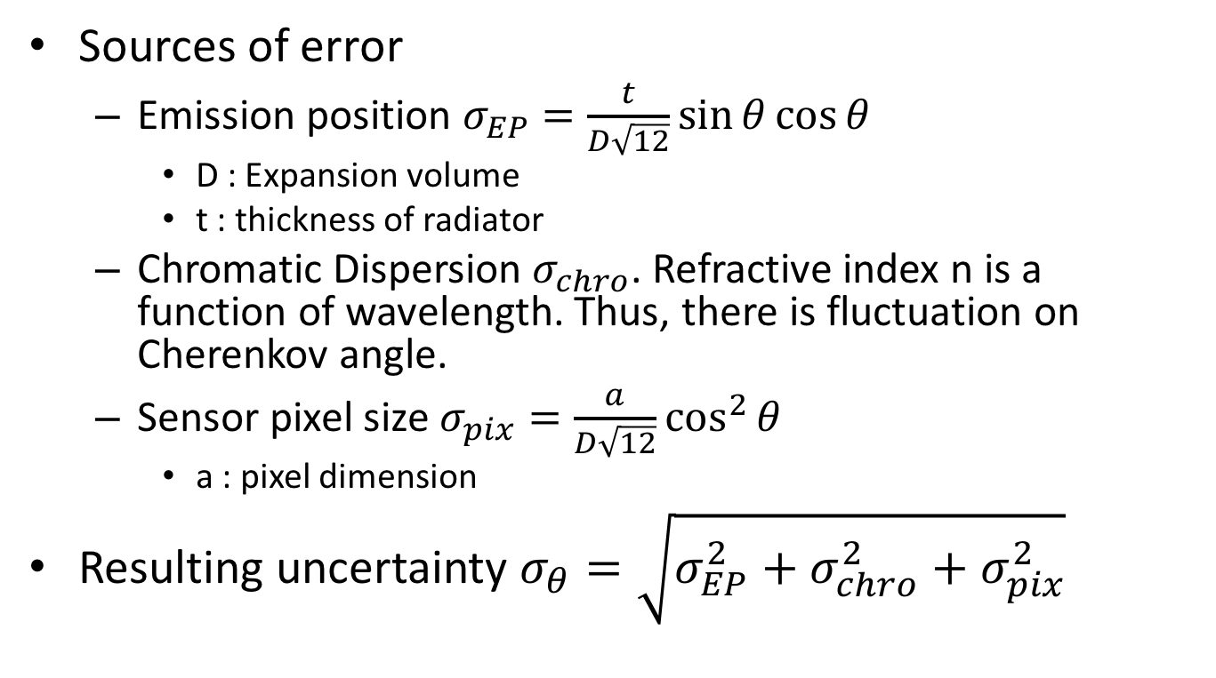
Uncertainty of Measured Cherenkov Angle $σ_{θ}$
Sources of error
Emission position $σ_{EP}=\frac{t}{D\sqrt{12}}\sin{θ}\cos{θ}$
D : Expansion volume
t : thickness of radiator
Chromatic Dispersion $σ_{chro}$. Refractive index n is a function of wavelength. Thus, there is fluctuation on Cherenkov angle.
Sensor pixel size $σ_{pix}=\frac{a}{D\sqrt{12}}\cos^{2}{θ}$
a : pixel dimension
Resulting uncertainty $σ_{θ}=\sqrt{σ_{EP}^{2}+σ_{chro}^{2}+σ_{pix}^{2}}$
Larger expansion volume D, smaller uncertainty on Cherenkov Angle. (See next slide)
Mitja Predikaka, Hybrid Avalanche Photo detector for Belle II ARICH Detector, December 27, 2014

Slide 5
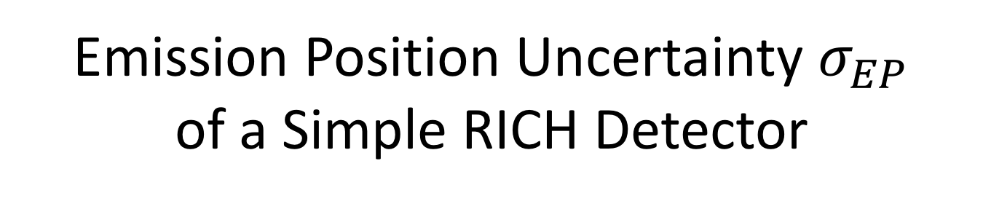

Emission Position Uncertainty $σ_{EP}$ of a Simple RICH Detector
r
Aerogel
Cherenkov photon
$$\tan{θ=\frac{r}{D}}$$
σ_{θ,1}
Incident particle
D₁
Larger expansion volume D, smaller uncertainty on Cherenkov Angle.

Slide 6
Emission Position Uncertainty $σ_{EP}$ of a Simple RICH Detector
r
Aerogel
Cherenkov photon
$$\tan{θ=\frac{r}{D}}$$
σ_{θ,2}
σ_{θ,1}
Incident particle
D₁
D₂
Larger expansion volume D, smaller uncertainty on Cherenkov Angle.

Slide 7
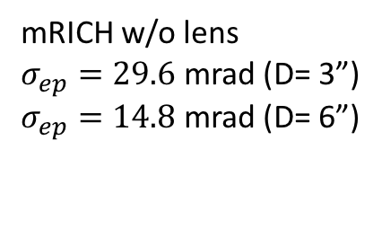
Emission Position Uncertainty $σ_{EP}$ of a Simple RICH Detector
mRICH w/o lens
$σ_{ep}=29.6$ mrad (D= 3”)
$σ_{ep}=14.8$ mrad (D= 6”)
Aerogel
Cherenkov photon
σ_{θ,2}
σ_{θ,1}
Incident particle
D₁
D₂
Larger expansion volume D, smaller uncertainty on Cherenkov Angle.

Slide 8
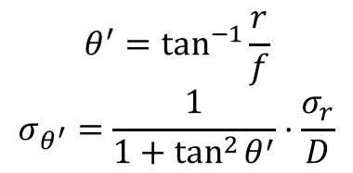
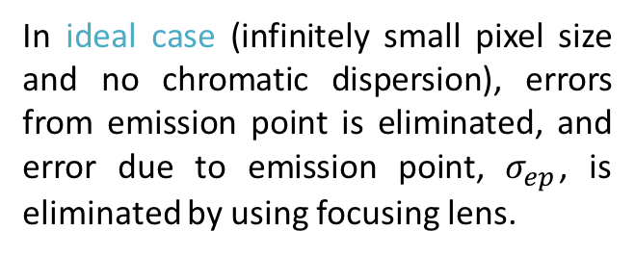
mRICH Lens Based Design
Sensor plane
Aerogel
Air
$$θ^{′}=\tan^{−1}{\frac{r}{f}}$$
$$σ_{θ^{′}}=\frac{1}{1+\tan^{2}{θ^{′}}}⋅\frac{σ_{r}}{D}$$
r
Cherenkov photons
θ’
θ
θ’
Incident particle
In ideal case (infinitely small pixel size and no chromatic dispersion), errors from emission point is eliminated, and error due to emission point, $σ_{ep}$, is eliminated by using focusing lens.
f
lens

Slide 9
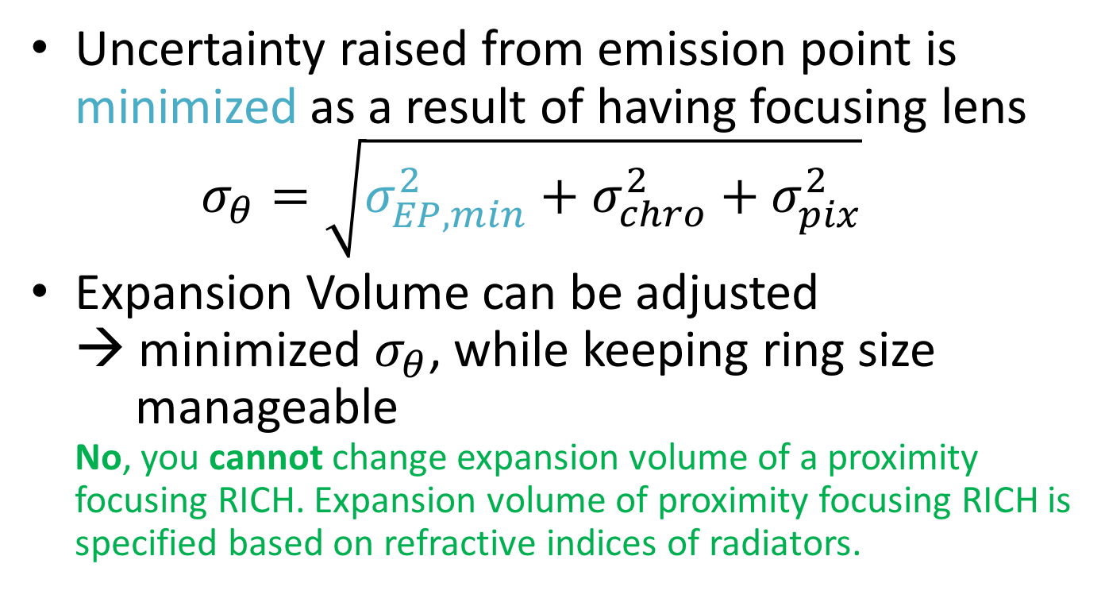
Advantage of Lens Based Design
Uncertainty raised from emission point is minimized as a result of having focusing lens $σ_{θ}=\sqrt{σ_{EP,min}^{2}+σ_{chro}^{2}+σ_{pix}^{2}}$
Expansion Volume can be adjusted → minimized $σ_{θ}$, while keeping ring size manageable No, you cannot change expansion volume of a proximity focusing RICH. Expansion volume of proximity focusing RICH is specified based on refractive indices of radiators.

Slide 10
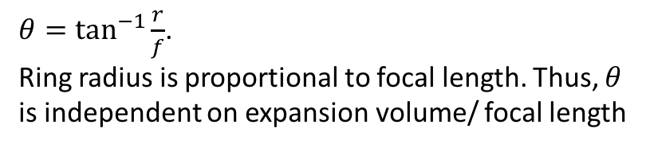
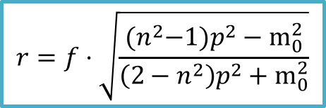
Simulation Result – Cherenkov Angle
Infinitesimal pixel size
f=3”
f=6”
$θ=\tan^{−1}{\frac{r}{f}}$.
Ring radius is proportional to focal length. Thus, $θ$ is independent on expansion volume/ focal length
$$r=f⋅\sqrt{\frac{{(n}^{2}{−1)p}^{2}−m_{0}^{2}}{\left(2−n^{2}\right)p^{2}+m_{0}^{2}}}$$

Slide 11
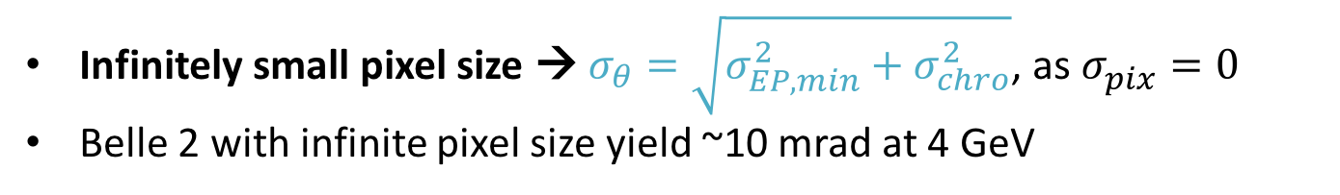
Simulation Result – σ_{θ} Single photon measurement
f=3”
f=6”
Infinitesimal pixel size
Infinitesimal pixel size
Infinitely small pixel size → $σ_{θ}=\sqrt{σ_{EP,min}^{2}+σ_{chro}^{2}}$, as $σ_{pix}^{}=0$
Belle 2 with infinite pixel size yield ~10 mrad at 4 GeV

Slide 12
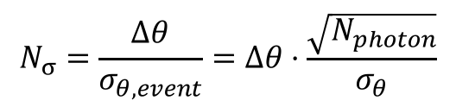
Simulation Result – Number of Sigma
f=3”
f=6”
Infinitesimal pixel size
Infinitesimal pixel size
$$N_{σ}=\frac{Δθ}{σ_{θ,event}}=Δθ⋅\frac{\sqrt{N_{photon}}}{σ_{θ}}$$

Slide 13
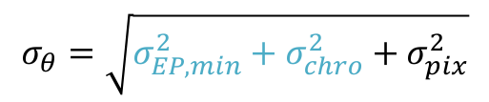
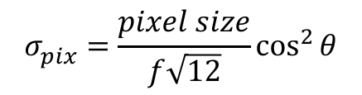
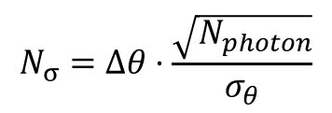
Simulation Result – Number of Sigma
f=3”
f=6”
Infinitesimal pixel size
6x6mm² pixel size
$$σ_{pix}^{}=\frac{pixel size}{f\sqrt{12}}\cos^{2}{θ}$$
$$σ_{θ}=\sqrt{σ_{EP,min}^{2}+σ_{chro}^{2}+σ_{pix}^{2}}$$
$$N_{σ}=Δθ⋅\frac{\sqrt{N_{photon}}}{σ_{θ}}$$
From simulation

Slide 14
Simulation Result – Number of Sigma
f=3”
f=6”
Infinitesimal pixel size
3x3mm² pixel size

Slide 15
Simulation Result – Number of Sigma
f=3”
f=6”
Infinitesimal pixel size
2x2mm² pixel size

Slide 16
Simulation Result – Number of Sigma
f=3”
f=6”
Infinitesimal pixel size
1x1mm² pixel size

Slide 17
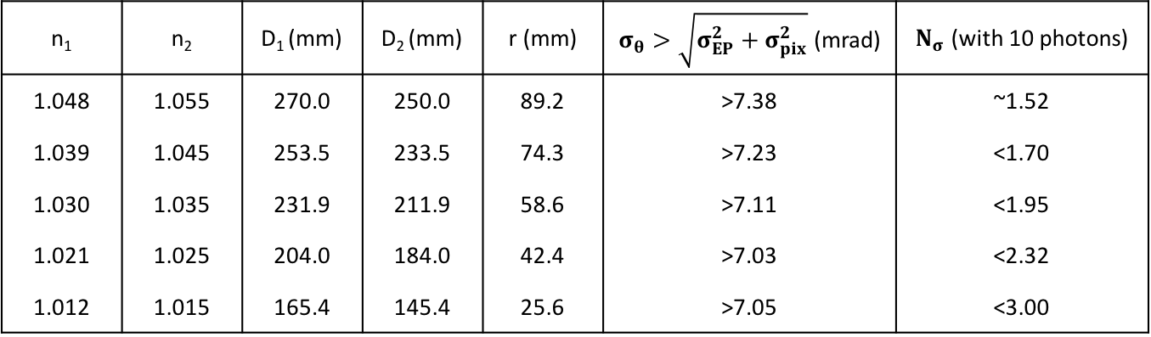
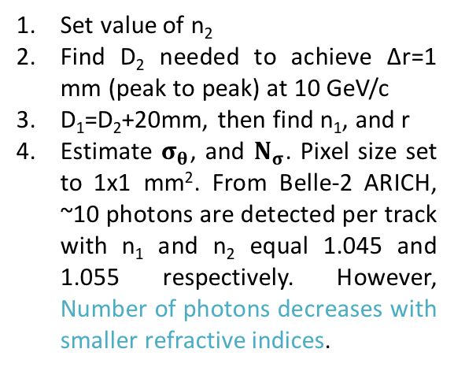
Proximity Focusing Design
n₁ | n₂ | D₁ (mm) | D₂ (mm) | r (mm) | $σ_{θ}>\sqrt{σ_{EP}^{2}+σ_{pix}^{2}}$ (mrad) | $N_{σ}$ (with 10 photons)
1.048 | 1.055 | 270.0 | 250.0 | 89.2 | >7.38 | ~1.52
1.039 | 1.045 | 253.5 | 233.5 | 74.3 | >7.23 | <1.70
1.030 | 1.035 | 231.9 | 211.9 | 58.6 | >7.11 | <1.95
1.021 | 1.025 | 204.0 | 184.0 | 42.4 | >7.03 | <2.32
1.012 | 1.015 | 165.4 | 145.4 | 25.6 | >7.05 | <3.00
Calculation
Sensor plane
Set value of n₂
Find D₂ needed to achieve Δr=1 mm (peak to peak) at 10 GeV/c
D₁=D₂+20mm, then find n₁, and r
Estimate $σ_{θ}$, and $N_{σ}$. Pixel size set to 1x1 mm². From Belle-2 ARICH, ~10 photons are detected per track with n₁ and n₂ equal 1.045 and 1.055 respectively. However, Number of photons decreases with smaller refractive indices.
2cm
2cm
r
Δr=1 mm
n₁
n₂
θ
Ring from kaon
Incident particle
D₂
Ring from Pion
D₁

Slide 18
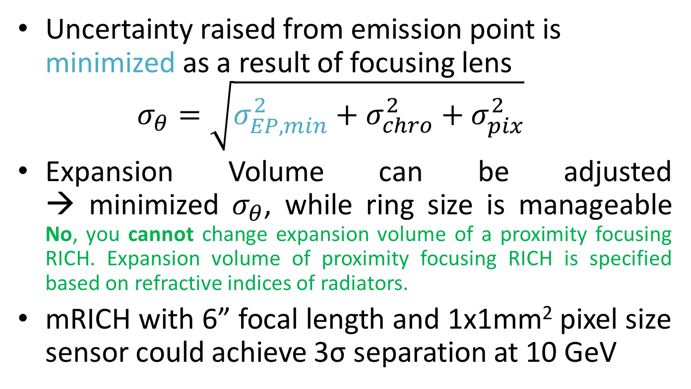
Summary
Uncertainty raised from emission point is minimized as a result of focusing lens $σ_{θ}=\sqrt{σ_{EP,min}^{2}+σ_{chro}^{2}+σ_{pix}^{2}}$
Expansion Volume can be adjusted → minimized $σ_{θ}$, while ring size is manageable No, you cannot change expansion volume of a proximity focusing RICH. Expansion volume of proximity focusing RICH is specified based on refractive indices of radiators.
mRICH with 6” focal length and 1x1mm² pixel size sensor could achieve 3σ separation at 10 GeV

Slide 19
Back Up

Slide 20
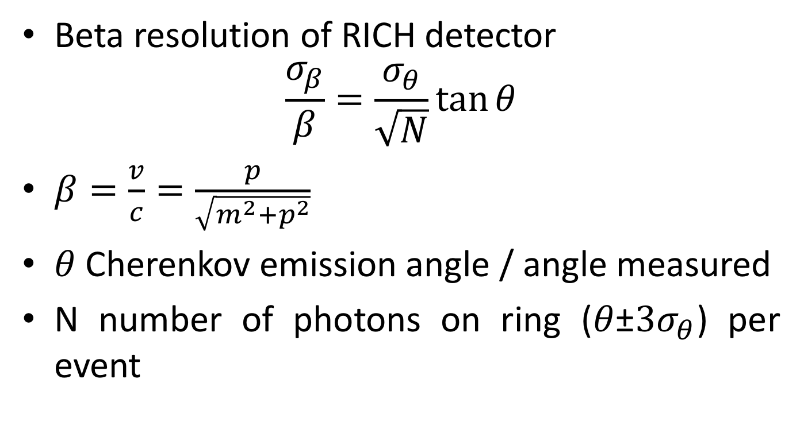



$β$Resolution
Beta resolution of RICH detector $\frac{σ_{β}}{β}=\frac{σ_{θ}}{\sqrt{N}}\tan{θ}$
$β=\frac{v}{c}=\frac{p}{\sqrt{m^{2}+p^{2}}}$
$θ$ Cherenkov emission angle / angle measured
N number of photons on ring ($θ$±${3σ}_{θ}$) per event
$$σ_{θ,event}=\frac{σ_{θ}}{\sqrt{N}}$$
Smaller $\frac{σ_{β}}{β}$ , higher $β$ resolution
T. Ypsilantis and J. Seguinot, Theory of Ring Imaging Cherenkov Counters, Nucl. Instr and Meth. In Phys. Res. A 343 (1994), 30.

