Slide 1
mRICH Simulation Analysis for Beam Test run 120
Cheuk-Ping Wong
Georgia State University
11-07-2016

Slide 2
Beam Test run 120 Setup
Detector
  Aerogel gel: thickness 3.3mm, n=1.03
  Fresnel lens: f=3” or 76.2mm
Beam
  8 GeV pion
  Beam position (x,y)~(-24,-24)mm
  Rings are not centered, and ring size has not been studied

Slide 3
Finding Expected
Ring radius and Ring Center Using Simulation
Launch 8 GeV pion at (x,y)=(-24,-24) mm with infinitesimal beam size
Quantum efficiency applied in analysis
Using Hough transform algorithm with infinitesimal pixel size
Ignore the hits that are sit at the corner (due to internal reflection inside glass window, see next slide).
If x<-20 and y<-20, ignore.
Uncertainty σ_{r} (0.44 mm) is from simulation with centered ring (beam launched toward the center of sensor plane)
If a hit falls between r±3σ_{r} of a possible ring, the hit is on the ring
Example of a single event from simulation
x : signal
(photons emitted by pion inside the aerogel)
o : noise

Slide 4
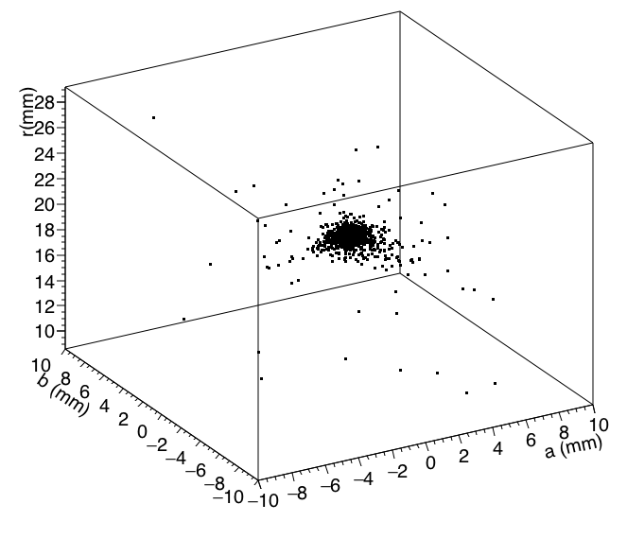
Finding Expected
Ring radius and Ring Center Using Simulation
All found rings in each event are filled in a three-dimensional (a,b,r) histogram
The expected values (a,b,r) are extracted from the most densest bin of the three-dimensional histogram
All rings found in one run

Slide 5
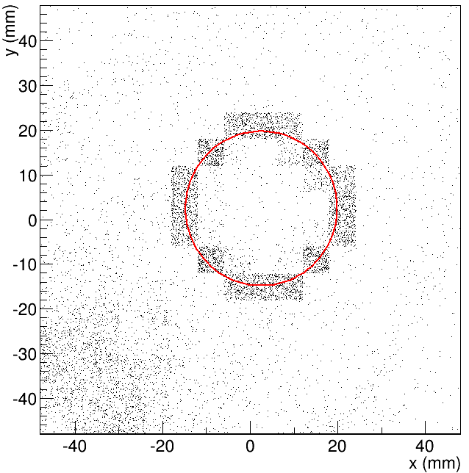
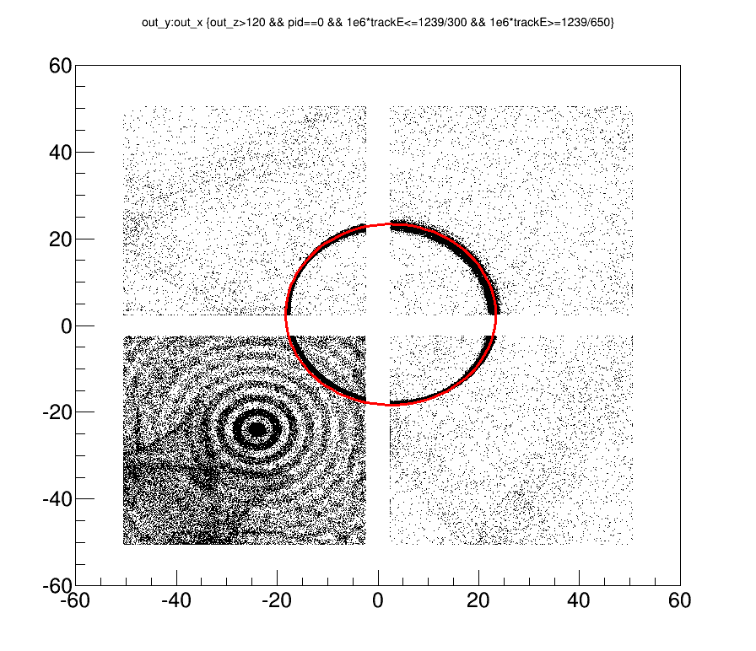
Result
Accumulated hit map
Draw from TTree. no Q.E. applied
Pixelated display
Infinitesimal pixel size
Center position (a,b)=(2.5, 2.5) mm
Radius r=17.3 mm (6x6mm² pixel size) / 17.3+3.54=20.84 mm (Infinitesimal pixel size)

Slide 6
To Do List
Continue run 120 analysis
Reanalyze run 140 (try to reduce noise)
Paper for beam test

