Slide 1
Setup
Plastic Scintillator 1
Tungsten-SciFi Cal Bar
Plastic Scintillator 2
Cosmic

Slide 2
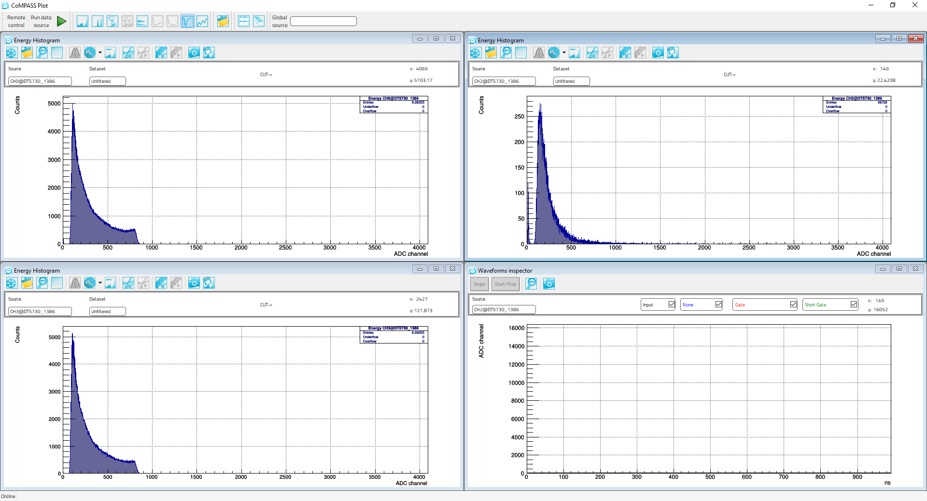
Energies in Each Detector
Plastic Scintillator 1
Tungsten-SciFi Cal Bar
Plastic Scintillator 2

Slide 3
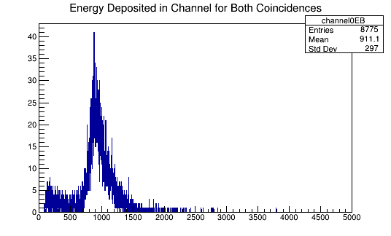
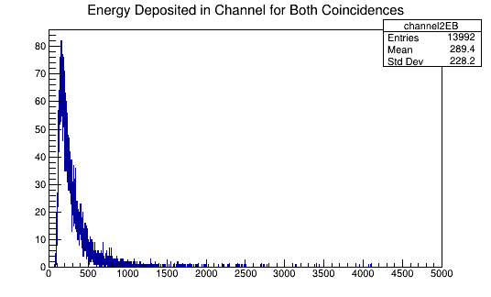
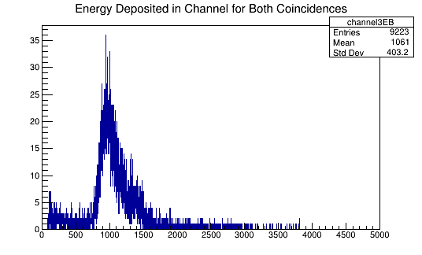
Energies in Each Detector for Coincidences
Plastic Scintillator 1
Plastic Scintillator 2
Tungsten-SciFi Cal Bar

Slide 4
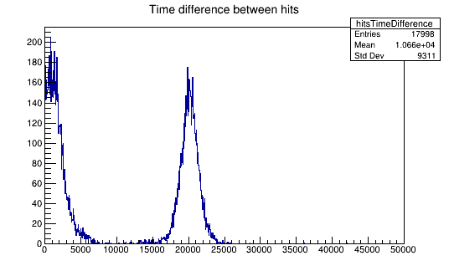
Time Difference Between Hits

