Slide 1
Q1. What activities are planned for the shutdown and can you start Run 25 earlier than late March? How much earlier?
The most time-intensive task during the shutdown is the TPC maintenance, which is primarily focused on repairing disabled channels. This work is currently estimated to take four months, primarily due to limited expert manpower. If necessary, the timeline may be shortened by one month, potentially moving the shutdown completion date to the end of February.
Feasibility of a 40-week run scenario
A 40-week scenario with one month down-time in August is in principle possible. Our concern will be with expert support and especially those at BNL. One month break in August would be necessary and we will keep 2-person shifts during this month.

Slide 2
Q2. On Slide 13 of Lijuan’s presentation, she showed a projection (green band) for gamma-jet I_AA with anticipated Run 25 AuAu statistics, and pp statistics from Run 24. What is the statistical error bar on this I_AA from only the pp statistics? From only the AuAu statistics? And does the band include an estimate of systematic error? Please also answer this question for other hard probes observables important to the STAR program where a pp reference measurement is critical.
Anticipated statistical uncertainty for Au+Au Run25 is 35-40% and for pp Run24, it is 10-15% statistical uncertainty. These bands include systematic uncertainty.
For hard probes observables, we do not need more pp data for the reference measurement.

Slide 3
Q3. It is written in your BUR (and similar phrases have also been written in many previous PAC reports) that there are “must-do” measurements in pAu that can only be realized during the final year of RHIC running that “will be essential if we are to fully realize the scientific promise of the EIC” by providing measurements in pAu collisions that, when combined with future EIC measurements, “will establish the validity and limits of factorization and universality.” Please provide one (or at most two) plots showing projected error bars for a pAu measurement that STAR can make with a 5 week run that will realize this outstanding scientific opportunity, and for each pAu projection plot please also provide a plot or plots showing projections for future EIC measurements, and explain what outcome (i.e. which data point from which pAu observable as to align with which EIC data point, how) would be consistent with universality or factorization, and why.

Slide 4
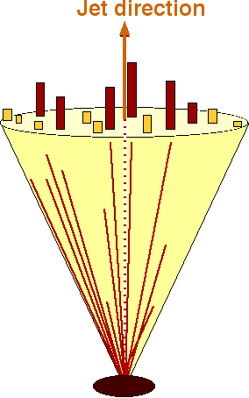
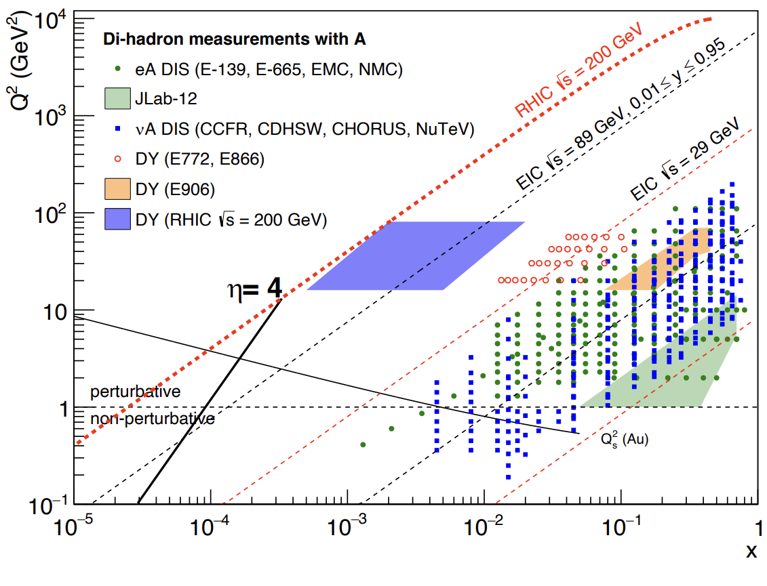
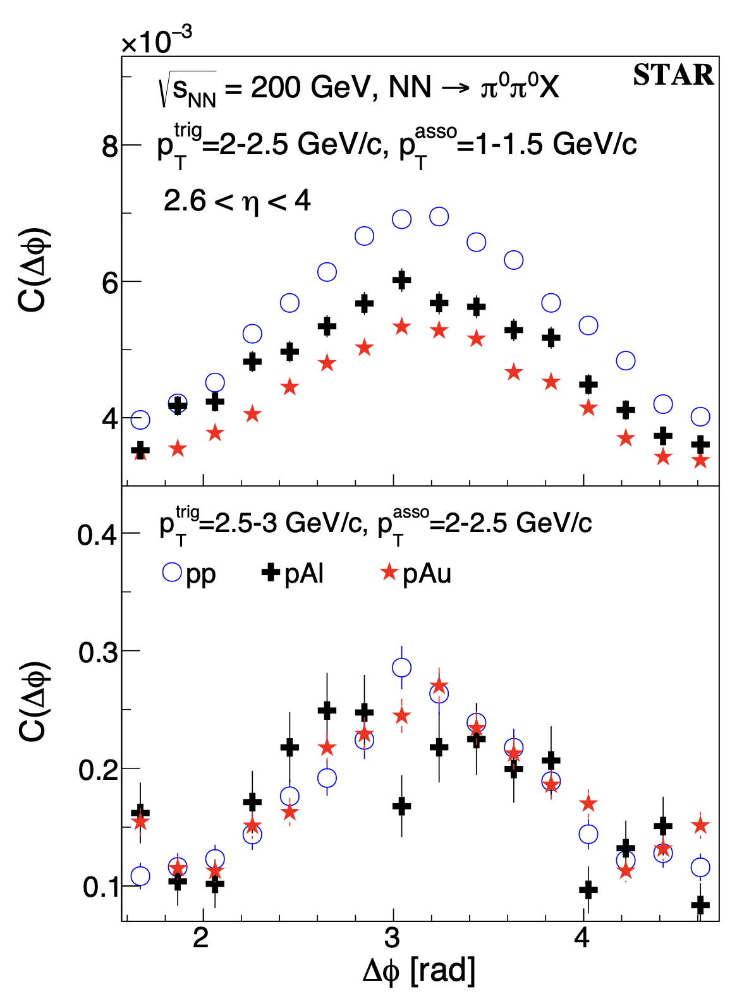
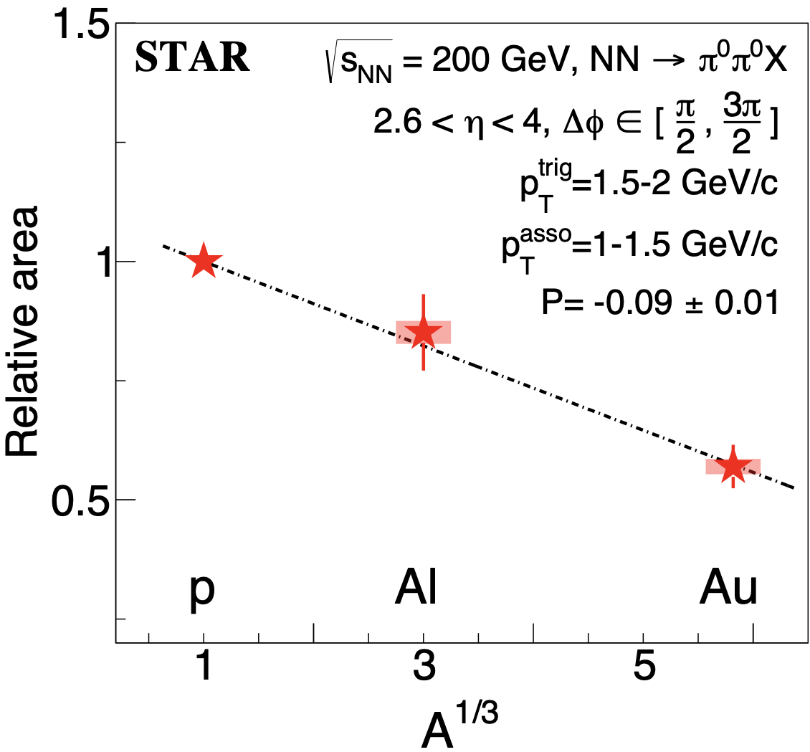
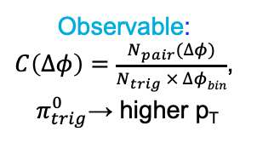
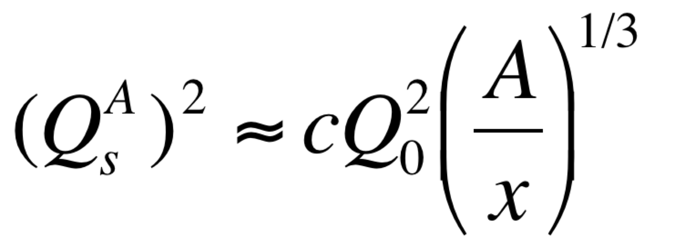
Probing Non-linear QCD effects
Forward rapidities at STAR provide an absolutely
unique opportunity to have very high gluon densities
→ proton – Au collisions
combined with an unambiguous observable
counting experiment of di-hadrons in pp and pA
Saturation: Disappearance of backward hadron in pA
p
p
p
A
Phys.Rev.Lett. 129 (2022) 092501
Observable:
$C\left(∆φ\right)=\frac{N_{pair}(∆φ)}{N_{trig} × ∆φbin}$,
$π_{trig}^{0}$→ higher p_{T}
A dependence: at low p_{T} more suppression in pAu than pAl relative to the pp
x dependence: at high p_{T} (large x) no suppression in pA

Slide 5
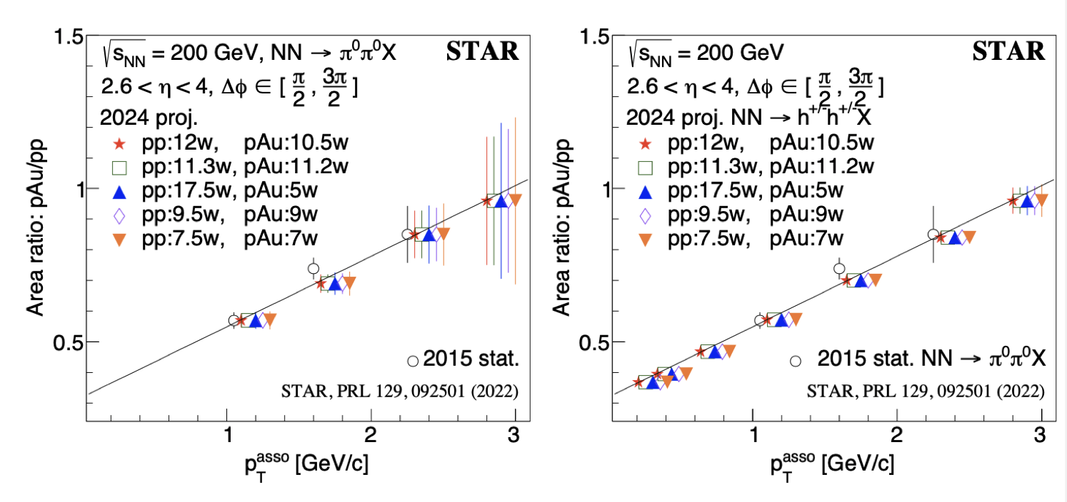
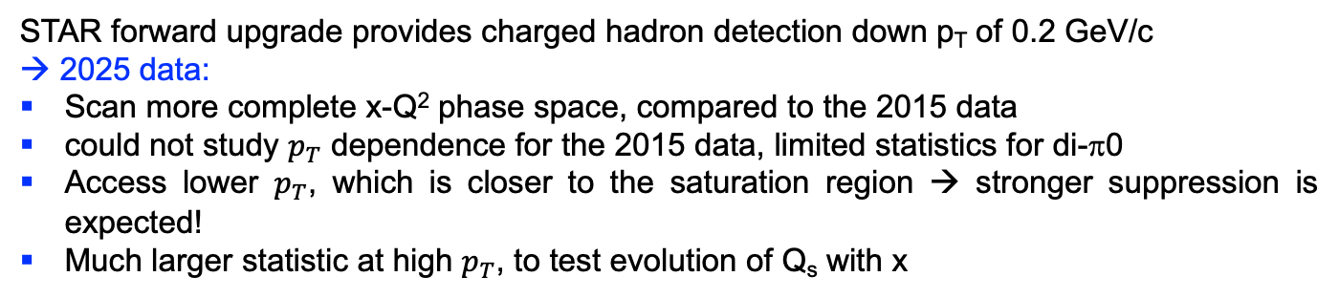
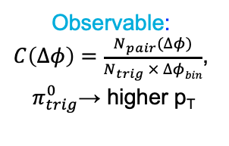
Probing Non-linear QCD effects
Forward rapidities at STAR provide an absolutely
unique opportunity to have very high gluon densities
→ proton – Au collisions
combined with an unambiguous observable
counting experiment of di-hadrons in pp and pA
Saturation: Disappearance of backward hadron in pA
p
p
p
A
Utilizing fSTAR in 2025
Observable:
$C\left(∆φ\right)=\frac{N_{pair}(∆φ)}{N_{trig} × ∆φbin}$,
$π_{trig}^{0}$→ higher p_{T}
STAR forward upgrade provides charged hadron detection down p_{T} of 0.2 GeV/c
→ 2025 data:
Scan more complete x-Q² phase space, compared to the 2015 data
could not study $p_{T}$ dependence for the 2015 data, limited statistics for di-π0
Access lower $p_{T}$, which is closer to the saturation region → stronger suppression is expected!
Much larger statistic at high $p_{T}$, to test evolution of Q_{s} with x

Slide 6
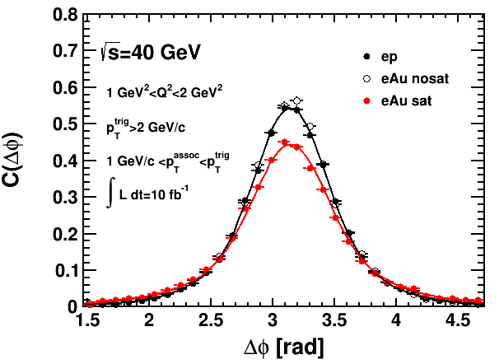
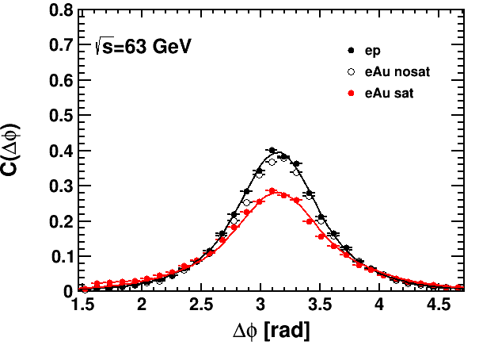
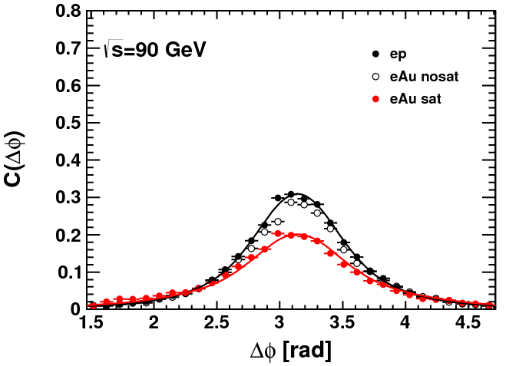
EIC: Probing Non-linear QCD effects
EIC can map the transition
from a linear to a non-linear QCD regime → evolution of Q_{s} with x
EIC has the unique opportunity
to have very high gluon densities
→ electron – lead collisions
Observable: Di-hadrons (jets) in ep and eA
x
Ratio

Slide 7
Q4. On slide 23 of Lijuan’s presentation, UPC in pAu was discussed, in particular J/psi measurement. Would it be possible to make a connection to the similar process at the EIC and explore the complementarity in the kinematics between EIC and pA at RHIC? What would be the impact of the proposed measurement of J/Psi production in polarized pAu UPC on the EIC program?

Slide 8
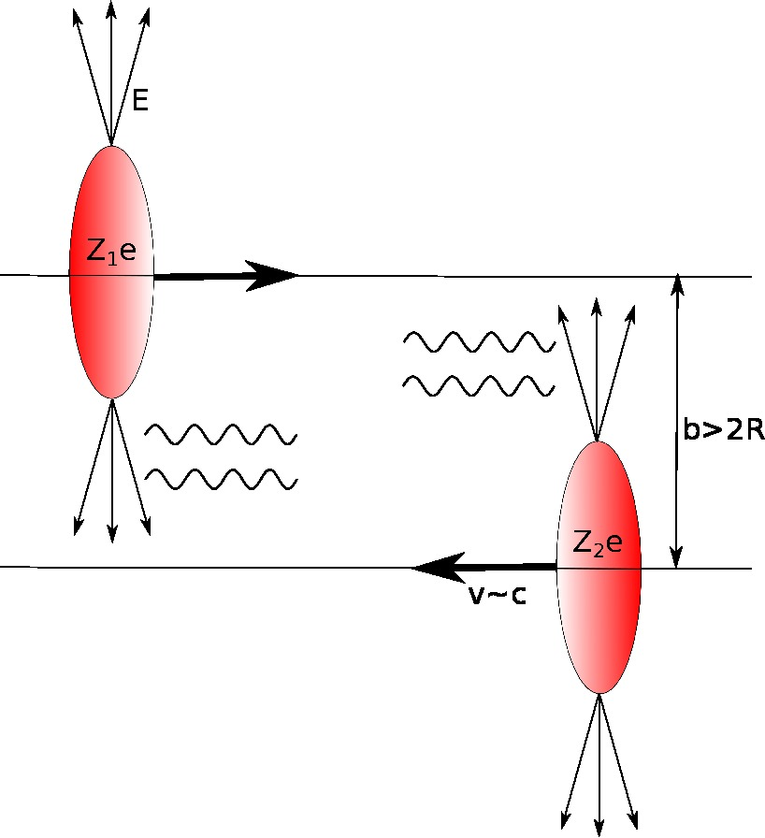
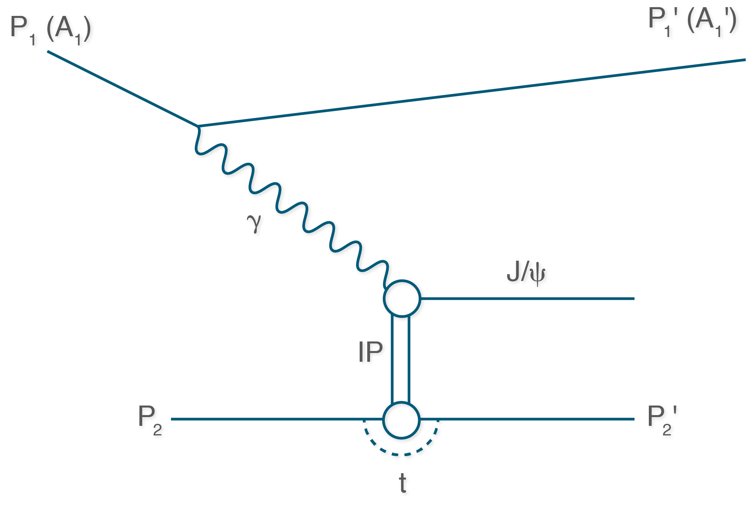
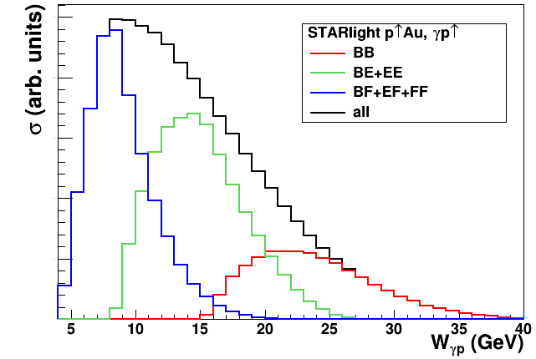

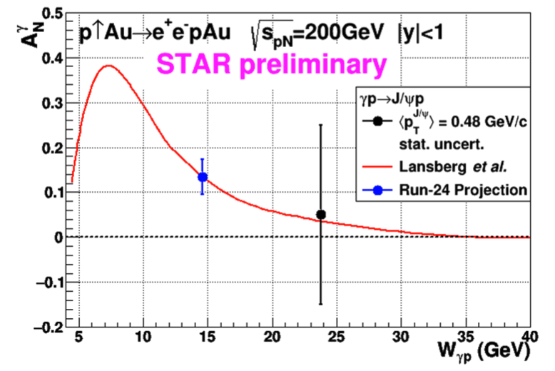
3d Spatial Imaging through UPC
UPC:
worldwide only access to GPD E for gluons
→ J/Ψ production in p↑Au or p↑p (500 GeV)
Forward rapidity gives access to the large asymmetry region
2015 polarized pA data:
J/Ψ cross section as fct of Wγp can be done as well complementary to ep
STAR forward upgrade → closer to J/Ψ threshold
Complementary to JLab experiments for J/Ψ production at threshold

Slide 9
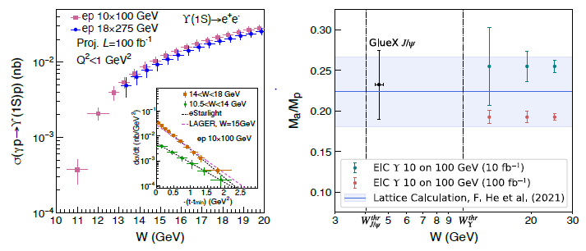
Exclusive Upsilon Production
photo- and electro-production of heavy quarkonia near-threshold
t measured from:
Incoming and out-going proton four-momenta
Υ four-momenta
uncertainty of total and differential cross section of Υ(1S) near threshold for photo-production and electro-production (Q² < 1 GeV²) in e+p collisions via the di-electron decay channel
trace anomaly contribution to the proton mass in Ji’s decomposition;
green and red points are offset; band from a recent lattice QCD calculation; di-electron and di-muon decay channels
Identical study can be done with J/Ψ at EIC cross section and single spin asymmetry A_{UT}
KEY:
good sensitivity over the entire rapidity range
good mass resolution to separate the three Υ states
good t resolution
e and m PID

Slide 10
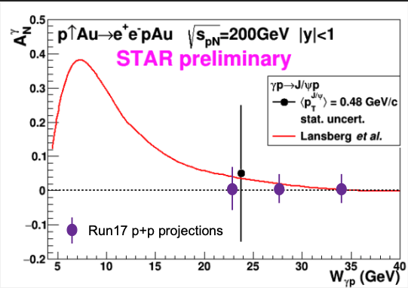
Q5. Exclusive J/Psi asymmetry: could you show the comparison of statistical uncertainties of from a 5 week pAu run in 2025 pAu; 2015 pAu on tape; and all pp on tape?
200 GeV Run-15 pAu: ~300 J/Ψ
500 GeV Run-17 pp: ~1000 J/Ψ (400 pb⁻¹)
Run 22: doubles the statistics
at 500 GeV W shifted to higher values
→ more difficult to measure at max. A_{N}
Exclusive J/ѱ A_{N} in UPC, Q²~10 GeV², 10⁻⁴<x<10⁻¹
Access GPD Eg for gluons, sensitive to spin-orbit correlation
Run-24: acceptance improved by a factor of 9-10, combined with iTPC and forward upgrades, stat. error for A_{N}^{𝛾}: 0.04 (0.07) for <W_{𝜸p}>=14 GeV, where the signal is expected to be large.

Slide 11
Q6. If, after the completion of the Au+Au collisions, there are additional 2 or 3 or 4 weeks available, would your priorities change?
No. We would strongly recommend NPP management to secure additional funding to enable the additional 4 or 3, or 2 cryo-weeks so that we can achieve 5 weeks of pAu physics data taking.
We do have an opportunistic program “Imaging shape and radial profile of atomic nuclei” which can take only 1 or 2 weeks.

Slide 12
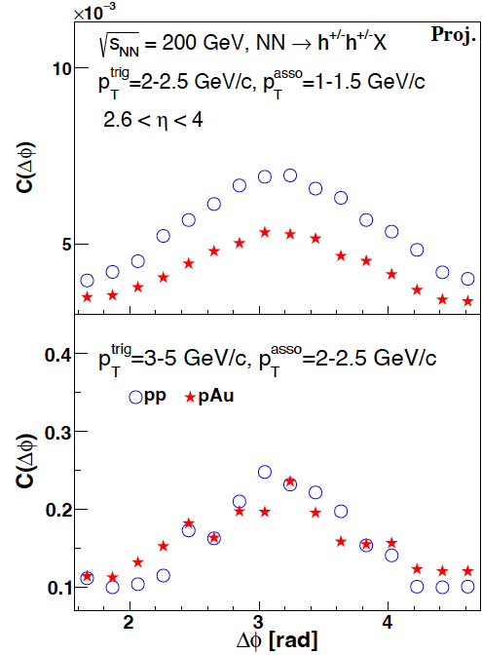
Q7. Do you have any projections for the forward charged dihadron measurement in pAu (something similar to correlation plots on page 24 in Lijuan’s presentation for pi0pi0 )?

Slide 13
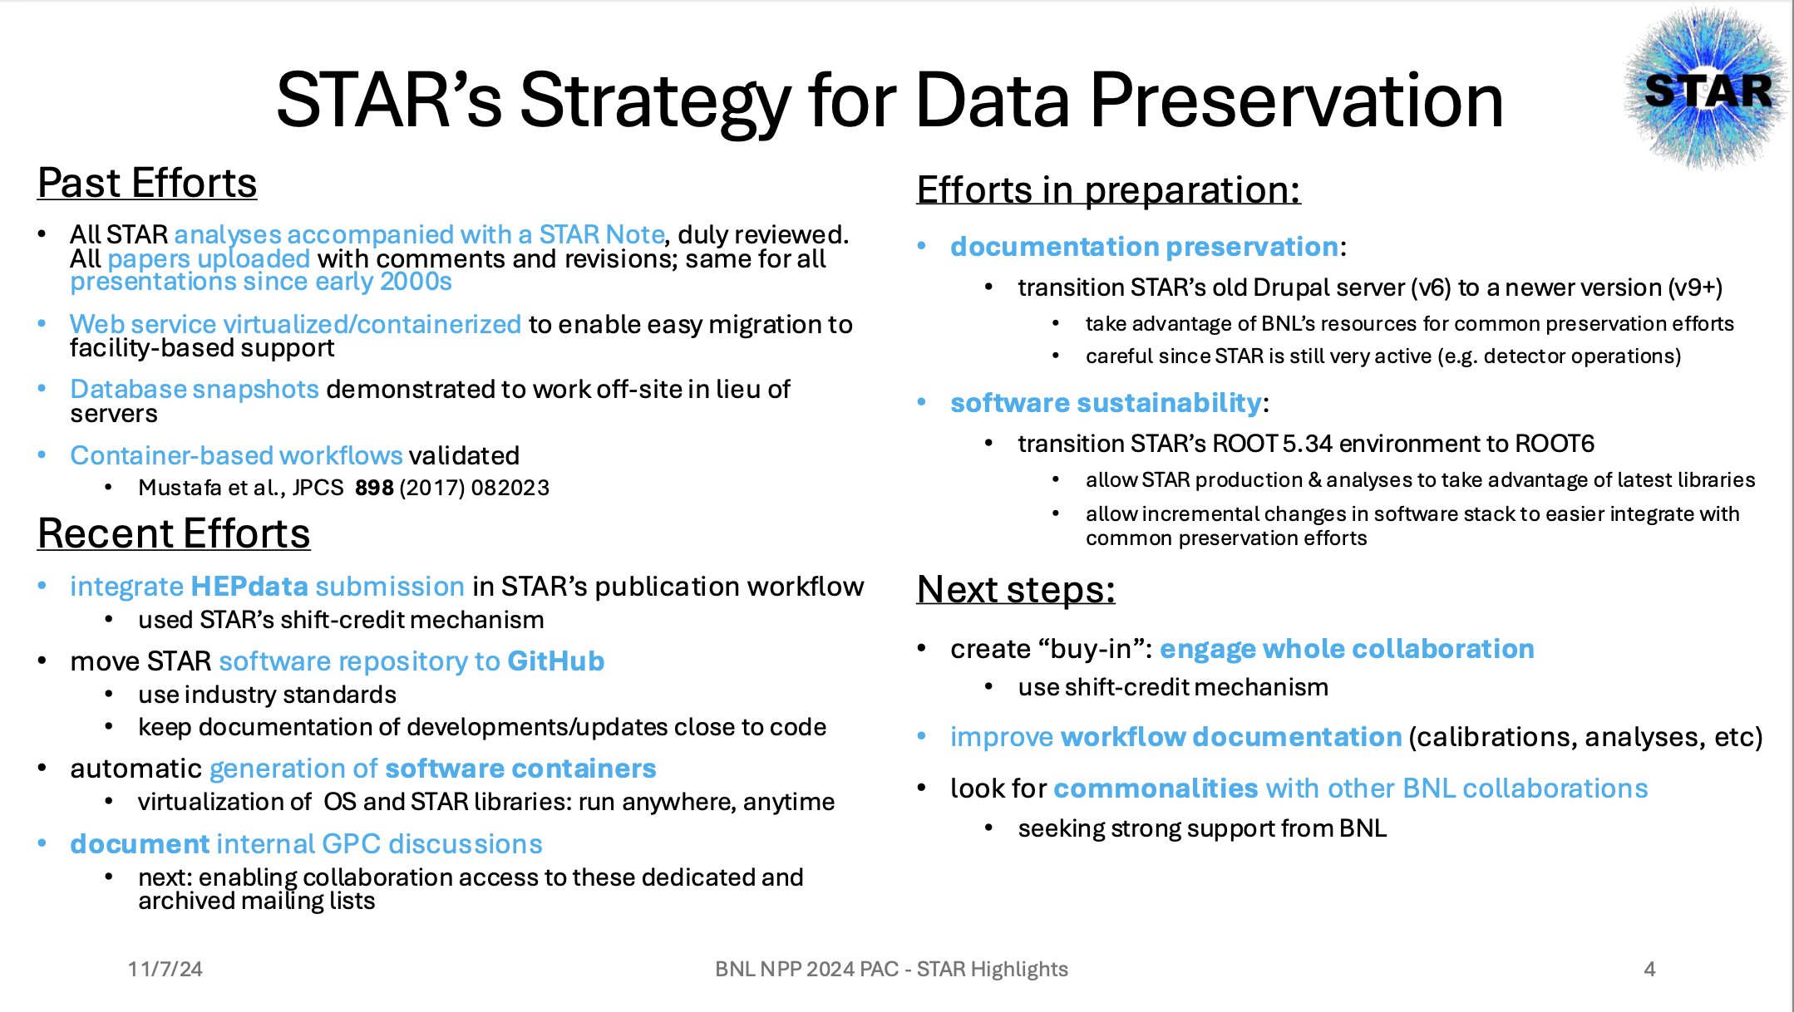
Q8. Could you update the PAC on your current efforts and plans for data preservation?
See slide #4 in Frank’s presentation:

Slide 14
Q9. What is the status/timing of the FXT BESII data analysis?
The final calibration process for FXT is ongoing. We expect production to be finished by December. Fine-tuning of the embedding will follow next. Expectation is that FXT results will be ready in time for QM25.

Slide 15
Q10. Last year we recommended BNL to assist STAR in finding the necessary resources (computing and IT-personnel) to achieve timely completion of the BES-II analyses. Can you update us on whether and how the problem was resolved?
Last year, the BNL-STAR group hired a postdoc who has been instrumental in processing the backlog of embedding requests. We are grateful for BNL management to quickly address recent other personnel changes. Concerns remain with the long-term structural availability of general support for STAR’s software environment at BNL, and the availability of the resources that it depends on. This may be further exacerbated by reorganizations of SDCC. Furthermore, support from NPPS is very limited, below one FTE.

Slide 16
Backup

Slide 17
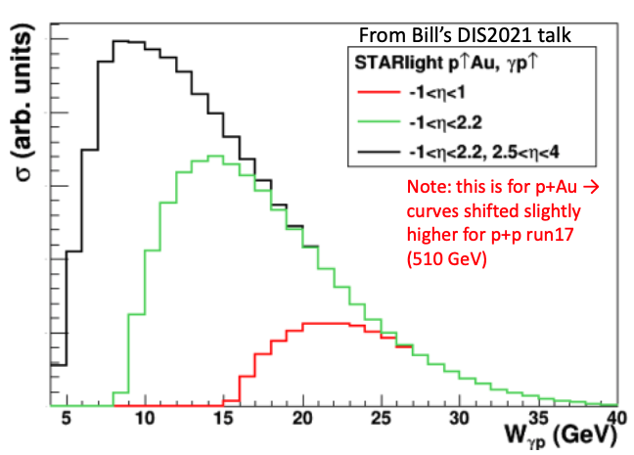
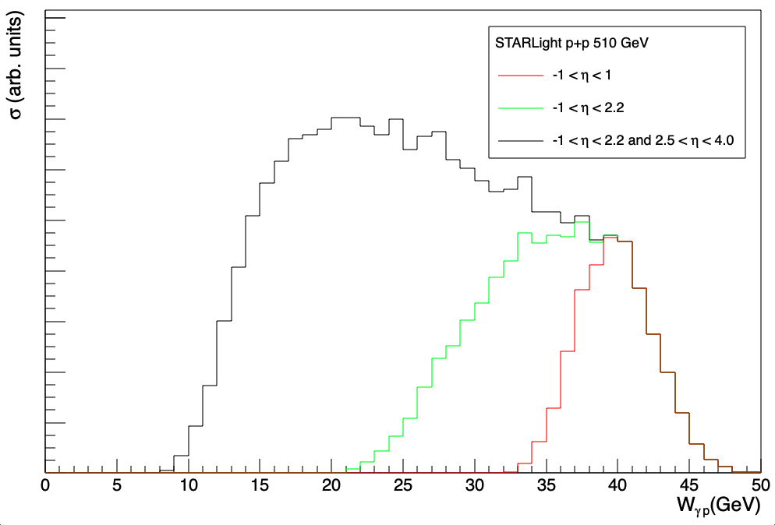
Some Facts about UPC
Photon Flux; ~Z²
200 GeV pAu
→ for statistics Au as photon
source much preferable
200 GeV Run-15 pAu: ~300 J/Ψ
500 GeV Run-17 pp: ~1000 J/Ψ (400 pb⁻¹)
Run 22: doubles the statistics
at 500 GeV W shifted to higher values
→ more difficult to measure at max. A_{N}
fSTAR allows access to low W
→ max A_{N}

