Slide 1
The eA – pA Synergies and
Complementarities
Elke-Caroline Aschenauer (BNL)

Slide 2
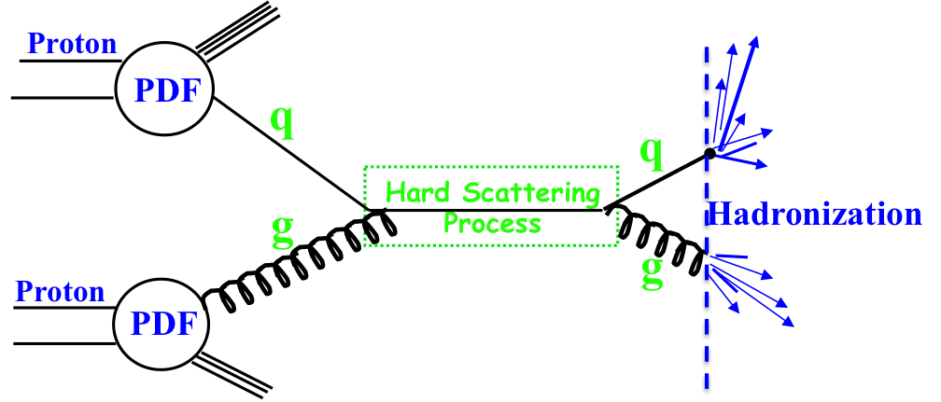
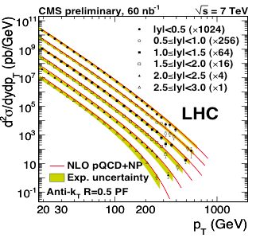
Why do we need different probes
Complementarity
QCD has two concepts which lay its foundation
factorization and universality
To tests these concepts and separate interaction dependent phenomena from
intrinsic nuclear properties
different complementary probes are critical
Probes: high precision data from ep, pp, e+e-
Factorization
Universality
Example: Measure PDFs at HERA at √s=0.3 TeV:
Predict pp and measurements at √s=0.2, 1.96 & 7 TeV
(un)polarized cross section ~
PDF ⊗ hard-scattering ⊗ Hadronization
hard-scattering : calculable in QCD
PDFs and Hadronization: need to be determined experimentally
$$p\overline{p}$$

Slide 3
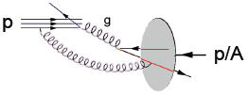
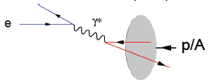
Different Processes
Hadron-Hadron:
Ultra-Peripheral Collisions:
probe has complex structure
no simple access to parton kinematics:
η → x; p_{t}² → Q² → x-Q²
strongly correlated
Gluons can be accessed directly
→ qg & gg
  gluon fragmentation
Electron-Hadron:
Photon induced process
no simple access to parton kinematics:
η → x; M²→ Q² can only be
varied by VM
access to initial state
Point-like probe → resolution
High precision & access to partonic kinematics through scattered lepton
→ x_{B}, Q²
    initial and final state effects can be cleanly disentangled
      inclusive measurements of Structure functions only sensitive to initial state
Notes:
details in backup
picture much more schematic / carton

Slide 4



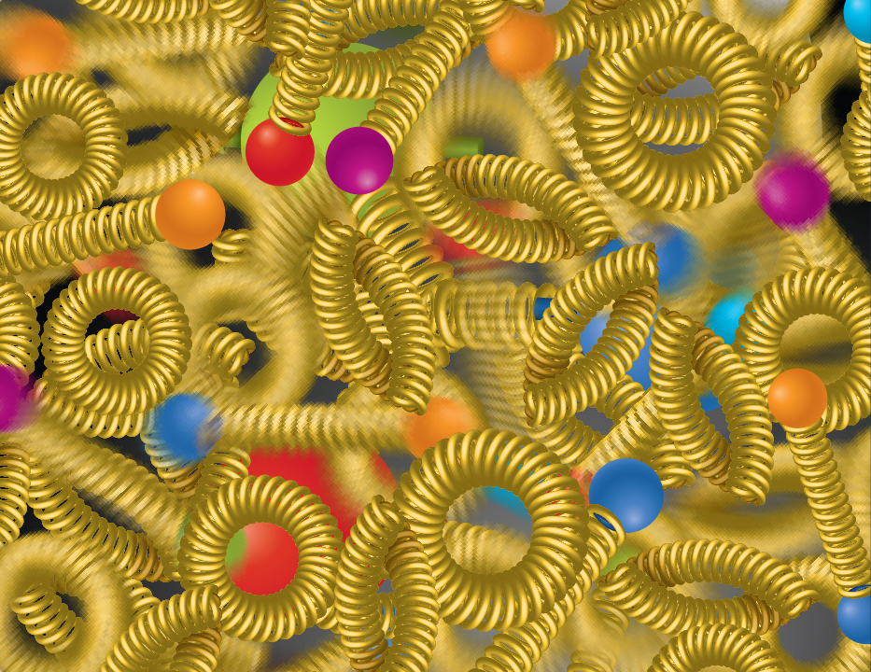
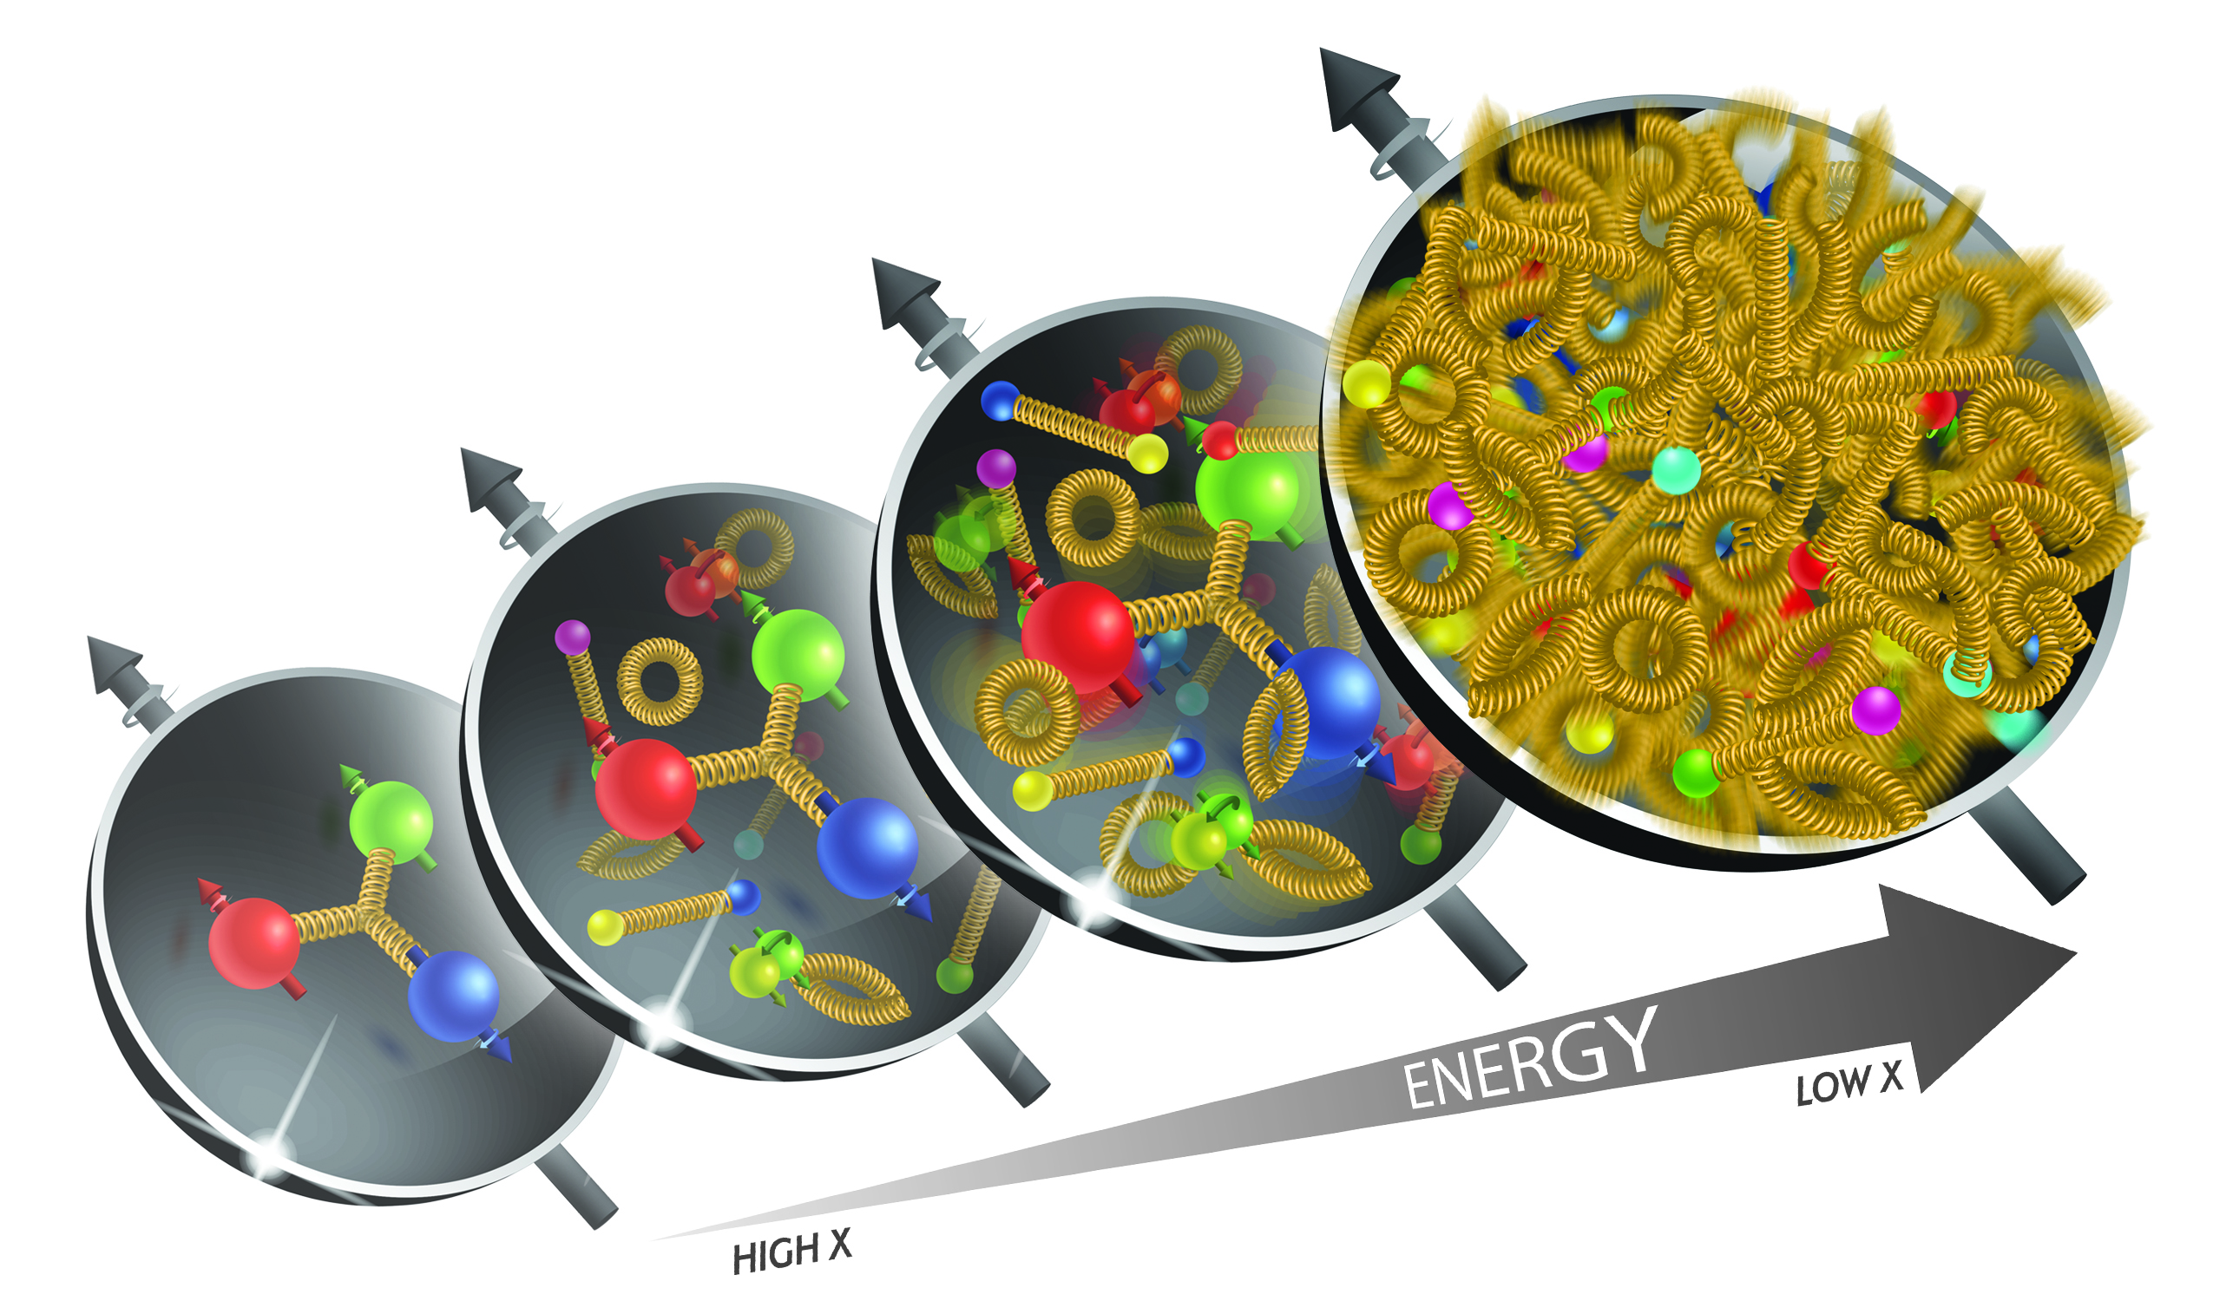
The Pillars of the eA – pA Program
nuclear
PDFs
nuclear
Fragmentation
Saturation
Need to understand the energy dependence (x - Q²)
→ different √s → LHC, RHIC, EIC
and A-dependence

Slide 5
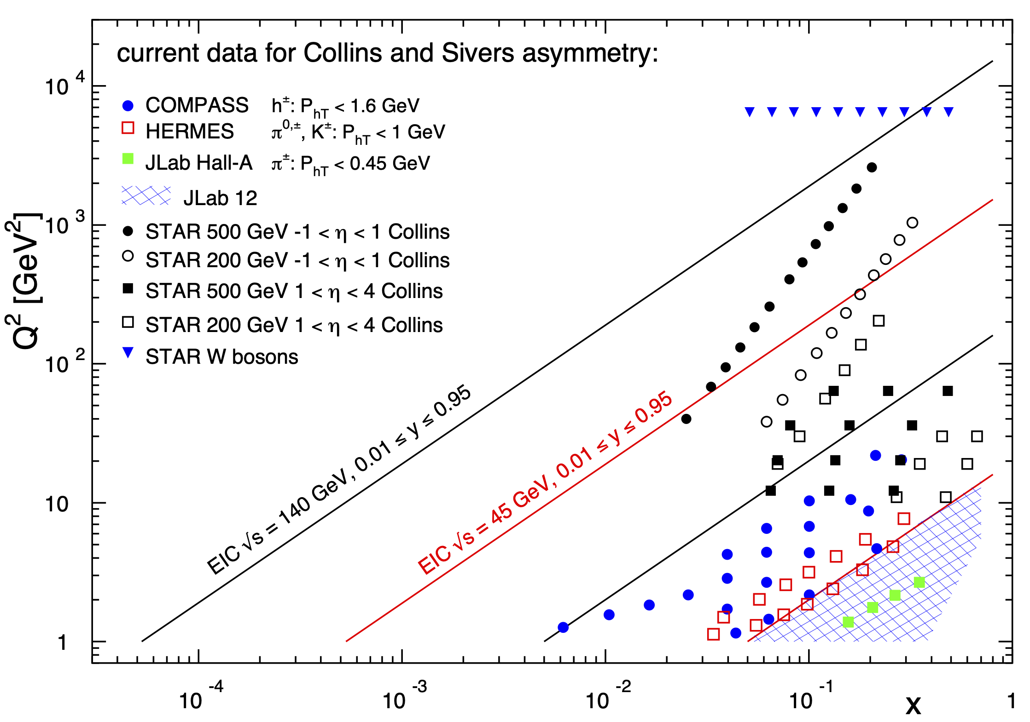
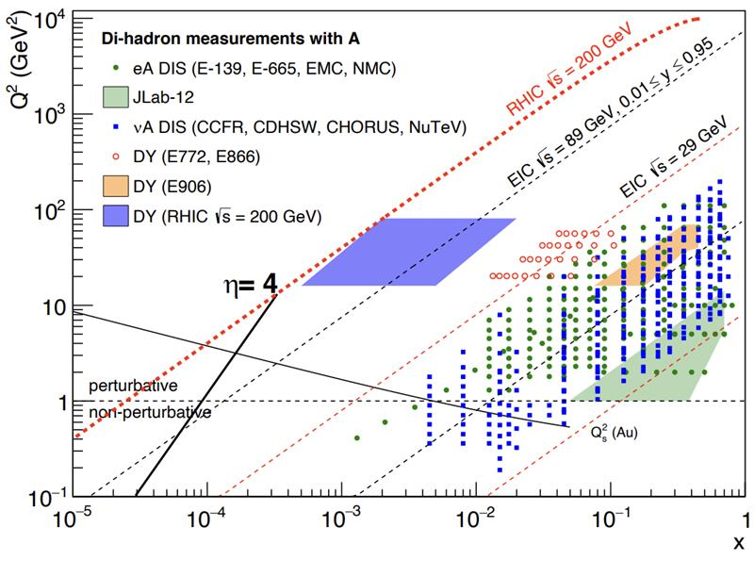
RHIC and EIC Kinematics
pp vs ep
pA vs eA
The STAR@RHIC pp data have a wide range of overlap with the EIC ep kinematics and reach to even higher Q² then the EIC
The STAR@RHIC data have a wide rangeof overlap with the EIC kinematics and reach to lower x at low Q²
→ critical for saturation
It has been shown that studying polarized observables helps to tease out effects hidden in unpolarized observables like cross sections, i.e. TMDs

Slide 6
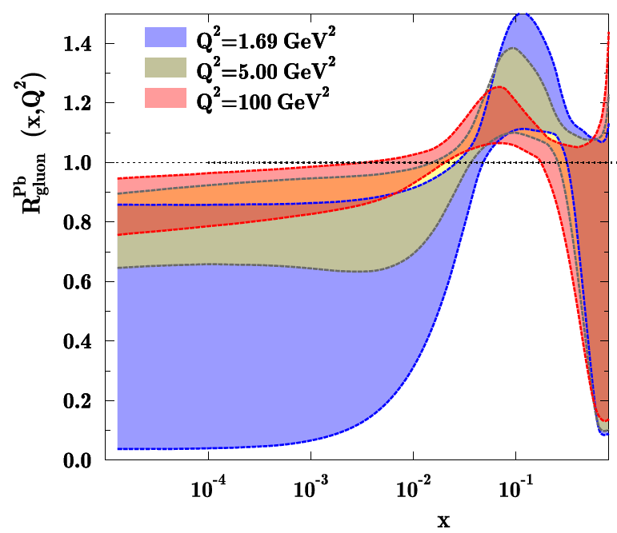
How Does the initial state in Nuclei Look?
3 conundrums of the initial state:
What are the nPDFs at low-x?
How saturated is the initial state of the nucleus?
What is the spatial transverse distributions
of nucleons and gluons?
→ How much does the spatial distribution fluctuate?
Lumpiness, hot-spots etc.
Current knowledge including
first LHC pA data
RHIC can measure nPDF in a x-Q² region
where nuclear effects are large
  Suppression evolves away quickly with Q²
  → challenge for LHC
  Q² > Q_{s}² over a wide range in x
Observables free of final state effects
  Gluons: R_{pA} for direct photons
  Sea-quarks: R_{pA} for DY
Scan A-dependence prediction by
saturation models
can access saturation regime at forward rapidities

Slide 7
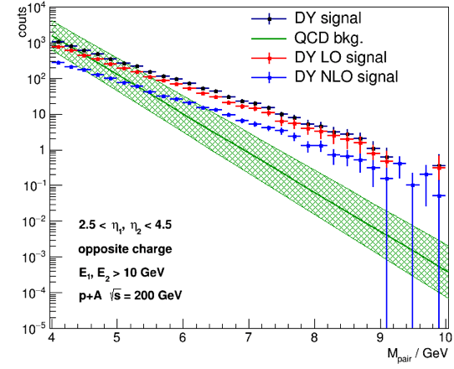
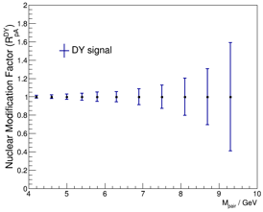
How Does the initial state in Nuclei Look?
pA: DY@2.5 < η < 4.5
pA: Direct Photon@2.5 < η < 4.5
Uncertainties:
2015 + 2023 pp&pA
direct photon:
Q²: ~p_{t}²
Q²>5 GeV²
Both DY and direct photon R_{pA} give significant constraints on nPDF
alternative observables and kinematics to EIC
Impact on nPDFs: → sea quarks
Impact on nPDFs: → gluons
DY:
Q²: ~M²
Q²>16 GeV²
Uncertainties:
2023 pp & pA

Slide 8
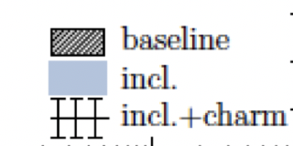
How Does the initial state in Nuclei Look?
Measure different structure function in eA → constrain nPDF:
quark+anti-quark momentum distributions
gluon momentum distribution
Gluon distribution ~ dσ(x,Q²)/dlnQ²
√s < 45 GeV
√s < 90 GeV
arXiv:1708.05654

Slide 9
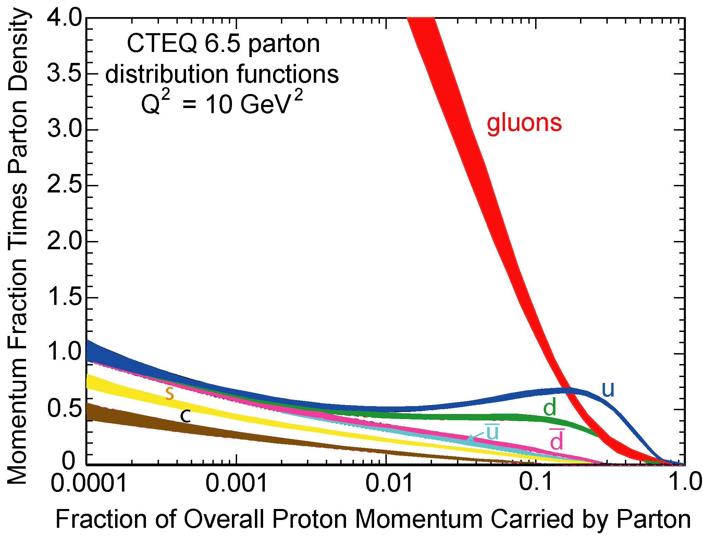
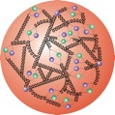

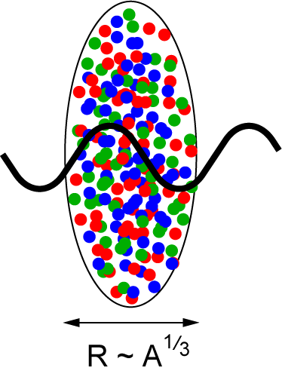
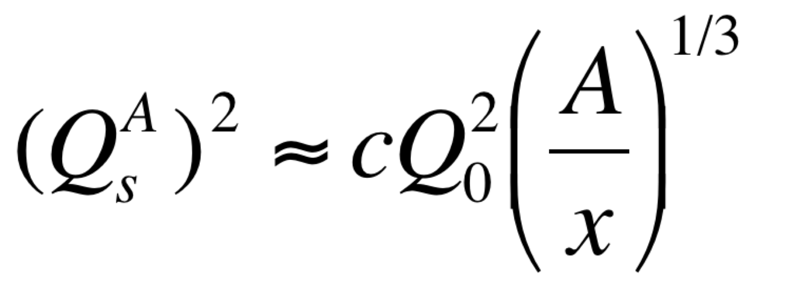
Studying non-linear QCD effects
Does the rise of g(x,Q²) get tamed ?
Important to understand the initial condition for heavy ion collisions
Scattering of electrons off nuclei:
Probes interact over distances L ~ (2m_{N} x)⁻¹
For L > 2 R_{A} ~ A^{1/3} probe cannot distinguish between nucleons in front or back of nucleon
Probe interacts coherently with all nucleons
Nuclear “Oomph” Factor
Pocket Formula:
Enhancement of Q_{S} with A ⇒ non-linear QCD regime reached at significantly lower √s in nuclei than in proton

Slide 10
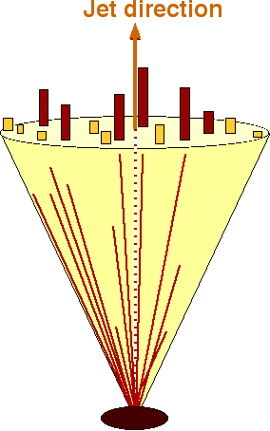
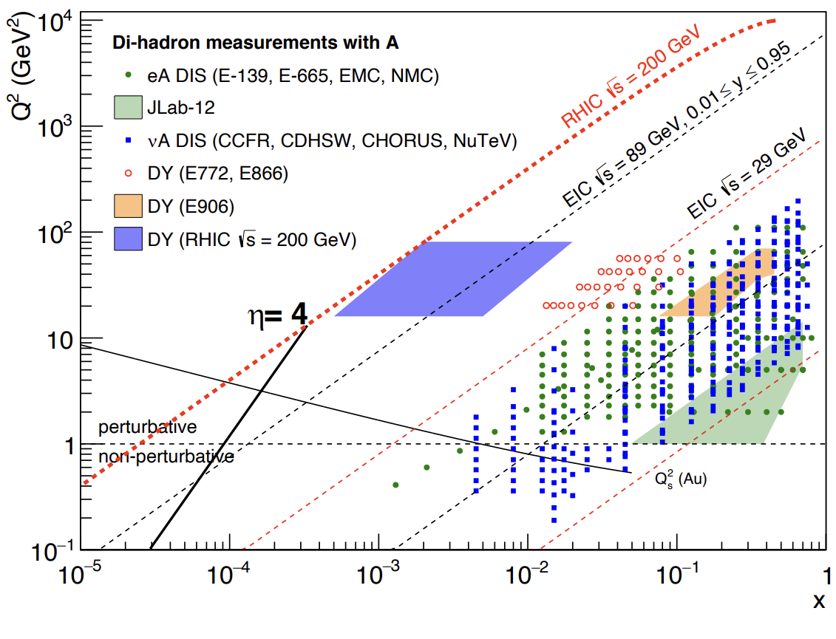
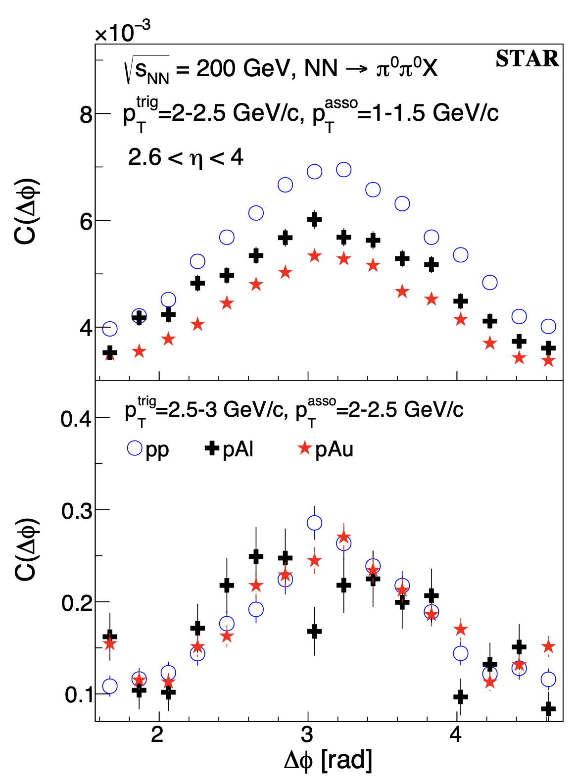
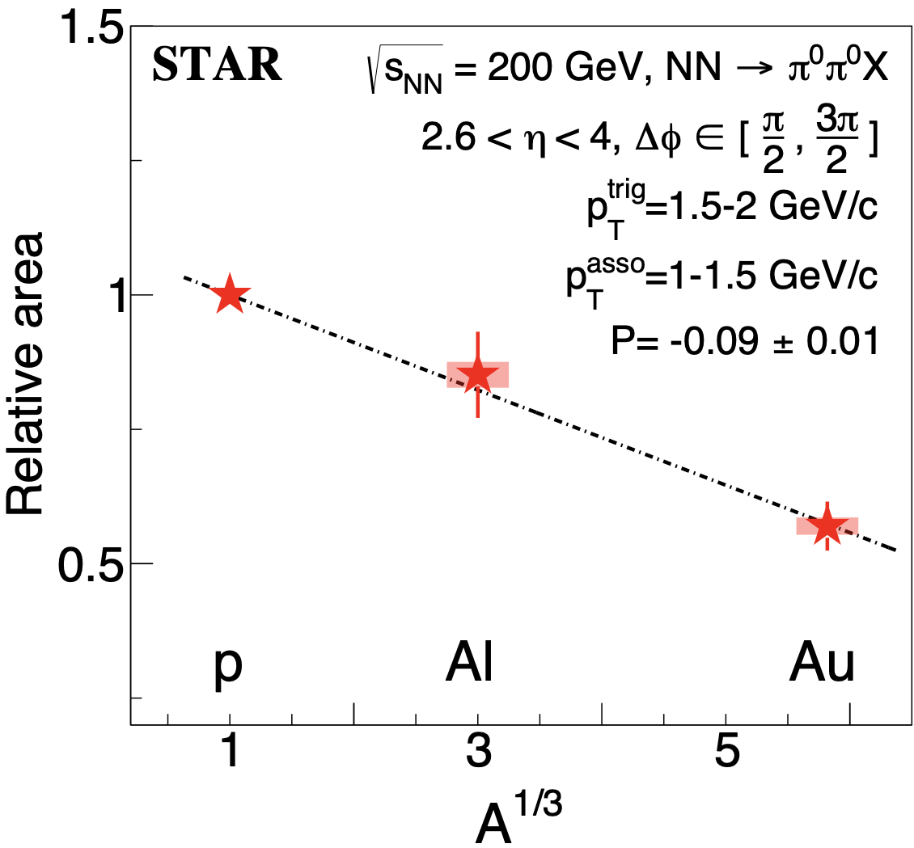
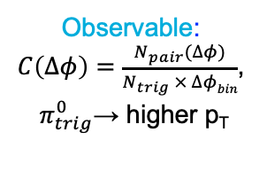
Probing Non-linear QCD effects
Forward rapidities at STAR provide an absolutely
unique opportunity to have very high gluon densities
→ proton – Au collisions
combined with an unambiguous observable
counting experiment of di-hadrons in pp and pA
Saturation: Disappearance of backward hadron in pA
p
p
p
A
Phys.Rev.Lett. 129 (2022) 092501
Observable:
$C\left(∆φ\right)=\frac{N_{pair}(∆φ)}{N_{trig} × ∆φbin}$,
$π_{trig}^{0}$→ higher p_{T}
A dependence: at low p_{T} more suppression in pAu than pAl relative to the pp
x dependence: at high p_{T} (large x) no suppression in pA

Slide 11
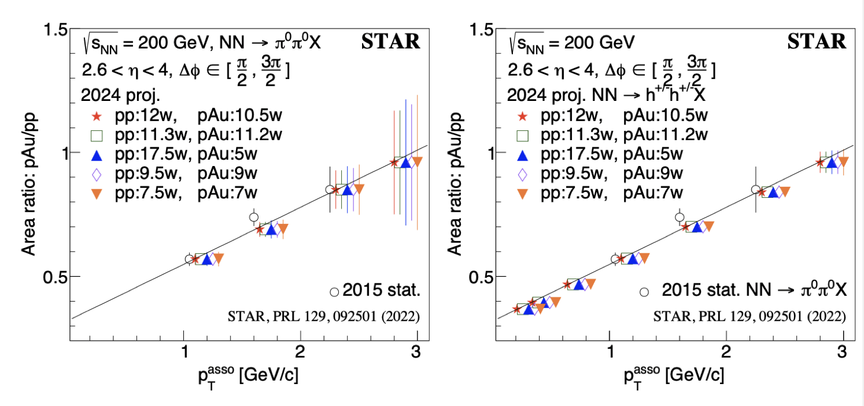
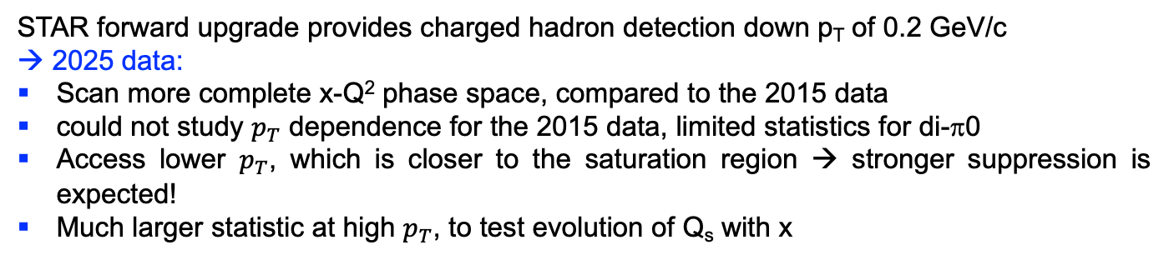
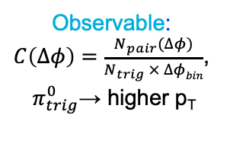
Probing Non-linear QCD effects
Forward rapidities at STAR provide an absolutely
unique opportunity to have very high gluon densities
→ proton – Au collisions
combined with an unambiguous observable
counting experiment of di-hadrons in pp and pA
Saturation: Disappearance of backward hadron in pA
p
p
p
A
Utilizing fSTAR in 2025
Observable:
$C\left(∆φ\right)=\frac{N_{pair}(∆φ)}{N_{trig} × ∆φbin}$,
$π_{trig}^{0}$→ higher p_{T}
STAR forward upgrade provides charged hadron detection down p_{T} of 0.2 GeV/c
→ 2025 data:
Scan more complete x-Q² phase space, compared to the 2015 data
could not study $p_{T}$ dependence for the 2015 data, limited statistics for di-π0
Access lower $p_{T}$, which is closer to the saturation region → stronger suppression is expected!
Much larger statistic at high $p_{T}$, to test evolution of Q_{s} with x

Slide 12
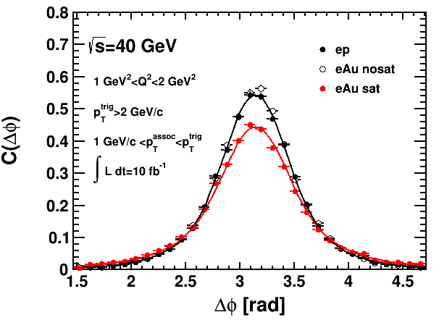
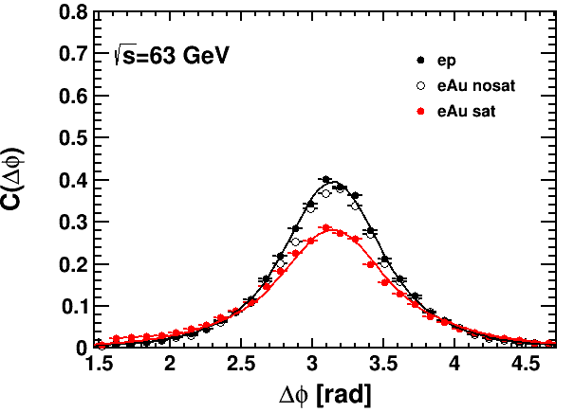
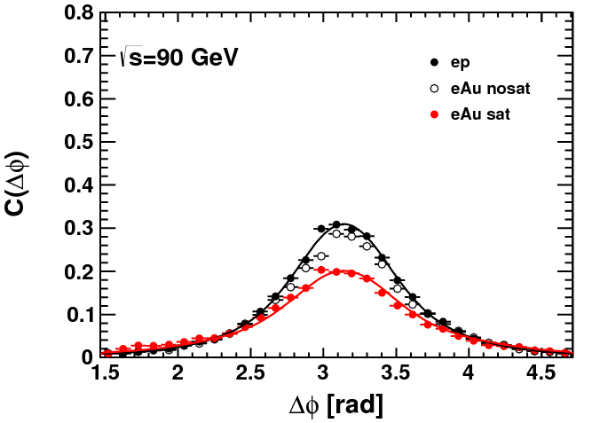
EIC: Probing Non-linear QCD effects
EIC can map the transition
from a linear to a non-linear QCD regime → evolution of Q_{s} with x
EIC has the unique opportunity
to have very high gluon densities
→ electron – lead collisions
Observable: Di-hadrons (jets) in ep and eA
x
Ratio

Slide 13
nFF: What we know
HERMES: production rates of identified hadrons in semi-inclusive deep inelastic
e+A scattering differ from those in e+p scattering
insensitive to initial state effects
→ cannot be explained by nPDF
extraction of effective nFF
do this effects survive at high √s
RHIC / LHC access to gluon FF

Slide 14
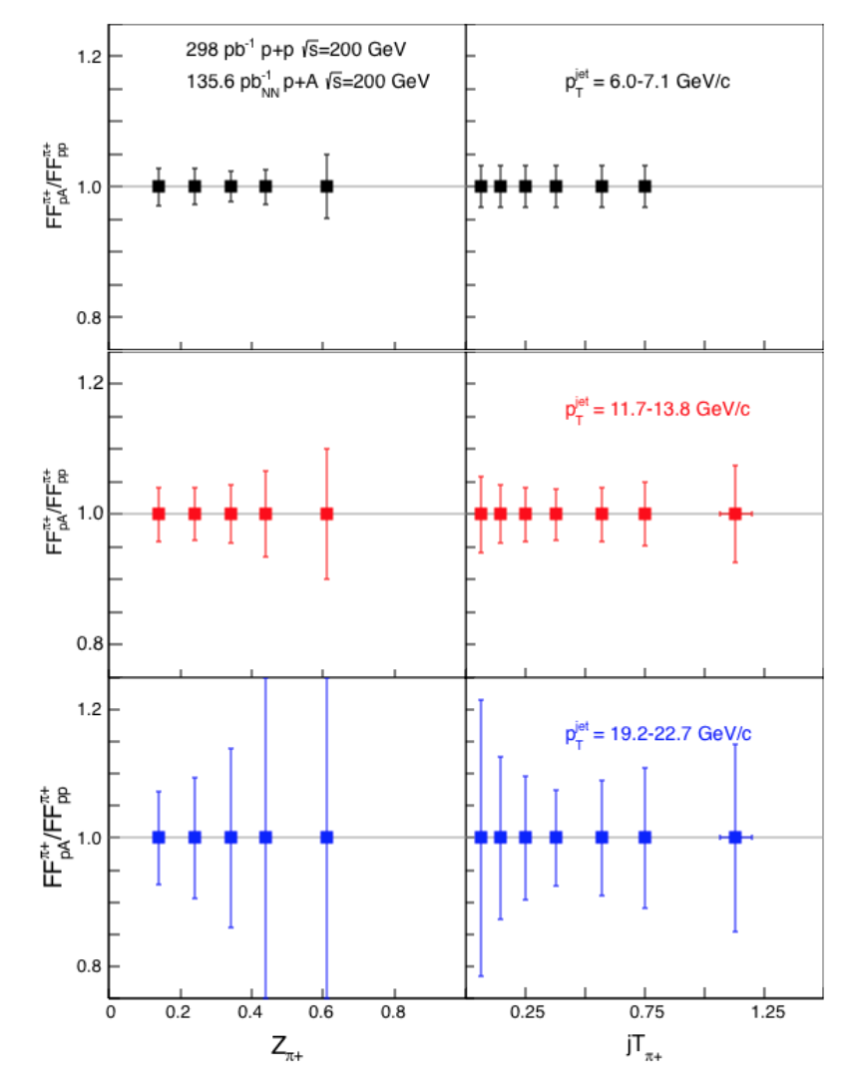
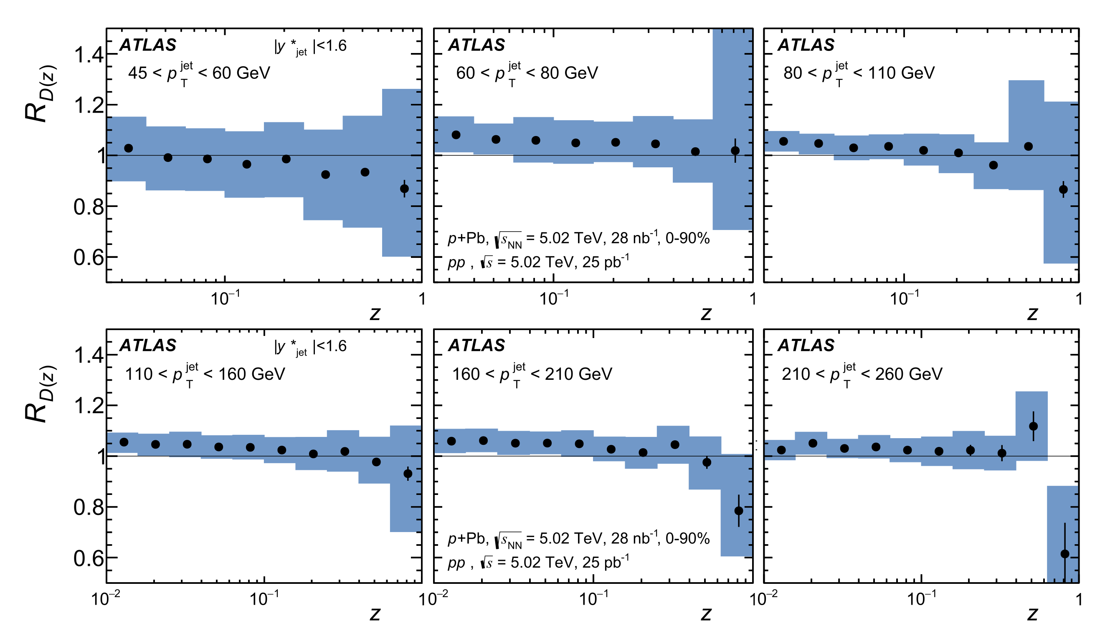
nFF in pA
Observable: Hadron distribution inside jet
→ Study hadron distributions inside a fully reconstructed jet
RHIC: nFF in p+A/p+p at |η| < 0.4
W. Vogelsang et al. arXiv:1506.01415
Nuclear Physics A 978 (2018) 65–106
LHC no suppression
→ current understanding LHC hadronization happens outside nuclear medium ?
√s dependence LHC to RHIC allows to vary kinematics
only at RHIC: measure nuclear effects for polarized TMD FF → nCollins

Slide 15
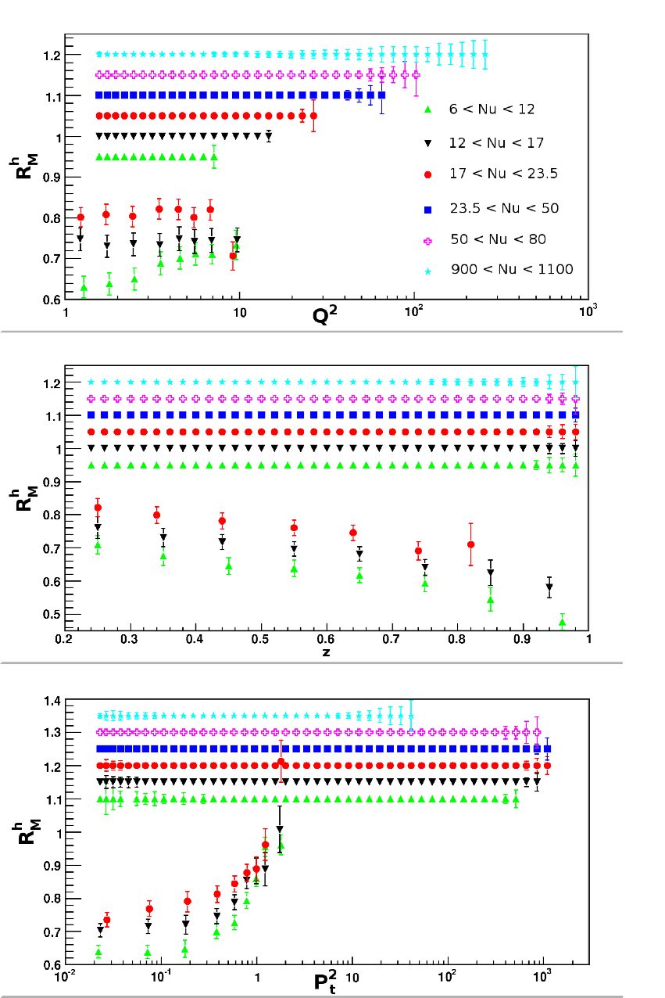
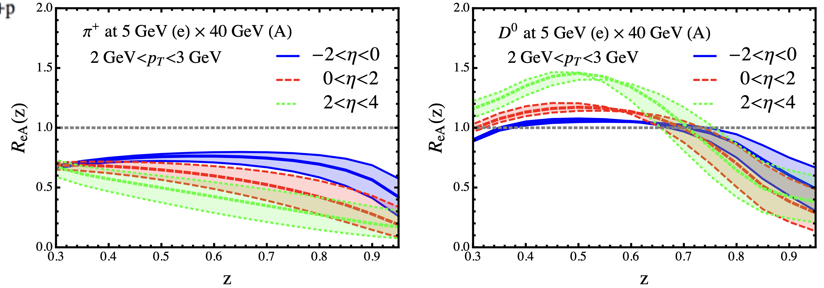
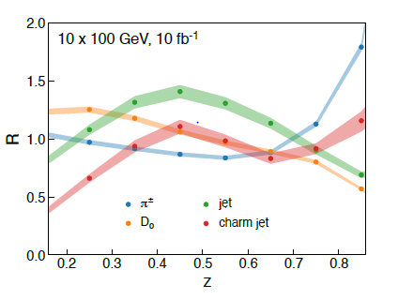
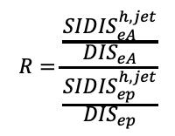
nFF in eA
EIC: large ν range
→ hadronization in and out of nucleus
z
$$R=\frac{\frac{{SIDIS}_{eA}^{h,jet}}{{DIS}_{eA}}}{\frac{{SIDIS}_{ep}^{h,jet}}{{DIS}_{ep}}}$$

Slide 16
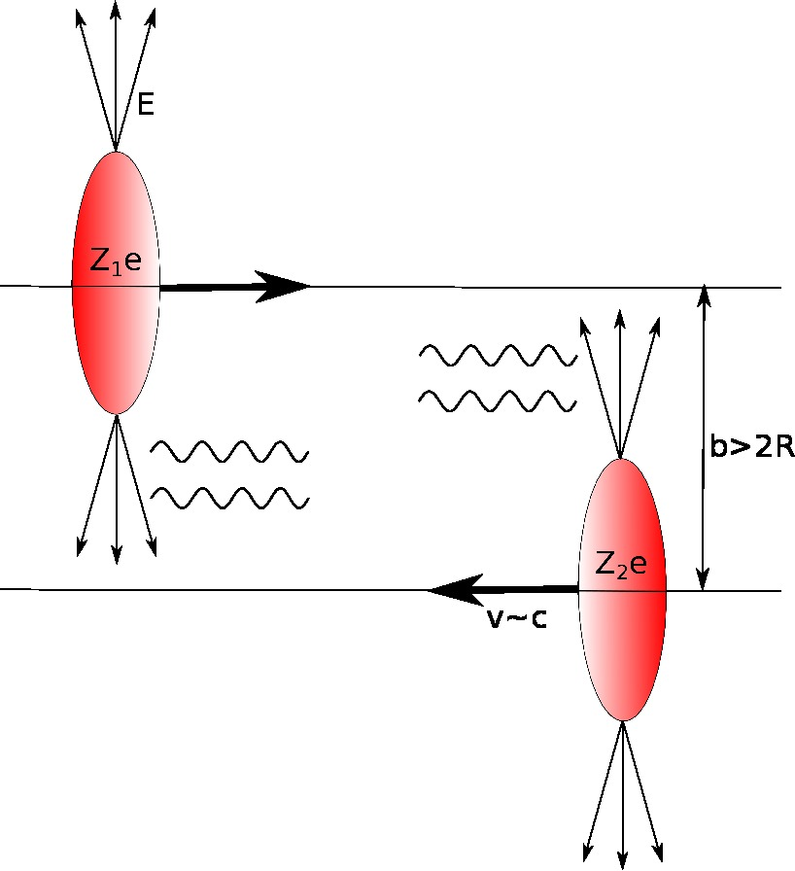
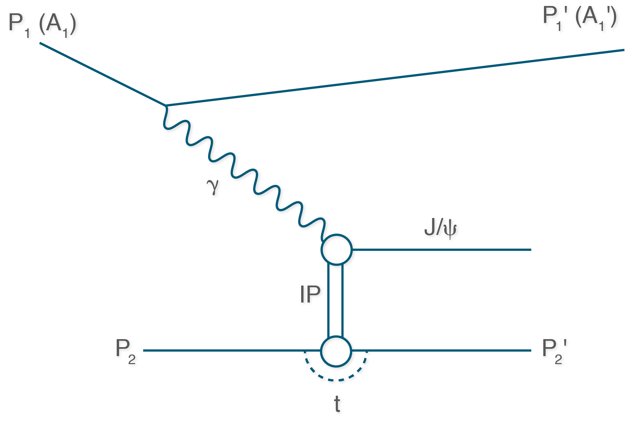
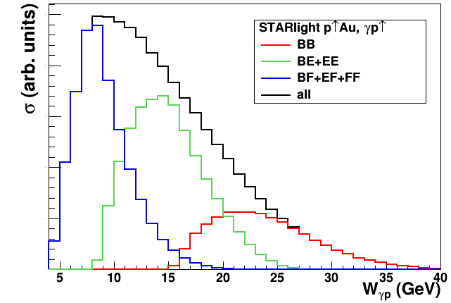

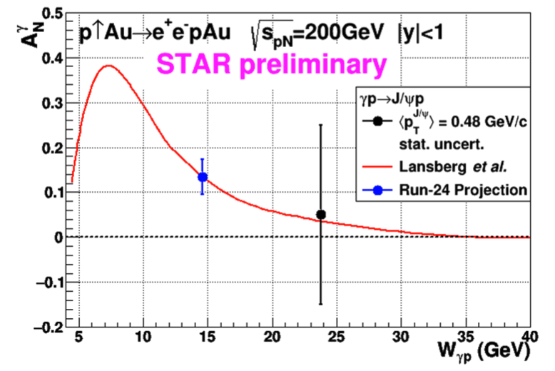
3d Spatial Imaging through UPC
UPC:
worldwide only access to GPD E for gluons
→ J/Ψ production in p↑Au or p↑p (500 GeV)
Forward rapidity gives access to the large asymmetry region
2015 polarized pA data:
J/Ψ cross section as fct of Wγp can be done as well complementary to ep
STAR forward upgrade → closer to J/Ψ threshold
Complementary to JLab experiments for J/Ψ production at threshold

Slide 17
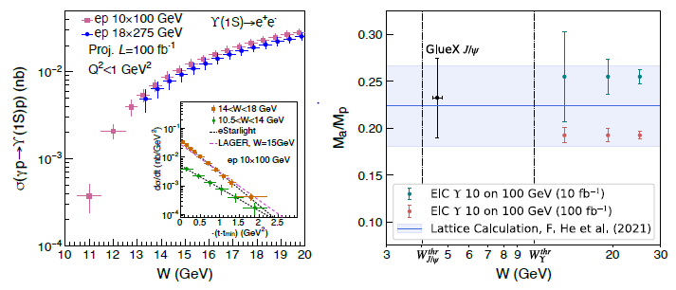
Exclusive Upsilon Production
photo- and electro-production of heavy quarkonia near-threshold
t measured from:
Incoming and out-going proton four-momenta
Υ four-momenta
uncertainty of total and differential cross section of Υ(1S) near threshold for photo-production and electro-production (Q² < 1 GeV²) in e+p collisions via the di-electron decay channel
trace anomaly contribution to the proton mass in Ji’s decomposition;
green and red points are offset; band from a recent lattice QCD calculation; di-electron and di-muon decay channels
Identical study can be done with J/Ψ at EIC cross section and single spin asymmetry A_{UT}
KEY:
good sensitivity over the entire rapidity range
good mass resolution to separate the three Υ states
good t resolution
e and m PID

Slide 18

Summary
pp/pA
ep/eA
universality
factorization
evolution
both probes are needed to
understand nuclear effects in QCD

Slide 19


Slide 20
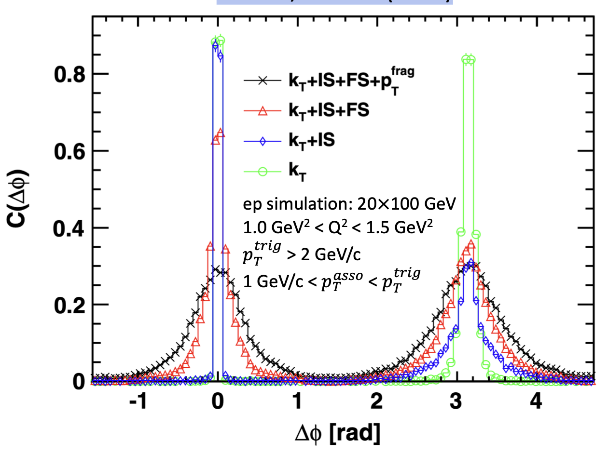
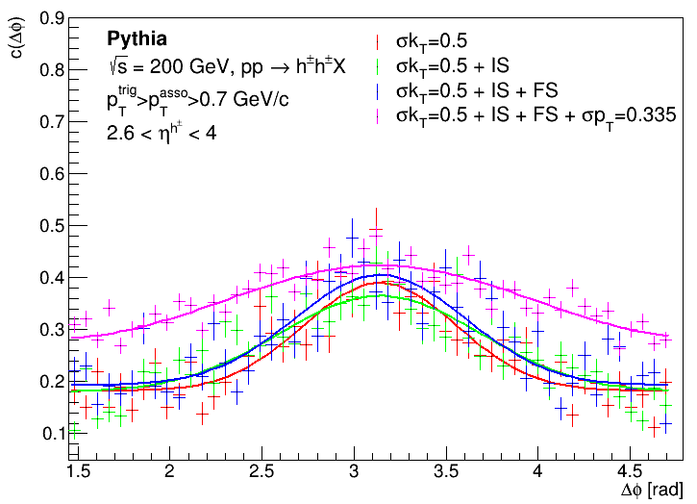
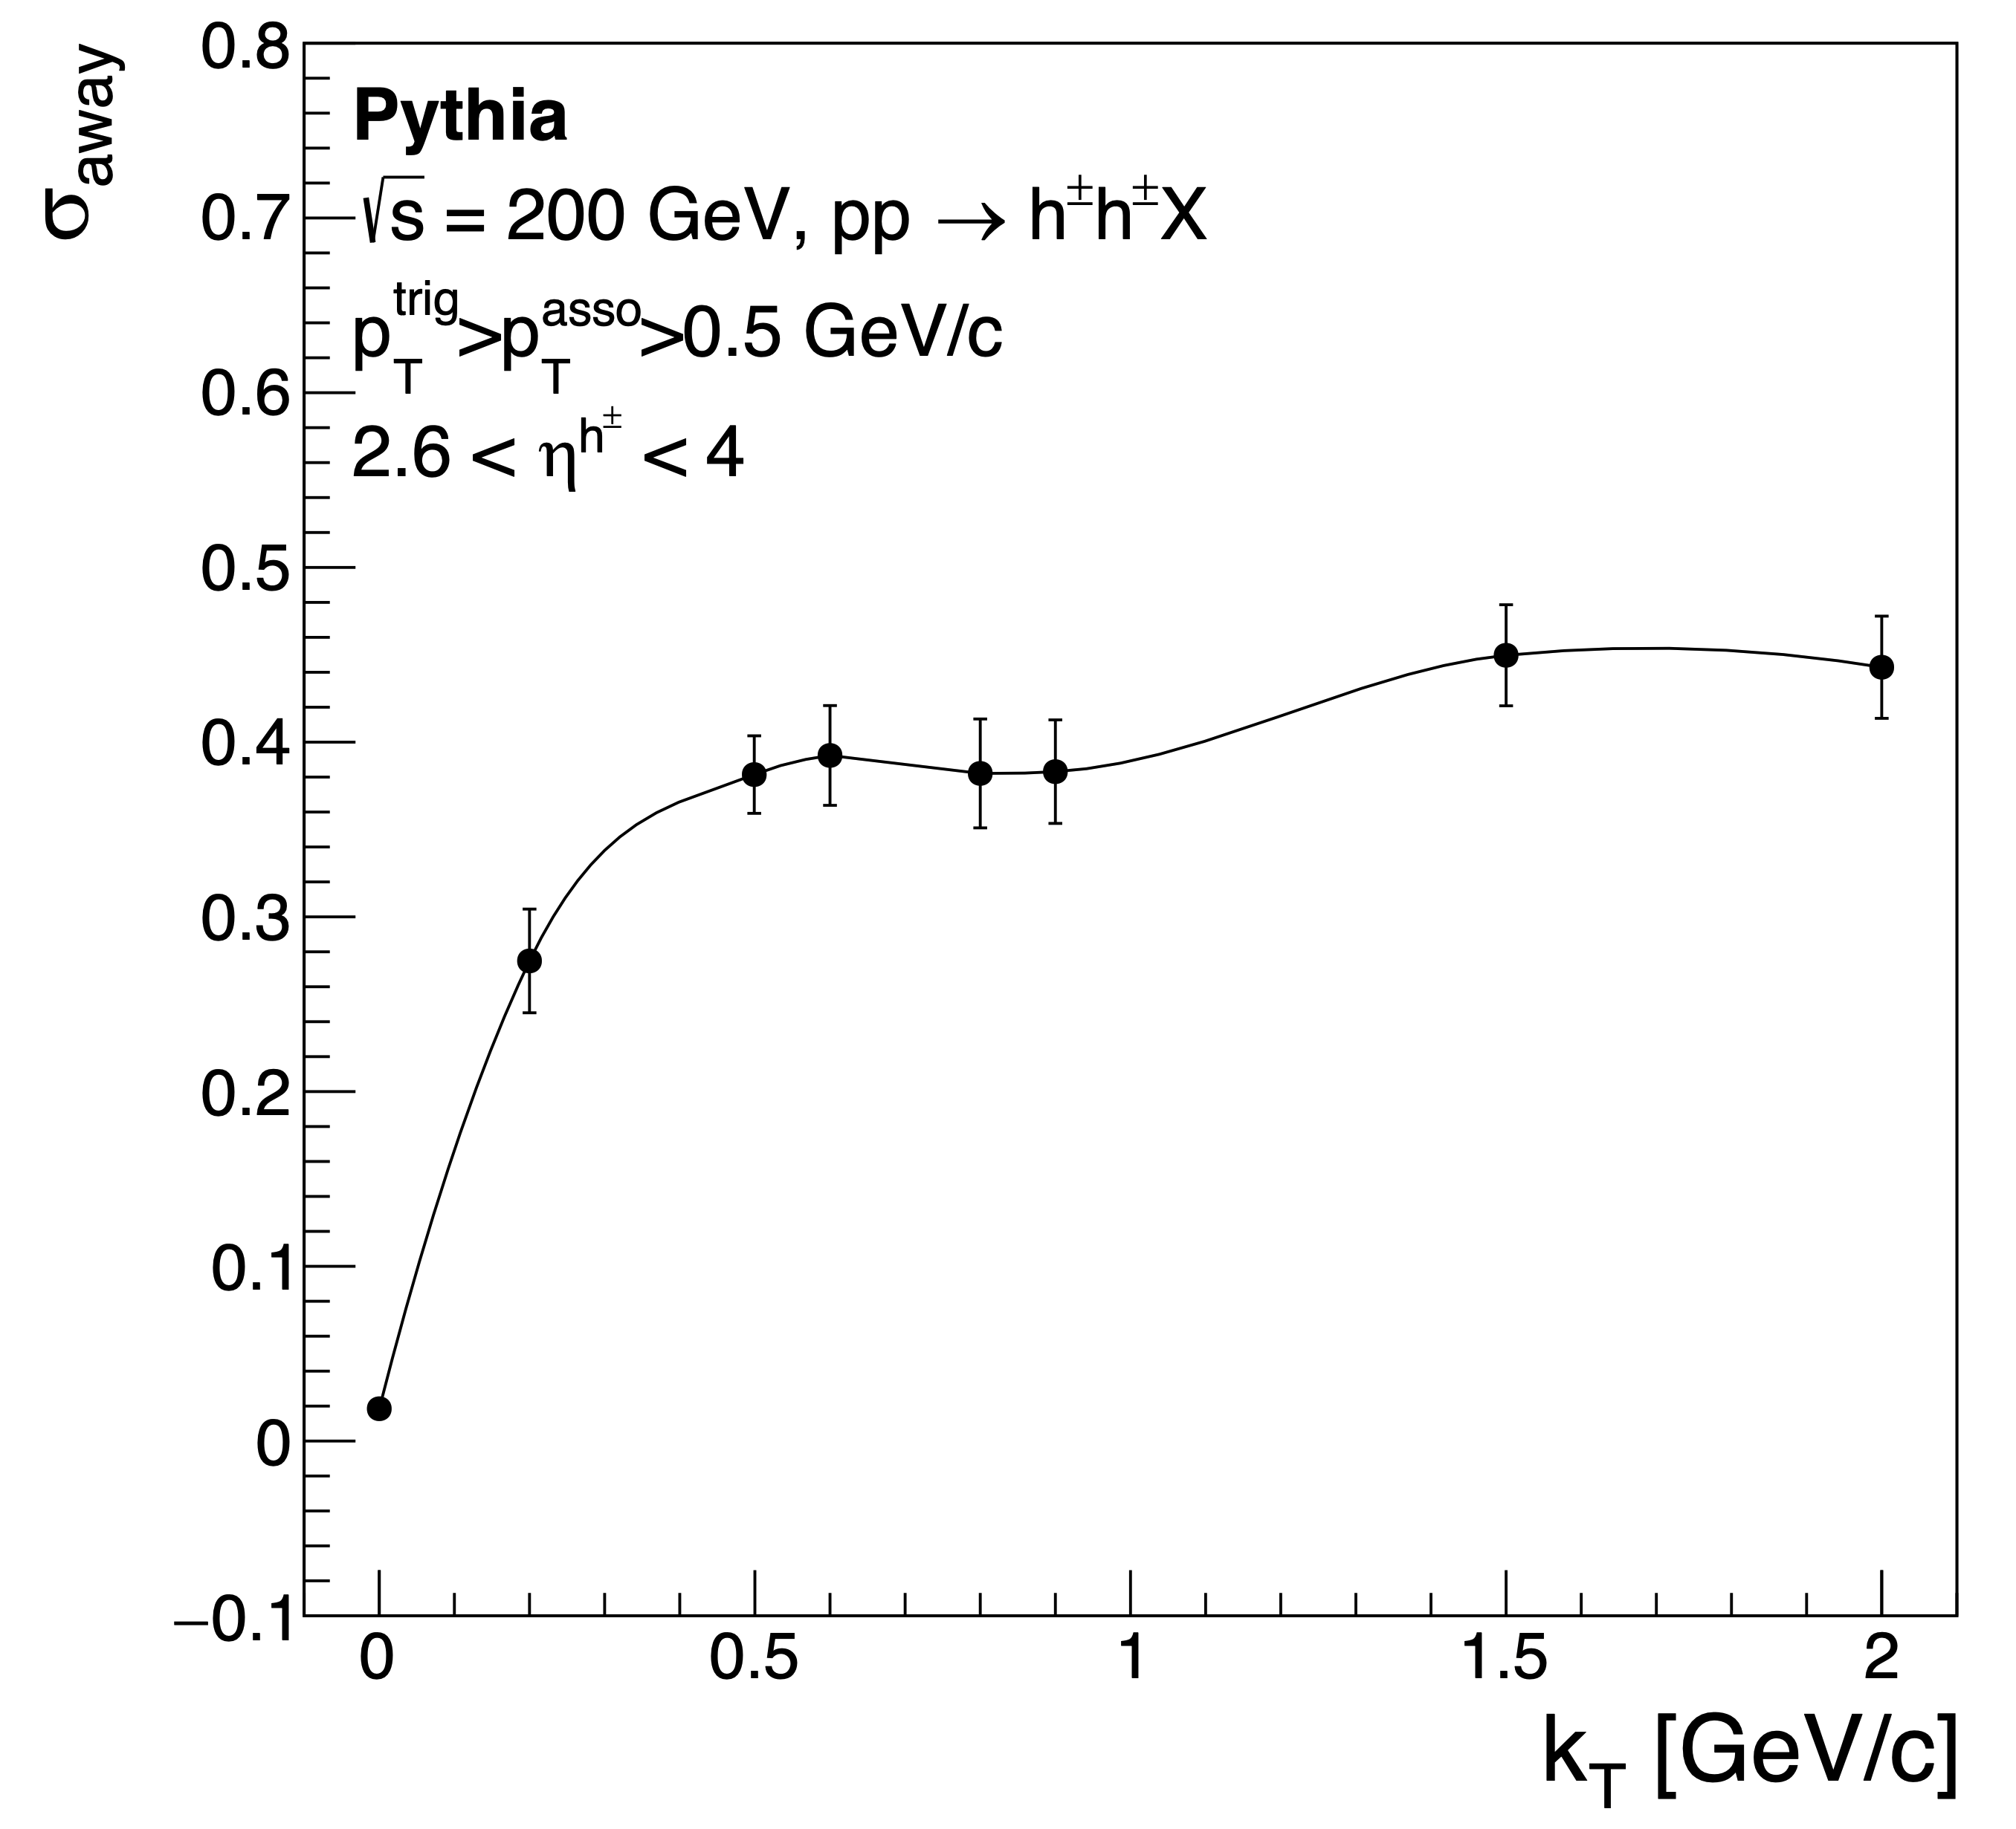

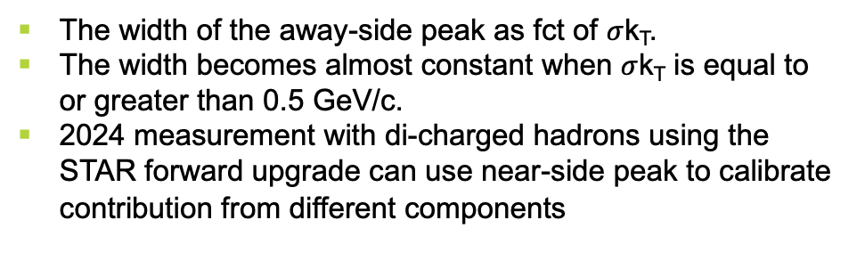
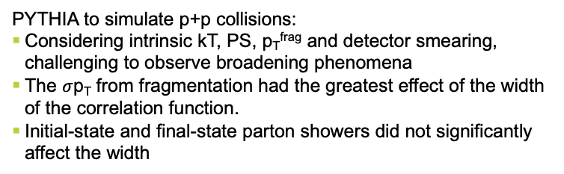
Probing Non-linear Effects in QCD
Saturation models predict broadening of away side peak
→ broadening driven by difference of Q_{s} at fixed x
→ Repeat study in PRD 89, 074037 (2014) for ep, eA for pp, pA
PRD 89, 074037 (2014)
PYTHIA to simulate p+p collisions:
Considering intrinsic kT, PS, p_{T}^{frag} and detector smearing, challenging to observe broadening phenomena
The $σ$p_{T} from fragmentation had the greatest effect of the width of the correlation function.
Initial-state and final-state parton showers did not significantly affect the width
The width of the away-side peak as fct of $σ$k_{T}.
The width becomes almost constant when $σ$k_{T} is equal to or greater than 0.5 GeV/c.
2024 measurement with di-charged hadrons using the STAR forward upgrade can use near-side peak to calibrate contribution from different components
$σ$k_{T} [GeV/c]

Slide 21
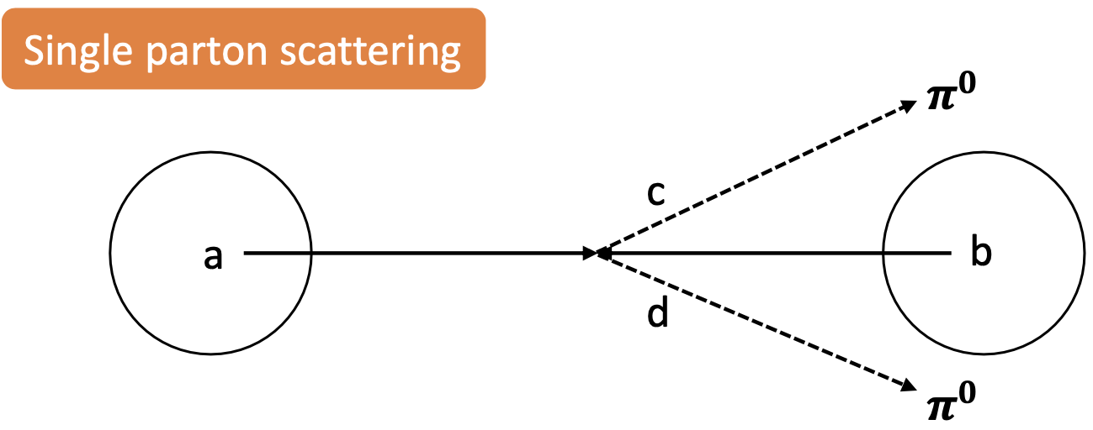
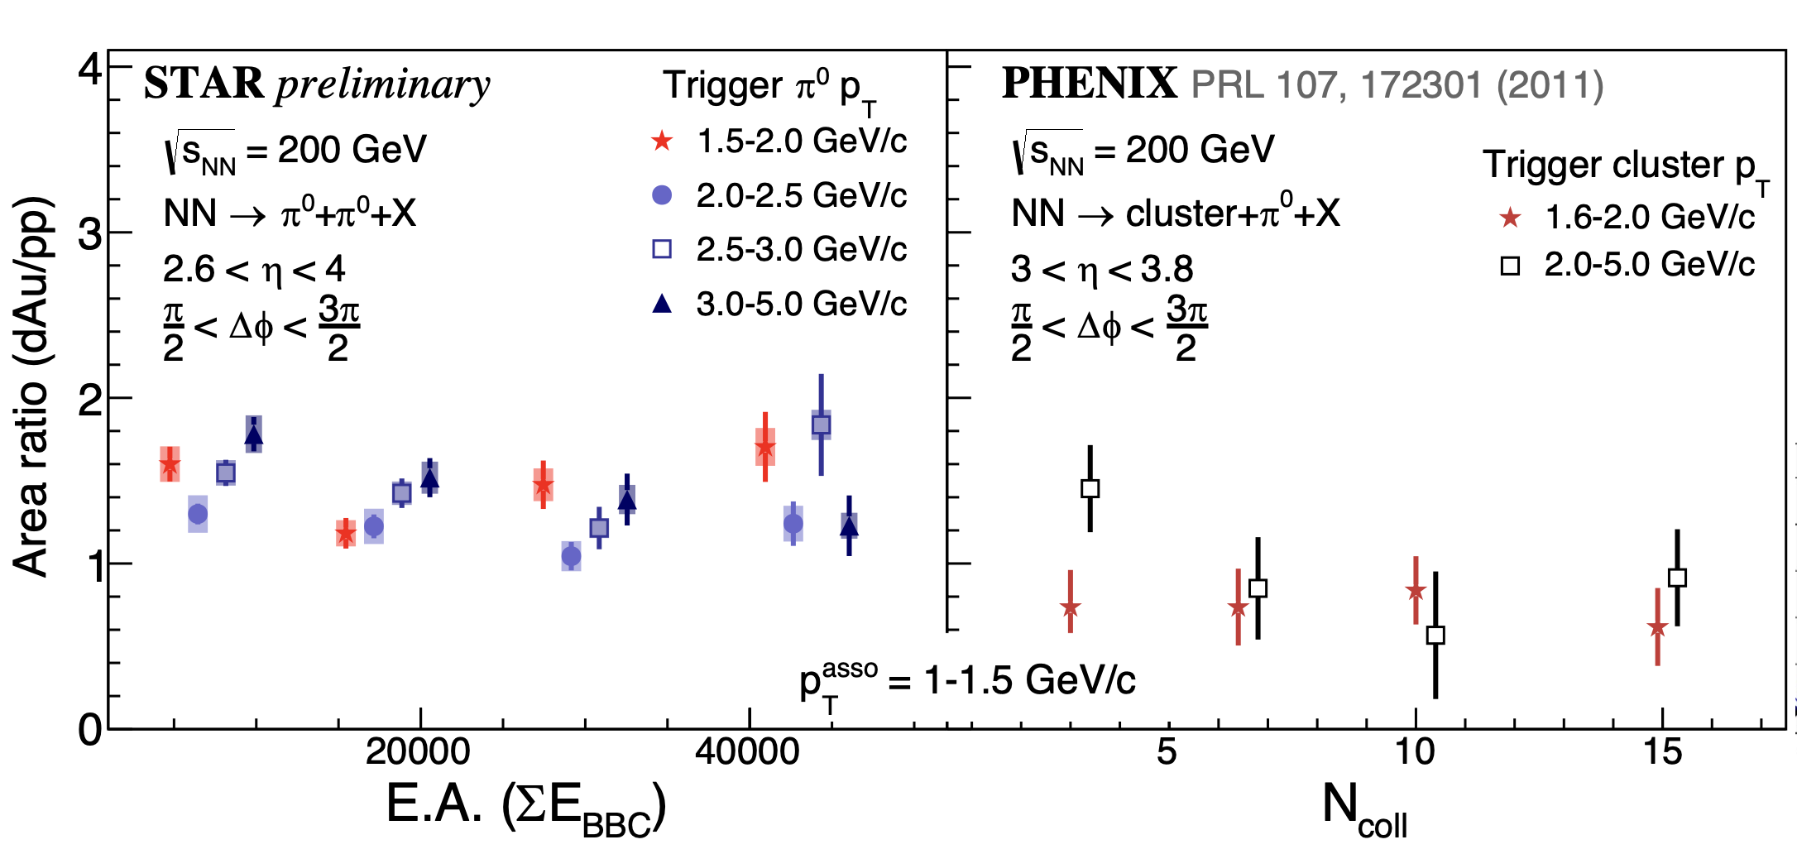
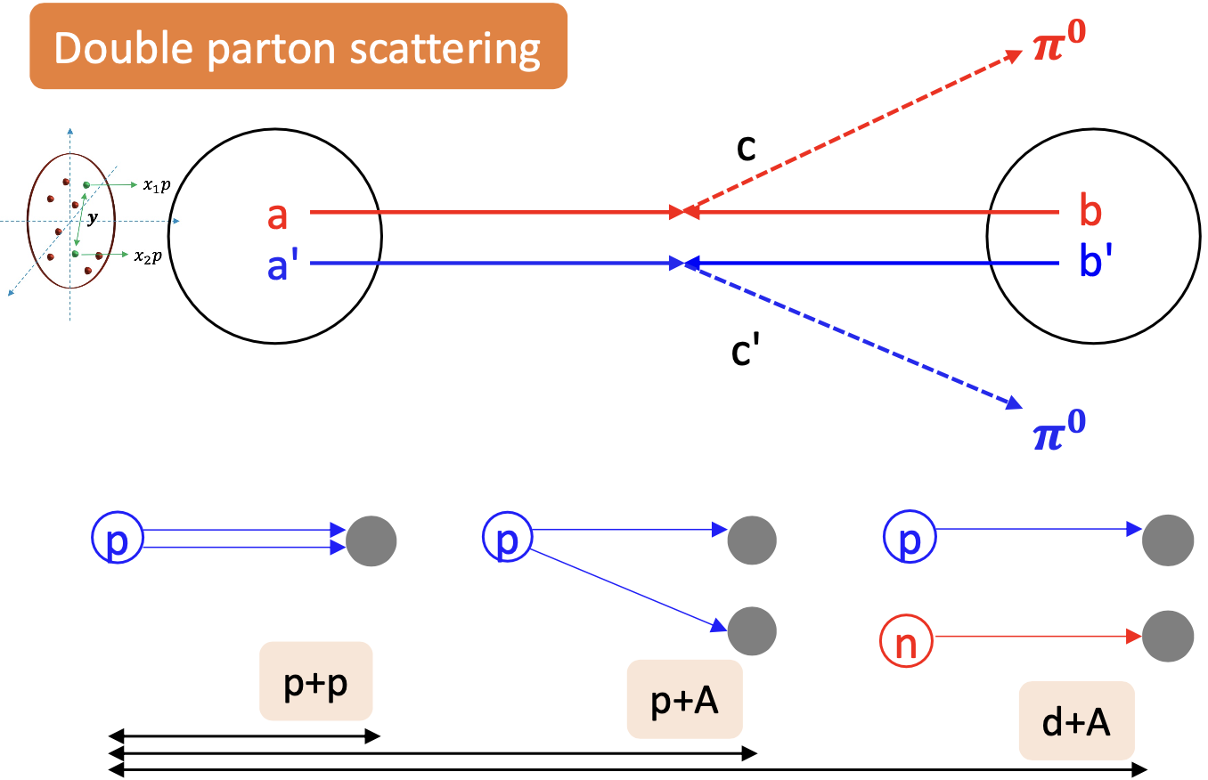

Probing Non-linear Effects in QCD
Forward rapidities at STAR provide an absolutely unique opportunity to have very high gluon densities → proton – Au collisions
combined with an unambiguous observable: Di-hadron/jet correlation in pp and pA
Saturation: Disappearance/Decorrelation of backward hadron / jet in pA
Absolutely critical to observe universality for saturation between pA and eA@EIC
Observable: $C\left(∆φ\right)=\frac{N_{pair}(∆φ)}{N_{trig} × ∆φbin}$, $π_{trig}^{0}$→ higher p_{T}
Two π⁰s generated from the same hard scattering
In the overlapping 𝑝_{T} range of two collaborations, no suppression or E.A./centrality dependence in d+Au relative to p+p
Suppression observed only at very low p_{T} (p_{T}^{asso} = 0.5 – 0.75 GeV/c) at PHENIX, where STAR FMS cannot reach
STAR forward upgrade can go to low p_{T} → 0.2 GeV/c
Comparison of p+p, p+Au and d+Au → study the individual source of Double Parton Scattering (DPS)
Compare pedestal: DPS provides an explanation of higher pedestal in d+Au
Compare away-side correlation → window to study double parton distributions in nucleons

Slide 22
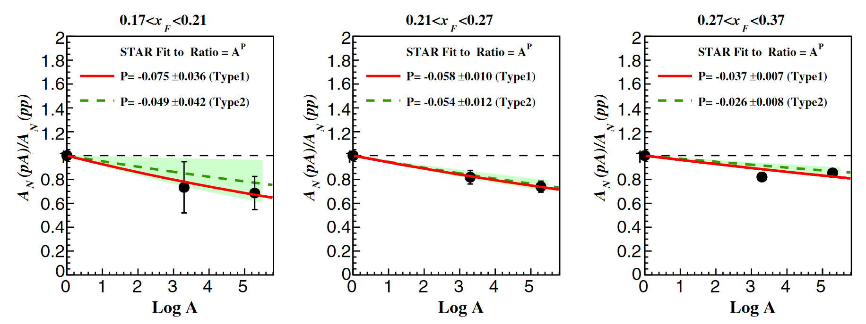
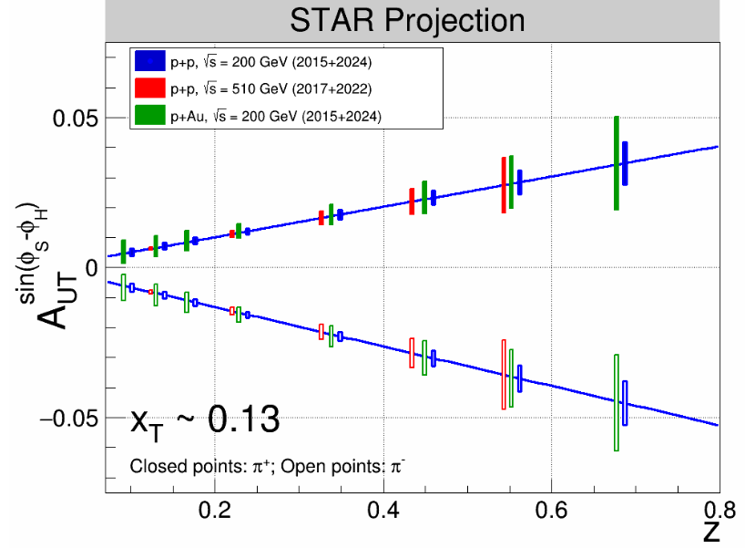
Polarized pA and eA
Polarization at RHIC and EIC provides unique opportunities in the world
STAR, PRD 103, 072005 (2021)
suppression increases at low x_{F} similar as di-hadron correlations
→ Unpolarized observables: initial state PDFs and TMDs are the driving force for suppression
→ Polarized observables: → TMD fragmentation functions, i.e. Collins FF
Golden probe to measure Collins FF: hadrons in jet
→ several results published and released for pp
Important Question: is the non-pertubative part in TMD evolution for the same in ep & eA (pp & pA) universal
and are nuclear effects universal?
polarized eA: till now few studies
→ Elliptic Anisotropy in eA Di-Jet Production driven by linearly polarized gluons → RHIC can inspire program

Slide 23
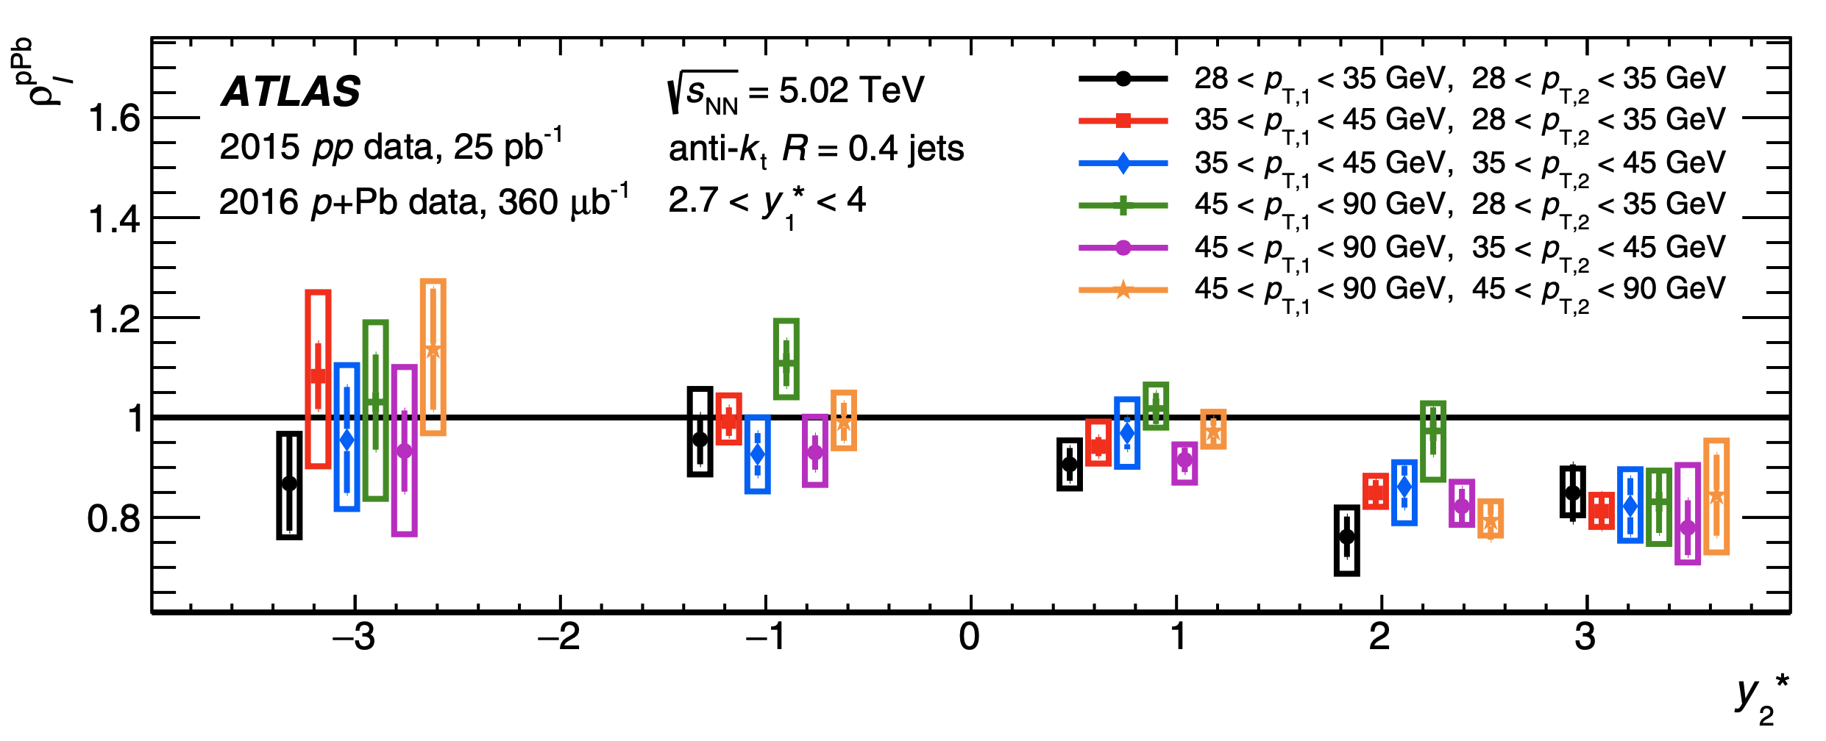
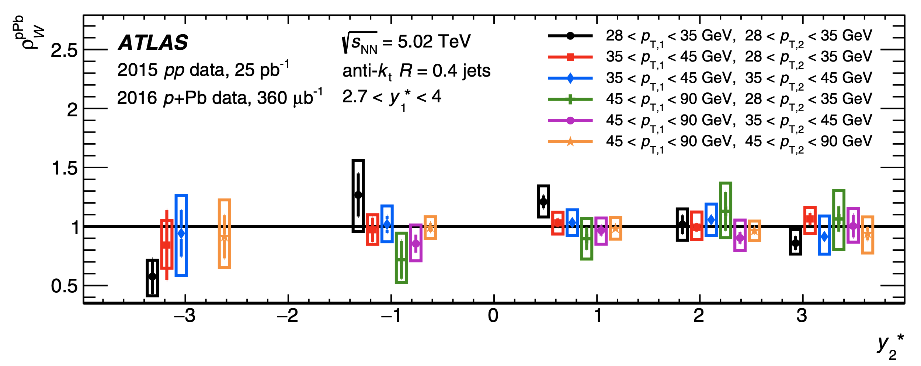


Dijets at ATLAS
ATLAS, PRC 100, 034903 (2019)
Conditional di-jet yields ratio of $\frac{pPb}{pp}$ is measured:
Rapidity dependence
$\frac{pPb}{pp}\sim 0.8$ at most forward, less suppression compared to STAR dihadron
$x_{Pb}$→${10}^{−4}$; but $Q^{2 }$ > $\sim 800 GeV^{2}$, too high?
Width extracted as $σ$ from the Gaussian fit:
Remains the same in p+p and p+Pb
Same conclusion with RHIC dihadron

