Slide 1
pfRICH Sensor Plate Prototype
Simon Snydersmith, Kevin Chang, Pau Simpson Crusafon, Sushrut Karmarkar, Andreas Jung
28 Oct 2024

Slide 2
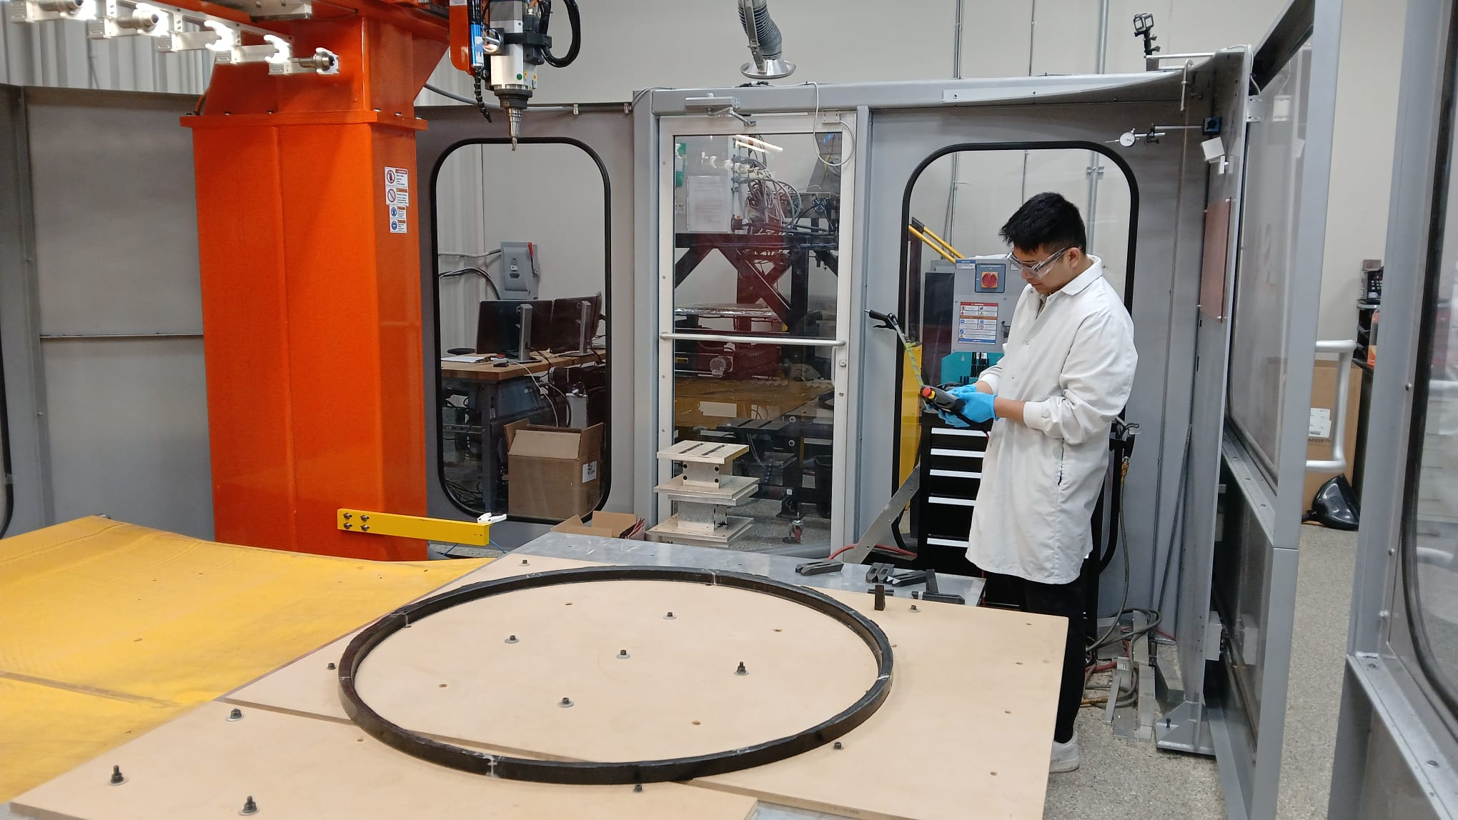
Summary
End Ring is machining today- !! Finally
Sealing tests – CAD changes proposed emailed to Alex – we will have offline meeting to discuss those and then propose to the group
Had meeting with Kong/Preet/Alex
Mirror co-bond next set of samples are in prep.
Shipping expected by Wed/Thursday this week

